Slide 1

ET4171 Processor Design Project
LEON3 processor optimization
Group 1:
Luca Feltrin
Henrique Dantas

Slide 2
Objectives
Target: Embedded applications
Compound metric: P*BS
Poor Mul/Div execution time
Implementation with different algorithms

Slide 3
Multiplier

Slide 4
Divider
Which algorithm?
Repeated Multiplication Fast Area
Reciprocation Fast Area
Array Divider No control on physical placing
Radix >8 Fast Area
Radix-4 Good compromise:
Execution time ~ ½ of the baseline

Slide 5
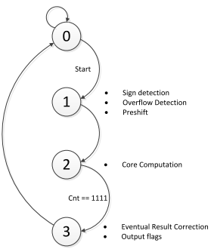
Divider

Slide 6
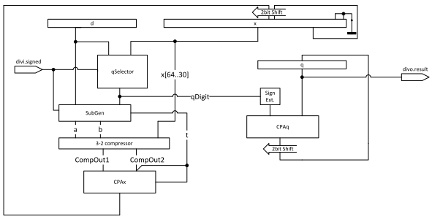
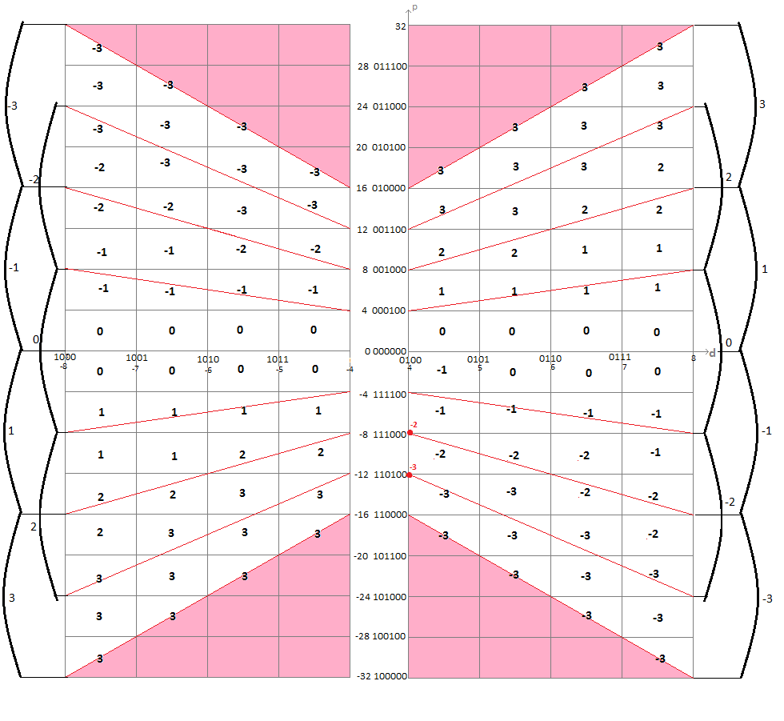
Divider

Slide 7
Divider
Signed division (signed p-d plot) vs. Unsigned division (half p-d plot) + 1 cycle for sign
No area differences but 1 more cycle delay: signed Division

Slide 8
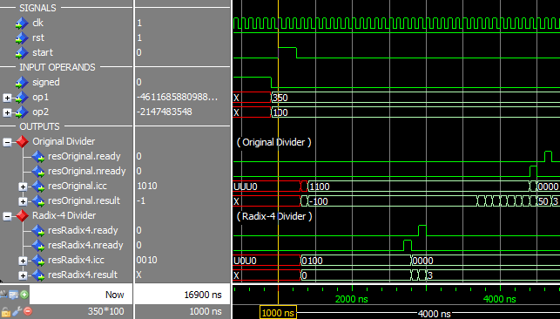
Divider
Baseline vs. Radix-4: 19 cycles vs 36

Slide 9
Synthesis Results
 | Clk freq [MHz] | LUTs | Slices | Quiescent Power [W] | Dynamic Power [W] | Total Power [W] | P/f [W/MHz]
Baseline | 80,522 | 9904 | 16889 | 2,467 | 0,721 | 3,188 | 0,03959
Only Div | 80,535 | 10479 | 17865 | 2,468 | 0,743 | 3,211 | 0,03987
Div+Mul | 40,197 | 11886 | 20469 | 2,511 | 0,832 | 3,343 | 0,08317
Area, Power, Frequency

Slide 10
Benchmarks Scores
 | Stanford [sec] | Whetstone [sec] | Gmpbench Multiply [Op/sec] | Gmpbench Divide [Op/sec] | Gmpbench RSA [Op/sec] | Division [sec] | Mibench JPEG (average) [sec] | SSD [sec] | Total [sec]
Baseline | 2,30 | 116,2 | 781 | 15876 | 5123 | 8,06 | 23,215 | 10,59 | 219,28
Modified | 2,21 | 112,08 | 914 | 19205 | 5353 | 7,31 | 21.76 | 8,60 | 206,92
Only slight improvement probably due to the Operative System’s Scheduling

Slide 11
Conclusion
Comparison with metrics (only divider)
Version | Primitive metrics |  |  |  | Composite metrics
 | A (*10^4) | D (*10^-2) | P | BS (*10^2) | A*D (*10^2) | A*BS (*10^6) | P*D (*10^-2) | P*BS (*10^2)
Baseline | 2,68 | 1,24 | 3,19 | 2,19 | 3,33 | 5,88 | 3,96 | 6,99
Modified | 2,83 | 1,24 | 3,21 | 2,13 | 3,52 | 6,05 | 3,99 | 6,85
Improvements | -5,8% | - | -0,7% | 2,7% | -5,8% | -2,9% | -0,7% | 2,0%

Slide 12
Conclusion
Comparison with metrics (div + mul)
Version | Primitive metrics |  |  |  | Composite metrics
 | A (*10^4) | D (*10^-2) | P | BS (*10^2) | A*D (*10^2) | A*BS (*10^6) | P*D (*10^-2) | P*BS (*10^2)
Baseline | 2,68 | 1,24 | 3,19 | 2,19 | 3,33 | 5,88 | 3,96 | 6,99
Modified | 3.24 | 2,49 | 3,34 | 2,07 | 8,05 | 6,69 | 8,32 | 6,92
Improvements | -21% | -100% | -5% | 6% | -142% | -14% | -110% | 1%

Slide 13
Furhter Improvements
Cache size
More power consumption, need to determine actual miss rate
Branch prediction
Now: Static prediction, only slight advantage, power consumption
Out of Order Execution
Radical change of the integer unit, improved execution time

