Slide 1
Introduction to VHDL
Dr. Adnan Shaout
The University of Michigan-Dearborn

Slide 2
Objective
Quick introduction to VHDL
  basic language concepts
  basic design methodology
  examples

Slide 3
VHDL
Very Hard Difficult Language

Slide 4
jk -- VHDL
VHSIC Hardware
Description Language
--------------------------------------
VHSIC --
Very High Speed Integrated Circuits

Slide 5
Modeling Digital Systems
VHDL is for coding models of a digital system...
Reasons for modeling
  requirements specification
  documentation
  testing using simulation
  formal verification
  synthesis
  class assignments
Goal
  most ‘reliable’ design process, with minimum cost and time
  avoid design errors!

Slide 6
Basic VHDL Concepts
Interfaces -- i.e. ports
Behavior
Structure
Test Benches
Analysis, simulation
Synthesis

Slide 7
VHDL --
VHDL is a programming language that allows one to model and develop complex digital systems in a dynamic envirornment.
Object Oriented methodology for you C people can be observed -- modules can be used and reused.
Allows you to designate in/out ports (bits) and specify behavior or response of the system.

Slide 8
VHDL Intro.--
Oh yeah, For all you C people --forget everything you know...
Well, not EVERYTHING ...
But VHDL is NOT C ...
There are some similarities, as with any programming language, but syntax and logic are quite different; so get over it !!
-obviously, this was a painful transition for me.

Slide 9
3 ways to DO IT -- the VHDL way
Dataflow
Behavioral
Structural
Kindof BORING sounding huh??
well, it gets more exciting with the details !!
:)

Slide 10
Modeling the Dataflow way
uses statements that defines the actual flow of data.....
  such as,
    x <= y -- this is NOT less than equl to
    -- told you its not C
    this assigns the boolean signal x to the value of boolean signal y... i.e. x = y
    this will occur whenever y changes....

Slide 11
Jumping right in to a Model -- e.g. 1
lets look at a d - flip-flop model -- doing it the dataflow way..... ignore the extra junk for now --
entity dff_flow is
port ( d :in bit;
prn :in bit;
clrn :in bit;
q :out bit;
qbar :out bit;
);
end dff_flow;
architecture arch1 of dff_flow is
begin
q <= not prn Or (clrn And d); % this is the DATAFLOW %
qbar <= prn And (not clrn Or not d); % STUFF %
end arch1;

Slide 12
-------Dr. Adnan Shaout
library ieee; use ieee.std_logic_1164.all;
entity fulladd is
port(A1,A2,Cin: IN std_logic;
Sum, Cout: OUT std_logic);
end fulladd;
Architecture a of fulladd is
Begin
process(A1,A2,Cin)
Begin
Sum <= Cin XOR A1 XOR A2;
Cout <= (A1 AND A2) OR (Cin AND (A1 XOR A2));
end process;
end a;

Slide 13
Modeling Interfaces
Entity declaration
  describes the input/output ports of a module
entity name
port names
port mode (direction)
entity reg4 is
port ( d0, d1, d2, d3, en, clk : in bit;
q0, q1, q2, q3 : out bit );
end entity reg4;
punctuation
reserved words
port type

Slide 14
Modeling the Behavior way
Architecture body
  describes an implementation of an entity
  may be several per entity
Behavioral architecture
  describes the algorithm performed by the module
  contains
    process statements, each containing
      sequential statements, including
        signal assignment statements and
        wait statements

Slide 15
The Behavior way -- eg 2
architecture behav of reg4 is
begin
process (d0, d1, d2, d3, en, clk)
variable stored_d0, stored_d1, stored_d2, stored_d3 : bit;
begin
if en = '1' and clk = '1' then
stored_d0 := d0;
stored_d1 := d1;
stored_d2 := d2;
stored_d3 := d3;
end if;
q0 <= stored_d0 after 5 ns;
q1 <= stored_d1 after 5 ns;
q2 <= stored_d2 after 5 ns;
q3 <= stored_d3 after 5 ns;
end process;
end behav;
sensitivity list
notice := syntax
used for equating values
from signals...
simulates real-world
propagation delays.

Slide 16
VHDL -- goofy syntax to know..
Omit entity at end of entity declaration
Omit architecture at end of architecture body
Omit is in process statement header
entity reg4 is
port ( d0, d1, d2 : in bit
d3, en, clk : in bit;
q0, q1, q2, q3 : out bit
);
end reg4;
architecture behav of reg4 is
begin
process (d0, ... )
...
begin
...
end process ;
end behav;

Slide 17
Modeling the Structurural way
Structural architecture
  implements the module as a composition of subsystems
  contains
    signal declarations, for internal interconnections
      the entity ports are also treated as signals
    component instances
      instances of previously declared entity/architecture pairs
    port maps in component instances
      connect signals to component ports

Slide 18
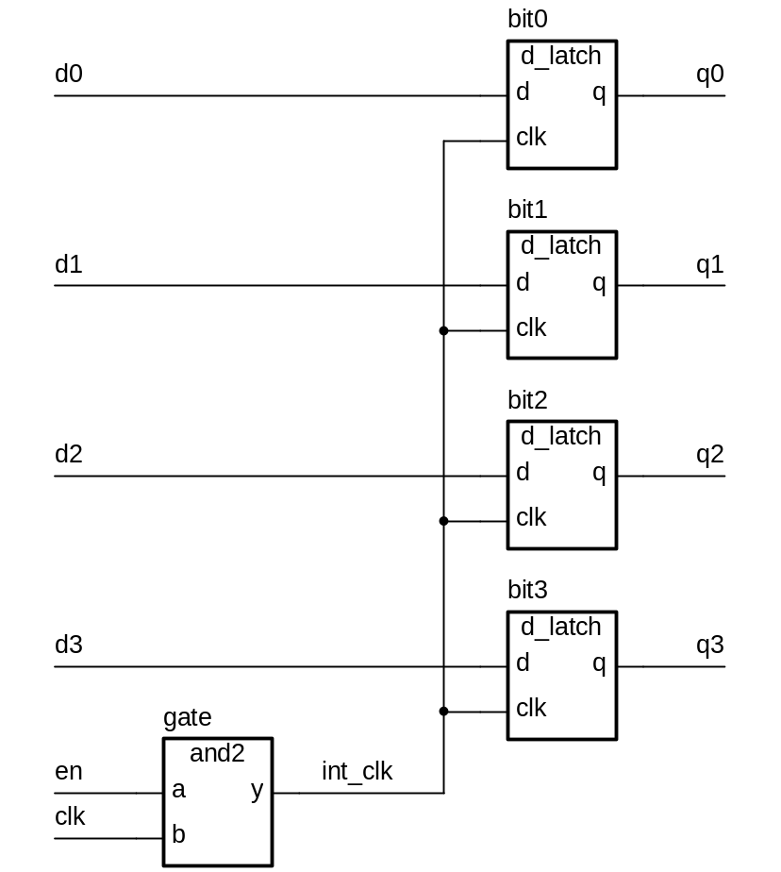
Structural way -- e.g. 3

Slide 19
Structural way cont..
First declare D-latch and and-gate entities and architectures
notice semicolon placements -- odd as it is, omit from last statement
entity d_latch is
port ( d, clk : in bit; q : out bit );
end entity d_latch;
architecture basic of d_latch is
begin
process (clk, d)
begin
if clk = ‘1’ then
q <= d after 2 ns;
end if;
end process;
end basic;
entity and2 is
port ( a, b : in bit; y : out bit );
end entity and2;
architecture basic of and2 is
begin
process (a, b)
begin
y <= a and b after 2 ns;
end process ;
end basic;

Slide 20
Structural way...
Declare corresponding components in register architecture body
architecture struct of reg4 is
component d_latch
port ( d, clk : in bit; q : out bit );
end component;
component and2
port ( a, b : in bit; y : out bit );
end component;
signal int_clk : bit;
...

Slide 21
Structural way..
Now use them to implement the register
...
begin
bit0 : d_latch
port map ( d0, int_clk, q0 );
bit1 : d_latch
port map ( d1, int_clk, q1 );
bit2 : d_latch
port map ( d2, int_clk, q2 );
bit3 : d_latch
port map ( d3, int_clk, q3 );
gate : and2
port map ( en, clk, int_clk );
end struct;

Slide 22
Mixed Behavior and Structure
An architecture can contain both behavioral and structural parts
  process statements and component instances
    collectively called concurrent statements
  processes can read and assign to signals
Example: register-transfer-level (RTL) Model
  data path described structurally
  control section described behaviorally

Slide 23
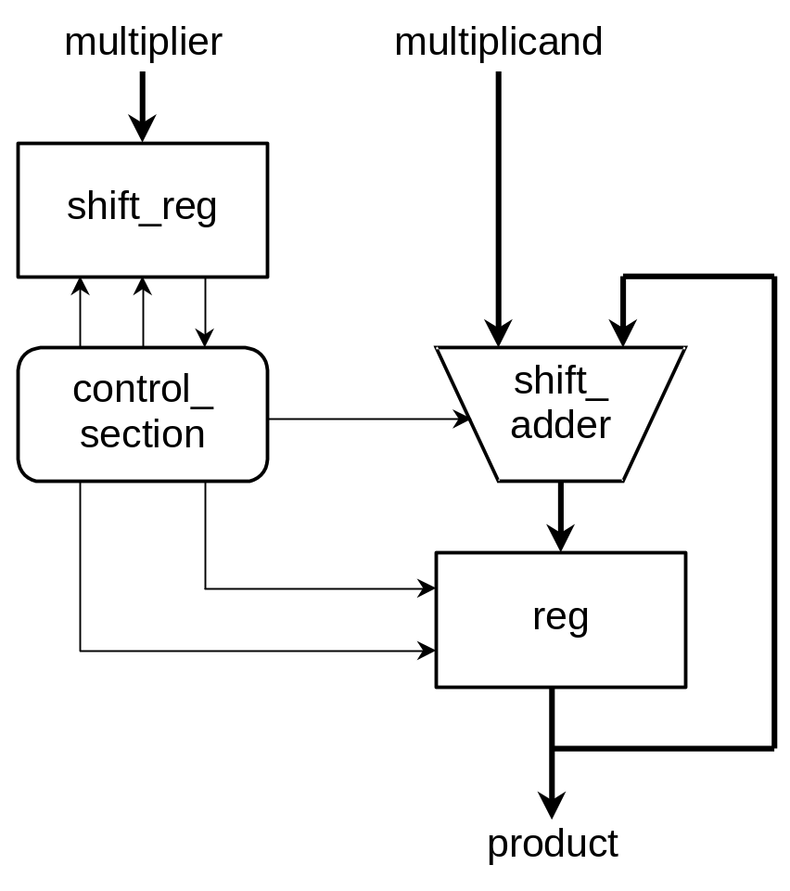
Mixed Example

Slide 24
Mixed Example
entity multiplier is
port ( clk, reset : in bit;
multiplicand, multiplier : in integer;
product : out integer );
end multiplier;
architecture mixed of mulitplier is
signal partial_product, full_product : integer;
signal arith_control, result_en, mult_bit, mult_load : bit;
begin
arith_unit : entity work.shift_adder(behavior)
port map ( addend => multiplicand, augend => full_product,
sum => partial_product,
add_control => arith_control );
result : entity work.reg(behavior)
port map ( d => partial_product, q => full_product,
en => result_en, reset => reset );
...

Slide 25
Mixed Example
…
multiplier_sr : entity work.shift_reg(behavior)
port map ( d => multiplier, q => mult_bit,
load => mult_load, clk => clk );
product <= full_product;
process (clk, reset)
-- variable declarations for control_section
-- …
begin
-- sequential statements to assign values to control signals
-- …
end process;
end mixed;

Slide 26
Test Bench your Model
Testing a design by simulation
Use a test bench model
  a Model that uses your Model
  apply test sequences to your inputs
  monitors values on output signals
    either using simulator
    or with a process that verifies correct operation
    or logic analyzer

Slide 27
Analysis
Check for syntax and logic errors
  syntax: grammar of the language
  logic: how your Model responds to stimuli
Analyze each design unit separately
  entity declaration
  architecture body
  …
  put each design unit in a separate file -- helps a lot.
Analyzed design units are placed in a library
  make sure your Model is truly OOP

Slide 28
Simulation
Discrete event simulation
  time advances in discrete steps
  when signal values change—events occur
A processes is sensitive to events on input signals
  specified in wait statements
  resumes and schedules new values on output signals
    schedules transactions
    event on a signal if value changes

Slide 29
Simulation Algorithm
Initialization phase
  each signal is given its initial value
  simulation time set to 0
  for each process
    activate
    execute until a wait statement, then suspend
      execution usually involves scheduling transactions on signals for later times

Slide 30
Simulation Algorithm
Simulation cycle
  advance simulation time to time of next transaction
  for each transaction at this time
    update signal value
      event if new value is different from old value
  for each process sensitive to any of these events, or whose “wait for …” time-out has expired
    resume
    execute until a wait statement, then suspend
Simulation finishes when there are no further scheduled transactions

Slide 31

Basic Design Methodology
Requirements
RTL Model
Simulate
Synthesize
Gate-level
Model
Simulate
Test Bench
ASIC or FPGA
Place & Route
Timing
Model
Simulate

Slide 32
VHDL -- conclusion...
Thats it !! in review -- replay presentaion
Now for first asignment design a computer
  Memory access
  processor
  data/address bus
  display
Always remember to use this knowledge for GOOD...

