Slide 1




Reproducible Research
Hector D. Perez
Grossmann Group Meeting
2022

Slide 2
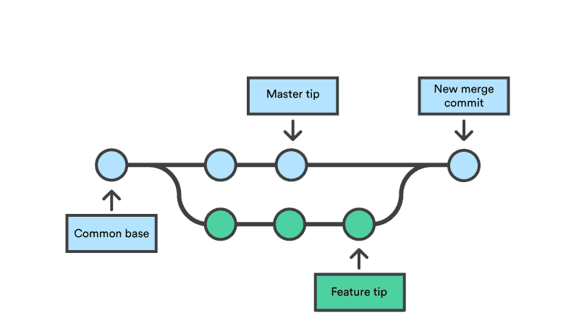
Free version control of your source code (repository) in the cloud:
Branching: With branching, you duplicate part of the repository. You can then safely make changes to that part of the code without affecting the rest of the project.
Merging: Then, once you your part of the code working properly, you can merge that code back into the main source code to make it official.
Cherry picking: Pull changes from a different branch into the current branch.
All of these changes are then tracked and can be reverted if need be.
You can also clone (fork) public repositories to contribute to open-source software make changes/improvements.
https://anexinet.com/blog/git-practical-aspects-of-merge-rebase-cherry-pick/
https://kinsta.com/knowledgebase/what-is-github/

Slide 3
Microsoft VS Code
Powerful Integrated Development Environment (IDE) by Microsoft
Supports syntax from ANY programming language
Python
Julia
R
LaTeX
GAMS
Integrated terminal
Support for Jupyter notebooks
Integrates with GitHub to clone and push your code to a GitHub repository

Slide 4

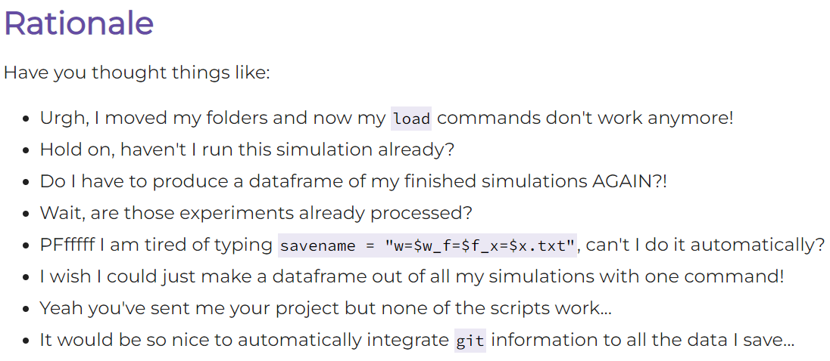
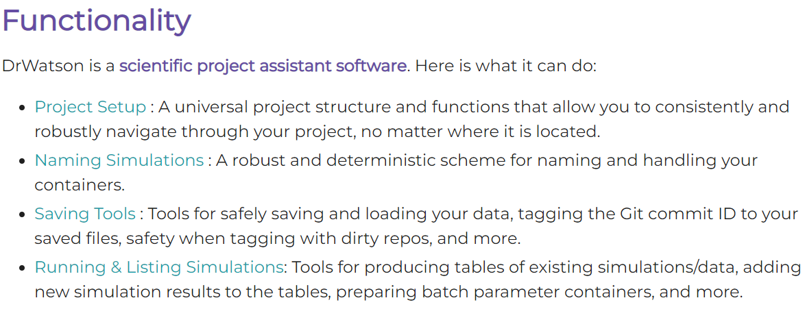
https://juliadynamics.github.io/DrWatson.jl/stable/

Slide 5
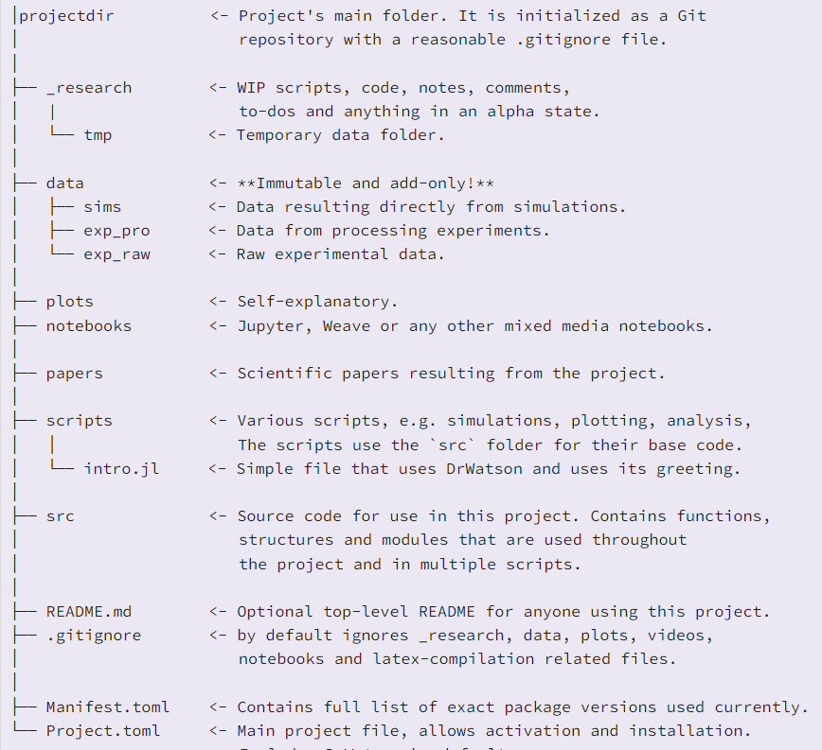
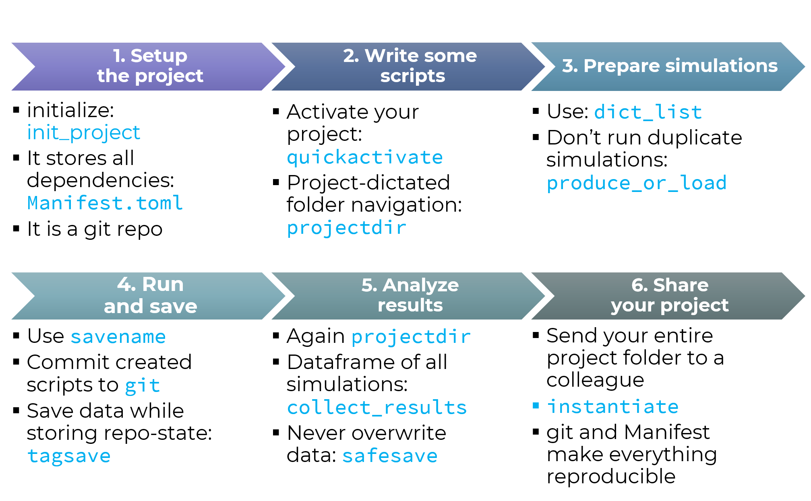
https://juliadynamics.github.io/DrWatson.jl/stable/

Slide 6
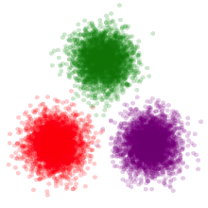
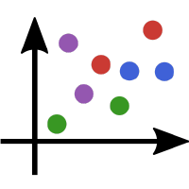
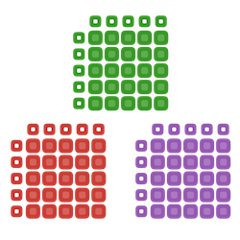

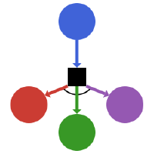

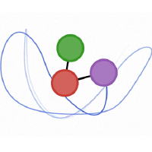

Ecosystem
JuliaStats
JuliaPlots
JuliaData
SciML
JuliaDynamics
FluxML
JuliaRL

Slide 7
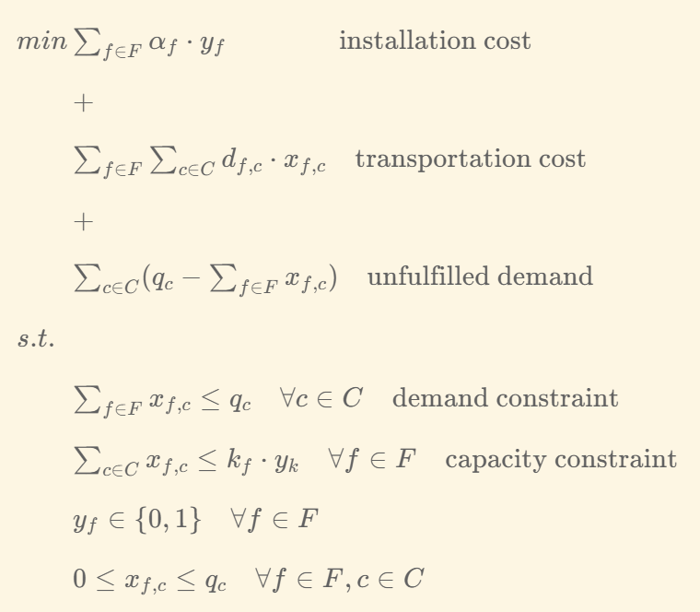
Example: Facility Location Problem

Slide 8
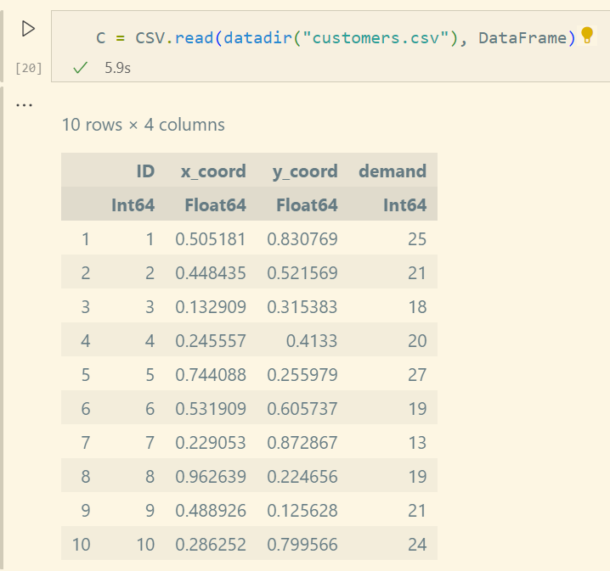
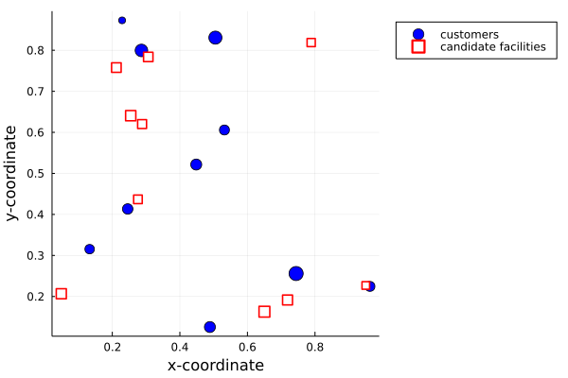
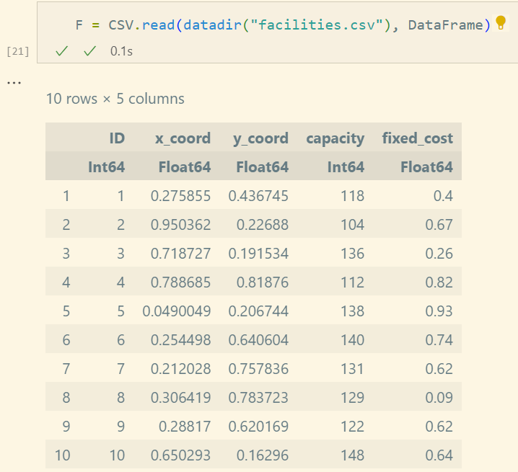
Example: Facility Location Problem

Slide 9
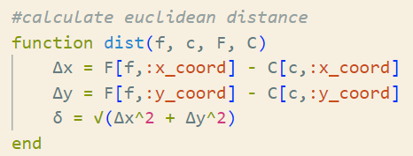
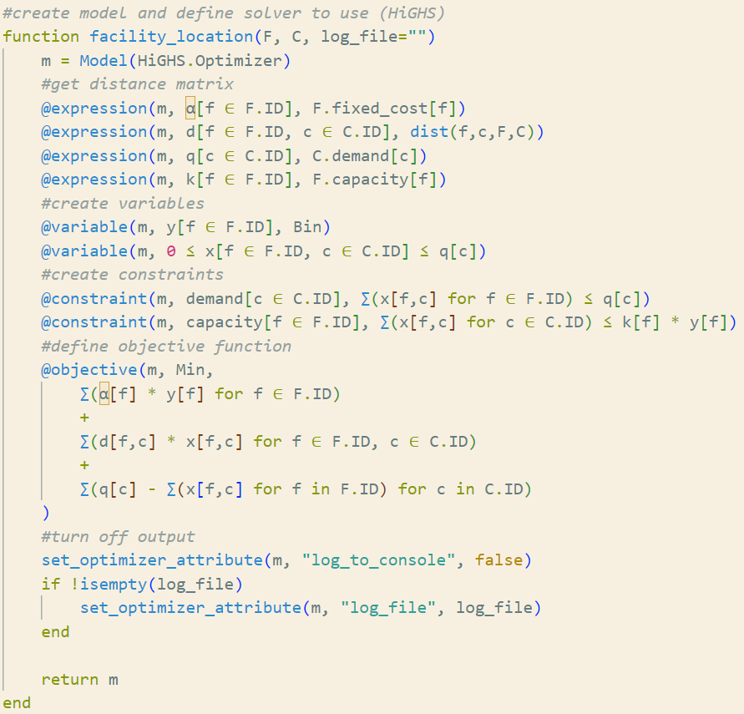
Example: Facility Location Problem

Slide 10
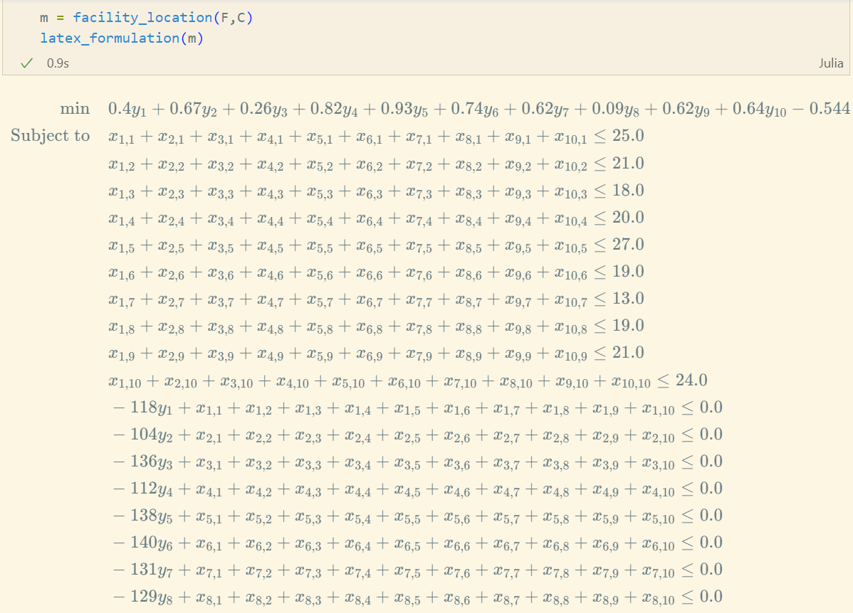
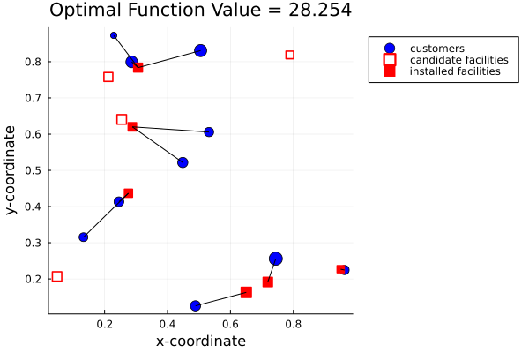
Example: Facility Location Problem

Slide 11
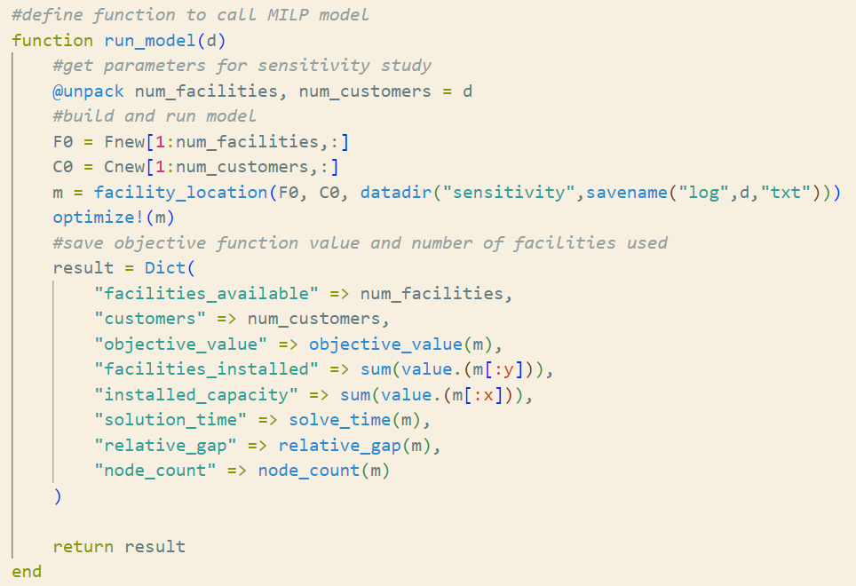
Example: Facility Location Problem Sensitivity

Slide 12
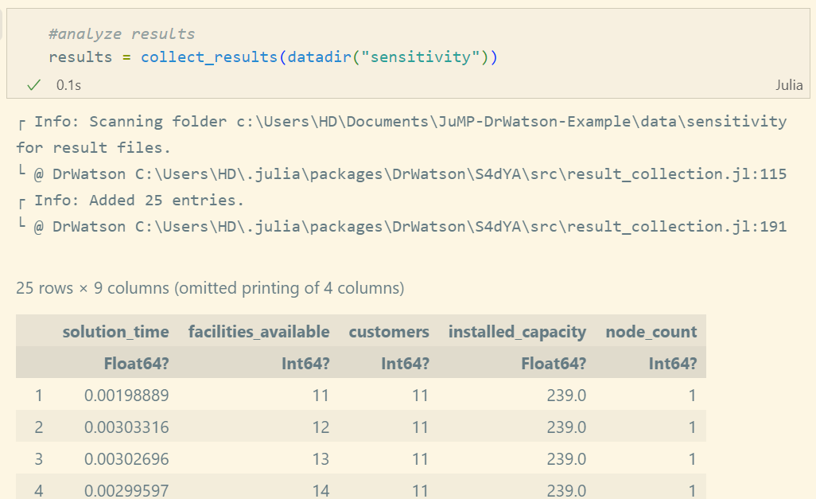
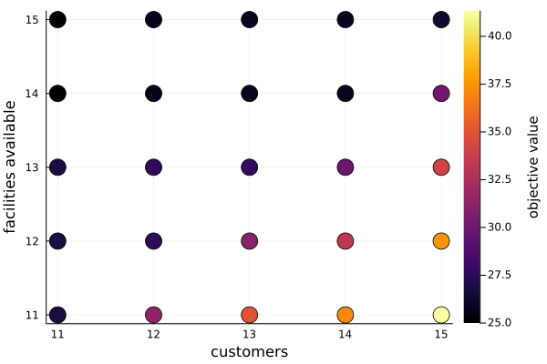
Example: Facility Location Problem Sensitivity

