Slide 1

Leveraging a Bayesian network approach to model and analyze supplier vulnerability to severe weather risk: A case study of the U.S. pharmaceutical supply chain following Hurricane Maria
Journal : International Journal of Disaster Risk Reduction
Authors : Jeanne-Marie Lawrence, Niamat Ullah Ibne Hossain, Raed Jaradat Michael Hamilton
Year : 2020
Prepared by : Harshit Bhalsod (21IM60R13)

Slide 2





Introduction
Supply chain
Supply chain Disruption
Supplier
Pharmaceutical manufacturer
Wholesale
distributor
Hospital
Patient

Slide 3
Problem Description
Operational
Demand fluctuation
Quality failures
Equipment breakdown
Disruptive
Political protest
Natural disasters
Cyber crime

Slide 4
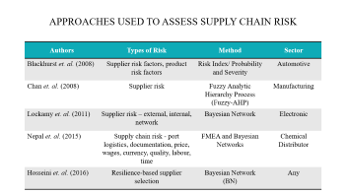
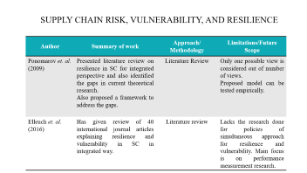
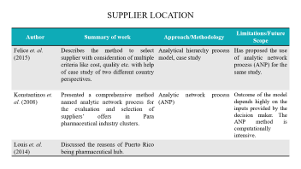
Literature Review
To describe how supplier locations are selected
To discuss the interrelationships between risk, vulnerability, and resilience
To review the methods developed and approaches used to evaluate supplier and supply chain network risk.

Slide 5
Supplier Location
Author | Summary of work | Approach/Methodology | Limitations/Future Scope
Felice et. al. (2015) | Describes the method to select supplier with consideration of multiple criteria like cost, quality etc. with help of case study of two different country perspectives. | Analytical hierarchy process model, case study | Has proposed the use of analytic network process (ANP) for the same study.
Konstantinos et. al. (2008) | Presented a comprehensive method named analytic network process for the evaluation and selection of suppliers’ offers in Para pharmaceutical industry clusters. | Analytic network process (ANP) | Outcome of the model depends highly on the inputs provided by the decision maker. The ANP method is computationally intensive.
Louis et. al. (2014) | Discussed the reasons of Puerto Rico being pharmaceutical hub.

Slide 6
Supply chain risk, vulnerability, and resilience
Author | Summary of work | Approach/ Methodology | Limitations/Future Scope
Ponomarov et. al. (2009) | Presented literature review on resilience in SC for integrated perspective and also identified the gaps in current theoretical research. Also proposed a framework to address the gaps. | Literature Review | Only one possible view is considered out of number of views. Proposed model can be tested empirically.
Elleuch et. al. (2016) | Has given review of 40 international journal articles explaining resilience and vulnerability in SC in integrated way. | Literature review | Lacks the research done for policies of simultaneous approach for resilience and vulnerability. Main focus is on performance measurement research.

Slide 7
Approaches used to assess supply chain risk
Authors | Types of Risk | Method | Sector
Blackhurst et. al. (2008) | Supplier risk factors, product risk factors | Risk Index/ Probability and Severity | Automotive
Chan et. al. (2008) | Supplier risk | Fuzzy Analytic Hierarchy Process (Fuzzy-AHP) | Manufacturing
Lockamy et. al. (2011) | Supplier risk – external, internal, network | Bayesian Network | Electronic
Nepal et. al. (2015) | Supply chain risk - port logistics, documentation, price, wages, currency, quality, labour, time | FMEA and Bayesian Networks | Chemical Distributor
Hosseini et. al. (2016) | Resilience-based supplier selection | Bayesian Network (BN) | Any

Slide 8
Objective
Causal factors and Intermediate events?
Estimation of disruption?
Risk mitigation strategies ?

Slide 9
Solution Approach
Potential factors for pharmaceutical supply chain disruption
Probabilistic graphical model
Predictive inference reasoning
Sensitivity analysis

Slide 10
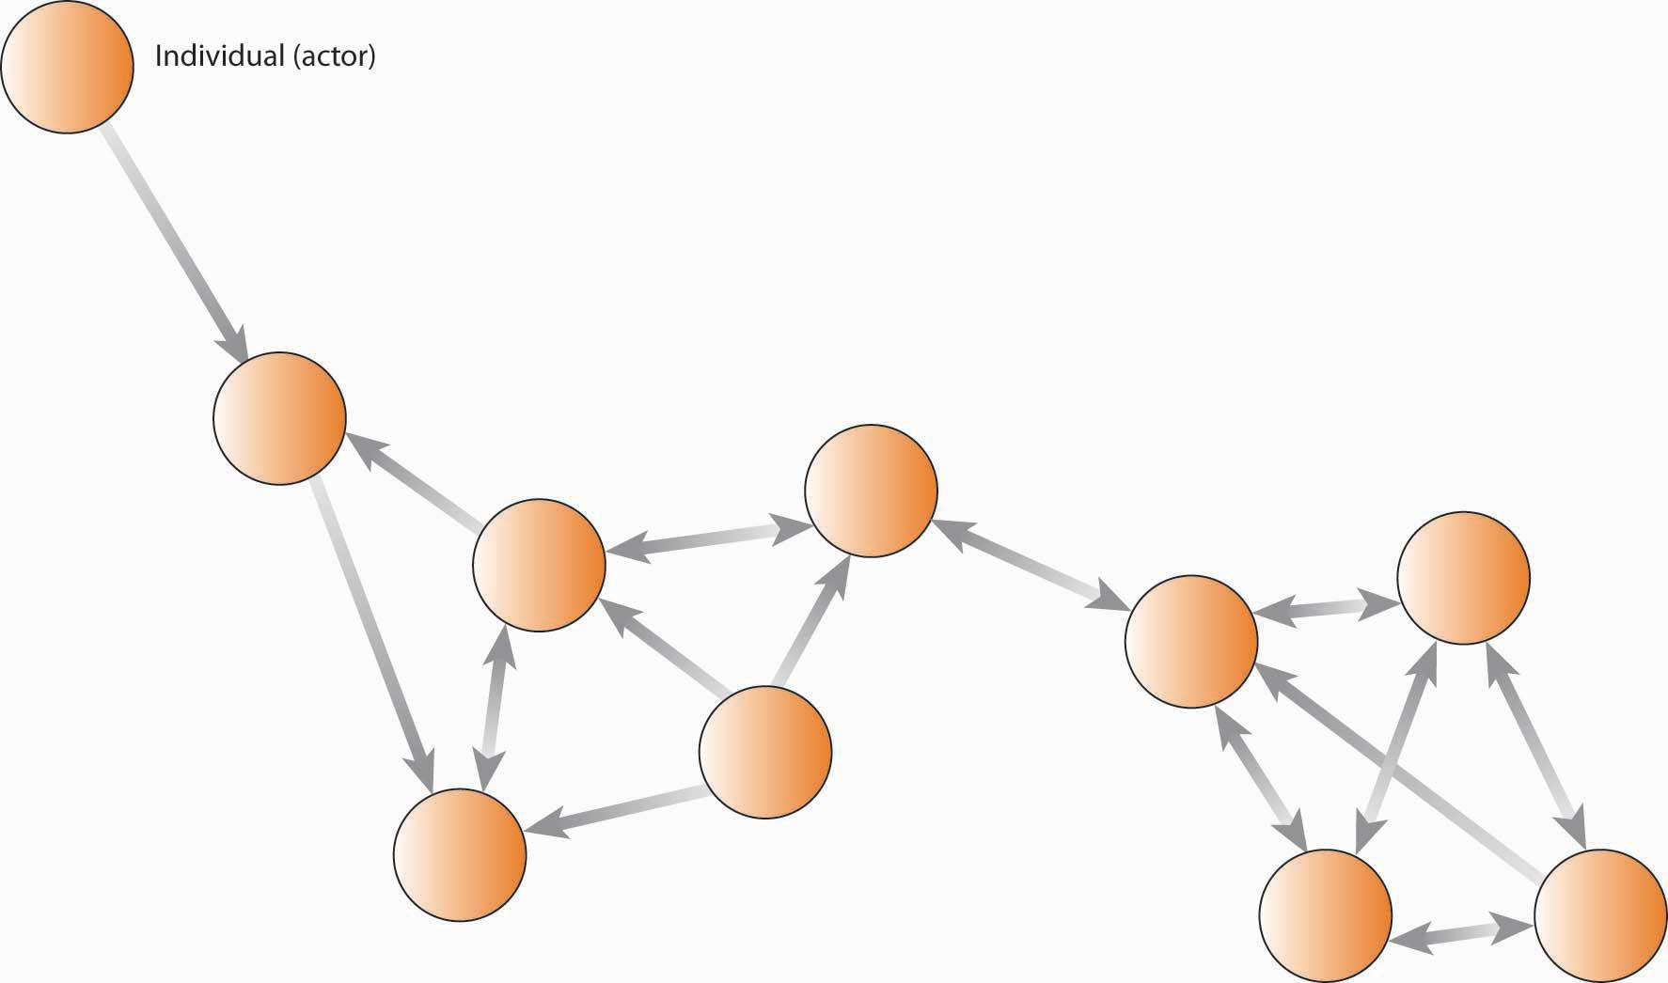


Model Description
Intermediate risk events and dependencies
Disruption in hospital supplies (consequence)
Main Risk Factors

Slide 11
Main Risk Factors
Category V Hurricane
Factory Building damage
Employees’ houses damage
Utilities company limitation and Electric grid resilience
Major Part supplier
Other supplier
Influenza Outbreak after hurricane

Slide 12
Intermediate risk events and dependencies
Increase in product demand
Product supply state

Slide 13
Disruption in hospital supplies (consequence)
Increase in demand
Reduced supply

Slide 14
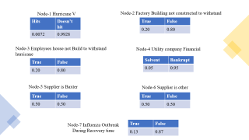
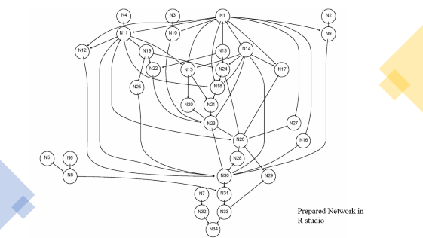
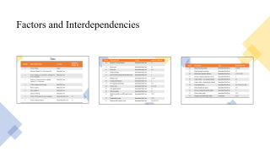
Data set Description
Factors
Independent events probabilities
Model Graph

Slide 15
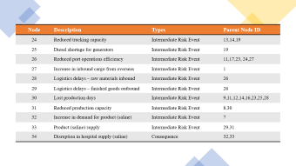
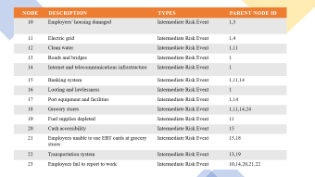
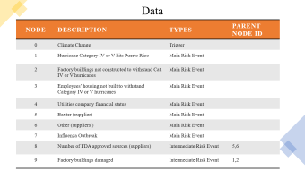
Factors and Interdependencies

Slide 16
Data
Node | Description | Types | Parent Node ID
0 | Climate Change | Trigger
1 | Hurricane Category IV or V hits Puerto Rico | Main Risk Event
2 | Factory buildings not constructed to withstand Cat. IV or V hurricanes | Main Risk Event
3 | Employees’ housing not built to withstand Category IV or V hurricanes | Main Risk Event
4 | Utilities company financial status | Main Risk Event
5 | Baxter (supplier) | Main Risk Event
6 | Other (suppliers ) | Main Risk Event
7 | Influenza Outbreak | Main Risk Event
8 | Number of FDA approved sources (suppliers) | Intermediate Risk Event | 5,6
9 | Factory buildings damaged | Intermediate Risk Event | 1,2

Slide 17
Node | Description | Types | Parent Node ID
10 | Employees’ housing damaged | Intermediate Risk Event | 1,3
11 | Electric grid | Intermediate Risk Event | 1,4
12 | Clean water | Intermediate Risk Event | 1,11
13 | Roads and bridges | Intermediate Risk Event | 1
14 | Internet and telecommunications infrastructure | Intermediate Risk Event | 1
15 | Banking system | Intermediate Risk Event | 1,11,14
16 | Looting and lawlessness | Intermediate Risk Event | 1
17 | Port equipment and facilities | Intermediate Risk Event | 1,14
18 | Grocery stores | Intermediate Risk Event | 1,11,14,24
19 | Fuel supplies depleted | Intermediate Risk Event | 11
20 | Cash accessibility | Intermediate Risk Event | 15
21 | Employees unable to use EBT cards at grocery stores | Intermediate Risk Event | 15,18
22 | Transportation system | Intermediate Risk Event | 13,19
23 | Employees fail to report to work | Intermediate Risk Event | 10,14,20,21,22

Slide 18
Node | Description | Types | Parent Node ID
24 | Reduced trucking capacity | Intermediate Risk Event | 13,14,19
25 | Diesel shortage for generators | Intermediate Risk Event | 19
26 | Reduced port operations efficiency | Intermediate Risk Event | 11,17,23, 24,27
27 | Increase in inbound cargo from overseas | Intermediate Risk Event | 1
28 | Logistics delays – raw materials inbound | Intermediate Risk Event | 26
29 | Logistics delays – finished goods outbound | Intermediate Risk Event | 26
30 | Lost production days | Intermediate Risk Event | 9,11,12,14,16,23,25,28
31 | Reduced production capacity | Intermediate Risk Event | 8,30
32 | Increase in demand for product (saline) | Intermediate Risk Event | 7
33 | Product (saline) supply | Intermediate Risk Event | 29,31
34 | Disruption in hospital supply (saline) | Consequence | 32,33

Slide 19
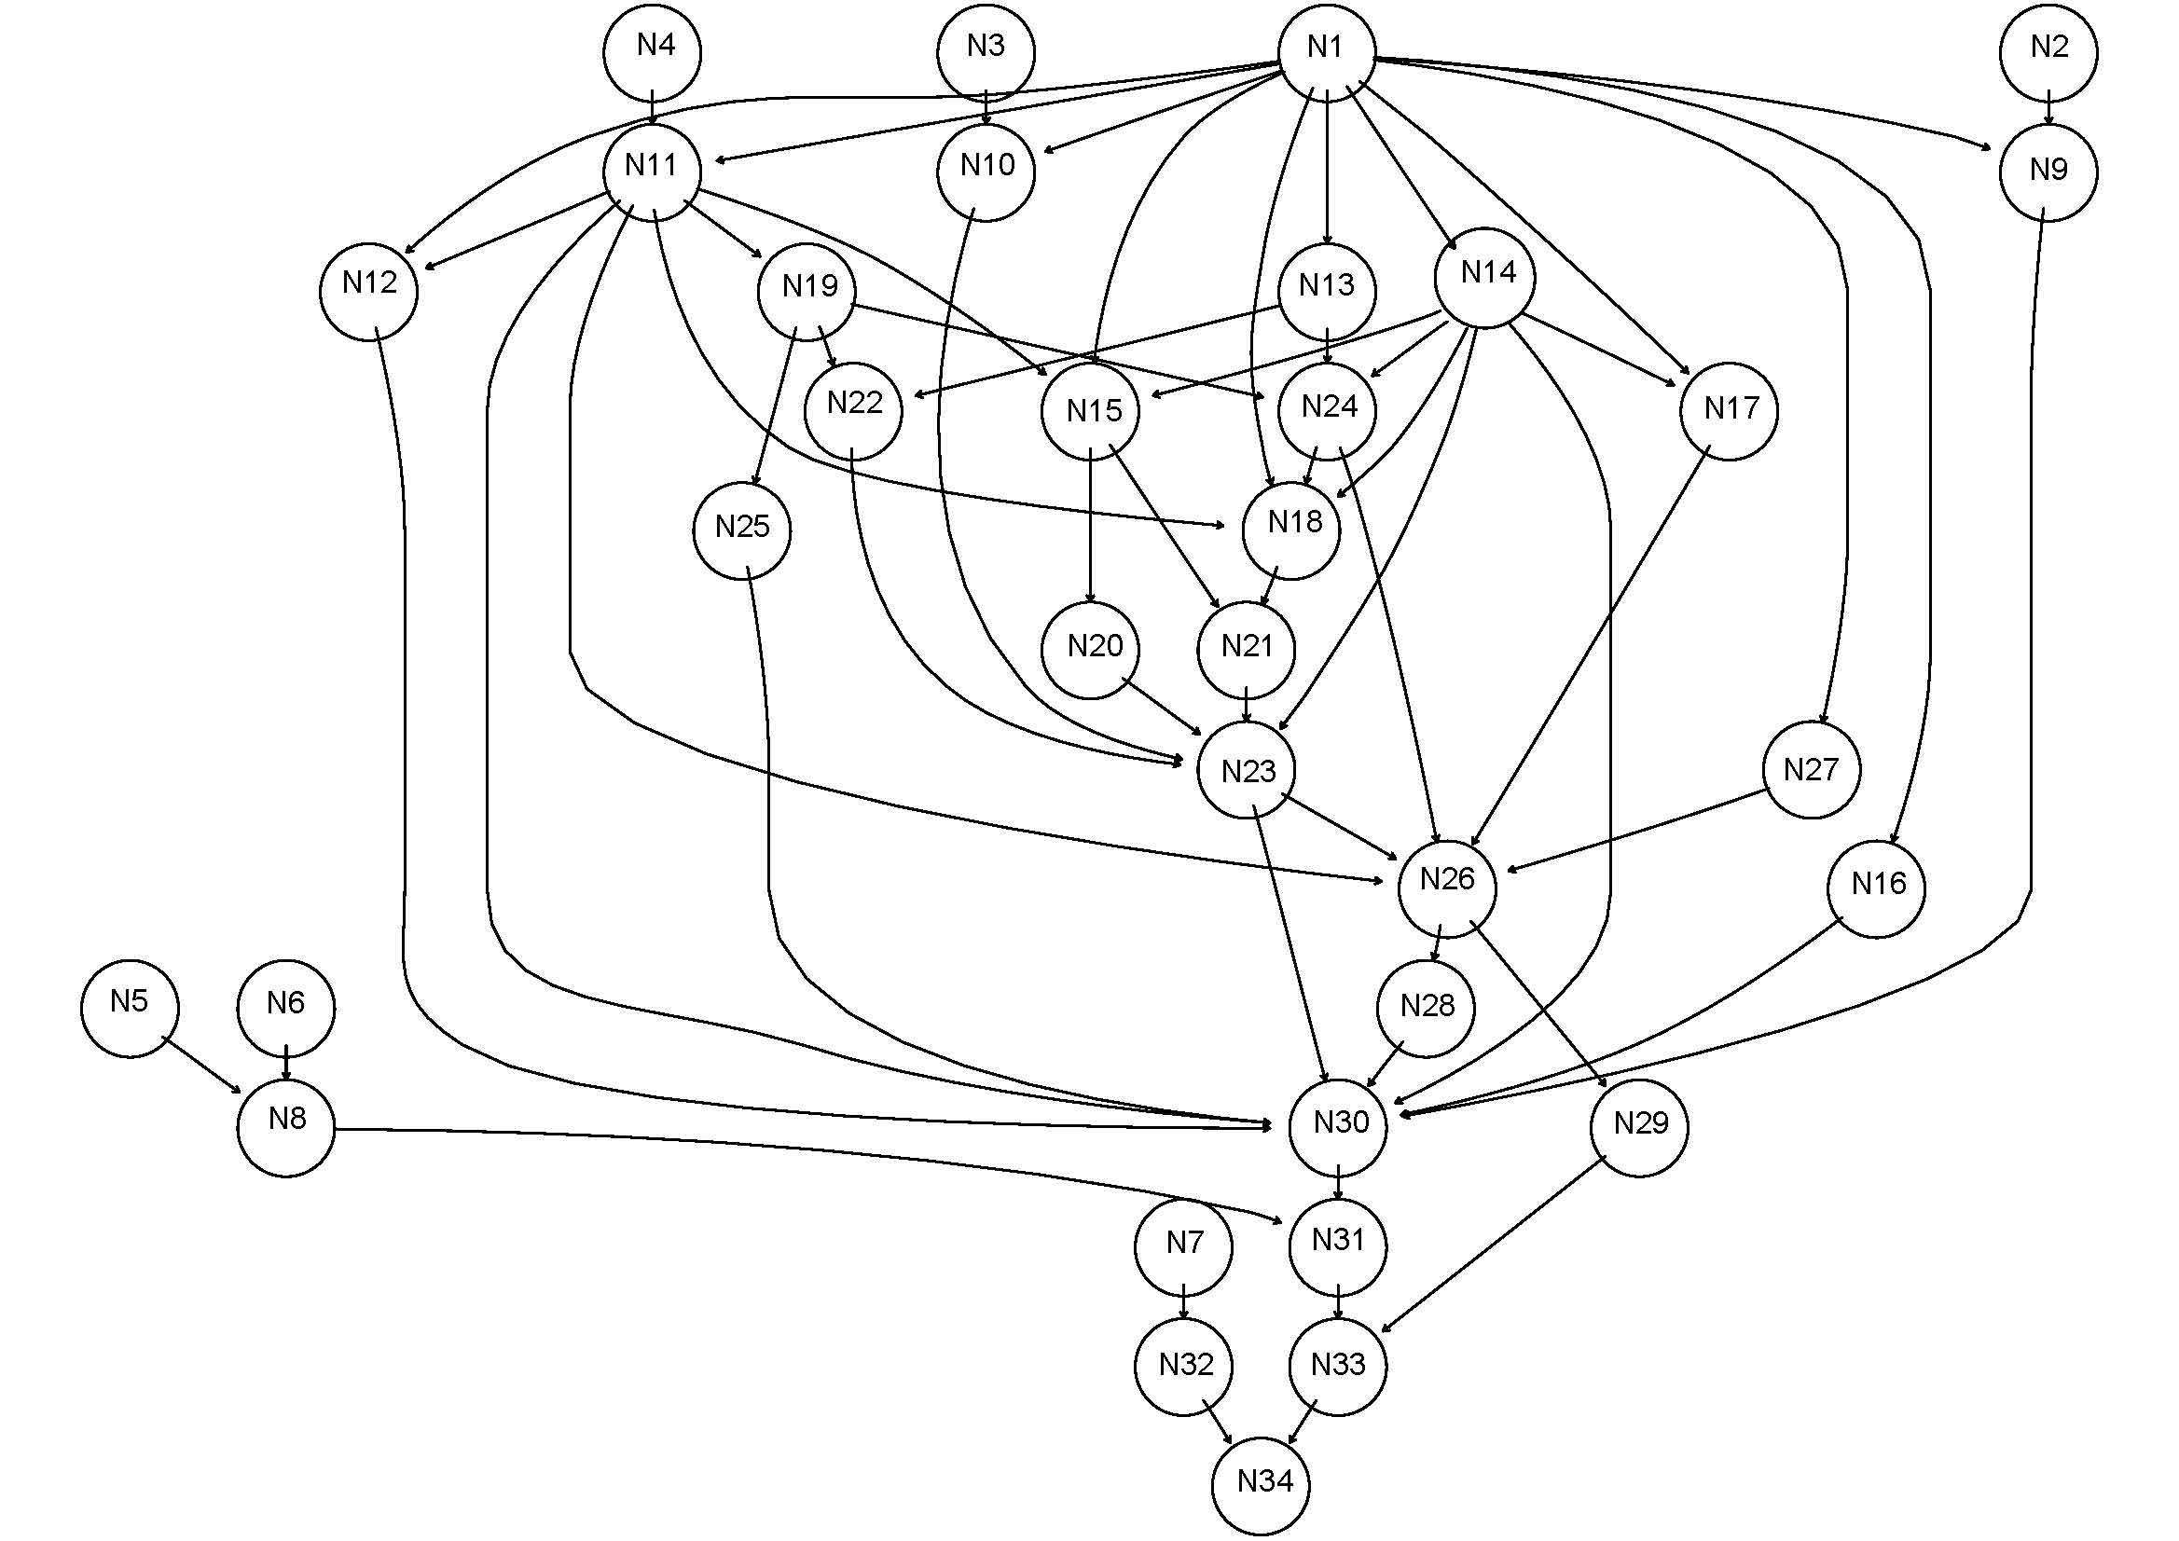
Prepared Network in
R studio

Slide 20
Node-1 Hurricane V
Node-2 Factory Building not constructed to withstand
Hits | Doesn’t hit
0.0072 | 0.9928
True | False
0.20 | 0.80
Node-3 Employees house not Build to withstand hurricane
Node-4 Utility company Financial
True | False
0.20 | 0.80
Solvent | Bankrupt
0.05 | 0.95
Node-5 Supplier is Baxter
Node-6 Supplier is other
True | False
0.50 | 0.50
True | False
0.50 | 0.50
Node-7 Influenza Outbreak During Recovery time
True | False
0.13 | 0.87

Slide 21
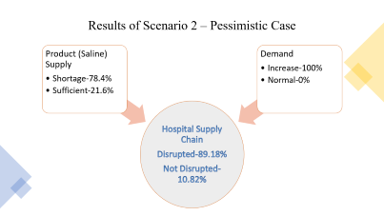
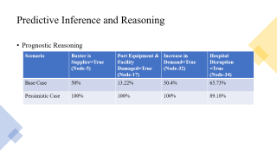
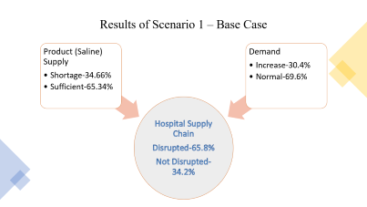

Results
Change in nodes
Base Scenario
Pessimistic Scenario

Slide 22
Results of Scenario 1 – Base Case
Hospital Supply Chain
Disrupted-65.8%
Not Disrupted-34.2%
Product (Saline) Supply
Demand
Increase-30.4%
Shortage-34.66%
Sufficient-65.34%
Normal-69.6%

Slide 23
Predictive Inference and Reasoning
Prognostic Reasoning
Scenario | Baxter is Supplier=True (Node-5) | Port Equipment & Facility Damaged=True (Node-17) | Increase in Demand=True (Node-32) | Hospital Disruption =True (Node-34)
Base Case | 50% | 13.22% | 30.4% | 65.73%
Pessimistic Case | 100% | 100% | 100% | 89.18%

Slide 24
Results of Scenario 2 – Pessimistic Case
Hospital Supply Chain
Disrupted-89.18%
Not Disrupted-10.82%
Product (Saline) Supply
Demand
Increase-100%
Shortage-78.4%
Sufficient-21.6%
Normal-0%

Slide 25
Result : Sensitivity analysis

Slide 26
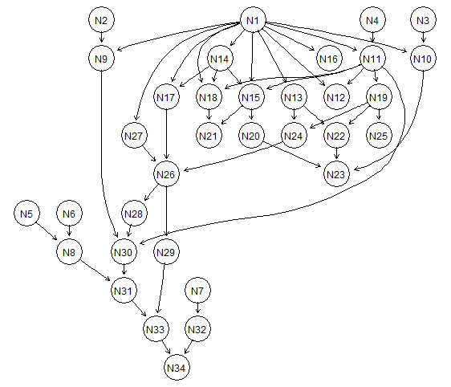
Implementation
Reduced Graphical Model

Slide 27
Results of Implementation in R
Comparison Of Results

Slide 28
Concluding Remarks , Limitations & Future scope
Design of Resilient Supply chain
Minimize impact
Control measures
Lack of knowledge
COVID-19 impact

Slide 29
References
American Medical Association (AMA), New AMA policy reflects frustration over ongoing drug shortage. https://www.ama-assn.org/press-center/press-releases/ new-ama-policy-reflects-frustration-over-ongoing-drug-shortages, 2018.
Pharmacy Checkroom, FDA understates percentage of foreign-made medication sold in the U.S. Pharmacy Checker. https://www.prnewswire.com/news-releases/ fda-understates-percentage-of-foreign-made-medication-sold-in-us-300551124.ht ml, 2017.
Tang, C.S., 2006. Perspectives in supply chain risk management. International journal of production economics, 103(2), pp.451-488.
K. O’Marrah, Supply chain risk 2020: new worries. Forbes. https://www.forbes. com/sites/kevinomarah/2017/10/06/supply-chain-risk-2020-new-worries/#6d460af77127, 2017.
http://refhub.elsevier.com/S2212-4209(19)31184-7/sref7
AANA, IV saline solution shortage. https://www.aana.com/practice/u.s.-food-an d-drug- administration/iv-saline-solution, 2019.
M. Mazer- Amirshahi, E.R. Fox, Saline shortages – many causes, No simple solution, N. Engl. J. Med. 378 (16) (2018) 1472–1474.
A. Sifferlin, Hospitals struggle with IV saline shortage. Time. http://time.com /2589/hospitals-struggle-with-iv-saline-shortage/, 2014.

Slide 30
De Felice, F., Deldoost, M.H. and Faizollahi, M., 2015. Performance measurement model for the supplier selection based on AHP. International Journal of Engineering Business Management, 7(Godište 2015), pp.7-17.
Konstantinos Kirytopoulos Vrassidas Leopoulos Dimitra Voulgaridou, (2008),"Supplier selection in pharmaceutical industry", Benchmarking: An International Journal, Vol. 15 Iss 4 pp. 494 – 516
https://www.outsourcedpharma.com/doc/puerto-rico-back-on-the-map-of-pharmaceutical-locations-0001
Ritchie, B. and Brindley, C. (2007), "Supply chain risk management and performance: A guiding framework for future development", International Journal of Operations & Production Management, Vol. 27 No. 3, pp. 303-322
H. Elleuch, E. Dafaoui, A. Elmhamedi, H. Chabchoub,Resilience and Vulnerability in Supply Chain: Literature eview,IFAC-PapersOnLine,Volume 49, Issue 12,2016,Pages 1448-1453,ISSN 2405-8963.
Ponomarov, S.Y. and Holcomb, M.C. (2009), "Understanding the concept of supply chain resilience", The International Journal of Logistics Management, Vol. 20 No. 1, pp. 124-143. https://doi.org/10.1108/09574090910954873
Lockamy, A. (2011), "Benchmarking supplier risks using Bayesian networks", Benchmarking: An International Journal, Vol. 18 No. 3, pp. 409-427. https://doi.org/10.1108/14635771111137787

Slide 31
Seyedmohsen Hosseini and Kash Barker, A Bayesian Network Model for Resilience-Based Supplier Selection, Intern. Journal of Production Economics, http://dx.doi.org/10.1016/j.ijpe.2016.07.007
Jennifer V. Blackhurst, Kevin P. Scheibe, Danny J. Johnson, (2008),"Supplier risk assessment and monitoring for the automotive industry", International Journal of Physical Distribution & Logistics Management, Vol. 38 Iss: 2 pp. 143 – 165
Felix T. S. Chan , N. Kumar , M. K. Tiwari , H. C. W. Lau & K. L. Choy (2008) Global supplier selection: a fuzzy-AHP approach, International Journal of Production Research, 46:14, 3825-3857, DOI:10.1080/00207540600787200
Archie Lockamy III, (2011),"Benchmarking supplier risks using Bayesian networks", Benchmarking: An International Journal, Vol. 18 Iss 3 pp. 409 – 427 http://dx.doi.org/10.1108/14635771111137787

