Slide 1
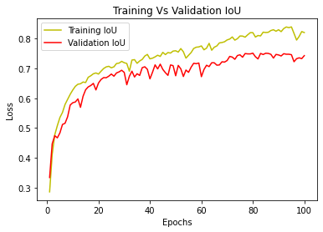


Intersection over Union (IoU)
Epochs

Slide 3
