Slide 1
C#
Session 2

Slide 2

Topics
Struct vs Class
Data types: Reference vs Value
Delegate and Event
Design Pattern: Strategy

Slide 3
Struct vs Class
Struct value data type, single variable holds related various data types
Struct has methods, fields, constructors but not explicit constructor
Implement interfaces
Struct cannot inherit from other struct or class
Struct members cannot be specified as abstract, virtual, or protected

Slide 4
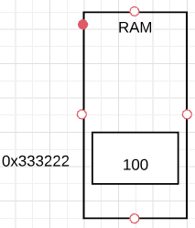
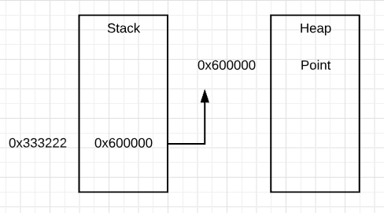
Value vs Reference type
Value type:
Derived from System.ValueType
Holds data value within its memory space
In Stack
Primitive type
Reference type:
Store address where value its stored
Heap
Array, List, Dictionary

Slide 5
Value vs Reference type
Deep vs Shallow copy
Value type passes byval by default. Reference type passes ref by default

Slide 6
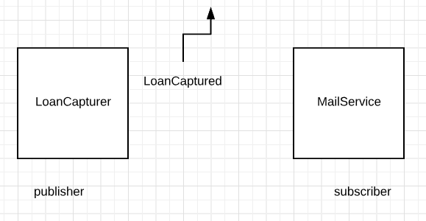
Events
Mechanism for communication between objects
Something happens inside object → notify other objects
Building in Loosely coupled applications

Slide 7
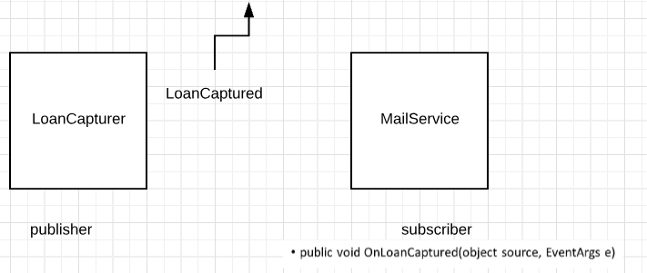
Delegate
Send notification in practical C# means invoking subscribers’ method.
Agreement/Contract between publisher and subscriber
Signature of event handler in subscriber

Slide 8
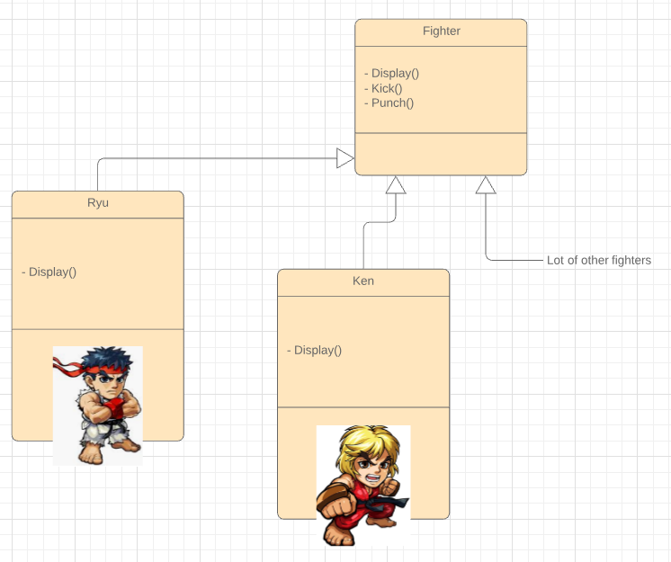
SimStreetFighter App
List large variety of fighters
Show characteristic or each fighter

Slide 9
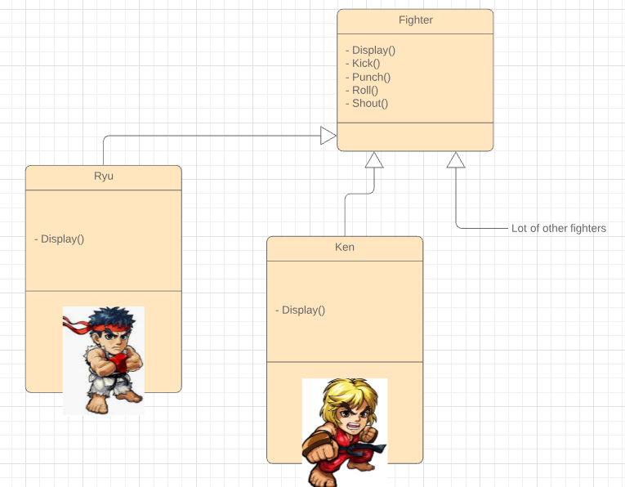
SimStreetFighter App (2)
Roll(), Shout()
Roll forward/backward
Shout female/male voice

Slide 10
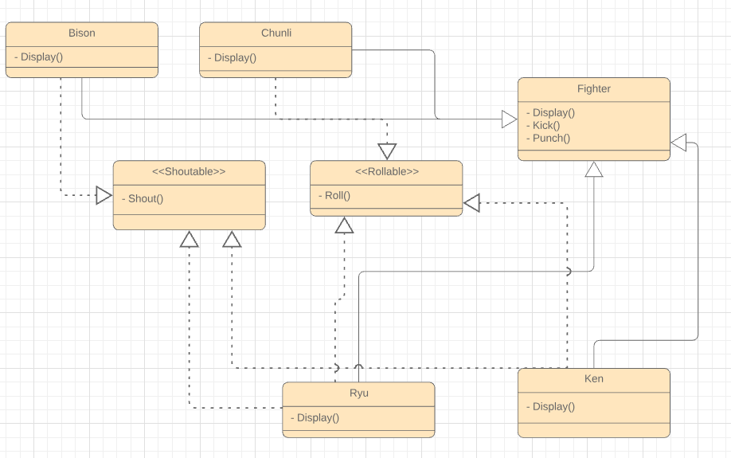
SimStreetFighter App (3)
New characters no shout() or no roll()

Slide 11
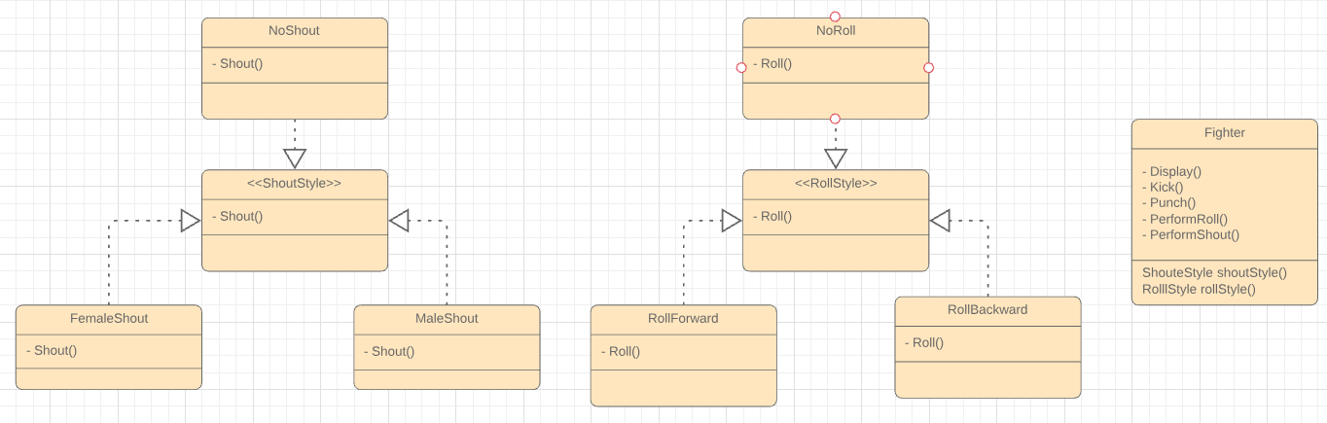
SimStreetFighter App (4)

