Slide 1
Fall 2020
DATS 501 Fundamentals of Data Science
Hasan Demirtaş
hdemirtas.academic@gmail.com

Slide 2
Tree-Based Models

Slide 3
Random Forest Idea

Slide 4
Random Forest
Why benefit from just a single tree?:
Would it be better if we could use multiple trees?
Would it fit better?
Does it have overfit risk?

Slide 5
Random Forest
Bagging:
Bagging is a method which random forest is based on
Even its library is the same in R
The idea is to sample data from original data
Behaving each sample as new data and training parallel models is bagging
The sampling is with replacement i.e. Sampled data is returned to the bag
Notes:
The data is taken from a sample of 50 soft drink purchases.
Each purchase is for one of five popular soft drinks, which define the five bins: Coca-Cola, Diet Coke, Dr. Pepper, Pepsi, and Sprite.

Slide 6
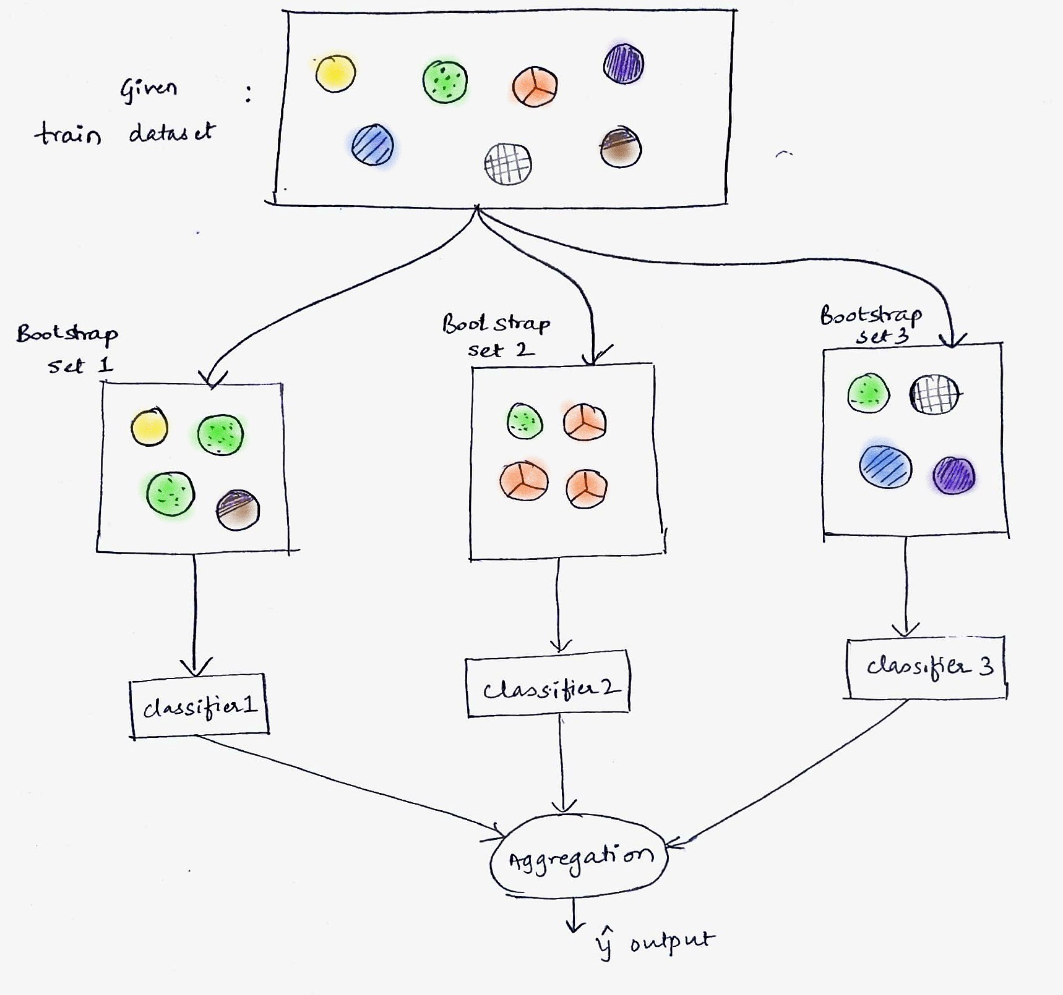
Random Forest
Bagging
Notes:
The data is taken from a sample of 50 soft drink purchases.
Each purchase is for one of five popular soft drinks, which define the five bins: Coca-Cola, Diet Coke, Dr. Pepper, Pepsi, and Sprite.

Slide 7
Random Forest
Bagging:
A mile step for ensembling methods
Proposed by Leo Breiman in 1994
Better than a single tree
Con is the interprebility is worser compared to a single tree
The idea of creating new data by sampling the original is nice
It increase the bias since the same data is learned again and again
Variance is expected to be reduced
Notes:
The data is taken from a sample of 50 soft drink purchases.
Each purchase is for one of five popular soft drinks, which define the five bins: Coca-Cola, Diet Coke, Dr. Pepper, Pepsi, and Sprite.

Slide 8
Random Forest
Variance – bias trade off:
Bias is the difference between predicted target values and real target values
Variance is the fluctuative deviation from real target values
It is a said that sometimes to gain better variance values, some bias is introduced by the models or vice versa
Fitting to the training data multiple times results in bias since the training data and future test data probably does not have same mean values
Notes:
The data is taken from a sample of 50 soft drink purchases.
Each purchase is for one of five popular soft drinks, which define the five bins: Coca-Cola, Diet Coke, Dr. Pepper, Pepsi, and Sprite.

Slide 9
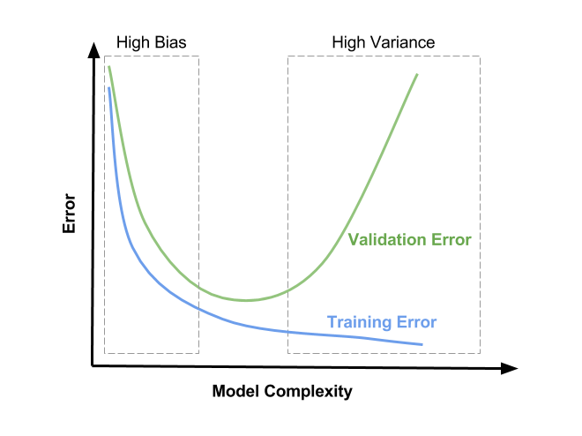
Random Forest
Variance – bias trade off
Notes:
The data is taken from a sample of 50 soft drink purchases.
Each purchase is for one of five popular soft drinks, which define the five bins: Coca-Cola, Diet Coke, Dr. Pepper, Pepsi, and Sprite.

Slide 10
Random Forest
Random Forest:
It introduces randomness in features
It uses some portion of variable pool
As an example, python sklearn random forest classifier uses sqrt as «auto» default option
The idea is to prevent trees to be created by same dominant features again and again
Randomly selected features allow not dominant features to shine also
Notes:
The data is taken from a sample of 50 soft drink purchases.
Each purchase is for one of five popular soft drinks, which define the five bins: Coca-Cola, Diet Coke, Dr. Pepper, Pepsi, and Sprite.

Slide 11
Random Forest
Random Forest:
Random forest also has feature selection property since it creates multiple trees and selects features to create trees for root, 1st level and 2nd level etc.
The idea is even in the small feature pool if a variable does not seem like important, that variable is not important
Notes:
The data is taken from a sample of 50 soft drink purchases.
Each purchase is for one of five popular soft drinks, which define the five bins: Coca-Cola, Diet Coke, Dr. Pepper, Pepsi, and Sprite.

Slide 12
Random Forest
Random Forest:
Pros:
Improvement over bagging. Almost always beats it. Practically bagging is not used anymore
Benefits of tree algoritms
Way faster compared to bagging
Cons:
Not that many
It can overfit if number of trees are increased too much
Notes:
The data is taken from a sample of 50 soft drink purchases.
Each purchase is for one of five popular soft drinks, which define the five bins: Coca-Cola, Diet Coke, Dr. Pepper, Pepsi, and Sprite.

Slide 13
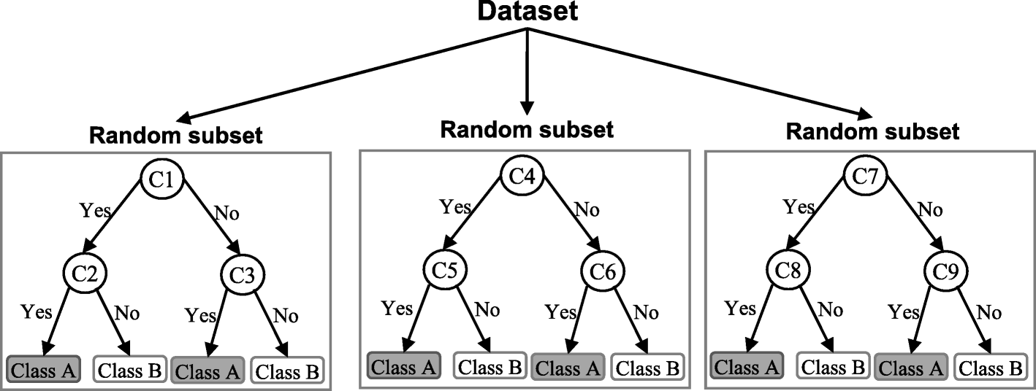
Random Forest
Random Forest
Notes:
The data is taken from a sample of 50 soft drink purchases.
Each purchase is for one of five popular soft drinks, which define the five bins: Coca-Cola, Diet Coke, Dr. Pepper, Pepsi, and Sprite.

Slide 14
Boosting
Is parallel ensembling good enough?:
Is there an alternative?
Turning a weak learner ( a slow learning single tree ) to a strong learner is the boosting idea
It boosts an original learner and name comes from it
How does it boost?
Tries to learn from errors
That is trying to fit new trees in a way that reduces the errors caused by previous trees
Notes:
The data is taken from a sample of 50 soft drink purchases.
Each purchase is for one of five popular soft drinks, which define the five bins: Coca-Cola, Diet Coke, Dr. Pepper, Pepsi, and Sprite.

Slide 15
Boosting
Boosting:
Its tree implementation is the common one
The trees are placed in a serial manner
The state of algorithms are developed with this concept
Notes:
The data is taken from a sample of 50 soft drink purchases.
Each purchase is for one of five popular soft drinks, which define the five bins: Coca-Cola, Diet Coke, Dr. Pepper, Pepsi, and Sprite.

Slide 16
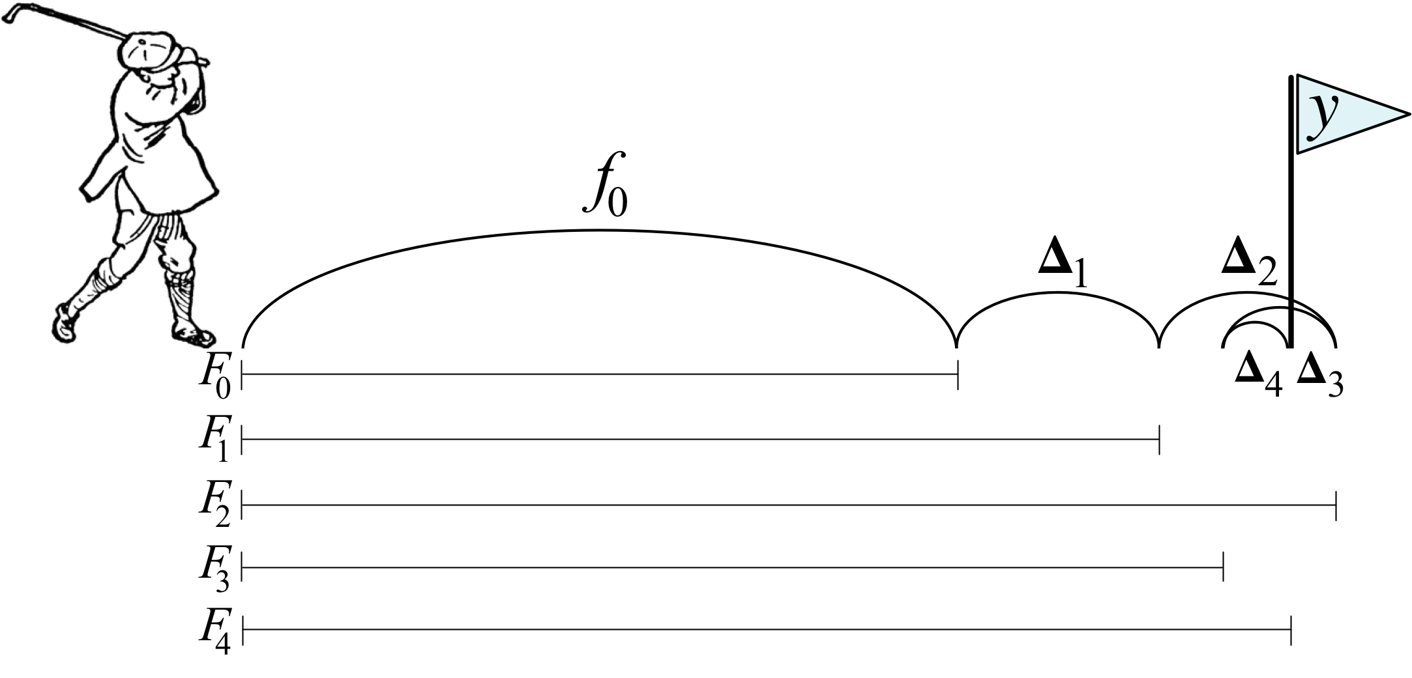
Boosting
Boosting
Notes:
The data is taken from a sample of 50 soft drink purchases.
Each purchase is for one of five popular soft drinks, which define the five bins: Coca-Cola, Diet Coke, Dr. Pepper, Pepsi, and Sprite.

Slide 17
Development of Tree Algorithms
Single Classification and Regression Tree:
Using trees for a single algorithm created the CART concept (Gordon, Breiman, Friedman, Olshen & Stone, 1984). Metrics and methods for a computer to use decision trees are also defined by the creators of CART. Their work later helped the evolution of more complex tree algorithms. The main advantage of using a single tree is the interpretability of the model.
Gordon, A. D., Breiman, L., Friedman, J. H., Olshen, R. A., & Stone, C. J. (1984). Classification and regression trees. Biometrics, 40 (3), 874.
Notes:
The data is taken from a sample of 50 soft drink purchases.
Each purchase is for one of five popular soft drinks, which define the five bins: Coca-Cola, Diet Coke, Dr. Pepper, Pepsi, and Sprite.

Slide 18
Development of Tree Algorithms
Bagging:
Random forest algorithm is established over bagging, that is why it is introduced before explaining random forest. Bagging is introduced as an improvement to CART idea (Breiman, 1996). Bagging is using multiple decision trees based on randomly taken samples from the same dataset. It is mentioned averaging a set of observations reduces variance (James et al., 2013). Hence a natural way to reduce the variance and hence increase the prediction accuracy of a statistical learning method is to take many training sets from the population, build a separate prediction model using each training set, and average the resulting predictions. Using separate prediction results, ˆf 1 (x), ˆf 2 (x),..., ˆf B(x) (x)), trained on B separate training sets and average them is logical to obtain a single low-variance statistical learning model. In reality, data is not redundant to use them separately for each training. The solution is to create separate datasets by using the available with the methodology called bootstrapping as B different bootstrapped training data sets are created by taking repeated samples from the (single) training data set. The result of averaging prediction results can be denoted as ˆfbag(x) = 1 B PB b=1 ˆf ∗b (x).
Breiman, L. (1996). Bagging predictors. Machine Learning, 24 (2), 123–140.
Notes:
The data is taken from a sample of 50 soft drink purchases.
Each purchase is for one of five popular soft drinks, which define the five bins: Coca-Cola, Diet Coke, Dr. Pepper, Pepsi, and Sprite.

Slide 19
Development of Tree Algorithms
Random Forest:
The most dominant feature in decision trees is in the first parts of the tree. This causes dominant features to suppress other features. The idea to overcome this problem is using randomly selected features (typically the square-root of the original number of features) for each decision tree. Random forest algorithm is introduced as an enhancement of tree bagging (Breiman, 2001). This process is called as decorrelating the trees and assert this process makes the combined prediction outcomes of resulting trees less variable and hence steadier (James et al., 2013).
Breiman, L. (2001). Machine Learning, 45 (1), 5–32.
Notes:
The data is taken from a sample of 50 soft drink purchases.
Each purchase is for one of five popular soft drinks, which define the five bins: Coca-Cola, Diet Coke, Dr. Pepper, Pepsi, and Sprite.

Slide 20
Development of Tree Algorithms
Extremely Randomized Trees:
It is stated the key differences of the algorithm with other tree-based ensemble methods splitting nodes by choosing cut-points fully at random and using the whole learning sample rather than a bootstrap replica to grow the trees (Geurts, Ernst & Wehenkel, 2006).
Geurts, P., Ernst, D., & Wehenkel, L. (2006). Extremely randomized trees. Machine Learning, 63 (1), 3–42.
Notes:
The data is taken from a sample of 50 soft drink purchases.
Each purchase is for one of five popular soft drinks, which define the five bins: Coca-Cola, Diet Coke, Dr. Pepper, Pepsi, and Sprite.

Slide 21
Development of Tree Algorithms
Boosting:
The idea of creating additional models to correct the errors of the previous models by fitting to the errors of the previous models is introduced (Kearns, 1988). Later, It is mentioned the concept of a weak learner as a produced hypothesis achieving slightly better performance than a random guess (Schapire, 1990). It is stated boosting uses stacking models back to back regarding the previous error by first creating a tree than creating another tree that tries to fit the residuals of the previous one in a stage-wise fashion until the predefined number of trees are reached. Note that boosting does not involve bootstrap sampling (James et al., 2013).
Kearns, M. (1988). Thoughts on hypothesis boosting.
Schapire, R. E. (1990). Machine Learning, 5 (2), 197–227.
Notes:
The data is taken from a sample of 50 soft drink purchases.
Each purchase is for one of five popular soft drinks, which define the five bins: Coca-Cola, Diet Coke, Dr. Pepper, Pepsi, and Sprite.

Slide 22
Development of Tree Algorithms
AdaBoost:
A version of boosting called adaptive boosting which tries to create successive trees (weak learners) by sampling the wrongly predicted instances more and correctly predicted instances less is introduced. It also gives an adaptive coefficient to the trees’ weights in the final model (strong learner) regarding their performance (Freund & Schapire, 1997).
Freund, Y. & Schapire, R. E. (1997). A decision-theoretic generalization of on-line learning and an application to boosting. Journal of Computer and System Sciences, 55 (1), 119–139.
Notes:
The data is taken from a sample of 50 soft drink purchases.
Each purchase is for one of five popular soft drinks, which define the five bins: Coca-Cola, Diet Coke, Dr. Pepper, Pepsi, and Sprite.

Slide 23
Development of Tree Algorithms
Gradient boosting:
Gradient boosting is introduced as an idea to use the gradient descent method in boosting as his method views function estimation/approximation from numerical optimization in function space rather than parameter optimization perspective (Friedman, 2000). The developed connection between the general boosting idea, stagewise additive expansions, and steepest-descent minimization is named a general gradient descent boosting paradigm. A month later a modification is added to the algorithm as stochastic gradient boosting by using subsamples of the training data for each learning iteration is introduced. Software implemented versions of gradient boosting are generally the later version (Friedman, 2002). Gradient Boosting and Adaboost were the champion algorithms before Xgboost, LightGBM and Catboost started become more popular
Friedman, J. H. (2000). Greedy function approximation: A gradient boosting machine. Annals of Statistics, 29, 1189–1232.
Friedman, J. H. (2002). Stochastic gradient boosting. Computational Statistics & Data Analysis, 38 (4), 367–378.
Notes:
The data is taken from a sample of 50 soft drink purchases.
Each purchase is for one of five popular soft drinks, which define the five bins: Coca-Cola, Diet Coke, Dr. Pepper, Pepsi, and Sprite.

Slide 24
Development of Tree Algorithms
XGBoost:
It is one of the most popular algorithms used in machine learning competitions. The algorithm first came as an R package with a 4-page article like a user guide, then with the success of the algorithm, the creators have published their methodology in a more conventional paper format. It is stated choosing the split point in a tree with a basic exact greedy algorithm takes too much time and the solution is to use a second-order gradient for approximately best-split point candidates (Chen & Guestrin, 2016). The algorithm also focuses on the sparsity problem by setting a default direction for each node.
Chen, T. & Guestrin, C. (2016). XGBoost. In Proceedings of the 22nd ACM SIGKDD International Conference on Knowledge Discovery and Data Mining. ACM.
Notes:
The data is taken from a sample of 50 soft drink purchases.
Each purchase is for one of five popular soft drinks, which define the five bins: Coca-Cola, Diet Coke, Dr. Pepper, Pepsi, and Sprite.

Slide 25
Development of Tree Algorithms
LightGBM:
Light Gradient Boosting Machine, was created by researchers of Microsoft Company with their claim improvement over XGBoost. It is state the algorithm’s key difference is the way it creates splits with Gradient-based One-side Sampling (GOSS) and Exclusive Feature Bundling (EFB) methods as they named them (Ke, Meng, Finley, Wang, Chen, Ma, Ye & Liu, 2017). GOSS remarks that data points with greater gradients are more significant to decide splits. Data points with small gradients are already minimized, so data points with larger gradients should be the focus as the information gains achieved by splitting at that point are higher. Note that small gradient points are still kept and GOSS performs a random sampling of them and puts a constant weight value to keep the original data distribution while the focus is placed on the large gradient points. EFB prioritizes the exclusive features (features only rarely take non-zero values at the same time) as such features can be bundled or combined effectively, which reduces the width in a dataset.
Ke, G., Meng, Q., Finley, T., Wang, T., Chen, W., Ma, W., Ye, Q., & Liu, T. (2017). Lightgbm: A highly efficient gradient boosting decision tree. In NIPS
Notes:
The data is taken from a sample of 50 soft drink purchases.
Each purchase is for one of five popular soft drinks, which define the five bins: Coca-Cola, Diet Coke, Dr. Pepper, Pepsi, and Sprite.

Slide 26
Development of Tree Algorithms
CatBoost:
Yandex Company’s researchers introduced the CatBoost algorithm. It is stated they introduce a new boosting scheme which fights biases with a dynamic boosting they call ordered boosting which helps to reduce overfitting and improves the quality of the model (Ostroumova, Gusev, Vorobev, Dorogush & Gulin, 2018). Catboost also provides support for categorical features inherently which means it does not require one hot encoding process the boosting algorithms that do not support.
Ostroumova, L., Gusev, G., Vorobev, A., Dorogush, A. V., & Gulin, A. (2018). Catboost: unbiased boosting with categorical features. In NeurIPS.
Notes:
The data is taken from a sample of 50 soft drink purchases.
Each purchase is for one of five popular soft drinks, which define the five bins: Coca-Cola, Diet Coke, Dr. Pepper, Pepsi, and Sprite.

