Slide 1
Fall 2020
DATS 501 Fundamentals of Data Science
Hasan Demirtaş
hdemirtas.academic@gmail.com

Slide 2
PRESCRIPTIVE ANALYTICS

Slide 3
Linear Optimization Models

Slide 4
Optimization
Optimization problems:
Maximize or minimize some function, called the objective function, and have a set of restrictions known as constraints.
Can be linear or nonlinear.
Can be used to support and improve managerial decision making.

Slide 5
Typical Applications of Optimization
Manufacturing: A manufacturer wants to develop a production schedule and an inventory policy that will satisfy demand in future periods and at the same time minimize the total production and inventory costs
Investment: A financial analyst would like to establish an investment portfolio from a variety of stock and bond investment alternatives that maximizes the return on investment
Marketing: A marketing manager wants to determine how best to allocate a fixed advertising budget among alternative advertising media such as web, radio, television, newspaper, and magazine that maximizes advertising effectiveness

Slide 6
Key Features of Optimization Problems
Each example has a clear objective
Each problem has constraints that limit the degree to which the objective can be pursued

Slide 7
A Simple Maximization Problem

Slide 8
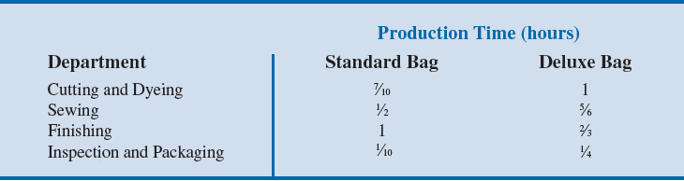
A Simple Maximization Problem
Operations involved in manufacturing a golf bag:
Cutting and dyeing the material
Sewing
Finishing (inserting umbrella holder, club separators, etc.)
Inspection and packaging
Production requirement per golf bag:

Slide 9
A Simple Maximization Problem
Estimated total time available for the next three months to perform different operations:
Required Profit contribution
Standard bag: $10/unit
Deluxe bag: $9/unit
Department | Number of hours
Cutting and Dyeing | 630
Sewing | 600
Finishing | 708
Inspection and Packaging | 135

Slide 10
A Simple Maximization Problem
Task: Develop a mathematical model of the company’s problem to determine the number of standard bags and the number of deluxe bags to produce to maximize total profit contribution.
Problem formulation or modeling: Process of translating the verbal statement of a problem into a mathematical statement (or model).
General guidelines for problem formulation:
Understand the problem thoroughly.
Describe the objective: Maximize total contribution to profit.

Slide 11
A Simple Maximization Problem
Constraints:
Constraint | Constraint
1 | Number of hours of cutting and dyeing time used must be less than or equal to the number of hours of cutting and dyeing time available.
2 | Number of hours of sewing time used must be less than or equal to the number of hours of sewing time available.
3 | Number of hours of finishing time used must be less than or equal to the number of hours of finishing time available.
4 | Number of hours of inspection and packaging time used must be less than or equal to the number of hours of inspection and packaging time available.

Slide 12
A Simple Maximization Problem
General guidelines for problem formulation
Define the decision variables.
S = number of standard bags
D = number of deluxe bags
Write the objective in terms of the decision variables.
If the corp. makes $10 for every standard and $9 for every deluxe bag:
Total profit contribution = 10S + 9D = Objective function
Objective: Max 10S + 9D

Slide 13
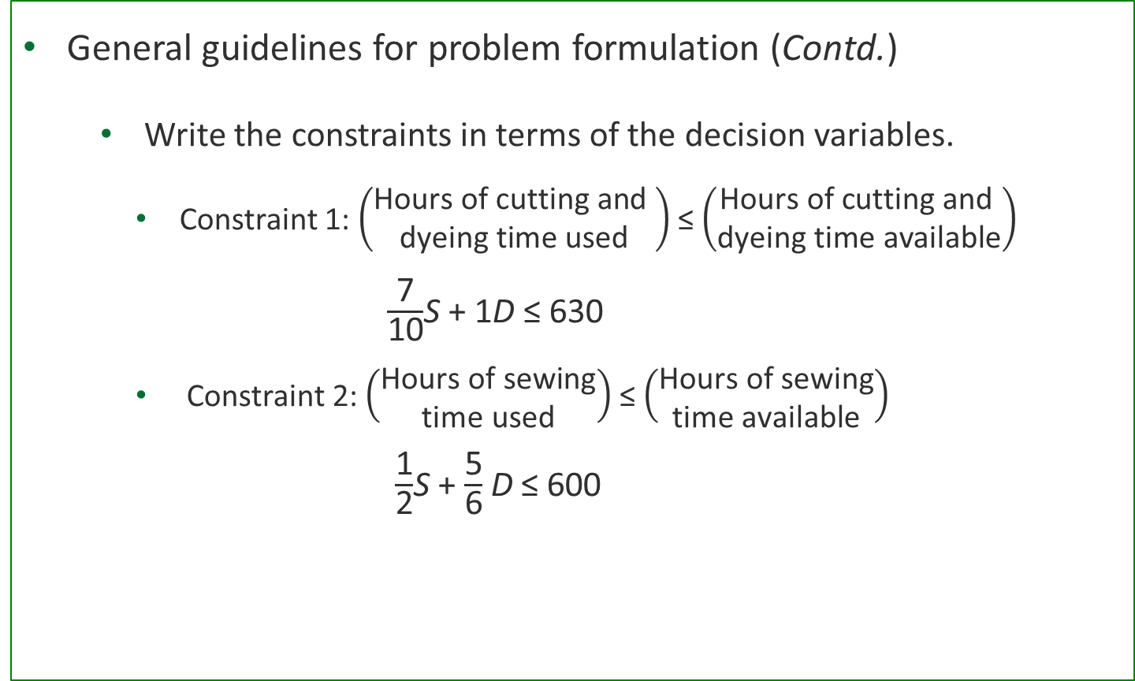
A Simple Maximization Problem
General guidelines for problem formulation (Contd.)
Write the constraints in terms of the decision variables.
Constraint 1: $\left(\begin{aligned}\text{Hours} \text{of} \text{cutting} \text{and} \\ \text{dyeing} \text{time} \text{used}\end{aligned}\right)$ ≤ $\left(\begin{aligned}\text{Hours} \text{of} \text{cutting} \text{and} \\ \text{dyeing} \text{time} \text{available}\end{aligned}\right)$
$\frac{\text{7}}{\text{10}}$S + 1D ≤ 630
Constraint 2: $\left(\begin{aligned}\text{Hours} \text{of} \text{sewing} \\ \text{time} \text{used}\end{aligned}\right)$ ≤ $\left(\begin{aligned}\text{Hours} \text{of} \text{sewing} \\ \text{time} \text{available}\end{aligned}\right)$
$\frac{\text{1}}{\text{2}}$S + $\frac{\text{5}}{\text{6}}$D ≤ 600

Slide 14
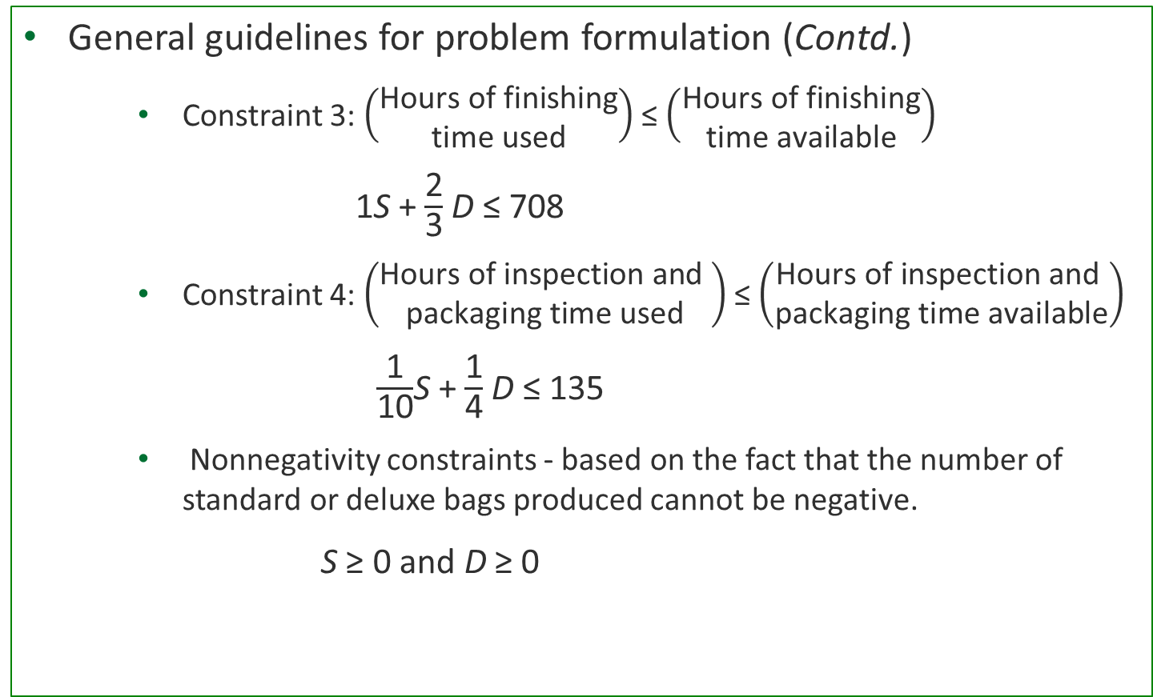
A Simple Maximization Problem
General guidelines for problem formulation (Contd.)
Constraint 3: $\left(\begin{aligned}\text{Hours} \text{of} \text{finishing} \\ \text{time} \text{used}\end{aligned}\right)$ ≤ $\left(\begin{aligned}\text{Hours} \text{of} \text{finishing} \\ \text{time} \text{available}\end{aligned}\right)$
1S + $\frac{\text{2}}{\text{3}}$D ≤ 708
Constraint 4: $\left(\begin{aligned}\text{Hours} \text{of} \text{inspection} \text{and} \\ \text{packaging} \text{time} \text{used}\end{aligned}\right)$ ≤ $\left(\begin{aligned}\text{Hours} \text{of} \text{inspection} \text{and} \\ \text{packaging} \text{time} \text{available}\end{aligned}\right)$
$\frac{\text{1}}{\text{10}}$S + $\frac{\text{1}}{\text{4}}$D ≤ 135
Nonnegativity constraints - based on the fact that the number of standard or deluxe bags produced cannot be negative.
S ≥ 0 and D ≥ 0

Slide 15
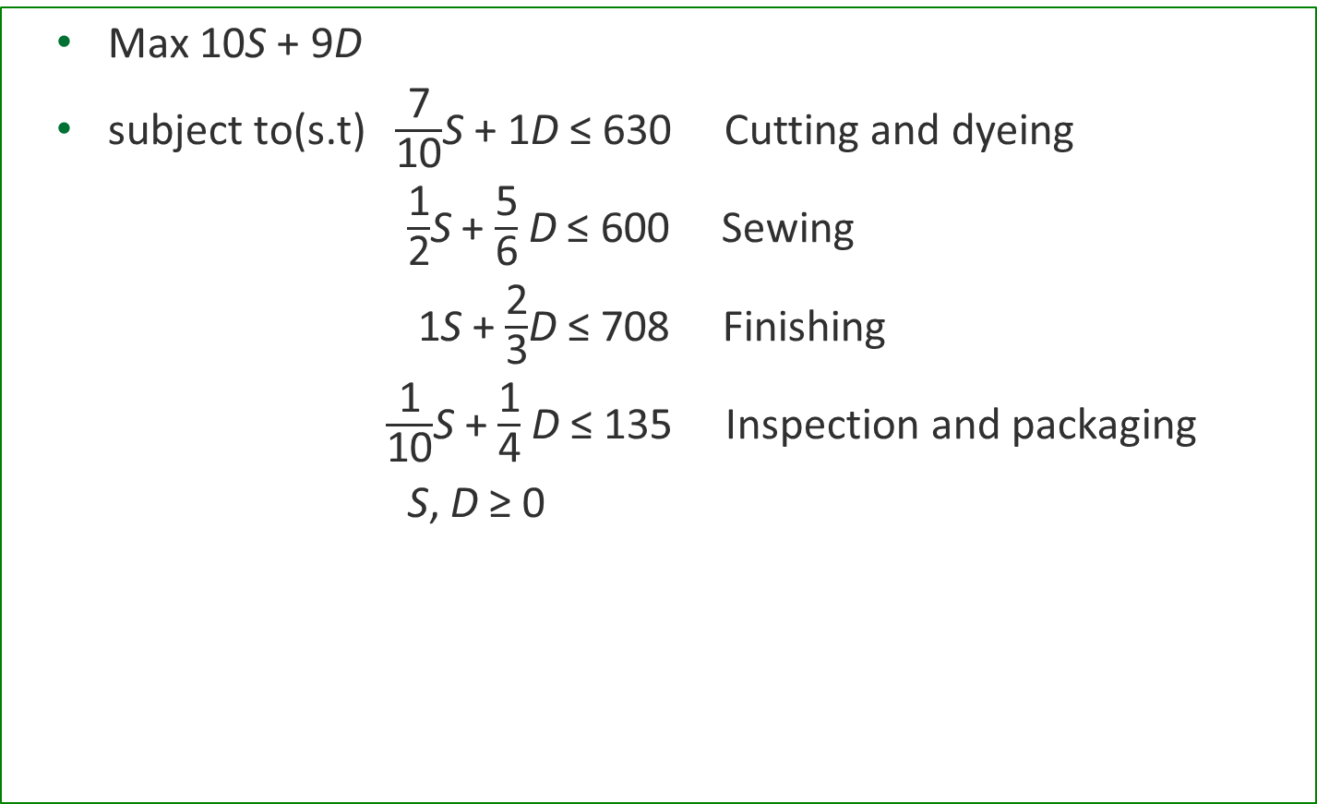
A Simple Maximization Problem
Max 10S + 9D
subject to(s.t) $\frac{\text{7}}{\text{10}}$S + 1D ≤ 630 Cutting and dyeing
$\frac{\text{1}}{\text{2}}$S + $\frac{\text{5}}{\text{6}}$D ≤ 600 Sewing
1S + $\frac{\text{2}}{\text{3}}$D ≤ 708 Finishing
$\frac{\text{1}}{\text{10}}$S + $\frac{\text{1}}{\text{4}}$D ≤ 135 Inspection and packaging
S, D ≥ 0

Slide 16
A Simple Maximization Problem
This is a linear programming model because the objective function and all constraint functions are linear functions of the decision variables.
Linear function: Mathematical function in which each variable appears in a separate term and is raised to the first power.

Slide 17
Solving the Problem

Slide 18
A Simple Maximization Problem
Solving linear programs with Excel Solver
Corp1_Bags

Slide 19
A Simple Maximization Problem
To find the optimal solution to the problem modeled as a linear program:
The optimal solution must have the highest objective function value.
The optimal solution must be a feasible solution.
A feasible solution is a setting of the decision variables that satisfies all of the constraints of the problem.
Search over the feasible region which is a set of all possible solutions.
Find the solution that gives the best objective function value.

Slide 20
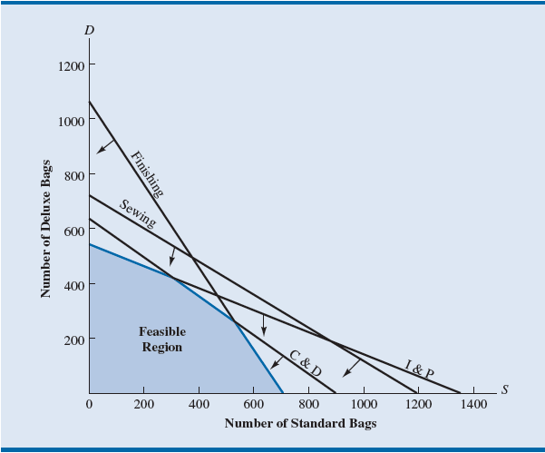
A Simple Maximization Problem
Feasible Region for problem

Slide 21
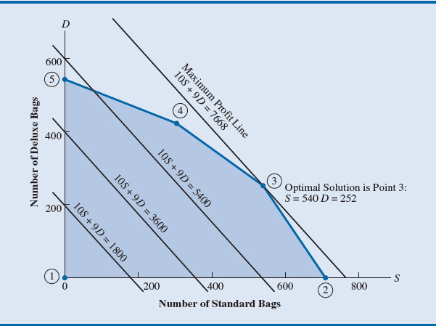
A Simple Maximization Problem
Optimal solution

Slide 22
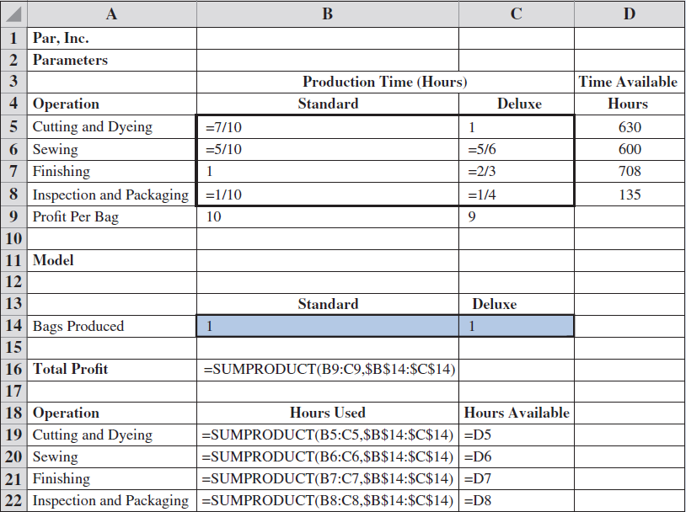
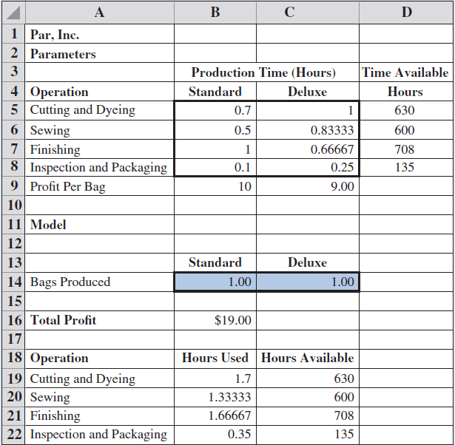
A Simple Maximization Problem
Before solver

Slide 23
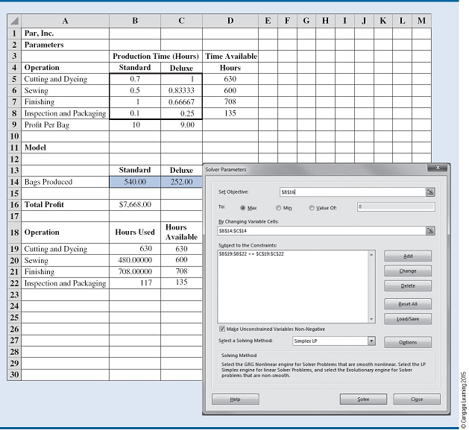
A Simple Maximization Problem
Solver

Slide 24
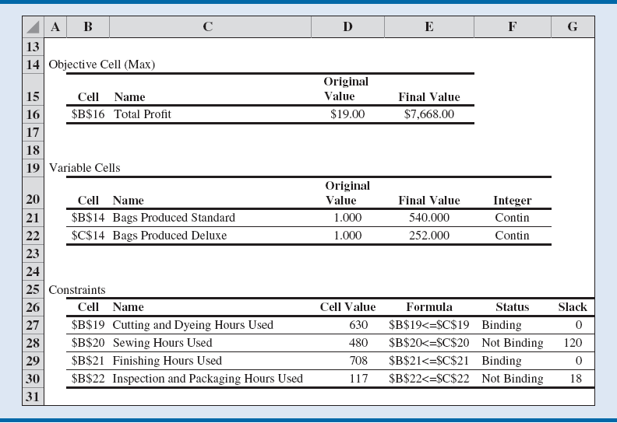
A Simple Maximization Problem
Summary

Slide 25
A Simple Minimization Problem

Slide 26
A Simple Minimization Problem
Corp2_Chemicals

Slide 27
A Simple Minimization Problem
Production requirements for Corp2 Chemicals:
The combined production for products A and B must total at least 350 gallons.
Separately a major customer’s order for 125 gallons of product A must also be satisfied.
Processing time:
Product A: 2 hours/gallon
Product B: 1 hour/gallon
For the coming month, 600 hours of processing time are available.

Slide 28
A Simple Minimization Problem
Production cost:
Product A: $2/gallon; Product B: $3/gallon
Objective: Minimizing the total production cost
Problem formulation: To find the minimum-cost production schedule.
Decision variables:
A = number of gallons of product A
B = number of gallons of product B
Objective function = 2A + 3B

Slide 29
A Simple Minimization Problem
Linear program for the Corp2 Chemicals problem:
Min 2A + 3B
s.t.
1A ≥ 125 - Demand for product A
A + B ≥ 350 - Total production
2A + 1B ≤ 600 - Processing time
A, B ≥ 0

Slide 30
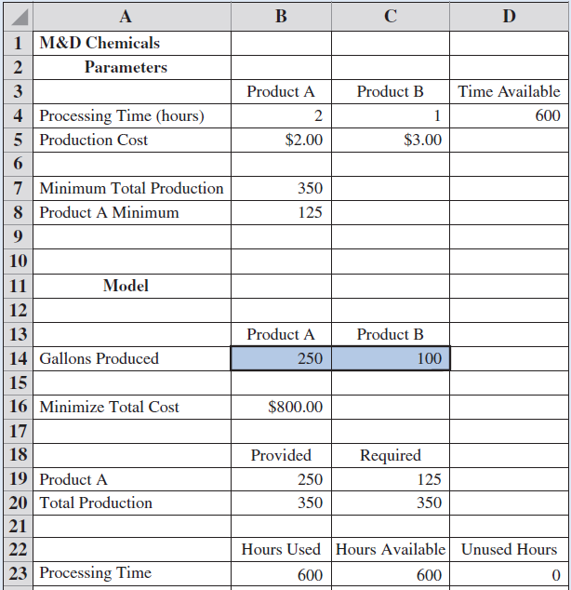
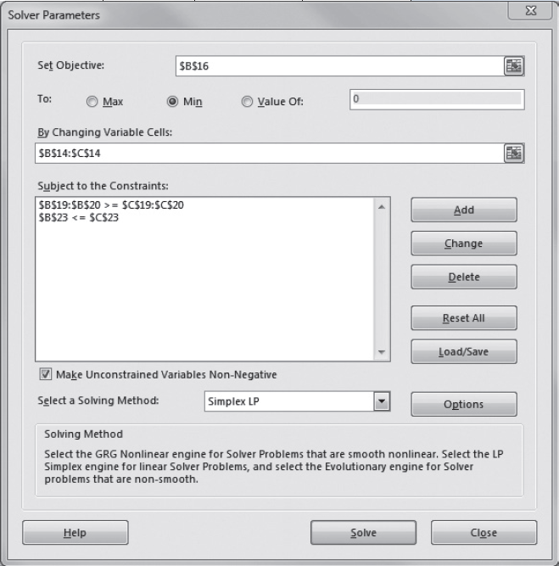
A Simple Minimization Problem

Slide 31
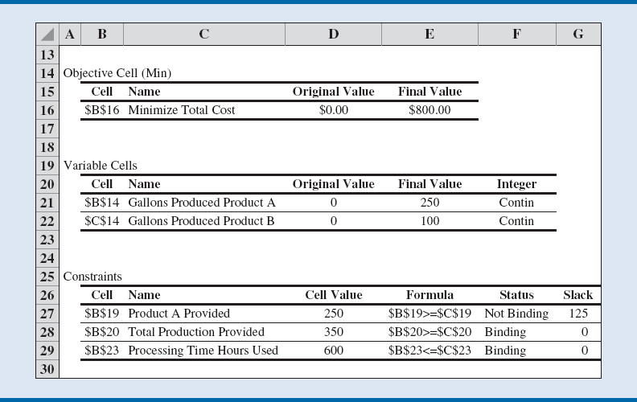
A Simple Minimization Problem

