Slide 1
Fall 2020
DATS 501 Fundamentals of Data Science
Hasan Demirtaş
hdemirtas.academic@gmail.com

Slide 2
PRESCRIPTIVE ANALYTICS

Slide 3
Special Cases of Linear Program Outcomes

Slide 4
Multiple solutions case
Where the optimal objective function contour line coincides with one of the binding constraint lines on the boundary of the feasible region
In these situations, more than one solution provides the optimal value for the objective function

Slide 5
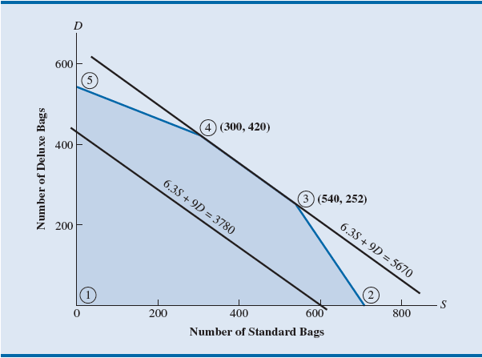
Multiple solutions case
Any point on the line between 4 to 3 is a solution

Slide 6
Infeasibility
Means no solution to the linear programming problem
No points satisfy all the constraints and the nonnegativity conditions simultaneously.
Graphically, a feasible region does not exist.
Infeasibility occurs because
Management’s expectations are too high.
Or, because too many restrictions have been placed on the problem.

Slide 7
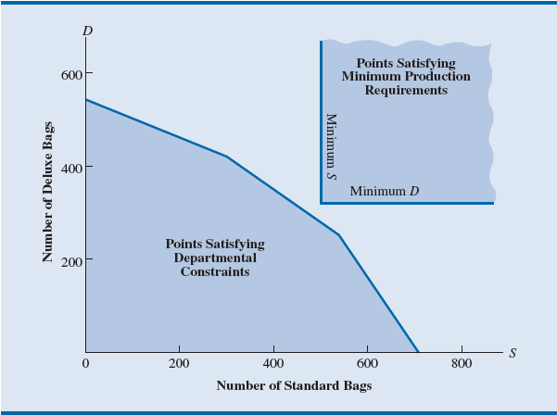
Infeasibility
Requirements and constraints do not intersect

Slide 8
Unbounded
The situation in which the value of the solution
May be made infinitely large - for a maximization linear programming
May be made infinitely small - for a minimization linear programming
Without violating any of the constraints

Slide 9
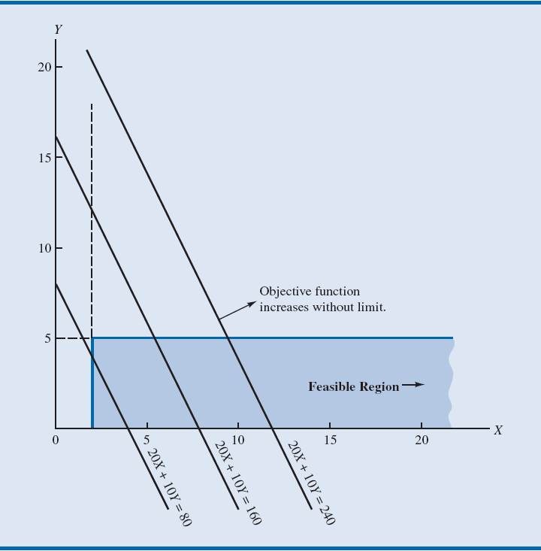
Unbounded
It seems like the result of a not well-defined case

Slide 10
Sensitivity Analysis

Slide 11
Sensitivity
Interpreting Excel Solver sensitivity report
Consider the Corp2_Chemicals problem:
A = number of gallons of product A
B = number of gallons of product B
Min 2A + 3B
s.t. 1A ≥ 125 - Demand for product A
1A + 1B ≥ 350 - Total production
2A + 1B ≤ 600 - Processing time
A, B ≥ 0

Slide 12
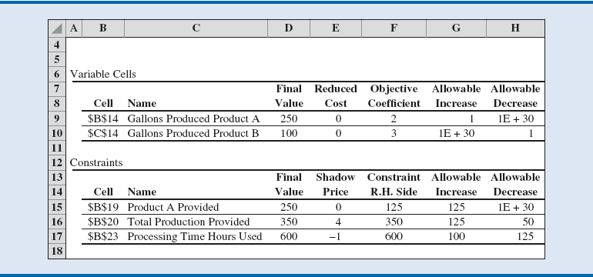
Sensitivity

Slide 13
Sensitivity
Classical sensitivity analysis:
Based on the assumption that only one piece of input data has changed
It is assumed that all other parameters remain as stated in the original problem
When interested in what would happen if two or more pieces of input data are changed simultaneously:
The easiest way to examine the effect of simultaneous changes is to make the changes and rerun the model

Slide 14
Integer Linear Optimization Models

Slide 15
Integer linear programs
Problems that are modeled as linear programs with the additional requirement that one or more variables must be integer
The objective is to provide an applications-oriented introduction to integer linear programming

Slide 16
Types of Integer Linear Optimization Models
All-integer linear program: If all variables are required to be integer.
Mixed-integer linear program: If some, but not necessarily all, variables are required to be integer.
Binary integer linear program: The integer variables may take on only the values 0 or 1.
LP Relaxation (linear programming relaxation) of the integer linear program: The linear program that results from dropping the integer requirements.

