Slide 1
Fall 2020
DATS 501 Fundamentals of Data Science
Hasan Demirtaş
hdemirtas.academic@gmail.com

Slide 2
Tree-Based Models

Slide 3
Tree Idea

Slide 4
Decision Tree
A tree:
A method of dividing data into segments according to features
The data is united at first, then it is divided more and more with each feature
The final shape looks like a tree
It creates many micro segments
Notes:
The data is taken from a sample of 50 soft drink purchases.
Each purchase is for one of five popular soft drinks, which define the five bins: Coca-Cola, Diet Coke, Dr. Pepper, Pepsi, and Sprite.

Slide 5
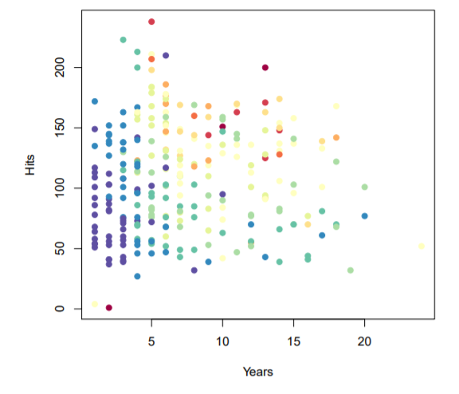
Decision Tree
An example with numeric target (salary here):
Salary of the baseball players are tried to be understand by seasonal hits and their years in the league
Notes:
The data is taken from a sample of 50 soft drink purchases.
Each purchase is for one of five popular soft drinks, which define the five bins: Coca-Cola, Diet Coke, Dr. Pepper, Pepsi, and Sprite.

Slide 6
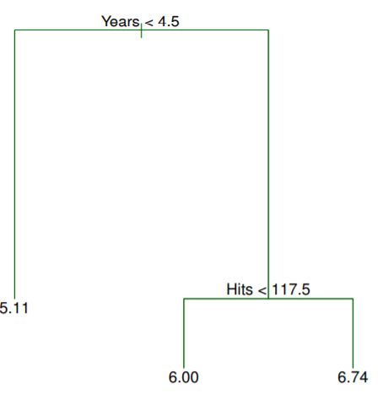
Decision Tree
An example:
Dt for baseball data
Notes:
The data is taken from a sample of 50 soft drink purchases.
Each purchase is for one of five popular soft drinks, which define the five bins: Coca-Cola, Diet Coke, Dr. Pepper, Pepsi, and Sprite.

Slide 7
Decision Tree
Baseball data:
For the Hitters data, a regression tree for predicting the log salary of a baseball player, based on the number of years that he has played in the major leagues and the number of hits that he made in the previous year.
At a given internal node, the label (of the form Xj < tk) indicates the left-hand branch emanating from that split, and the right-hand branch corresponds to Xj ≥ tk. For instance, the split at the top of the tree results in two large branches. The left-hand branch corresponds to Years=4.5
The tree has two internal nodes and three terminal nodes, or leaves. The number in each leaf is the mean of the response for the observations that fall there
Notes:
The data is taken from a sample of 50 soft drink purchases.
Each purchase is for one of five popular soft drinks, which define the five bins: Coca-Cola, Diet Coke, Dr. Pepper, Pepsi, and Sprite.

Slide 8
Decision Tree
Baseball data:
Years is the most important factor in determining Salary, and players with less experience earn lower salaries than more experienced players.
Given that a player is less experienced, the number of Hits that he made in the previous year seems to play little role in his Salary.
But among players who have been in the major leagues for five or more years, the number of Hits made in the previous year does affect Salary, and players who made more Hits last year tend to have higher salaries.
Surely an over-simplification, but compared to a regression model, it is easy to display, interpret and explain
Notes:
The data is taken from a sample of 50 soft drink purchases.
Each purchase is for one of five popular soft drinks, which define the five bins: Coca-Cola, Diet Coke, Dr. Pepper, Pepsi, and Sprite.

Slide 9
Decision Tree
Splits:
The tree tries to reduce the mixture of the data regarding the target
For numeric input the feature is tried to be split from a point with best gain ( gini and numeric error for classification and regression respectively)
For categoric input the features are tried to be grouped with best gain
It is not possible to consider every possibility, so it considers the best split for each branch with greedy approach
The splits can be binary or more regarding the user’s desire in programs. Using binary is easier
Notes:
The data is taken from a sample of 50 soft drink purchases.
Each purchase is for one of five popular soft drinks, which define the five bins: Coca-Cola, Diet Coke, Dr. Pepper, Pepsi, and Sprite.

Slide 10
Decision Tree
Depth:
It decides how much deep a tree can go. Basically how many questions can be asked (how many features can be used until a data microsegment is obtained)
Pruning :
The tree depth is important as it goes deeper the gain decrease and it tends to overfit
Note that every brach do not need to go too deep. The division can be finished early if no gain is provided with any other feature
Notes:
The data is taken from a sample of 50 soft drink purchases.
Each purchase is for one of five popular soft drinks, which define the five bins: Coca-Cola, Diet Coke, Dr. Pepper, Pepsi, and Sprite.

Slide 11
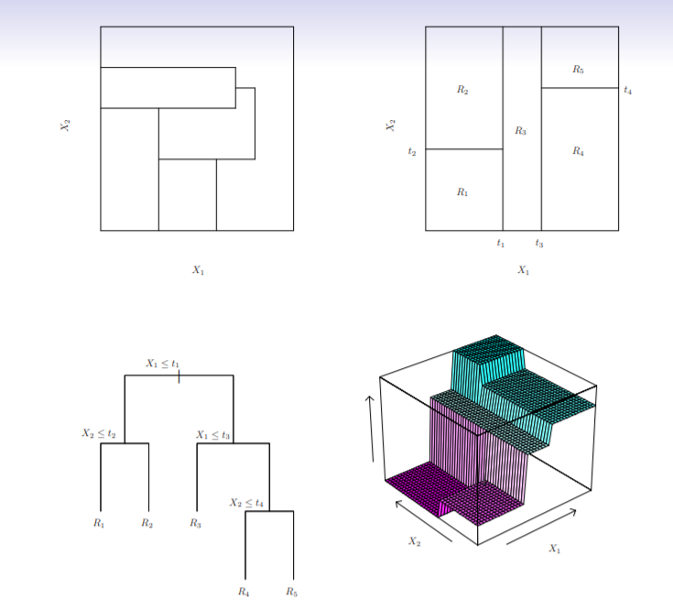
Decision Tree
Creating microsegments by space division visualization:
Notes:
The data is taken from a sample of 50 soft drink purchases.
Each purchase is for one of five popular soft drinks, which define the five bins: Coca-Cola, Diet Coke, Dr. Pepper, Pepsi, and Sprite.

Slide 12
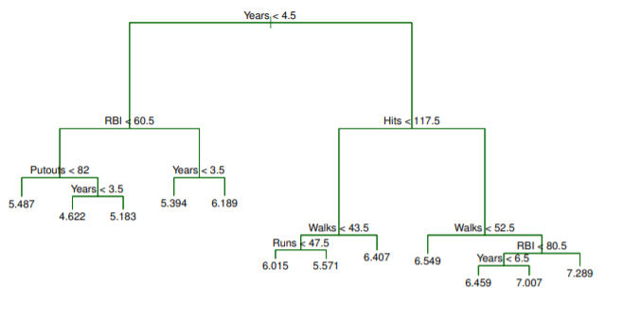
Decision Tree
A deeper tree:
Notes:
The data is taken from a sample of 50 soft drink purchases.
Each purchase is for one of five popular soft drinks, which define the five bins: Coca-Cola, Diet Coke, Dr. Pepper, Pepsi, and Sprite.

Slide 13
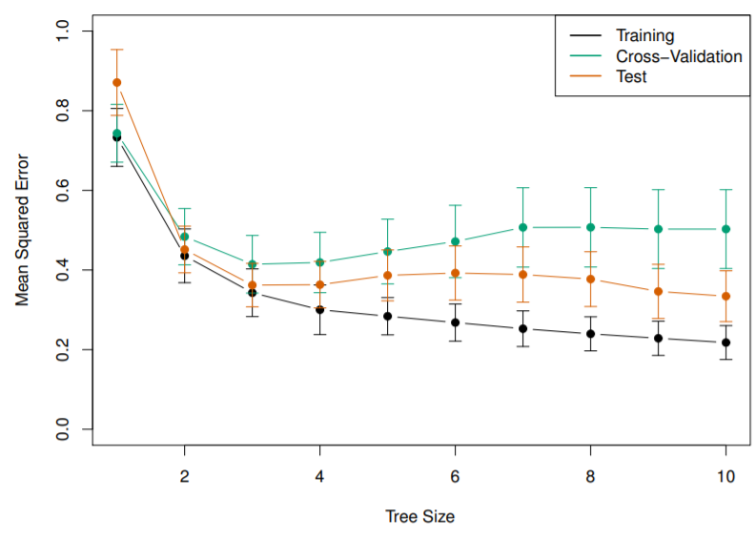
Decision Tree
It can result in overfitting or it can saturate:
Notes:
The data is taken from a sample of 50 soft drink purchases.
Each purchase is for one of five popular soft drinks, which define the five bins: Coca-Cola, Diet Coke, Dr. Pepper, Pepsi, and Sprite.

Slide 14
Decision Tree Pros and Cons
Pros:
Works for regression and classification
Tree-based methods are simple and useful for interpretation
Cons:
Basic decision tree may not perform well
Notes:
The data is taken from a sample of 50 soft drink purchases.
Each purchase is for one of five popular soft drinks, which define the five bins: Coca-Cola, Diet Coke, Dr. Pepper, Pepsi, and Sprite.

Slide 15
Ensembling Concept
Ensembling:
Using multiple models for prediction is called ensembling
Ensemble models:
Bagging, random forests, and boosting
These methods grow multiple trees which are then combined to yield a single consensus prediction
Combining a large number of trees can often result in dramatic improvements in prediction accuracy, at the expense of some loss interpretation.
Notes:
The data is taken from a sample of 50 soft drink purchases.
Each purchase is for one of five popular soft drinks, which define the five bins: Coca-Cola, Diet Coke, Dr. Pepper, Pepsi, and Sprite.

Slide 16
More on Ensembling
Ensembling the multiple ML models:
Combining results of multiple models can give better results then single model in terms of
Prediction performance (accuracy for classification, rsquare for regression)
Model stability
Ensembling versions:
Voting: Using parallel models
Averaging for regression
Accepting highest voted class for classification
Stacking: Using serial models
Using models to understand the errors of the previos model
Notes:
The data is taken from a sample of 50 soft drink purchases.
Each purchase is for one of five popular soft drinks, which define the five bins: Coca-Cola, Diet Coke, Dr. Pepper, Pepsi, and Sprite.

Slide 17
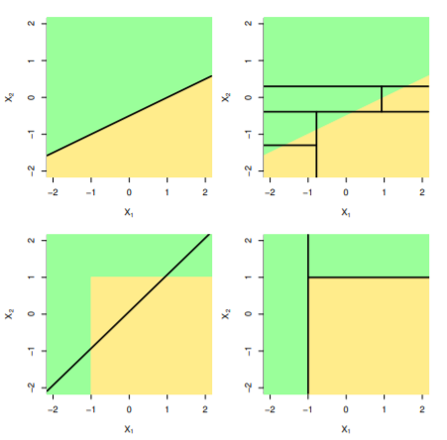
More on Ensembling
Trees vs linear models:
Notes:
The data is taken from a sample of 50 soft drink purchases.
Each purchase is for one of five popular soft drinks, which define the five bins: Coca-Cola, Diet Coke, Dr. Pepper, Pepsi, and Sprite.

Slide 18
Decision Tree Pros and Cons
Pros:
Trees are very easy to explain to people. In fact, they are even easier to explain than linear regression
Some people believe that decision trees more closely mirror human decision-making than do the regression and classification approaches seen in previous chapters
Trees can be displayed graphically and are easily interpreted even by a non-expert (especially if they are small).
Trees can easily handle qualitative predictors without the need to create dummy variables.
Notes:
The data is taken from a sample of 50 soft drink purchases.
Each purchase is for one of five popular soft drinks, which define the five bins: Coca-Cola, Diet Coke, Dr. Pepper, Pepsi, and Sprite.

Slide 19
Decision Tree Pros and Cons
Cons:
Not many practically ☺
Notes:
The data is taken from a sample of 50 soft drink purchases.
Each purchase is for one of five popular soft drinks, which define the five bins: Coca-Cola, Diet Coke, Dr. Pepper, Pepsi, and Sprite.

