Slide 1
Fall 2020
DATS 501 Fundamentals of Data Science
Hasan Demirtaş
hdemirtas.academic@gmail.com

Slide 2
Data Analytics for Business
Business Analytics
in Practice

Slide 3
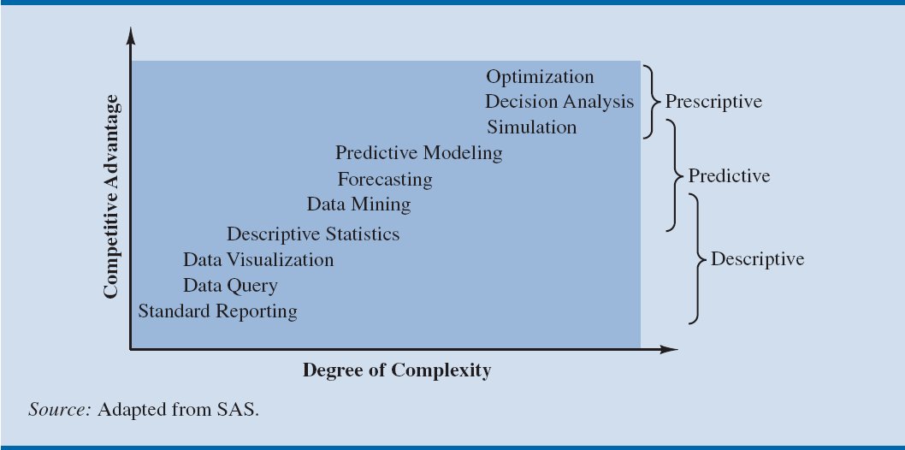
The Spectrum of Business Analytics
Notes:
Companies that apply analytics often follow a trajectory similar to that shown in Figure 1.2.
Organizations start with basic analytics in the lower left.
As they realize the advantages of these analytic techniques, they often progress to more sophisticated techniques in an effort to reap the derived competitive advantage.
Predictive and prescriptive analytics are sometimes therefore referred to as advanced analytics.

Slide 4
Business Analytics in Practice
Types of applications of analytics by application area
Financial analytics
Use of predictive models
To forecast future financial performance
To assess the risk of investment portfolios and projects
To construct financial instruments such as derivatives

Slide 5
Business Analytics in Practice
Financial analytics (contd.)
Use of prescriptive models
To construct optimal portfolios of investments
To allocate assets, and
To create optimal capital budgeting plans.
Simulation is often used to assess risk in the financial sector
Notes:
Example for use of prescriptive models:
GE Asset Management uses optimization models to decide how to invest its own cash received from insurance policies and other financial products, as well as the cash of its clients such as Genworth Financial.
The estimated benefit from the optimization models was $75 million over a five-year period.
Example for use of simulation:
Deployment by Hypo Real Estate International of simulation models to successfully manage commercial real estate risk.

Slide 6
Business Analytics in Practice
Human resource (HR) analytics
New area of application for analytics
The HR function is charged with ensuring that the organization
Has the mix of skill sets necessary to meet its needs
Is hiring the highest-quality talent and providing an environment that retains it, and
Achieves its organizational diversity goals.
Notes:
Example for Human Resource (HR) Analytics:
Sears Holding Corporation (SHC), owners of retailers Kmart and Sears, Roebuck and Company, has created an HR analytics team inside its corporate HR function.
The team uses descriptive and predictive analytics to support employee hiring and to track and influence retention.

Slide 7
Business Analytics in Practice
Marketing analytics
Marketing is one of the fastest growing areas for the application of analytics.
A better understanding of consumer behavior through the use of scanner data and data generated from social media has led to an increased interest in marketing analytics.

Slide 8
Business Analytics in Practice
Marketing analytics (contd.)
A better understanding of consumer behavior through marketing analytics leads to:
The better use of advertising budgets
More effective pricing strategies
Improved forecasting of demand
Improved product line management, and
Increased customer satisfaction and loyalty
Notes:
Example of high-impact marketing analytics:
Automobile manufacturer Chrysler teamed with J. D. Power and Associates to develop an innovate set of predictive models to support its pricing decisions for automobiles.
These models help Chrysler to better understand the ramifications of proposed pricing structures (a combination of manufacturer’s suggested retail price, interest rate offers, and rebates) and, as a result, to improve its pricing decisions.
The models have generated an estimated annual savings of $500 million.

Slide 9
Business Analytics in Practice
Health care analytics
Descriptive, predictive, and prescriptive analytics are used:
To improve patient, staff, and facility scheduling
Patient flow
Purchasing
Inventory control
Use of prescriptive analytics for diagnosis and treatment
Notes:
Example for use of prescriptive analytics for diagnosis and treatment:
Working with the Georgia Institute of Technology, Memorial Sloan-Kettering Cancer Center developed a real-time prescriptive model to determine the optimal placement of radioactive seeds for the treatment of prostate cancer.
Using the new model, 20–30 percent fewer seeds are needed, resulting in a faster and less invasive procedure.

Slide 10
Business Analytics in Practice
Supply chain analytics
The core service of companies such as UPS and FedEx is the efficient delivery of goods, and analytics has long been used to achieve efficiency.
The optimal sorting of goods, vehicle and staff scheduling, and vehicle routing are all key to profitability for logistics companies such as UPS, FedEx, and others like them.
Companies can benefit from better inventory and processing control and more efficient supply chains.
Notes:
Example for supply chain analytics:
ConAgra Foods uses predictive and prescriptive analytics to better plan capacity utilization by incorporating the inherent uncertainty in commodities pricing.
ConAgra realized a 100 percent return on their investment in analytics in under three months—an unheard of result for a major technology investment.

Slide 11
Business Analytics in Practice
Analytics for government and nonprofits
To drive out inefficiencies
To increase the effectiveness and accountability of programs
Analytics for nonprofit agencies
To ensure their effectiveness and accountability to their donors and clients.
Notes:
Example of analytics for government agencies:
The New York State Department has worked with IBM to use prescriptive analytics in the development of a more effective approach to tax collection. The result was an increase in collections from delinquent payers of $83 million over two years.
Example of analytics for nonprofit agencies:
Catholic Relief Services (CRS) is the official international humanitarian agency of the U.S. Catholic community. The CRS mission is to provide relief for the victims of both natural and human-made disasters and to help people in need around the world through its health, educational, and agricultural programs.
CRS uses an analytical spreadsheet model to assist in the allocation of its annual budget based on the impact that its various relief efforts and programs will have in different countries.

Slide 12
Business Analytics in Practice
Sports analytics
Used for player evaluation and on-field strategy in professional sports.
To assess players for the amateur drafts and to decide how much to offer players in contract negotiations.
Professional motorcycle racing teams that use sophisticated optimization for gearbox design to gain competitive advantage.

Slide 13
Business Analytics in Practice
Sports analytics (contd.)
The use of analytics for off-the-field business decisions is also increasing rapidly.
Using prescriptive analytics, franchises across several major sports dynamically adjust ticket prices throughout the season to reflect the relative attractiveness and potential demand for each game.

Slide 14
Business Analytics in Practice
Web analytics - It is the analysis of online activity, which includes, but is not limited to, visits to Web sites and social media sites such as Facebook and LinkedIn.
Leading companies apply descriptive and advanced analytics to data collected in online experiments to:
Determine the best way to configure Web sites,
Position ads, and
Utilize social networks for the promotion of products and services
Notes:
Online experimentation involves exposing various subgroups to different versions of a Web site and tracking the results.
Because of the massive pool of Internet users, experiments can be conducted without risking the disruption of the overall business of the company.
Such experiments are proving to be invaluable because they enable the company to use trial-and-error in determining statistically what makes a difference in their Web site traffic and sales.

Slide 15
Descriptive Analytics

Slide 16
Overview of Using Data: Definitions and Goals
Data: The facts and figures collected, analyzed, and summarized for presentation and interpretation.
Variable: A characteristic or a quantity of interest that can take on different values.
Observation: Set of values corresponding to a set of variables.
Variation: The difference in a variable measured over observations.
Random variable/uncertain variable: A quantity whose values are not known with certainty.
Notes:
When we collect data, we are gathering past observed values, or realizations of a variable.
By collecting these past realizations of one or more variables, our goal is to learn more about the variation of a particular business situation.

Slide 17
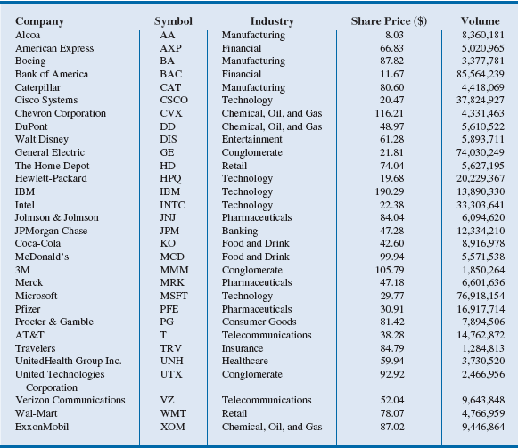
Table 2.1 - Data for Dow Jones Industrial Index Companies
Notes:
For the data in Table 2.1:
Variables: Symbol, Industry, Share Price, and Volume
Observation: Each row in Table 2.1
Variation: Time, customers, items, etc.

Slide 18
Types of Data
Population: All elements of interest
Sample: Subset of the population
Random sampling - A sampling method to gather a representative sample of the population data.
Quantitative data: Data on which numeric and arithmetic operations, such as addition, subtraction, multiplication, and division, can be performed.
Categorical data: Data on which arithmetic operations cannot be performed.
Notes:
Examples:
Population: With the thousands of publicly traded companies in the United States, tracking and analyzing all of these stocks every day would be too
time consuming and expensive.
Sample: The Dow represents a sample of 30 stocks of large public companies based in the United States, and it is often interpreted to represent
the larger population of all publicly traded companies.
Quantitative data: The values for Volume in the Dow data in Table 2.1 can be summed to calculate a total volume of all shares traded by companies included in the Dow.
Categorical data: The data in the Industry column in Table 2.1 are categorical - the number of companies in the Dow that are in the telecommunications industry can be counted.

Slide 19
Types of Data
Cross-sectional data: Data collected from several entities at the same, or approximately the same, point in time.
Time series data: Data collected over several time periods.
Graphs of time series data are frequently found in business and economic publications.
Help analysts understand what happened in the past, identify trends over time, and project future levels for the time series.
Notes:
Example:
Cross-sectional data: The data in Table 2.1 are cross-sectional because they describe the 30 companies that comprise the Dow at the same point in time (April 2013).

Slide 20
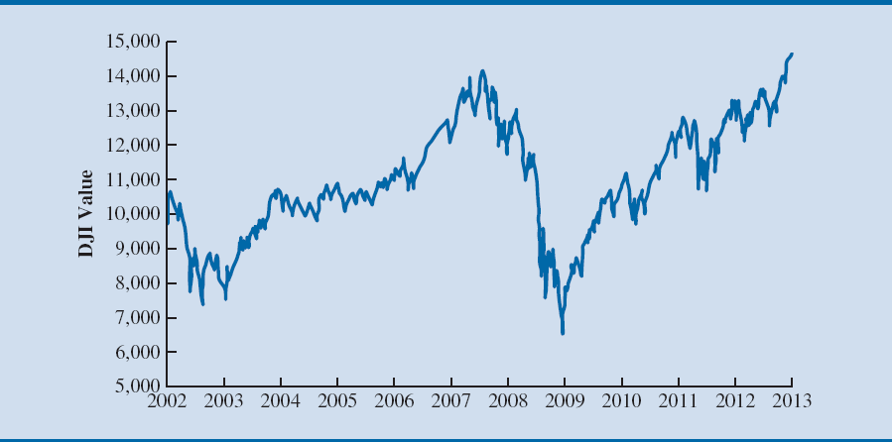
Figure 2.1 - Dow Jones Index Values Since 2002
Notes:
Example: (contd.)
Time series data: Figure 2.1 illustrates that the DJI was near 10,000 in 2002 and climbed to above 14,000 in 2007. However, the financial crisis in 2008 led to a significant decline in the DJI to between 6000 and 7000 by 2009. Since 2009, the DJI has been generally increasing and topped 14,000 in April 2013.

Slide 21
Types of Data
Sources of data
Experimental study - A variable of interest is first identified.
Then one or more other variables are identified and controlled or manipulated so that data can be obtained about how they influence the variable of interest.
Nonexperimental study or observational study - Make no attempt to control the variables of interest.
A survey is perhaps the most common type of observational study.
Notes:
Example:
Experimental study:
If a pharmaceutical firm is interested in conducting an experiment to learn about how a new drug affects blood pressure, then blood pressure is the variable of interest in the study.
The dosage level of the new drug is another variable that is hoped to have a causal effect on blood pressure.
To obtain data about the effect of the new drug, researchers select a sample of individuals.
The dosage level of the new drug is controlled as different groups of individuals are given different dosage levels.
Before and after the study, data on blood pressure are collected for each group.
Statistical analysis of these experimental data can help determine how the new drug affects blood pressure.

Slide 22
Creating Distributions from Data

Slide 23
Creating Distributions from Data
Frequency distributions for categorical data
Frequency distribution: A summary of data that shows the number (frequency) of observations in each of several nonoverlapping classes, typically referred to as bins, when dealing with distributions.

Slide 24
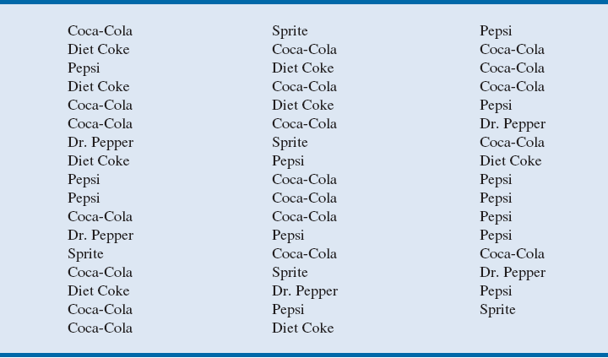
Table 2.3 - Data from a Sample of 50 Soft Drink Purchases
Notes:
The data in Table 2.3 is taken from a sample of 50 soft drink purchases.
Each purchase is for one of five popular soft drinks, which define the five bins: Coca-Cola, Diet Coke, Dr. Pepper, Pepsi, and Sprite.

Slide 25
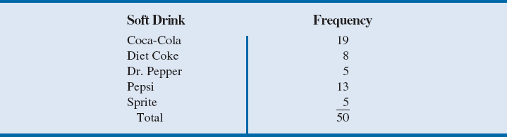
Table 2.4 - Frequency Distribution of Soft Drink Purchases
The frequency distribution summarizes information about the popularity of the five soft drinks:
Coca-Cola is the leader, Pepsi is second, Diet Coke is third, and Sprite and Dr. Pepper are tied for fourth.
Notes:
The frequency distribution of soft drink purchases (table 2.4) is obtained by counting the number of times each soft drink appears in Table 2.3.
Coca-Cola appears 19 times, Diet Coke appears 8 times, Dr. Pepper appears 5 times, Pepsi appears 13 times, and Sprite appears 5 times.
This frequency distribution provides a summary of how the 50 soft drink purchases are distributed across the five soft drinks.

Slide 26
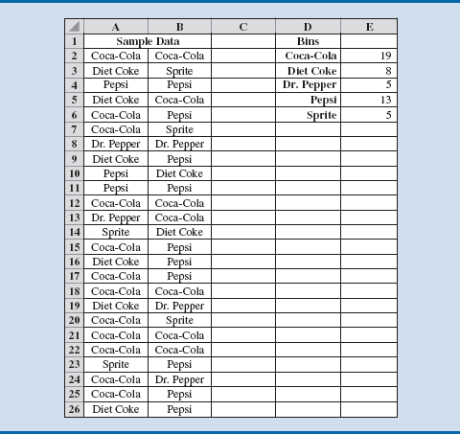
Figure 2.9 - Creating a Frequency Distribution for Soft Drinks Data in Excel
Notes:
Figure 2.9 shows the sample of 50 soft drink purchases in an Excel spreadsheet.
Column D contains the five different soft drink categories as the bins.
In cell E2, enter the formula =COUNTIF($A$2:$B$26, D2), where A2:B26 is the range for the sample data, and D2 is the bin (Coca-Cola) to match.
The COUNTIF function in Excel counts the number of times a certain value appears in the indicated range.
In this case, we want to count the number of times Coca-Cola appears in the sample data. The result is a value of 19 in cell E2, indicating that Coca-Cola appears 19 times in the sample data.
The formula from cell E2 to cells E3 to E6 can be copied to get frequency counts for Diet Coke, Pepsi, Dr. Pepper, and Sprite. By using the absolute reference $A$2:$B$26 in the formula.

Slide 27
Creating Distributions from Data
Frequency distributions for quantitative data
Three steps necessary to define the classes for a frequency distribution with quantitative data:
1. Determine the number of nonoverlapping bins.
2. Determine the width of each bin.
3. Determine the bin limits.
Notes:
Number of bins:
Bins are formed by specifying the ranges used to group the data.
Generally, use between 5 and 20 bins.
Small number of data items - five or six bins.
Larger number of data items - more bins are required.
The goal is to use enough bins to show the variation in the data, but not so many classes that some contain only a few data items.
Width of the bins:
It should be the same for each bin.
Thus the choices of the number of bins and the width of bins are not independent decisions.
A larger number of bins means a smaller bin width and vice versa.
Approximate bin width = $\frac{\text{Largest} \text{data} \text{value} − \text{smallest} \text{data} \text{value}}{\text{Number} \text{of} \text{bins}}$
Bin limits:
Bin limits must be chosen so that each data item belongs to one and only one class.
The lower bin limit identifies the smallest possible data value assigned to the bin.
The upper bin limit identifies the largest possible data value assigned to the class.

Slide 28
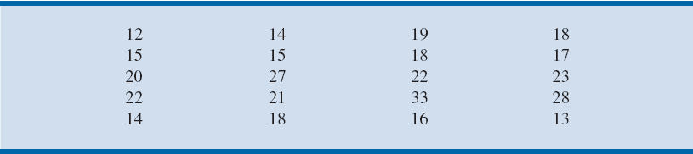
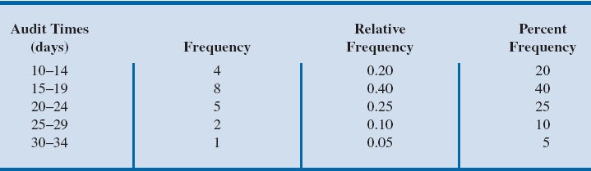
Creating Distributions from Data
Table 2.6 - Year-End Audit Times (Days)
Table 2.7 - Frequency, Relative Frequency, and Percent Frequency
Distributions for the Audit Time Data
Notes:
Number of bins:
The number of data items in Table 2.6 is relatively small (n = 20). Hence, we choose to develop a frequency distribution with five bins.
Width of bins:
The largest data value is 33, and the smallest data value is 12.
Because we decided to summarize the data with five classes, using the expression “Approximate bin width = $\frac{\text{Largest} \text{data} \text{value} − \text{smallest} \text{data} \text{value}}{\text{Number} \text{of} \text{bins}}$”, provides an approximate bin width of (33 – 12)/5 = 4.2.
We therefore decided to round up and use a bin width of five days in the frequency distribution.
Bin limits:
We selected 10 days as the lower bin limit and 14 days as the upper bin limit for the first class. This bin is denoted 10–14 in Table 2.7.
The smallest data value, 12, is included in the 10–14 bin. We then selected 15 days as the lower bin limit and 19 days as the upper bin limit of the next class.
We continued defining the lower and upper bin limits to obtain a total of five classes: 10–14, 15–19, 20–24, 25–29, and 30–34.
The difference between the upper bin limits of adjacent bins is the bin width. Using the first two upper bin limits of 14 and 19, we see that the bin width is 19 – 14 = 5.
With the number of bins, bin width, and bin limits determined, a frequency distribution can be obtained by counting the number of data values belonging to each bin.
Using the frequency distribution in Table 2.7, we can observe that:
The most frequently occurring audit times are in the bin of 15–19 days.
Eight of the 20 audit times are in this bin.
Only one audit required 30 or more days.

Slide 29
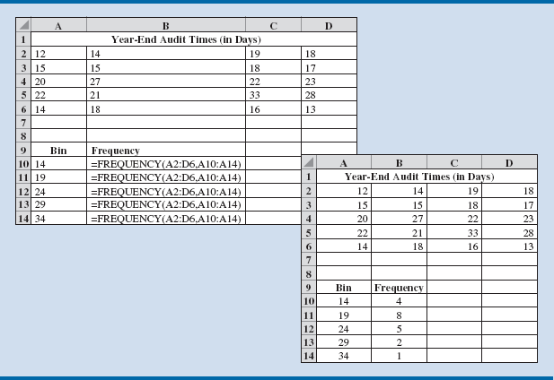
Figure 2.10 - Using Excel to Generate a Frequency Distribution for Audit Times Data
Notes:
Figure 2.10 shows the data from Table 2.6 entered into an Excel Worksheet.
The sample of 20 audit times is contained in cells A2:D6.
The upper limits of the defined bins are in cells A10:A14.
We can use the FREQUENCY function in Excel to count the number of observations in each bin:
Step 1. Select cells B10:B14
Step 2. Enter the formula =FREQUENCY(A2:D6, A10:A14). The range A2:D6 defines the data set, and the range A10:A14 defines the bins
Step 3. Press CTRL+SHIFT+ENTER
Excel will then fill in the values for the number of observations in each bin in cells B10 through B14 because these were the cells selected in Step 1 above.

Slide 30
Creating Distributions from Data
Histogram: A common graphical presentation of quantitative data
Constructed by placing the variable of interest on the horizontal axis and the selected frequency measure (absolute frequency, relative frequency, or percent frequency) on the vertical axis.
The frequency measure of each class is shown by drawing a rectangle whose base is determined by the class limits on the horizontal axis and whose height is the corresponding frequency measure.

Slide 31
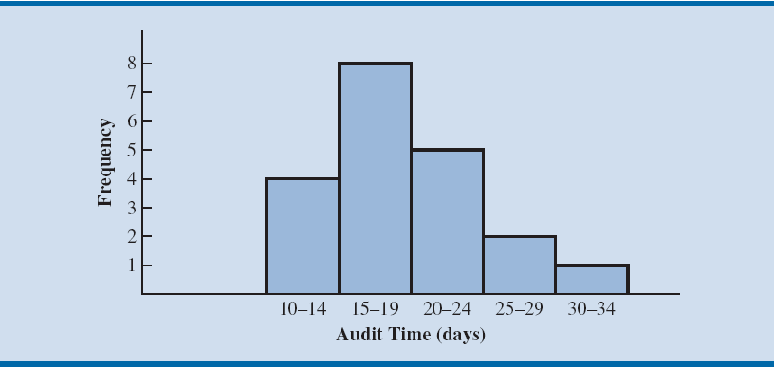
Figure 2.11 - Histogram for the Audit Time Data
Notes:
In figure 2.11, note that the class with the greatest frequency is shown by the rectangle appearing above the class of 15–19 days.
The height of the rectangle shows that the frequency of this class is 8.

Slide 32
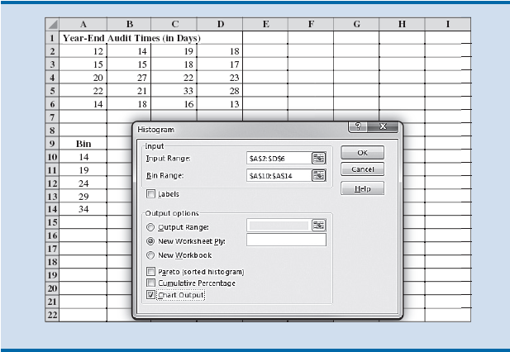
Figure 2.12 - Creating a Histogram for the Audit Time Data using Data Analysis Toolpak in Excel
Notes:
Histograms can be created in Excel using the Data Analysis ToolPak. Following are the steps to create histogram in Excel.
Step 1. Click the DATA tab in the Ribbon
Step 2. Click Data Analysis in the Analysis group
Step 3. When the Data Analysis dialog box opens, choose Histogram from the list of Analysis Tools, and click OK
In the Input Range: box, enter A2:D6
In the Bin Range: box, enter A10:A14
Under Output Options:, select New Worksheet Ply:
Select the check box for Chart Output
Click OK

Slide 33
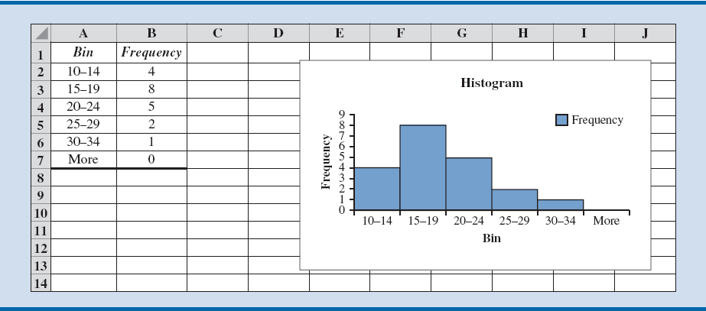
Figure 2.13 - Completed Histogram for the Audit Time Data using Data Analysis ToolPak in Excel
Notes:
In figure 2.13, we have modified the bin ranges in column A by typing the values shown in Figure 2.13 into cells A2:A6 so that the chart created by Excel shows both the lower and upper limits for each bin.
We have also removed the gaps between the columns in the histogram in Excel to match the traditional format of histograms.
To remove the gaps between the columns in the Histogram created by Excel, follow these steps:
Step 1. Right-click on one of the columns in the histogram
Select Format Data Series…
Step 2. When the Format Data Series pane opens, click the Series Options button.
Set the Gap Width to 0%

Slide 34
Creating Distributions from Data
Histogram provides information about the shape, or form, of a distribution.
Skewness: Lack of symmetry
Important characteristic of the shape of a distribution

Slide 35
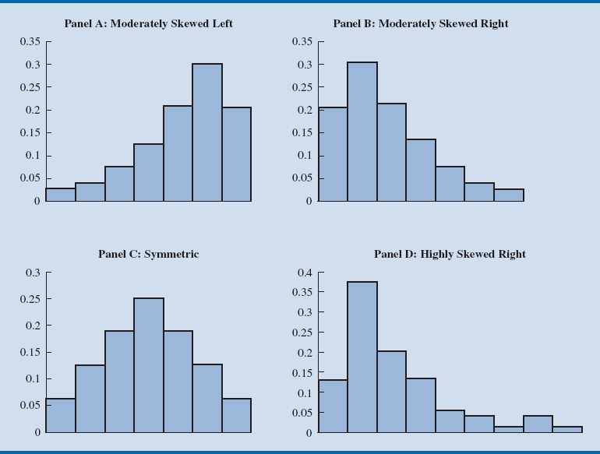
Figure 2.14 - Histograms Showing Distributions with Different Levels of Skewness
Notes:
Panel A: Moderately skewed to the left
Here, tail extends farther to the left than to the right.
Example: Exam scores, with no scores above 100 percent, most of the scores above 70 percent, and only a few really low scores.
Panel B: Moderately skewed to the right
Tail extends farther to the right than to the left.
Example: Housing prices; a few expensive houses create the skewness in the right tail.
Panel C: Symmetric
The left tail mirrors the shape of the right tail.
Example: Data for SAT scores, the heights and weights of people, and so on lead to histograms that are roughly symmetric.
Panel D: Highly skewed to the right
Example: Data on housing prices, salaries, purchase amounts, and so on often result in histograms skewed to the right.
Positive skewness: right-skewed
Negative skewness: left-skewed
0 skewness: symmetric (usually)
Kurtosis: total “tailedness” in the distribution. (Normal distr: 3)

Slide 36
Measures of Location

Slide 37
Measures of Location
Mean/Arithmetic mean
Average value for a variable.
The mean is denoted by x.
Sample mean,
n = sample size
x₁ = value of variable x for the first observation
x₂ = value of variable x for the second observation
x_{n} = value of variable x for the n-th observation
Notes:
Arithmetic Mean:
Provides a measure of central location for the data.
Denoted by $\overline{x}$for sample data.
Denoted by µ for population data.

Slide 38
Measures of Location
Median: Value in the middle when the data are arranged in ascending order.
Middle value, for an odd number of observations
Average of two middle values, for an even number of observations

Slide 39
Computation of Sample Median
Illustration - When the number of observations are odd
Consider the class size data for a sample of five college classes:
46 54 42 46 32
Arrange the class size data in ascending order .
32 42 46 46 54
Middlemost value in the data set = 46.
Median is 46.
Notes:
Because n = 5 is odd, median is the middlemost value in the data set, 46.

Slide 40
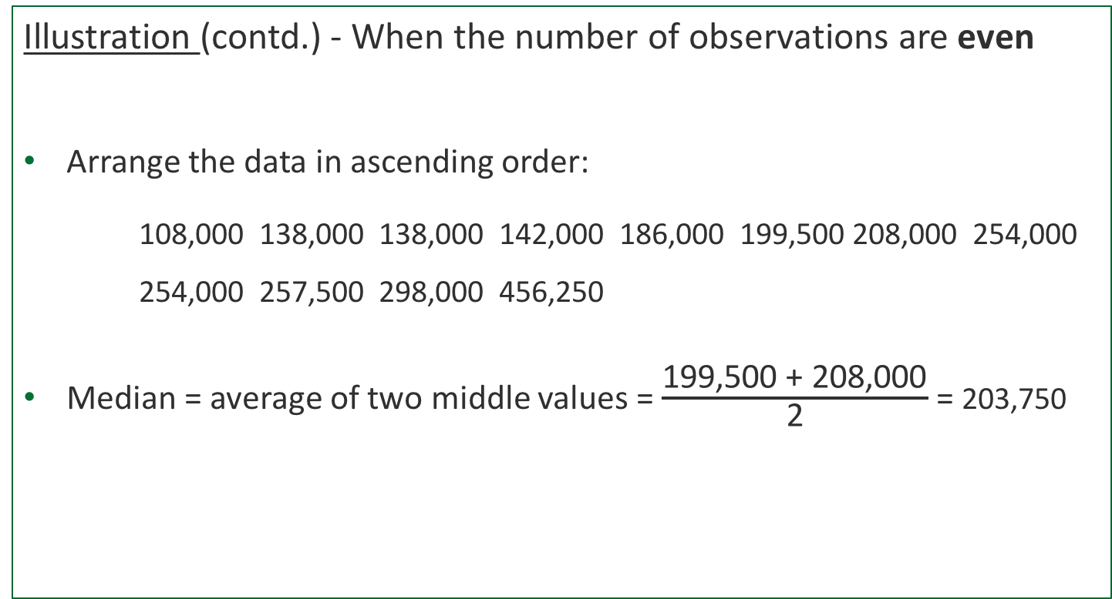
Computation of Sample Median
Illustration (contd.) - When the number of observations are even
Arrange the data in ascending order:
108,000 138,000 138,000 142,000 186,000 199,500 208,000 254,000 254,000 257,500 298,000 456,250
Median = average of two middle values = $\frac{\text{199,500} \text{+}\text{ 208}\text{,}\text{0}\text{00}}{\text{2}}$ = 203,750
Middle Two Values
Notes:
Data: house selling prices
Because n = 12 is even, the median is the average of the middle two values: 199,500 and 208,000.

Slide 41
Measures of Location
Mode: Value that occurs most frequently in a data set.
Consider the class size data:
32 42 46 46 54
Observe - 46 is the only value that occurs more than once.
Mode is 46.
Multimodal data - Data contain at least two modes.
Bimodal data - Data contain exactly two modes.

Slide 43
Measures of Location
Geometric mean: nth root of the product of n values
Used in analyzing growth rates in financial data.
Sample geometric mean:

Slide 44
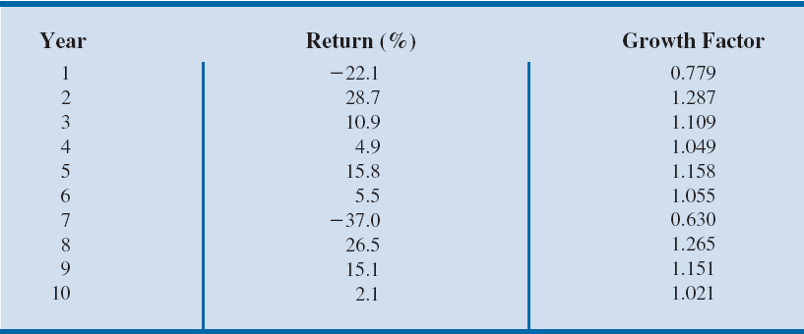
Percentage Annual Returns and Growth Factors for the Mutual Fund Data
Illustration - Consider the percentage annual returns and growth factors for the mutual fund data over the past 10 years.
We will determine the mean rate of growth for the fund over the 10-year period.

Slide 45
Computation of Geometric Mean
Solution:
Product of the growth factors:
(.779)(1.287)(1.109)(1.049)(1.158)(1.055)(.630)(1.265)(1.151)(1.021) = 1.335
Geometric mean of the growth factors:
Conclude that annual returns grew at an average annual rate of (1.029-1)100% or 2.9%.
Excel: GEOMEAN function.

Slide 46
Measures of Variability

Slide 47
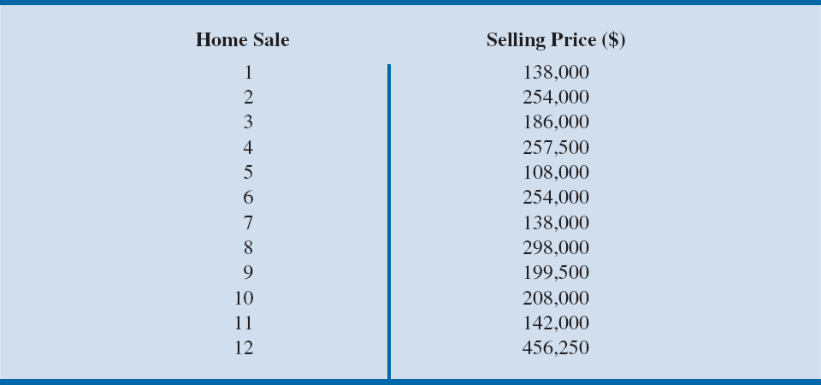
Measures of Variability
Range: Found by subtracting the smallest value from the largest value in a data set.
Illustration: Consider the data on home sales:

Slide 48
Computation of Range
Illustration (contd.):
Largest home sales price - $456,250
Smallest home sales price - $108,000
Range = Largest value – Smallest value
= $456,250 – $108,000
= $348,250
Drawback: Range is based on only two of the observations and thus is highly influenced by extreme values.

Slide 49
Measures of Variability
Variance: Measure of variability that utilizes all the data.
It is based on the deviation about the mean, which is the difference between the value of each observation (x_{i}) and the mean.
The deviations about the mean are squared while computing the variance.
Sample variance:
Population variance:

Slide 50
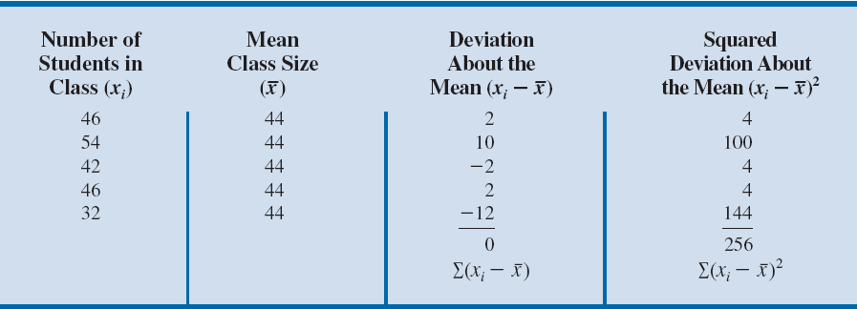
Computation of Deviations and Squared Deviations about the Mean for the Class Size Data
Computation of Sample Variance:

Slide 51
Measures of Variability
Standard deviation: Positive square root of the variance
Measured in the same units as the original data.
For sample, s = √ s²
For population, σ = √ σ²
Coefficient of variation:
(Standard deviation / Mean x 100)%
Measures the standard deviation relative to the mean.
Expressed as a percentage.

Slide 52
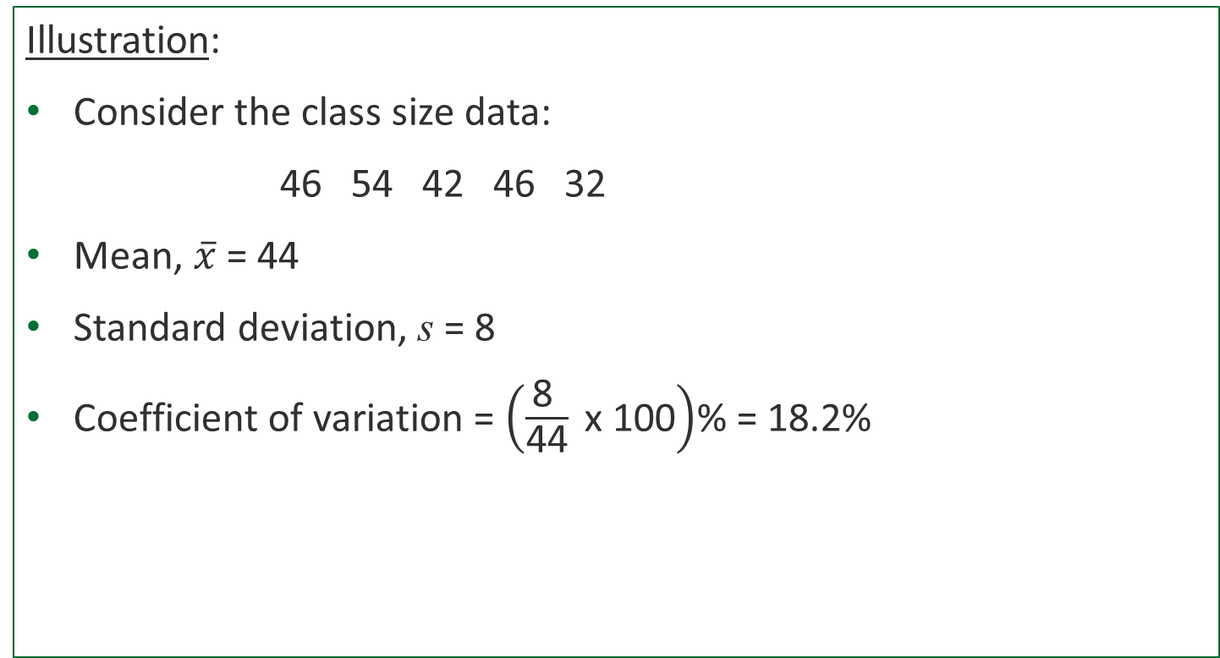
Computation of Coefficient of Variation
Illustration:
Consider the class size data:
46 54 42 46 32
Mean, $\overline{x}$ = 44
Standard deviation, s = 8
Coefficient of variation = $\left(\frac{\text{8 }}{\text{44}} \text{x}\text{ 100}\right)$% = 18.2%
Notes:
The coefficient of variation tells that the sample standard deviation is 18.2 percent of the value of the sample mean.

Slide 53
Analyzing
Distributions

Slide 54
Analyzing Distributions
Percentile: Value of a variable at which a specified (approximate) percentage of observations are below that value.
The pth percentile tells us the point in the data where:
Approximately p percent of the observations have values less than the pth percentile;
Approximately (100 – p) percent of the observations have values greater than the pth percentile.
Excel: PERCENTILE function

Slide 55
Analyzing Distributions
Quartiles:
When the data is divided into four equal parts:
Each part contains approximately 25% of the observations.
Division points are referred to as quartiles.
Q₁ = first quartile, or 25th percentile
Q₂ = second quartile, or 50th percentile (also the median)
Q₃ = third quartile, or 75th percentile
Excel: QUARTILE function

Slide 56
Analyzing Distributions
z-score:
Measures the relative location of a value in the data set.
Helps to determine how far a particular value is from the mean relative to the data set’s standard deviation.
Standardized value
If x₁, x₂, …, x_{n} is a sample of n observations
z_{i} = z-score for x_{i}
= sample mean
s = sample standard deviation
Excel: STANDARDIZE function
Notes:
The z -score can be interpreted as the number of standard deviations $x_{i}$ is from the mean $\overline{x}$.

Slide 57
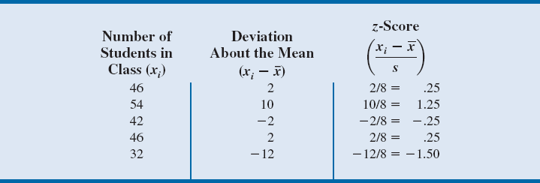

Table 2.13 - z-Scores for the Class Size Data
For class size data, $\overline{x}$ = 44 and s = 8.
For observations with a value > mean, z-score > 0.
For observations with a value < mean, z-score < 0.
Notes:
$z_{1}$ = .25 would indicate that $x_{1}$ is .25 standard deviations greater than the sample mean.

Slide 58
Analyzing Distributions
Empirical rule:
For data having a bell-shaped distribution:
Within 1 standard deviation – approximately 68% of the data values.
Within 2 standard deviations – approximately 95% of the data values.
Within 3 standard deviations – almost all the data values.
Identifying outliers:
Outliers: Extreme values in a data set.
It can be identified using standardized values (z-scores).
Any data value with a z-score less than –3 or greater than +3 is an outlier.
Notes:
Empirical rule:
The height of adult males in the United States has a bell-shaped distribution with a mean of approximately 69.5 inches and standard deviation of approximately 3 inches.
Using the empirical rule, the following conclusions can be drawn.
Approximately 68 percent of adult males in the United States have heights between 69.5 – 3 = 66.5 and 69.5 + 3 = 72.5 inches.
Approximately 95 percent of adult males in the United States have heights between 63.5 and 75.5 inches.
Almost all adult males in the United States have heights between 60.5 and 78.5 inches.
Outliers:
An outlier may be a data value that has been incorrectly recorded; if so, it can be corrected before further analysis.
It may also be from an observation that doesn’t belong to the population we are studying and was incorrectly included in the data set; if so, it can be removed.
It may be an unusual data value that has been recorded correctly and is a member of the population we are studying. In such cases, the observation should remain.

Slide 59
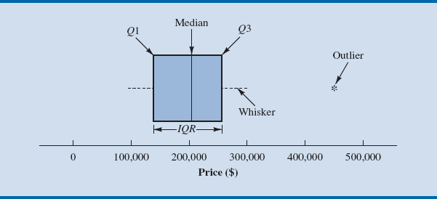
Analyzing Distributions
Box plot: Graphical summary of the distribution of data.
Developed from the quartiles for a data set.
Box Plot for the Home Sales Data
Notes:
Steps used to construct the box plot for the home sales data:
A box is drawn with the ends of the box located at the first and third quartiles. For the home sales data, Q1 = 139,000 and Q3 = 256,625. This box contains the middle 50 percent of the data.
A vertical line is drawn in the box at the location of the median (203,750 for the home sales data).
By using the interquartile range, IQR = Q₃ – Q₁, limits are located. The limits for the box plot are 1.5(IQR) below Q1 and 1.5(IQR) above Q3. For the home sales data, IQR = Q₃ – Q₁ = 256,625 – 139,000 = 117,625. Thus, the limits are 139,000 – 1.5(117,625) = –37,437.5 and 256,625 + 1.5(117,625) = 433,062.5. Data outside these limits are considered outliers.
The dashed lines in Figure 2.21 are called whiskers. The whiskers are drawn from the ends of the box to the smallest and largest values inside the limits computed in step 3. Thus, the whiskers end at home sales values of 108,000 and 298,000.
Finally, the location of each outlier is shown with an asterisk (*). In Figure 2.21, we see one outlier, 456,250.

Slide 60
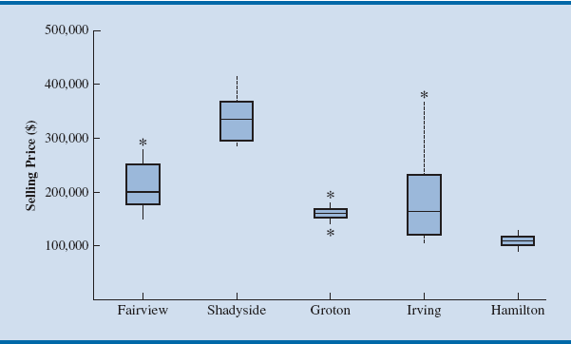
Box Plots Comparing Home Sale Prices in Different Communities
Notes:
To compare home sales from several different communities, we have created box plots for recent home sales in each community.
The most expensive houses appear to be in Shadyside and the cheapest houses in Hamilton.
The median home selling price in Groton is about the same as the median home selling price in Irving. However, home sales prices in Irving have much greater variability.
Homes appear to be selling in Irving for many different prices, from very low to very high.
Home selling prices have the least variation in Groton and Hamilton.
Unusually expensive home sales (relative to the respective distribution of home sales vales) have occurred in Fairview, Groton, and Irving, which appear as outliers.
Groton is the only location with a low outlier, but note that most homes sell for very similar prices in Groton, so the selling price does not have to be too far from the median to be considered an outlier.

Slide 61
Measures of Association Between Two Variables

Slide 62
Measures of Association Between Two Variables
Scatter Charts: Useful graph for analyzing the relationship between two variables.
Covariance: Descriptive measure of the linear association between two variables.
Sample covariance for a sample of size n with the observations
(x₁, y₁), (x₂, y₂), and so on:
s_{xy} =
Population covariance, σ_{xy} =

Slide 63
Measures of Association Between Two Variables
Correlation coefficient: Measures the relationship between two variables.
Not affected by the units of measurement for x and y.
Sample correlation coefficient denoted by r_{xy}.
r_{xy} = s_{xy} / (s_{x} s_{y})
s_{xy} = sample covariance =
s_{x} = sample standard deviation of x =
s_{y} = sample standard deviation of y =
Excel: CORREL function
Notes:
Population correlation coefficient is denoted by $ρ_{xy}$.
$ρ_{xy}$ = $\frac{σ_{xy}}{σ_{x}σ_{y}}$
$σ_{xy}$ = population covariance = $\frac{\sum{\left(x_{i} − {\text{µ }}_{x}\right)\left(y_{i} − {\text{µ }}_{y}\right)}}{N}$.
$σ_{x}$ = population standard deviation of x = $\sqrt{\frac{{\sum{\left(x_{i} −{\text{µ }}_{x}\right)}}^{2}}{N}}$.
$σ_{y}$ = population standard deviation of y = $\sqrt{\frac{{\sum{\left(y_{i} −{\text{µ }}_{y}\right)}}^{2}}{N}}$.

Slide 64
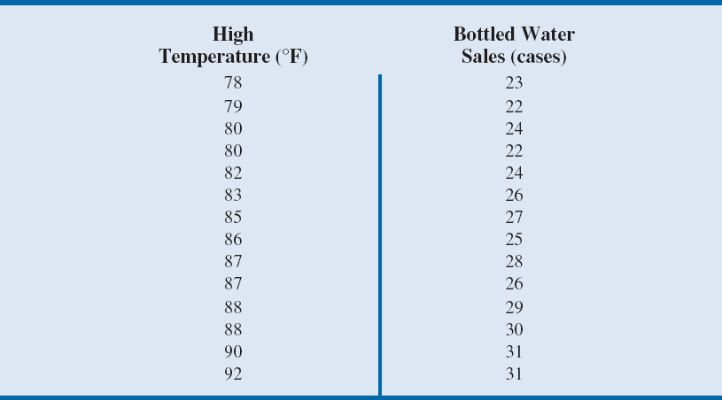
Data for Bottled Water Sales at Queensland Amusement Park for a Sample of 14 Summer Days

Slide 65
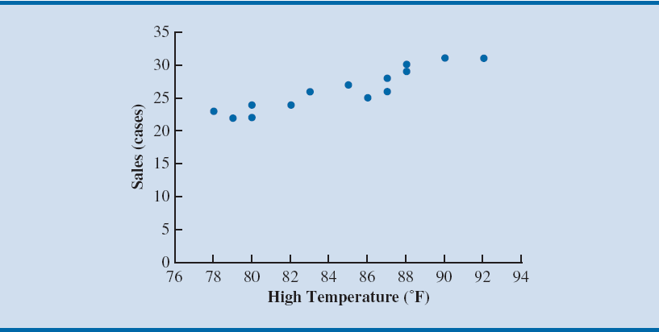
Figure 2.23 - Chart Showing the Positive Linear Relation Between Sales and High Temperatures
Notes:
The scatter chart in the figure suggests that higher daily high temperatures are associated with higher bottled water sales.
This is an example of a positive relationship because when one variable (high temperature) increases, the other variable (sales of bottled water) generally also increases.
The scatter chart also suggests that a straight line could be used as an approximation for the relationship between high temperature and sales of bottled water.

Slide 66
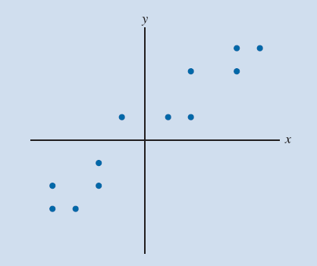
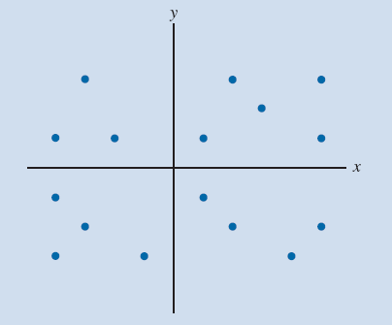
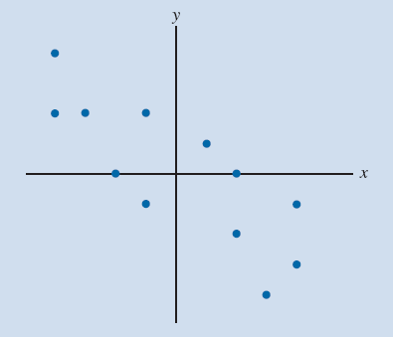
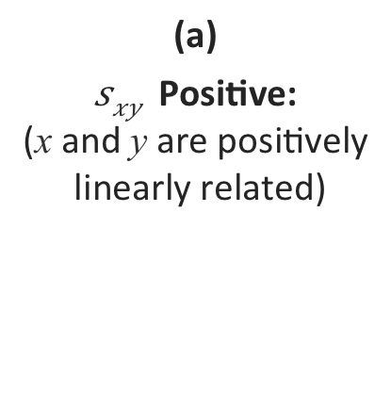
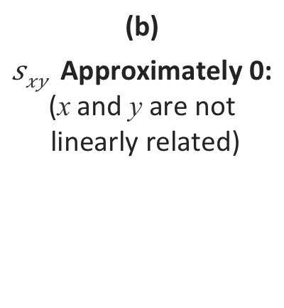
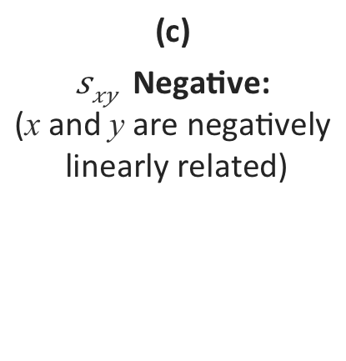
Figure 2.25 - Scatter Diagrams and Associated Covariance Values for Different Variable Relationships
(a)
Positive:
(x and y are positively
linearly related)
(b)
Approximately 0:
(x and y are not
linearly related)
(c)
Negative:
(x and y are negatively
linearly related)

Slide 67
Computation of Correlation Coefficient
Illustration – To determine the sample correlation coefficient for bottled water sales at Queensland Amusement Park
There is a very strong linear relationship between high temperature and sales.
Notes:
We have already obtained the value of $s_{xy}$ as 12.8.
Using data in Table 2.14, we can compute sample standard deviations for x and y.
${ s}_{x}\text{=}\sqrt{\frac{{\sum{\left(x_{i}−\overline{x}\right)}}^{2}}{n−1}}$ = 4.36
$s_{y}\text{=}\sqrt{\frac{{\sum{\left(y_{i}−\overline{y}\right)}}^{2}}{n−1}}$ = 3.15

Slide 68
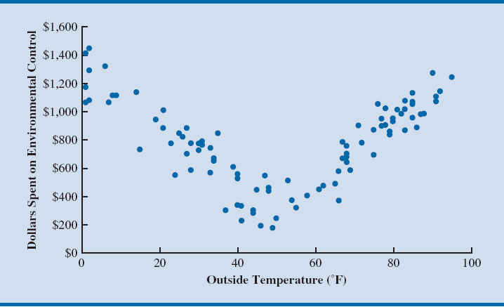
Example of Nonlinear Relationship Producing a Correlation Coefficient Near Zero
Notes:
The scatter diagram in Figure 2.26 shows the relationship between the amount spent by a small retail store for environmental control (heating and cooling) and the daily high outside temperature over 100 days.
The sample correlation coefficient for these data is r_{xy} = –0.007 and indicates that there is no linear relationship between the two variables.
However, Figure 2.26 provides strong visual evidence of a nonlinear relationship.
That is, we can see that as the daily high outside temperature increases, the money spent on environmental control first decreases as less heating is required and then increases as greater cooling is required.

Slide 69
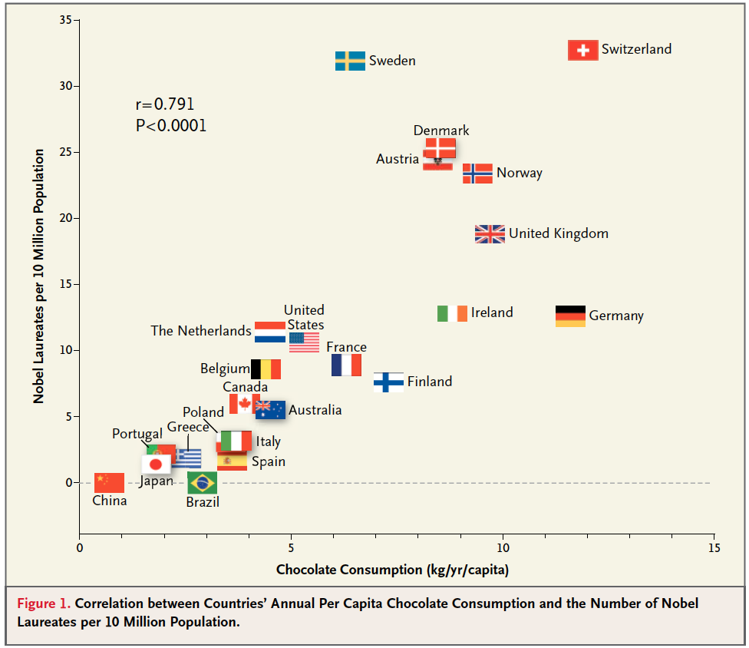
Correlation? Really?
Source: New England Journal of Medicine

Slide 70
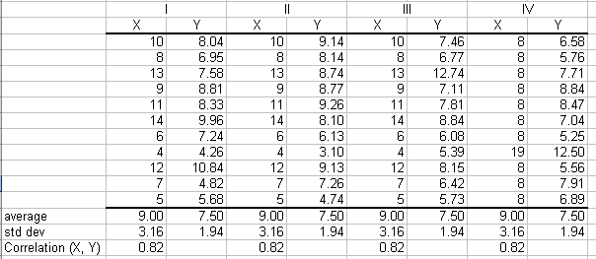
Importance of Graphical Display

Slide 71
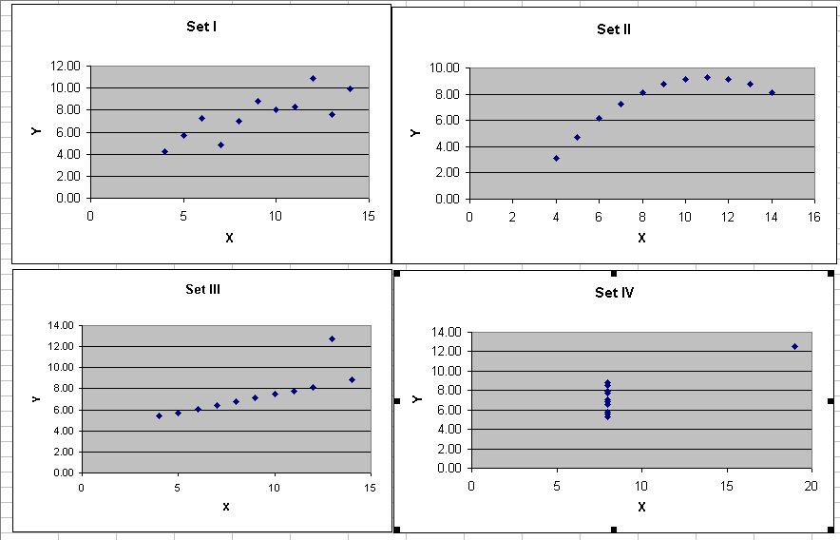
Importance of Graphical Display

