Slide 1
Fall 2020
DATS 501 Fundamentals of Data Science
Hasan Demirtaş
hdemirtas.academic@gmail.com

Slide 2

Quiz is coming

Slide 3
Conditional Probability

Slide 4
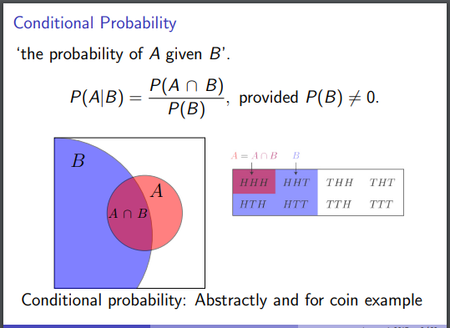
Conditional Probability

Slide 5
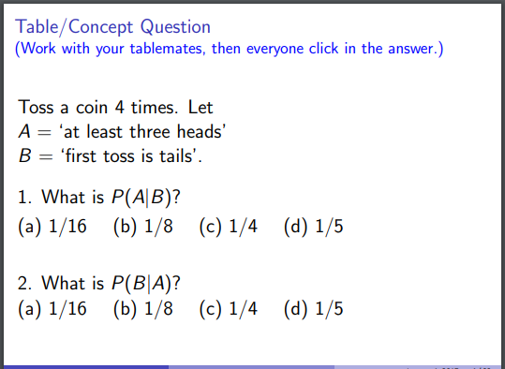
Conditional Probability

Slide 6
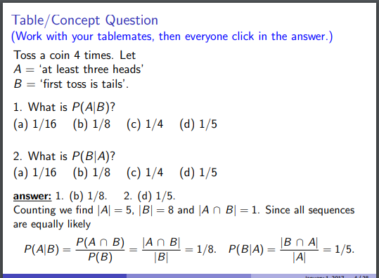
Conditional Probability

Slide 7
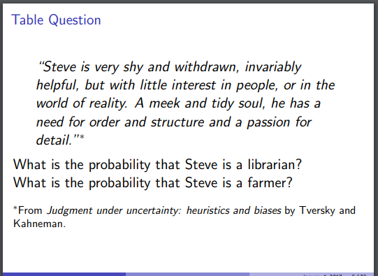
Importance of prior probability

Slide 8
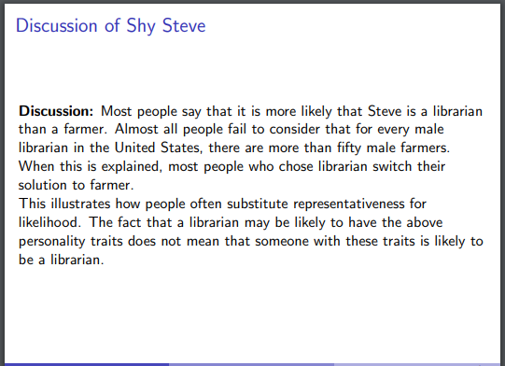
Importance of prior probability

Slide 9
Covariance

Slide 10
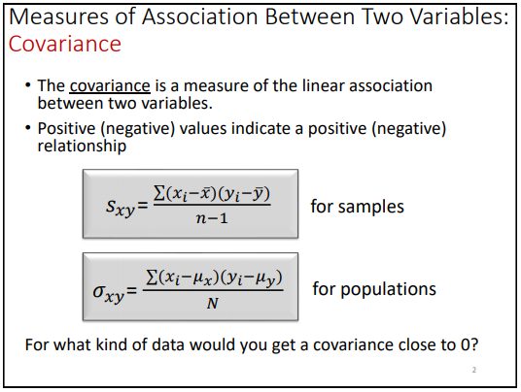
Covariance

Slide 11
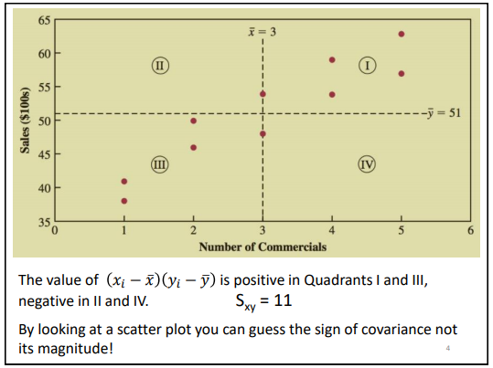
Covariance

Slide 12
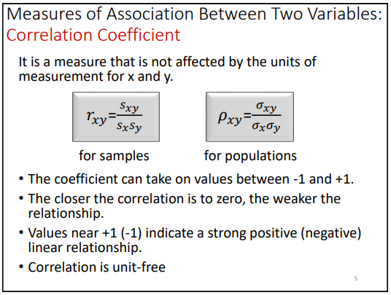
Correlation Coefficient

Slide 13
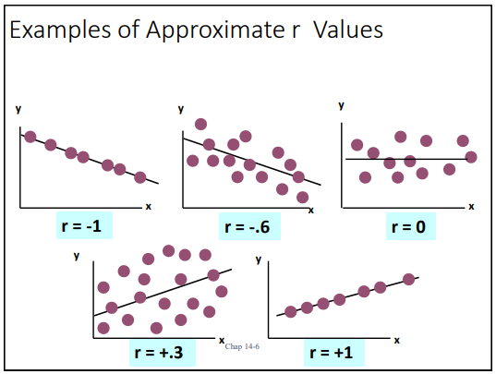
Correlation Coefficient

Slide 14
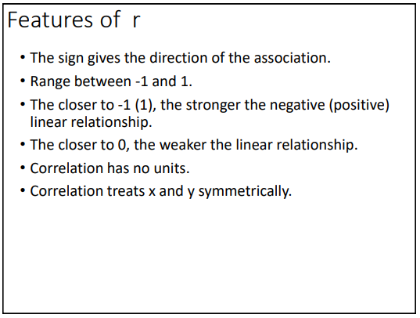
Correlation Coefficient

Slide 15
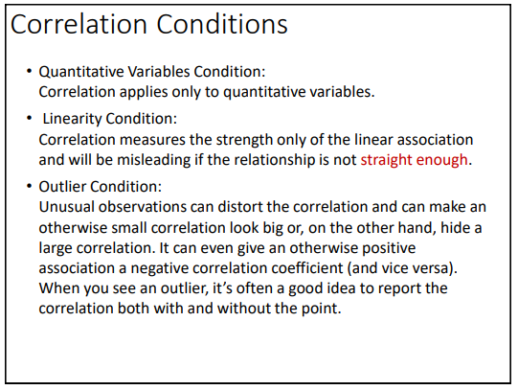
Correlation Coefficient

Slide 16
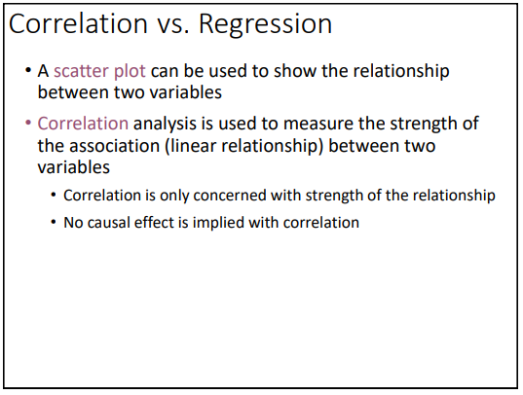
Correlation Coefficient

