Slide 1
Fall 2020
DATS 501 Fundamentals of Data Science
Hasan Demirtaş
hdemirtas.academic@gmail.com

Slide 2
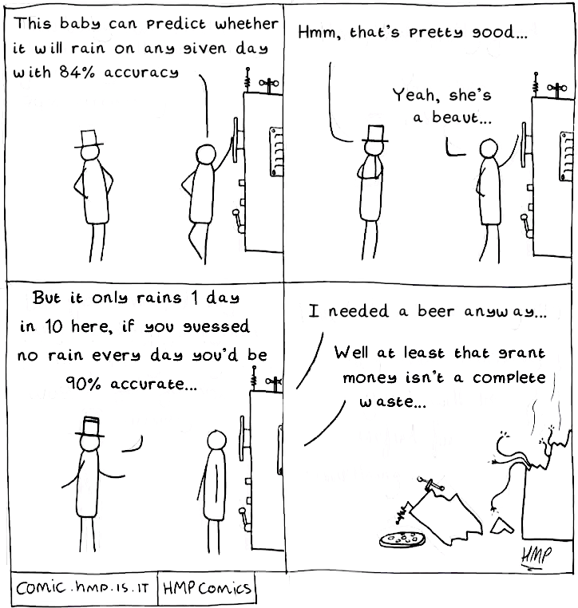

Slide 3
Excels

Slide 4
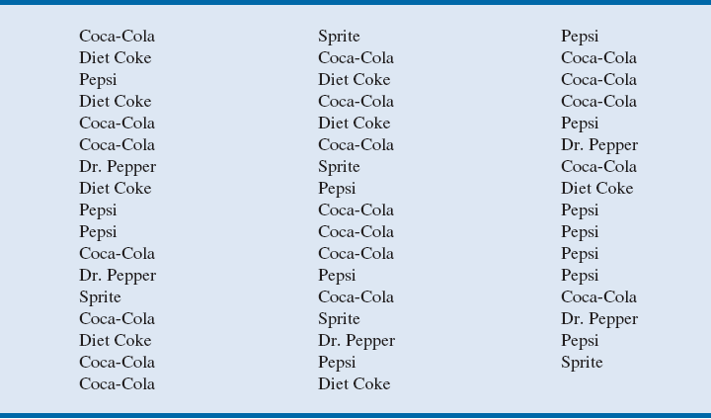
01_SoftDrinks:
Task: Find the frequencies
Notes:
The data is taken from a sample of 50 soft drink purchases.
Each purchase is for one of five popular soft drinks, which define the five bins: Coca-Cola, Diet Coke, Dr. Pepper, Pepsi, and Sprite.

Slide 5
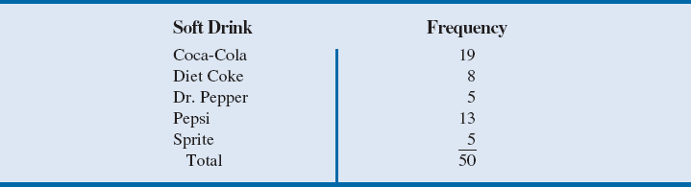
01_SoftDrinks
The frequency distribution summarizes information about the popularity of the five soft drinks:
Coca-Cola is the leader, Pepsi is second, Diet Coke is third, and Sprite and Dr. Pepper are tied for fourth.
Notes:
The frequency distribution of soft drink purchases is obtained by counting the number of times each soft drink appears.
Coca-Cola appears 19 times, Diet Coke appears 8 times, Dr. Pepper appears 5 times, Pepsi appears 13 times, and Sprite appears 5 times.
This frequency distribution provides a summary of how the 50 soft drink purchases are distributed across the five soft drinks.

Slide 6
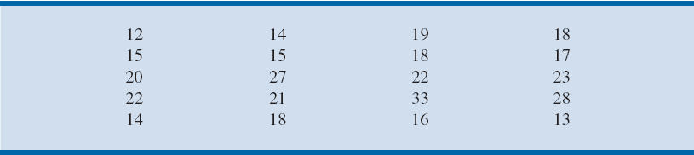
02_AuditData
Task: Find Frequency, Relative Frequency, and Percent Frequency
Distributions for the Audit Time Data && Draw its histogram
Year-End Audit Times (Days)
Notes:
Number of bins:
The number of data items is relatively small (n = 20). Hence, we choose to develop a frequency distribution with five bins.
Width of bins:
The largest data value is 33, and the smallest data value is 12.
Because we decided to summarize the data with five classes, using the expression “Approximate bin width = $\frac{\text{Largest} \text{data} \text{value} − \text{smallest} \text{data} \text{value}}{\text{Number} \text{of} \text{bins}}$”, provides an approximate bin width of (33 – 12)/5 = 4.2.
We therefore decided to round up and use a bin width of five days in the frequency distribution.
Bin limits:
We selected 10 days as the lower bin limit and 14 days as the upper bin limit for the first class. This bin is denoted 10–14.
The smallest data value, 12, is included in the 10–14 bin. We then selected 15 days as the lower bin limit and 19 days as the upper bin limit of the next class.
We continued defining the lower and upper bin limits to obtain a total of five classes: 10–14, 15–19, 20–24, 25–29, and 30–34.
The difference between the upper bin limits of adjacent bins is the bin width. Using the first two upper bin limits of 14 and 19, we see that the bin width is 19 – 14 = 5.
With the number of bins, bin width, and bin limits determined, a frequency distribution can be obtained by counting the number of data values belonging to each bin.
Using the frequency distribution, we can observe that:
The most frequently occurring audit times are in the bin of 15–19 days.
Eight of the 20 audit times are in this bin.
Only one audit required 30 or more days.

Slide 7
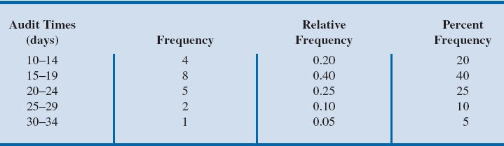
02_AuditData
Frequency, Relative Frequency, and Percent Frequency
Distributions for the Audit Time Data
Notes:
Number of bins:
The number of data items is relatively small (n = 20). Hence, we choose to develop a frequency distribution with five bins.
Width of bins:
The largest data value is 33, and the smallest data value is 12.
Because we decided to summarize the data with five classes, using the expression “Approximate bin width = $\frac{\text{Largest} \text{data} \text{value} − \text{smallest} \text{data} \text{value}}{\text{Number} \text{of} \text{bins}}$”, provides an approximate bin width of (33 – 12)/5 = 4.2.
We therefore decided to round up and use a bin width of five days in the frequency distribution.
Bin limits:
We selected 10 days as the lower bin limit and 14 days as the upper bin limit for the first class. This bin is denoted 10–14.
The smallest data value, 12, is included in the 10–14 bin. We then selected 15 days as the lower bin limit and 19 days as the upper bin limit of the next class.
We continued defining the lower and upper bin limits to obtain a total of five classes: 10–14, 15–19, 20–24, 25–29, and 30–34.
The difference between the upper bin limits of adjacent bins is the bin width. Using the first two upper bin limits of 14 and 19, we see that the bin width is 19 – 14 = 5.
With the number of bins, bin width, and bin limits determined, a frequency distribution can be obtained by counting the number of data values belonging to each bin.
Using the frequency distribution in Table 2.7, we can observe that:
The most frequently occurring audit times are in the bin of 15–19 days.
Eight of the 20 audit times are in this bin.
Only one audit required 30 or more days.

Slide 8
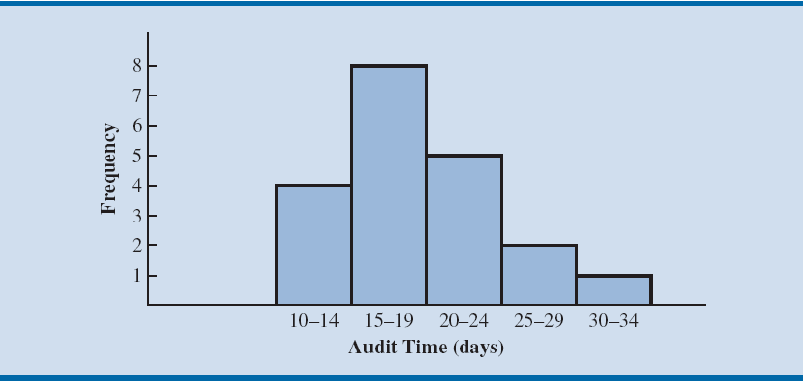
02_AuditData
Notes:
Note that the class with the greatest frequency is shown by the rectangle appearing above the class of 15–19 days.
The height of the rectangle shows that the frequency of this class is 8.

Slide 9
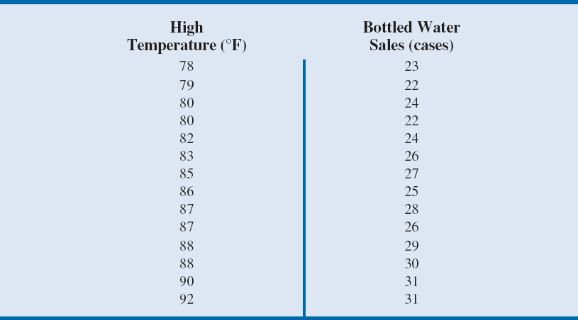
03_BottledWater
Task: Draw a scatterplot

Slide 10
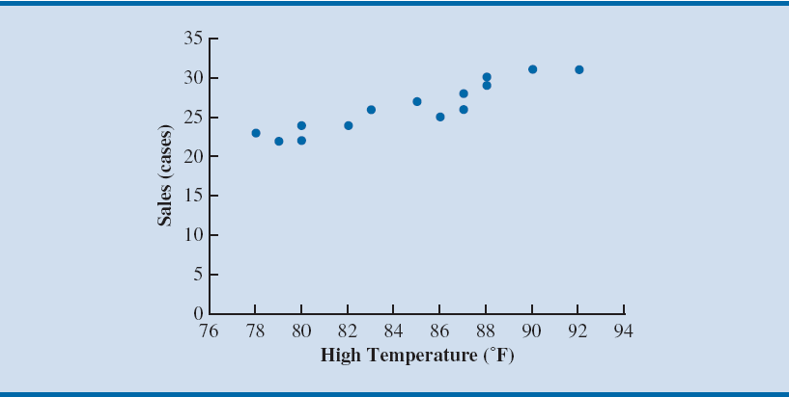
03_BottledWater
Notes:
The scatter chart in the figure suggests that higher daily high temperatures are associated with higher bottled water sales.
This is an example of a positive relationship because when one variable (high temperature) increases, the other variable (sales of bottled water) generally also increases.
The scatter chart also suggests that a straight line could be used as an approximation for the relationship between high temperature and sales of bottled water.

Slide 11
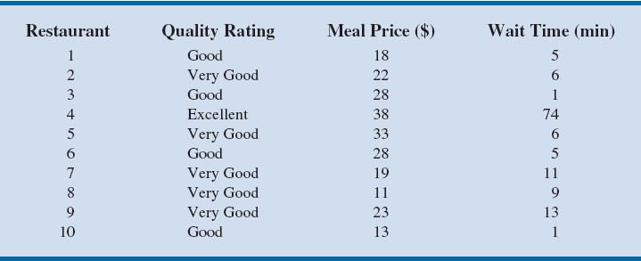
04_Restaurant
Task: Make a pivot table with grouped meal price
Notes:
Data on the quality rating, meal price, and the usual wait time for a table during peak hours were collected for a sample of 300 Los Angeles area restaurants.
The table shows the data for the first ten restaurants.
Quality ratings - categorical data; Meal prices - quantitative data.

Slide 12
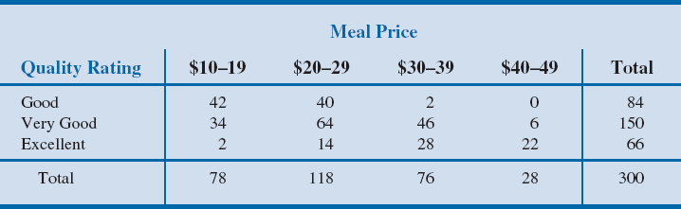
04_Restaurant
The greatest number of restaurants in the sample (64) have a very good rating and a meal price in the $20–29 range.
Only two restaurants have an excellent rating and a meal price in the $10–19 range.
The right and bottom margins of the crosstabulation give the frequency of quality rating and meal price separately.
Notes:
A crosstabulation of the data for quality rating and meal price data is shown.
The left and top margin labels define the classes for the two variables. In the left margin, the row labels (Good, Very Good, and Excellent) correspond to the three classes of the quality rating variable.
In the top margin, the column labels ($10–19, $20–29, $30–39, and $40–49) correspond to the four classes (or bins) of the meal price variable.
Each restaurant in the sample provides a quality rating and a meal price.
For example, restaurant 5 is identified as having a very good quality rating and a meal price of $33. This restaurant belongs to the cell in row 2 and column 3.
From the right margin, we see that data on quality ratings show 84 good restaurants, 150 very good restaurants, and 66 excellent restaurants. Similarly, the bottom margin shows the counts for the meal price variable. The value of 300 in the bottom right corner of the table indicates that 300 restaurants were included in this data set.
In constructing a crosstabulation, we simply count the number of restaurants that belong to each of the cells in the crosstabulation.

Slide 13
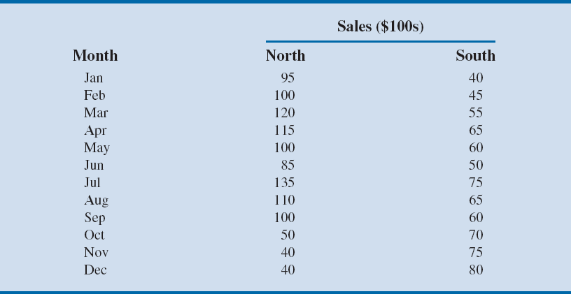
05_KirklandRegional
Task: Draw a line chart with two lines

Slide 14
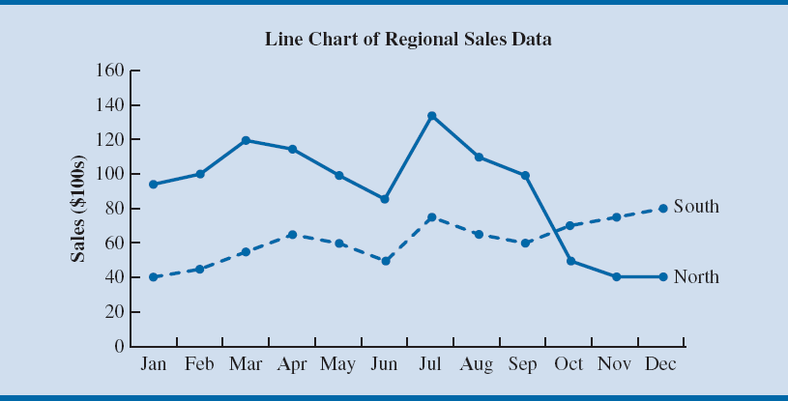
05_KirklandRegional
Notes:
We can create a line chart in Excel that shows sales in both regions by following similar steps but selecting cells A2:C14 in the file KirklandRegional before creating the line chart.
Sales in both the North and South regions seemed to follow the same increasing/decreasing pattern until October.
Starting in October, sales in the North continued to decrease while sales in the South increased.
We would probably want to investigate any changes that occurred in the North region around October.

Slide 15
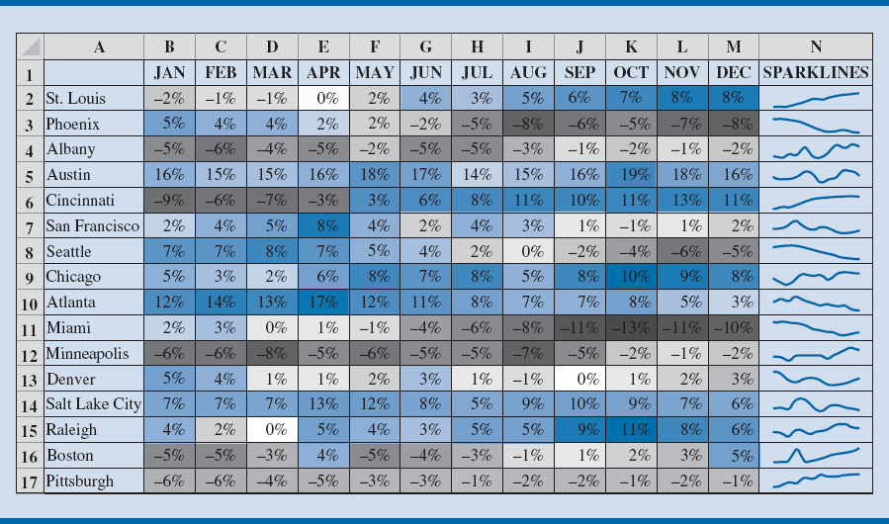
06_SameStoreSales
Task: Introduce heat map colors to data
Notes:
Figure can be created in Excel by following these steps:
Step 1: Select cells B2:M17
Step 2: Click the HOME tab on the Ribbon
Step 3: Click Conditional Formatting in the Styles group
Choose Color Scales and click on Blue–White–Red Color Scale
To add the sparklines in Column N, we use the following steps:
Step 4: Select cell N2
Step 5: Click the INSERT tab on the Ribbon
Step 6: Click Line in the Sparklines group
Step 7: When the Create Sparklines dialog box opens:
Enter B2:M2 in the Data Range: box
Enter N2 in the Location Range: box and click OK
Step 8: Copy cell N2 to N3:N17
The heat map in the Figure helps the reader to easily identify trends and patterns.
The cells shaded grey in the Figure indicate declining same-store sales for the month, and cells shaded blue indicate increasing same-store sales for the month. Column N in the Figure also contains sparklines for the same-store sales data.
We can see that Austin has had positive increases throughout the year, while Pittsburgh has had consistently negative same-store sales results.
Same-store sales at Cincinnati started the year negative but then became increasingly positive after May.
In addition, we can differentiate between strong positive increases in Austin and less substantial positive increases in Chicago by means of color shadings.
A sales manager could use the heat map in the Figure to identify stores that may require intervention and stores that may be used as Models.
To avoid problems with interpreting differences in color, we can add the sparklines in Column N of the Figure.

Slide 16
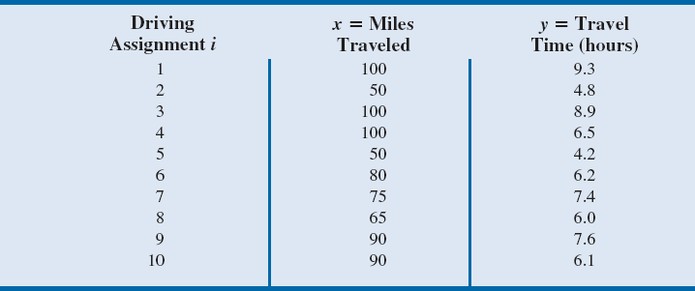
07_Butler
Task: Find least square error && total error && draw a scatter plot with trendline for these errors
Notes:
To illustrate the least squares method, suppose data were collected from a sample of ten Butler Trucking Company driving assignments.
For the ith observation or driving assignment in the sample, x_{i} is the miles traveled and y_{i} is the travel time (in hours).
The values of x_{i} and y_{i} for the ten driving assignments in the sample are summarized.

Slide 17
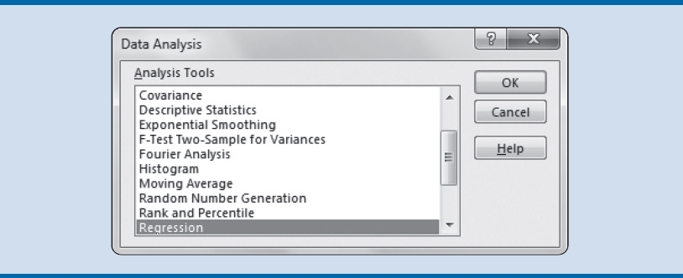
07_Butler
Data Analysis Tools Box
Notes:
Note that:
The sum of predicted values ${\hat{y}}_{i}$ is equal to the sum of the values of the dependent variable y.
The sum of the residuals e_{i} is 0.
The sum of the squared residuals $e_{i}^{2}$ has been minimized.

Slide 18
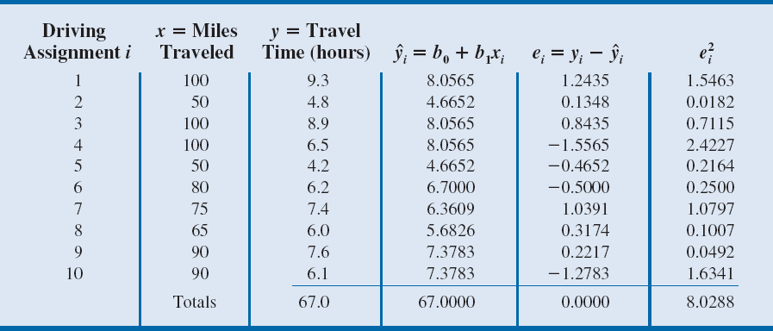
07_Butler
Notes:
Note that:
The sum of predicted values ${\hat{y}}_{i}$ is equal to the sum of the values of the dependent variable y.
The sum of the residuals e_{i} is 0.
The sum of the squared residuals $e_{i}^{2}$ has been minimized.

Slide 19
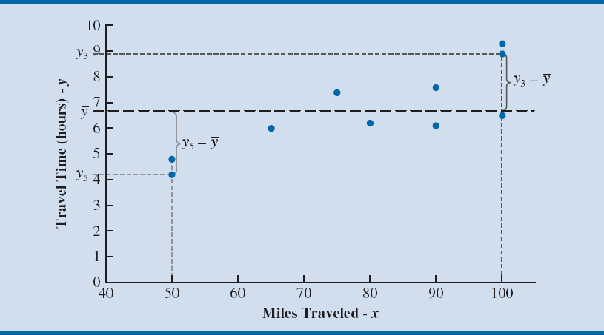
07_Butler
Notes:
Without knowledge of any related variables, we would use the sample mean $\overline{y}$ as a predictor of travel time for any given driving assignment.
To find $\overline{y}$, we divide the sum of the actual driving times y_{i} from the Table by the number of observations n in the data (10); this yields $\overline{y}$ = 6.7.
The Figure provides insight on how well we would predict the values of y_{i} in the Butler Trucking company example using $\overline{y}$ = 6.7.
From this figure, which again highlights the residuals for driving assignments 3 and 5, we can see that $\overline{y}$ tends to overpredict travel times for driving assignments that have relatively small values for miles traveled (such as driving assignment 5) and tends to underpredict travel times for driving assignments have relatively large values for miles traveled (such as driving assignment 3).

Slide 20
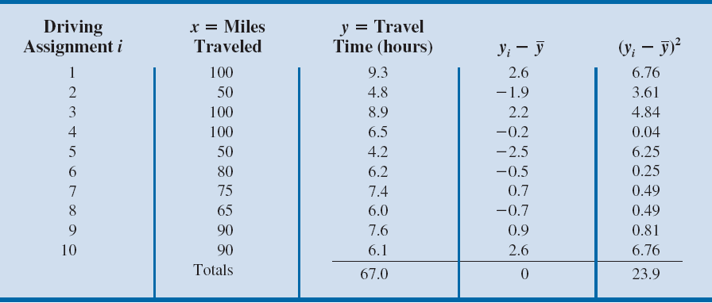
07_Butler
Notes:
The sum at the bottom of the last column in the Table is the total sum of squares for Butler Trucking Company: SST = 23.9.

Slide 21
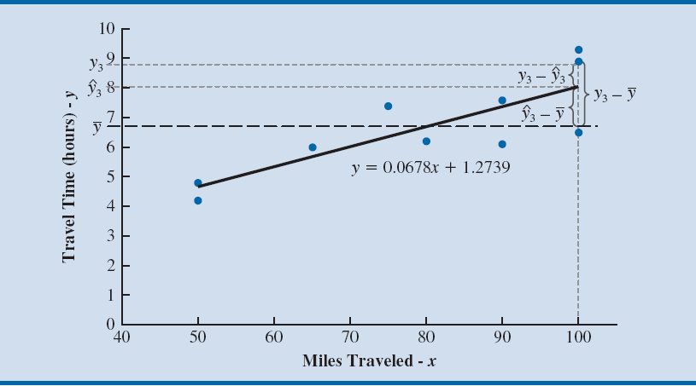
07_Butler
Notes:
In the Figure, we show the estimated regression line ${\hat{y}}_{i}$ = 1.2739 + 0.0678x_{i} and the line corresponding to $\overline{y}$ = 6.7.
Note that the points cluster more closely around the estimated regression line ${\hat{y}}_{i}$ = 1.2739 + 0.0678x_{i} than they do about the horizontal line $\overline{y}$ = 6.7.

Slide 22
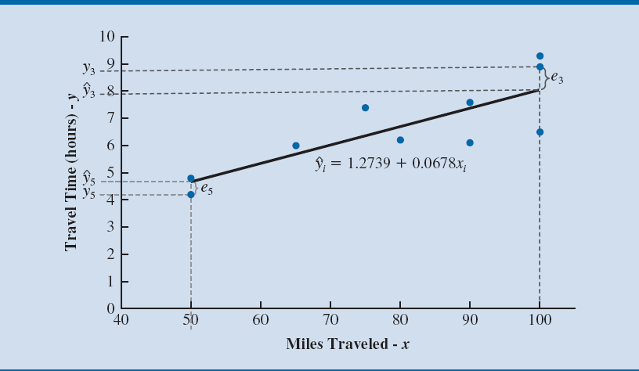
07_Butler
Notes:
The Figure shows the simple linear regression line ${\hat{y}}_{i}$ = 1.2739 + 0.0678x_{i} superimposed on the scatter chart for the Butler Trucking Company data in the Table.
This figure, which also highlights the residuals for driving assignment 3 (e₃) and driving assignment 5 (e₅), shows that the regression model underpredicts travel time for some driving assignments (such as driving assignment 3) and overpredicts travel time for others (such as driving assignment 5), but in general appears to fit the data relatively well.

Slide 23
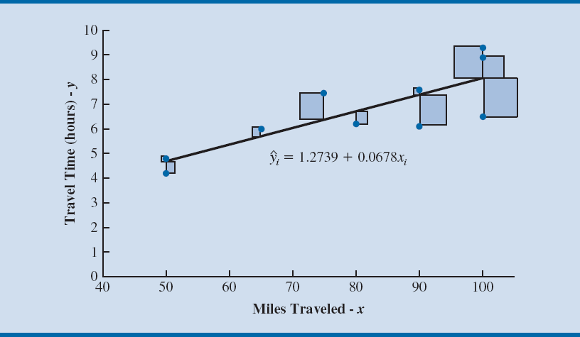
07_Butler
Notes:
In the Figure, a vertical line is drawn from each point in the scatter chart to the linear regression line.
Each of these lines represents the difference between the actual driving time and the driving time to be predicted using linear regression for one of the assignments in the data.
The length of each line is equal to the absolute value of the residual for one of the driving assignments.
When a residual is squared, the resulting value is equal to the square that is formed using the vertical dashed line representing the residual in the Figure as one side of a square.
Thus, when we find the linear regression model that minimizes the sum of squared errors for the Butler Trucking example, we are positioning the regression line in the manner that minimizes the sum of the areas of the ten squares in the Figure.

Slide 24
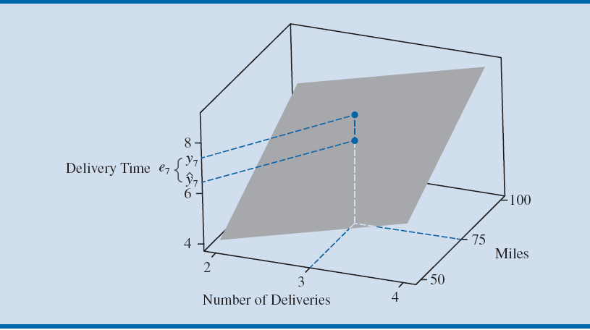
08_ButlerWithDeliveries
Task: This time rather than simple linear regression perform multiple regression analysis && Write the regression formula
Notes:
To illustrate the least squares method, suppose data were collected from a sample of ten Butler Trucking Company driving assignments.
For the ith observation or driving assignment in the sample, x_{i} is the miles traveled and y_{i} is the travel time (in hours).
The values of x_{i} and y_{i} for the ten driving assignments in the sample are summarized.

Slide 25
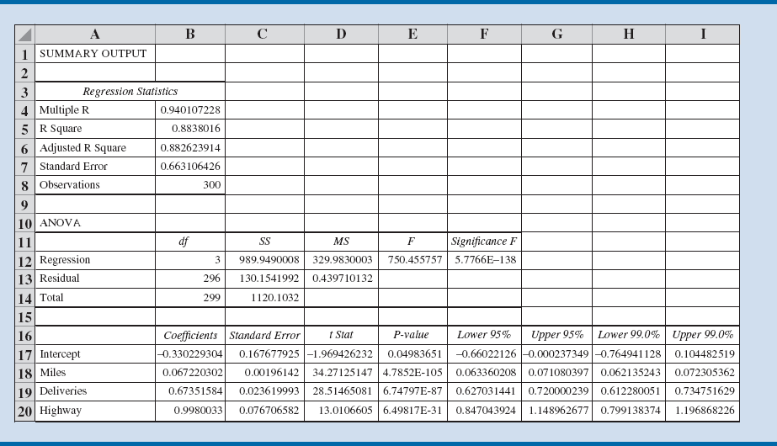
09_ButlerHighway
Task: Write the regression formula
Notes:
To illustrate the least squares method, suppose data were collected from a sample of ten Butler Trucking Company driving assignments.
For the ith observation or driving assignment in the sample, x_{i} is the miles traveled and y_{i} is the travel time (in hours).
The values of x_{i} and y_{i} for the ten driving assignments in the sample are summarized.

Slide 26
Model Fitting

Slide 27
Model Fitting
Variable selection procedures
Special procedures are sometimes employed to select the independent variables to include in the regression model.
Stepwise regression
Forward selection procedure
Sequential replacement procedure
Best-subsets procedure
Iterative procedures:
At each step of the procedure a single independent variable is added or removed and the new model is evaluated.
Evaluates regression models involving different subsets
of the independent variables.

Slide 28
Model Fitting
Variable selection procedures
Forward selection procedure:
The analyst establishes a criterion for allowing independent variables to enter the model.
Example: The independent variable j with the smallest p-value associated with the test of the hypothesis β_{j} = 0, subject to some predetermined maximum p-value for which a potential independent variable will be allowed to enter the model).

Slide 29
Model Fitting
Forward selection procedure (Contd.):
First step: The independent variable that best satisfies the criterion is added to the model.
Each subsequent step: The remaining independent variables not in the current model are evaluated, and the one that best satisfies the criterion is added to the model.
Procedure stops: When there are no independent variables not currently in the model that meet the criterion for being added to the regression model.

Slide 30
Model Fitting
Backward selection procedure:
The analyst establishes a criterion for allowing independent variables to remain in the model.
Example: The largest p-value associated with the test of the hypothesis β_{j} = 0, subject to some predetermined minimum p-value for which a potential independent variable will be allowed to remain in the model.

Slide 31
Model Fitting
Backward selection procedure (Contd.):
First step: The independent variable that violates this criterion to the greatest degree is removed from the model.
Each subsequent step: The independent variables in the current model are evaluated, and the one that violates this criterion to the greatest degree is removed from the model.
Procedure stops: When there are no independent variables currently in the model that violate the criterion for remaining in the regression model.

Slide 32
Model Fitting
Stepwise procedure:
The analyst establishes both a criterion for allowing independent variables to enter the model and a criterion for allowing independent variables to remain in the model.
In the first step of the procedure, the independent variable that best satisfies the criterion for entering the model is added.
First, the remaining independent variables not in the current model are evaluated, and the one that best satisfies the criterion for entering is added to the model.

Slide 33
Model Fitting
Stepwise procedure (Contd.):
Then the independent variables in the current model are evaluated, and the one that violates the criterion for remaining in the model to the greatest degree is removed.
The procedure stops when no independent variables not currently in the model meet the criterion for being added to the regression model, and no independent variables currently in the model violate the criterion for remaining in the regression model.

Slide 34
Model Fitting
Best-subsets procedure:
Simple linear regressions for each of the independent variables under consideration are generated, and then the multiple regressions with all combinations of two independent variables under consideration are generated, and so on.
Once a regression has been generated for every possible subset of the independent variables under consideration has been generated, an output that provides some criteria for selecting regression models is produced for all models generated.

Slide 35
Model Fitting
Overfitting: Results from creating an overly complex model to explain idiosyncrasies in the sample data.
Results from the use of complex functional forms or independent variables that do not have meaningful relationships with the dependent variable.
If a model is overfit to the sample data, it will perform better on the sample data used to fit the model than it will on other data from the population.
Thus, an overfit model can be misleading about its predictive capability and its interpretation.

Slide 36
Model Fitting
How does one avoid overfitting a model?
Use only independent variables that you expect to have real and meaningful relationships with the dependent variable.
Use complex models, such as quadratic models and piecewise linear regression models, only when you have a reasonable expectation that such complexity provides a more accurate depiction of what you are modeling.
Do not let the software dictate your model. Use iterative modeling procedures, such as the stepwise and best-subsets procedures, only for guidance and not to generate your final model.

Slide 37
Model Fitting
How does one avoid overfitting a model? (Contd.)
If you have access to a sufficient quantity of data, assess your model on data other than the sample data that were used to generate the model (this is referred to as cross-validation).
It is recommended to divide the original sample data into training and validation sets.
Training set: The data set used to build the candidate models that appear to make practical sense.
Validation set: The set of data used to compare model performances and ultimately pick a model for predicting values of the dependent variable.
Notes:
For example:
We might randomly select half of the data for use in developing regression models.
We could use these data as our training set to estimate a model or a collection of models that appear to perform well.
Finally, we use the remaining half of the data as a validation set to assess and compare the models’ performances and ultimately select the model that minimizes some measure of overall error when applied to the validation set.

