Slide 1
Fall 2020
DATS 501 Fundamentals of Data Science
Hasan Demirtaş
hdemirtas.academic@gmail.com

Slide 2
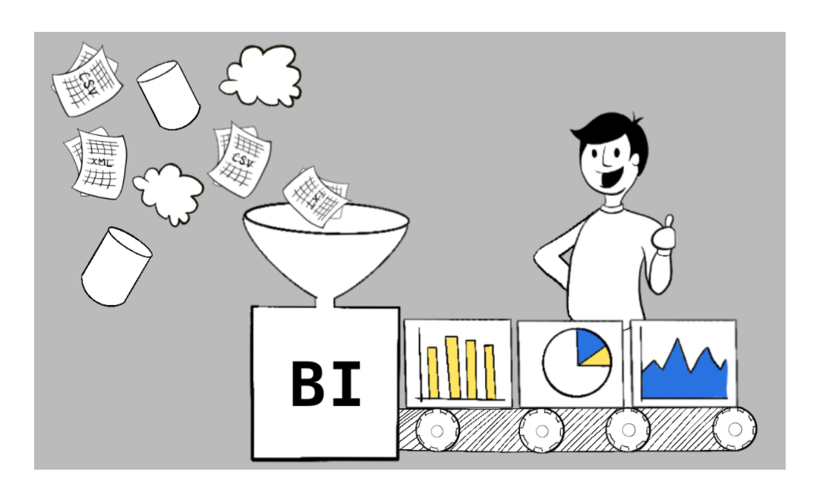
Business Intelligence

Slide 3
Power BI

Slide 4
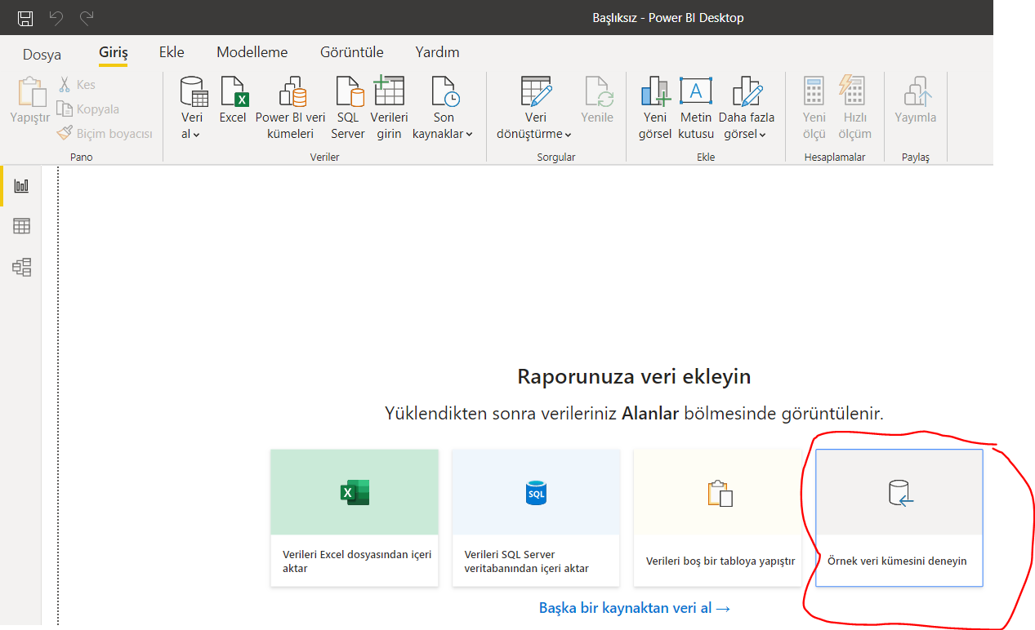
Loading data
Notes:
The data is taken from a sample of 50 soft drink purchases.
Each purchase is for one of five popular soft drinks, which define the five bins: Coca-Cola, Diet Coke, Dr. Pepper, Pepsi, and Sprite.

Slide 5
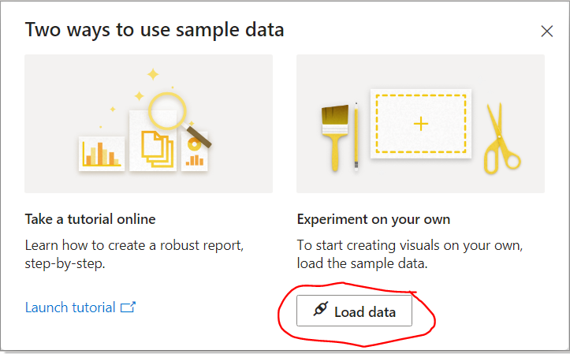
Loading data
Notes:
The data is taken from a sample of 50 soft drink purchases.
Each purchase is for one of five popular soft drinks, which define the five bins: Coca-Cola, Diet Coke, Dr. Pepper, Pepsi, and Sprite.

Slide 6
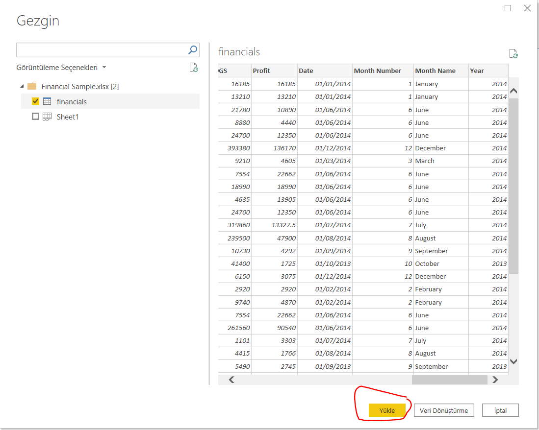
Loading data
Notes:
The data is taken from a sample of 50 soft drink purchases.
Each purchase is for one of five popular soft drinks, which define the five bins: Coca-Cola, Diet Coke, Dr. Pepper, Pepsi, and Sprite.

Slide 7
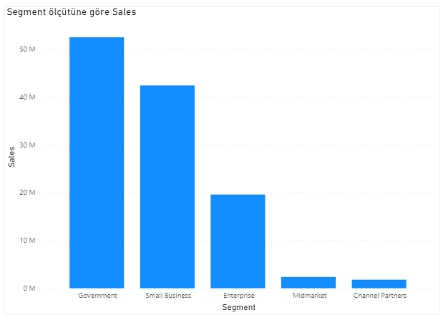
Drag sales first then segment over it
Notes:
The data is taken from a sample of 50 soft drink purchases.
Each purchase is for one of five popular soft drinks, which define the five bins: Coca-Cola, Diet Coke, Dr. Pepper, Pepsi, and Sprite.

Slide 8
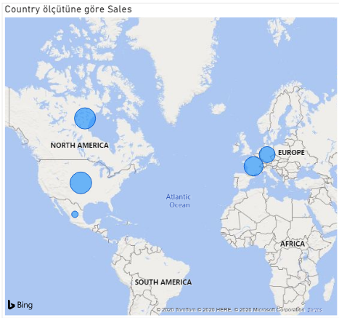
Click on map then drag sales and country over it
Notes:
The data is taken from a sample of 50 soft drink purchases.
Each purchase is for one of five popular soft drinks, which define the five bins: Coca-Cola, Diet Coke, Dr. Pepper, Pepsi, and Sprite.

Slide 9
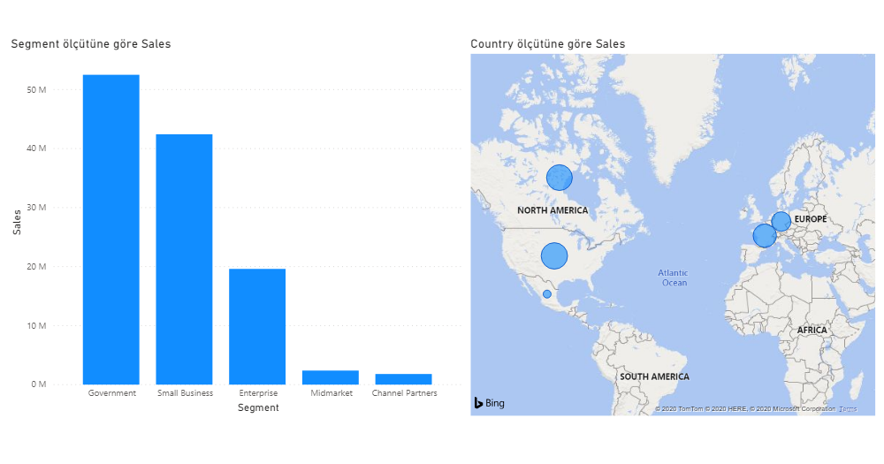
Graphs are linked
Notes:
The data is taken from a sample of 50 soft drink purchases.
Each purchase is for one of five popular soft drinks, which define the five bins: Coca-Cola, Diet Coke, Dr. Pepper, Pepsi, and Sprite.

Slide 10
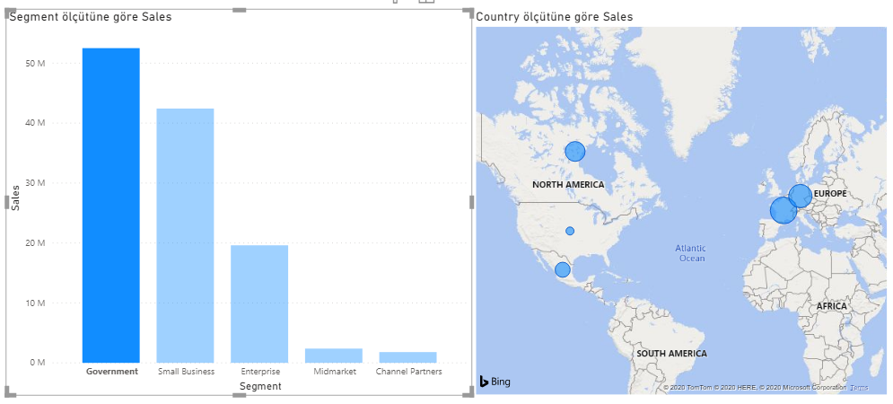
Clicking one affects the other: only Goverment segment
Notes:
The data is taken from a sample of 50 soft drink purchases.
Each purchase is for one of five popular soft drinks, which define the five bins: Coca-Cola, Diet Coke, Dr. Pepper, Pepsi, and Sprite.

Slide 11
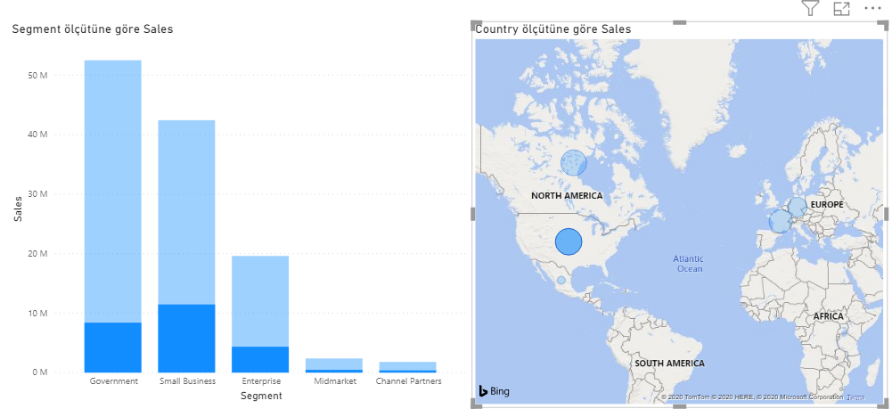
Clicking one affects the other: just USA sales
Notes:
The data is taken from a sample of 50 soft drink purchases.
Each purchase is for one of five popular soft drinks, which define the five bins: Coca-Cola, Diet Coke, Dr. Pepper, Pepsi, and Sprite.

Slide 12
More can be self learned
https://www.youtube.com/watch?v=1Bo1BrpR3AY&list=PL1N57mwBHtN0JFoKSR0n-tBkUJHeMP2cP&index=2&ab_channel=MicrosoftPowerBI
Notes:
The data is taken from a sample of 50 soft drink purchases.
Each purchase is for one of five popular soft drinks, which define the five bins: Coca-Cola, Diet Coke, Dr. Pepper, Pepsi, and Sprite.

