Slide 1
Fall 2020
DATS 501 Fundamentals of Data Science
Hasan Demirtaş
hdemirtas.academic@gmail.com

Slide 2
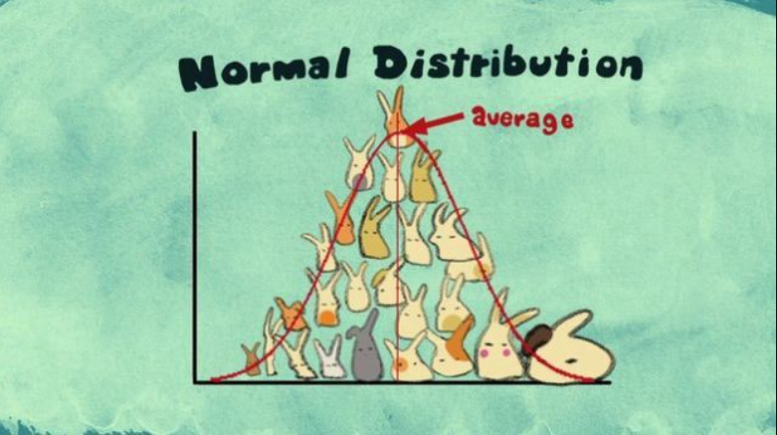
Quiz is coming

Slide 3
A Quick Glance on Probability Distribution Function & Cumulative Distribution Function

Slide 4
Density vs Mass
When the distribution is continuous, density is used
When the distribution is discrete, mass is used

Slide 5
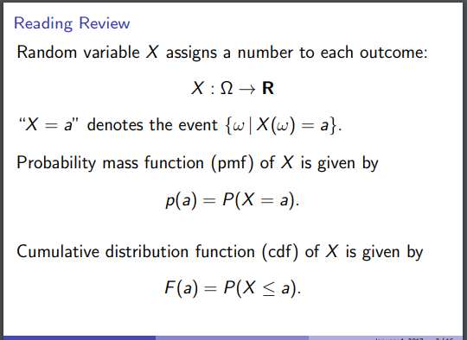
Probability Mass Function & Cumulative Distribution Function

Slide 6
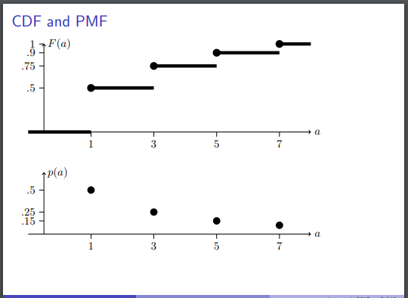
PMF & CDF

Slide 7
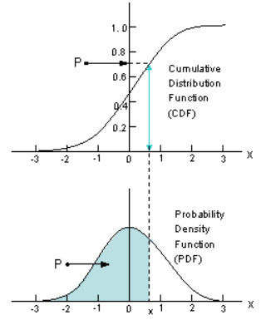
PDF & CDF

Slide 8
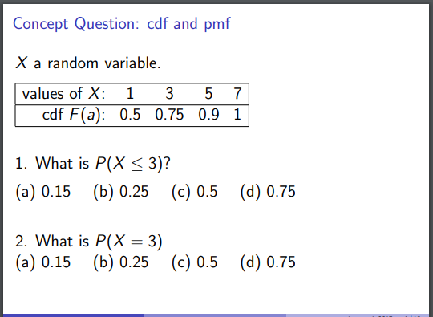
An example

Slide 9
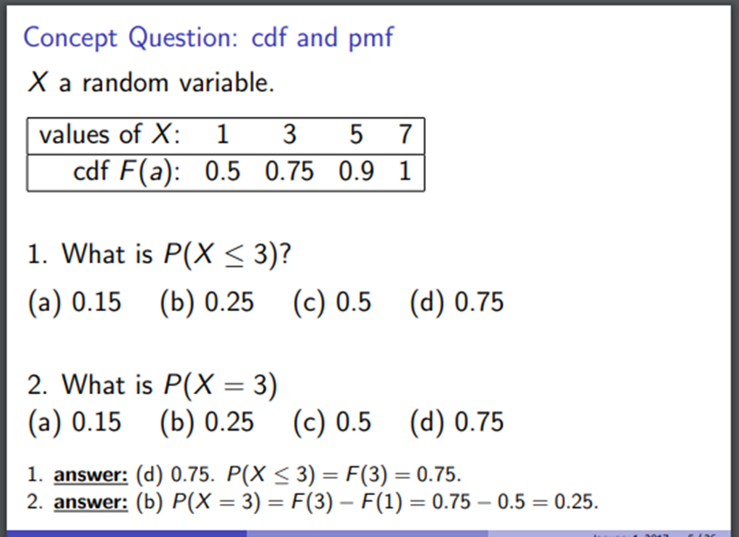
Solution

Slide 10
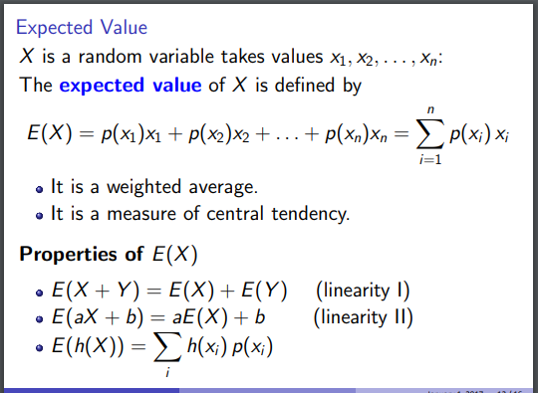
Expected value and pmf connection

Slide 11
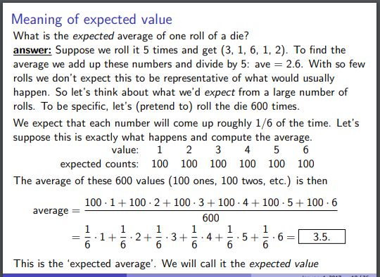
Expected value and pmf connection

Slide 12
Expected value and pmf connection

Slide 13
A Quick Glance on Variance and PMF Relation

Slide 14
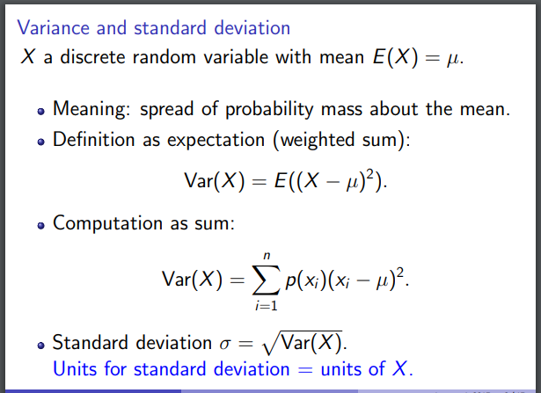
Formulas

Slide 15
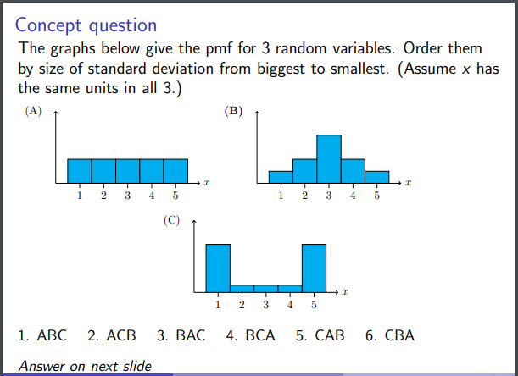
An example

Slide 16
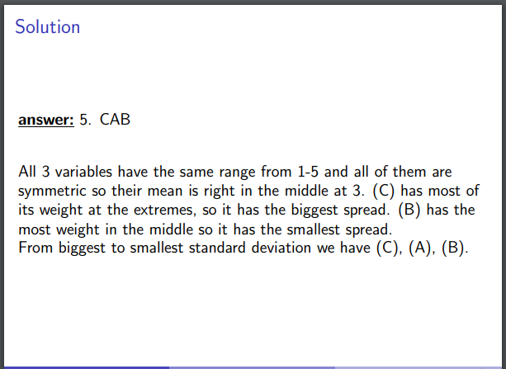
The Solution

Slide 17
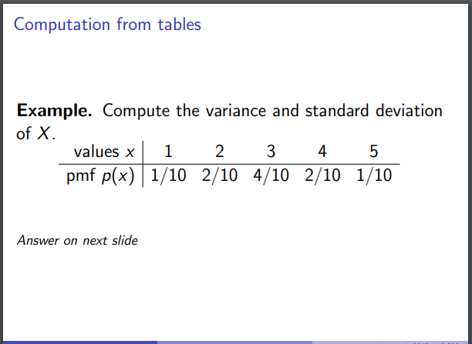
An example

Slide 18
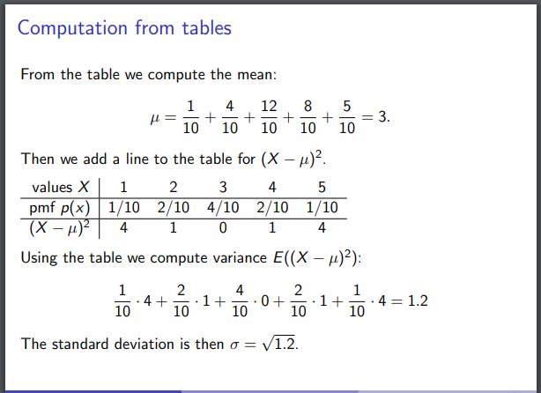
The Solution

Slide 19
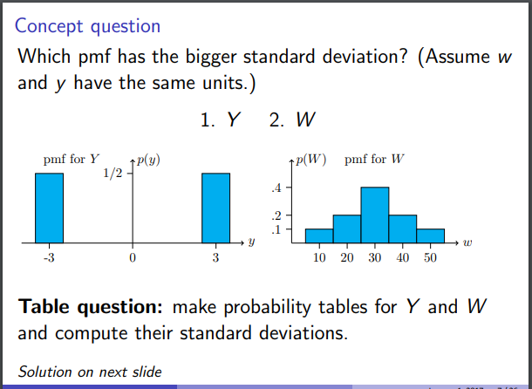
An example

Slide 20
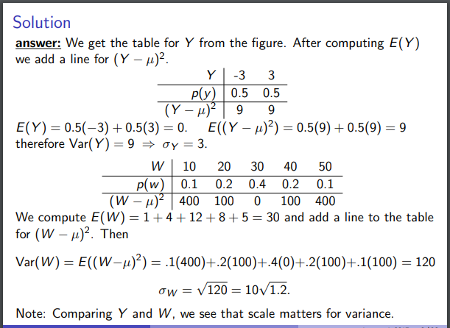
The Solution

Slide 21
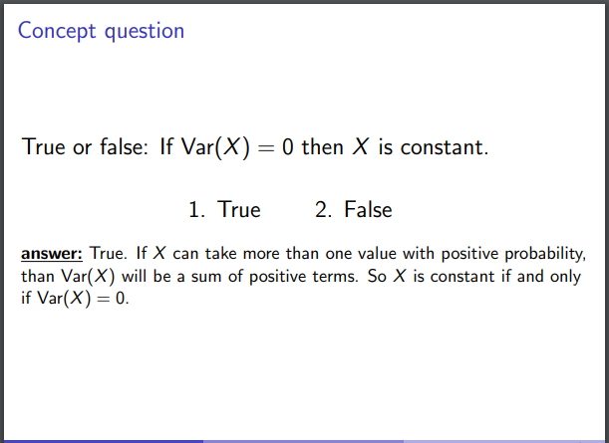
The Solution

