Slide 1
Fall 2021_2022
DATS 501 Fundamentals of Data Science
Hasan Demirtaş
hasan.demirtas@yeditepe.edu.tr (hdemirtas.academic@gmail.com)

Slide 2
Conditional Probability

Slide 3
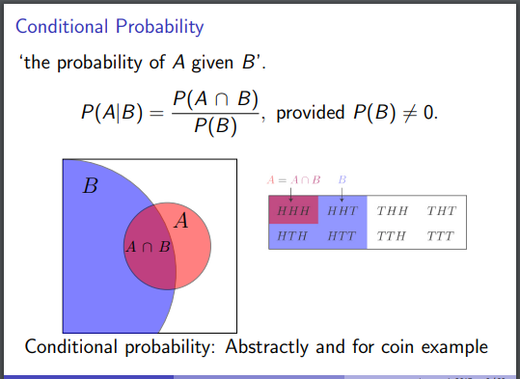
Conditional Probability

Slide 4
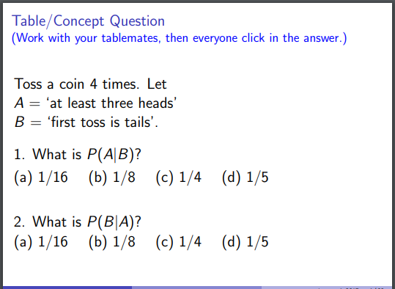
Conditional Probability

Slide 5
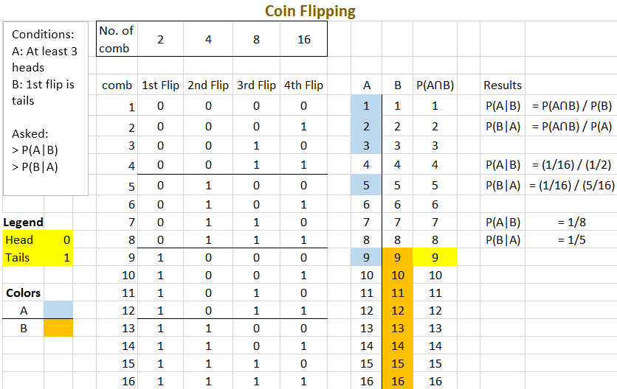
Conditional Probability

Slide 6
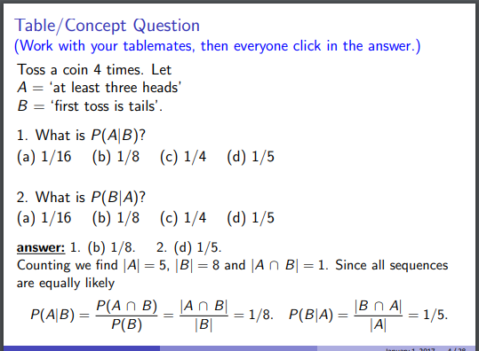
Conditional Probability

Slide 7
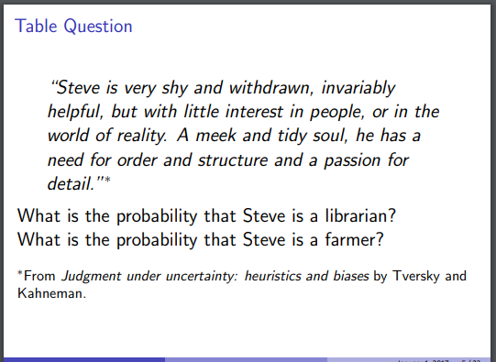
Importance of prior probability

Slide 8
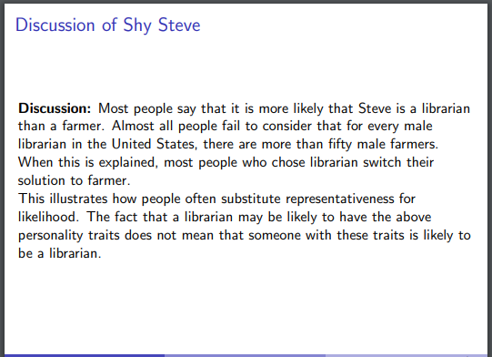
Importance of prior probability

Slide 9
A Quick Glance on Probability Distribution Function & Cumulative Distribution Function

Slide 10
Density vs Mass
When the distribution is continuous, density is used
When the distribution is discrete, mass is used

Slide 11
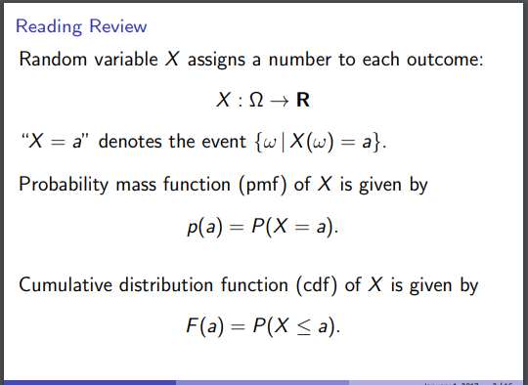
Probability Mass Function & Cumulative Distribution Function

Slide 12
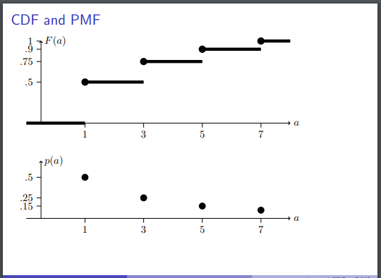
PMF & CDF

Slide 13
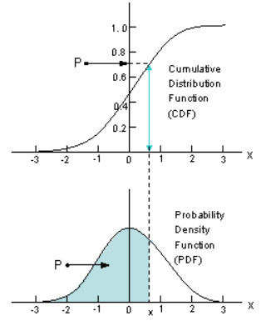
PDF & CDF

Slide 14
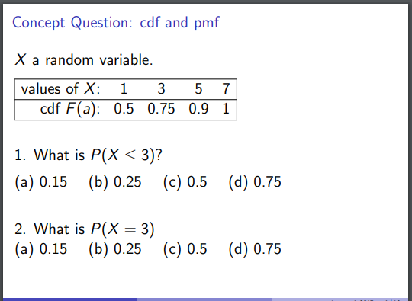
An example

Slide 15
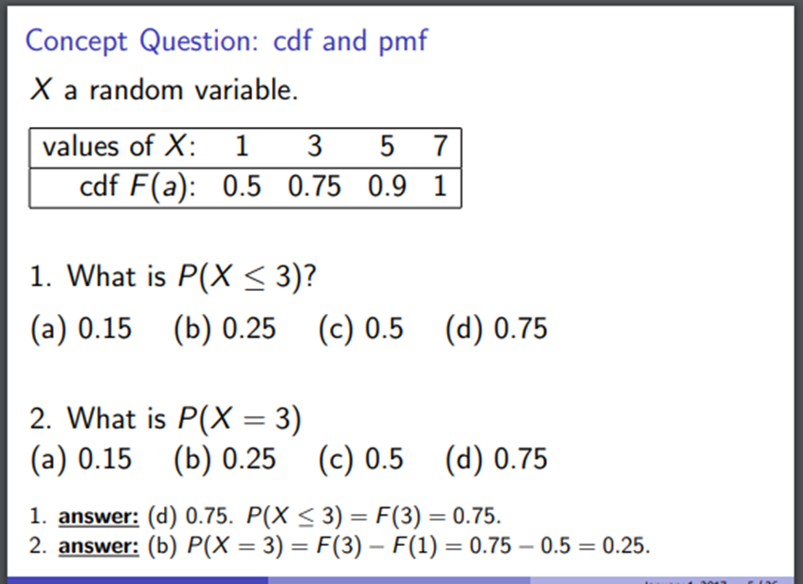
Solution

Slide 16
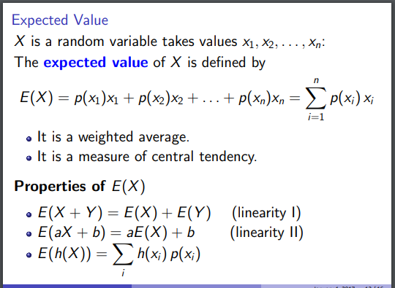
Expected value and pmf connection

Slide 17
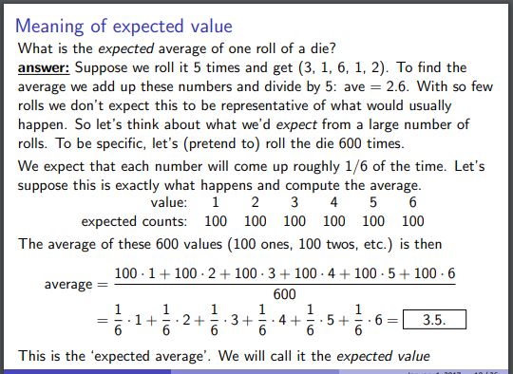
Expected value and pmf connection

Slide 18
Expected value and pmf connection

Slide 19
A Quick Glance on Variance and PMF Relation

Slide 20
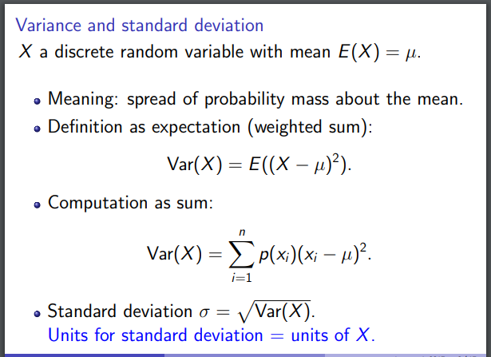
Formulas

Slide 21
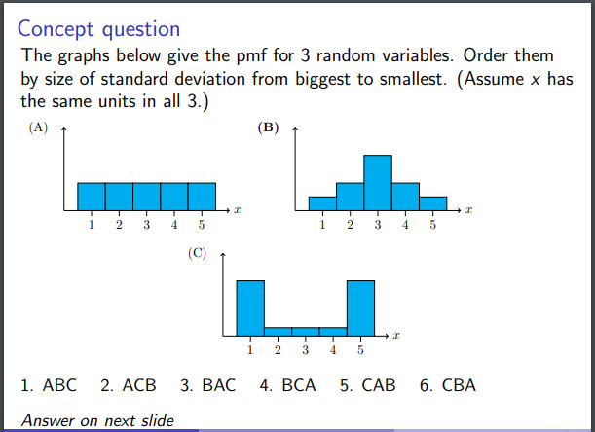
An example

Slide 22
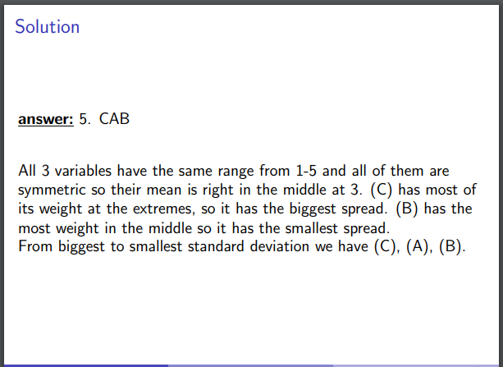
The Solution

Slide 23
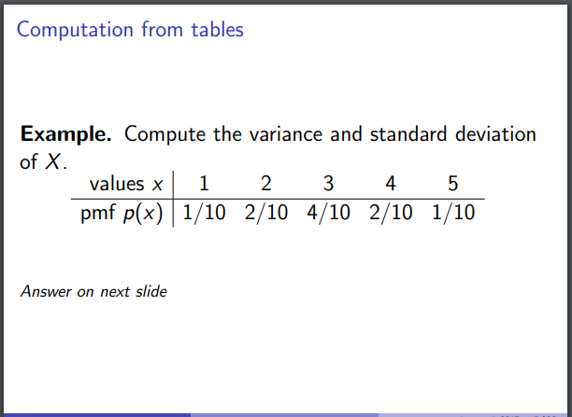
An example

Slide 24
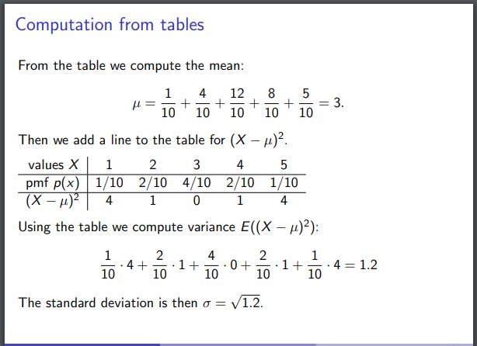
The Solution

Slide 25
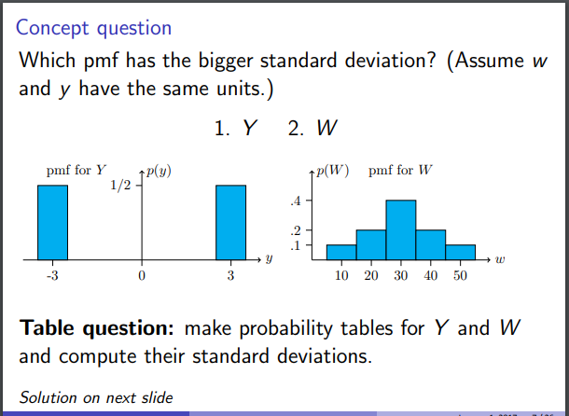
An example

Slide 26
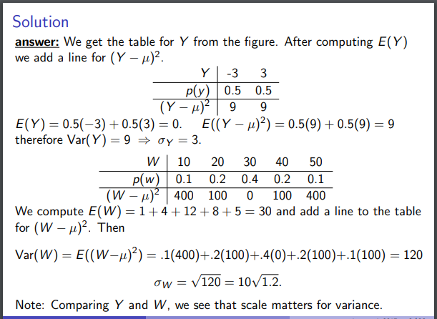
The Solution

Slide 27
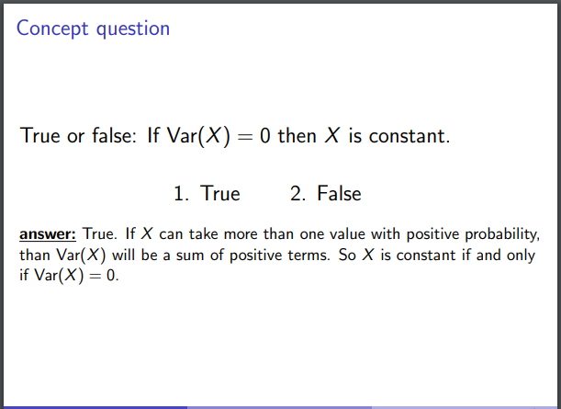
The Solution

Slide 28
Covariance

Slide 29
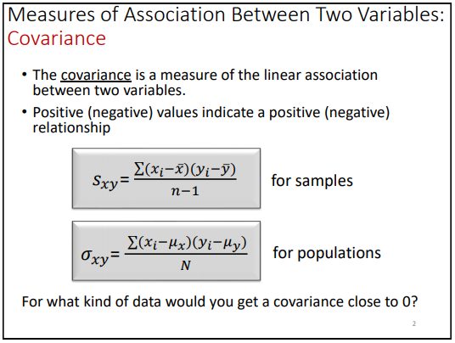
Covariance

Slide 30
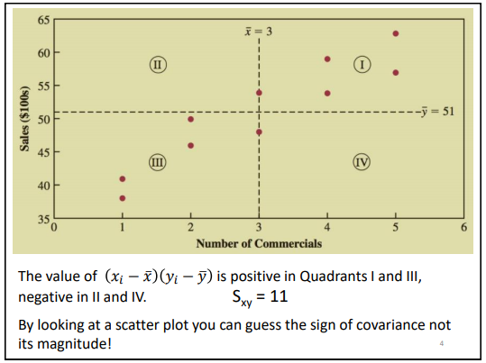
Covariance

Slide 31
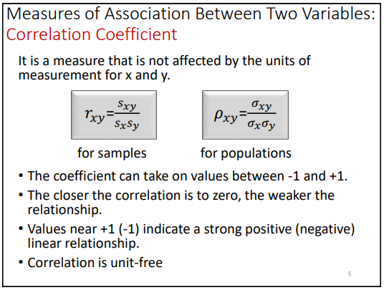
Correlation Coefficient

Slide 32
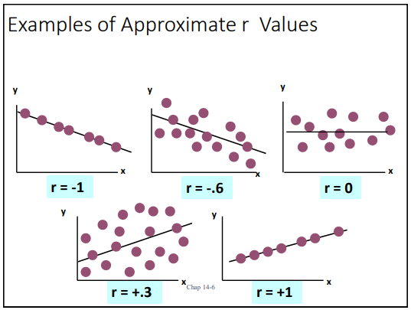
Correlation Coefficient

Slide 33
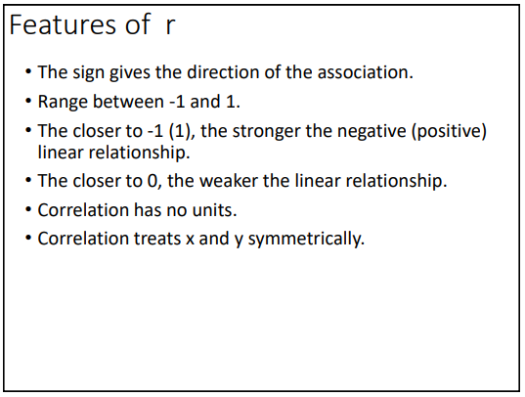
Correlation Coefficient

Slide 34
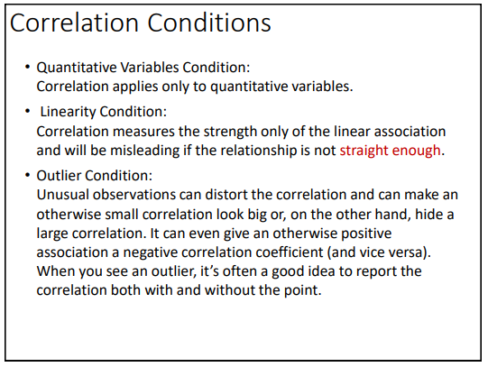
Correlation Coefficient

Slide 35
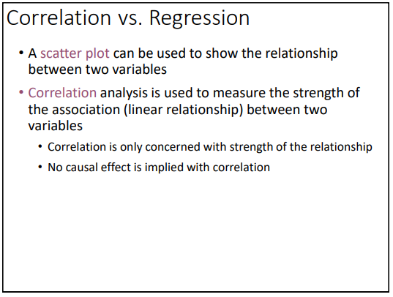
Correlation Coefficient

