Slide 1
Developments of a Simple Model to Elucidate the Shape of
Enveloped Viruses: Motivated by Monkeypox and SARS-CoV-2
Hua Deng
Mentor: Prof. Chwen-yang Shew

Slide 2
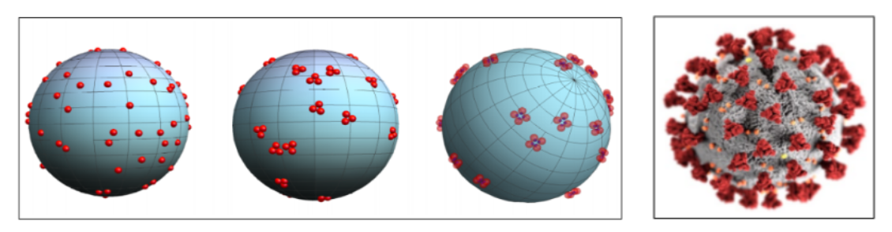
Motivation
Figure 1 Left image: Simulation of the SARS-CoV-2 spike protein on a spherical surface, illustrating the progression from randomly distributed monomers (left) to trimer (center) and tetramer (right) formations. Right image: SARS-CoV-2 for Covid-19 schematic image (CDC Public Health Image Library)
Previously, we investigated how spherical monomers self-organize into dimers, trimers, and tetramers on spherical surfaces, inspired by the trimeric spike proteins found in COVID-19 viruses. Using Monte Carlo simulations with an anistropic attraction and excluded volume repulsion between monomers, we identified the conditions that trimer formation becomes a favorable process. Both interaction energy form and interaction strength are crucial to surpass the entropically favorable dimers. By adjusting the angular part of the anistropic interaction, tetramers become the major specie. The simulated trimers are consistent with observations from cryo-electron microscopy of SARS-CoV-2 spike proteins.
Building on the foundation of previous studies, we intend to develop a simple coarse-grained model with minimal parameters to elucidate how the interplay between the membrane and genome regulates the shape of viruses. The goal of this approach is to provide deeper thermodynamic insights into viral interior organization at molecular and larger length scales, the mutual influence between the membrane and genome, and the internal pressure created by genome, with knowledge that could inform the development of new antiviral strategies.

Slide 3
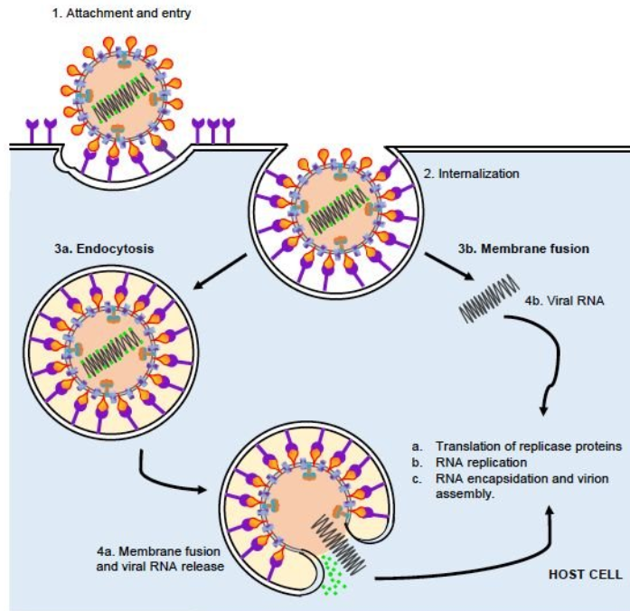
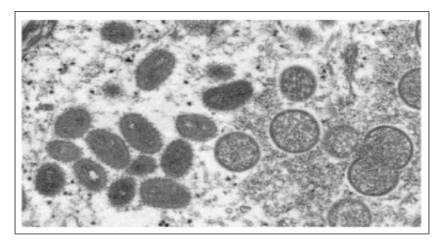
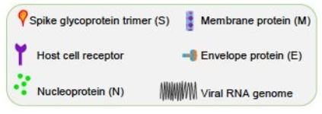
Goal
Figure 2 Electron microscopic (EM) image for Monkeypox virus particles. Oval-shaped virus particles are mature, and spherical particles are immature virions.[6]
First: our goal is to develop models and simulations combining polymer and liquid-state physics to study how viral genome properties—shape, length, and flexibility—influence membrane morphology. By simulating genome behavior in confined spaces, we want to know the viral assembly and stability, informing strategies to prevent and treat infections like Monkeypox and SARS-CoV-2.
Figure 3 The virus attaches to the target host cell via interaction between the viral S protein and target cell receptor.
Second: understanding internal pressure in the virus uncovers how they inject their genomes into host cells. Packaging builds up pressure that drives genome to release rapidly. Studying this process may lead to antiviral strategies targeting genome packaging, inspire virus-like drug delivery systems, improve vaccine design, understand nucleic acids under extreme conditions.

Slide 4
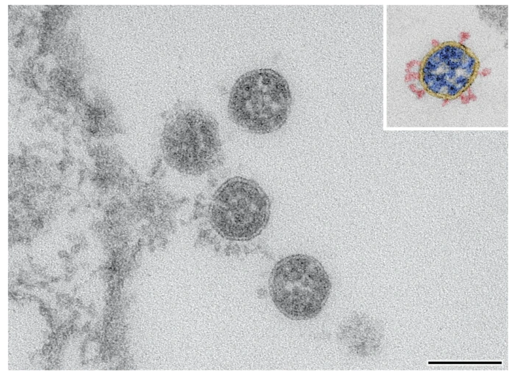
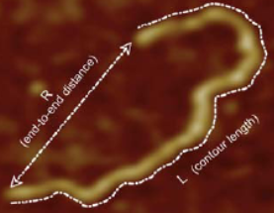
Background
Monkeypox virus has a ∼ 190 kb double-stranded DNA genome with a contour length of ~3000 nm, much larger than the ∼ 250 nm virus particle.[4][5]
Immature Monkeypox viruses are spherical, while mature forms show oval.
Contour length
Mature
Spherical
Immature
Figure 6. Electron microscopic (EM) image for Monkeypox virus particles. Oval-shaped virus particles are mature, and spherical particles are immature virions.[6]
Figure 7. Determination of the contour length and the end-to-end distance for an isolated DNA. [23]
Figure 8. Four SARS-CoV-2 particles imaged by transmission electron microscopy at 135,000x magnification, positioned near the Vero cell surface on the left. The inset displays a color-coded particle with spikes in red, the viral membrane in yellow, and the ribonucleoprotein in blue. Scale bar = 100 nm.[22]
In contrast, SARS-CoV-2 has a ~30 kb single RNA and with a contour length of ~1400 nm. . Virus particles are spherical and smaller with size of 80 – 120 nm.

Slide 5
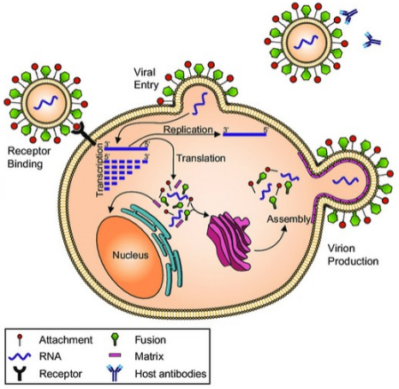
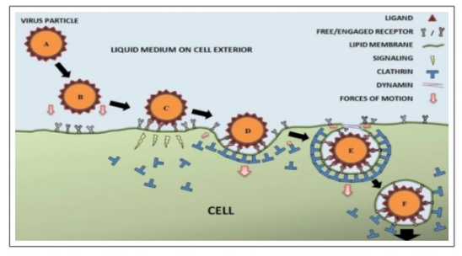
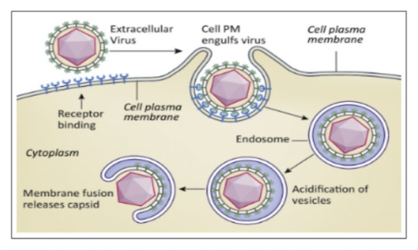
Background
Figure a) Illustration of the steps of virus
entry via clathrin-mediated endocytosis.
(A) Virus approaches the cell surface. (B)
Biochemical interactions between ligands
and receptors attract virus to the cell
surface. (C) Virus attaches to the cell
surface and signals the cell. (D) A
clathrin-coated pit is formed around the
bound virus. (E) A clathrin-coated vesicle
is formed, and the dynamin at the neck
region facilitates vesicle scission. (F) The
vesicle travels to the cell interior
(b) Membrane fusion.
Many viruses, both enveloped and
unenveloped, are brought into cells by
endocytosis. The low pH environment in the endosome triggers molecular
rearrangements of capsid or envelope
proteins. In this example, an enveloped
virus is fusing with an endosomal
membrane to release the capsid into the
cytosol.
Diagram of the viral life cycle. Virions bind to host
cell receptors (black), facilitating viral entry into the cell. Once within the cell, transcription and
replication occur. This allows the production of viral proteins, which are processed and trafficked through the cell using host cell machinery (endoplasmic reticulum and Golgi apparatus). Viral proteins and RNA are packaged into new virions, which are then released from the cell. These virions can then interact with the host immune system.

Slide 6
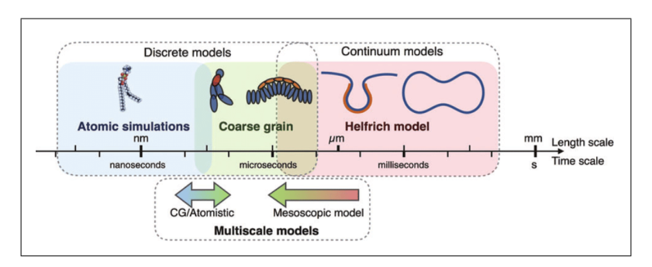
Techniques
As shown in Figure 6, these two approaches, namely discrete and continuum approaches.
(1) Discrete models:
For many molecular-level processes, such as protein folding, ion transport, or short biomolecular interactions with time scale of nanoseconds to microseconds, and tens to hundreds of nanometers are often sufficient and appropriate.
Figure 6. Different computational methods developed to study membrane and genome are valid in different length and time scales[14]
(2)Coarse-Grained Models (CGM):
It simplifies complex systems by grouping atoms or molecules into larger particles called beads. This allows for large-scale simulations at low computational cost and supports the identification of minimal-parameter models.
(3)Continuum models:The accuracy of the continuum model relies on its physically relevant parameters. Continuum approaches can be used to represent geometries at the cellular scale. Besides treating solvents as dielectric continuum, the continuum models in this work exclude molecular details like lipid composition, phase transitions, and specific atom interactions, and cannot capture small atom-scale fluctuations. However, it efficiently studies large-scale membrane shapes and mechanics, capturing bending and tension without high computational cost. (Note that phase transitions have been argued as a possible driving force to induce cellular self-organization.)

Slide 7
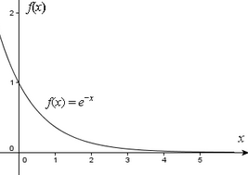
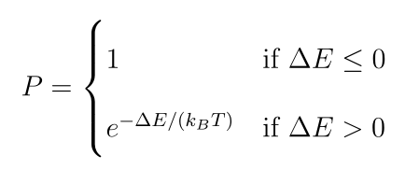

Techniques
Monte Carlo Simulation (MC)
The Metropolis acceptance probability P is defined as:
Metropolis rule:
This is a key expression in the Metropolis algorithm, often used in Monte Carlo simulations, to determine the acceptance probability of a proposed move in a system. P : Probability of accepting the proposed move; if accepted, positions update, otherwise the move is reverted. ∆E: Energy change from the move (Enew − Eold ). β: Inverse temperature factor, β = 1/(kB T ), from the Boltzmann distribution. If ∆E ≤ 0, the move is always accepted (P = 1) since it means a lower-energy, more favorable state.

Slide 8
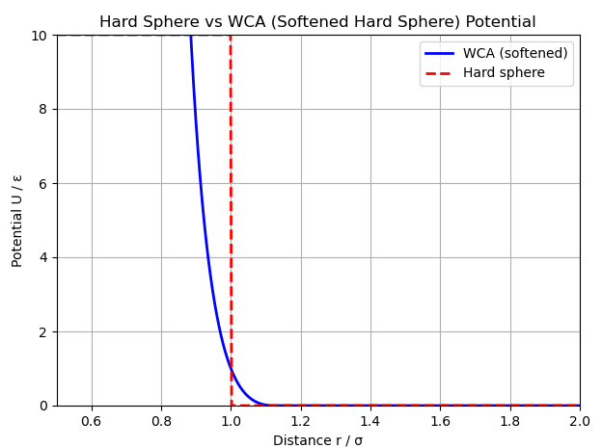
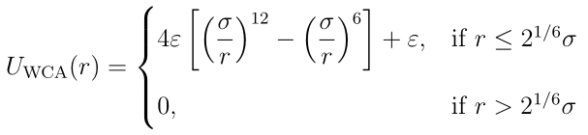
Excluded volume
Excluded volume is a key component of coarse-grained (CG) modeling, ensuring that two particles cannot occupy the same space. Without it, particles may overlap or penetrate each other, causing unphysical behavior. To incorporate excluded volume effects, repulsive interaction potentials—such as the Lennard-Jones potential—are commonly used. This equation represents an excluded volume interaction using the Weeks–Chandler–Andersen (WCA) potential. WCA is a softened version of the hard sphere potential,which is derived from the Lennard–Jones potential but truncated and shifted at its minimum (rc=2^{1/6}σ).It is commonly used in coarse-grained simulations (like polymers or DNA beads).
r is the distance between two particles,
ϵ is the depth of the potential well (sets energy scale),
σ is the particle diameter (distance scale),
rc = 2^{1/6} σ is the cutoff distance at the potential minimum.
For r < rc , the potential sharply rises to strongly repel particles as they get too close.
For r > rc , the potential is zero — no interaction beyond the cutoff.

Slide 9
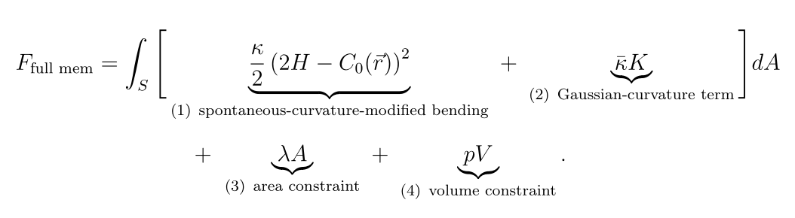
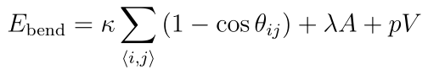
Methods
Helfrich-Canham Model for membrane
(1)Analytical Form for the total free energy of a closed lipid bilayer:
(2)The full mathematical version of the membrane model includes extra terms that make it match real membranes more closely. But to use it, you’d have to measure the mean curvature H or Gaussian curvature K at many points on the surface. If moving even one point (vertex) in the surface mesh, we must recalculate a lot of things — like the surface’s slopes, curvatures, and the total area or volume — over many surrounding triangles. This makes each step in the simulation slow and costly. The angle-based version avoids most of that work. It only needs to update the parts directly connected to the moved point, so each Monte Carlo step is much quicker.
(2)Discrete angle-based form used for simulations
κ is the bending rigidity,
θij is the angle between adjacent triangles sharing edge ⟨i, j⟩.
(1)The Helfrich-Canham model doesn’t capture the details of lipid composition or molecular shape, local lipid phase transitions, specific molecular interactions, or fluctuations below the coarse-grained scale,but it does capture large-scale bending deformations, the effects of spontaneous curvature, membrane elastic properties, shape transitions and the response to pressure, tension, and curvature.

Slide 10
Analytical Model
κ : bending rigidity
κ̄ : Gaussian modulus
K : Gaussian curvature = c1 ∗ c2
H : mean curvature = (c1 + c2 )/2
c1 , c2 : principal curvatures at a point on the surface
C0 : spontaneous curvature
A : total surface area
λ : Lagrange multiplier for area constraint (surface tension)
P : Lagrange multiplier for volume constraint (pressure)
V : Enclosed volume
dA : Area element on the surface
(2H − C0 )² : A spontaneous-curvature term for local bending preferences.
κ̄K : A Gaussian-curvature term for energy changes.
The Gaussian curvature term measures how the surface bends in two perpendicular directions at the same point and multiplies them together.
If both bends go the same way (like the top of a sphere), it’s positive.
If the bends go opposite ways (like a saddle), it’s negative.
If the surface is flat in at least one direction (like a cylinder), it’s zero.
Membranes have almost fixed area and volume. They don’t stretch easily and don’t compress or expand much inside. That’s why we add area and volume constraints — to keep the membrane’s surface area and enclosed volume nearly constant during deformation

Slide 11
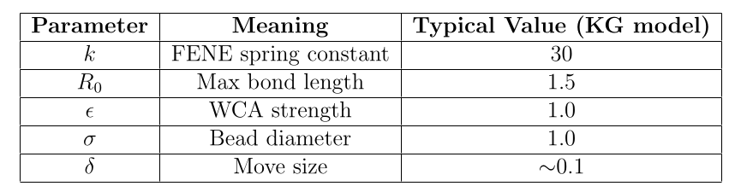
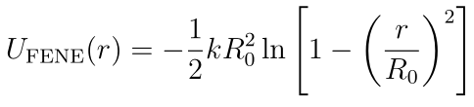
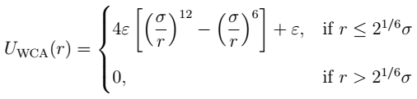
Method
Kremer–Grest Bead-Spring Model for genome
(1)FENE potential(Finitely Extensible Nonlinear Elastic) for bonded interactions. Finitely Extensible Nonlinear spring keeps beads connected but prevents them from stretching too far Elastic or breaking
(2) WCA potential, a purely repulsive form of the Lennard-Jones (LJ) potential for excluded volume (non-bonded interactions).
r is the distance between two particles,
ϵ is the depth of the potential well (sets energy scale),
σ is the bead diameter (distance scale),
rc = 2^{1/6} σ is the cutoff distance at the potential minimum.
For r < rc , the potential sharply rises to strongly repel beads as they get too close.
For r > rc , the potential is zero — no interaction beyond the cutoff.

Slide 12
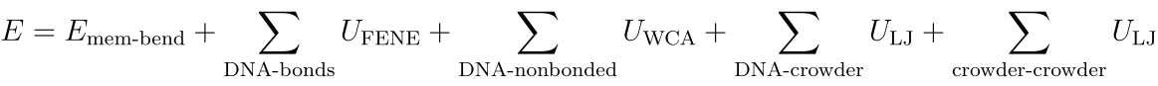
Methods
Simple Liquid Models for Crowders (organelles)
Membrane bending energy
This term comes from the Helfrich–Canham bending energy (continuum model) describing the shape and fluctuations of the lipid membrane.
DNA terms:
(1)Bonded DNA interactions
FENE (Finite Extensible Nonlinear Elastic) potential connects beads in a chain.
(2)Excluded volume between DNA beads
WCA is a purely repulsive potential (softened hard sphere).
DNA–crowder (organelles) interactions:
Lennard-Jones potential accounts for both repulsion and mild attraction between DNA beads and crowder particles (organelles).
Crowder–crowder interactions:
LJ potential governs the interactions among the crowders themselves.

Slide 13
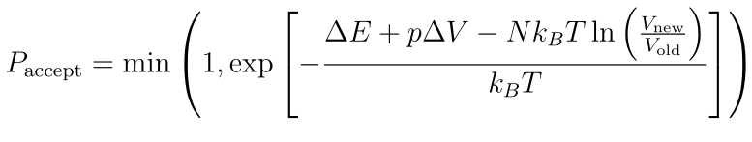

Ensemble Settings
(1) NPT (Isothermal–Isobaric Ensemble):
(1)Average volume will be calculated and plotted against pressure by running several P values.
(2)Plot volume V against Monte Carlo step to check whether the volume has equilibrated and remains stationary at the target pressure P and temperature T
(3)Plot volume and energy fluctuations over time will be examined to assess stability and equilibration
(2) NVT (Canonical Ensemble)
(1)Plot the instantaneous Pinst against Monte Carlo step to confirm the stability of the system’s thermodynamic properties.
(2)Plot the total E against Monte Carlo step to verify that the system has equilibrated and remains stable under fixed N, V, and T conditions.

Slide 14


Pressure of genome inside membrane
Pressure Calculation by Theoretical Model
R is the radius of capsid/membrane
ξ is the persistence length of DNA
N (r) is the number of loops of DNA at a distance r from the spool axis
r is the radial distance from the central axis of the spool. The spool axis is the straight line
Pressure Calculation by Primitive Model
σ: Each bead’s diameter
ρ(z): hard-sphere fluids at hard walls the pressure normal to the wall density only along the z-direction
L: the slit width

Slide 15
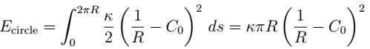

2D dimension
If the viral membrane forms a circular shape(a = b), energy of membrane:
If the viral membrane takes an elliptical shape(a ‡ b), energy of membrane:

Slide 16
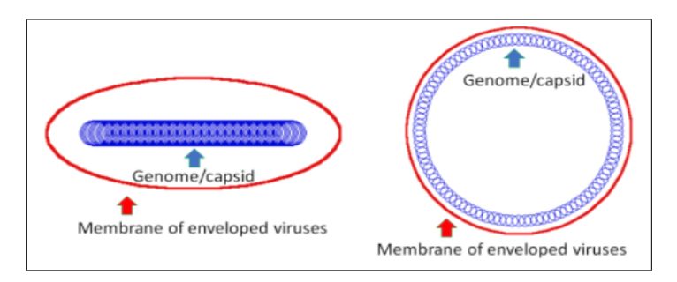
Expectation
(1)A rod-like genome induces
an elliptic shape whereas a circular genome leads to a circular shape
(2)In simulations of genome translocation through a narrow membrane slit, the pressure normal to the slit walls calculated using the contact
theorem in the Primitive Model—based on the bead density at the slit surface—will agree with the pressure predicted by the Theoretical Model.

Slide 17
Projected timeline
Months 0-3: Fine-tune the continuum membrane model.
Months 4-6: Investigate competition among different membrane shapes.
Months 7-9: Study chain model and crowding effect
Months 10-12: Expand the developed models from 2D to 3D.

Slide 18
Reference
[1] Zhenhao Ke, Jose Oton, Kun Qu, Marcella Cortese, Vedran Zila, Liam McKeane, Takanori Nakane, Jasenko Zivanov, Christopher J Neufeldt, Bastian Cerikan, Jianmin M Lu, Julian Peukes, Xiaoli Xiong, Hans-Georg Kräusslich, Sjors H. W. Scheres, Ralf Bartenschlager, and
John A. G. Briggs. Structures and distributions of sars-cov-2 spike proteins on intact virions. Nature, 588(7838):498–502, December 2020. Epub 2020 Aug 17.
[2] Centers for Disease Control and Prevention (CDC). Sars-cov-2 illustration. https://www.cdc.gov/museum/timeline/covid19.html, n.d. Accessed April 18, 2025.
[3] Naoki Nakatani, Hiroshi Sakuta, Makoto Hayashi, Shunsuke Tanaka, Kohei Takiguchi, Kouhei Tsumoto, and Kenichi Yoshikawa. Specific spatial localization of actin and dna in a water/water microdroplet: Self-emergence of a cell-like structure. Chembiochem, 19(13):1370–1374, 2018.
[4] Nir Erez, Hagit Achdout, Einat Milrot, Yaron Schwartz, Yonit Wiener-Well, Nir Paran, Boaz Politi, Haim Tamir, Tomer Israely, Sharon Weiss, Adi Beth-Din, Orli Shifman, Ohad Israeli, Shmuel Yitzhaki, Shaul C Shapira, Shay Melamed, and Eli Schwartz. Diagnosis of imported
monkeypox, israel, 2018. Emerging Infectious Diseases, 25(5):980–983, May 2019.
[5] Shane Parker, Andrea Nuara, R Mark Buller, and David A Schultz. Human monkeypox: an emerging zoonotic disease. Future Microbiology, 2(1):17–34, Feb 2007.
[6] Cynthia S Goldsmith and Russell Regnery. Monkeypox virus particle. Public Health Image Library, Centers for Disease Control and Prevention, 2003. Image ID: 22664.
[7] Yinon M Bar-On, Avi Flamholz, Rob Phillips, and Ron Milo. Sars-cov-2 (covid-19) by the numbers. Elife, 9:e57309, Apr 2020.
[8] Lei Wu, Wenhui Zhou, Lihua Lin, Anhong Chen, Jing Feng, Xiangmeng Qu, Hongbo Zhang, and Jun Yue. Delivery of therapeutic oligonucleotides in nanoscale. Bioactive Materials, 7:292– 323, 2022.

Slide 19
Reference
[9] Emily Barrow, Anthony V. Nicola, and Jun Liu. Multiscale perspectives of virus entry via endocytosis. Virology Journal, 10:177, 2013.
[10] Susan Payne. Viruses: From Understanding to Investigation. Elsevier, 2nd edition, 2022.
[11] A. Brandariz-Nuñez, T. Liu, T. Du, and A. Evilevitch. Pressure-driven release of viral genome into a host nucleus is a mechanism leading to herpes infection. eLife, 8:e47212, 2019.
[12] Kurt Kremer and Gary S. Grest. Dynamics of entangled linear polymer melts: A molecular-ynamics simulation. The Journal of Chemical Physics, 92(8):5057–5086, 1990.
[13] Ralf Everaers, Ali Karimi, Frank Fleck, Nils Hojdis, and Carsten Svaneborg. Kremer–grest models for commodity polymer melts:
Linking theory, experiment, and simulation at the kuhn scale. Macromolecules, 53, 2020.
[14] Morgan Chabanon, Jeanne C. Stachowiak, and Padmini Rangamani. Systems biology of cellular membranes: a
convergence with biophysics. Wiley Interdisciplinary Reviews: Systems Biology and Medicine, 9(5), sep 2017. Epub 2017 May 5.
[15] BYJU’S. Chromatin. https://byjus.com/biology/chromatin/, n.d. Accessed: 2025-05-14.
[16] Ludvig Lizana and Yuri B. Schwartz. The scales, mechanisms, and dynamics of the genome architecture. Science Advances, 10(15):eadm8167, April 2024. Epub 2024 Apr 10.
[17] Patricia Bassereau, Benjamin Sorre, and Anne Lévy. Bending lipid membranes: Experiments after w. helfrich’s model.
Advances in Colloid and Interface Science, 208:47–57, June 2014. Epub 2014 Feb 11.
[18] Gerhard Gompper and D M Kroll. Triangulated-surface models of fluctuating membranes. Journal of Physics:
Condensed Matter, 9(42):8795–8834, 1997.
[19] S. Harish, M. Murugan, M. Kannan, S. Parthasarathy, S.R. Prabhukarthikeyan, and K. Elango. Entomopathogenic viruses. In Microbial Approaches for Insect Pest Management, pages 1–57. Springer, 2021.

Slide 20
Reference
[20] Paul Grayson, Alex Evilevitch, Mandar M. Inamdar, Prashant K. Purohit, William M. Gelbart, Charles M. Knobler, and Rob Phillips. The effect of genome length on ejection forces in bacteriophage lambda. Virology, 348(2):430–436, 2006.
[21] Horst L. Vörtler and Matthias Kettler. Monte carlo simulation of pore systems: primitive
model of water in slit-like pores. Chemical Physics Letters, 266(3–4):368–374, 1997.
[22]Hoffmann, T., Michel, J., Nitsche, A. et al. Electron microscopy images and morphometric data of SARS-CoV-2 variants in ultrathin plastic sections. Sci Data 11, 1322 (2024). https://doi.org/10.1038/s41597-024-04182-3
[23]S. Mantelli, Pierre Muller, Sebastien Harlepp, Mounir Maaloum. Conformational analysis and estimation of the persistence length of DNA using atomic force microscopy in solution. Soft Matter, 2011, 7 (7), pp.3412. ⟨10.1039/c0sm01160f⟩. ⟨hal-04846185⟩
[24]Willows, Steven & Alam, Syed Benazir & Sandhu, Jagdeep & Kulka, Marianna. (2020). A Canadian perspective on severe acute respiratory syndrome coronavirus 2 infection and treatment: how prevalent underlying inflammatory disease contributes to pathogenesis (Accepted for publicaiton). Biochemistry and Cell Biology.

