Slide 1


Modeling and Simulation of the Shape and Interior Pressure of Enveloped Viruses:
Motivated by Orthopoxviruses and Coronaviruses
Hua Deng
Department of Chemistry
College of Staten Island, Staten Island, NY 10314

Slide 2
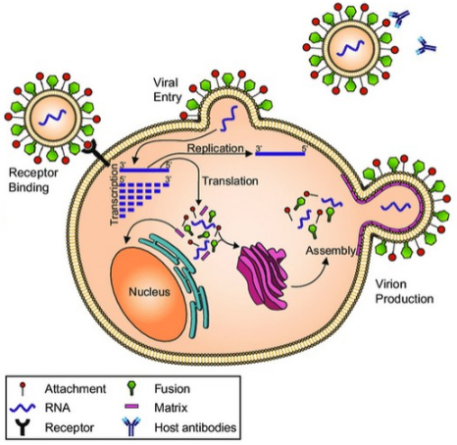
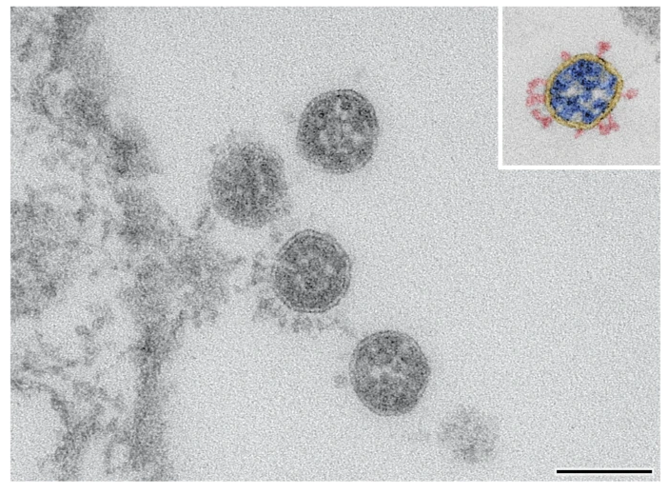
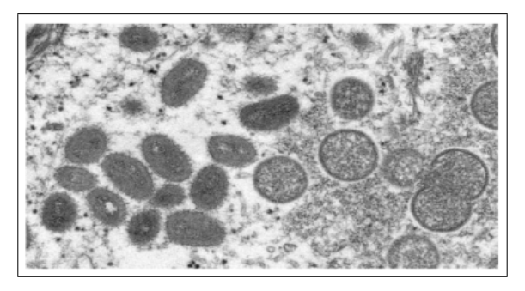
Introduction
Figure 1 SARS-CoV-2 particles
Figure 3 Monkeypox virus particles
Figure 3 Diagram of the viral life cycle.
Notes:
Viral infections have a significant impact on global health, driving pandemics. Enveloped viruses, such as Monkeypox virus and SARS-CoV-2, are surrounded by lipid membranes that protect their genomes and facilitate infection through interactions with host-cell receptors. Understanding these mechanisms is essential for developing effective antiviral treatments.
Virions are acellular particles lacking cellular structures such as organelles.
Left figure: Electron microscopy image of SARS‑CoV‑2 particles, showing roughly spherical virions with surface spike proteins.
Right figure: Electron microscopy image of Monkeypox virus particles, with a larger, brick- or oval-shaped and rounded morphology.
Middle figure: Schematic diagram of the viral life cycle, illustrating virus attachment, entry, genome release, replication, assembly, and release of new virions from the host cell.

Slide 3
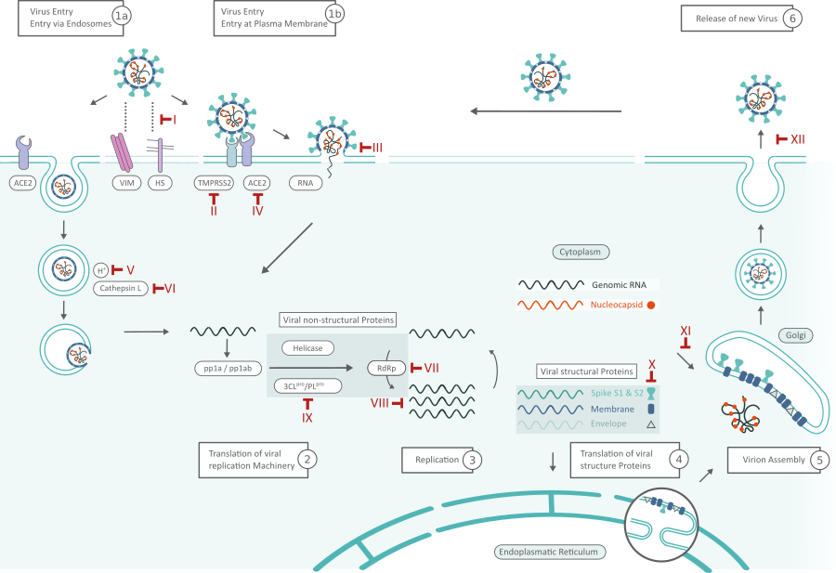
Introduction
Figure 4 SARS-CoV-2 particles
Notes:
This diagram shows the life cycle of an enveloped virus inside a host cell, from entry to the release of new virus particles.
The virus first attaches to the cell surface and enters the cell. Once inside, it releases its genetic material into the cytoplasm. The host cell then reads this genetic information and quickly begins producing viral proteins. These early proteins help copy the viral genome and generate the components to build new viruses.
Structural proteins are produced inside the cell and transported through the cell’s internal membrane system, where they assemble together with the viral genome to form new virus particles. Finally, the newly formed viruses are packaged and released from the cell, allowing them to infect neighboring cells and continue the infection process.

Slide 4
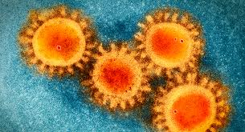
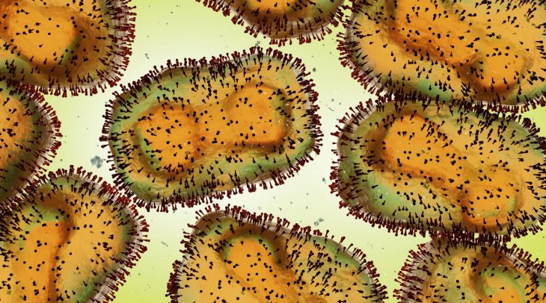
Introduction
Figure 5 Coronaviruses. Colorized transmission electron micrograph (TEM) of SARS-CoV-2, the coronavirus that causes COVID-19. The round particles with a fuzzy outer edge show the spike (S) glycoproteins projecting from the viral envelope.
Figure 6 Orthopoxviruses. Colorized transmission electron micrograph highlighting the brick-shaped morphology and surface structures of mature virions.
Figure 7 Four SARS-CoV-2 particles imaged by transmission electron microscopy at 135,000x magnification, positioned near the Vero cell surface on the left. The inset displays a color-coded particle with spikes in red, the viral membrane in yellow, and the ribonucleoprotein in blue. Scale bar = 100 nm.[22]
Figure 8. Electron microscopic (EM) image for Monkeypox virus particles. Oval-shaped virus particles are mature, and spherical particles are immature virions.[6]
Notes:
This slide compares the shapes of two very different viruses: SARS-CoV-2 and Orthopoxviruses such as Monkeypox.
On the top left, we see transmission electron microscopy images of SARS-CoV-2. These viruses are mostly spherical. The fuzzy outer edge comes from spike proteins. Even at high magnification, the overall shape remains round.
On the top right, we see images of Orthopoxviruses, such as Monkeypox. These viruses are much larger and have a brick-like or oval shape. It appears more complex and structured compared to coronaviruses.
The bottom left image, For SARS-CoV-2, particles remain spherical throughout their life cycle.
The bottom right For Monkeypox, immature particles are spherical, but mature particles become elongated or oval.

Slide 5
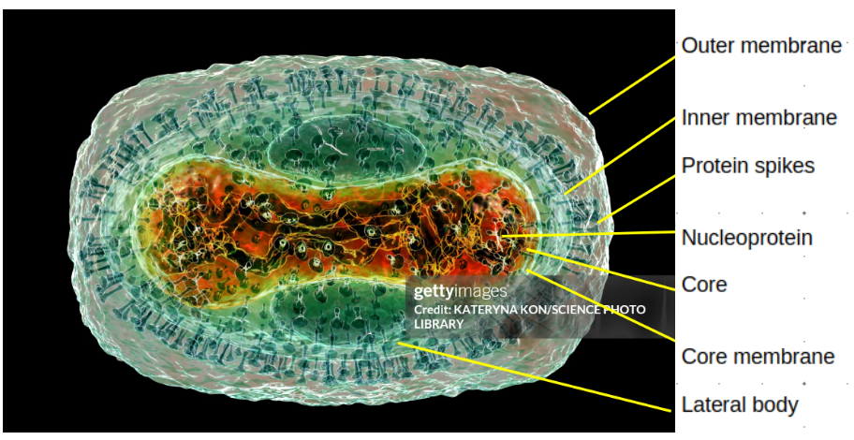
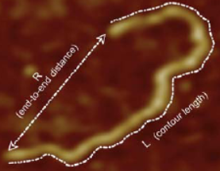
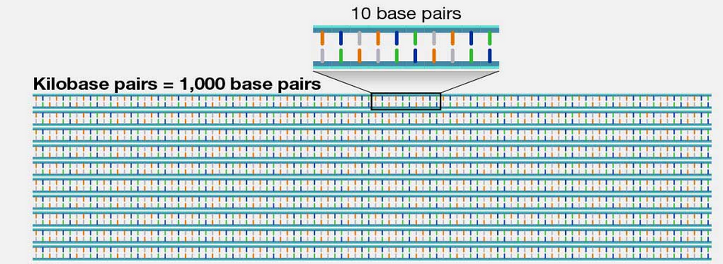
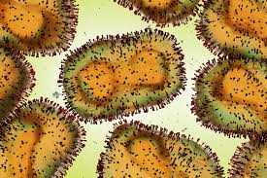
Introduction
Figure 11. A kilobase (abbreviated kb) is a unit of measurement used to help designate the length of DNA or RNA. One kilobase is equal to 1,000 bases.
Figure 9 Determination of the contour length and the end-to-end distance for an isolated DNA. [23]
Figure 10 Monkeypox virus particle, Illustration
Figure 12 Orthopoxviruses
Figure 13 Coronaviruses
Notes:
Orthopoxviruses are DNA viruses containing about 200 kilobase pairs of double-stranded DNA on average, forming a rigid, elongated dumbbell morphology with a contour size of about 250 nm in length and 200 nm in width.
Coronaviruses,by contrast, are single-stranded RNA viruses with around 30 kilobase pairs and an average contour size of 50–140 nm. Their genomes are highly confined and crowded inside the capsid. As a result, they may display internal pressures ranging between 10–60 atm to facilitate genome injection into the host cell’s nucleus.

Slide 6
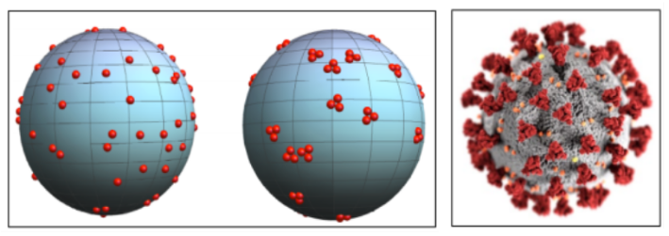
Motivation from previous Coarse-Grained Modeling and Monte Carlo simulation
Figure 14 Left image: Simulation of the SARS-CoV-2 spike protein on a spherical surface, illustrating the progression from randomly distributed monomers (Left) to trimer (Right) formations. Right image: SARS-CoV-2 for Covid-19 schematic image (CDC Public Health Image Library)
Notes:
In our previous work, we studied how spherical monomers assemble into dimers, trimers, and tetramers on curved surfaces, motivated by the trimer spike proteins of SARS-CoV-2.
We identified the interaction conditions under which trimer formation is energetically favored. This slide shows spike proteins spreading randomly at first and then coming together to form trimers on the virus surface, in good agreement with what we saw in real SARS-CoV-2 particle
Building on this work, we want to develop a simple coarse-grained model with a minimal number of parameters to understand how interactions between the viral membrane and the enclosed genome control the shape of enveloped viruses.
The goal is to gain thermodynamic insight into how genetic material is organized inside viruses,
how the genome and membrane influence each other,
how internal pressure is generated by the packed genome.
Understanding these physical mechanisms may help the development of new antiviral treatments.

Slide 7
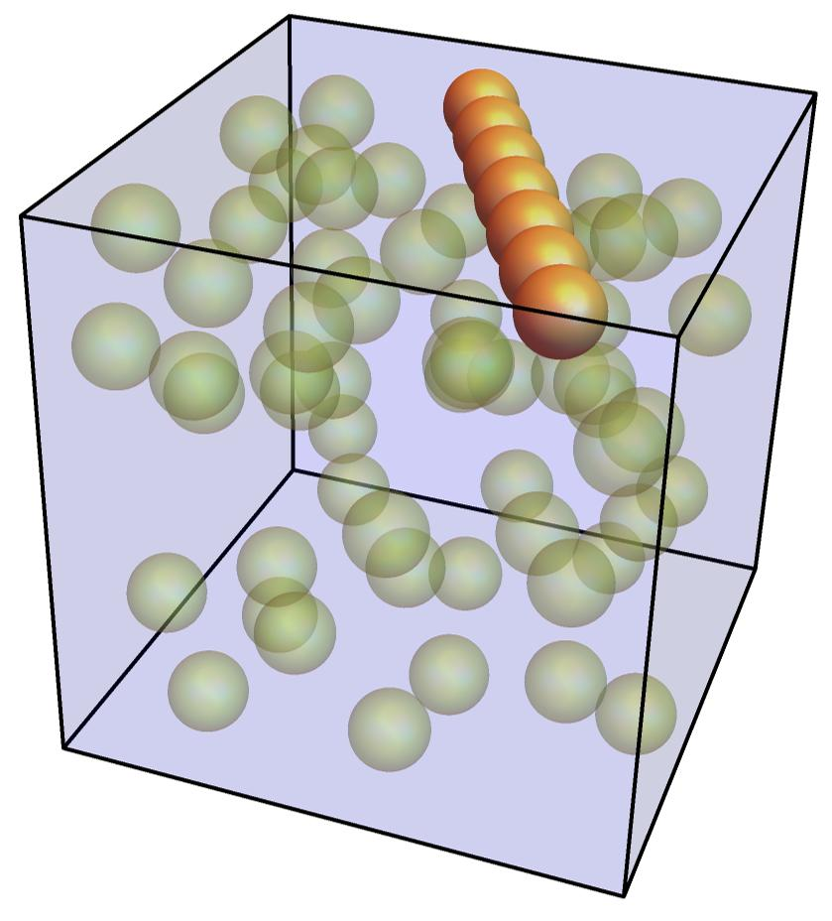
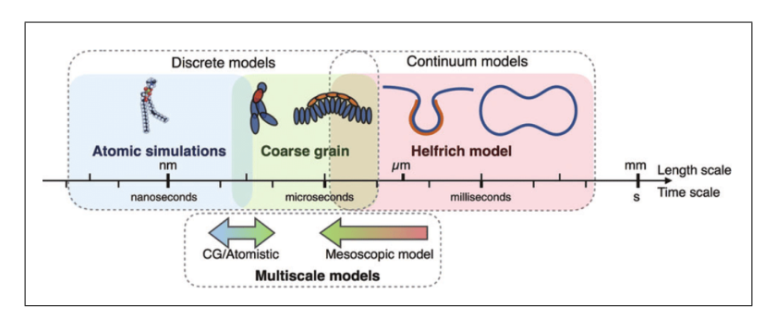
Modeling Approach
Coarse-Grained Models (CGM):
It simplifies complex systems by grouping atoms or molecules into larger particles called beads. This allows for large-scale simulations at low computational cost and supports the identification of minimal-parameter models.
Figure 15 Different computational methods developed to study membrane and genome are valid in different length and time scales.
Figure 16 Model of DNA/RNA (Orange Rod) and Organelles (Green Spheres) Confined in a Membrane (Rectangular Prism)
We use a coarse-grained model simulated by the Monte Carlo method. Combine many atoms into one bead to:
Reduce complexity
Run much faster simulations
Study large systems (genomes, membranes, polymers)
Notes:
Coarse-Grained Models (CGM):
It simplifies complex systems by grouping atoms or molecules into larger particles called beads. This allows for large-scale simulations at low computational cost and supports the identification of minimal-parameter models.
Left figure: shows how scientists use different types of models to study the same system at different sizes and time scales. At very small scales, atomistic simulations describe every atom in detail, which gives accurate information but can only be used for tiny systems and very short times. At a larger scale, coarse-grained models simplify the system by grouping many atoms together, making it possible to study bigger system and longer processes while keeping the main physical behavior. At the largest scale, continuum models treat the system as a smooth shape instead of individual particles, which is useful for understanding overall form and bending. In this work, we use a coarse-grained model to balance physical realism with computational efficiency.
Right figure: Coarse-grained representation of a confined viral interior, where the membrane is modeled as a cubic box, the genome as an orange rod, and proteins as green beads.

Slide 8
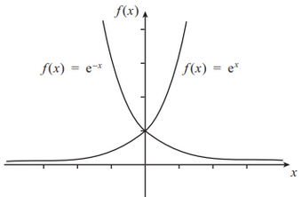
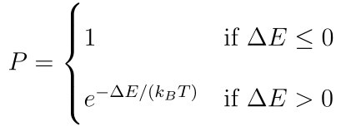

Simulation method
Monte Carlo Simulations: Using random sampling to solve math and physics problems
The Metropolis acceptance probability P is defined as:
Metropolis rule:
If ΔE<0, accept the move.
If ΔE>0, generate a random number r∈(0,1)
If r<P, accept the move.
If r>P, reject the move.
Notes:
Monte Carlo Simulations
Monte Carlo (MC) simulation uses random trial moves to study a physical system. At each step, the program slightly changes the system, such as moving one particle, and then checks whether the new configuration is physically reasonable. By repeating many steps, the system explores many possible configurations and reaches equilibrium. This allows us to calculate average properties such as energy, pressure, and structure.
Metropolis Algorithm
The Metropolis algorithm decides whether to accept a trial move. If the energy change ΔE<0, the move is always accepted. If ΔE>0, the move is accepted with probability P=exp(−βΔE) The computer generates a random number r between 0 and 1, if r<P, move is accepted, if r>p, move is rejected. By repeating this process many times, the system explores many possible configurations and gradually reaches equilibrium, allowing us to measure properties such as energy, pressure, and structure.

Slide 9

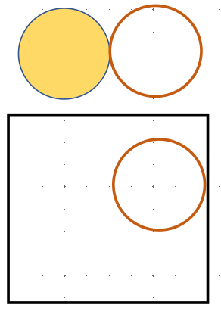

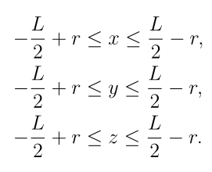
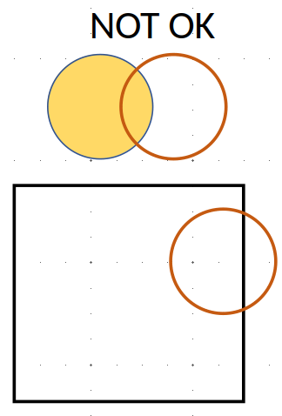
Exclude Volume
To ensure that any two particles i and j do not overlap, we compute the squared center-to-center distance
(1)
For the particles with the diameter σ, overlap is rejected by imposing the condition
(2)
(3)
(4)
(5)
Notes:
Excluded volume is a key part of coarse-grained (CG) modeling. It ensures that two particles cannot occupy the same space. It is nonphysical
To make sure two particles do not overlap, we calculate the distance between their centers. We first compute the squared distance using the differences in the x, y, and z coordinates(see eq 1). Then we take the square root to get the real distance dij. If the distance between the two particle centers is smaller than the particle diameter σ(see eq2) that means the particles are overlapping. In that case, we reject the move.
To stop particles from passing through the box boundaries (membrane walls), we require that the center of each particle stays inside the box (see Eq. (345)).
The first condition prevents particles from overlapping, while the second condition is keeping each particle completely inside the simulation box. If either condition is violated, the trial move is rejected.

Slide 10
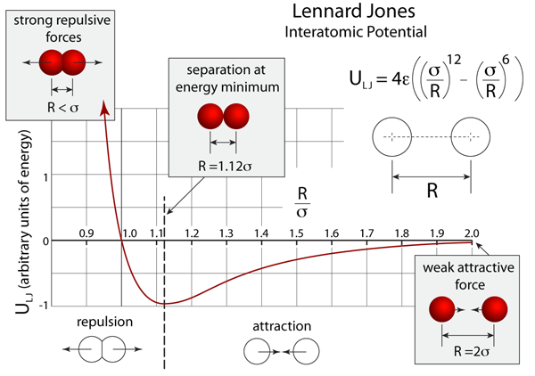
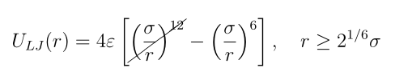
Effective Interaction Potential (Lennard–Jones)
Attraction between genome and intracelluar components
σ is the distance at which the Lennard–Jones potential crosses zero, ULJ (r = σ) = 0.
Notes:
On this slide, I introduce the interaction potential we use in our coarse-grained model, which is Lennard–Jones potential. In our simulation, we do not model detailed chemical bonding, but we still need a simple way to describe how particles push and pull each other.
The Lennard–Jones potential has two main parts.
First, when two particles get extremely close, the energy rises very sharply. This represents a strong repulsive force. Physically, it means two particles cannot overlap.
Second, when particles are a little farther apart, the potential becomes negative, which means there is a weak attraction. This attraction represents van der Waals attraction, or weak binding between different components inside the virus. This attractive part is important because it allows particles to stay near each other and form clusters, instead of spreading out randomly.
In our virus model, we use this attraction of LJ potential to represent interactions between genome and other internal components. This gives us a simple and realistic way to study genome packing, crowding effects, and internal pressure inside the virus.

Slide 11
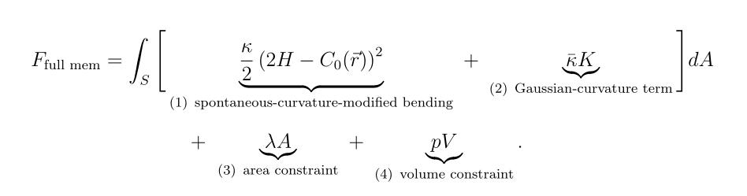
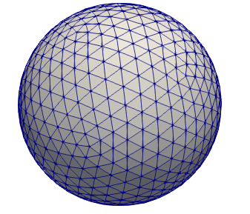

Helfrich–Canham Membrane Elasticity Model
(1)Continuum description of membrane bending energy (theoretical):
(2)Discrete angle-based formulation for simulations (practical):
where θij is the dihedral angle between neighboring triangles
Notes:
Here I explain the difference between the continuous Helfrich membrane theoretical version and the discrete version we use in simulations.
The Helfrich–Canham model is originally written as a continuous theoretical equation. It describes membrane bending energy using smooth curvature, which is very useful for understanding the physics.
However, in a computer simulation we cannot represent a perfectly smooth surface. Instead, we represent the membrane as many small flat triangles, like a mesh.
Because of this, we rewrite the Helfrich–Canham energy into a discrete form. In the discrete model, curvature is approximated by measuring the angles between neighboring triangles. If the membrane bends strongly, the angles change more, and the bending energy becomes larger.
The theoretical model gives the correct physical description, and the discrete model allows us to compute the same bending energy in Monte Carlo simulations

Slide 12
Theoretical version
(1)Continuum description of membrane bending energy (theoretical):
Notes:
On this slide, I explain the Helfrich membrane model a little bit more. This is a standard physics model used to describe how a lipid membrane bends.
The main idea is that a membrane prefers to stay smooth, and bending it costs energy. The parameter κ is called the bending rigidity, and it measures how stiff the membrane is. If κ is large, the membrane is harder to bend.
The model also includes a preferred curvature, written as C₀. If C0 is large, it means the membrane naturally prefers to bend strongly, even without external forces. When C0=0 the membrane prefers to stay flat or symmetric
We include constraints on the total surface area and enclosed volume. These are important because real membranes cannot stretch freely, and viruses also maintain a roughly fixed volume. These terms help us describe realistic virus shapes and internal pressure.
A and V are usually treated as constraints, meaning they are kept fixed (constant) in the model, but we can choose values depending on what virus size/shape we want to represent.

Slide 13
Discrete version
(2)Discrete angle-based formulation for simulations (practical):
where θij is the dihedral angle between neighboring triangles
Notes:
On this slide, I explain the discrete membrane model that we actually use in the simulation.
We build the membrane using many small flat triangles, like a mesh. When these triangles connect together, the membrane can bend.
In this discrete model, bending is measured by the angle between two neighboring triangles. This angle is called the dihedral angle, θ. If the surface is almost flat, the triangles are aligned and the bending energy is small. If the membrane bending is strong, the triangles turn relative to each other, the angle changes more, and the bending energy becomes larger.
We also include constraints on surface area and volume so the membrane does not stretch too much and the virus keeps a realistic size.
In the simulation we usually try to keep area and volume close to constant. This discrete model is based on Helfrich theory, and it allows us to calculate membrane bending energy step by step in Monte Carlo.

Slide 14

Simple Liquid Models
A simple liquid model describes a many-particle system by adding together simple pairwise interaction potentials between particles. The total energy is the sum of the membrane bending energy and basic pairwise interactions.
Notes:
A simple liquid model means we treat everything inside the virus as simple particles, like beads. We do not include detailed chemistry. Instead, we keep only the most important physical interactions.
The equation shows that the total energy is the sum of different contributions. The first term is the membrane bending energy. The other terms represent interactions between different components, such as genome–genome, genome–membrane, genome–crowders, and crowder–crowder interactions.
In this model, we mainly include attraction, which allows particles to weakly stick together when they are close.
Even though the model is simple, it is useful because the virus interior is extremely crowded. In a crowded system, these basic forces can already explain important behavior, such as internal pressure, genome packing, and membrane deformation.

Slide 15
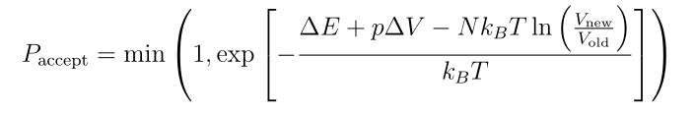
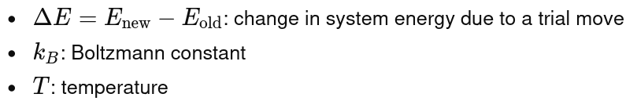

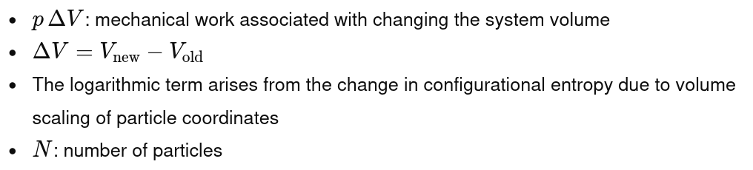
Monte Carlo Acceptance Criteria in NVT and NPT Ensembles
NPT ensemble (constant N,P,T)
NVT ensemble (constant N,V,T)
Notes:
On this slide, I show the Metropolis acceptance rules used in Monte Carlo simulations for two different simulation conditions.
In the NVT condition, number of particles, volume, and the temperature are fixed. So a trial move is accepted based only on the energy change, ΔE. If the move lowers the energy, it is accepted. If energy increased, it may still be accepted with a probability that depends on exp(−ΔE / kBT).
In NPT condition, number of particles, pressure and temperature are fixed, but volume can change. So the acceptance rule includes extra terms, including the pΔV work term and the logarithm term −NkBTln⁡(Vnew/Vold).
This allows the simulation box size to fluctuate so the system can equilibrate at the desired pressure.

Slide 16
Hypothesis
Hypothesis 1:Virus shape is determined by genome packing and by interactions between the genome, internal components, and the viral membrane.
Notes:
For Hypothesis 1, we believe that the shape of a virus is mainly controlled by how the genome is packed inside the membrane. Viral genomes are extremely long, but the virus is very small, so the genome must be squeezed into a tight space. This makes the inside of the virus very crowded.
When the genome is crowded, it creates strong forces and internal pressure. The genome can also interact with other materials inside the virus, such as proteins or other particles, and these interactions can change how tightly the genome is packed. In addition, the genome may push on the membrane or bind to it.
Because of these forces, the viral membrane may bend or deform. So the final virus shape depends on a balance between the internal pressure from genome packing and the membrane stiffness. This means the genome structure and the membrane shape can influence each other, leading to different virus shapes.

Slide 17
Hypothesis
Hypothesis 2: During maturation, increased genome condensation raises internal pressure, which drives a transition from spherical to elongated virus shape.
Notes:
For Hypothesis 2, we propose that virus shape changes during maturation because the genome becomes more condensed and more organized. In the early stage, the genome may be loosely packed, but during maturation it can condense into a denser structure. This increased condensation makes the viral interior more crowded and raises the internal pressure. The higher pressure can push outward on membrane and drive membrane deformation. As a result, the virus may transition from a spherical shape to a more elongated or oval shape, which is consistent with experimental observations in viruses such as Monkeypox.

Slide 18
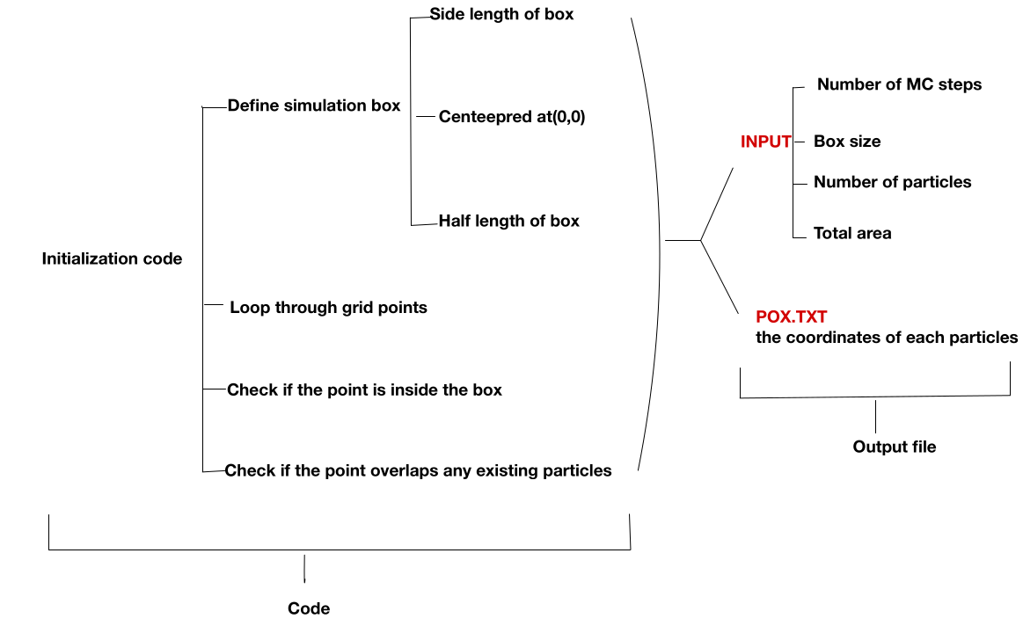
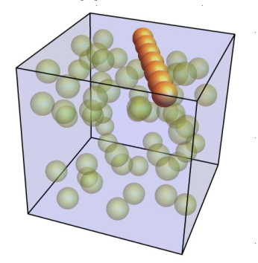
Notes:
This slide shows how we build the simulation code and generate the initial configuration. First, we define a cubic simulation box with side length L, centered at the origin. This box represents the membrane boundary that confines all particles.
Then the program places the genome model, which is shown as the orange rod, and also places the internal particles, shown as green beads. Their positions are generated randomly by computer.
However, the particles cannot be placed anywhere freely. Every time a new particle is added, the code checks two conditions. First, the particle must stay completely inside the box, meaning its center cannot be too close to the walls. Second, it cannot overlap with any particle that is already placed.
If either condition fails, the program rejects that trial position and tries a new random location. This loop continues until all particles are successfully placed. After initialization, the particle coordinates are saved in output file, which becomes the starting point for Monte Carlo simulation.

Slide 19
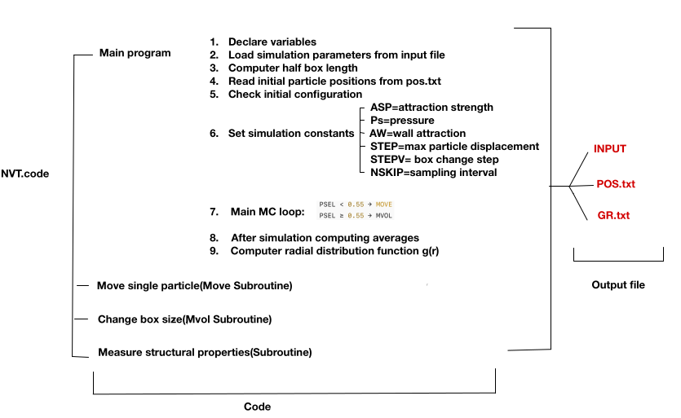

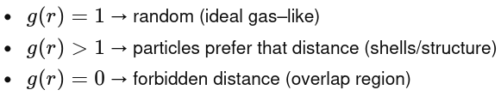
Notes:
After the initial setup, we run the simulation in NVT condition.
First, the program reads all input parameters, such as the box size, number of particles.Then it reads the initial particle coordinates from the POS file and checks the configuration, make sure particles do not overlap and all particles stay inside the box.
Next, we define simulation constants, such as the attraction strength, step size for particle displacement, and the total number of Monte Carlo steps.
Then the main Monte Carlo loop begins. In each step, we randomly select a particle and move slightly. The move is accepted or rejected using the Metropolis rule based on the energy change.
During the simulation, the code also measures structural properties, such as particle density and radial distribution function g(r). Finally, the results are written to output files, including POS.txt and GR.txt.
We use the function g(r)to describe how particles are spaced inside the box. we can see whether particles are randomly spread out or stay close together and form clusters. We also see how the beads and the rod are distributed.

Slide 20
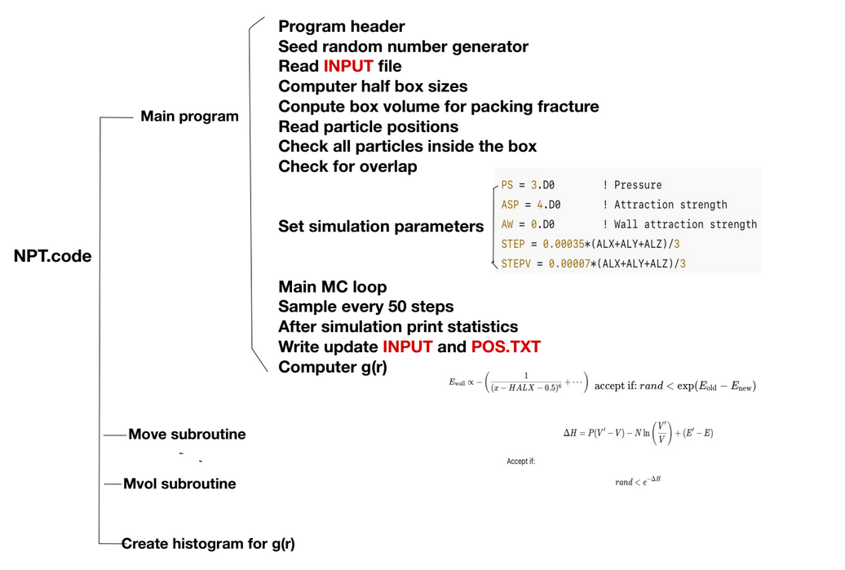
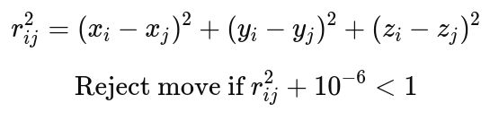
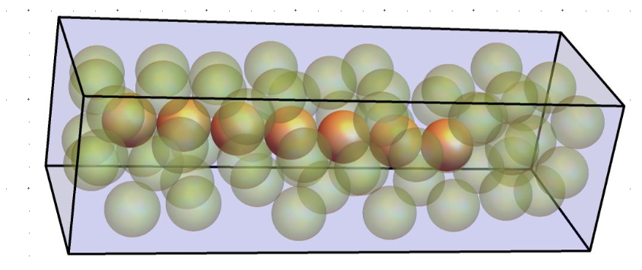

Too many volume moves makes the simulation unstable.
Too few volume moves and the pressure cannot equilibrate.
A common rule is 50–90% particle moves, the rest volume moves.
Notes:
This slide shows the overall structure of our Monte Carlo simulation code in the NPT condition. In NPT, number of particles, pressure and temperature are fixed, but the simulation box size is allowed to change. Changing the box size is like allowing the membrane to expand or shrink.
First, the program reads the input parameters, such as the number of particles, the initial box size, the target pressure, and the interaction strengths. Then it reads the initial particle positions from POS.txt and checks that all particles are valid. This means particles must stay inside the box and cannot overlap.
Next, the code enters the main Monte Carlo loop. In each step, we attempt one of two types of moves. Most of the time, we perform a particle move, where one bead is moved slightly. Sometimes, we perform a membrane move, also called a volume move, where the box size changes.
We control the ratio between particle moves and membrane moves. If we perform too many membrane moves, the simulation becomes unstable. If we perform too few volume moves, the pressure cannot equilibrate. Here it is about 55% particle moves, and 45% are membrane moves.
Finally, the program calculates properties such as particle density and g(r)g(r)g(r), and saves the results into output files like POS.txt and GR.txt

Slide 21
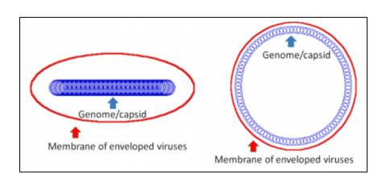
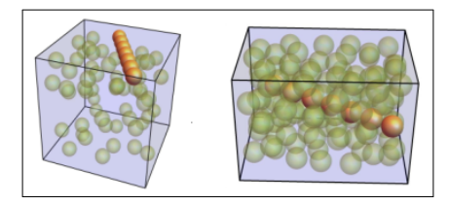
Preliminary results
Figure 17 Preliminary 2D model studies to investigate the effect of the geometry of a genome on the shape of a virus. A rod-like genome induces an elliptic shape whereas a circular genome leads to a circular shape
Figure 18 Initial cubic configuration (left) and final elongated cuboid configuration (right) obtained after sequential NVT equilibration followed by NPT simulation, consistent with the morphology of Monkeypox (Orthopoxvirus) particles.
Notes:
This slide shows a simple idea of how the shape of a virus can be influenced by the geometry of genome.
On the left side, I show a preliminary 2D model. The red boundary represents the virus membrane, and the blue structure represents the genome. When the genome is rod-like and elongated, it naturally pushes the membrane into an elliptical shape. When the genome is circular, the membrane remains round. We can already see that genome geometry can strongly affect virus morphology.
On the right side, I show a 3D simulation using a coarse-grained model inside a cubic box. The green spheres represent crowded particles, and the orange rod represents genome. The left image is the initial configuration, and the right image is the final shape after equilibration. After running NVT equilibration and then allowing volume changes using NPT, the system evolves into an elongated cuboid shape.
This final elongated shape is interesting because it resembles the morphology observed in real Monkeypox virus particles. Our main idea: internal crowding and genome structure can provide a physical driving force for viral shape deformation.

Slide 22
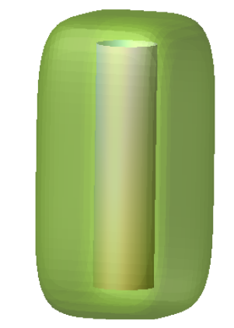

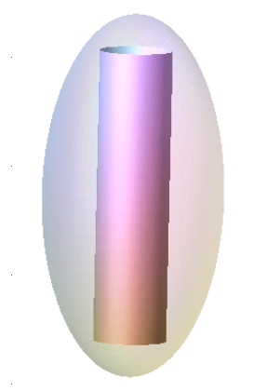
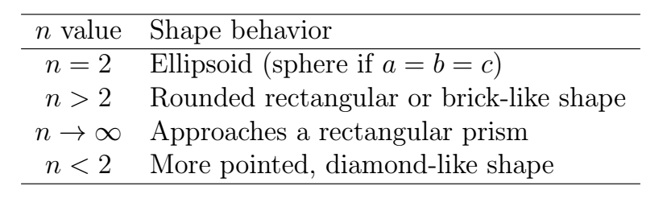
Super ellipsoid
A super-ellipsoid is a smooth 3D shape defined by the equation below
The equation generalizes simple shapes by changing parameter n.
a,b,c: Control the size along the three axes→ long, flat, or brick-like shapes
n(shape parameter):Controls how rounded or box-like the surface
Table 1 Effect of the shape parameter n on superellipsoid geometry
Notes:
The parameters a b,c set the size along each axis, determining whether the shape is elongated, flattened, or brick-like. a,b,c control the overall dimensions and aspect ratios
N:Controls how rounded or box-like the surface
We use the super-ellipsoid model because it gives a smooth and flexible way to describe virus shape. By changing the parameters a b c, we control the overall size and aspect ratios, and by changing n, we control how rounded or box-like the surface is. This allows us to represent realistic virus shapes while keeping the curvature well, which is important for calculating membrane bending energy.
If a = b = c → the shape is symmetric (sphere when n=2)
If one parameter is larger → the shape is elongated in that direction
e.g. c>a=b → long, rod-like shape
If one parameter is smaller → the shape is flattened in that direction
e.g. c<a=b → disk- or pancake-like shape
If a, b, c are all different → a brick-like / cuboid-like shape
As n increases, the super-ellipsoid gradually transitions from a smooth, rounded shape to a more box-like geometry.

Slide 23
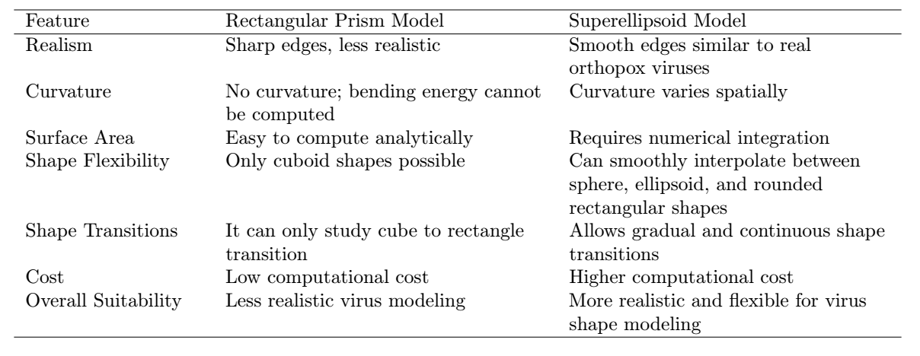
Superellipoid
Table 2: Comparison of Rectangular Prism and Superellipsoid Shape Models
Notes:
To understand the advantages and limitations of different shape descriptions, we compare a rectangular prism model with a super-ellipsoid model.
The rectangular prism is very simple, but it has sharp corners and flat faces, so it does not look very realistic. It also has no curvature, which means we cannot properly calculate membrane bending energy. It is easy to compute, but it can only represent a limited set of shapes, mainly cube-like or box-like shapes, and it cannot smoothly describe shape changes.
In contrast, the superellipsoid model has smooth and rounded edges, so it looks much closer to real viruses, especially orthopox viruses like Monkeypox. It allows the curvature to change across the surface, which makes it possible to calculate bending energy and study realistic membrane deformation. It is more computationally expensive because it usually requires numerical calculations, but it can smoothly transition between spherical, ellipsoidal, and brick-like shapes. Overall, the superellipsoid model is a more flexible and realistic choice for studying virus shape transitions.

Slide 24
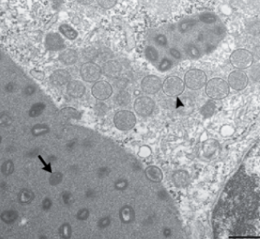
Expected result
The Superellipsoid model may helps explain:
Why
COVID-19 virus particle stays more spherical
Monkeypox virus particle becomes dumbbell-shaped
How:
Crowding + container curvature reshape genome packing
Why:
Immature viruses are round
Mature orthopoxviruses are brick-like
Figure 18 Orthopoxviruses.
Figure 19 he upper box in Panel A at a higher magnification. Type A viral inclusion bodies, which are observed in infections caused by some orthopoxvirus species, are composed of proteinaceous material and mature virus particles (arrow). Type B viral inclusion bodies, also known as viral factories, are composed of spherical, immature virus particles (arrowhead).
Figure 17 Coronaviruses.

Slide 25
Timeline
Goal 1: Build a Simple Virus Model
Build a simple model of a genome inside a soft membrane.
Model the genome as connected beads.
Model the membrane as a flexible surface.
Include basic weak attraction.
Study how the genome pushes on and deforms the membrane.
Goal 2: Study What Controls Virus Shape
Use the model to test what physical factors change virus shape.
Change genome length (short vs long).
Change genome stiffness (soft vs stiff).
Change membrane size and flexibility.
Measure changes in shape, pressure, and genome position.
Goal 3:Explain Shape Changes in Real Viruses
Use the model to explain experimental observations.
Explain why COVID-19 particles stay mostly spherical.
Explain why Monkeypox particles are elongated.
Explain the change from spherical immature particles to elongated mature particles.

Slide 26
Reference
[1] Zhenhao Ke, Jose Oton, Kun Qu, Marcella Cortese, Vedran Zila, Liam McKeane, Takanori Nakane, Jasenko Zivanov, Christopher J Neufeldt, Bastian Cerikan, Jianmin M Lu, Julian Peukes, Xiaoli Xiong, Hans-Georg Kräusslich, Sjors H. W. Scheres, Ralf Bartenschlager, and John A. G. Briggs. Structures and distributions of sars-cov-2 spike proteins on intact virions. Nature, 588(7838):498–502, December 2020. Epub 2020 Aug 17.
[2] Centers for Disease Control and Prevention (CDC). Sars-cov-2 illustration. https://www.cdc.gov/museum/timeline/covid19.html, n.d. Accessed April 18, 2025.
[3] Naoki Nakatani, Hiroshi Sakuta, Makoto Hayashi, Shunsuke Tanaka, Kohei Takiguchi, Kouhei Tsumoto, and Kenichi Yoshikawa. Specific spatial localization of actin and dna in a water/water microdroplet: Self-emergence of a cell-like structure. Chembiochem, 19(13):1370–1374, 2018.
[4] Nir Erez, Hagit Achdout, Einat Milrot, Yaron Schwartz, Yonit Wiener-Well, Nir Paran, Boaz Politi, Haim Tamir, Tomer Israely, Sharon Weiss, Adi Beth-Din, Orli Shifman, Ohad Israeli, Shmuel Yitzhaki, Shaul C Shapira, Shay Melamed, and Eli Schwartz. Diagnosis of imported monkeypox, israel, 2018. Emerging Infectious Diseases, 25(5):980–983, May 2019.
[5] Shane Parker, Andrea Nuara, R Mark Buller, and David A Schultz. Human monkeypox: an emerging zoonotic disease. Future Microbiology, 2(1):17–34, Feb 2007.

Slide 27
Reference
[13] Paul Grayson, Alex Evilevitch, Mandar M. Inamdar, Prashant K. Purohit, William M. Gelbart,
Charles M. Knobler, and Rob Phillips. The effect of genome length on ejection forces in bacteriophage
lambda. Virology, 348(2):430–436, 2006.
[14] Horst L. Vörtler and Matthias Kettler. Monte carlo simulation of pore systems: primitive model of
water in slit-like pores. Chemical Physics Letters, 266(3–4):368–374, 1997.

Slide 28
Thank you!

Slide 29
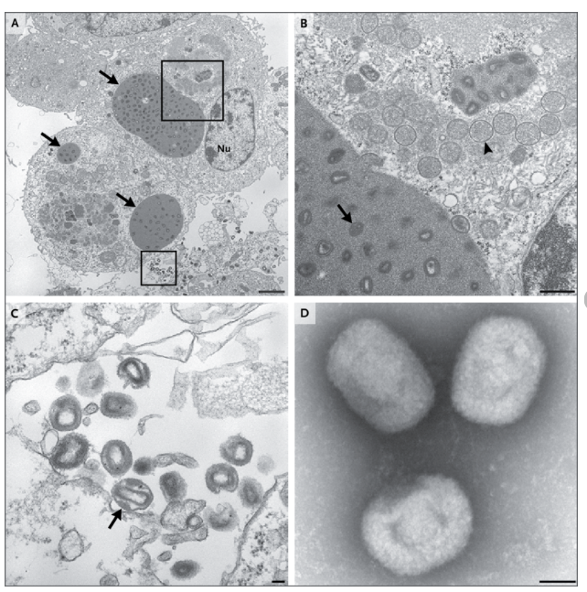
The Novel Orthopoxvirus on Transmission Electron Microscopy. Thin-section electron microscopy and negative-stain electron microscopy were performed, as previously described . 20,21 Panel A shows type A viral inclusion bodies (arrows) in infected cell-culture cells on thin-section electron microscopy. Nu denotes the cell nucleus. The scale bar represents 2 μm. Panel B shows the area in the upper box in Panel A at a higher magnification. Type A viral inclusion bodies, which are observed in infections caused by some orthopoxvirus species, are composed of proteinaceous material and mature virus particles (arrow). Type B viral inclusion bodies, also known as viral factories, are composed of spherical, immature virus particles (arrowhead). The scale bar represents 500 nm. Panel C shows a higher magnification of the extracellular mature virions shown in the area in the lower box in Panel A. A lateral body within a maturing virus particle (arrow) is shown. The scale bar represents 100 nm. Panel D shows brick-shaped virions, with short, whirled filaments on the surface on negativestain electron microscopy. The scale bar represents 100 nm.
Vora, Neil & Li, Yu & Geleishvili, Marika & Emerson, Ginny & Khmaladze, Ekaterine & Maghlakelidze, Giorgi & Navdarashvili, Archil & Zakhashvili, Khatuna & Kokhreidze, Maka & Endeladze, Marina & Mokverashvili, Gela & Satheshkumar, P.S. & Gallardo-Romero, Nadia & Goldsmith, Cynthia & Metcalfe, Maureen & Damon, Inger & Maes, Edmond & Reynolds, Mary & Morgan, Juliette & Carroll, Ph.D.. (2015). Human Infection with a Zoonotic Orthopoxvirus in the Country of Georgia. New England Journal of Medicine. 372. 10.1056/NEJMoa1407647.

Slide 30
Reference
[6] Cynthia S Goldsmith and Russell Regnery. Monkeypox virus particle. Public Health Image Library, Centers for Disease Control and Prevention, 2003. Image ID: 22664.
[7] Yinon M Bar-On, Avi Flamholz, Rob Phillips, and Ron Milo. Sars-cov-2 (covid-19) by the numbers. Elife, 9:e57309, Apr 2020.
[8] Lei Wu, Wenhui Zhou, Lihua Lin, Anhong Chen, Jing Feng, Xiangmeng Qu, Hongbo Zhang, and Jun Yue. Delivery of therapeutic oligonucleotides in nanoscale. Bioactive Materials, 7:292–323, 2022.
[9] Emily Barrow, Anthony V. Nicola, and Jun Liu. Multiscale perspectives of virus entry via endocytosis. Virology Journal, 10:177, 2013.
[10] Susan Payne. Viruses: From Understanding to Investigation. Elsevier, 2nd edition, 2022.
[11] A. Brandariz-Nuñez, T. Liu, T. Du, and A. Evilevitch. Pressure-driven release of viral genome into a
host nucleus is a mechanism leading to herpes infection. eLife, 8:e47212, 2019.
[12] Morgan Chabanon, Jeanne C. Stachowiak, and Padmini Rangamani. Systems biology of cellular
membranes: a convergence with biophysics. Wiley Interdisciplinary Reviews: Systems Biology and
Medicine, 9(5), sep 2017. Epub 2017 May 5.

