Slide 1


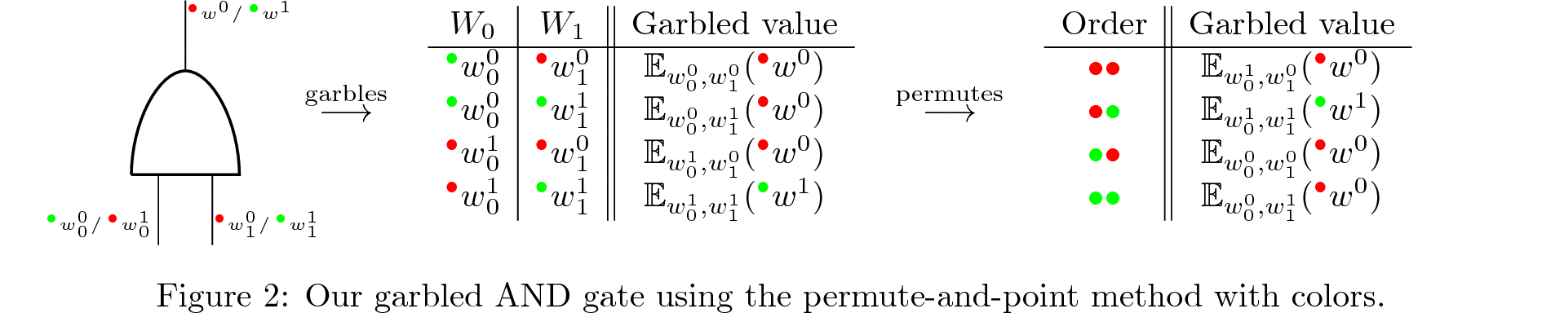








Privacy-friendly machine learning algorithms for intrusion detection systems
Context
Intrusion detection systems
Working
As computers are used more and more (including for sensible data), and the connection between them increases as well, there is a constant need for better intrusion detection systems.
Machine learning algorithms can increase performance of a lot of existing applications, but they need a significant dataset.
The amount of data needed increases as well, but remains sensible in the case of intrusion detection systems, hence the need for encryption.
« Privacy-friendly collaborative network intrusion detection system »
Network Intrusion Detection System (NIDS)
  Advantages: detects attack before it occurs
  Disadvantages: needs to be implemented on the network
Host Intrusion Detection System (HIDS)
  Advantages: collects broader data type
  Disadvantages: needs to be implemented on each machine and only detects after the intrusion
Hybrid Intrusion Detection System
  Advantages: much more effective
  Disadvantages: huge implementation necessary, not privacy-friendly
Secure multi-party computation
  Idea: different people jointly compute a function over their imput that remains secret
  Two types:
    Garbled
      Boolean
      Constant number of rounds
    Arithmetic
      Based on somwhat homomorphic encryption
      Allows for addition and multiplication
      Ex: Samir secret sharing
  SPDZ library (n-party, arithmetic)
Machine learning
  A lot of existing datasets
  Different existing algorithms
Further optimizations
  Hybrid Intrusion Detection Systems
  Speed and complexity optimizations (research on homomorphic encryption)
Master of
Mathemtical Engineering
Master’s thesis
Henri De Plaen
Promotor
Pr. dr. ir. Bart Preneel
Detection
Academic year
2017-2018
Signature based
  Advantages: accuracy and time
  Disadvantages: only known intrusion types are detected
Anomaly based
  Advantages: new intrusion types can be detected
  Disadvantages: malicious activity disguised as normal traffic can pass through
Machine learning (classification)
Implementation
Build on existing application, as a plug-in
Feed with constant new data, provided from other analysis tools
User-friendly
Off-line

