Slide 1

SM1
• block/SM: The block-per-SM limit is defined by the CUDA architecture itself, not by user code.
block(logical unit)
warp(logical unit)
• thread/block: The number of threads per block is determined by the user when launching a kernel.
thread
• Thread/warp: The number of threads per warp is fixed at 32 in current GPU architectures, so we don’t need to worry about it.
① HW MAX
• thread/warp: 32
• MAX warp/SM: 48
▶︎ Limit warp: 48
▶︎ Theoretical Occupancy:
Active warp/Limit warp
② Case1
• Suppose thread/block is 32(block size)
• Limit block/SM: 16(block limit SM)
▶︎ Limit thread/SM:
(thread/block)*(Limit block/SM)
= thread/SM= 32*16= 512
▶︎ Active warp: 512/32= 16
▶︎ Theoretical Occupancy: 16/48= 33.34%
③ Case2
• Suppose thread/block is 64(block size)
• Limit block/SM: 16(block limit SM)
▶︎ Limit thread/SM:
(thread/block)*(Limit block/SM)
= thread/SM= 64*16= 1024
▶︎ Active warp: 1024/32= 32
▶︎ Theoretical Occupancy: 32/48= 66.67%

Slide 2
ACE (Asynchronous Compute Engine) : work-group : CU mapping
CU
clock cycle | 1st (16-way) | 2nd (16-way) | 3rd (16-way) | 4th (16-way)
cycle 1 | R | - | - | -
cycle 2 | E | R | - | -
cycle 3 | W | E | R | -
cycle 4 | - | W | E | R
cycle 5 | - | - | W | E
cycle 6 | - | - | - | W
Instruction Fetch(per each WF)
WF context
WF context
WF context
WF context
Scheduler(instruction issue per each WF)
SIMD
SIMD
SIMD
SIMD
SIMD Unit Architecture and Parallelism
A single 16-way SIMD unit possesses 16 ALU lanes.
There are 16 parallel processing paths-one set for R (Read), E (Execute), and W (Write-it can perform individual operations on 16 different operands simultaneously.
Register Files
Global
Memory Pipeline
Local Data Store

Slide 3
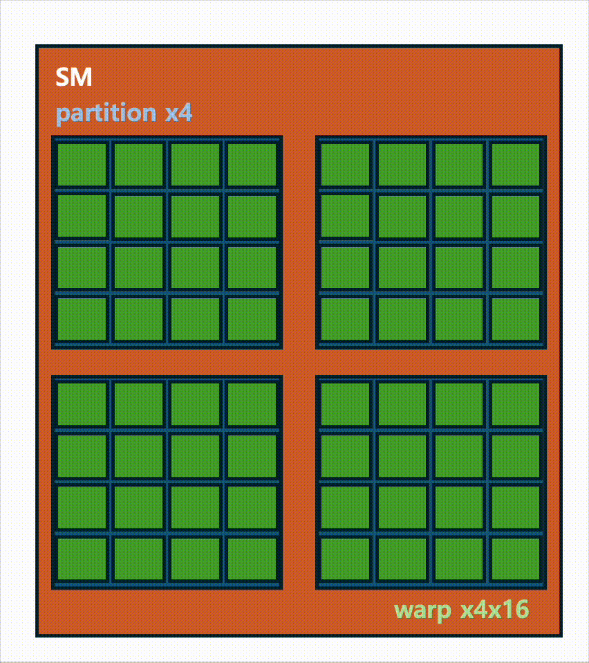
SM
Warp Schedulerx4
Scheduled Warp x4x16

Slide 4
SM
Warp Schedulerx4
Scheduled Warp x4x16

Slide 5
