Slide 2
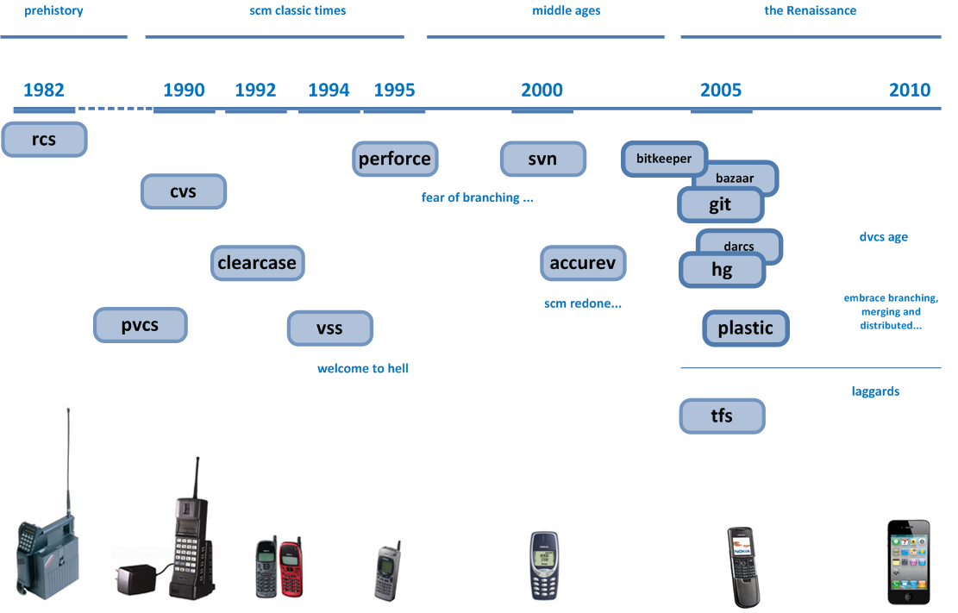
version control timeline
Image source: http://codicesoftware.blogspot.com/2010/11/version-control-timeline.html
Notes:
Another aspect ….
Version control systems have an average timespan of 5-10 years before something new pops up and is the new gold standard.
It took 10 years from cvs to svn … and 5 years from svn to git.

Slide 3
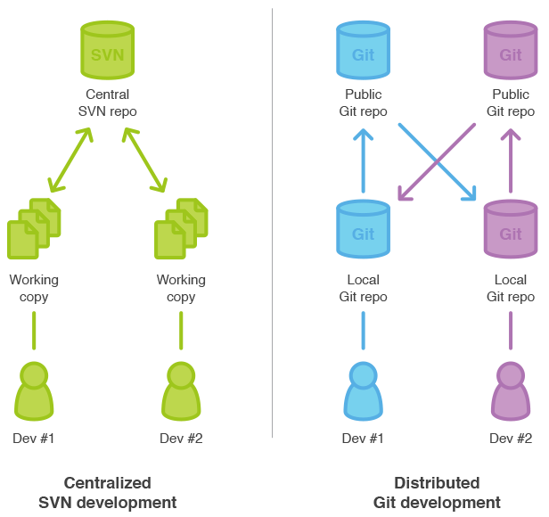
its all about collaboration
Gitlab is all about
how to manage This!
Image source: https://www.atlassian.com/pt/git/migration#!migration-share
Notes:
The brilliant part about git itself is, that even if the central git repository management system would be dropped at one point, the projects wouldn’t take any harm.
Git was intrinsically designed for non-linear and decentralised development.
You always have a full copy of the repository on the machine you work on and you don’t need to have central server (gitlab).
The central server is used to make it easier to collaborate (, but you can as well walk in my office and pull some changes from a git repo on my machine to yours.)
It is clear that one should never store mission critical things on one system / at one location only.

Slide 4
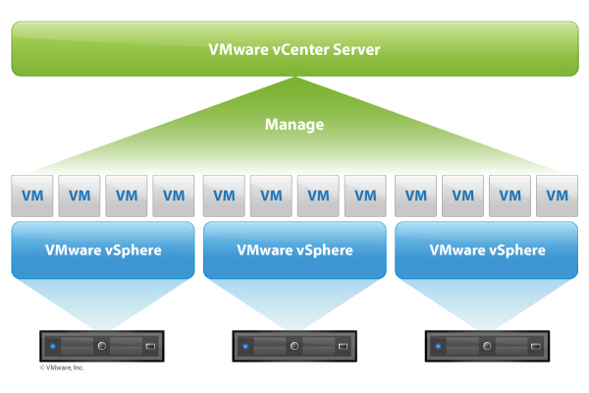
infrastructure
EMBL IT services
git.embl.de (grass-roots)
Virtual Machine (VM), 2 cpus, 8 GB RAM, 50 GB
Supported by EMBL IT (thanks michael & carlos)
Gentoo Linux
Gitlab
Repos on NFS
backups:
physically located on IT storage system
daily backups (server & repos on nfs)
…and every git repo is a backup ;)

Slide 5
LDAP / ssh keys
EMBL hosted! Private!
Public/Private
Rights
anbindung an github?
Example: project fork, edit, pull request

