Slide 1


Slide 2
Version Control with GitLab at EMBL
Holger Dinkel und Grischa Tödt

Slide 3
Version control (system)
!=
Version control (system) management system

Slide 4
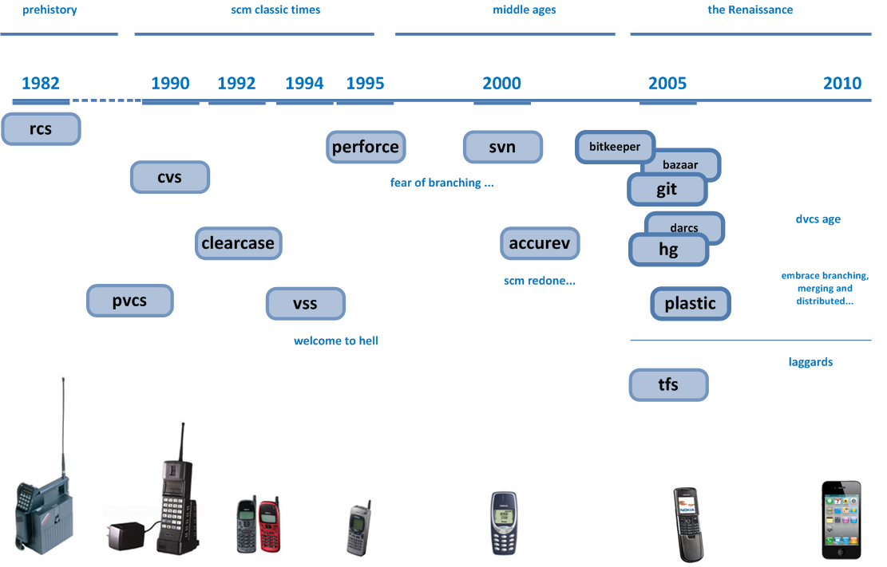
version control timeline
Image source: http://codicesoftware.blogspot.com/2010/11/version-control-timeline.html
Notes:
Anyone used one of these??
Another aspect ….
Version control systems have an average timespan of 5-10 years before something new pops up and is the new gold standard.
It took 10 years from cvs to svn … and 5 years from svn to git.

Slide 5
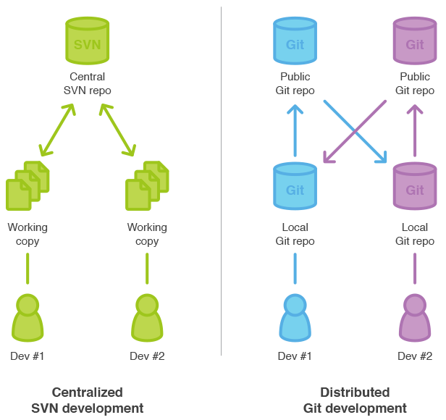
its all about collaboration
Gitlab is all about
how to manage This!
Wikis
Issue tracking
Code review
Image source: https://www.atlassian.com/pt/git/migration#!migration-share
Notes:
The brilliant part about git itself is, that even if the central git repository management system would be dropped at one point, the projects wouldn’t take any harm.
Git was intrinsically designed for non-linear and decentralised development.
You always have a full copy of the repository on the machine you work on and you don’t need to have central server (gitlab).
The central server is used to make it easier to collaborate (, but you can as well walk in my office and pull some changes from a git repo on my machine to yours.)
It is clear that one should never store mission critical things on one system / at one location only.

Slide 6





Version Control
Version Control on Steroids
[Frank Thommen]
Git repository management systems
2.4k $/year 125 repos
4.9k $/year 100 users
git.embl.de
open source MIT licensed

Slide 7
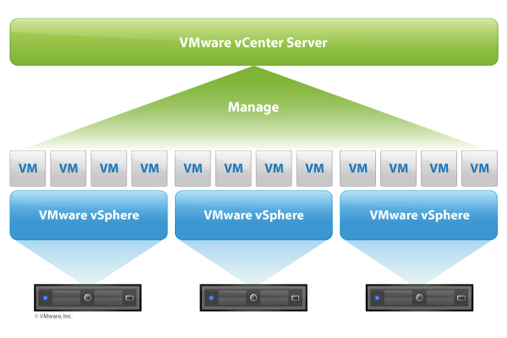
infrastructure
EMBL IT services
git.embl.de (grass-roots)
Virtual Machine (VM), 2 cpus, 8 GB RAM, 50 GB
Supported by EMBL IT (thanks michael & carlos)
Gentoo Linux
Gitlab
Repos on NFS
backups:
physically located on IT storage system
daily backups (server & repos on nfs)

Slide 8
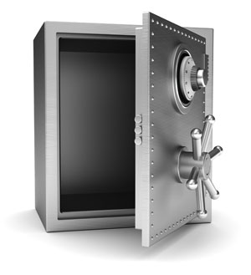


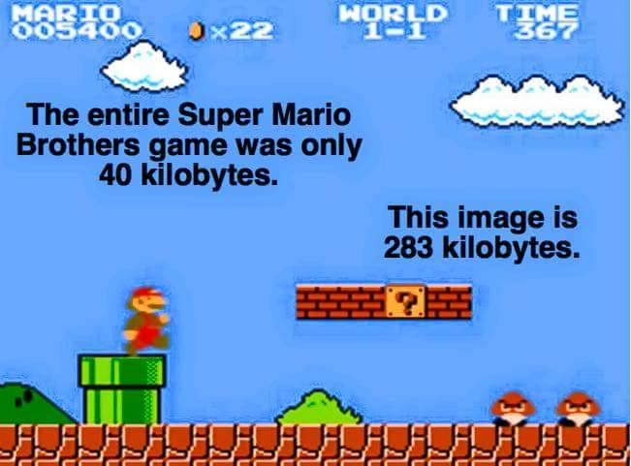


EMBL hosted
(data privacy issues avoided)
Access Controlled
repository management, code reviews, issue tracking, activity feeds and wikis….
➔ lets have a look
not a backup system
git
https://git.embl.de

Slide 9
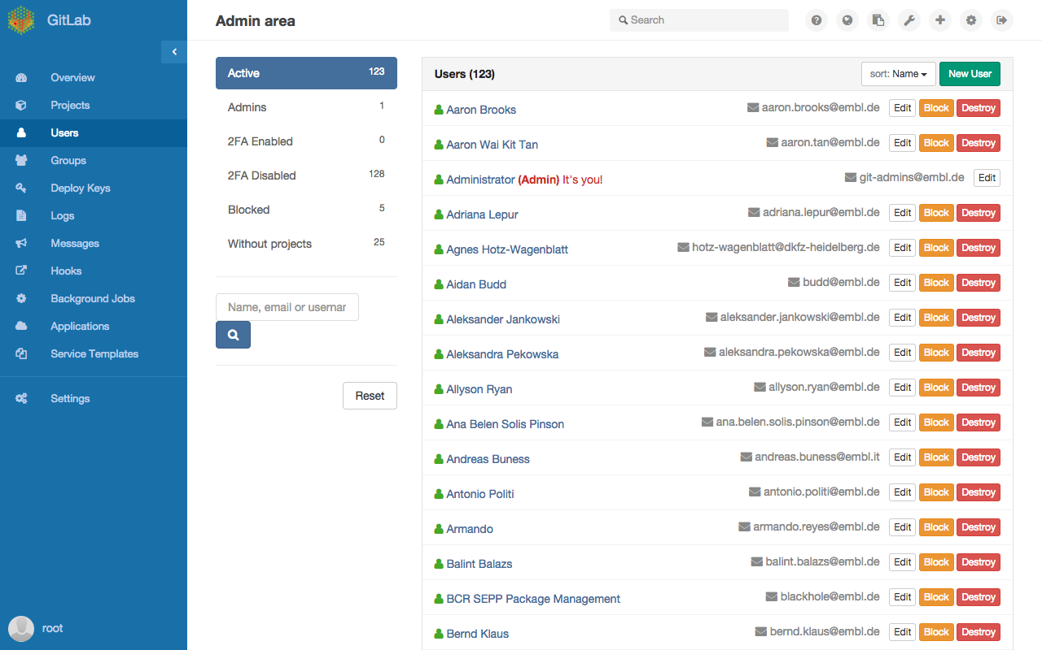
stats

Slide 10
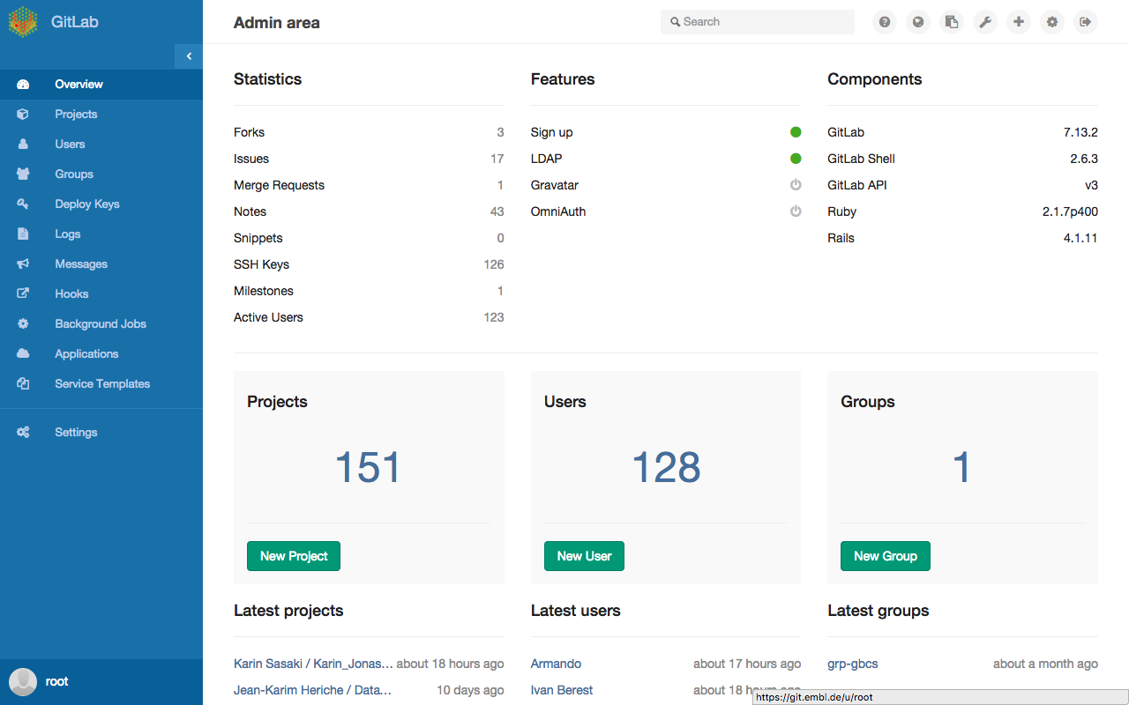
stats

Slide 11
Acknowledgements
Frank Thommen (Structures IT Management & Support)
Michael Wahlers and Carlos Fernandez San Millan
The EMBL Git server is part of the Bio-IT Project.
The server, disk space and backup are kindly provided by EMBL IT Services

