Slide 1
Enhancing Fisheries Research Insights through Big Data Analytics: Leveraging Apache Spark for Scalable and In-Depth Analysis
INFO H516 Applied Cloud Computing for Data Intensive Sciences
Group 7:
Bhushan Shelke
Hasaranga Jayathilake

Slide 2

Lineup - Project final presentation
Project Introduction
Project Methodology
Data Analysis
Conclusion and Discussion
Importance of Spark and Cloud Computing

Slide 3
Project Introduction
SECTION 1

Slide 4
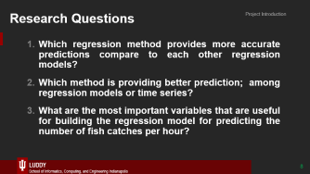
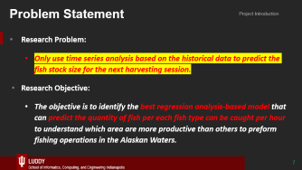
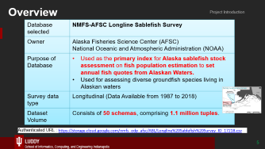
Project Introduction

Slide 5

Overview
Project Introduction
Database selected | NMFS-AFSC Longline Sablefish Survey
Owner | Alaska Fisheries Science Center (AFSC) National Oceanic and Atmospheric Administration (NOAA)
Purpose of Database | Used as the primary index for Alaska sablefish stock assessment on fish population estimation to set annual fish quotes from Alaskan Waters. Used for assessing diverse groundfish species living in Alaskan waters
Survey data type | Longitudinal (Data Available from 1987 to 2018)
Dataset Volume | Consists of 50 schemas, comprising 1.1 million tuples.
Authenticated URL : https://storage.cloud.google.com/nmfs_odp_afsc/ABL/Longline%20Sablefish%20Survey_ID_17218.csv

Slide 6
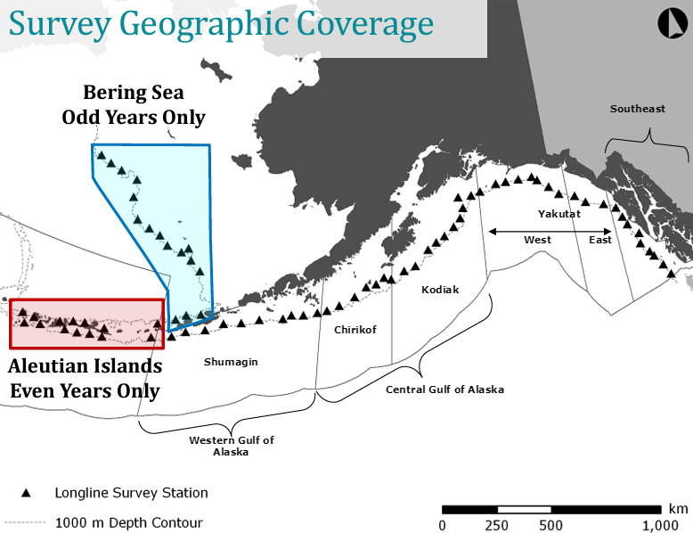
Project Introduction

Slide 7
Problem Statement
Project Introduction
Research Problem:
Only use time series analysis based on the historical data to predict the fish stock size for the next harvesting session.
Research Objective:
The objective is to identify the best regression analysis-based model that can predict the quantity of fish per each fish type can be caught per hour to understand which area are more productive than others to preform fishing operations in the Alaskan Waters.
Notes:
Time series analysis give the results based on the pattern identification for the short- and medium-term forecasting with temporal insight on data evaluation over the time (More weight on Historical side)

Slide 8
Research Questions
Project Introduction
Which regression method provides more accurate predictions compare to each other regression models?
Which method is providing better prediction; among regression models or time series?
What are the most important variables that are useful for building the regression model for predicting the number of fish catches per hour?

Slide 9
Project Methodology
SECTION 2

Slide 10
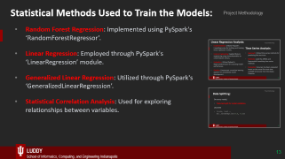
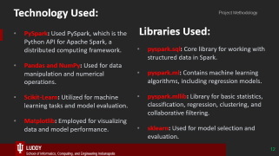
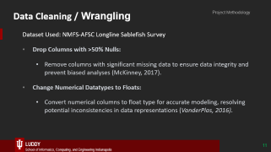
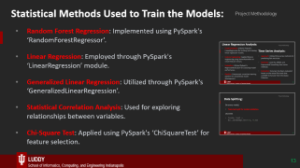
Project Methodology

Slide 11
Data Cleaning / Wrangling
Project Methodology
Dataset Used: NMFS-AFSC Longline Sablefish Survey
Drop Columns with >50% Nulls:
Remove columns with significant missing data to ensure data integrity and prevent biased analyses (McKinney, 2017).
Change Numerical Datatypes to Floats:
Convert numerical columns to float type for accurate modeling, resolving potential inconsistencies in data representations (VanderPlas, 2016).

Slide 12
Technology Used:
Project Methodology
Libraries Used:
PySpark: Used PySpark, which is the Python API for Apache Spark, a distributed computing framework.
Pandas and NumPy: Used for data manipulation and numerical operations.
Scikit-Learn: Utilized for machine learning tasks and model evaluation.
Matplotlib: Employed for visualizing data and model performance.
pyspark.sql: Core library for working with structured data in Spark.
pyspark.ml: Contains machine learning algorithms, including regression models.
pyspark.mllib: Library for basic statistics, classification, regression, clustering, and collaborative filtering.
sklearn: Used for model selection and evaluation.

Slide 13
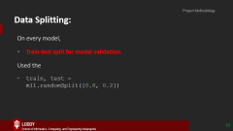
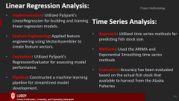
Statistical Methods Used to Train the Models:
Project Methodology
Random Forest Regression: Implemented using PySpark's ‘RandomForestRegressor’.
Linear Regression: Employed through PySpark's ‘LinearRegression’ module.
Generalized Linear Regression: Utilized through PySpark's ‘GeneralizedLinearRegression’.
Statistical Correlation Analysis: Used for exploring relationships between variables.

Slide 14
Linear Regression Analysis:
Project Methodology
Implementation: Utilized PySpark's LinearRegression for building and training linear regression models.
Feature Engineering: Applied feature engineering using VectorAssembler to create feature vectors.
Evaluation: Utilized PySpark's RegressionEvaluator for assessing model performance.
Pipeline: Constructed a machine learning pipeline for streamlined model development.
Time Series Analysis:
Approach: Utilized time series methods for predicting fish stock size.
Methods: Used the ARIMA and Exponential Smoothing time series methods
Evaluation: Accuracy has been evaluated based on the actual fish stock that available to harvest from the Alaska Fisheries

Slide 15
Data Splitting:
Project Methodology
On every model,
Train-test split for model validation.
Used the
train, test = ml1.randomSplit([0.8, 0.2])

Slide 16
Data Analysis
SECTION 3

Slide 17
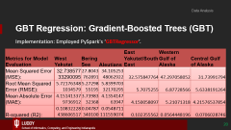
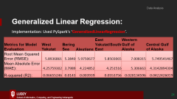
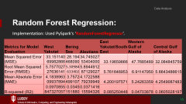
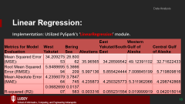
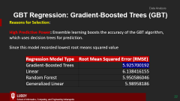
Data Analysis
Regression Model Comparison
Regression Model Selected

Slide 18
Linear Regression:
Data Analysis
Implementation: Utilized PySpark's ‘LinearRegression’ module.
Metrics for Model Evaluation | West Yakutat | Bering Sea | Aleutians | East Yakutat/SouthEast | Western Gulf of Alaska | Central Gulf of Alaska
Mean Squared Error (MSE): | 34.20927553 | 28.80062 | 35.96565 | 34.28599542 | 49.12391102 | 32.71622433
Root Mean Squared Error (RMSE): | 5.848869594 | 5.3666209 | 5.997136 | 5.855424444 | 7.008845199 | 5.719809816
Mean Absolute Error (MAE): | 4.235607964 | 3.7847745 | 4.235873 | 4.250325773 | 5.311962066 | 4.298742868
R-squared (R2): | 0.068265907 | 0.0137583 | 0.003316 | 0.055231554 | 0.019999919 | 0.042015014

Slide 19
Random Forest Regression:
Data Analysis
Implementation: Used PySpark's ‘RandomForestRegressor’.
Metrics for Model Evaluation | West Yakutat | Bering Sea | Aleutians | East Yakutat/SouthEast | Western Gulf of Alaska | Central Gulf of Alaska
Mean Squared Error (MSE): | 33.15114069982866 | 28.194468090 | 34.74502753404000 | 33.19659866 | 47.7685489 | 32.084845759
Root Mean Squared Error (RMSE): | 5.757702727636141 | 5.30984633402 | 5.894491287129027 | 5.761648953 | 6.91147950 | 5.6643486615
Mean Absolute Error (MAE): | 4.183896309937894 | 3.7572499107 | 4.172258879239949 | 4.200197571 | 5.24263359 | 4.2549087483
R-squared (R2): | 0.0970855847327057 | 0.0345151880 | 0.037141615594326 | 0.085250448 | 0.04703878 | 0.0605028197

Slide 20
GBT Regression: Gradient-Boosted Trees (GBT)
Data Analysis
Implementation: Employed PySpark's ‘GBTRegressor’.
Metrics for Model Evaluation | West Yakutat | Bering Sea | Aleutians | East Yakutat/SouthEast | Western Gulf of Alaska | Central Gulf of Alaska
Mean Squared Error (MSE): | 32.73857733290095 | 27.8043762891 | 34.10525348062922 | 32.575847764 | 47.297058052 | 31.73991794
Root Mean Squared Error (RMSE): | 5.721763481034579 | 5.2729855195 | 5.839970332170295 | 5.7075255 | 6.87728566 | 5.6338191264
Mean Absolute Error (MAE): | 4.151413379736912 | 3.7398332368 | 4.135414763947 | 4.150058097 | 5.21071318 | 4.21576537854
R-squared (R2): | 0.10832228438606517 | 0.04787340100 | 0.0548711111559074 | 0.102355562 | 0.0564448196 | 0.0706028746

Slide 21
Generalized Linear Regression:
Data Analysis
Implementation: Used PySpark's ‘GeneralizedLinearRegression’.
Metrics for Model Evaluation | West Yakutat | Bering Sea | Aleutians | East Yakutat/SouthEast | Western Gulf of Alaska | Central Gulf of Alaska
Root Mean Squared Error (RMSE): | 5.8936861 | 5.3840 | 5.9750677 | 5.8503065 | 7.008315 | 5.749541467
Mean Absolute Error (MAE): | 4.25759302 | 3.7989 | 4.224852 | 4.251516 | 5.306663 | 4.3142894304
R-squared (R2): | 0.06655246 | 0.0143 | 0.003939 | 0.0553756 | 0.020134596 | 0.0422426019

Slide 22
GBT Regression: Gradient-Boosted Trees (GBT)
Data Analysis
Reasons for Selection:
High Predictive Power: Ensemble learning boosts the accuracy of the GBT algorithm, which uses decision trees for prediction.
Since this model recorded lowest root means squared value
Regression Model Type | Root Mean Squared Error (RMSE)
Gradient-Boosted Trees | 5.925700192
Linear | 6.138416155
Random Forest | 5.950586046
Generalized Linear | 5.98958186

Slide 23
Conclusion and Discussion
SECTION 4

Slide 24

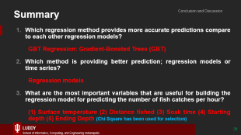
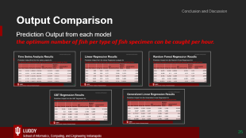
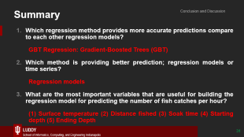

Conclusion and Discussion

Slide 25
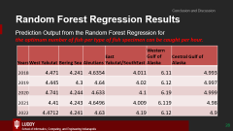
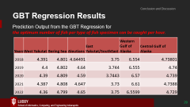
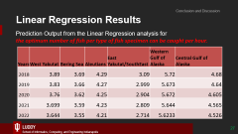
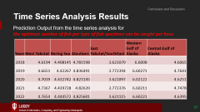
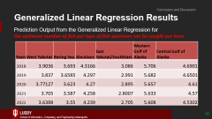
Output Comparison
Conclusion and Discussion
Prediction Output from each model the optimum number of fish per type of fish specimen can be caught per hour.

Slide 26
Time Series Analysis Results
Conclusion and Discussion
Prediction Output from the time series analysis for the optimum number of fish per type of fish specimen can be caught per hour.
Years | West Yakutat | Bering Sea | Aleutians | East Yakutat/SouthEast | Western Gulf of Alaska | Central Gulf of Alaska
2018 | 4.6194 | 4.408145 | 4.781598 | 3.621079 | 6.6008 | 4.6065
2019 | 4.6651 | 4.42267 | 4.836491 | 3.772394 | 6.60271 | 4.7641
2020 | 4.7039 | 4.432742 | 4.823145 | 3.621097 | 6.02122 | 4.6251
2021 | 4.7367 | 4.439728 | 4.82639 | 3.772376 | 6.60211 | 4.7478
2022 | 4.7654 | 4.444572 | 4.825601 | 3.621115 | 6.60221 | 4.6395

Slide 27
Linear Regression Results
Conclusion and Discussion
Prediction Output from the Linear Regression analysis for the optimum number of fish per type of fish specimen can be caught per hour.
Years | West Yakutat | Bering Sea | Aleutians | East Yakutat/SouthEast | Western Gulf of Alaska | Central Gulf of Alaska
2018 | 3.89 | 3.69 | 4.29 | 3.09 | 5.72 | 4.68
2019 | 3.83 | 3.66 | 4.27 | 2.999 | 5.673 | 4.64
2020 | 3.76 | 3.62 | 4.25 | 2.904 | 5.672 | 4.605
2021 | 3.699 | 3.59 | 4.23 | 2.809 | 5.644 | 4.565
2022 | 3.644 | 3.55 | 4.21 | 2.714 | 5.6233 | 4.526

Slide 28
Random Forest Regression Results
Conclusion and Discussion
Prediction Output from the Random Forest Regression for the optimum number of fish per type of fish specimen can be caught per hour.
Years | West Yakutat | Bering Sea | Aleutians | East Yakutat/SouthEast | Western Gulf of Alaska | Central Gulf of Alaska
2018 | 4.471 | 4.241 | 4.6354 | 4.011 | 6.11 | 4.993
2019 | 4.445 | 4.3 | 4.64 | 4.02 | 6.12 | 4.997
2020 | 4.741 | 4.244 | 4.633 | 4.1 | 6.19 | 4.999
2021 | 4.41 | 4.243 | 4.6496 | 4.009 | 6.119 | 4.98
2022 | 4.4712 | 4.241 | 4.63 | 4.19 | 6.12 | 4.9

Slide 29
GBT Regression Results
Conclusion and Discussion
Prediction Output from the GBT Regression for the optimum number of fish per type of fish specimen can be caught per hour.
Years | West Yakutat | Bering Sea | Aleutians | East Yakutat/SouthEast | Western Gulf of Alaska | Central Gulf of Alaska
2018 | 4.391 | 4.801 | 4.64491 | 3.75 | 6.554 | 4.73801
2019 | 4.4 | 4.802 | 4.64 | 3.744 | 6.555 | 4.74
2020 | 4.39 | 4.809 | 4.59 | 3.7443 | 6.57 | 4.739
2021 | 4.387 | 4.808 | 4.647 | 3.73 | 6.61 | 4.7388
2022 | 4.36 | 4.799 | 4.65 | 3.75 | 6.5599 | 4.729

Slide 30
Generalized Linear Regression Results
Conclusion and Discussion
Prediction Output from the Generalized Linear Regression for the optimum number of fish per type of fish specimen can be caught per hour.
Years | West Yakutat | Bering Sea | Aleutians | East Yakutat/SouthEast | Western Gulf of Alaska | Central Gulf of Alaska
2018 | 3.9036 | 3.693 | 4.3166 | 3.086 | 5.706 | 4.6901
2019 | 3.837 | 3.6585 | 4.297 | 2.991 | 5.682 | 4.6501
2020 | 3.77127 | 3.623 | 4.27 | 2.895 | 5.657 | 4.61
2021 | 3.705 | 3.587 | 4.258 | 2.8007 | 5.633 | 4.57
2022 | 3.6388 | 3.55 | 4.239 | 2.705 | 5.608 | 4.5302

Slide 31
Summary
Conclusion and Discussion
Which regression method provides more accurate predictions compare to each other regression models?
GBT Regression: Gradient-Boosted Trees (GBT)
Which method is providing better prediction; regression models or time series?
Regression models
What are the most important variables that are useful for building the regression model for predicting the number of fish catches per hour?
(1) Surface temperature (2) Distance fished (3) Soak time (4) Starting depth (5) Ending Depth
Notes:
surface_temperature: Temperature of the water's surface.
distance_fished: The distance covered during the fishing operation.
soak_time: The duration between setting and hauling the fishing gear.
starting_depth: The depth at which the fishing gear is initially set.
ending_depth: The depth at which the fishing gear is retrieved.

Slide 32
Future Recommendations:
Conclusion and Discussion
Opportunities to Fine-Tuning: (Optimum number of different types of fish can be cached per hour)
To identify how much fish can be generally capture from each specific catchment areas under the main council management areas
To identify each fish type and how much fish can be captured from each fish type in specific catchment areas.

Slide 33
Importance of Spark and Cloud Computing
SECTION 5

Slide 34

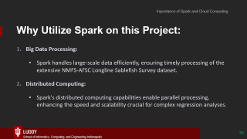
Importance of Spark and Cloud Computing
Authenticated URL For Dataset: https://storage.cloud.google.com/nmfs_odp_afsc/ABL/Longline%20Sablefish%20Survey_ID_17218.csv
Jupiter Notebook URL: https://colab.research.google.com/drive/1KsyJtBAG3F5GmbCNCrdSY6qV_ikTs6Tv?usp=sharing#scrollTo=Ffr6POr1syl5
Notes:
https://console.cloud.google.com/storage/browser/_details/nmfs_odp_afsc/ABL/Longline%20Sablefish%20Survey_ID_17218.csv;tab=live_object?pli=1

Slide 35
Why Utilize Spark on this Project:
Importance of Spark and Cloud Computing
Big Data Processing:
Spark handles large-scale data efficiently, ensuring timely processing of the extensive NMFS-AFSC Longline Sablefish Survey dataset.
Distributed Computing:
Spark's distributed computing capabilities enable parallel processing, enhancing the speed and scalability crucial for complex regression analyses.

Slide 36
Why Cloud Computing Technologies are Crucial:
Importance of Spark and Cloud Computing
Scalability:
Cloud platforms provide on-demand resources, facilitating seamless scalability to accommodate varying computational needs in fisheries industry analyses.
Data Accessibility:
Cloud storage enhances collaboration and accessibility, enabling team members to work with the dataset seamlessly, fostering efficient project management.

Slide 37
References
Alaska Fisheries Science Center. (2023). AFSC/ABL: Longline Sablefish Survey. Available at: https://www.fisheries.noaa.gov/inport/item/17218 Accessed: October 20, 2023.
Alaska Fisheries Science Center. (2023). Longline Sablefish Survey Results. Available at: https://apps-afsc.fisheries.noaa.gov/maps/longline/Results.php Accessed: October 20, 2023.
Alaska Fisheries Science Center. (2023). Longline Fishing Survey Information. Available at: https://www.fisheries.noaa.gov/tags/longline-fishing-survey Accessed: October 20, 2023.
National Marine Fisheries Service. (2022). NPFMC Bering Sea and Aleutian Islands SAFE. Available at: https://www.fisheries.noaa.gov/alaska/science-data/alaska-sablefish-longline-survey-reports Accessed: October 20, 2023.
McKinney, W. (2017). "Python for Data Analysis," O'Reilly Media
VanderPlas, J. (2016). "Python Data Science Handbook," O'Reilly Media.

Slide 38
Google Colab Notebook:
Importance of Spark and Cloud Computing
Google Colab notebook - Group 7

Slide 39
Thank You

