Slide 1
Enhancing Fisheries Research Insights through Big Data Analytics: Leveraging Apache Spark for Scalable and In-Depth Analysis
INFO H516 Applied Cloud Computing for Data Intensive Sciences
Group 7:
Bhushan Shelke
Hasaranga Jayathilake

Slide 2
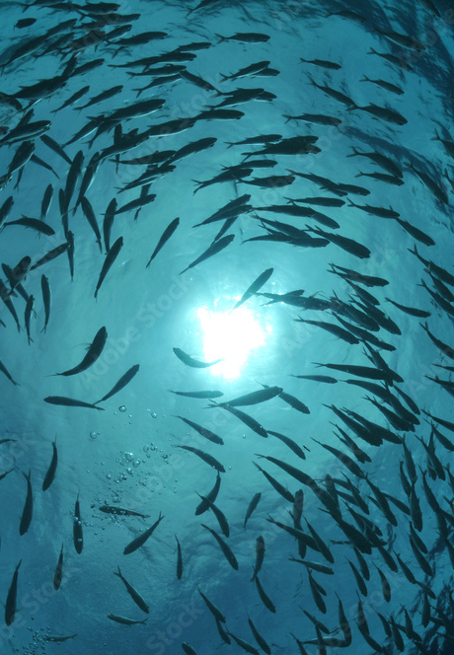
Lineup - Project preliminary presentation
Problem Introduction
Project Objectives
Utilization of Spark
Current Progress
Expected Results

Slide 3
Problem Introduction
SECTION 1

Slide 4




Spark ML for Fisheries Quotas: Usability Assessment
Problem Introduction
Database selected: NMFS-AFSC Longline Sablefish Survey
Owner | Alaska Fisheries Science Center (AFSC) National Oceanic and Atmospheric Administration (NOAA)
Purpose of Database | Primary index for Alaska sablefish stock assessment and population estimation. Used for assessing diverse groundfish species and setting fishery quotas.
Survey data type | Longitudinal (Data Available from 1987 to 2021)
Dataset Volume | Consists of 50 schemas, comprising 1.1 million tuples.
Notes:
https://www.fisheries.noaa.gov/inport/hierarchy?select=17218

Slide 5
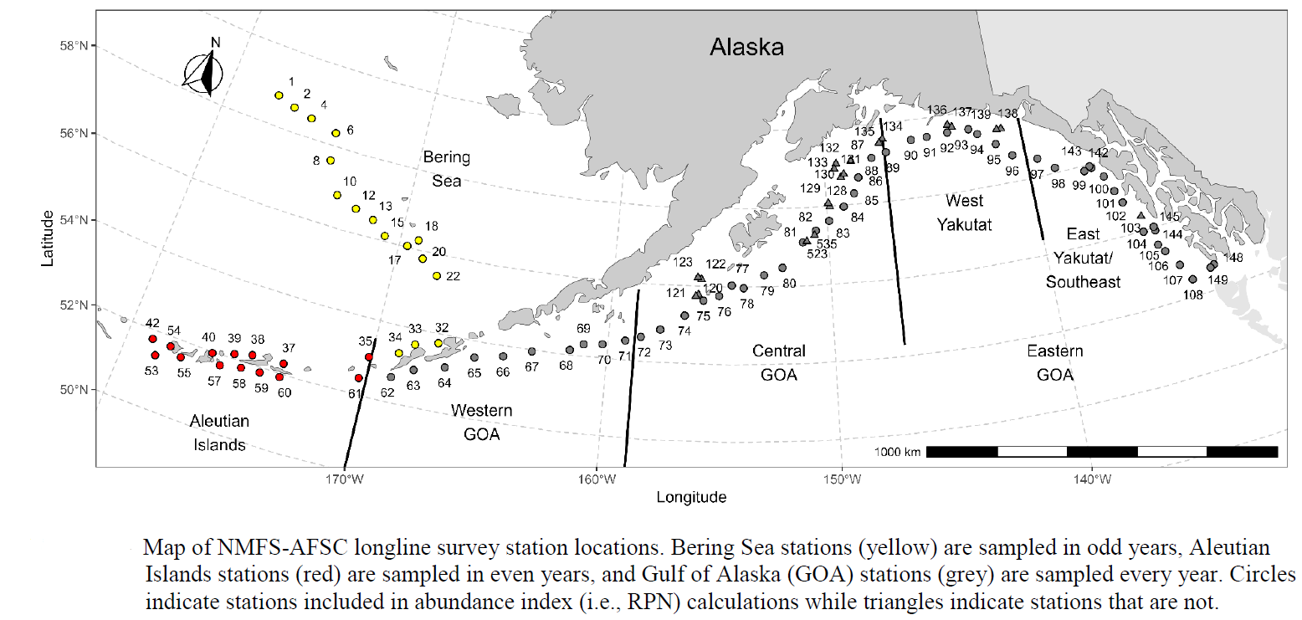
Map of survey coverage
(Alaska Fisheries Science Center, 2023)

Slide 6
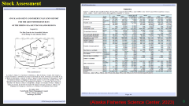
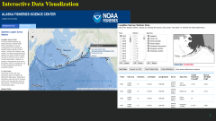
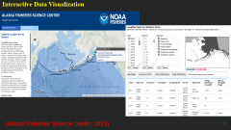
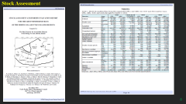
Current Usage of the survey data
Interactive Data Visualization
Data from the Alaska Longline Survey is presented interactively (Data Map) for stakeholders' convenience.
Explore the summary here: Alaska Longline Survey Data Map
Stock Assessment
The data plays a crucial role in calculating relative population numbers and weights, contributing to the assessment of Alaska groundfish stock status.
Explore regional stock assessments and fishery evaluations NPFMC Stock Assessment Reports.

Slide 7
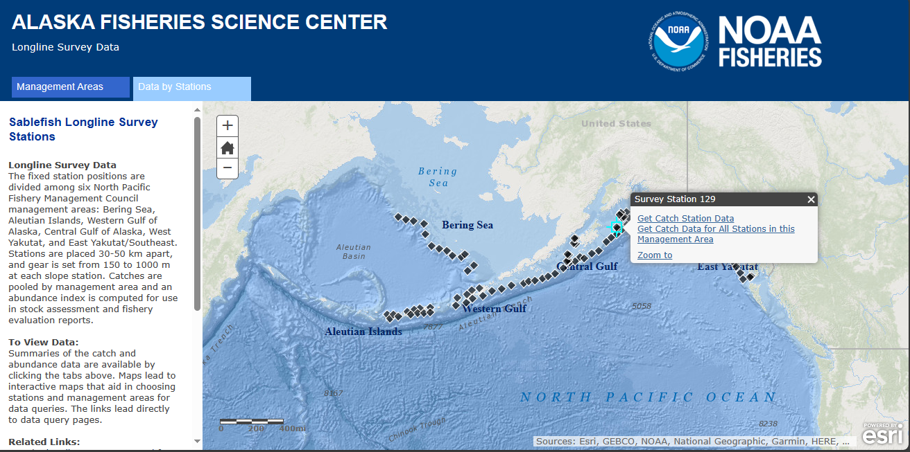
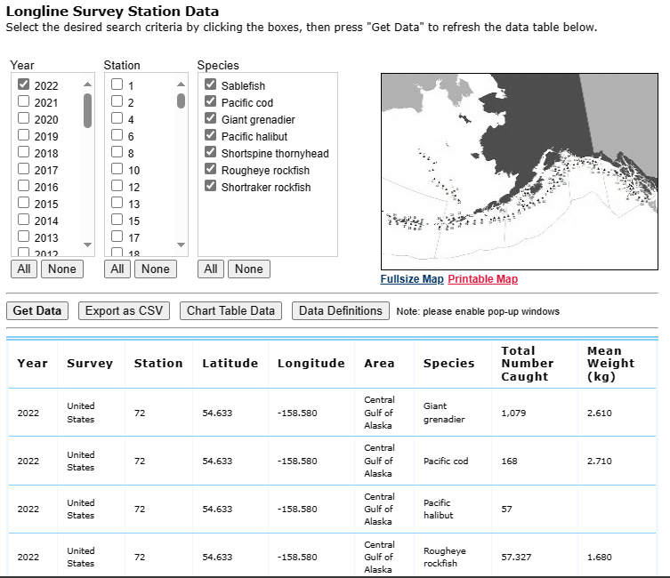
Interactive Data Visualization
(Alaska Fisheries Science Center, 2023)

Slide 8
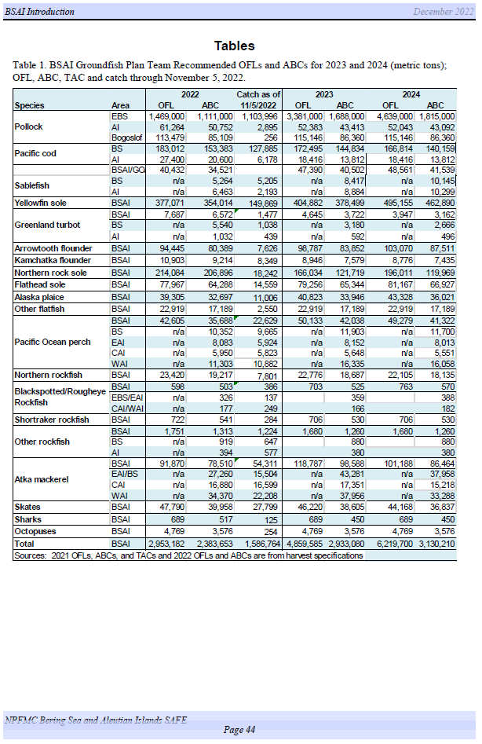
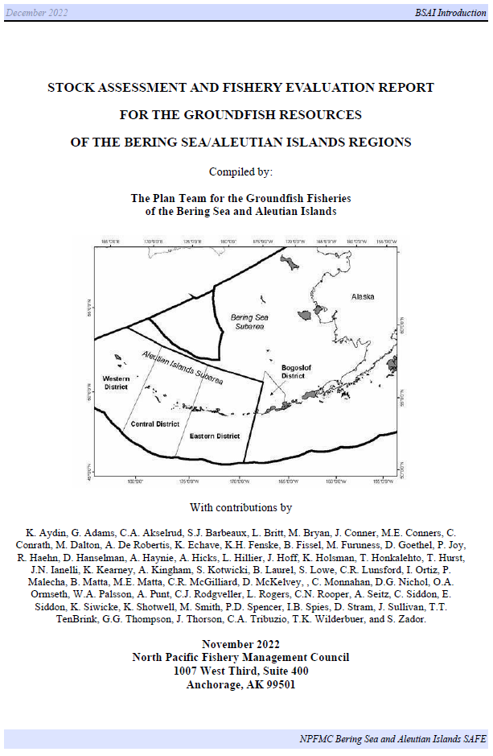
Stock Assessment
(Alaska Fisheries Science Center, 2023)

Slide 9
Project Objectives
SECTION 2

Slide 10
Problem & Objective
Project Objectives
Present Technique utilization :
Mainly reports are driven through the time series techniques for extrapolate the data.
Present survey objectives for understanding Trends in Fisheries:
Data Analysis Reveals Pertinent Fisheries Trends.
Key to Informed Decision-Making for Sustainable Practices.
PROBLEM:
Time series analysis give the results based on the pattern identification for the short- and medium-term forecasting with temporal insight on data evaluation over the time (More weight on Historical side)
PRIMARY OBJECTIVE:
Therefore, using spark, trying to combine the time series and regression modeling to find the model algorithm for compose predictive variables in terms of the fish stocks based on the regions
Notes:
Build a predictive regression model to estimate catch frequencies using time series features, leveraging Apache Spark's distributed computing capabilities.

Slide 11
Utilization of Spark
SECTION 3

Slide 12
Spark and Objectives
Utilization of Spark
Objective: Assess data processing scalability for growing fisheries datasets.
Rationale: Spark handles large datasets, enabling trend analysis over multiple years.
Complex Query Processing
Objective: Investigate habitat-depth correlation using Spark's distributed query processing.
Rationale: Spark efficiently processes complex queries for habitat-fishing depth insights.
Scalability Demonstration
Notes:
Scalability Demonstration
Objective: Evaluate the performance and scalability of data processing as the dataset grows by analyzing trends in catch frequency over the years.
Rationale: Apache Spark's distributed computing capabilities can efficiently handle large datasets, allowing to assess trends and patterns in fisheries data over multiple years and across various stations.
Complex Query Processing
Objective: Investigate the relationship between habitat type and the depth of fishing operations by executing complex queries and aggregations.
Rationale: Spark's ability to process complex queries and perform aggregations across distributed data sets is crucial for deriving insights into the correlation between habitat types and fishing depths.

Slide 13
Spark and Objectives Cont.
Efficient Time Series Analysis
Objective: Use Spark's time series libraries for catch frequency insights.
Rationale: Spark efficiently uncovers temporal patterns in sablefish survey data.
Geospatial Analysis
Objective: Analyze sablefish distribution with Spark's geospatial capabilities..
Rationale: Spark enables spatial analysis with large-scale geospatial datasets.
Machine Learning Model Training
Objective: Train predictive models for catch frequencies using Spark's MLlib.
Rationale: Spark efficiently handles distributed machine learning model training.
Notes:
Efficient Time Series Analysis:
Objective: Perform time series analysis on the catch frequency and species diversity to identify seasonal patterns and changes over time.
Rationale: Spark's built-in libraries for time series analysis can efficiently process temporal data, allowing to uncover patterns, anomalies, and trends in the longline sablefish survey data.
Geospatial Analysis:
Objective: Conduct geospatial analysis to understand the distribution of sablefish and their interaction with temperature, using geographical coordinates and surface temperature data.
Rationale: Spark's geospatial capabilities can handle large-scale geospatial datasets and enable to analyze the spatial distribution of sablefish in relation to environmental factors such as surface temperature
Machine Learning Model Training
Objective: Train a machine learning model to predict catch frequencies based on various features such as depth, distance fished, and habitat type.
Rationale: Spark's MLlib (Machine Learning Library) can efficiently handle the training of machine learning models on distributed data, allowing to build predictive models for catch frequencies and explore the factors influencing them.

Slide 14
Current Progress
SECTION 4

Slide 15
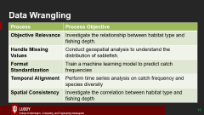
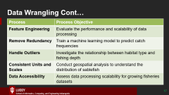
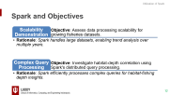
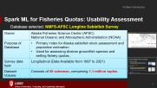

Presently…
Current Progress
Have selected a database
Set the objectives
Progressing: Data Wrangling based on objectives
Progressing: Spark Features utilization in terms of the Data Wrangling
Expecting: Create a Regression Model with IVs

Slide 16
Data Wrangling
Process | Process Objective
Objective Relevance | Investigate the relationship between habitat type and fishing depth.
Handle Missing Values | Conduct geospatial analysis to understand the distribution of sablefish.
Format Standardization | Train a machine learning model to predict catch frequencies
Temporal Alignment | Perform time series analysis on catch frequency and species diversity
Spatial Consistency | Investigate the correlation between habitat type and fishing depth
Notes:
Ensure Data Quality
Explanation: Ensure that the habitat type and depth data are accurate and consistent for meaningful analysis
Handle Missing Values
Explanation: Ensure that geospatial coordinates and surface temperature data are complete for accurate spatial analysis
Format Standardization:
Explanation: Standardize input features to ensure uniformity for machine learning model training.
Temporal Alignment:
Explanation: Align timestamps and ensure temporal consistency for accurate time series insights.
Spatial Consistency:
Explanation: Ensure spatial consistency in habitat and depth data for meaningful correlation analysis.

Slide 17
Data Wrangling Cont…
Process | Process Objective
Feature Engineering | Evaluate the performance and scalability of data processing
Remove Redundancy | Train a machine learning model to predict catch frequencies
Handle Outliers | Investigate the relationship between habitat type and fishing depth
Consistent Units and Scales | Conduct geospatial analysis to understand the distribution of sablefish
Data Accessibility | Assess data processing scalability for growing fisheries datasets
Notes:
Feature Engineering:
Explanation: Create relevant features or aggregates to enhance scalability assessments.
Remove Redundancy:
Explanation: Remove redundant or irrelevant features to improve model training efficiency.
Handle Outliers:
Explanation: Identify and handle outliers to prevent skewed correlations in the analysis.
Consistent Units and Scales:
Explanation: Ensure consistent units and scales for geospatial coordinates to facilitate accurate analysis.
Data Accessibility:
Explanation: Organize data to enhance accessibility, facilitating efficient scalability assessments.

Slide 18
Expected Results / Outcome
SECTION 5

Slide 19
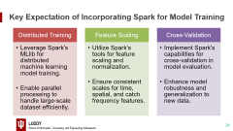
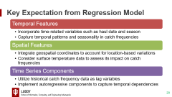
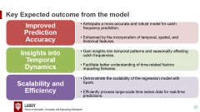
Expected Results
Expected Results / Outcome
Build a Predictive Regression Model to estimate catch frequencies using time series features, leveraging Apache Spark's distributed computing capabilities.

Slide 20
Key Expectation from Regression Model
Temporal Features
Incorporate time-related variables such as haul date and season
Spatial Features
Integrate geospatial coordinates to account for location-based variations
Utilize historical catch frequency data as lag variables
Time Series Components
Capture temporal patterns and seasonality in catch frequencies
Consider surface temperature data to assess its impact on catch frequencies
Implement autoregressive components to capture temporal dependencies

Slide 21
Key Expectation of Incorporating Spark for Model Training
Distributed Training
Leverage Spark's MLlib for distributed machine learning model training.
Feature Scaling
Utilize Spark's tools for feature scaling and normalization.
Implement Spark's capabilities for cross-validation in model evaluation.
Cross-Validation
Enable parallel processing to handle large-scale dataset efficiently.
Ensure consistent scales for time, spatial, and catch frequency features.
Enhance model robustness and generalization to new data.

Slide 22
Key Expected outcome from the model
Improved Prediction Accuracy
Anticipate a more accurate and robust model for catch frequency prediction.
Insights into Temporal Dynamics
Gain insights into temporal patterns and seasonality affecting catch frequencies.
Demonstrate the scalability of the regression model with Spark.
Scalability and Efficiency
Enhanced by the incorporation of temporal, spatial, and historical features.
Facilitate better understanding of time-related factors impacting fisheries.
Efficiently process large-scale time series data for real-time predictions.

Slide 23
References
Alaska Fisheries Science Center. (2023). AFSC/ABL: Longline Sablefish Survey. Available at: https://www.fisheries.noaa.gov/inport/item/17218 Accessed: October 20, 2023.
Alaska Fisheries Science Center. (2023). Longline Sablefish Survey Results. Available at: https://apps-afsc.fisheries.noaa.gov/maps/longline/Results.php Accessed: October 20, 2023.
Alaska Fisheries Science Center. (2023). Longline Fishing Survey Information. Available at: https://www.fisheries.noaa.gov/tags/longline-fishing-survey Accessed: October 20, 2023.
National Marine Fisheries Service. (2022). NPFMC Bering Sea and Aleutian Islands SAFE. Available at: https://www.fisheries.noaa.gov/alaska/science-data/alaska-sablefish-longline-survey-reports Accessed: October 20, 2023.

Slide 24
Thank You

