Slide 1
CMPT 371
Data Communications and Networking
Delays throughput and packet loss
Multiplexing

Slide 2
Travel through a network
Data can travel along different paths from one station to another through the network
Station 1
Station 2
Station 3
Station 14
Station 13
Station 12
Station 7
Station 6
Station 10
Station 9
Station 4
Station 5
Station 8
Station 11

Slide 3
Packet travel times
Packets can travel along different paths from one station to another
Different paths have different travel times
Packets that leave in order A-B-C may arrive in any order, because they travel along different paths with different travel times

Slide 4
Store and Forward node
A network node that
receives and stores incoming packets
checks incoming packets for bit level errors
Forwards the correct packets to the next store and forward node or to the destination end system
Important: Think of each hop as a separate communication

Slide 5
What is a hop
T=1
T=2
Host 1
Host 1
First hop
Host 1 is source
Host 2 is receiver
Host 2
Host 2
Second hop
Host 2 is source
Host 3 is receiver
Host 3
Host 3

Slide 6
Store and Forward node
Important: Think of each hop as a separate communication
Source sends packet
Receiver receives packet processes it and queues it
If the queue is full the receiver drops the packet
Receiver checks the packet for correctness.
If a packet is not correct the receiver may drop the packet (best effort transmission)

Slide 7
At each store and forward node
Delay is introduced
Waiting for the whole packet to arrive
Checking the packet for transmission errors
Forwarding the packet
Waiting in the transmission queue
Sending the packet
As the packet travels to the next node

Slide 8
Delays in each node
☺: Transmission delay: Wait for the whole packet to arrive (or be sent)
A: Processing delay: check that packet has not been corrupted
1: Processing delay: forwarding, calulate which interface should the
packet leave through
Queueing delay: time waited until packet begins to be transmitted
Queueing delay
1
Arriving packet
☺
A

Slide 9
Processing delay
When a packet reaches a store and forward node
Its header must be read and analyzed to determine which interface to send the packet out through
Its contents must be checked for bit level errors. Completing this check requires the whole packet.
The time taken to do these calculations (and perhaps some others) is the processing delay.

Slide 10
Queuing delay
After processing the packet is forwarded to the interface through which it will be transmitted
There may be other packets that have arrived from any interface on the router/host that are already waiting to be transmitted.
The time from when the packet is placed in the queue to be transmitted until the time that it begins to be transmitted is the queueing delay

Slide 11
Queuing delay
After a packet arrives at a store and forward node and is processed by that node it may experience a queueing delay
Unlike other delays, the queueing delay is independent of the properties of the packet experiencing it
Usually analyze queuing delays statistically

Slide 12
Transmission delay
When a packet is sent the hardware used translates one bit at a time and inserts it onto the transmission medium.
Consider the link can send R bits per second
The time taken for all L bits in the packet to be inserted into the transmission medium is the transmission delay, L/R

Slide 13
Propagation Delay
Each bit must travel from the source to the destination through the transmission medium
The time taken by each bit to travel distance d from the source to the destination is the propagation delay
This time Is short (travels near light speed )
velocity v is 2-3 x 10⁸ m/s

Slide 14
Delay Types: Summary
What are the delays introduced as a packet travels from one end system to another?
d_{proc} Processing delay
d_{queue} Queuing delay
d_{trans} Transmission delay
d_{prop} Propagation delay
d_{head} Transmission delay (for header)
d_{data} Transmission delay (for data)

Slide 15
Packet loss
The length of the queue is finite, therefore when the system is busy it is possible for a packet to arrive and find there is no room in the queue: Such a packet is dropped
A packet may have bits corrupted in transmission. Such a packet will not pass the tests for bit level errors and will thus not reach the queue at all

Slide 16
Delays + Optimal Packet size
Consider the next 3 figures. The packet takes a 2 hop path through the network
Message could sent as a single packet: message switching
Message could be broken into smaller packets: packet switching
Message could be sent though a connection: connection oriented
How do we determine the optimal size for a packet/message?
What delays are involved in each case?

Slide 17
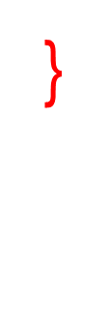
Message switching
}
{
d_{proc}
Assume t_{queue}=0
Message is in 1 packet
d_{trans} = d_{head} + d_{data}
Overhead includes 1*d_{head} for each transmission
Time increases
d_{prop}
M1
M1
d_{trans}
}
d_{proc}
M1
M1

Slide 18
End to end delay
For a single packet the delay at each router is
Ignore the queuing delay (statistical)
Consider a single packet (or message)
the delay between the source and the receiver (the end to end delay) will be

Slide 19
Single message
Consider the previous figure. The packet takes a 2 hop path through the network
Message is sent as a single packet: message switching
The amount of added overhead due to packet headers is minimal since only one packet header is needed
the intermediate nodes must wait until the entire packet has arrived before the packet can be FCS checked and queued for transmission across the next hop.

Slide 20
Packet switching
Assume t_{queue}=0
Message is in 3 packets
Overhead includes 3*d_{head} 1 header for each packet for each transmission
Time increases
{
d_{prop}
P1
P2
{
d_{trans}
P1
d_{proc}
}
P3
P2
P3

Slide 21
Packets
Consider the previous figure. The packets take a 2 hop path through the network
When the message is broken into smaller packets (packet switching)
The amount of added overhead due to packet headers increases as the size of the packet decreases
The delay, waiting for each packet to arrive, at each intermediate node is reduced as the length of the packets is reduced
The amount of data to be retransmitted if a packet is lost is reduced as packet length decreases

Slide 22
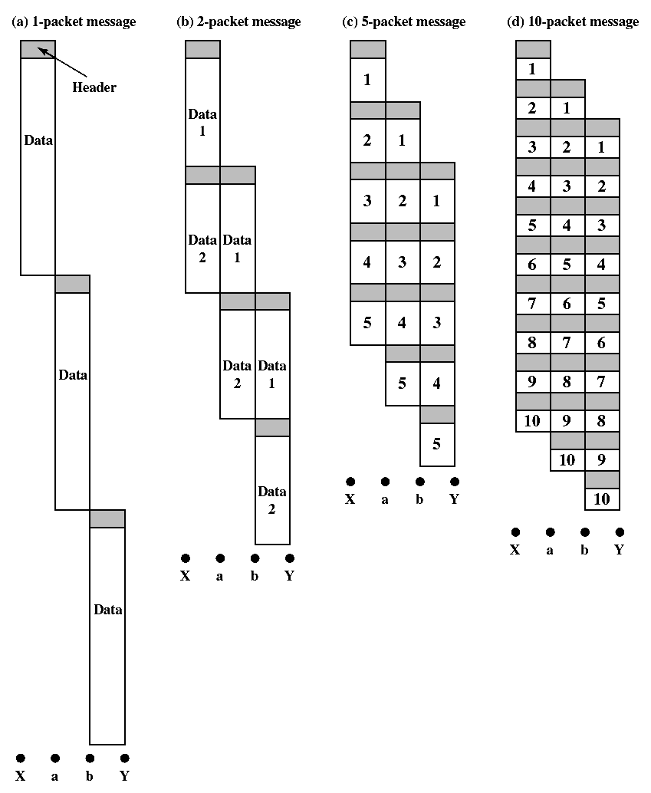
Effect of packet size
Stallings 2003: Figure 10.14

Slide 23
End to end delay: 1 packet
First consider the delay for the single packet case
where
d_{data} transmission time of the packet
d_{head} transmission time of the header
d_{prop} propagation time per transmission
N_{trans} # of time the signal is transmitted
N_{pack} # of packets
$$d_{endtoend}=\left\{d_{proc}+d_{prop}+\left(d_{data}+d_{head}\right)\right\}×3$$
$$d_{endtoend} =\left\{d_{proc}+d_{prop}+\left(d_{data}+d_{head}\right)\right\}×\left\{N_{pack}+(N_{trans}−1)\right\}$$

Slide 24
Effect of packet size
Stallings 2003: Figure 10.14

Slide 25
End to end delay: 2 packets
When there are 2 packets,
the first packet travels from the 2nd node to the 3rd node
at the same time the 2nd packet travels from the 1st node the 2nd node`
The delay becomes
$$d_{endtoend}=\left\{d_{proc}+d_{prop}+\left(d_{data}+d_{head}\right)\right\}×\left\{4\right\}$$
$$d_{endtoend} =\left\{d_{proc}+d_{prop}+\left(d_{data}+d_{head}\right)\right\}×\left\{N_{pack}+(N_{trans}−1)\right\}$$

Slide 26
Effect of packet size
Stallings 2003: Figure 10.14

Slide 27
End to End Delay: more packets
For the five packet case
Therefore we can generalize the relation to
$d_{endtoend}=\left\{d_{proc}+d_{prop}+\left(d_{data}+d_{head}\right)\right\}×$7
$$d_{endtoend} =\left\{d_{proc}+d_{prop}+\left(d_{data}+d_{head}\right)\right\}×\left\{N_{pack}+(N_{trans}−1)\right\}$$

Slide 28
Effect of packet size
Stallings 2003: Figure 10.14

Slide 29
Packet size considerations
Delay is introduced by requiring packet, or section of message, to arrive at an intermediate station before the message is forwarded is smaller than for message switching
Packet headers add additional overhead that increases as the size of the packet decreases
Waits for next link will be minimized if smaller packets of data are being transmitted as single units
Shorter packets are less likely to contain errors and require retransmission than long messages
Required retransmissions are shorter, and add less additional load to the system

Slide 30
Packet Switching:
No call setup or call termination required.
Each packet, referred to as a datagram, is sent individually, and is routed through the network individually
Packets with the same source and destination may take different paths through the network and thus may arrive at the receiver out of order
Flexible reaction to congestion and failure
Robust delivery of packets, less loss of information in lost packet than in broken virtual connection when a node fails

Slide 31
Circuit switching
Time increases
Call request signal
Message is in 1 block
No headers
Overhead includes establishing and breaking connection
d_{proc}
}
Call accept signal
}
d_{proc}
d_{prop}
{
M1
M1
d_{trans}
M1
d_{proc}
}
ack

Slide 32
End to End Throughput
The amount of data that can pass through from one edge system to another
Instantaneous end to end throughput: rate data is passing between the end systems at a particular instant
Average end to end throughput: rate data is passing between the end systems averaged over a specified length of time

Slide 33
End to end throughput considerations
For some processes like video, efficient operation requires a minimum level of instantaneous throughput over time and a minimum level of average end to end throughput
For some processes like mail, efficient operation requires only a minimum average end to end throughput level

Slide 34

Bottleneck Link: throughput
server
Link C bps
Link A bps
Link B bps
BOTTLENECK
A > B >> C
client
Link A bps

Slide 35
Access Networks
Mobile Networks
National ISP (Internet Service Provider)
Local ISP
Enterprise (business) network
Home network
ISPs use ADSL, Cable, wireless, fibre

Slide 36
Multiplexing
When multiple signals are carried through a single transmission medium at the same time, the signals are multiplexed
Multiplexing allows the efficient use of wider band transmission media. Such media can carry multiple narrower band signals.
Long haul links are frequently examples of high capacity channels
The multiple signals must be combined or multiplexed in such a way that the individual signals can be easily extracted from the composite signal (demultiplexed) on reception

Slide 37
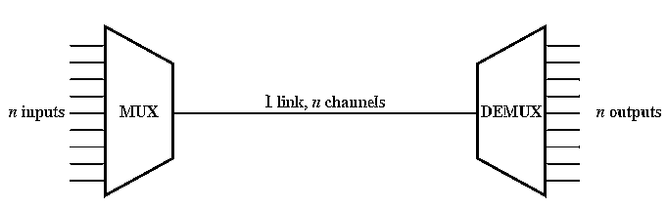
Methods of Multiplexing
Frequency Division Multiplexing
Time Division Multiplexing
Synchronous
Statistical
Code Division Multiplexing (spread spectrum)
Diagram Stallings 2003:Figure 8.1

Slide 38
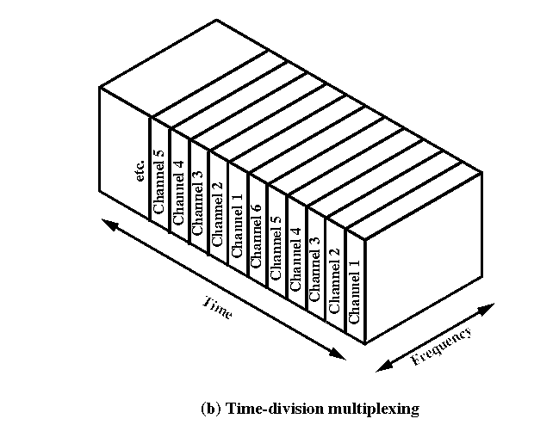
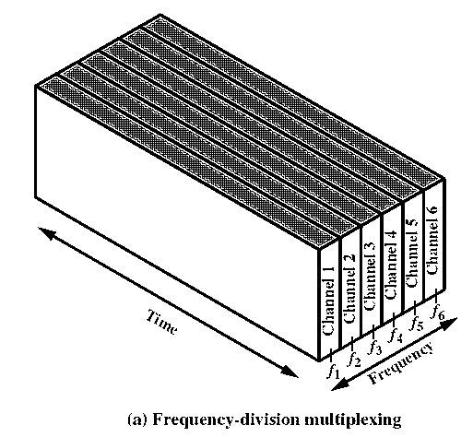
FDM and TDM
Stallings 2003:Figure 8.2

Slide 39
Frequency Division Multiplexing
When the transmission media has a bandwidth many times larger than the bandwidth of the signal to be transmitted, it makes sense to transmit more than one signal at a time through the medium.
Each of the signals to be transmitted are modulated to a different carrier frequency.
The different carrier frequencies are separated by at least the bandwidth of the individual signals to be transmitted
The frequency bandwidth is shared by the signals being simultaneously transmitted

Slide 40
Frequency division multiplexing
Bandwidth of Medium is f_{max}-f_{min}
f₁
f₂
f₃
f₄
f₅
f₆
f₇
f₈
f_{min}
f_{max}
f_{(i+1}}=f_{i} + bandwidth of signal
Bandwidth of each signal

Slide 41
FDM
Examples of FDM include multiplexing of voice signals over telephone lines, and multiplexing of cable channels into the allocated cable frequency band
FDM can be done in stages. M signals can be multiplexed into a particular frequency band. Groups of M signal can then be combined and multiplexed into a larger frequency band

Slide 42
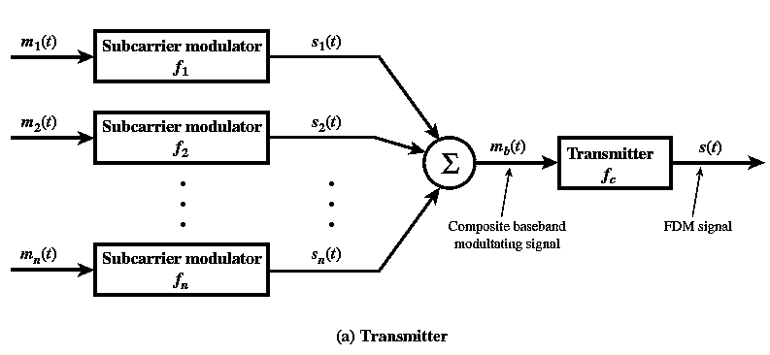
FDM multiplexing system
Stallings 2003:Figure 8.3

Slide 43
FDM and voice signals: 1
A typical voice signal has an effective spectrum of 300 to 3400 Hz, When multiplexing signals the signals must be adequately separated, so allow 4KHz bandwidth for each voice signal
A voice signal can be modulated so that the spectrum of the modulated signal has a center frequency at the frequency of the modulation carrier f_{c,}
If the carrier has a bandwidth between f₁ Hz and f₂ Hz then f_{c} would be chosen to be f₁+4KHz

Slide 44
Cable and ADSL
ADSL uses the fixed telephone system.
Each user has a dedicated connection to the end office
User must be close enough to the end office
Each of these connections use twisted pair
Capacity of twisted pair less than capacity of cable
Uses FDM
Cable shares a higher capacity coaxial cable between multiple users.
Available capacity may be higher or lower than ADSL
Can intercept packets of other users on the same cable link
Uses TDM

Slide 45
Cable access to Internet
Cable Providers Internet Access

Slide 46
ADSL
Asymmetric Digital Subscriber Line, to 20Mbps downstream and 100Mbps upstream. (Typically 512 kbps and 64 kbps)
Provides high speed access over twisted pair telephone wires. Up to 256 4MHz channels available
Normal telephone connection filtered to 4KHz bandwidth at end office (switching station)
For ADSL filter is removed making entire capacity of the twisted pair (category 3) available to the user. The capacity and attainable speed depend on the distance from the end office (length of connection).
Typical user needs more downstream capacity than upstream capacity for internet applications
Uses FDM and/or discrete multitone (DMT)

Slide 47
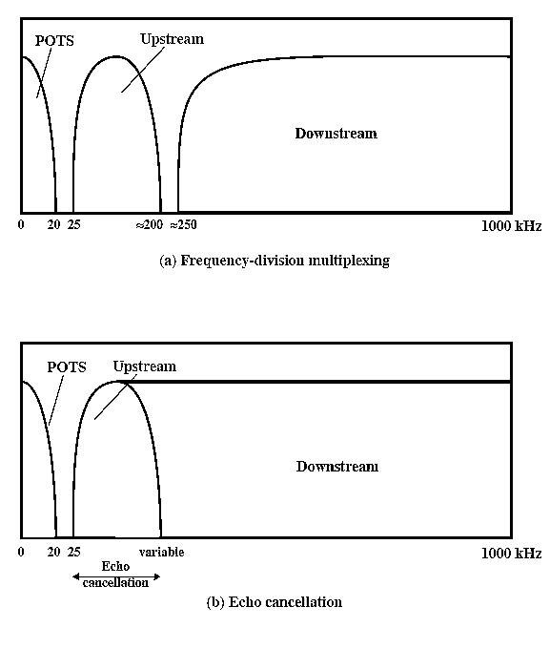
ADSL channel configurations

Slide 48
Wavelength Division Multiplexing
Used with optical fibre
Light passing through the fiber consists of many colours or wavelengths (frequencies)
Each wavelength carries a signal
The fibre can carry many signals at the same time, as signals with different wavelengths
As many as 160 channels at 10 Gbps
Used for cable (between central offices)

Slide 49
TDM (Time Division)
The data are organized in frames
Each frame contains a cycle of time slots
A sequence of slots dedicated to one source is a channel
Data from different sources is inserted into slots or channels in some sequence
Synchronous TDM slots are filled from a predetermined sequence of sources. If there is no data to transmit an ‘idle’ signal is sent (circuit switching)
Statistical TDM fills slots as data is available. There is not preset sequence. Therefore, data must be associated with the source by address. No empty or ‘idle’ slots are sent if any source has data ready to transmit. Idle is sent only if all channels have no data to transmit (packet switching)

Slide 50
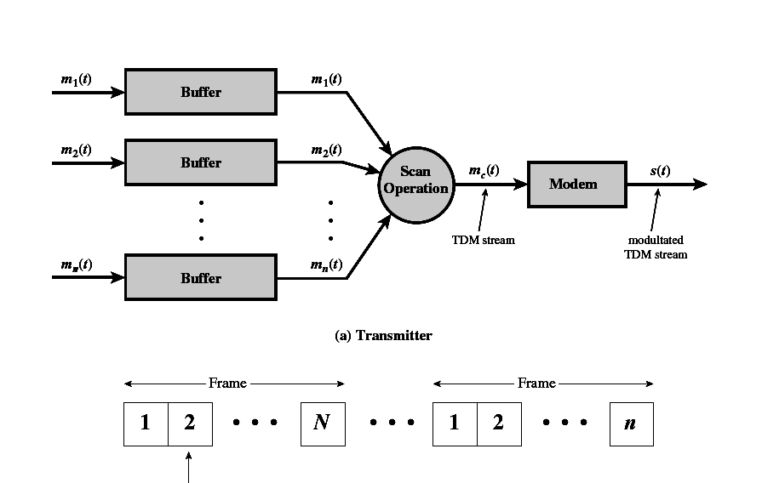
Synchronous TDM
Channel (1 or more slots)
Cycle of time slots
Stallings 2003:Figure 8.6

Slide 51
Statistical TDM
Time slots are not pre-allocated to particular sources, they are allocated on demand.
There are M sources, N available channels .: M>=N
Rather than transmitting an idle signal when no data is available from a source i, data from source j can be transmitted.
The data rate of the transmission line can be smaller than the sum of the data rates for all sources being serviced
At peak times the data rate of received data from the sources may exceed the data rate of the transmission media. In these cases excess data must be buffered in the multiplexer for later transmission

Slide 52
Statistical TDM
Statistical TDM is most useful is systems where sources do not broadcast continuously.
If each source broadcasts 80% of the time. Statistical TDM can handle 20% more channels than asynchronous TDM
There are overhead costs associated with this gain in efficiency.
Sources are not transmitted in a predetermined order, so there is not a direct way to know which source is being transmitted in a given channel. Thus, each channel must contain an address that indicates the source

Slide 53
Internet over Cable
HFC (Hybrid Fiber and Coax systems)
Coaxial cables for users and local branches
Branches connecting to optical fiber trunks
Use a cable modem connected to your computer
Cable modems follow DOCSIS (Data Over Cable Service Interface Specification)
Assymetric data flow

Slide 54
Spectrum allocation for cable
MHz 750
5
42
54
550
Upstream
data
TV and FM radio
Downstream
data
downstream
upstream

Slide 55
Data transfer using cable
Upstream channel (from user) is divided into slots. Each modem is assigned a slot. More than one modem can be assigned to a particular slot causing possible contention
A user will request downstream capacity, be granted the capacity and then receive the information at the appointed time

Slide 56
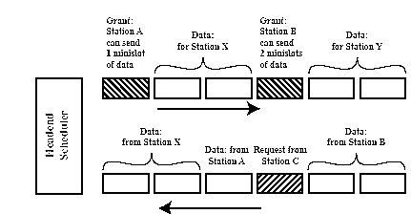
Cable Modem TDM Scheme
Downstream
No contention

