Slide 1
CMPT 365 Multimedia Systems
Media Representations
- Video
Summer 2020

Slide 2
Outline
Analog Video
Digital Video
Video Interfaces
HDTV
Further Exploration

Slide 3
Analog Video
An analog signal f(t) samples a time-varying image
Progressive scanning
  traces through a complete picture (a frame) row-wise for each time interval.
Interlaced scanning
  Odd-numbered lines traced first, and then the even-numbered lines.
  “odd" and “even" fields - two fields make up one frame
  Widely used in traditional (non-digital) TV

Slide 4
Digital vs Analog TV Signal
Digital video:
Progressive Frame
All lines
TV signal:
Interlaced Fields: even lines or odd lines only
Tradeoff between frame rate and bandwidth
y
y
time
odd / bot. field
even / top field
x
x
y
y
De-interlacing
t
t

Slide 5
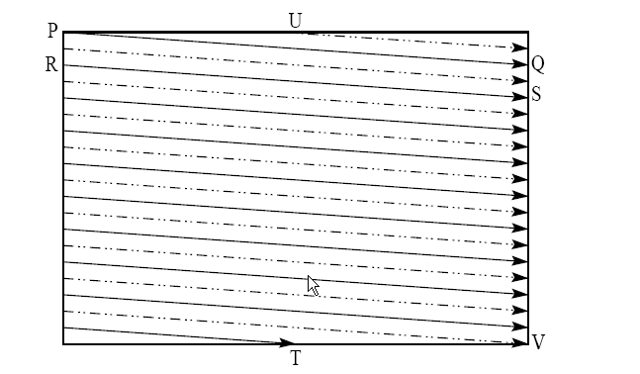
Interlaced Scan
First the solid (odd) lines are traced, P to Q, then R to S, etc., ending at T; then the even field starts at U and ends at V.
The jump from Q to R, etc. is called the horizontal retrace, during which the electronic beam in the CRT is blanked.
The jump from T to U or V to P is called the vertical retrace

Slide 6
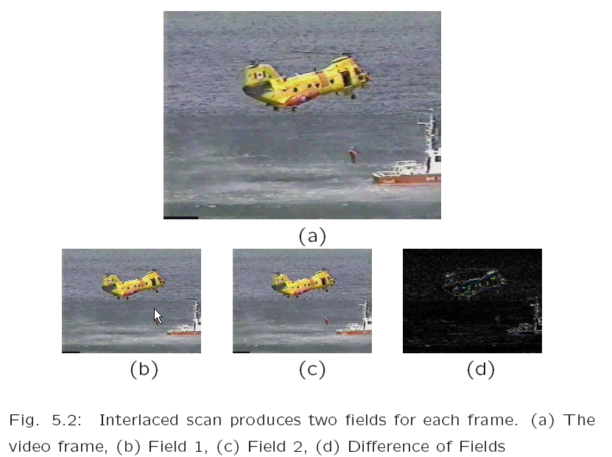
Example of Interlaced Scan

Slide 7
NTSC Video
NTSC (National Television System Committee) TV standard is mostly used in North America and Japan
  YIQ color model
  4:3 aspect ratio (i.e., the ratio of picture width to its height)
  525 scan lines per frame at 30 frames per second (fps).
Interlaced scanning, and each frame is divided into two fields, with 262.5 lines/field
  horizontal sweep frequency is 525x29.97 = 15,734 lines/sec,
  each line is swept out in 1/15,734 = 63.6 us
  the horizontal retrace takes 10.9 sec, this leaves 52.7 sec for the active line signal during which image data is displayed
PAL in Asia/Europe, SECAM in Europe
All faded out (Canada, Aug 31, 2011)

Slide 8
Outline
Analog Video
Digital Video
Video Interfaces
HDTV
Further Exploration

Slide 9
Digital Video
Why digital video ?
Advantages
  Stored on digital device or in memory
  Faithful duplication in digital domain
    Good or bad ?
  Direct (random) access,
    nonlinear video editing achievable as a simple, rather than a complex task
  Ease of manipulation (noise removal, cut and paste, etc.)
  Ease of encryption and better tolerance to channel noise
    Multimedia communications
  Integration to various multimedia applications

Slide 10
ITU-R digital video specifications
 | CCIR 601 525/60 NTSC | CCIR 601 625/50 PAL/SECAM | CIF | QCIF
Luminance resolution | 720 x 480 | 720 x 576 | 352 x 288 | 176 x 144
Chrominance resolution | 360 x 480 | 360 x 576 | 176 x 144 | 88 x 72
Colour Subsampling | 4:2:2 | 4:2:2 | 4:2:0 | 4:2:0
Fields/sec | 60 | 50 | 30 | 30
Interlaced | Yes | Yes | No | No
Note, CIF is a compromise of NTSC and PAL in that it adopts the ‘NTSC frame rate and half of the number of active lines as in PAL.

Slide 11
CCIR-601
CCIR-601 for component digital video
  specified by Consultative Committee for International Radio (CCIR)
  aspect ratio of 4:3
  interlaced scan, so each field has only half as much vertical resolution
  Now become standard ITU-R-601, adopted by many digital video formats including the popular DV video.

Slide 12
CIF
CIF: Common Intermediate Format
  Specified by CCITT (Comité Consultatif International Téléphonique et Télégraphique).
A format for lower bitrate
  CIF is about the same as VHS quality.
  Progressive (non-interlaced) scan.
QCIF: “Quarter-CIF"
CIF/QCIF resolutions are evenly divisible by 8, and all except 88 are divisible by 16; this provides convenience for block-based video coding in H.261 and H.263, discussed later

Slide 13
Chroma Subsampling
Since humans see color with much less spatial resolution than they see black and white, it makes sense to subsample chrominance signal
Interesting (but not necessarily informative!) names have arisen to label the different schemes used.
  4:4:4
  4:2:2
  4:1:1
  4:2:0
To begin with, numbers are given stating how many pixel values, per four original pixels, are actually sent:
  The chroma subsampling scheme 4:4:4 indicates that no chroma subsampling is used: each pixel's Y, Cb and Cr values are transmitted, 4 for each of Y, Cb, Cr.

Slide 14
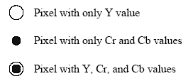

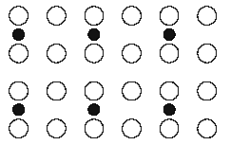
Chroma Subsampling cont’d
4:2:2: horizontal subsampling of the Cb, Cr signals by a factor of 2.
  of four pixels horizontally labelled as 0 to 3, all four Ys are sent, and every two Cb's and two Cr's are sent, as (Cb0, Y0)(Cr0, Y1)(Cb2, Y2)(Cr2, Y3)(Cb4, Y4), and so on (or averaging is used).
4:2:0: subsamples in both the horizontal and vertical dimensions by a factor of 2.
  an average chroma pixel is positioned between the rows and columns.
Scheme 4:2:0 along with other schemes is commonly used in JPEG and MPEG (more later).

Slide 15
Outline
Analog Video
Digital Video
Video Interfaces
HDTV
Further Exploration

Slide 16
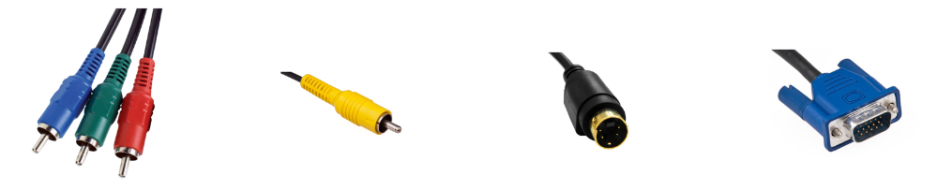
Analog Video Display Interfaces
Component video, Composite video, S-video, VGA

Slide 17
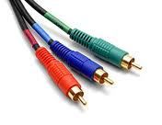
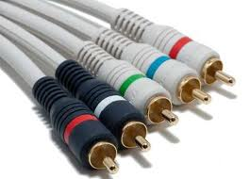
Component video
Component video: three separate video signals for the red, green, and blue image planes. Each color channel is sent as a separate video signal.
  For higher-end video systems
  Supported by most computer systems
  Best color reproduction
    no “crosstalk“ between the three channels.
  But more bandwidth and good synchronization

Slide 18
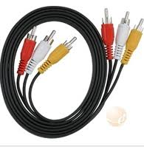
Composite Video - 1 Signal
Composite video: color (“chrominance") and brightness (“luminance") signals are mixed into a single wire
  Chrominance (I and Q, or U and V).
    Combined into a chroma signal, and then put at the high-frequency end of the signal shared with the luminance signal Y.
  Chrominance and luminance components separated at the receiver end and then two color components be further recovered.
  Only one wire for video signal
    Audio signals added through separate wires
Interference is inevitable.

Slide 19
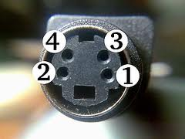
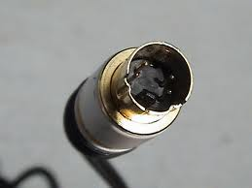
S-Video - 2 Signals
S-Video: Separated video, or Super-video
  a compromise, with two wires
  one for luminance and another for a composite chrominance signal.
  Less crosstalk between color and the crucial gray-scale information.
Reason for placing luminance into its own part
  black-and-white is most crucial for visual perception.
    Both in terms of brightness and spatial resolution
    Less information for color is fine

Slide 20
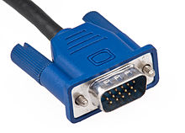
VGA (Video Graphics Array)
Analog only
Introduced with IBM x86 machines (1987), but became a universal analog display interface
R, G, B, plus power, syn, control etc
A VGA (D-sub) connector

Slide 21
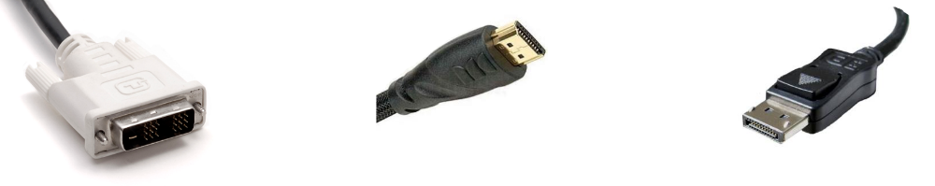
Digital Display Interfaces
Digital interfaces emerged in 1980s (e.g., Color Graphics Adapter (CGA), and evolved rapidly.
Connectors of different digital display interfaces: DVI, HDMI, DisplayPort.

Slide 22
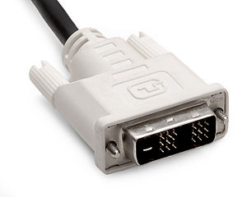
DVI (Digital Visual Interface)
Uncompressed digital video
Almost a ubiquitous computer display link replacing VGA (since 1999)
Uncompressed video only
  R, G, B (both digital and analog)
  plus clock, syn, power, control etc.
Single link: 1920x1080 60Hz
Dual link: 2560x1600 60Hz

Slide 23
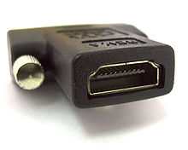
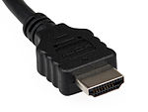
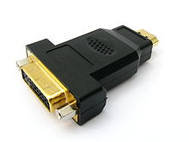
HDMI (High-Definition Multimedia Interface)
(2002) backward-compatible with DVI
RGB or YCbCr + digital audio
  + bidirectional audio, ethernet
High bandwidth digital content protection (HDCP)
HDMI 1.3 2560x1600

Slide 24
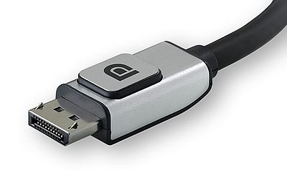
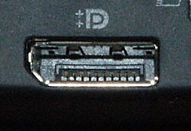
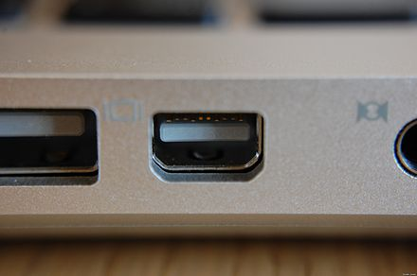
Display Port
(2006) Packetized transmission (like Internet)
  4K video support
Royalty-free (HDMI is not!)
Variation/enhancement: Thunderbolt

Slide 25
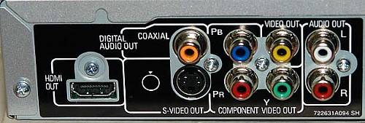
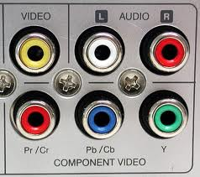
Example: DVD Player

Slide 26
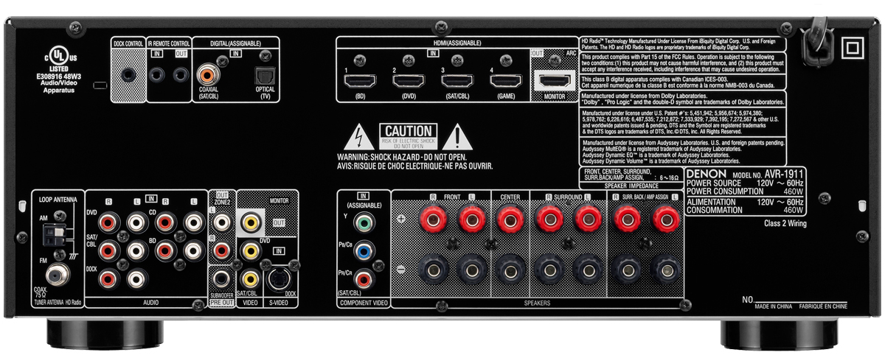
Example: Home Theatre Receiver

Slide 27
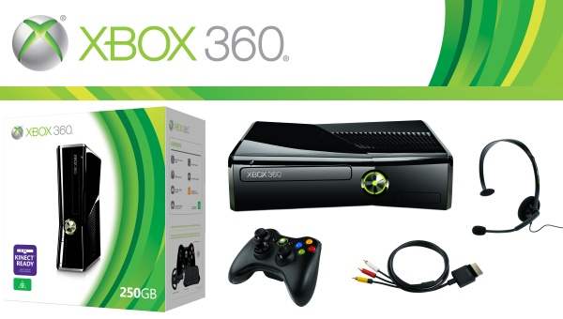
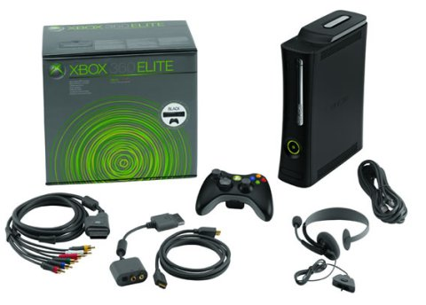
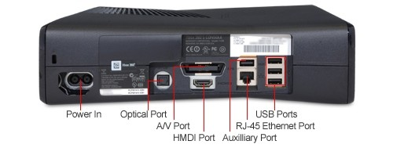
Example: Xbox 360
Simple package vs premium package

Slide 28

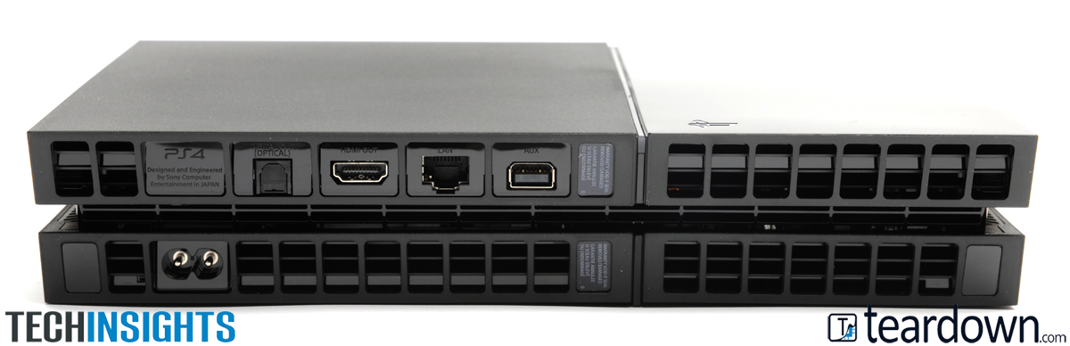
Example: PS4

Slide 29
Outline
Analog Video
Digital Video
Video Interfaces
HDTV
Further Exploration

Slide 30
HDTV
Main objective of HDTV (High Definition TV)
  not necessary to increase the “definition" in each unit area
  but rather to increase the visual field especially in its width.
First generation of HDTV
  an analog technology developed by Sony and NHK in Japan in the late 1970s.
MUSE (MUltiple sub-Nyquist Sampling Encoding)
  an improved NHK HDTV with hybrid analog/digital technologies in the 1990s.
  1,125 scan lines, interlaced (60 fields per second), and 16:9 aspect ratio.
Need for compressions
  uncompressed HDTV will easily demand more than 20 MHz bandwidth, which will not t in the current 6 MHz or 8 MHz channels
  high quality HDTV signals would be transmitted using more than one channel even after compression.

Slide 31
More about HDTV
For video, MPEG-2 is chosen as the compression standard.
For audio, AC-3 is the standard
  supports 5.1 channel Dolby surround sound -- 5 surround channels plus a subwoofer channel
Difference between conventional TV and HDTV:
  Much wider aspect ratio of 16:9 instead of 4:3.
  All progressive (non-interlaced) scan
    interlacing introduces serrated edges to moving objects and flickers along horizontal edges
    Upsampling ? 120 Hz, 200 Hz ?

Slide 32
HDTV in North America
1987: FCC (Federal Communications Commission) decided that HDTV standards must be compatible with existing NTSC and be confined to the existing VHF (Very High Frequency) and UHF (Ultra High Frequency) bands.
1990: FCC announced a very different initiative
  preference for a full-resolution HDTV
  HDTV would be simultaneously broadcast with the existing NTSC TV and eventually replace it.
1993: after a boom of proposals for digital HDTV, the FCC made a key decision to go all-digital.
  A “grand alliance" was formed that included four main proposals, by General Instruments, MIT, Zenith, and AT&T, and by Thomson, Philips, Sarnoff and others.
  This eventually led to the formation of the ATSC (Advanced Television Systems Committee) -- responsible for the standard for TV broadcasting of HDTV.
1995: U.S. FCC Advisory Committee on Advanced Television Service recommended that the ATSC Digital Television Standard be adopted.

Slide 33
Advanced Digital Formats by ATSC
“I”: interlaced scan
“P”: progressive (non-interlaced) scan
# of Active Pixels per line | # of Active Lines | Aspect Ratio | Picture Rate
1,920 | 1,080 | 16:9 | 60P 60I 30P 24P
1,280 | 720 | 16:9 | 60P 30P 24P
704 | 480 | 16:9 or 4:3 | 60P 60I 30P 24P
640 | 480 | 4:3 | 60P 60I 30P 24P

Slide 34
Recent Advances
The FCC (Federal Communications Commission) has planned to replace all analog broadcast services with digital TV broadcasting by the year 2006.
  later delayed to June 12,2009 in US
  Canada: August 31, 2011 (one year extension for some CBC transmitters)
The services provided will include:
  SDTV (Standard Definition TV): the current NTSC TV or higher
  EDTV (Enhanced Definition TV): 480 active lines or higher, i.e., the third and fourth rows in the Table
  HDTV (High Definition TV): 720 active lines or higher

Slide 35
Ultra High Definition TV (UHD, or 4K)
Announced in 2012
  4K UHDTV: 2160P (3,840×2,160, progressive scan) and 8K UHDTV: 4320P (7,680×4,320, progressive scan).
Aspect ratio is 16:9. Bit-depth can be up to 12 bits, and the chroma subsampling can be 4:2:0 or 4:2:2.
Supported frame rate has been gradually increased to 120 fps.
UHDTV will provide superior picture quality, comparable to IMAX movies, but it will require a much higher bandwidth and bitrate – 40MBps encoded !
VR/AR? 16K video ?

Slide 36
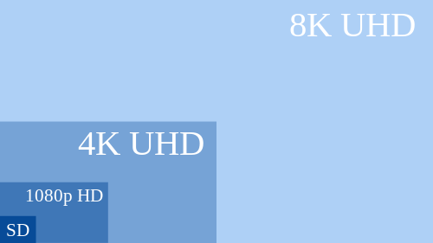
Ultra High Definition TV (UHD, or 4K)

Slide 37
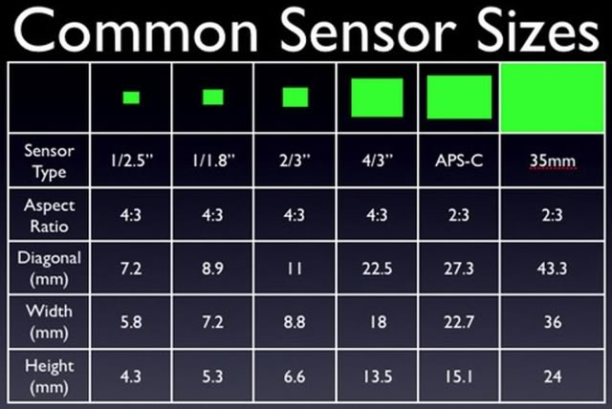
CCD/CMOS Image Sensor Size

Slide 38
Outline
Types of Video Signals
Analog Video
Digital Video
HDTV
Further Exploration

Slide 39
Further Exploration
Chapter 5.1, 5.2, 5.3

