Slide 1
CMPT 365 Multimedia Systems
Introduction
Jiangchuan Liu
Summer 2020

Slide 2
Outline
Course information
What is multimedia? A brief introduction
Popular multimedia tools
Summary

Slide 3
Course Information
Instructor:
  Jiangchuan (JC) LIU
  University Professor
  School of Computing Science
  Office: TASC I 9005
  E-mail: jcliu@cs.sfu.ca
  Office Hours: Wed 10:45-11:45am (Zoom)
  E-mail is the good way to communicate with me
TA

Slide 4
Course Information
Time & Venue
  M/W/F 13:30-14:20 Remote

Slide 5
Why this course?
Multimedia is cool
  Media -> Multimedia
  Everywhere
  Requires broad knowledge in mathematics, signal processing, communications, networking, software, hardware, ……
  You are paid to watch movies at your office !
Job opportunities
  Multimedia is a booming industry
    in the metro Vancouver area
  Tons of opportunities created by next-generation standards and emerging applications:
    JPEG/JPEG 2000
    MPEG-1/2/4 H.264/265/HEVC 4K/8K UHD 3D/freeview
    3G/4G/5G mobile communications
    Multimedia-enabled smartphone, tablets
    Social media, Cloud media, Crowd media
    Online gaming

Slide 6

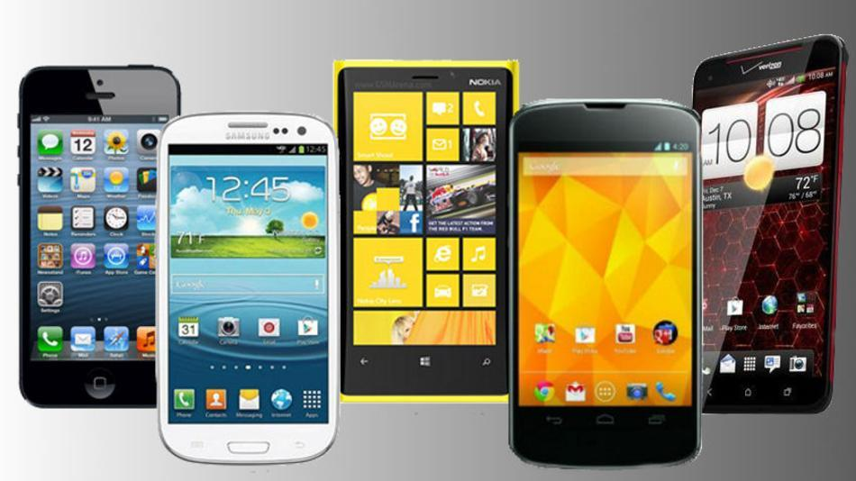
Example
Old: NTT DoCoMo 3G Mobile Phone:
  launch in 2001
  99% coverage in Japan as of March 2004
  Up to 384 kbps video downloading
  40 times faster than 2G network (comparable to ADSL)
New: 4G LTE Mobile Phone:
  100 Mbps stationary
  allow 3D virtual reality and interactive video / hologram images
  Commercial service since in 2010
  97% of the population in Canada now
Even newer: 5G
  1 Gbps
  VR/AR/Car …

Slide 7
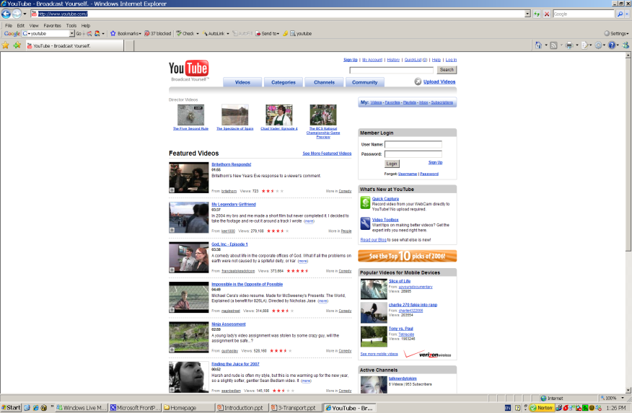
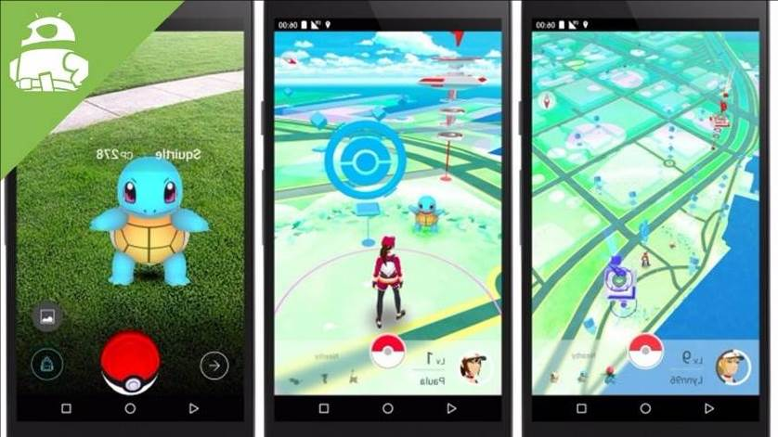
Example
Web2.0/Media streaming (Internet TV)
  YouTube, Netflix, Twitch, TikTok
  4K/8K/16K HD/UHD video ?
  3D/360 degree video ?
E-commerce
  Ebay, Amazon, Craigslist, Groupon
Online game
  PS, XBOX, Switch
…
Social networking (2004-)
  Facebook, Twitter …
  Instagram, TikTok …
  WhatsApp, Wechat …
AR/VR
AI

Slide 8
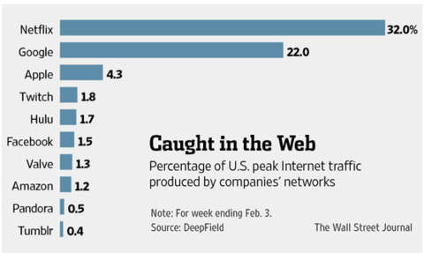
Multimedia Companies
Microsoft
Intel
AMD
Adobe
Apple
Amazon
Google
Facebook
Twitter
Zoom
Sony
NVidia
Philips
Twitch
YouTube
Netflix
Huawei
Qualcomm
…

Slide 9
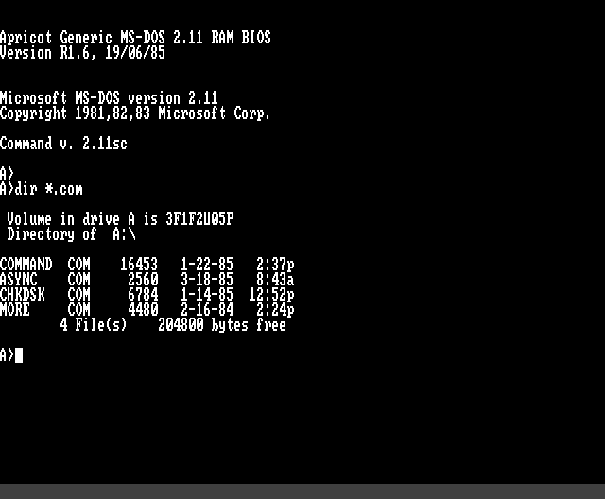
What are the objectives of this course?
Understand what’s behind the interface
  Behind BluRay, HDTV, mp3, mp4, flac, raw, jpeg ? …
  3D, 4K/8K UHD TV ?
Process multimedia data by yourself (programming projects)
Have fun!
  What a life without multimedia ?!
    A PC with black-white monitor only …

Slide 10
More details
To understand the methods for multimedia representation and compression
  - Representation (audio/video)
  Digitization
  Quantization
  - Compression (audio/video)
  Transform
  Entropy Coding
  Coding Standards
To study the issues in multimedia communications
  QoS Requirements
  Network Protocols
    TCP, UDP, IP, RTP…
  Streaming Media
Multimedia database
  Organization
  Retrieval
To help you survive a job interview in multimedia
  Programming assignments
  C, C++, Java, Matlab could be involved

Slide 11
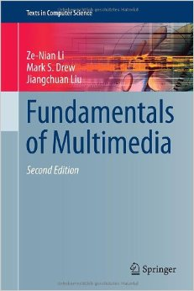
Books and References
Textbook
  Fundamentals of Multimedia, 2nd Edition, by Z.-N. Li, M.S. Drew, and J. Liu, Springer 2014.
Reference books
  Video Processing and Communications, Y. Wang, J. Ostermann, Y-Q Zhang, Prentice Hall.
  Computer Networking: A Top-Down Approach, by J. F. Kurose and K. W. Ross, Addison Wesley.

Slide 12
Other Resources
Others
  A reference book on C/C++/Java
Resource
  Home page
    www.cs.sfu.ca/~jcliu/cmpt365
  Pls check your email regularly

Slide 13
Tentative schedule
Introduction (1 week)
Media basics (2 weeks)
  Audio/Image/Video representation
Media compression (4-5 weeks)
  Audio coding (.wav, .mp3, .aac, .flac…)
  Image coding (.jpg, .bmp, .tiff, …)
  Video coding (.mpeg, .avi, mp4 …)
Multimedia networking and communications (2-3 weeks)
  Transport layer (RTP, RTCP, RTSP, HTTP streaming …)
  Cloud, edge computing
Multimedia database and information retrieval (1 week)

Slide 14
What Do You Need To Do?
Your prerequisites
  Data structure, algorithms
  Math (calculus, linear algebra, probability)
  programming: C/C++, Java
  basic concepts of operating systems/GUI
Your workload
  Written homework assignments
  Programming assignments
  Projects
  All individual, NOT group-based !

Slide 15
Grading (old, before COVID-19)
Written Homework x 3 | 15%
Programming work | 20%
In-class midterm x 2 | 30%
Final exam | 35%
Class participation
More important is what you learn than the grades

Slide 16
Grading (new)
Written Homework x 3 | 20% (6%+7%+7%)
Programming work x 3 | 30% (10%x3)
Mandatory project x 2 | 35% (17%+18%)
Self-proposed project (not mandatory; necessary if you want to get A/A+, though doesn’t warrant A/A+) | 15%
Class participation
More important is what you learn than the grades

Slide 17
Grading (new)
Plagiarism is absolutely unacceptable !
  Violators will have FD score (failed for academic dishonesty) !
  A simple rule: Every single sentence in your report/homework must be written by yourself !
  Check: www.sfu.ca/students/academicintegrity/resources/academichonestyguide.html
How do we detect it?
We will read your code and use several tools to cross check your code with other students’ and online.
These tools are smart enough if you only do moderate revision of the copied code. If you try to do big change to pass the check, you’ll find it’s not easier than writing from scratch.

Slide 18
What Do You Need To Do?
Your prerequisites
  Data structure, algorithms
  Math (calculus, linear algebra, probability…)
  Programming: C/C++, Java etc
  Basic concepts of operating systems/GUI
Remember: It’s a computer science course

Slide 19
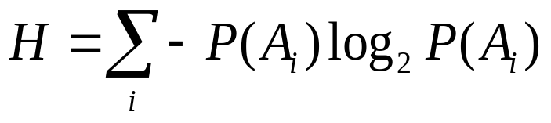
Hard math example (1)
Suppose:
  a data source generates output sequence from a set {A1, A2, …, AN}
  P(Ai): (Independent) probability of Ai
First-Order Entropy:
  the average self-information of the data set
The first-order entropy represents the minimal number of bits needed to losslessly represent one output of the source.

Slide 20

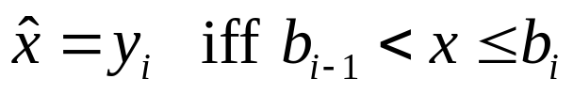
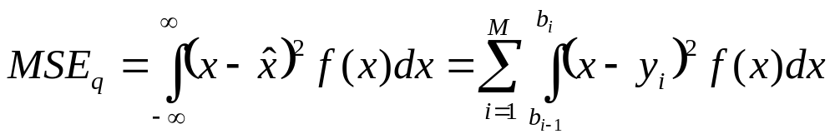
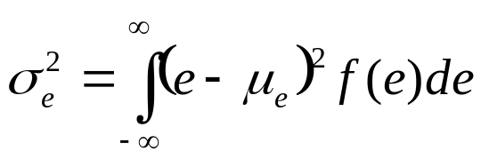
Hard math example (2)
Quantization error:
Mean Squared Error (MSE) for Quantization
  Average quantization error of all input values
  Need to know the probability distribution of the input
Number of bins: M
Decision boundaries: b_{i}, i = 0, …, M
Reconstruction Levels: y_{i}, i = 1, …, M
Reconstruction:
MSE:
  Same as the variance of e(x) if μ = E{e(x)} = 0 (zero mean).
  Definition of Variance:

Slide 21
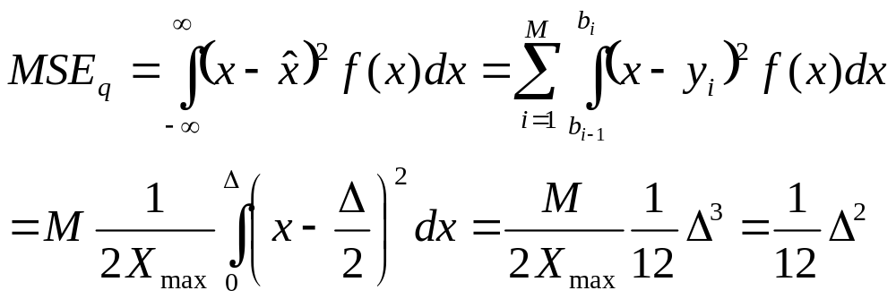
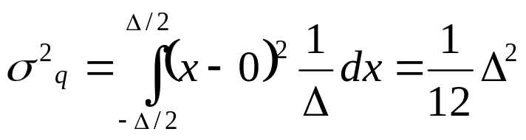
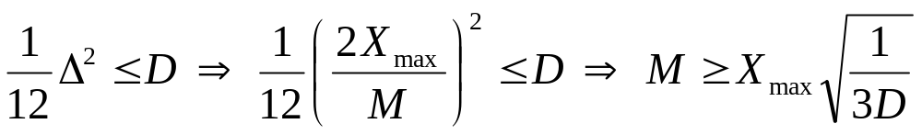
Hard math example (3)
MSE
M increases, ∆ decreases, MSE decreases
Variance of a random variable uniformly distributed in [- ∆/2, ∆/2]:
Optimization: Find M such that MSE ≤ D

Slide 22
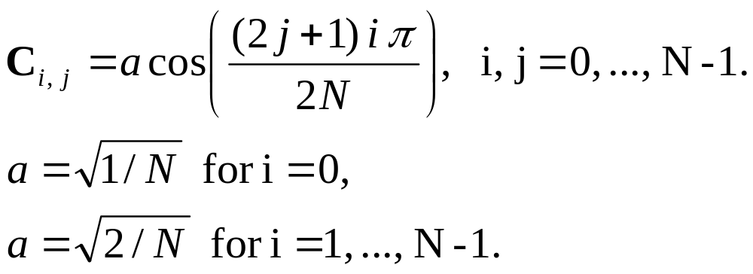
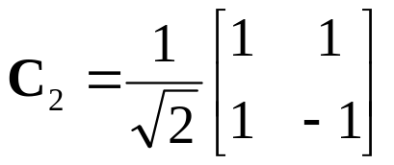
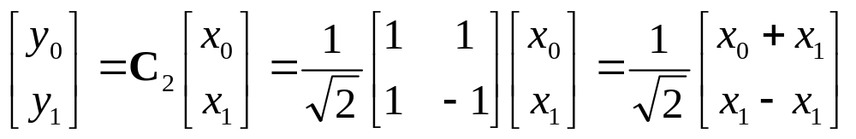
Hard math example (4)
Definition:
N = 2 (Haar Transform):
y₀ captures the mean of x₀ and x₁ (low-pass)
  x₀ = x₁ = 1 ➔ y₀ = sqrt(2) (DC), y₁ = 0
y1 captures the difference of x0 and x1 (high-pass)
  x₀ = 1, x₁ = -1 ➔ y₀ = 0 (DC), y₁ = sqrt(2).

Slide 23
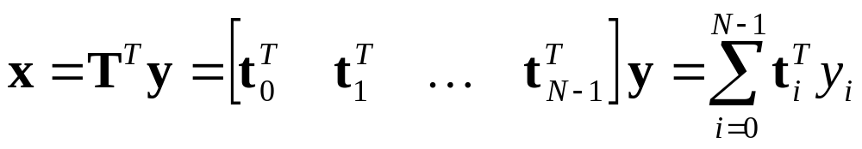
Hard math example (5)
Forward transform y = Tx (x is N x 1 vector)
  Let t_{i} be the i-th row of T
  ➔ y_{i} = t_{i} x = <t_{i}^{T}, x> (Inner product)
  y_{i} measures the similarity between x and t_{i}
  Higher similarity ➔ larger transform coefficient
Inverse transform:
x is the weighted combination of t_{i}.
  Rows of T are called basis vectors.

Slide 24
What Do You Need To Do?
Your prerequisites
  Math (calculus, linear algebra, probability…)
Never heard of them? -- you’d better drop the course
Forget ? –- you’d better drop unless you’re confident you can pick them up quickly

Slide 25
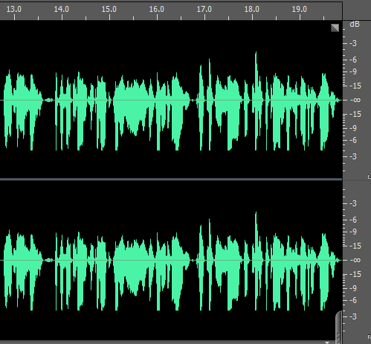
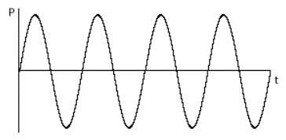
(Not so Hard) programming example
Interfaces
  Read data byte-by-byte from an input file
    E.g., read en.wikipedia.org/wiki/BMP_file_format
    Write a program to read a BMP file
  Output an image to screen pixel by pixel
  Don’t know how to do? Well, think about whether you should stay in this class (we will NOT teach GUI programming, and projects are individual based)
Algorithms
    Do this as fast as possible !

Slide 26
What Do You Need To Do?
Your prerequisites
  Data structure, algorithms
  Programming: C/C++, Java
  Basic concepts of operating systems/GUI
Can’t do them by yourself?
  Better drop this course
  project is NOT group-based!
  (The course is NOT about using YouTube, Twitch, Photoshop ….; rather, it’s about write your own YouTube, Twitch, Photoshop …)

Slide 27
Questions?

Slide 28
Outline
Course information
What is multimedia? A brief introduction
  Concepts
  Representation
  Compression
  Communication
Popular multimedia tools
Summary

Slide 29
What is “media” ?
Information represented in different formats/media
  text
  graphics
  images
  animation
  audio
  video
Analog vs Digital
  analog format: the time-varying feature (variable) of the signal is a continuous representation of the input, i.e., analogous to the input audio, image, or video signal
  Physical world is analog !
Discrete media: time independent
Continuous media: time dependent

Slide 30
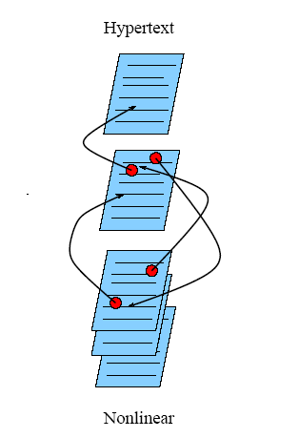
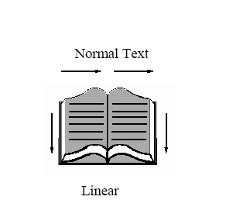
Hyper Text, Hypermedia
A hypertext system: meant to be read nonlinearly, by following links that point to other parts of the document, or to other documents
HTLM/XML
<HTML> <HEAD>
<TITLE>
A sample web page.
</TITLE>
<META NAME = "Author" CONTENT = "Cranky Professor">
</HEAD> <BODY>
<P>
We can put any text we like here, since this is a paragraph element.
</P>
</BODY> </HTML>

Slide 31
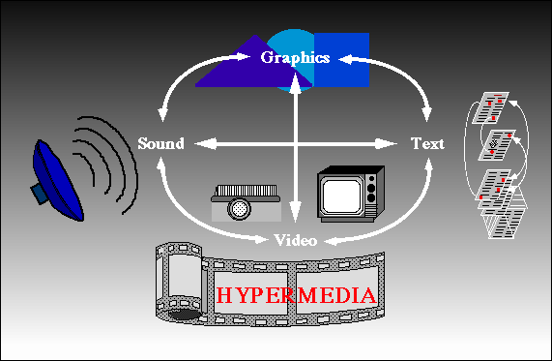
Hyper Text, Hypermedia
A hypertext system: meant to be read nonlinearly, by following links that point to other parts of the document, or to other documents
HyperMedia: not constrained to be text-based, can include other media, e.g., graphics, images, and especially the con tinuous media | sound and video.
  World Wide Web (WWW) --- the best example

Slide 32
Multimedia System
Multimedia: information represented through audio, graphics, images, video, and animation in an integrated and interactive manner (as contrast to traditional single-modality media, i.e., text and graphics drawing).
Multimedia system: the generation, manipulation, storage, presentation, and communication of multimedia information

Slide 33
Digital Media
Multimedia digitized
  Captured, stored, transmitted, processing in digital (discrete) domain
  By general purpose computers or dedicated embedded computers
    Today’s digital cameras’ have a number of CPUs inside, many of which are more powerful than a PC of 1990’s or even 2000’s.
What do you mean by digitized ?
Why digitized ?

Slide 34
(Digital/Computer) Multimedia Systems
Using computers to present and process multimedia information, in an integrated and interactive manner
Examples of Multimedia Systems:
  Digital camera/camcord
  World Wide Web
  Video conferencing
  Video-on-demand
  Interactive TV
  Online games
  Virtual reality
  Digital video editing and production systems
  Multimedia Database systems
  Social media

Slide 35
Different Views
Different views from different people
  A PC vendor: a PC that has sound capability, a DVD/BluRay drive, and perhaps the superiority of multimedia-enabled CPU/GPU (Graphical Processing Unit) that understand additional multimedia instructions.
  A consumer entertainment vendor: interactive cable TV with hundreds of digital channels available, or a cable TV-like service delivered over a high-speed Internet/wireless connection.
  A Computer Science (CS) student: applications that use multiple modalities, including text, images, drawings (graphics), animation, video, sound including speech; integration and interactivity.
Multimedia and Computer Science:
  Data representation compression
  Graphics, visualization, computer vision
  Networking, database systems

Slide 36
Multimedia Research Topics and Projects
To the computer science researcher, multimedia consists of a wide variety of topics:
1. Multimedia processing and coding: multimedia content analysis, content-based multimedia retrieval, multimedia security, audio/image/video processing, compression, etc.
2. Multimedia system support and networking: network protocols, Internet, operating systems, servers and clients, quality of service (QoS), and databases.
3. Multimedia tools, end-systems and applications: hypermedia systems, user interfaces, authoring systems.
4. Multi-modal interaction and integration: web-everywhere devices, multimedia education including Computer Supported Collaborative Learning, and design and applications of virtual environments.
5…

Slide 37
History of Multimedia
1. Newspaper: perhaps the first mass communication medium, uses text, graphics, and images.
2. Motion pictures: conceived of in the 1830's in order to observe motion too rapid for perception by the human eye.
3. Wireless radio transmission: Gugliemo Marconi, at Pontecchio, Italy, in 1895.
4. Television: the new medium for the 20th century, established video as a commonly available medium and has since changed the world of mass communications.
5. The connection between computers and ideas about multimedia covers what is actually only a short period: 1945 -- Vannevar Bush wrote a landmark article describing what amounts to a hypermedia system called Memex.

Slide 38
History of Multimedia cont’d
1960 Ted Nelson coined the term hypertext.
1967 Nicholas Negroponte formed the Architecture Machine Group.
1968 Douglas Engelbart demonstrated the On-Line System (NLS), another very early hypertext program.
1969 Nelson and van Dam at Brown University created an early hypertext editor called FRESS.
1976 The MIT Architecture Machine Group proposed a project entitled Multiple Media | resulted in the Aspen Movie Map, the first hypermedia videodisk, in 1978.
1985 Negroponte and Wiesner co-founded the MIT Media Lab.
1989 Tim Berners-Lee proposed the World Wide Web
1990 Kristina Hooper Woolsey headed the Apple Multimedia Lab.
1991 MPEG-1 was approved as an international standard for digital video | led to the newer standards, MPEG-2, MPEG-4, and further MPEGs in the 1990s.
1991 The introduction of PDAs in 1991 began a new period in the use of computers in multimedia.
1992 JPEG was accepted as the international standard for digital image compression | led to the new JPEG2000 standard.

Slide 39
History of Multimedia cont’d
1992 The first MBone audio multicast on the Net was made.
1993 The University of Illinois National Center for Supercomputing Applications produced NCSA Mosaic -the first full fledged browser.
1994 Jim Clark and Marc Andreessen created the Netscape
1995 The JAVA language was created for platform- independent application development.
1996 DVD video was introduced; high quality full-length movies were distributed on a single disk.
1998 XML 1.0 was announced as a W3C Recommendation.
1998 Hand-held MP3 devices first made inroads into consumerist tastes in the fall of 1998, with the introduction of devices holding 32MB of flash memory.
2000 WWW size was estimated at over 1 billion pages.

Slide 40
In the New Millennium
Year 2000-, your time …
Image/Audio
  Huge/cheap HDD/SSD
  High bandwidth/unlimited data plan
    3G/4G/5G
    ADSL, Fiber
  Cloud/data center
  No worry anymore ?
    4K-8K UHD (ultar-high definition)
      48-200 Gbps uncompressed
    VR/AR
      16K video
      Near zero delay

Slide 41
In the New Millennium
• 2001 The first peer-to-peer file sharing system, Napster, was shut down by court order. First commercial 3G wireless network.
• 2003 Skype: free peer-to-peer voice over the Internet.
• 2004 Web 2.0 promotes user collaboration and interaction. Examples include social networking, blogs, wikis.
Facebook founded.
Flickr founded .
• 2005 YouTube created.
Google launched online maps
• 2006 Twitter created: 500 million users in 2012, 340 million tweets/day.
Amazon launched its cloud computing platform.
Nintendo introduced the Wii home video game console -- can detect movement in three dimensions.
• 2007 Apple launched iPhone, running the iOS mobile operating system. .
Goolge launched Android mobile operating system.

Slide 42
In the New Millennium
• 2009 The first LTE (Long Term Evolution) network was set, an important step toward 4G wireless networking.
James Cameron’s film, Avatar, a surge on the interest in 3D video.
• 2010 Netflix migrated its infrastructure to the Amazon’s cloud computing platform.
Microsoft introduced Kinect, a horizontal bar with full-body 3D motion capture, facial recognition and voice recognition capabilities, for its game console Xbox 360.
• 2012 HTML5 subsumes the previous version, HTML4. Able to run on low powered devices such as smartphones and tablets.
• 2013 Twitter offered Vine, a mobile app that enables its users to create and post short video clips.
Sony released its PlayStation 4 a video game console, which is to be integrated with Gaikai, a cloud-based gaming service.
4K resolution TV started to be available in the consumer market.

Slide 43
In the New Millennium
• 2015 YouTube launched support for publishing and viewing 360-degree videos.
AlphaGo, a computer program that plays the board game Go, became the first program to beat a human professional player. The event attracted significant attention from the general public, particular on its core technology, deep learning, which, in the coming years, has seen success in multimedia content understanding and generation.
• 2016 HoloLens, a pair of mixed reality smartglasses developed and manufactured by Microsoft, started to be available in the market.
Pokémon Go, an augmented reality (AR) mobile game, was released and credited with popularizing location-based and AR technologies.
Netflix completely migrated to the Amazon AWS cloud platform, so for Skype to move to the Microsoft Azure platform.

Slide 44
In the New Millennium
• 2017 TikTok, a video-sharing social networking service for creating and sharing short lip-sync, comedy, and talent videos, was launched for the global market (it's Chinese version, Douyin, was launched in 2016).
• 2018 World's first 16K Ultra High Definition (UHD) short video film, Prairie Wind, was created.
• 2019 5G cellular systems started deployment, providing enhanced mobile broadband and ultra low latency access.
WiFi 6 (802.11ax) standard was released, offering theoretical maximum throughput of 1 Gbps.
2020 Due to the outbreak of coronavirus (COVID-19) around the world, work/study from home became a norm in early 2020.
Multimedia-empowered online meeting and teaching tools, e.g., Zoom, Google Class, and Microsoft Teams, have seen booming use during this period.

Slide 45
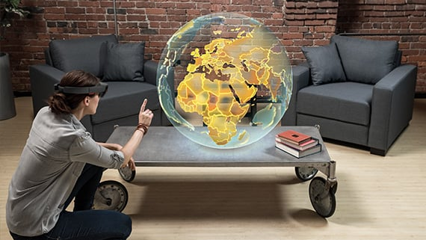
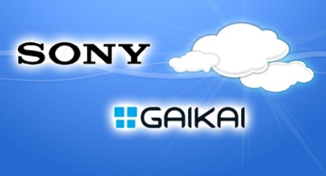
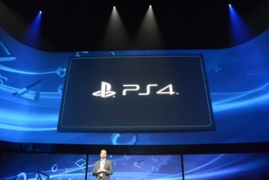
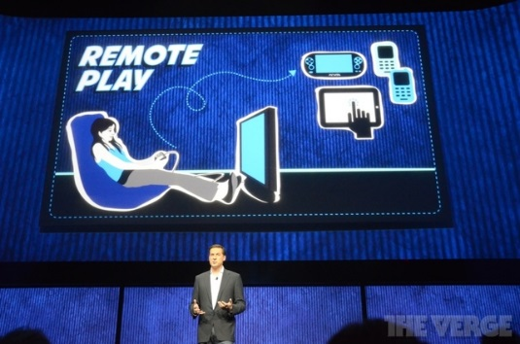
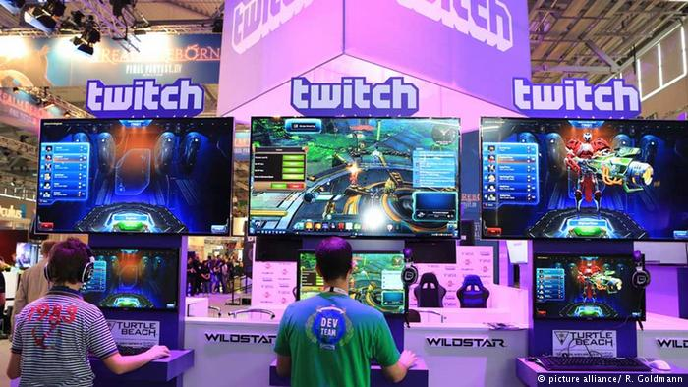
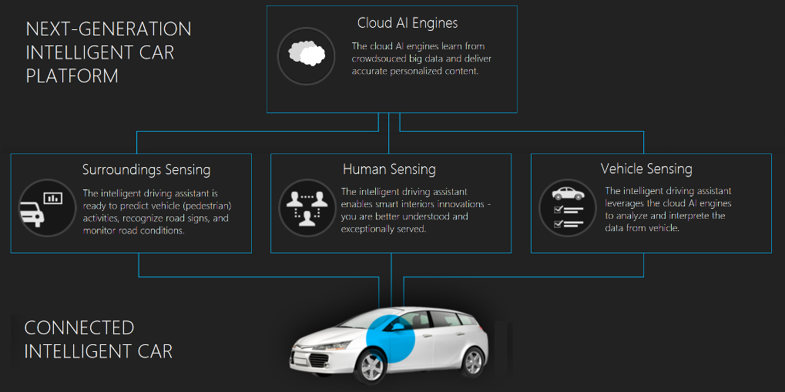
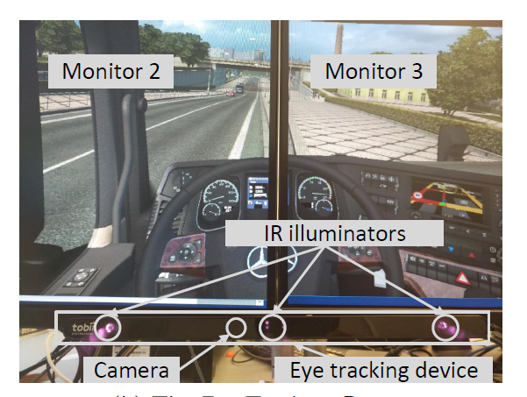
Past Decade
Skype/YouTube/Netflix
  Replacing phone, movie theatre, TV !
AR/VR immersive media
  Pokemon Go !, MS Hololens …
Cloud gaming
  Onlive, Gaikai, Sony …
Livecast
  Twitch.tv …
  eSports broadcast …
Drone/car
Deep learning

Slide 46
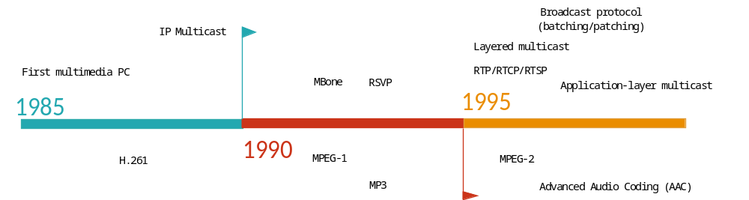
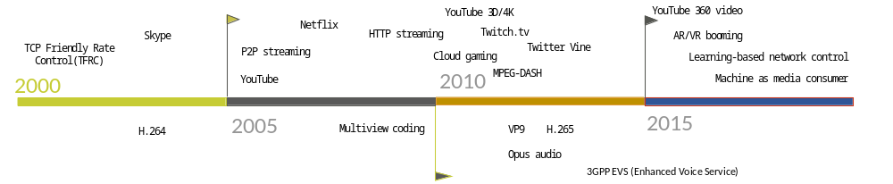
Digital Media Timeline

Slide 47
Outline
Course information
What is multimedia? A brief introduction
  Concepts
  Representation
  Compression
  Communication
Popular multimedia tools
Summary

Slide 48
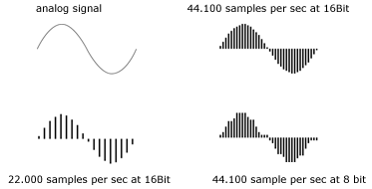
Audio Digitization (PCM)
Representation ? ➔ Digitization for computers

Slide 49
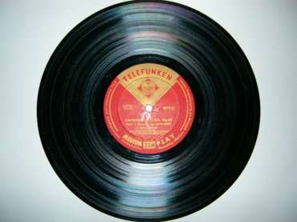
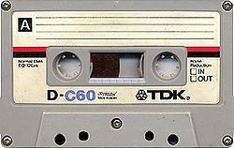
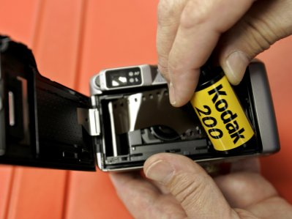
Digital Media
What do you mean by digitized ?
  Audio/visual signals from the natural world is Analog
    Continuous in time and space
    Conventional storage/playback: LP (audio record), tape, CRT TV (old TV), film
    Can’t be handled by computer
  A/D conversion
    to 1/0 discrete signals
Why digitized ?
  Bulky storage (space, cost, lifetime)
  Poor quality
  Poor/no compression
  Poor portability/mobility/editibility
  MP3 player, iPod, YouTube ? No way
  Film -> Polaroid -> Digital camera

Slide 50
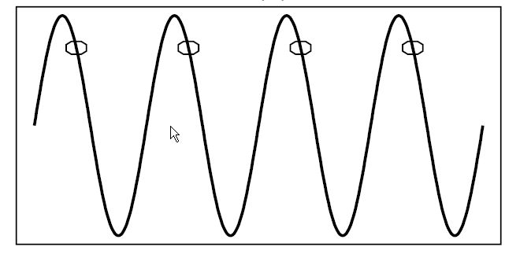
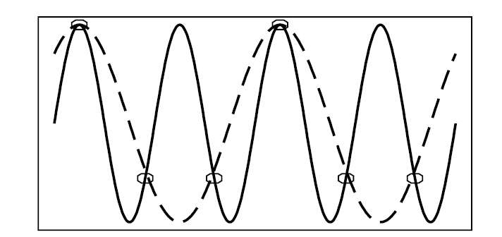
Sampling Rate
Sampling theory – Nyquist theorem

Slide 51


Image/Video Digitization
Digital image is a 2-D array of pixels
Each pixel represented by bits
  R:G:B
  Y:U:V
    Y = 0.299R + 0.587G + 0.114B (Luminance or Brightness)
    U = B - Y (Chrominance 1, color difference)
    V = R - Y (Chrominance 2, color difference)
Video is sequence of images (frames) displayed at constant frame rate
  e.g. 24 images/sec
Original
Image

Slide 52
Outline
Course information
What is multimedia? A brief introduction
  Concepts
  Representation
  Compression
  Communication
Popular multimedia tools
Summary

Slide 53
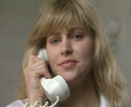
Why Compression ?
Multimedia data are too big
  “A picture is worth a thousand words ! “
File Sizes for a One-minute Audio CD Clip
Sampling Rate | Resolution | Channels | Bit-rate (bps) | File Size (Bytes)
44,100Hz | 16 bits | 2 | 1,411,200 | 10,584,000
File Sizes for a One-minute QCIF Video Clip
Frame Rate | Frame Size | Bits / pixel | Bit-rate (bps) | File Size (Bytes)
30 frames/sec | 176 x 144 pixels | 12 | 9,123,840 | 68,428,800

Slide 54

Data Compression
X
Y
X’
Decompress
Lossless Compression: X’=X
  Example: Computer file compression
  Low compression ratio
Lossy Compression: X’ ≠ X
  Many applications do not require lossless compression
  Our eyes and ears cannot identify some details
  High compression ratio

Slide 55
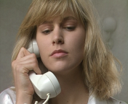
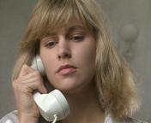
Essential of Compression
Remove redundant information:
  Spatial redundancy:
    Neighboring samples have similar values
  Temporal redundancy:
    Neighboring frames in a video sequence are similar
Prediction
Prediction

Slide 56
A Typical Image Compression System
Exploit the spatial redundancy:
DCT, Wavelet, lapped transform
Transform
Quantization
Eliminate smaller coefficients that
cannot be perceived
Huffman or arithmetic coding:
Assign shorter codes to more
probable symbols.
Entropy coding
Compressed bitstream

Slide 57
Decoder
Encoder
Entropy
coding
Transform
Quantization
Lossy!
Communications
channel
Decoder
Entropy
decoding
Inverse
Transform
Inverse
Quantization

Slide 58

A Typical Video Compression System
video frames
Remove temporal redundancy
Motion
Estimation
Prediction error
Transform
Quantization
Entropy coding
Compressed bitstream

Slide 59
Compression Standards
Why standards
  A standard allows products from multiple vendors to communicate
    Yet, users have flexibility in selecting equipment or software
  Assures a large market for a particular piece of equipment or software
    encourages mass production, VLSI technologies etc
    lower costs.
  Patent war !
    Qualcomm, InterDigital
Standard does not prevent innovation (?)
  Only decoder is specified by the standard.
  Encoder can still be improved.
  Example: MPEG-2
Bit rate has been reduced from 8Mbps in 1994 to 2Mbps now, offering the same quality.

Slide 60
Standardization Bodies
ITU: International Telecommunications Union
  ITU-T: ITU Telecommunication Standardization Sector (CCITT)
ISO: International Standards Organization
IEC: International Electro-technical Commission
SMPTE: Society of Motion Picture and Television Engineers
JPEG (ISO/IEC Joint Photographic Experts Group)
JBIG (ISO Joint Bi-level Image Experts Group)
MPEG (ISO Motion Picture Experts Group)
VCEG (ITU-T Video Coding Experts Group)

Slide 61
Image Coding Standards
JPEG:1993 (JPG file format)
  DCT-based block transform
JPEG2000: Dec. 2000
  Wavelet-based
  Much more complicated than JPEG
JBIG: Joint Bi-level Image Experts Group (1993)
  for lossless bi-level image compression (fax)
  can also be used for grayscale images
JBIG2: 1999
  Supports both lossless and lossy compression

Slide 62
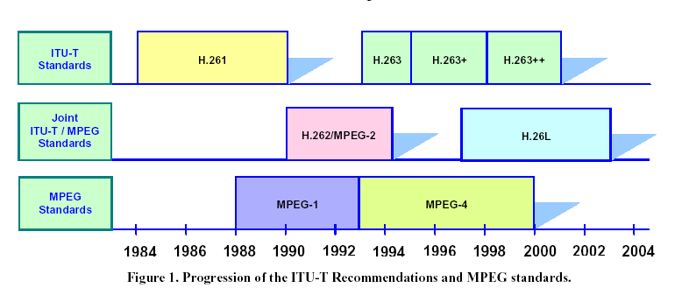
Video Coding Standards
H.264/AVC
H.264/AVC: ITU-T H.264 / MPEG-4 (Part 10) Advanced Video Coding (AVC)
- Finalized in May 2003 (for general purpose)
- Fidelity Range Extensions (FRExt): 2003-2004 (for professional)

Slide 63
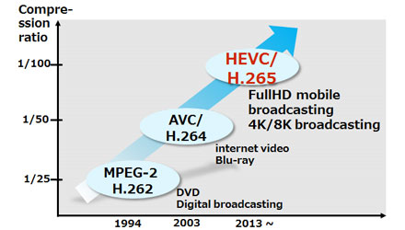
Video Coding Standards
H.265/HEVC (High Efficiency)
  50% goal (bitrate reduction)
  Start from 2010
  February 2012: Committee Draft (complete draft of standard)
  July 2012: Draft International Standard
  January 2013: Final Draft International Standard (ready to be ratified as a Standard)
  April 2013: Standard released
Google VP9 ? H. 266?

Slide 64
Coding Rate and Standards
Mobile
videophone
Videophone
over PSTN
ISDN
videophone
Video CD
Digital TV
HDTV
8
16
64
384
1.5
5
20
kbit/s
Mbit/s
Very low bitrate
Low bitrate
Medium bitrate
High bitrate
MPEG-4
H.263
H.261
MPEG-1
MPEG-2
H.264/265/266 can do all of them!

Slide 65
Audio coding standards
Range of human’ hearing: 20Hz - 20kHz
➔ Minimal sampling rate: 40 kHz (Nyquist frequency)
Format Bit Depth Sampling Rate Bit Rate (2 channels)
CD Audio 16 bits 44.1 kHz 1,411,200 bps
DVD Audio 24 bits 96 kHz 4,608,000 bps
MPEG-1 audio layer 3 (MP3)
  CD quality at 10 : 1 compression ratio.
MPEG-2 AAC (advanced audio coding):
  used by XM Radio (satellite radio in US)
MPEG-4 AAC :
  Up to 48 channels, 96KHz
ATSC AC-3: 1994
  Dolby Digital (5.1 channel)
  ATSC: Advanced Television Systems Committee
  For DTV, DVD
iTunes
  AAC
  AIFF (Audio Interchange File Format
IETF OPUS/3GPP EVS (Enhanced Voice Service)

Slide 66
Outline
Course information
What is multimedia? A brief introduction
  Concepts
  Representation
  Compression
  Communication
Popular multimedia tools
Summary

Slide 67
Multimedia communications
Examples of Multimedia Communication Systems:
  World Wide Web
  Video conferencing
  Video-on-demand
  Interactive TV
  Online games

Slide 68
Fundamental Characteristics
Typically delay sensitive
But can tolerate occasional loss:
  infrequent losses cause minor glitches
Cf. data transmission: (e.g. FTP)
  loss intolerant but delay tolerant

Slide 69
Challenges in Multimedia Communications
Transmission of Compressed Multimedia:
  Real-time communications
    Delay < 0.4 sec in video conference
  Sequencing within the media
  Synchronization (e.g., between video & audio)
  Robustness to transmission error
We will learn how to
  Transmit multimedia over Internet and wireless network

Slide 70



Recall: Challenges in Multimedia Communications
Real-time communications
  Delay < 0.4 sec in video conference
Sequencing within the media
Synchronization (e.g., between video & audio)
Robustness to transmission error
Can we achieve these requirements
through the Internet?

Slide 71

Internet
Packet-switched network
Network resources are shared
Each packet is handled by a series of routers before being received
Packets can be discarded if the buffer of a router is full
All packets are treated the same way in congestion
A
C
B

Slide 72
Internet Protocol Stack
IP: Internet Protocol
  Best effort (unreliable)!
TCP: Transmission Control Protocol
  Provides reliable (but slow) service
UDP: User Datagram Protocol
  Provides unreliable (but fast) service
  Suitable for real-time application
RTP: Real-time Transport Protocol
  packet format for multimedia streams
RTCP: RTP control protocol
  Monitor/report service quality
RTSP: Real-time streaming protocol
  “Internet VCR remote control”
application
RTP
TCP/UDP
IP
Data link
physical
transport

Slide 73
Quality of Service (QoS) Parameters
End-to-end Delay
  time required for the end-to-end transmission of a single data element
Jitter
    variation in delay
Packet loss rate
  the proportion of data elements that are dropped
Bandwidth: bits / second (bps)
  rate of flow of multimedia data

Slide 74
QoS Control
Algorithms to improve the QoS of Multimedia applications
Policing
  Control the input rate to network (leak bucket model)
Scheduling
  Divide buffers into logic queue
  Decide which queue to service next

Slide 75
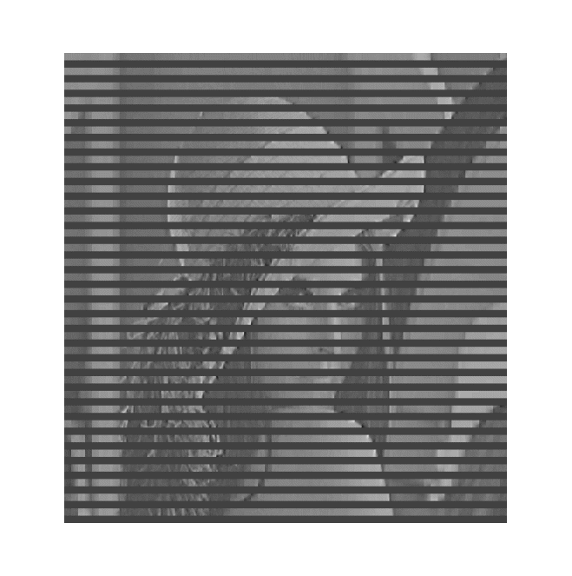

Error Resilience
Improve the decoded quality in the presence of lost data
- often occurs in wireless networks (and also Internet)
Add redundancy at encoder:
  Error correction code
  Layered coding
  Multiple description coding
Post-processing at decoder to hide the error
  Error concealment

Slide 76
Outline
Course information
What is multimedia? A brief introduction
  Concepts
  Representation
  Compression
  Communication
Popular multimedia tools
Summary

Slide 77
Popular Multimedia Software Tools
The categories of software tools briefly examined here are:
1. Music Sequencing and Notation
2. Digital Audio
3. Graphics and Image Editing
4. Video Editing
5. Animation
6. Multimedia Authoring

Slide 78
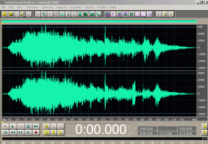
Digital Audio
Digital Audio tools deal with accessing and editing the actual sampled sounds that make up audio:
Cakewalk Pro Audio/Adobe Audition (formerly Cool Edit Pro)
  Powerful and popular digital audio toolkits; emulates a professional audio studio --- multitrack productions and sound editing including digital signal processing effects.
Pro Tools
  A high-end integrated audio production and editing environment | MIDI creation and manipulation powerful audio mixing, recording, and editing software.
Anvil Studio: free, for MIDI

Slide 79
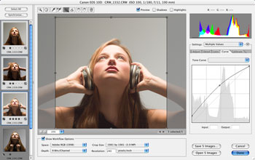
Graphics and Image/Photo Editing
Adobe Photoshop
  “Standard” image processing and manipulation tool.
  Allows layers of images, graphics, and text that can be separately manipulated for maximum flexibility.
GIMP: GNU Image Manipulation Program (free)
Adobe Illustrator
  A powerful publishing tool from Adobe.
  Uses vector graphics; graphics can be exported to Web.

Slide 80
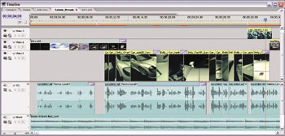
Non Linear Video Editing
Adobe Premiere
  An intuitive, simple video editing tool for nonlinear editing, i.e., putting video clips into any order: Video and audio are arranged in \tracks".
  Provides a large number of video and audio tracks, superimpositions and virtual clips.
  A large library of built-in transitions, filters and motions for clips ) effective multimedia productions with little effort.

Slide 81
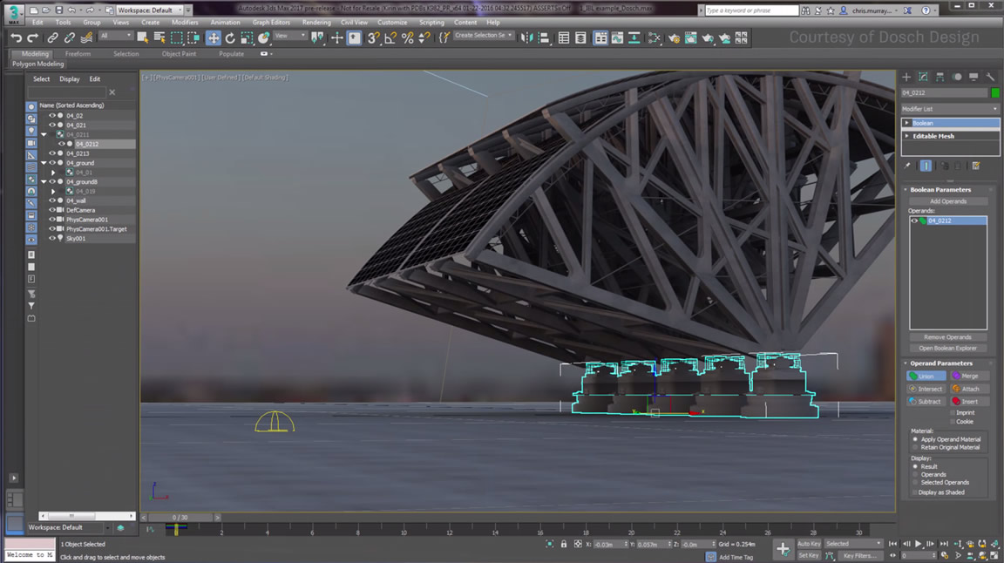
Rendering and Animation
Autodesk 3ds Max
  Rendering tool that includes a number of very high-end professional tools for character animation, game development, and visual effects production.
Autodesk Maya
  End-to-end creative workflow with comprehensive tools for animation, modeling, simulation, visual effects, rendering, match moving, and compositing on a highly extensible production platform.

Slide 82
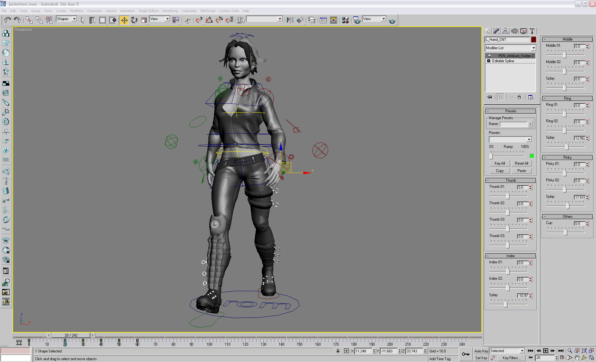

Slide 83
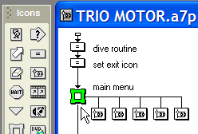
Multimedia Authoring
Adobe Flash
  Allows users to create interactive movies by using the score metaphor, i.e., a timeline arranged in parallel event sequences.
Adobe Director (discontinued from 2017)
  Uses a movie metaphor to create interactive presentations
  Very powerful and includes a built-in scripting language, Lingo, that allows creation of complex interactive movies
Authorware (used to be popular; but discontinued from 2003)
  A mature, well-supported authoring product based on the Iconic/Flow-control metaphor

Slide 84
Multimedia API
DirectX
  Windows API that supports video, images, audio and 3-D animation
OpenGL
  A highly portable, most popular 3-D API in use today.
Java3D
  API used by Java to construct and render 3D graphics, similar to the way in which the Java Media Framework is used for handling media files.
  An abstraction layer built on top of OpenGL or DirectX (the user can select which).
  Provides a basic set of object primitives (cube, splines, etc.) for building scenes.
Android multimedia API/iOS multimedia API

Slide 85
Behind the Tools …
Is this course about the use of these tools ?
  No !
What will we learn ?
  We will learn what’s behind the tools
  That is, how to design these tools
    (using them is then trivial)
Computer Science vs. Computer Applications vs. Art

Slide 86
Grand Challenge Problems
• Social Event Detection for Social Multimedia: discovering social events planned and attended by people.
• Search and Hyperlinking of Television Content: finding relevant video segments for a particular subject and generating useful hyperlinks for each of these segments.
• Geo-coordinate Prediction for Social Multimedia: estimating the GPS coordinates of images and videos.
• Violent Scenes Detection in Film: automatic detecting.
• Preserving Privacy in Surveillance Videos: methods obscuring private information (such as faces on Google Earth).
• Spoken Term Web Search: searching for audio content within audio content by using an audio query.
• Question Answering for the Spoken Web: a variant on the above, specifically for matching spoken questions with a collection of spoken answers.
• Soundtrack Selection for Commercials: choosing the most suitable music soundtrack from a list of candidates.

Slide 87
Summary
Topics to be covered:
  Media representation
    Audio/Image/Video
  Media Compression:
    Digital media signals
    Entropy coding: Huffman, arithmetic, Golumb-Rice
    Quantization
    Transform: KLT, DCT, Wavelet, Lapped Transform
    Coding standards: JPEG, MPEG, MP3, H.264
  Multimedia Transmission:
    Internet Protocols
    Multimedia QoS
    QoS Control
    Error Resilience
  Multimedia database and retrieval
End of Introduction

