Slide 1

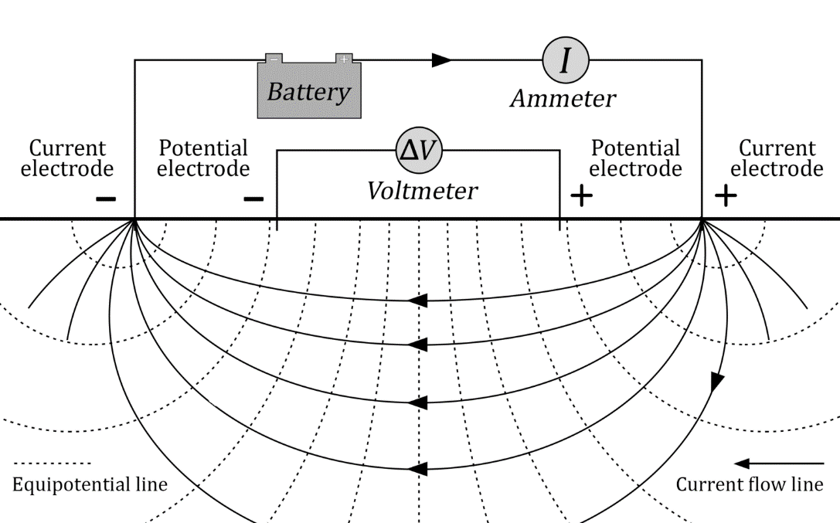
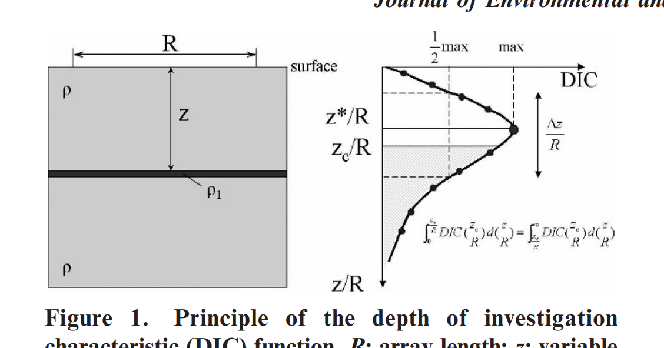
Response
A
Z* (Depth of maximum response)
V
A
M
N
B
Z_{E} (Effective Depth)
Z/L

Slide 2

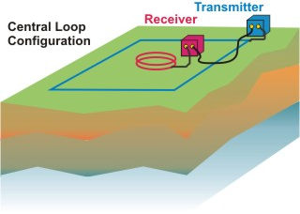
A
A
V
V
A
M
N
B
A
M
N
B
a
a
a
a
s
s
A
V
A
M
N
B

Slide 3
A
V
5m
500 Ωm
10m
250 Ωm
Basement: 1000 Ωm

Slide 4
ρ
A
L

Slide 5
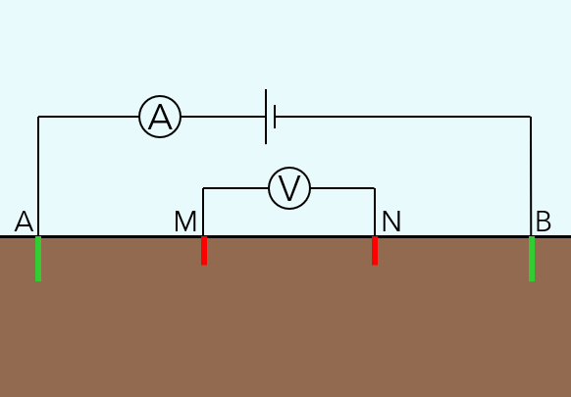
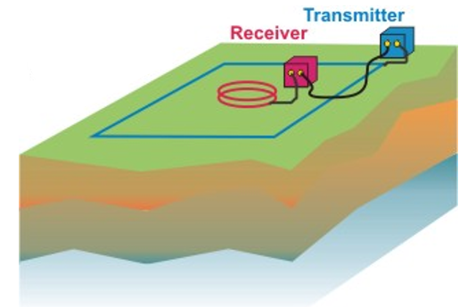
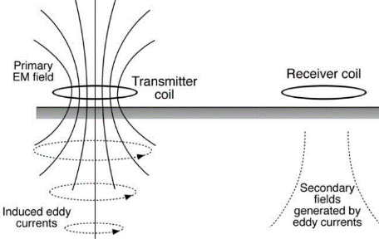
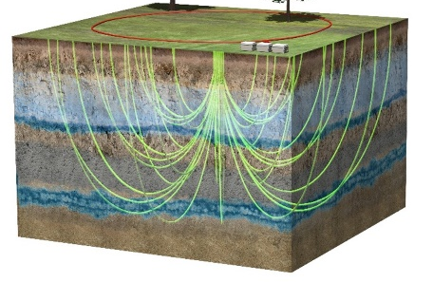
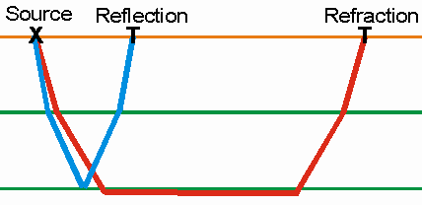
Method: |  | Resistivity |  | TEM |  | FEM |  | SNMR |  | Seismic
Criteria | Weighting | Score/5 | Weighted Score | Score/5 | Weighted Score | Score/5 | Weighted Score | Score/5 | Weighted Score | Score/5 | Weighted Score
Low-cost | 10.5 | 5 | 52.5 | 2 | 21 | 3 | 31.5 | 1 | 10.5 | 5 | 52.5
Technical simplicity | 7.5 | 5 | 37.5 | 2 | 15 | 3 | 22.5 | 1 | 7.5 | 4 | 30
Usability/training required | 6 | 3 | 18 | 3 | 18 | 5 | 30 | 1 | 6 | 4 | 24
Data value | 6 | 3 | 18 | 4 | 24 | 3 | 18 | 5 | 30 | 1 | 6
Depth of investigation | 6 | 4 | 24 | 5 | 30 | 2 | 12 | 4 | 24 | 1 | 6
Speed of taking measurements | 3 | 1 | 3 | 2 | 6 | 5 | 15 | 2 | 6 | 4 | 12
Size/moveability | 3 | 4 | 12 | 2 | 6 | 5 | 15 | 2 | 6 | 4 | 12
TOTAL: |  |  | 165 |  | 120 |  | 144 |  | 90 |  | 142.5

Slide 6
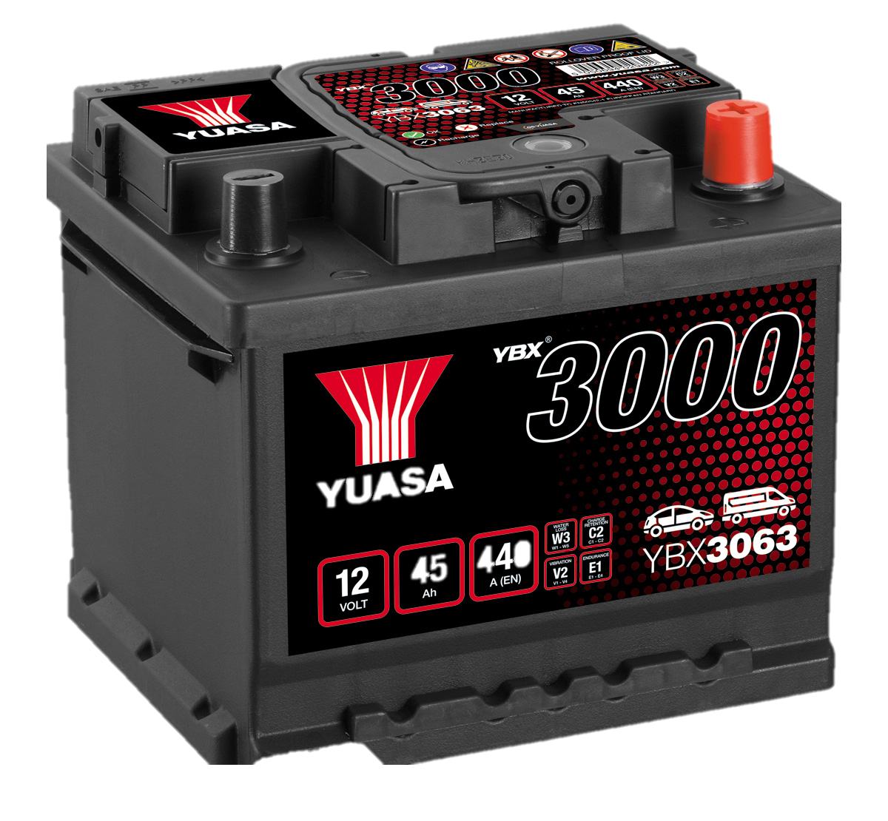
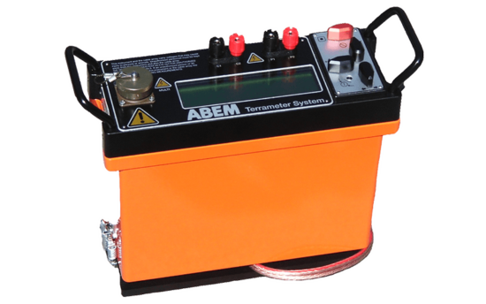



A
V
A
M
N
B
B
M
N
A

Slide 7



Slide 8
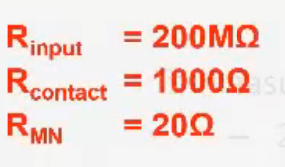
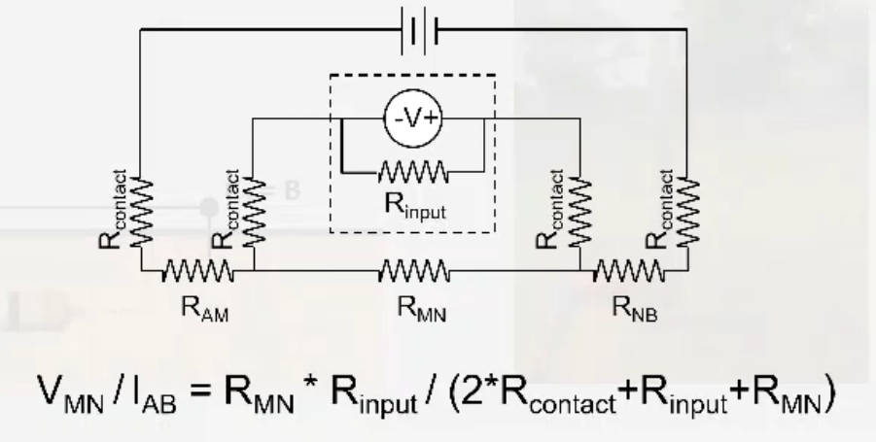
A

Slide 9
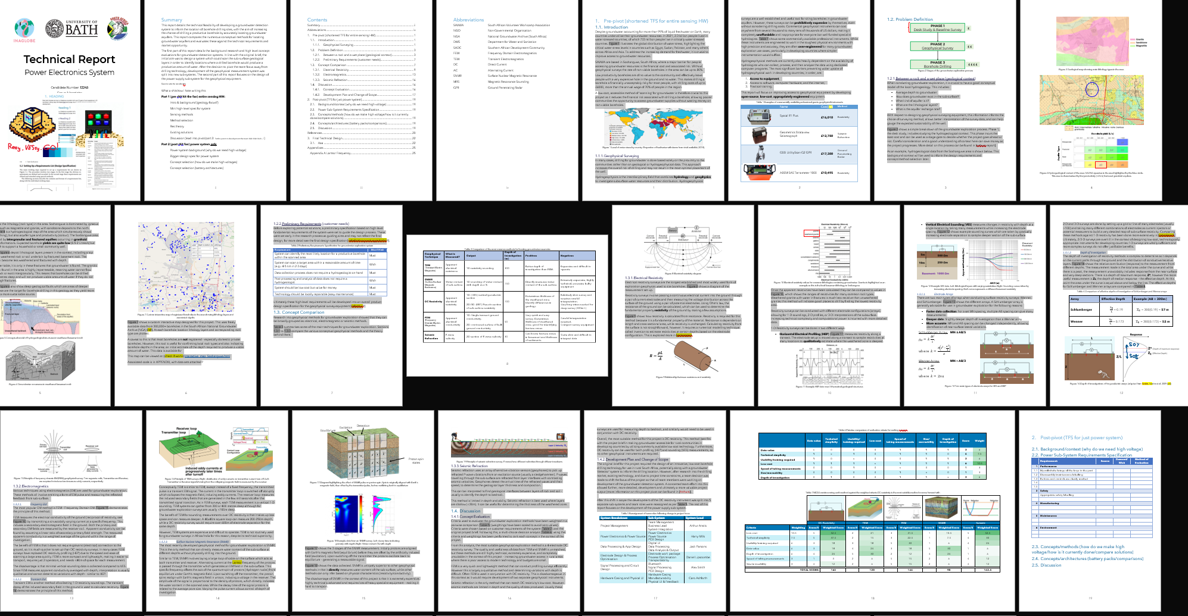
Extra sneaky highlights = 2950 words for TFS part 1

Slide 10
A
V
A
M
N
B
Current Flow
Equipotential

Slide 11
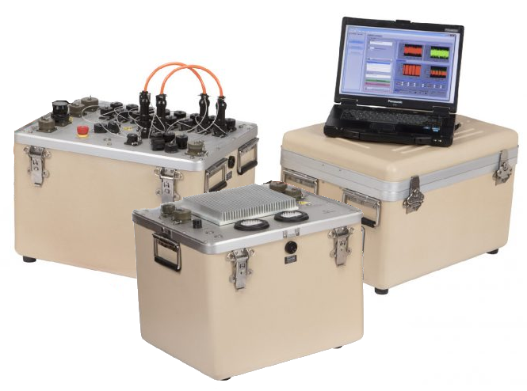
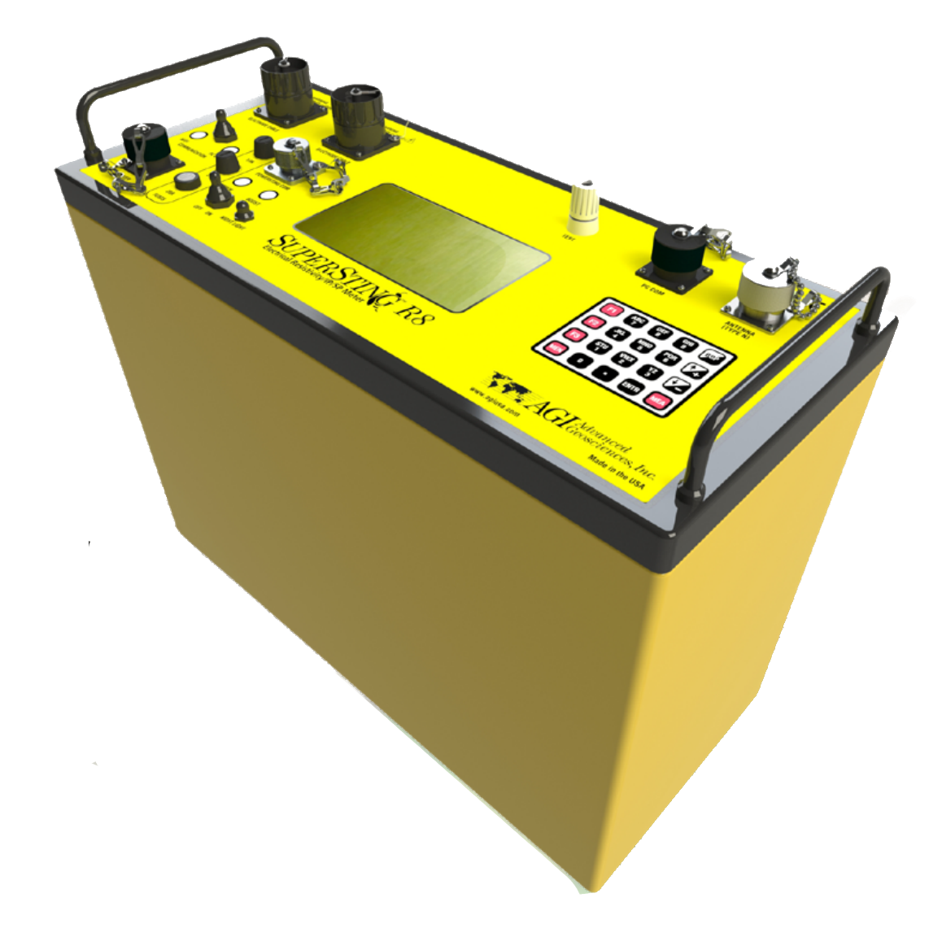
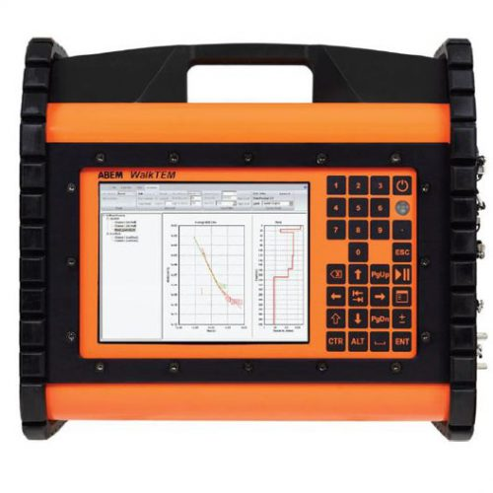
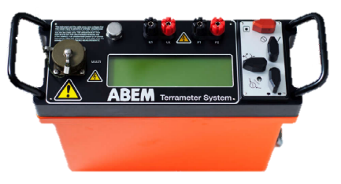
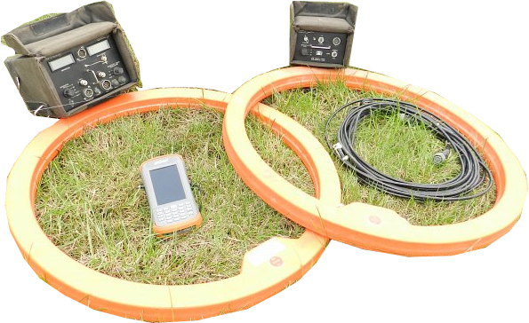
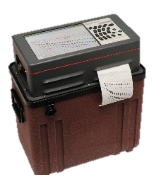
Data Value
SNMR
ERT
TEM
4-electrode Resistivity
FEM
Opportunity Zone
Seismic Refraction
Price

Slide 12
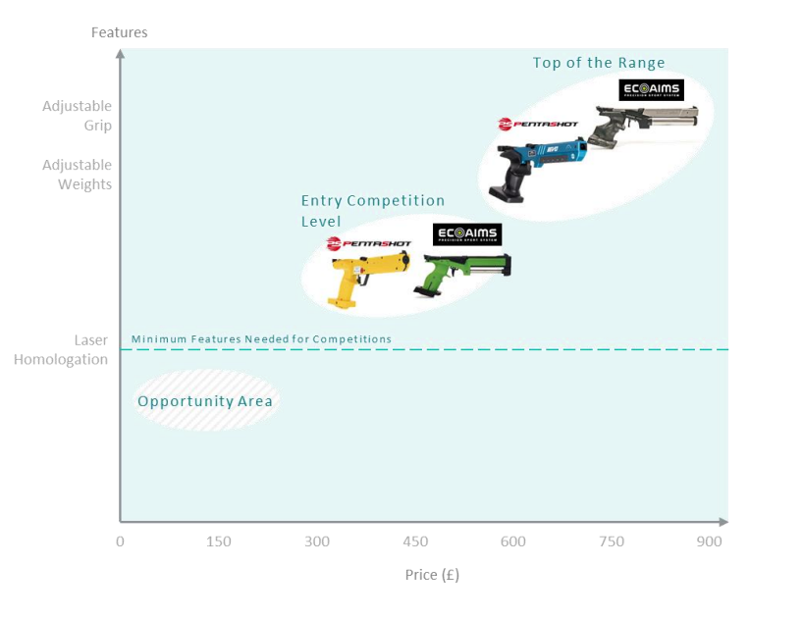
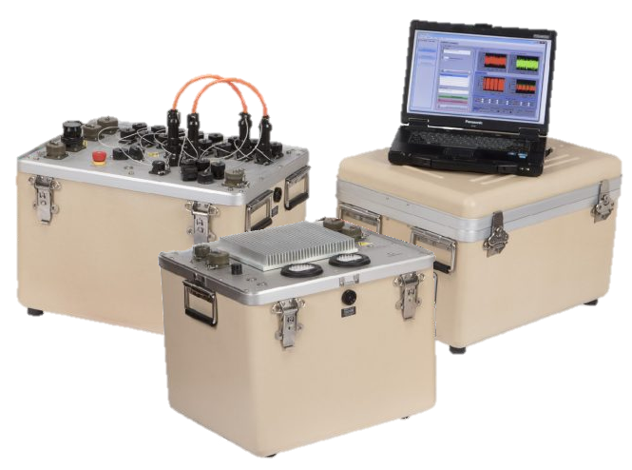
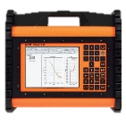


Data
Value
Specialist Scientific
SNMR
High-end Professional
ERT
Low-end Professional
TEM
4-electrode Resistivity
Opportunity Area
Seismic Refraction
FEM
1000
10,000
50,000
100,000
Price / £

Slide 13
