Slide 1
Probability Distributions
Instructions: Have these slides completed and have your likelihoods on the last slide ready to share in Live Session Module 1, on Tuesday, September 1. The first slide for the Bernoulli distribution is completed as an example for you. You may use any references or resources you want.
We will discuss results on Live Session Module 1, and they will be submitted by September 8.

Slide 2
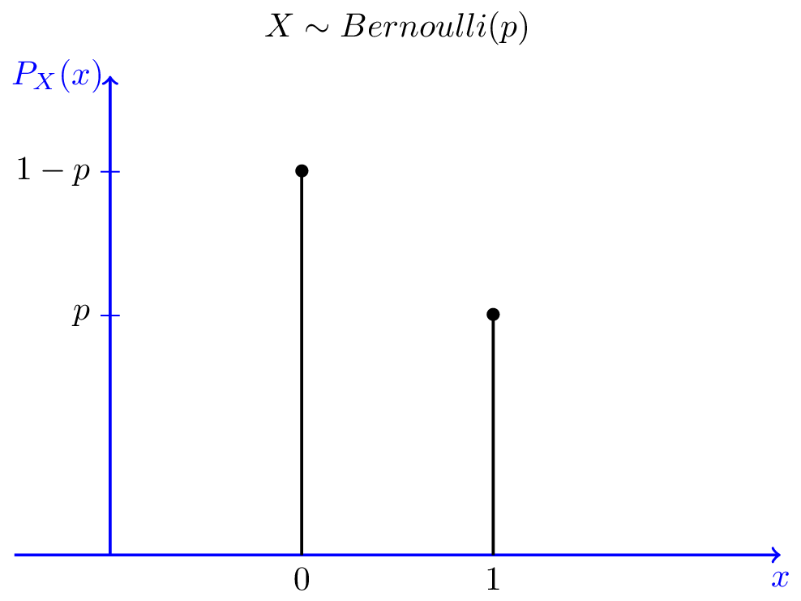
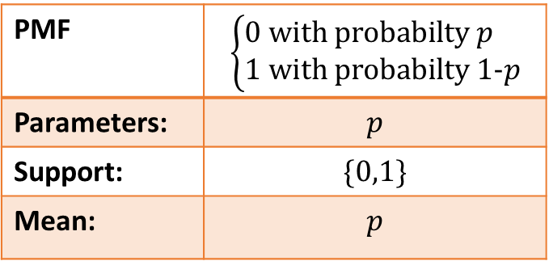
Bernoulli Distribution
Support Type:
Plot of the distribution:
Support Type: single variable, discrete
PMF | $$\left\{\begin{aligned}0 \text{with} \text{probabilty} p \\ 1 \text{with} \text{probabilty}\text{ 1−}p\end{aligned}\right.$$
Parameters: | $$p$$
Support: | $$\{0,1\}$$
Mean: | $$p$$
Typical Uses:
Flip of a fair coin (p=0.5)
Flip of unfair coin
Any single trial with two outcomes
Resources:
https://en.wikipedia.org/wiki/Bernoulli_distribution
https://www.probabilitycourse.com/chapter3/3_1_5_special_discrete_distr.php
Probability.pdf (storage.googleapis.com)

Slide 3
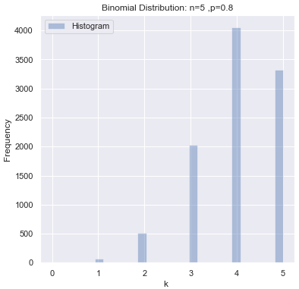

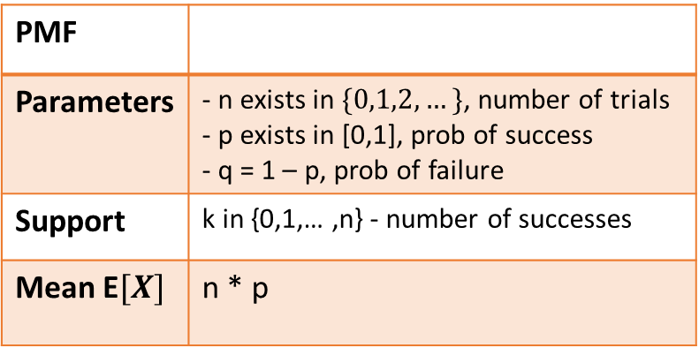
Binomial Distribution
Support Type:
Plot(s) of the distribution:
Support Type: single variable, discrete
PMF
Parameters | - n exists in $\{0,1,2,…\}$, number of trials - p exists in [0,1], prob of success - q = 1 – p, prob of failure
Support | k in {0,1,… ,n} - number of successes
Mean E$[X]$ | n * p
Typical Uses:
Flip of a fair coin multiple times (p=0.5)
Flip of unfair coin multiple times (p=?)
Multiples trial with two outcomes
Resources:
Probabilities, Likelihoods, and Bayes Theorem | Kaggle
Binomial distribution – Wikipedia
Probability.pdf (storage.googleapis.com)

Slide 4
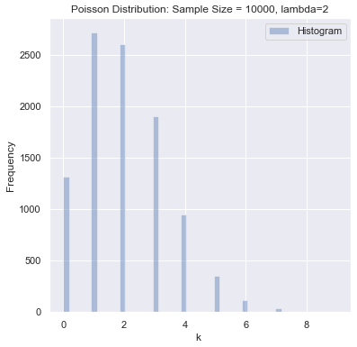

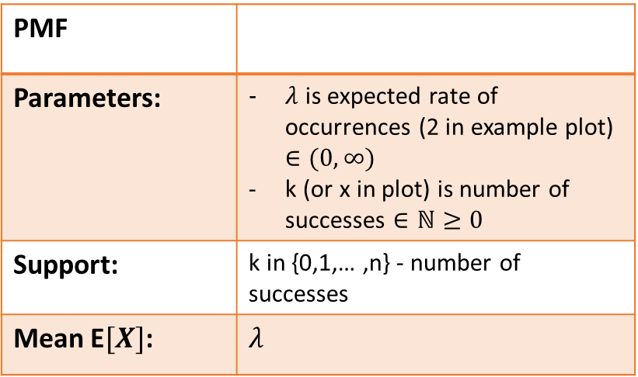
Poisson Distribution
Support Type:
Plot(s) of the distribution:
Support Type: single variable, discrete
PMF
Parameters: | $λ$ is expected rate of occurrences (2 in example plot) $∈(0,∞)$ k (or x in plot) is number of successes $∈ℕ≥0$
Support: | k in {0,1,… ,n} - number of successes
Mean E$[X]$: | $$λ$$
Typical Uses: number of times an event with a constant probability will happen during a fixed time. E.g. number of goals in a Super Bowl game.
Resources:
Probabilities, Likelihoods, and Bayes Theorem | Kaggle
Poisson distribution – Wikipedia
Probability.pdf (storage.googleapis.com)

Slide 5
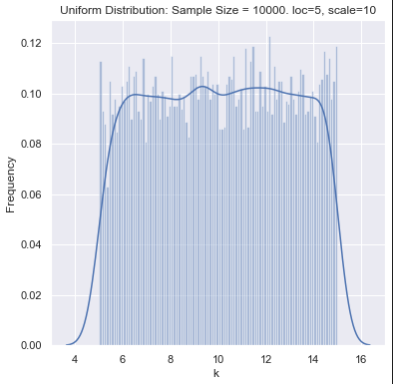
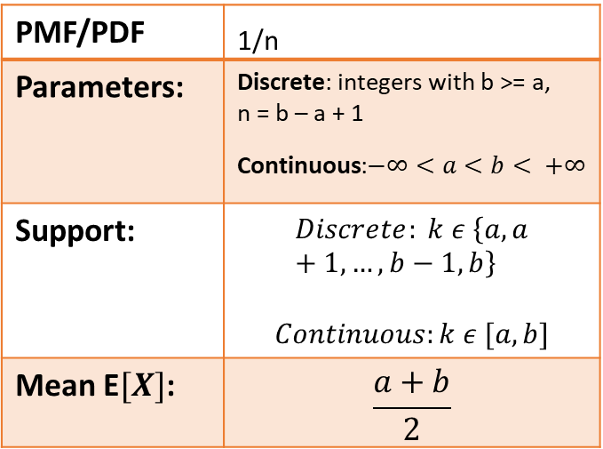
Uniform Distribution
Support Type:
Plot(s) of the distribution:
Support Type: single variable, discrete or continuous
PMF/PDF | _{1/n}
Parameters: | Discrete: integers with b >= a, n = b – a + 1 Continuous:$−∞<a<b< +∞$
Support: | $$Discrete: k ε \left\{a, a+1, …, b−1, b\right\}$$ $$Continuous:k ε [a,b]$$
Mean E$[X]$: | $$\frac{a+b}{2}$$
Typical Uses: any case where probability of the outcome, number of outcomes, or parameters is the same across the domain.
Resources:
Probabilities, Likelihoods, and Bayes Theorem | Kaggle
Continuous uniform distribution - Wikipedia

Slide 6
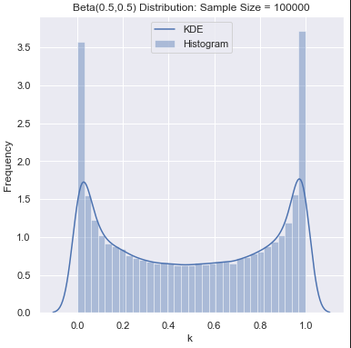
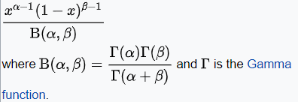
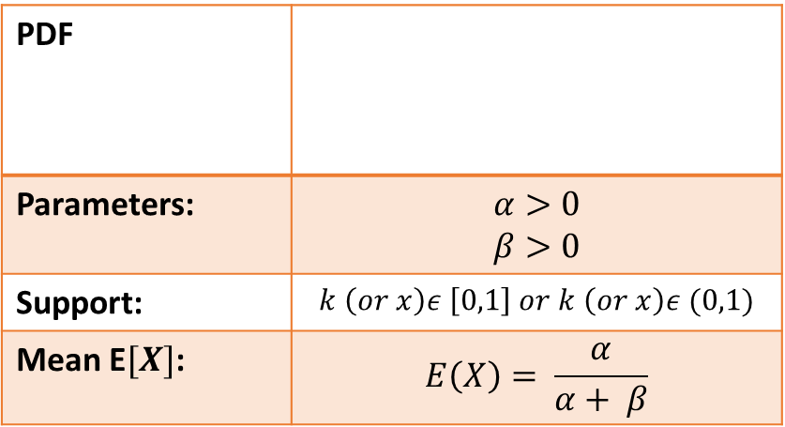
Beta Distribution
Support Type:
Plot(s) of the distribution:
Support Type: single variable, continuous
PDF
Parameters: | $$α>0$$ $$β>0$$
Support: | $$k \left(or x\right)ε \left[0,1\right] or k \left(or x\right)ε (0,1)$$
Mean E$[X]$: | $$E\left(X\right)= \frac{α}{α+ β}$$
Typical Uses: Likelihood of completion of a project task during a timeframe. Used for PERT analysis and critical path determination in project management.
Resources:
Beta distribution – Wikipedia
Probabilities, Likelihoods, and Bayes Theorem | Kaggle

Slide 7
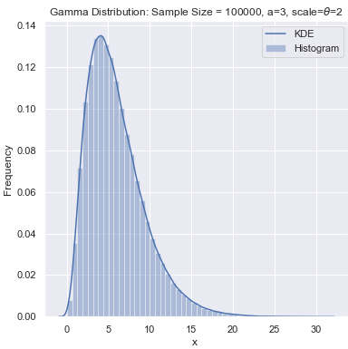

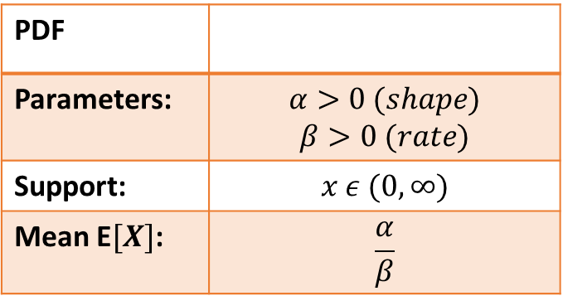
Gamma Distribution
Support Type:
Plot(s) of the distribution:
Support Type: single variable, continuous
PDF
Parameters: | $$α>0 (shape)$$ $$β>0 (rate)$$
Support: | $$x ε (0, ∞)$$
Mean E$[X]$: | $$\frac{α}{β}$$
Typical Uses: “in Bayesian statistics, where the gamma distribution is used as a conjugate prior distribution for various types of inverse scale (rate) parameters, such as the λ of an exponential distribution or a Poisson distribution^{[3]} – or for that matter, the β of the gamma distribution itself.” (Wikipedia)
Resources: Gamma distribution - Wikipedia

Slide 8
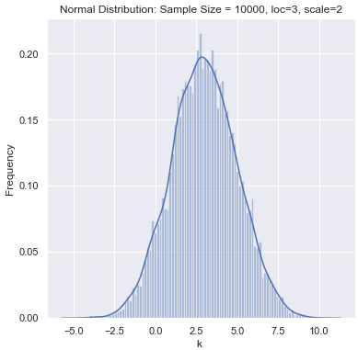

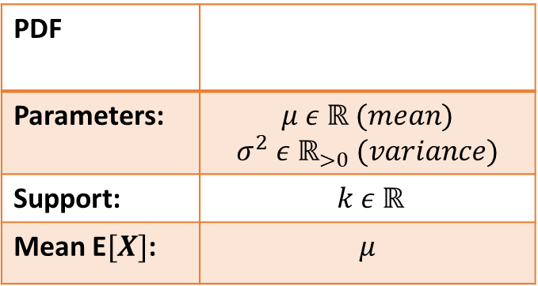
Gaussian Distribution
Support Type:
Plot(s) of the distribution:
Support Type: single variable, continuous
PDF
Parameters: | $$μ ε ℝ (mean)$$ $$σ^{2} ε ℝ_{>0} (variance)$$
Support: | $$k ε ℝ$$
Mean E$[X]$: | $$μ$$
Typical Uses:
real-valued random variables where the distribution is not known.
Height and weight distributions in a general population.
Resources:
Normal distribution - Wikipedia

Slide 9
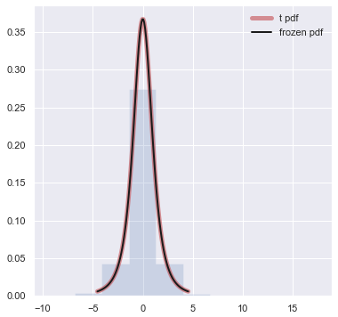

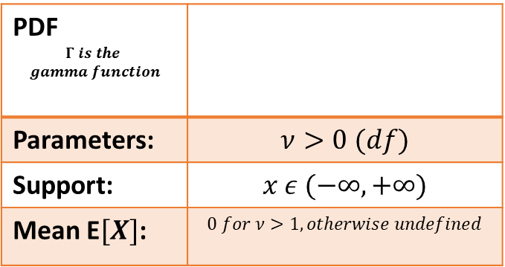
t Distribution
Support Type:
Plot(s) of the distribution:
Support Type: single variable, continuous
PDF $$Γ is the$$ $$gamma function$$
Parameters: | $$ν>0 (df)$$
Support: | $$x ε (−∞, +∞)$$
Mean E$[X]$: | $$0 for ν>1, otherwise undefined$$
Typical Uses:
- Significance tests
Resources:
Student's t-distribution - Wikipedia

Slide 10
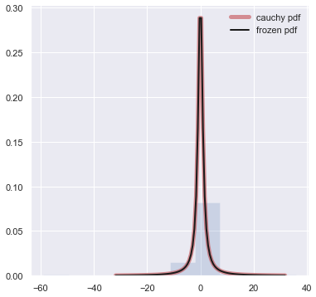

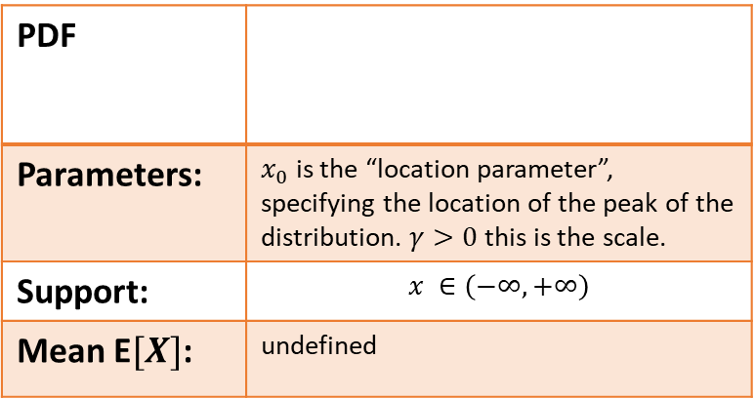
Cauchy Distribution
Support Type:
Plot(s) of the distribution:
Support Type: single variable, continuous
PDF
Parameters: | $x_{0}$ is the “location parameter”, specifying the location of the peak of the distribution. $γ>0$ this is the scale.
Support: | $$x ∈\left(−∞, +∞\right)$$
Mean E$[X]$: | undefined
Typical Uses: “The Cauchy distribution is often the distribution of observations for objects that are spinning.” (Wikipedia)
Resources: Cauchy distribution – Wikipedia
scipy.stats.cauchy — SciPy v1.7.1 Manual

Slide 11
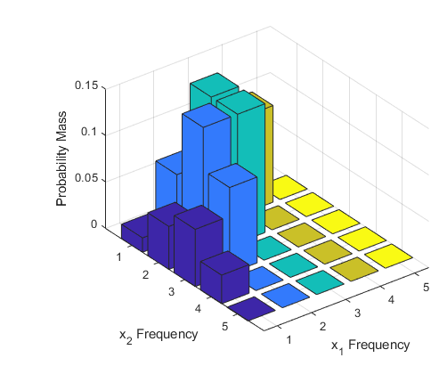

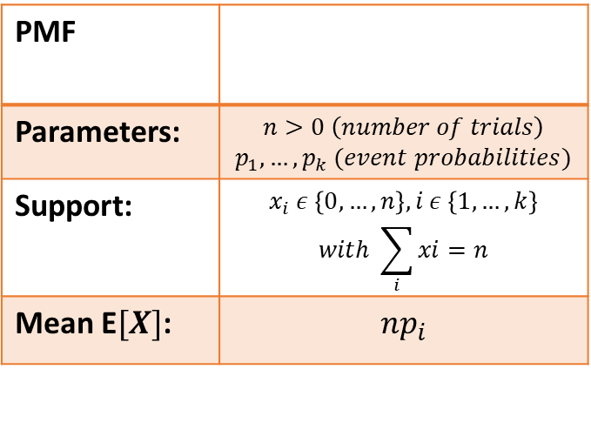
Multinomial Distribution
Support Type:
Plot(s) of the distribution:
Support Type: single variable, discrete
PMF
Parameters: | $$n>0 \left(number of trials\right)$$ $$p_{1}, …, p_{k} (event probabilities)$$
Support: | $$x_{i} ε \left\{0, …, n\right\}, i ε \left\{1, …, k\right\}$$ $$with \sum_{i}{xi}=n$$
Mean E$[X]$: | $$np_{i}$$
Typical Uses: and example is: to model the probability of counts for each side of a k-sided die rolled n times. If the die is unfair, then the probability for each side of the die may be different.
Resources: Multinomial distribution – Wikipedia
Multinomial Probability Distribution Functions - MATLAB & Simulink - MathWorks 한국

Slide 12
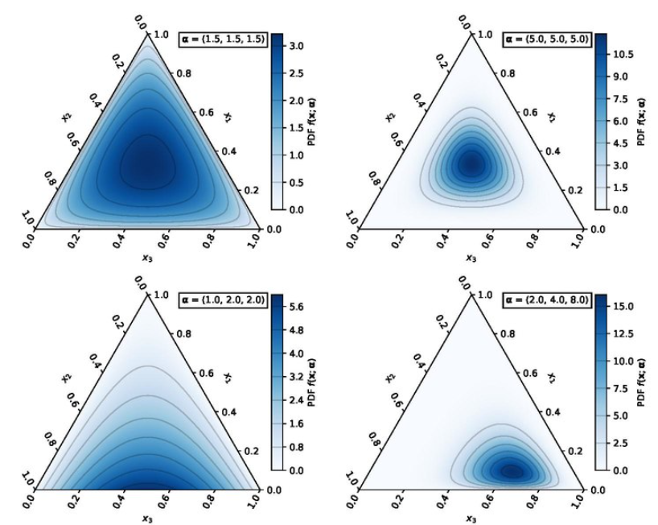
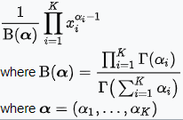
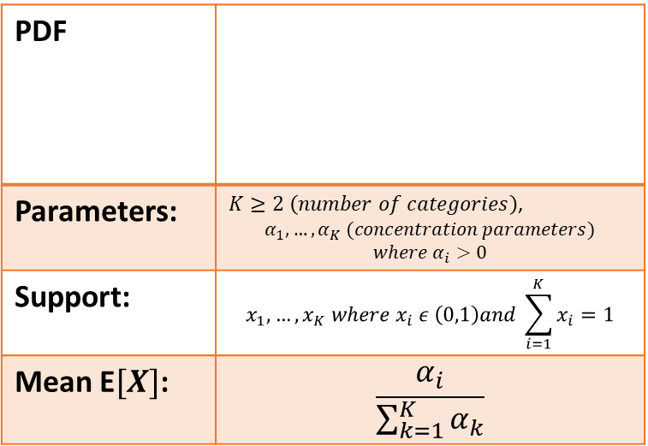
Dirichlet Distribution
Support Type:
Plot(s) of the distribution:
Support Type: multi variable, continuous
PDF
Parameters: | $K≥2 \left(number of categories\right)$, $$α_{1},…,α_{K} (concentration parameters)$$ $$where α_{i}>0$$
Support: | $$x_{1}, …, x_{K} where x_{i} ε \left(0,1\right)and \sum_{i=1}^{K}{x_{i}=1}$$
Mean E$[X]$: | $$\frac{α_{i}}{\sum_{k=1}^{K}{α_{k}}}$$
Typical Uses: This is the conjugate prior of the categorical distribution and multinomial distribution. (Wikipedia)
Resources:
Dirichlet distribution - Wikipedia

Slide 13
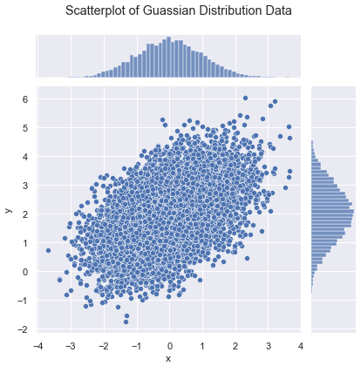

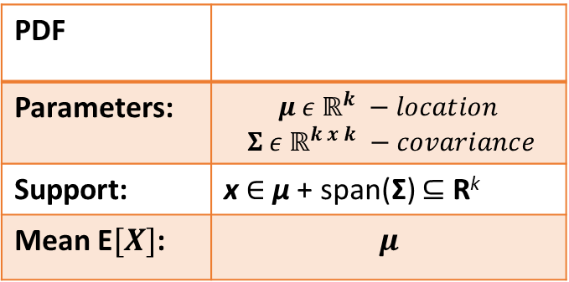
Multivariate Gaussian Distribution
Support Type:
Plot(s) of the distribution:
Support Type: multi variable, continuous
PDF
Parameters: | $$μ ε ℝ^{k} −location$$ $$Σ ε ℝ^{k x k} −covariance$$
Support: | x ∈ μ + span(Σ) ⊆ R^{k}
Mean E$[X]$: | $$μ$$
Typical Uses: often used to describe, at least approximately, any set of (possibly) correlated real-valued random variables each of which clusters around a mean value. (Wikipedia)
Resources:
Multivariate normal distribution – Wikipedia

Slide 14
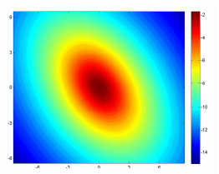

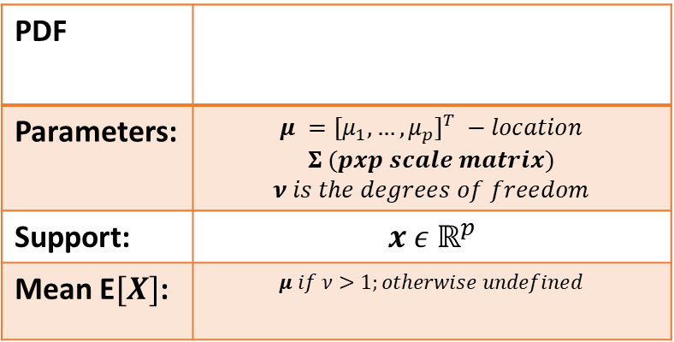
Multivariate t Distribution
Support Type:
Plot(s) of the distribution:
Support Type: multi variable, continuous
PDF
Parameters: | $$μ =[μ_{1},…,μ_{p}]^{T} −location$$ $$Σ (pxp scale matrix)$$ $$ν is the degrees of freedom$$
Support: | $$x ε ℝ^{p}$$
Mean E$[X]$: | $$μ if ν>1;otherwise undefined$$
Typical Uses: multivariant distribution that is better able to account for outliers than the Gaussian distribution.
Resources:
On the Multivariate t Distribution, Report no. LiTH-ISY-R-3059 (liu.se)
Multivariate t-distribution - Wikipedia

Slide 15
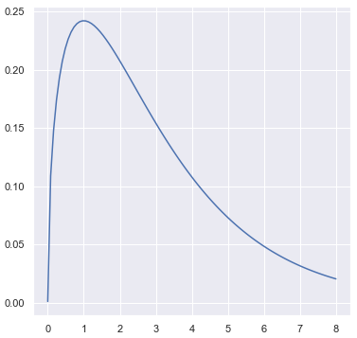
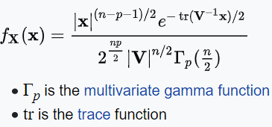
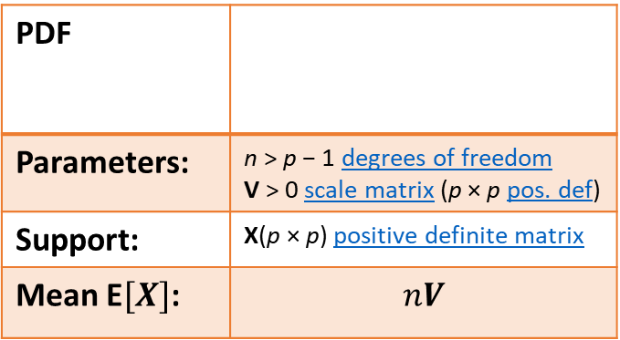
Wishart Distribution
Support Type:
Plot(s) of the distribution:
Support Type: multi variable, continuous
PDF
Parameters: | n > p − 1 degrees of freedom V > 0 scale matrix (p × p pos. def)
Support: | X(p × p) positive definite matrix
Mean E$[X]$: | $$nV$$
Typical Uses:
generalized Gamma distribution to multiple dimensions.
Estimation of covariance matrices in multivariate statistics.
In Bayesian statistics, the Wishart distribution is the conjugate prior of the inverse covariance-matrix of a multivariate-normal random-vector. (Wikipedia)
Resources:
Wishart distribution - Wikipedia

Slide 16
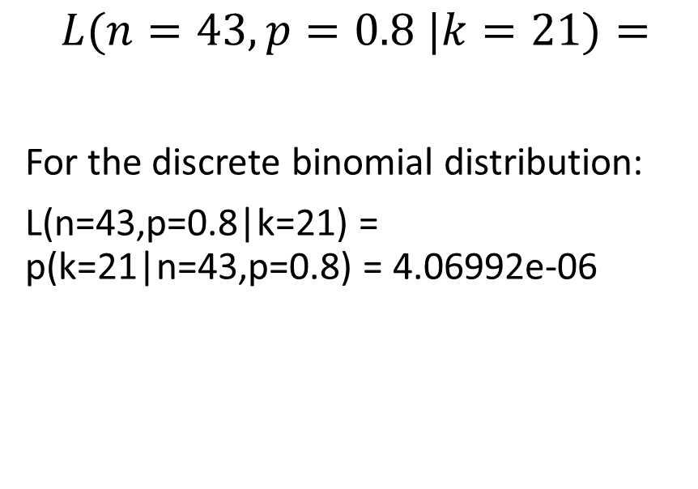
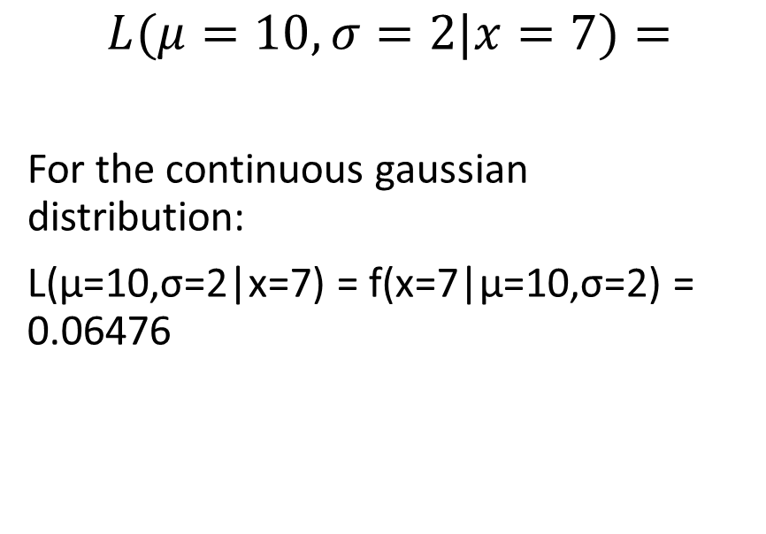
Compute the Likelihoods: (Use https://www.kaggle.com/billbasener/probability-distributions-and-likelihoods Section 2)
Discrete Binomial Distribution:
Continuous Gaussian Distribution
$$L(n=43,p=0.8 |k=21)=$$
For the discrete binomial distribution:
L(n=43,p=0.8|k=21) = p(k=21|n=43,p=0.8) = 4.06992e-06
$$L(μ=10,σ=2|x=7)=$$
For the continuous gaussian distribution:
L(μ=10,σ=2|x=7) = f(x=7|μ=10,σ=2) = 0.06476
NOTE: The values for the red box $∎$ will be given in our live session.
(If you miss/lose yours, just make something up. All that matters is that we have different values across the class.)

