Slide 1
Probability Distributions
Instructions: Have these slides completed and have your likelihoods on the last slide ready to share in Live Session Module 1, on Tuesday, September 1. The first slide for the Bernoulli distribution is completed as an example for you. You may use any references or resources you want.
We will discuss results on Live Session Module 1, and they will be submitted by September 8.

Slide 2
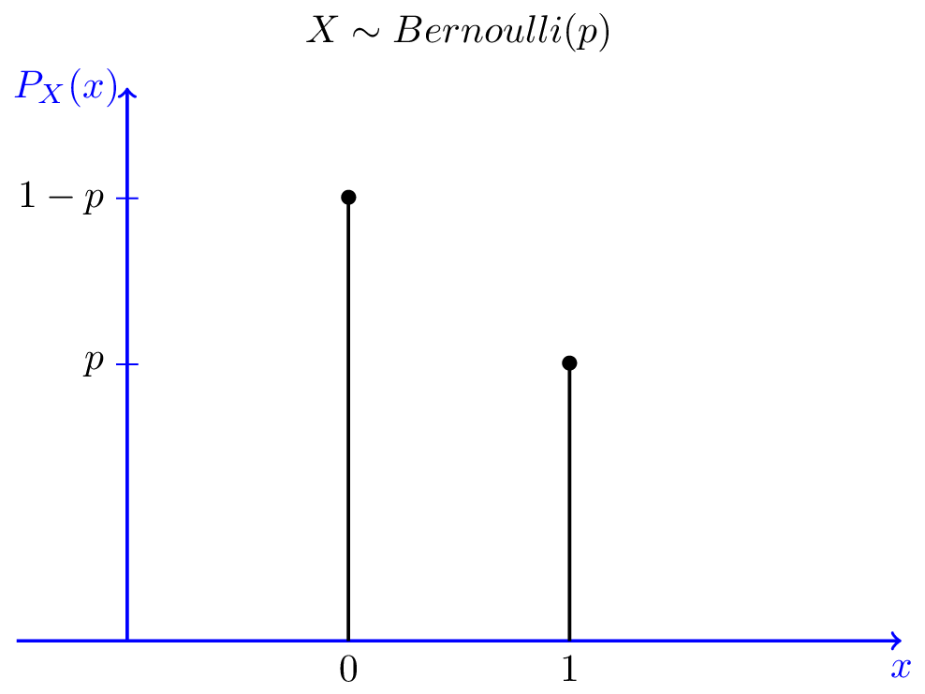
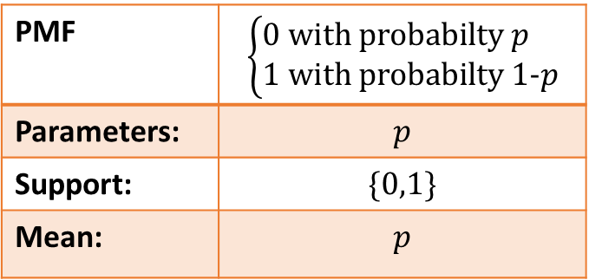
Bernoulli Distribution
Support Type:
Plot of the distribution:
Support Type: single variable, discrete
PMF | $$\left\{\begin{aligned}0 \text{with} \text{probabilty} p \\ 1 \text{with} \text{probabilty}\text{ 1−}p\end{aligned}\right.$$
Parameters: | $$p$$
Support: | $$\{0,1\}$$
Mean: | $$p$$
Typical Uses:
Flip of a fair coin (p=0.5)
Flip of unfair coin
Any single trial with two outcomes
Resources:
https://en.wikipedia.org/wiki/Bernoulli_distribution
https://www.probabilitycourse.com/chapter3/3_1_5_special_discrete_distr.php
Probability.pdf (storage.googleapis.com)

Slide 3
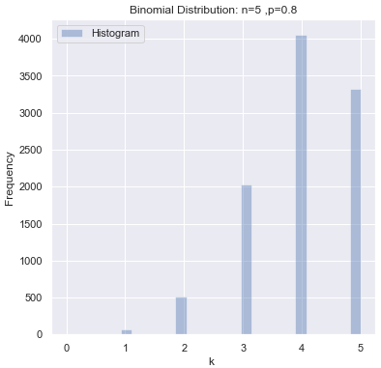

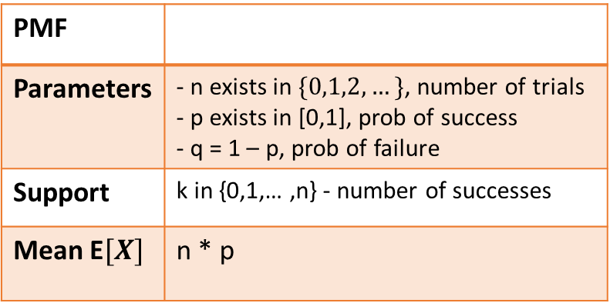
Binomial Distribution
Support Type:
Plot(s) of the distribution:
Support Type: single variable, discrete
PMF
Parameters | - n exists in $\{0,1,2,…\}$, number of trials - p exists in [0,1], prob of success - q = 1 – p, prob of failure
Support | k in {0,1,… ,n} - number of successes
Mean E$[X]$ | n * p
Typical Uses:
Flip of a fair coin multiple times (p=0.5)
Flip of unfair coin multiple times (p=?)
Multiples trial with two outcomes
Resources:
Probabilities, Likelihoods, and Bayes Theorem | Kaggle
Binomial distribution – Wikipedia
Probability.pdf (storage.googleapis.com)

Slide 4
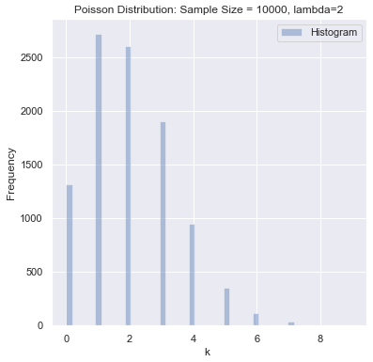

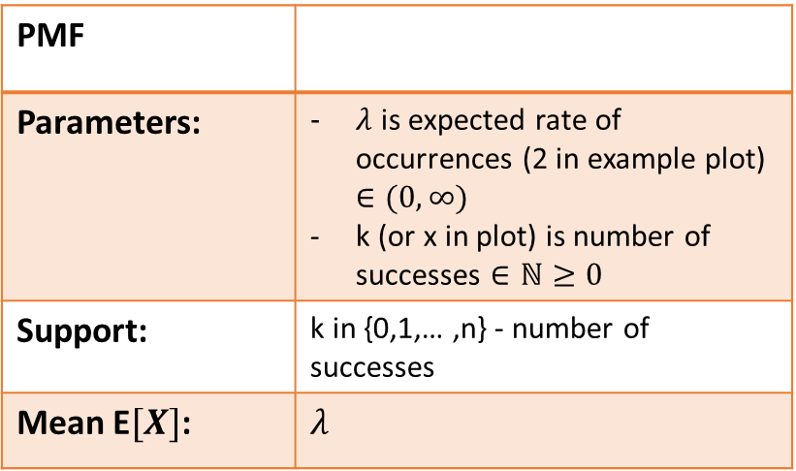
Poisson Distribution
Support Type:
Plot(s) of the distribution:
Support Type: single variable, discrete
PMF
Parameters: | $λ$ is expected rate of occurrences (2 in example plot) $∈(0,∞)$ k (or x in plot) is number of successes $∈ℕ≥0$
Support: | k in {0,1,… ,n} - number of successes
Mean E$[X]$: | $$λ$$
Typical Uses: number of times an event with a constant probability will happen during a fixed time. E.g. number of goals in a Super Bowl game.
Resources:
Probabilities, Likelihoods, and Bayes Theorem | Kaggle
Poisson distribution – Wikipedia
Probability.pdf (storage.googleapis.com)

Slide 5
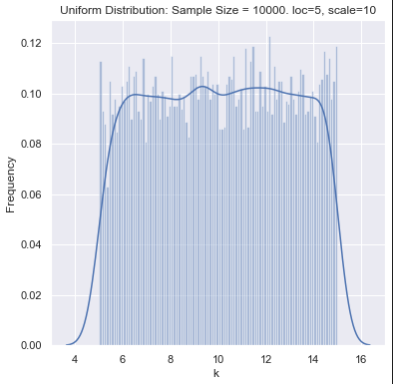
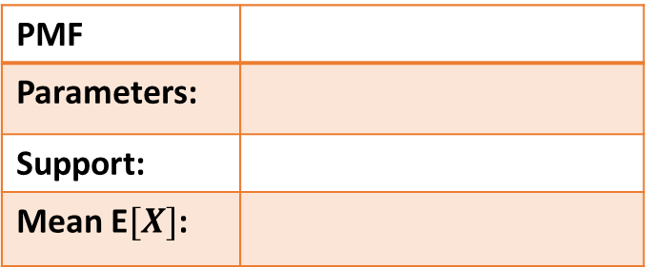
Uniform Distribution
Support Type:
Plot(s) of the distribution:
Support Type:
PMF
Parameters:
Support:
Mean E$[X]$:
Typical Uses:
Resources:

Slide 6
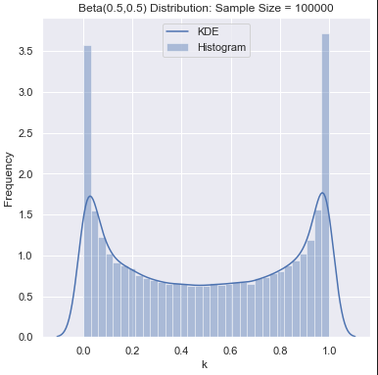
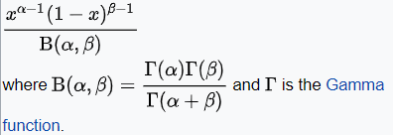
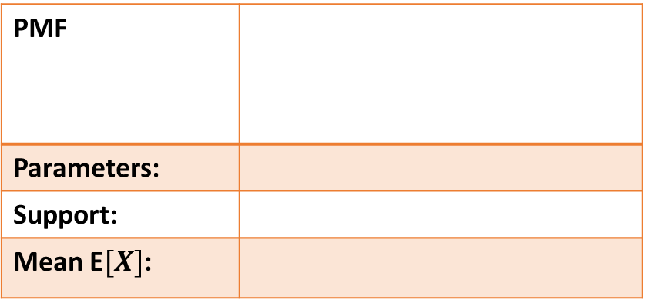
Beta Distribution
Support Type:
Plot(s) of the distribution:
Support Type: single variable, continuous
PMF
Parameters:
Support:
Mean E$[X]$:
Typical Uses: Likelihood of completion of a project task during a timeframe. Used for PERT analysis and critical path determination in project management.
Resources:
Beta distribution – Wikipedia
Probabilities, Likelihoods, and Bayes Theorem | Kaggle

Slide 7
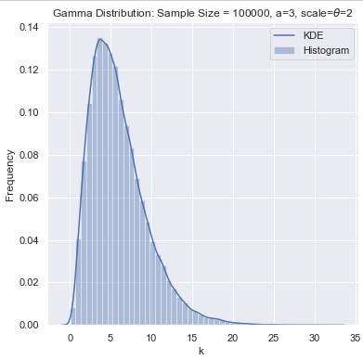
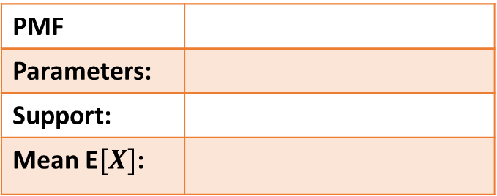
Gamma Distribution
Support Type:
Plot(s) of the distribution:
Support Type:
PMF
Parameters:
Support:
Mean E$[X]$:
Typical Uses:
Resources:

Slide 8
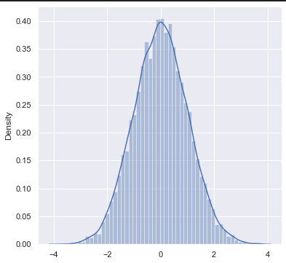
Gaussian Distribution
Support Type:
Plot(s) of the distribution:
Support Type:
PMF
Parameters:
Support:
Mean E$[X]$:
Typical Uses:
Resources:

Slide 9
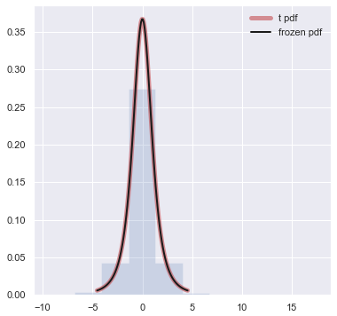
t Distribution
Support Type:
Plot(s) of the distribution:
Support Type:
PMF
Parameters:
Support:
Mean E$[X]$:
Typical Uses:
Resources:

Slide 10

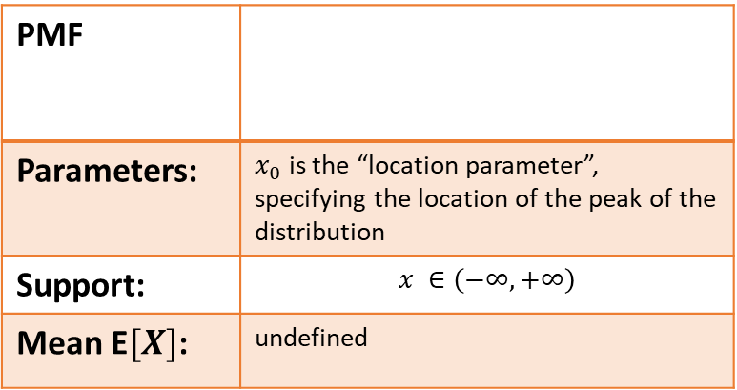
Cauchy Distribution
Support Type:
Plot(s) of the distribution:
Support Type: single variable, continuous
PMF
Parameters: | $x_{0}$ is the “location parameter”, specifying the location of the peak of the distribution
Support: | $$x ∈\left(−∞, +∞\right)$$
Mean E$[X]$: | undefined
Typical Uses:
Resources: Cauchy distribution – Wikipedia
scipy.stats.cauchy — SciPy v1.7.1 Manual

Slide 11
Multinomial Distribution
Support Type:
Plot(s) of the distribution:
Support Type:
PMF
Parameters:
Support:
Mean E$[X]$:
Typical Uses:
Resources:

Slide 12
Dirichlet Distribution
Support Type:
Plot(s) of the distribution:
Support Type:
PMF
Parameters:
Support:
Mean E$[X]$:
Typical Uses:
Resources:

Slide 13
Multivariate Gaussian Distribution
Support Type:
Plot(s) of the distribution:
Support Type:
PMF
Parameters:
Support:
Mean E$[X]$:
Typical Uses:
Resources:

Slide 14
Multivariate t Distribution
Support Type:
Plot(s) of the distribution:
Support Type:
PMF
Parameters:
Support:
Mean E$[X]$:
Typical Uses:
Resources:

Slide 15
Wishart Distribution
Support Type:
Plot(s) of the distribution:
Support Type:
PMF
Parameters:
Support:
Mean E$[X]$:
Typical Uses:
Resources:

Slide 16


Compute the Likelihoods: (Use https://www.kaggle.com/billbasener/probability-distributions-and-likelihoods Section 2)
Discrete Binomial Distribution:
Continuous Gaussian Distribution
$$L(n=50,p=∎|k=21)=$$
$$L(μ=∎,σ=∎|x=7)=$$
NOTE: The values for the red box $∎$ will be given in our live session.
(If you miss/lose yours, just make something up. All that matters is that we have different values across the class.)

