Slide 1
01
ABSTRACT FACTORY
ABSTRACT FACTORY

Slide 2

DEFINITION
As Factory Method Pattern, Abstract Factory Pattern is one of Creational patterns.
Considered as another layer of abstraction over factory pattern.
Work around a super factory to create other factories.
Notes:
Để dễ hình dung hơn, hãy tưởng tượng Abstract Factory như là một nhà máy lớn chứa nhiều nhà máy nhỏ, trong các nhà máy đó có những xưởng sản xuất, các xưởng đó tạo ra những sản phẩm khác nhau.

Slide 3

SOLVE

Slide 4
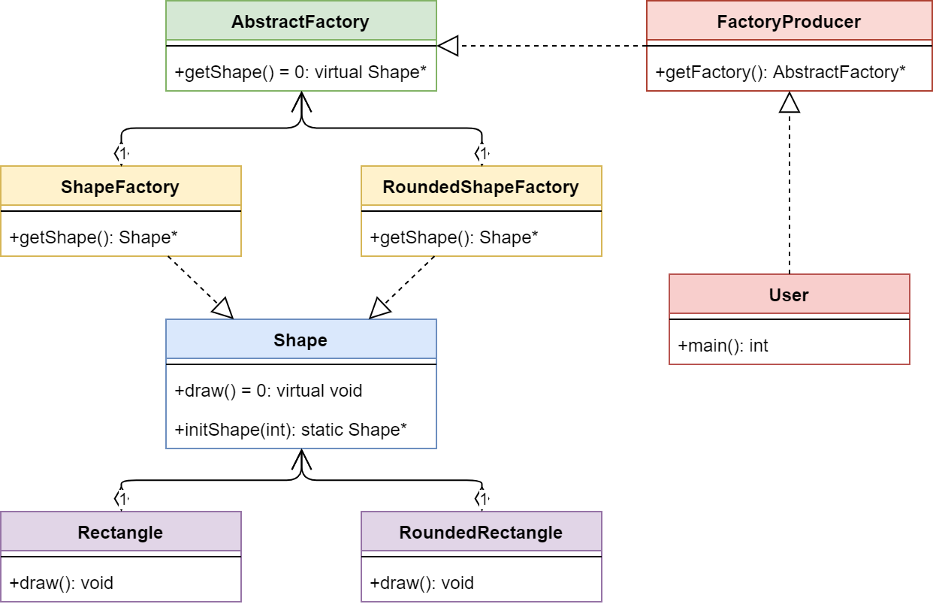

Slide 5
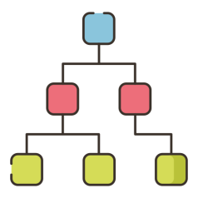
Structure
AbstractFactory : Declares an interface for operations that create abstract product objects.
ConcreteFactory : Implements the operations declared in the AbstractFactory to create concrete product objects.
Product : Defines a product object to be created by the corresponding concrete factory and implements the AbstractProduct interface.
Client : Uses only interfaces declared by AbstractFactory and AbstractProduct classes.

Slide 6
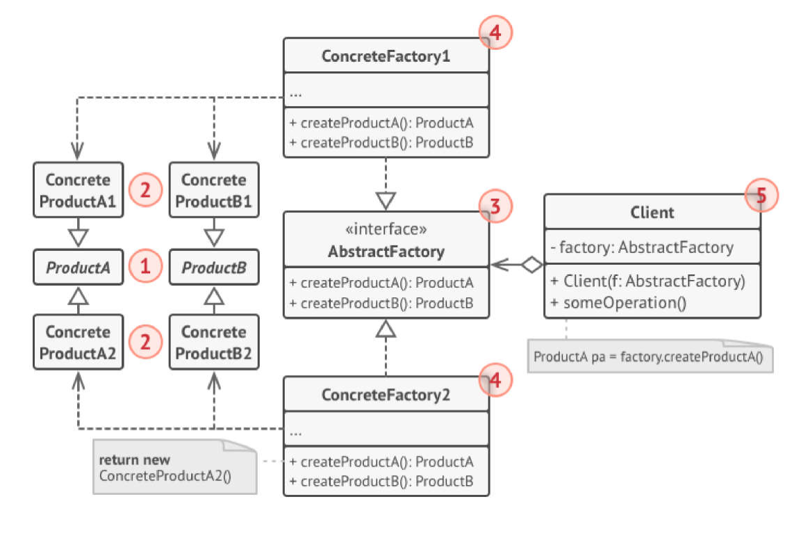

Slide 7
Advantages and Disadvantages
* Makes code more difficult to read as all of your code is behind an abstraction that may in turn hide abstractions.
* Reduced readability due to increased abstraction.
* Applicable only for families of classes.
ADVANTAGE
DISADVANTAGE
Ensure that all products you receive from a factory are compatible.
Cut down the dependence between creator and concrete products.
Create products into somewhere in the program → easy to track and manipulate.
Freely add many new products to the program without changing the existing code base.
Code will be more complicated and must use a lot of classes.

Slide 8
@REFERENCE:
https://vi.fitwp.com/abstract-factory-pattern/ (Vietnamese)
https://www.geeksforgeeks.org/abstract-factory-pattern/

Slide 9
02
FACTORY METHOD
FACTORY METHOD

Slide 10



Transportation
+ Transportation()
+ ~Transportation()
+ <<virtual>> Exit()
Car
Plane
Boat
+ Car()
+ ~Car()
+ <<virtual>> Exit()
+ Plane()
+ ~Plane()
+ <<virtual>> Exit()
+ Boat()
+ ~Boat()
+ <<virtual>> Exit()

Slide 11




Solve without FDP
Whenever we need to instantiate an object, we use the new operator as usual:
Transportation *p1=new Car;
Transportation *p2=new Plane;
Transportation *p3=new Boat;

Slide 12


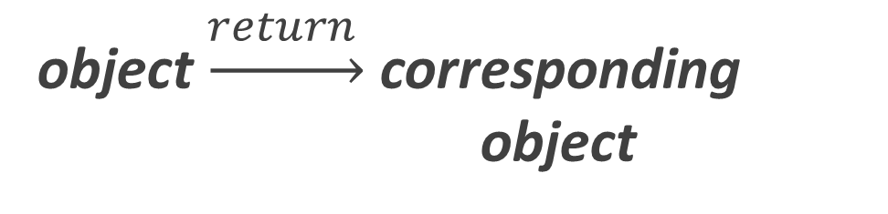
Difficulty of the above way
object
that can handle the initialization of these objects
object $\underset{→}{return }$ corresponding object
Factory object

Slide 13

Factory Method [ OverView]
Factory method is a Creational design pattern, i.e., related to object creation. In Factory pattern, we create object without exposing the creation logic to client and the client use the same common interface to create new type of object.
The idea is to use a static member-function (static factory method) which creates & returns instances, hiding the details of class modules from user.

Slide 14




above problem with Factory Method
Step 1: Create enum to save type
Step 2: Build Factory
Step 3: Using Factory

Slide 15
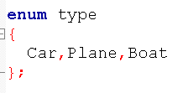

Slide 16
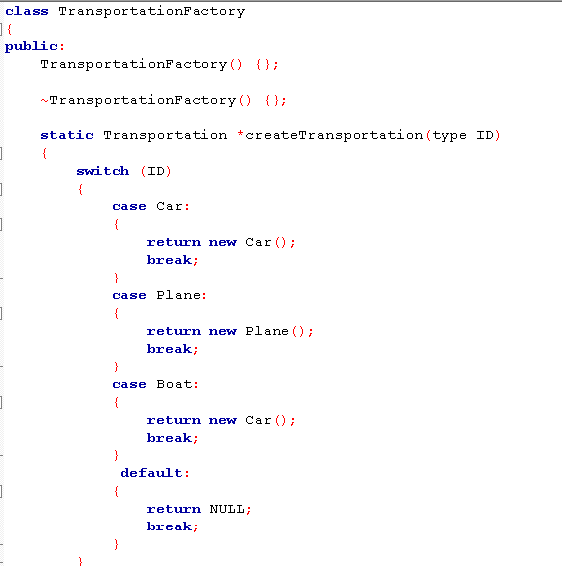

Slide 17
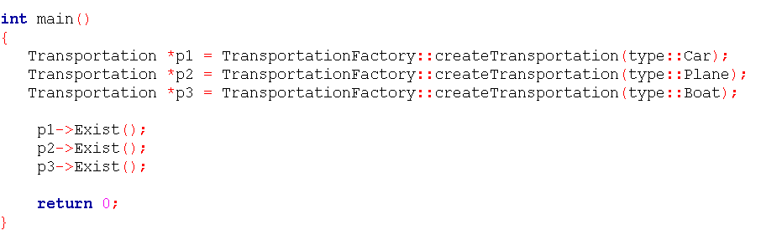

Slide 18

Other problems solved with Factory Method
‘Drawing’ system, depending on user’s input, different pictures like square, rectangle, circle can be drawn. Here we can use factory method to create instances depending on user’s input.
If a Restaurant serves Veg food, Non-Veg food, and Italian food.
→ Treat VegFood, NonVegFood, and ItalianFood as three classes whose superclass is Food.
→ If a customer asks "Veg" then Factory method would return the "VegFood" class.

Slide 19
Advantages and Disadvantages
* Makes code more difficult to read as all of your code is behind an abstraction that may in turn hide abstractions.
* Reduced readability due to increased abstraction.
* Applicable only for families of classes.
ADVANTAGE
DISADVANTAGE
Allows you to hide implementation of an application seam (the core interfaces that make up your application).
Allows you to easily test the seam of an application (that is to mock/stub) certain parts of your application so you can build and test the other parts
Allows you to change the design of your application more readily, this is known as loose coupling.
It makes the application more customizable.
Makes code more difficult to read as all of your code is behind an abstraction that may in turn hide abstractions.
Reduced readability due to increased abstraction.
Applicable only for families of classes.

Slide 20
@REFERENCE:
http://uttakarshtikku.blogspot.com
https://www.quora.com/
https://www.geeksforgeeks.org/
https://www.stdio.vn/

Slide 21


THANKS FOR WATCHING

