Slide 1
Future sale Prediction
Hung Nguyen

Slide 2
Purpose
Predict the sale of next month
Analysis the sale of shop
Maintain and keep the stock in store
Limit item over stock

Slide 3
Data Wrangling
Obtain data from kaggle
Merge the file together
Remove negative number for cnt_item_day and item_price
Remove outlier
Check missing value

Slide 4
Exploratory Data Analysis

Slide 5
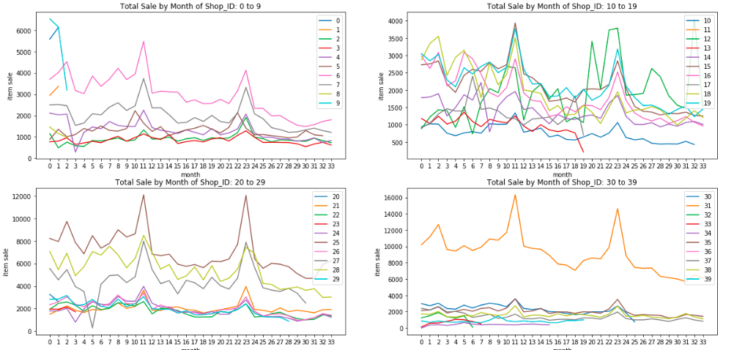
Total item sale for each month
X present the month
Y present the total sale

Slide 6
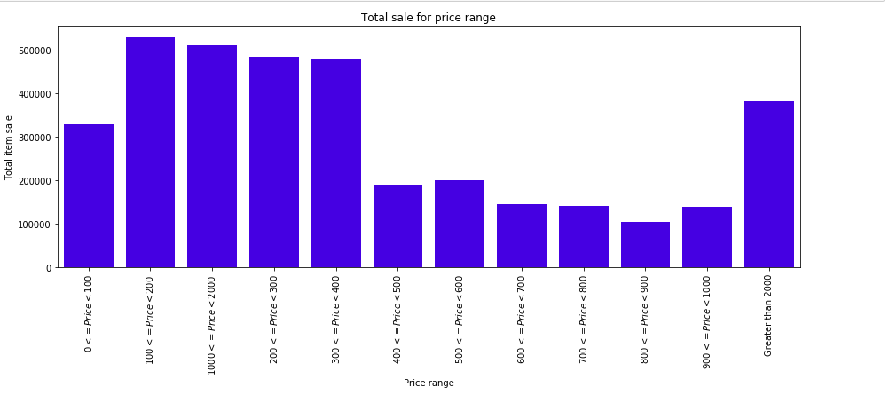
Total sale for price range
X is present the price range
Y is present the total item sale

Slide 7
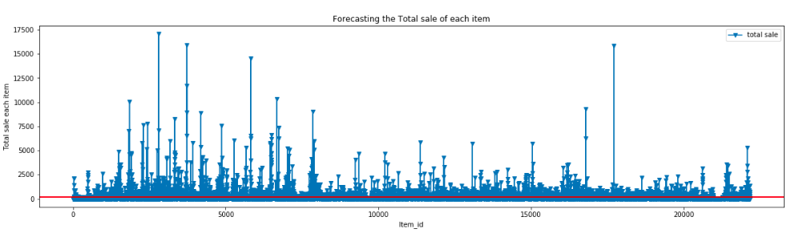
Total sale for each item
X is item_id
Y is total item sale

Slide 8
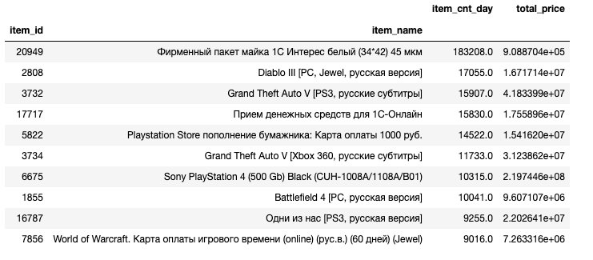
Top 10 item sale

Slide 9
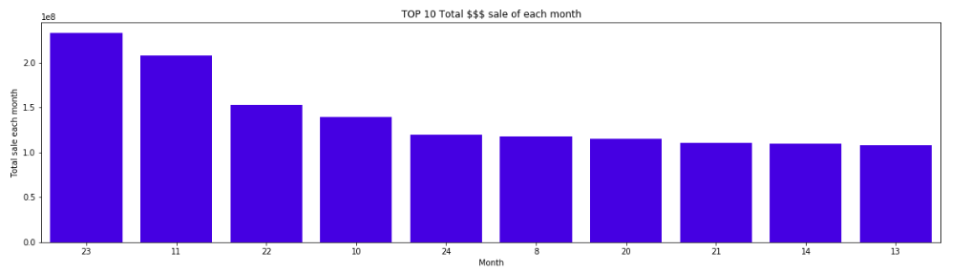
Top 10 month for total sale

Slide 10
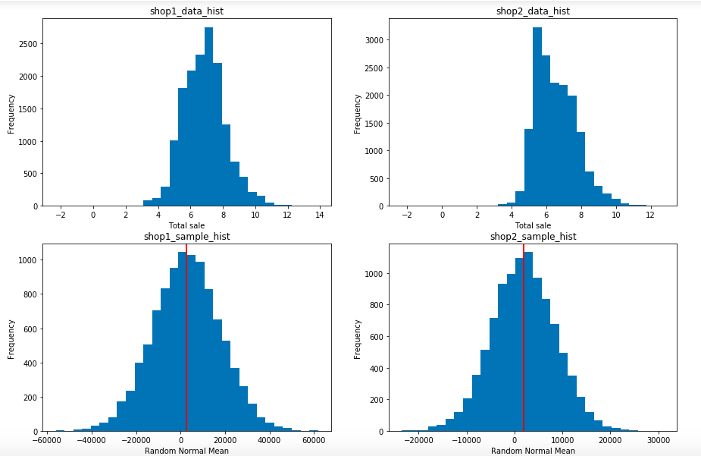
Frequency statistics test
Compare the average sale 2 shop
Resampling
T-value
p-value

Slide 11
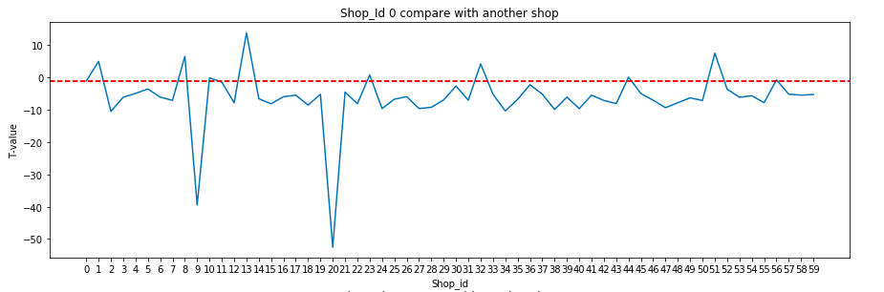
Compare T-value for each to the reach
Negative value mean that shop is less another
Positive are opposite

Slide 12
Hypothesis test
Ho(null hypothesis) : greater than mean
Ha(alternative hypothesis): less or equal the mean
Confidence interval 95%
Resampling over 1000 times

Slide 13
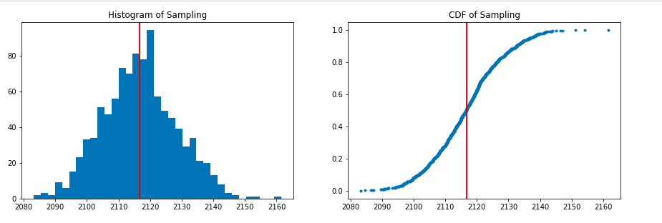
As p_value = 0.514
And the 95% confidence interval is [1939.1,1970.3].
The p value is so high so we can not reject Null hypothesis

Slide 14
Machine Learning Model
Feature Engineering
KNN regression
Random forest regression
Xgboost regression
Summary the best model:
Random forest regression
Xgboost regression

Slide 15
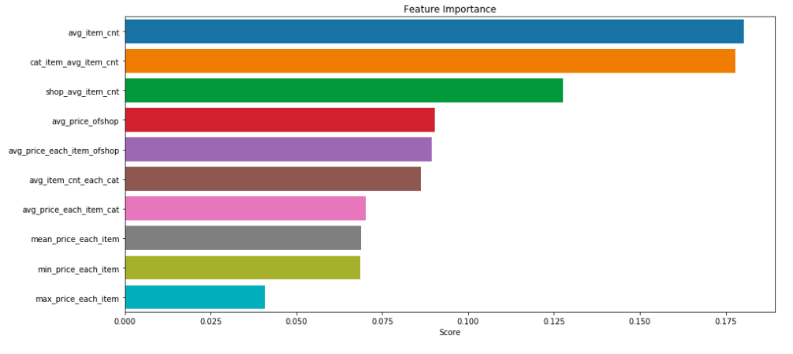
Random forest regression
R square = 0.68
RMSE = 0.47

Slide 16
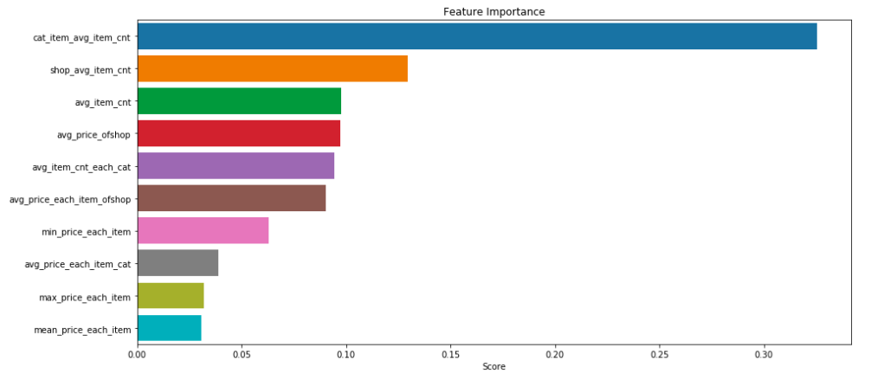
Xgboost Regression
R square = 0.69
RMSE = 0.46

Slide 17
Summary
The best month sale is December
The total sale of shop decreasing
Overall, you can see that we have Xgboost is give us a best model.
We will choice xgboost model for future prediction of our data.

