Slide 1

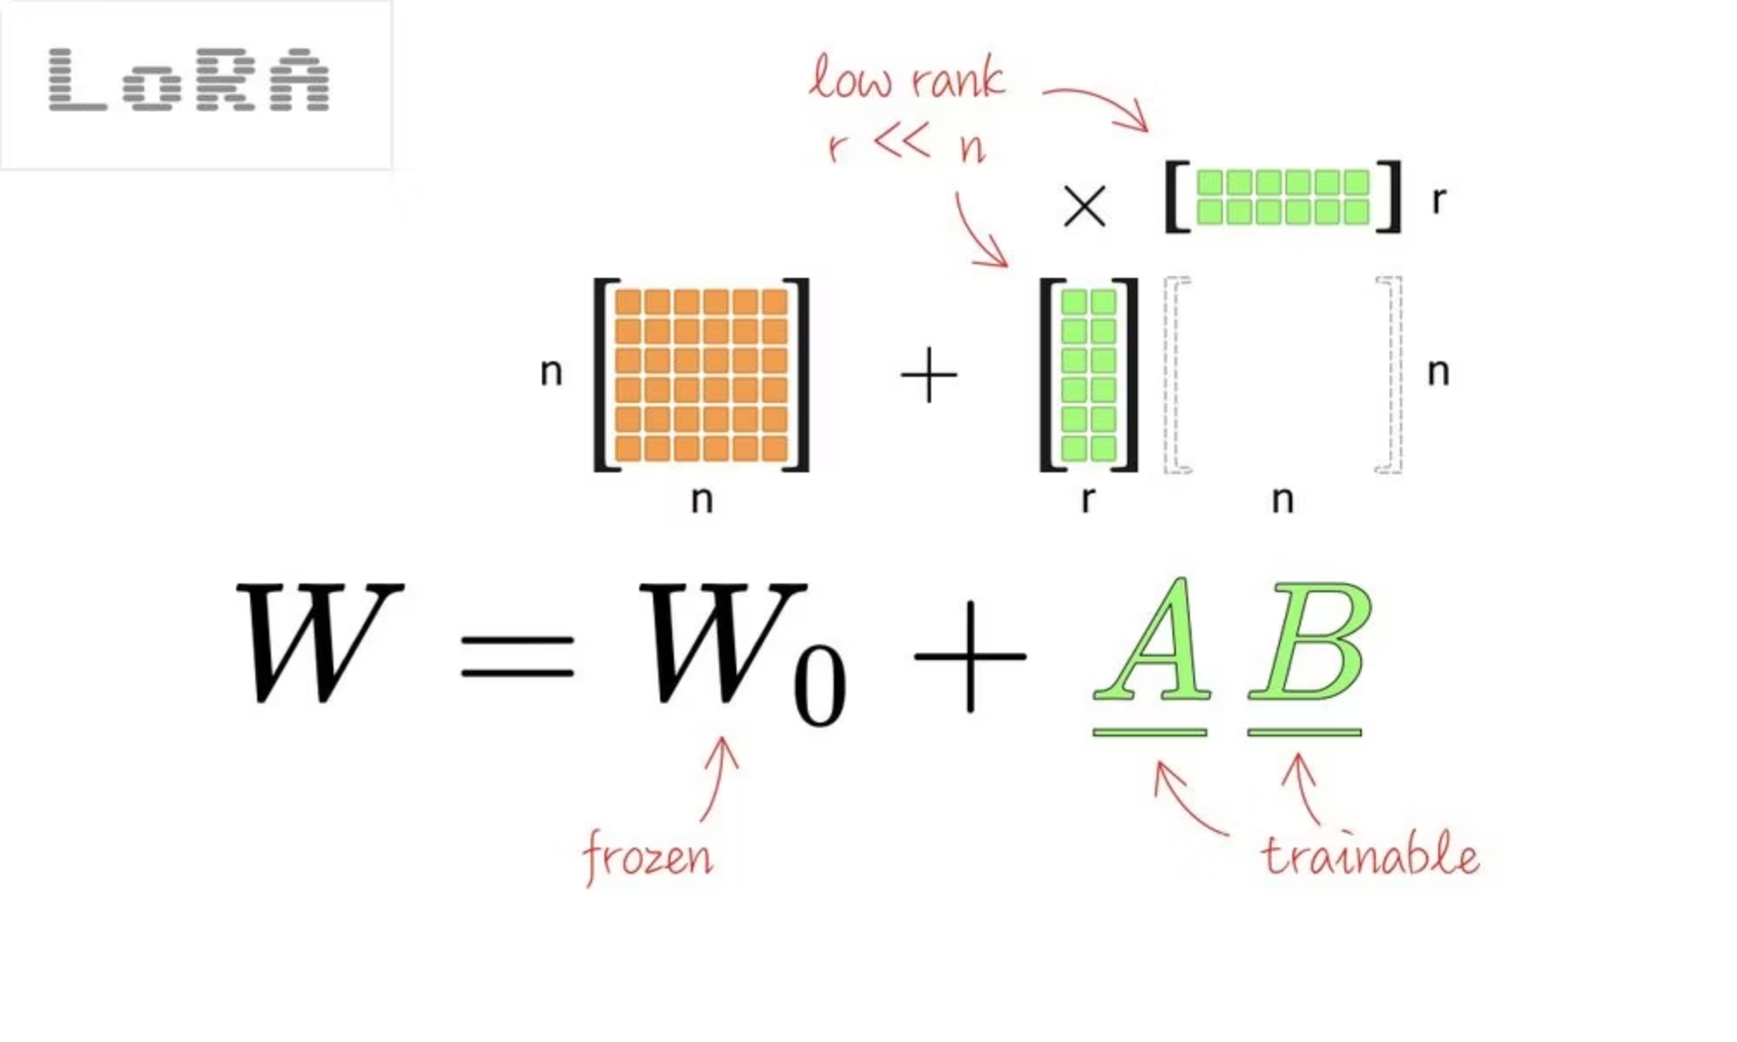
AdaLoRA-Drop: Parameter-Efficient RoBERTa Fine-Tuning on SICK-E
Task: Textual Entailment on SICK-E (classify pairs as entailment, contradiction, neutral).
Base model: RoBERTa-base – a "robustly optimised BERT" trained longer, with more data and better hyperparameters.
Our code for the experiment : https://github.com/hdnguyen1802/AdaLoRa-drop-roberta-sicke
Inspired by:
LoRA Without Regret
AdaLoRA: Adaptive Budget Allocation for Parameter-Efficient Fine-Tuning
LoRA-drop: Efficient LoRA Parameter Pruning based on Output Evaluation

Slide 2
The Challenge
Problem with full fine-tuning
Memory & Compute Heavy
Overkill for SICK-E
All ~125M RoBERTa parameters become trainable → memory / compute heavy.
Overkill for SICK-E (≈10k sentence pairs).
Goal: Match or approach full fine-tuning performance for SICK-E whilst training only a tiny fraction of parameters.

Slide 3




From RoBERTa to AdaLoRA-Drop
RoBERTa-base
LoRA (Low-Rank Adaptation)
Transformer encoder; improves BERT via longer training, more data, and better hyperparameters.
Freeze backbone; inject small low-rank matrices (A,B) into selected layers. Can reduce trainable parameters by up to 10,000× vs full fine-tune with comparable performance.
AdaLoRA (Adaptive LoRA)
LoRA-Drop
Allocates rank adaptively per layer based on importance. Prunes unimportant singular values → better performance in low-budget regimes.
Compute per-layer importance from LoRA output ΔWx. Keep LoRA in important layers; share one LoRA module across all other layers. Achieves near-LoRA performance whilst dropping ≈50% of LoRA parameters.

Slide 4
Our Method: Two-Stage AdaLoRA-Drop on RoBERTa
Stage 1 – Importance Estimation
Stage 2 – AdaLoRA-Drop Fine-Tuning
Attach AdaLoRA modules to targeted RoBERTa layers.
Reset to a fresh RoBERTa-base classifier (num_labels = 3).
Train briefly on ~10% of SICK-E (e.g., 3 epochs, small adapter rank).
Apply AdaLoRA with a small target rank (e.g., r=4) as per AdaLoRA's low-budget recommendations.
For each layer, compute importance Iᵢ ∝ E[‖ΔWᵢx‖²] across this subset (like LoRA-Drop).
High-importance layers: each gets its own AdaLoRA module.
Sort layers by Iᵢ; choose minimal set reaching 95% (or 90%) cumulative importance → high-importance layers; rest are low-importance.
Low-importance layers: share a single AdaLoRA module per shape group (instead of a shared LoRA as in LoRA-Drop).

Slide 5
Experimental Setup
Dataset: SICK-E
Base model
Training details
≈9.8k sentence pairs, labelled as entailment / contradiction / neutral.
Example:
S1: A lone biker is jumping in the air
S2: A biker is jumping in the air, alone
Relatedness: ENTAILMENT
RoBERTa-base encoder with classification head.
Same task setting for all models: Cross-entropy loss, AdamW optimiser. Small batch size (e.g., 64) and learning rate in LoRA/AdaLoRA-friendly range. 5 epochs of fine-tuning, early stopping by validation accuracy.
Models compared:
AdaLoRA-drop@95 / @90 (our): Two variants with cumulative importance thresholds 95% and 90%.
Baseline (Full FT): all RoBERTa weights trainable (~124M params).
LoRA-all: standard LoRA on all chosen layers.
LoRA-drop@95: reproduce LoRA-Drop with 95% importance threshold.
AdaLoRA-all: AdaLoRA on all layers, no sharing.

Slide 6
Results – Accuracy vs Trainable Parameters
Model
Trainable Params
Test Accuracy
Baseline (full)
124,647,939
0.8863
LoRA-all
1,256,451
0.8939
LoRA-drop@95
1,062,915
0.8900
AdaLoRA-all
682,272
0.8805
AdaLoRA-drop@95
133,698
0.8744
AdaLoRA-drop@90
66,846
0.8736
Key insight: AdaLoRA-drop@90 achieves >99.9% reduction in trainable parameters with only modest accuracy drop.

Slide 7

Findings & Limitations
1
2
Extreme parameter efficiency
Adapter methods are strong on SICK-E
AdaLoRA-drop@90 shows >99.9% reduction in trainable parameters with modest accuracy drop.
LoRA-all slightly beats full fine-tuning—consistent with LoRA results that low-rank constraints can regularise adaptation.
3
4
Importance-based sharing works
AdaLoRA + sharing = tunable knob
Layer importance from ΔWx (as proposed in LoRA-Drop) is robust enough that low-importance layers can share a single module with minimal harm.
Adjusting the cumulative importance threshold (95% vs 90%) gives a clear trade-off curve between parameters and accuracy.
Limitations
Only evaluated on SICK-E and RoBERTa-base – no guarantee the same trade-offs hold for larger models or tasks.
Importance uses only ΔWx energy; other metrics might give better rankings.

Slide 8




Takeaway & Why It Matters!
Two-Stage Method
Extreme Efficiency
Leverages a small data subset to score layer importance, applying individual AdaLoRA modules to important layers and a shared module for low-importance layers.
Achieves up to ≈1,865× fewer trainable parameters (≈0.054% of RoBERTa) with only ~1–1.5% accuracy loss compared to full fine-tuning.
Cost-Effective
Edge Deployment
Significantly smaller adapters reduce memory and computation, enabling cheaper GPUs, more models per server, and faster fine-tuning and deployment.
Adapter sizes in the tens of thousands of parameters make on-device or low-resource deployment scenarios viable.

