Slide 1
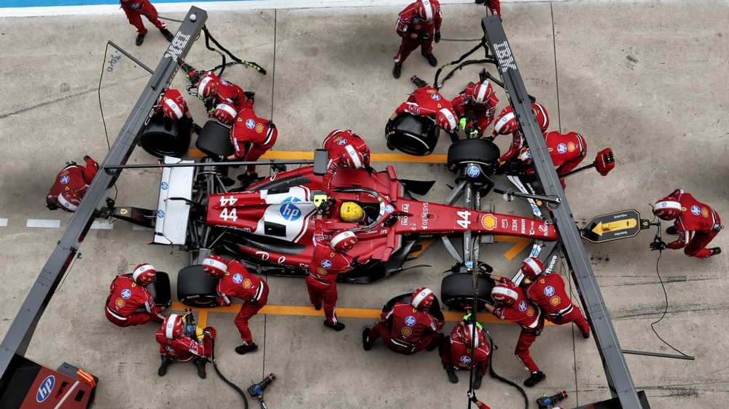

Slide 2
OpenF1 API - https://openf1.org/
OpenF1 API provides a comprehensive view of an array of different F1 Metrics.
Using this service, I imported three primary datasets, that being pitstop_data, session_data, and driver_data

Slide 3

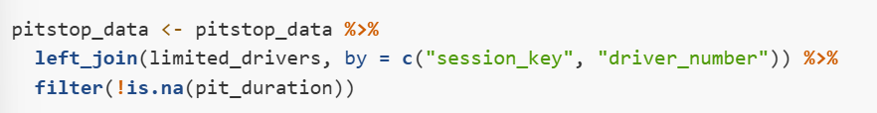
Two Primary Data Cleaning Steps
1.3 Session Isolation
1.5.1 Joining Driver Information

Slide 4
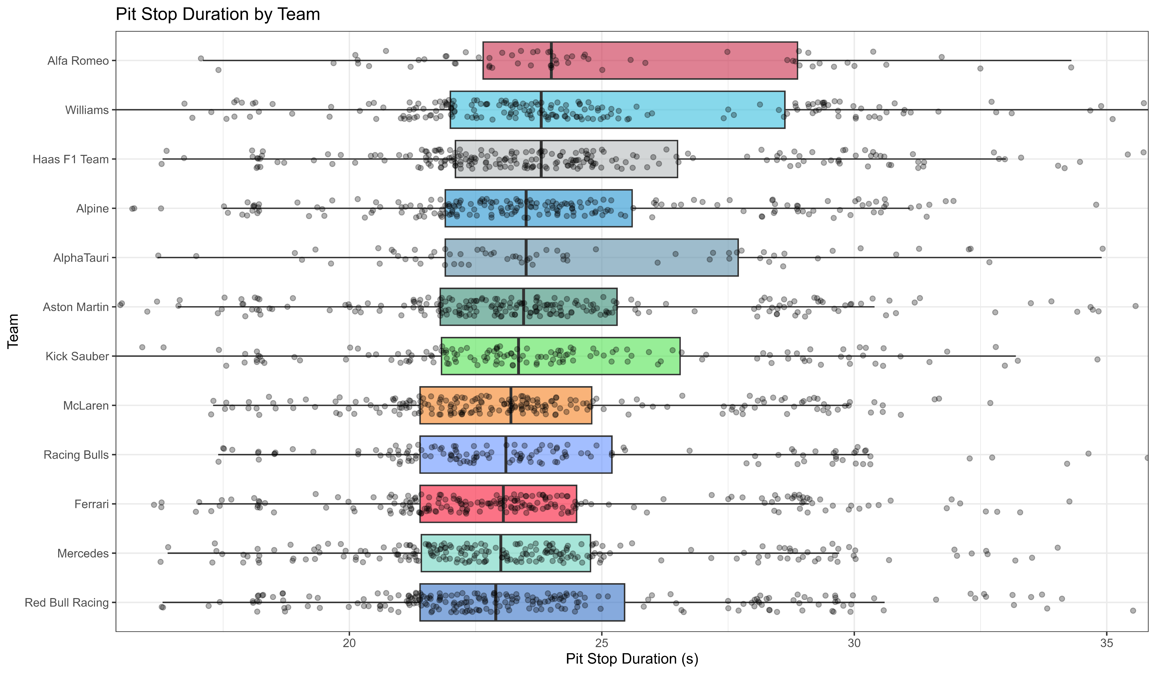

Slide 5
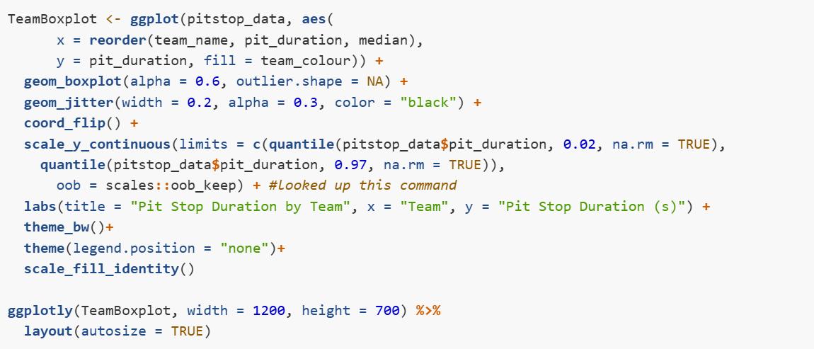
Notes:
TeamBoxplot Object is created from a ggplot funcition that orders team name and the associated pit duration by the median pit duration of that team, while using the teams official color code to color the boxplots.

Slide 6
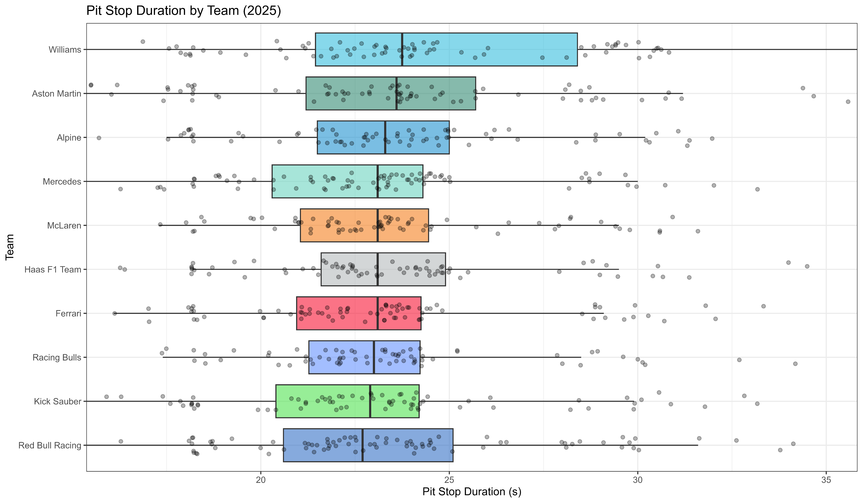

Slide 7
