Slide 1

Los Angeles Crime Rate Analysis
Hector Peña
DSC 530
03 June 2023

Slide 2

Objective
The main goal for my project was to provide individuals with a breakdown and analysis of crime rate and how they are occurring in Los Angeles, so that they may see it for themselves and make their decision on whether to live in certain areas of Los Angeles.

Slide 3
Dataset
The dataset I chose is a collection of crime entries ranging from 2010 through 2017, this dataset contains multiple variables; some of which are not relevant to the analysis for this project. The variables I will be mostly focusing on are: Victim Age, Victim Sex, Area Name, Time Occurred, and Area ID.

Slide 4
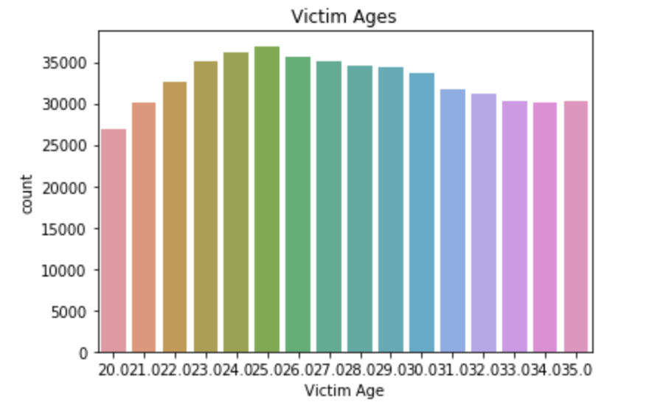
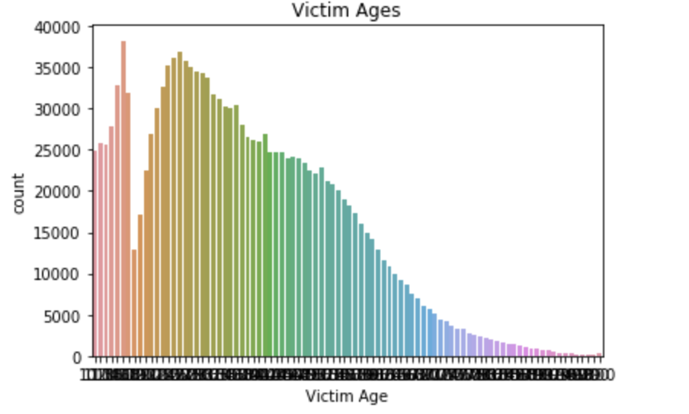
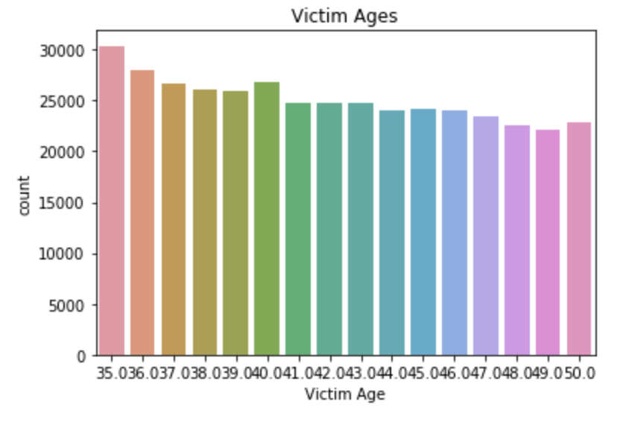
Victim Age

Slide 5
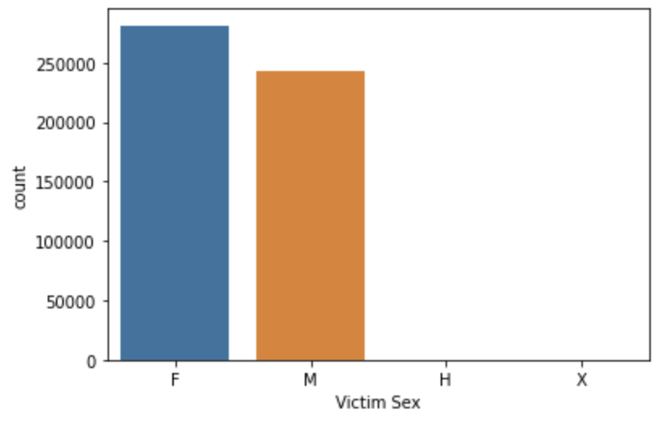
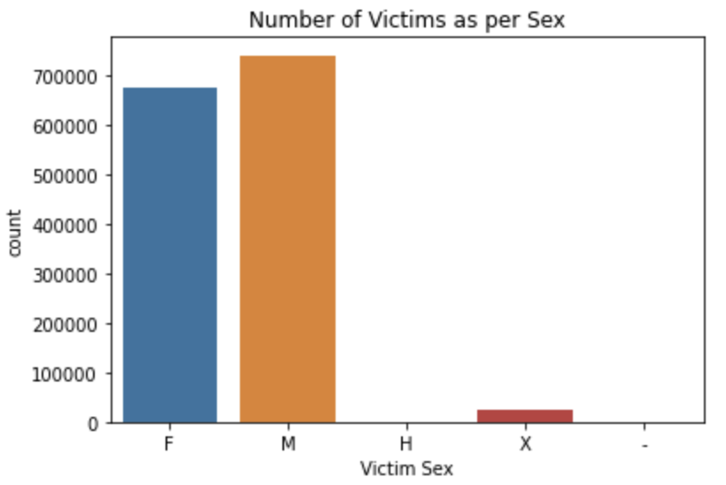
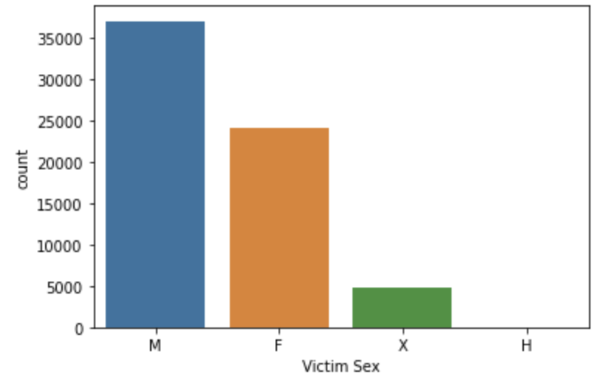
Victim Sex

Slide 6
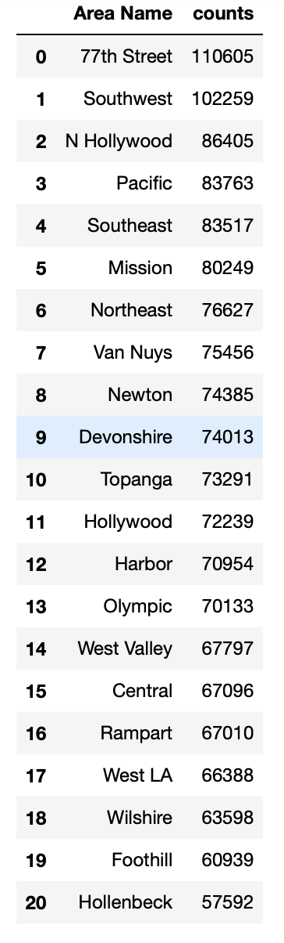
Area Name

Slide 7
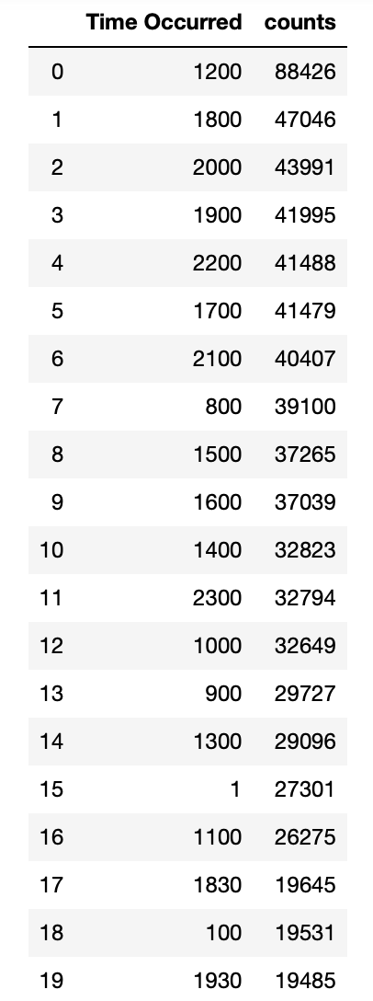
Time Occurred

Slide 8
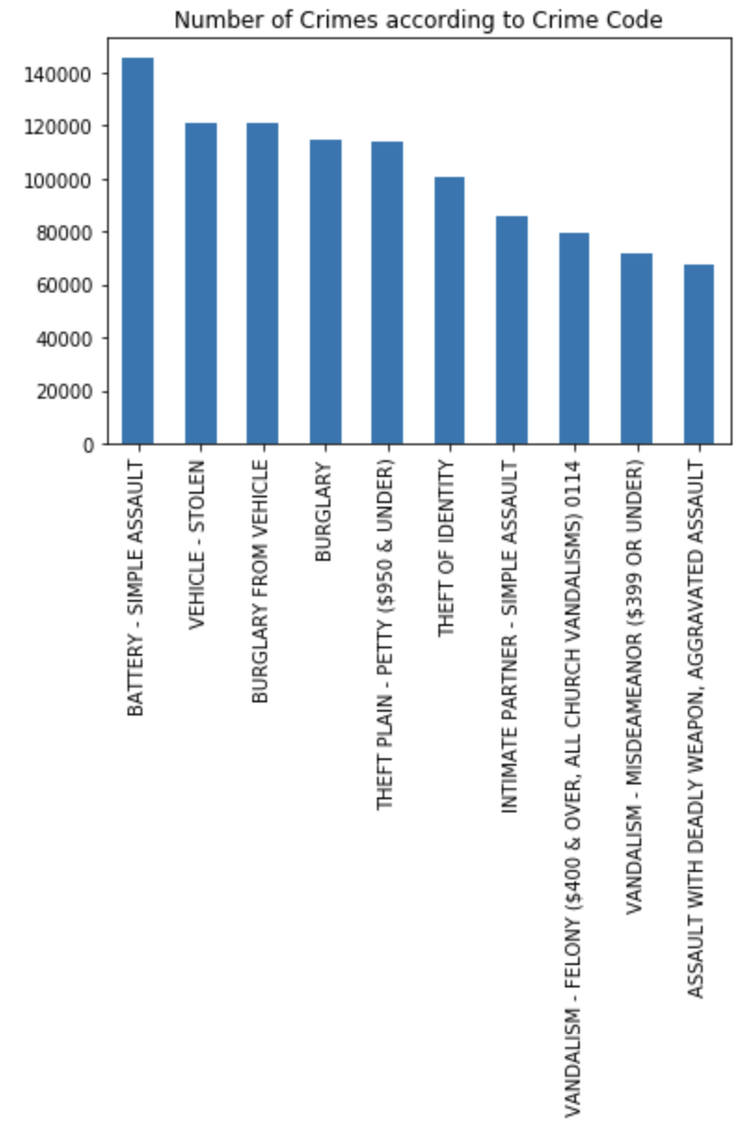
Crime Code Description

