Slide 1


Building a recommendation system
IA316: IA & E-commerce
HAMZAOUI Mariem & HOUIDI Ramzi
2018-2019

Slide 2
PLAN
Introduction:
What’s a recommendation system
Why do we need a recommendation system
Types of a recommendation systems
First environment
Second environment
Third environment
Deploying an API
Conclusion

Slide 3

Introduction

Slide 4
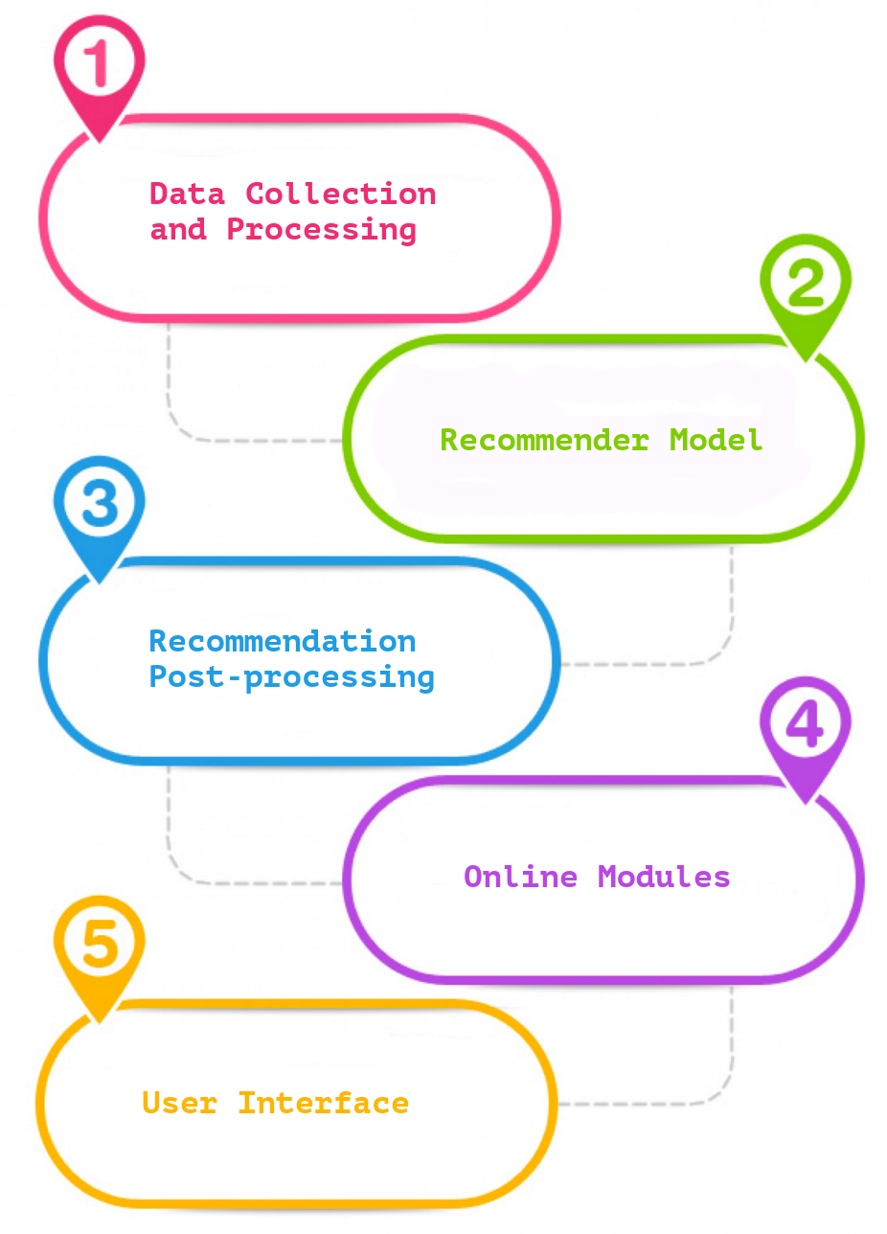

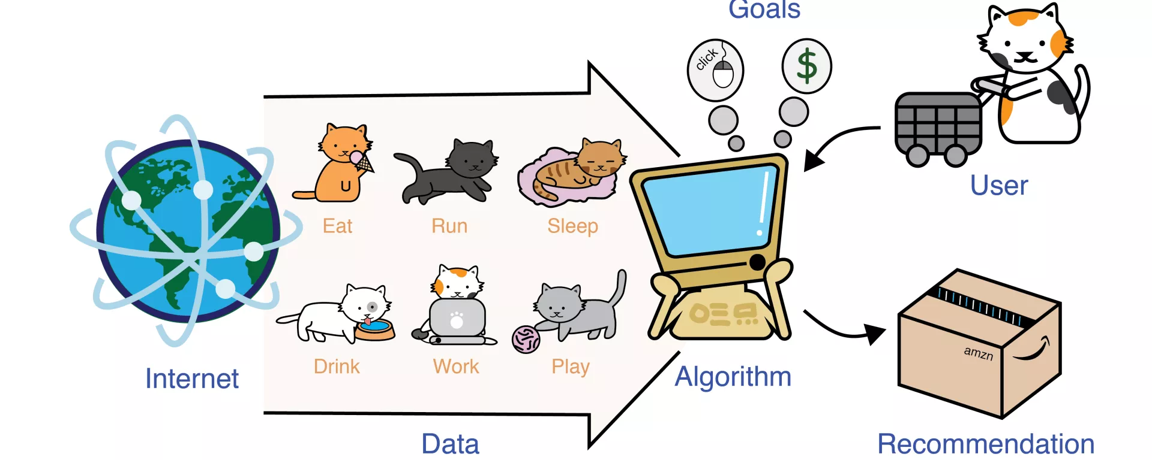
What’s a recommendation system ?
A recommender system or a recommendation system is a subclass of information filtering system that seeks to predict the "rating" or "preference" a user would give to an item.
Recommendation Systems are software tools and techniques providing suggestions for items to be of use to a user.
Notes:
The increasing importance of the Web as a medium for electronic and business transactions
has served as a driving force for the development of recommender systems technology. An
important catalyst in this regard is the ease with which the Web enables users to provide
feedback about their likes or dislikes, A typical methodology to provide feedback is in the form of ratings, in which users select numerical values from a specific evaluation system that specify their likes and dislikes of various items.
Other forms of feedback are not quite as explicit but are even easier to collect in the
Web-centric paradigm. For example, the simple act of a user buying or browsing an item
may be viewed as an endorsement for that item. Such forms of feedback are commonly
used by online merchants such as Amazon.com, and the collection of this type of data
is completely effortless in terms of the work required of a customer. The basic idea of
recommender systems is to utilize these various sources of data to infer customer interests.
The entity to which the recommendation is provided is referred to as the user, and the
product being recommended is also referred to as an item.

Slide 5

Why do we need a recommendation system ?
Recommender systems:
help the users to get personalized recommendations
help users to take correct decisions in their online transactions
increase sales and redefine the users web browsing experience
retain the customers
enhance their shopping experience.
➔ Information overload problem is solved by search engines, but they do not provide personalization of data. Recommendation engines provide personalization.

Slide 6
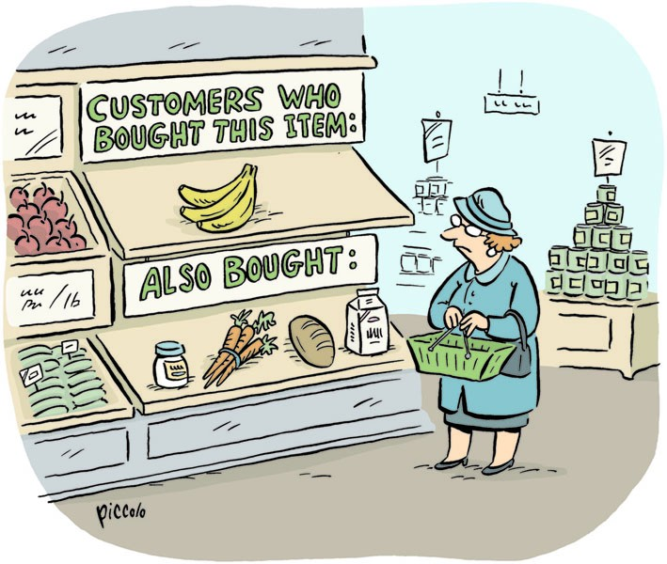

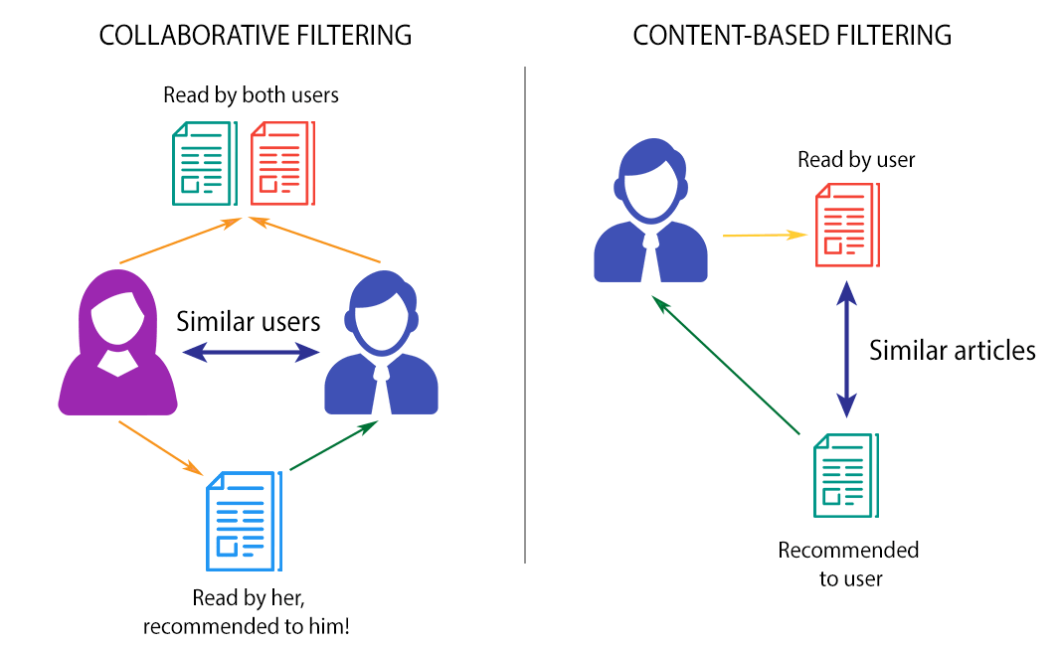
Types of recommendation systems
Content-based: recommendations are based on the assumption that if in the past a user liked a set of items with particular features, they will likely go for items having similar characteristics
Collaborative-filtering: recommendations are based on the assumption that users having similar history are more likely to have similar tastes/needs

Slide 7
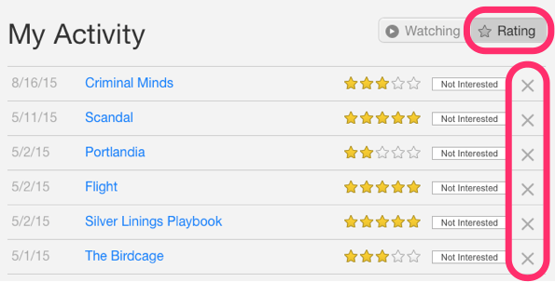
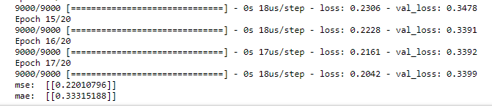


First environment : Explicit data
Description:
Explicit data
Rating system
Methods:
Matrix factorization
Deep learning
Input for our model
User history
Item history
rating history
Output for our model
Rating
N-users
$$⋮$$
i-user 30
x
N-items
i-item 30
Prediction: score
$$⋮$$
Dropout -0,5
Dropout -0,5
Dense - 64
Dense - 32
Dense - 1
Element-wise
Input
Embedding

Slide 8
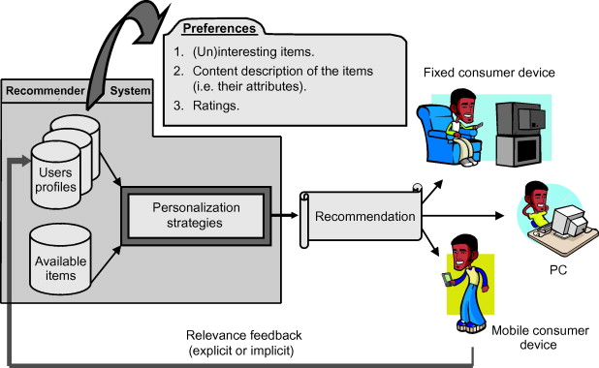
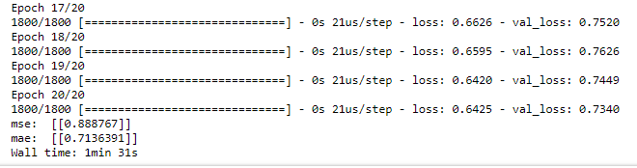


Second environment: content based
Description:
explicit data
Rating system & meta data
Method:
Deep learning : concatenating variables after embedding,
Input for our model
User history
Item history
rating history
Variables history
Output for our model
Rating
N-users
var
$$⋮$$
i-user 30
x
N-items
i-item 30
Prediction: score
$$⋮$$
var
Dropout -0,5
Dropout -0,5
Dense - 64
Dense - 32
Dense - 1
Input
Embedding
Element-wise

Slide 9
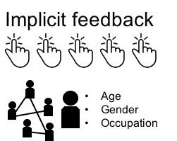
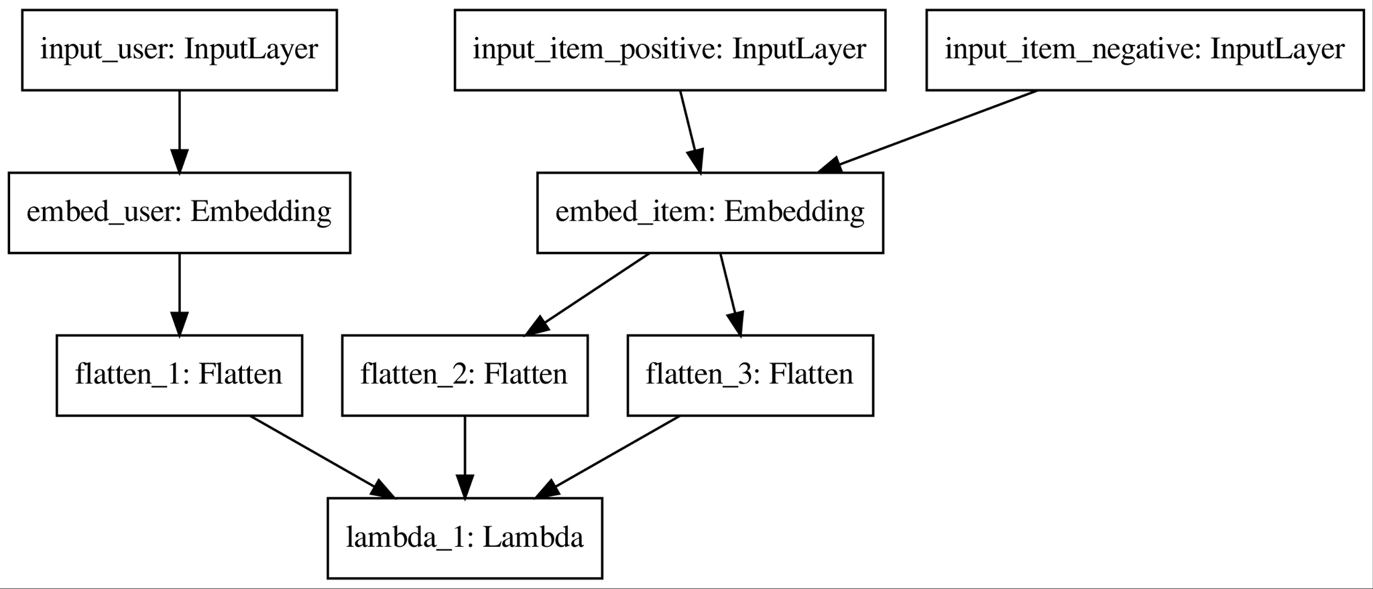
Third environment: Implicit data
Description:
Implicit data
Positive data :item where reward > 0
Negative data :random item where: the item’s reward excluding selected positive item
Method:
Deep learning : Siamese network with triplet loss
Notes:
Implicit data is nothing but the feedback that we collect from customers in the form of clicks, purchases, number of views
Ranking,
Training
matching

Slide 10
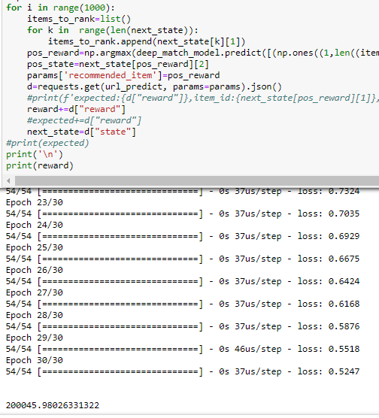
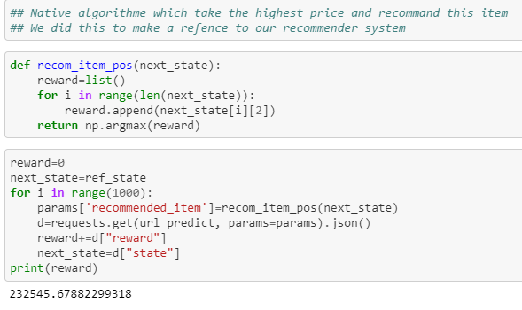
Third environment: Implicit data
➔Results cumulative reward for 1000 iterations:
Another approach with random algorithm that recommends the item with the highest price
➔Results cumulative reward for 1000 iterations:
Notes:
Ranking,
Training
matching

Slide 11
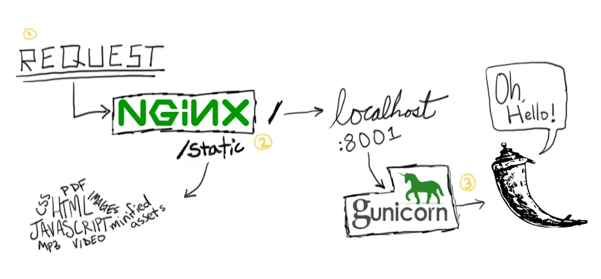
Deploying an API
Architecture :
Client (cURL, Python script or Browser)
HTTP Request/ Response
Docker composer
Flask Docker Container
Flask app
Gunicom
NGINX Docker Container
NGINX

Slide 12
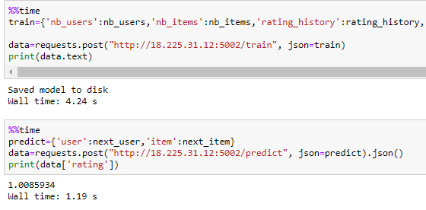
Deploying an API

Slide 13
Conclusion
Notes:
In real word one must stop using explicit recommendation system for implicit data are highly avalaible and they tell us more than missing explicit data
More dense and available for all users
Better representativr of user behavior vs user reflection
More related to final objective function
However we should combine diffrent fors of implicit + explicit to better represent long-term goal

Slide 14
Thank you for your attention !

