Slide 1
Analysis Workflow for Dynamic Exposure Calculation KDE – DR - PO
Jay Yang, HDScaleCollab
12/22/2023

Slide 2
Activity
Space
GPS
Exposure
To
PM2.5
PM2.5

Slide 3
Workflow option #1
For KDE & PO, option #1 is to calculate the exposure directly from GPS files.

Slide 4
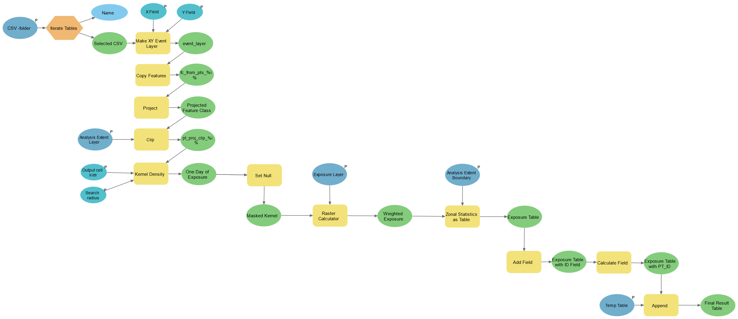
Dynamic Exposure Calculation Workflow – KDE (kernel density estimation)
Input:
A directory with CSV files (GPS points)
Study area boundary (polygon)
Exposure layer (raster)
Output: Exposure Table

Slide 5
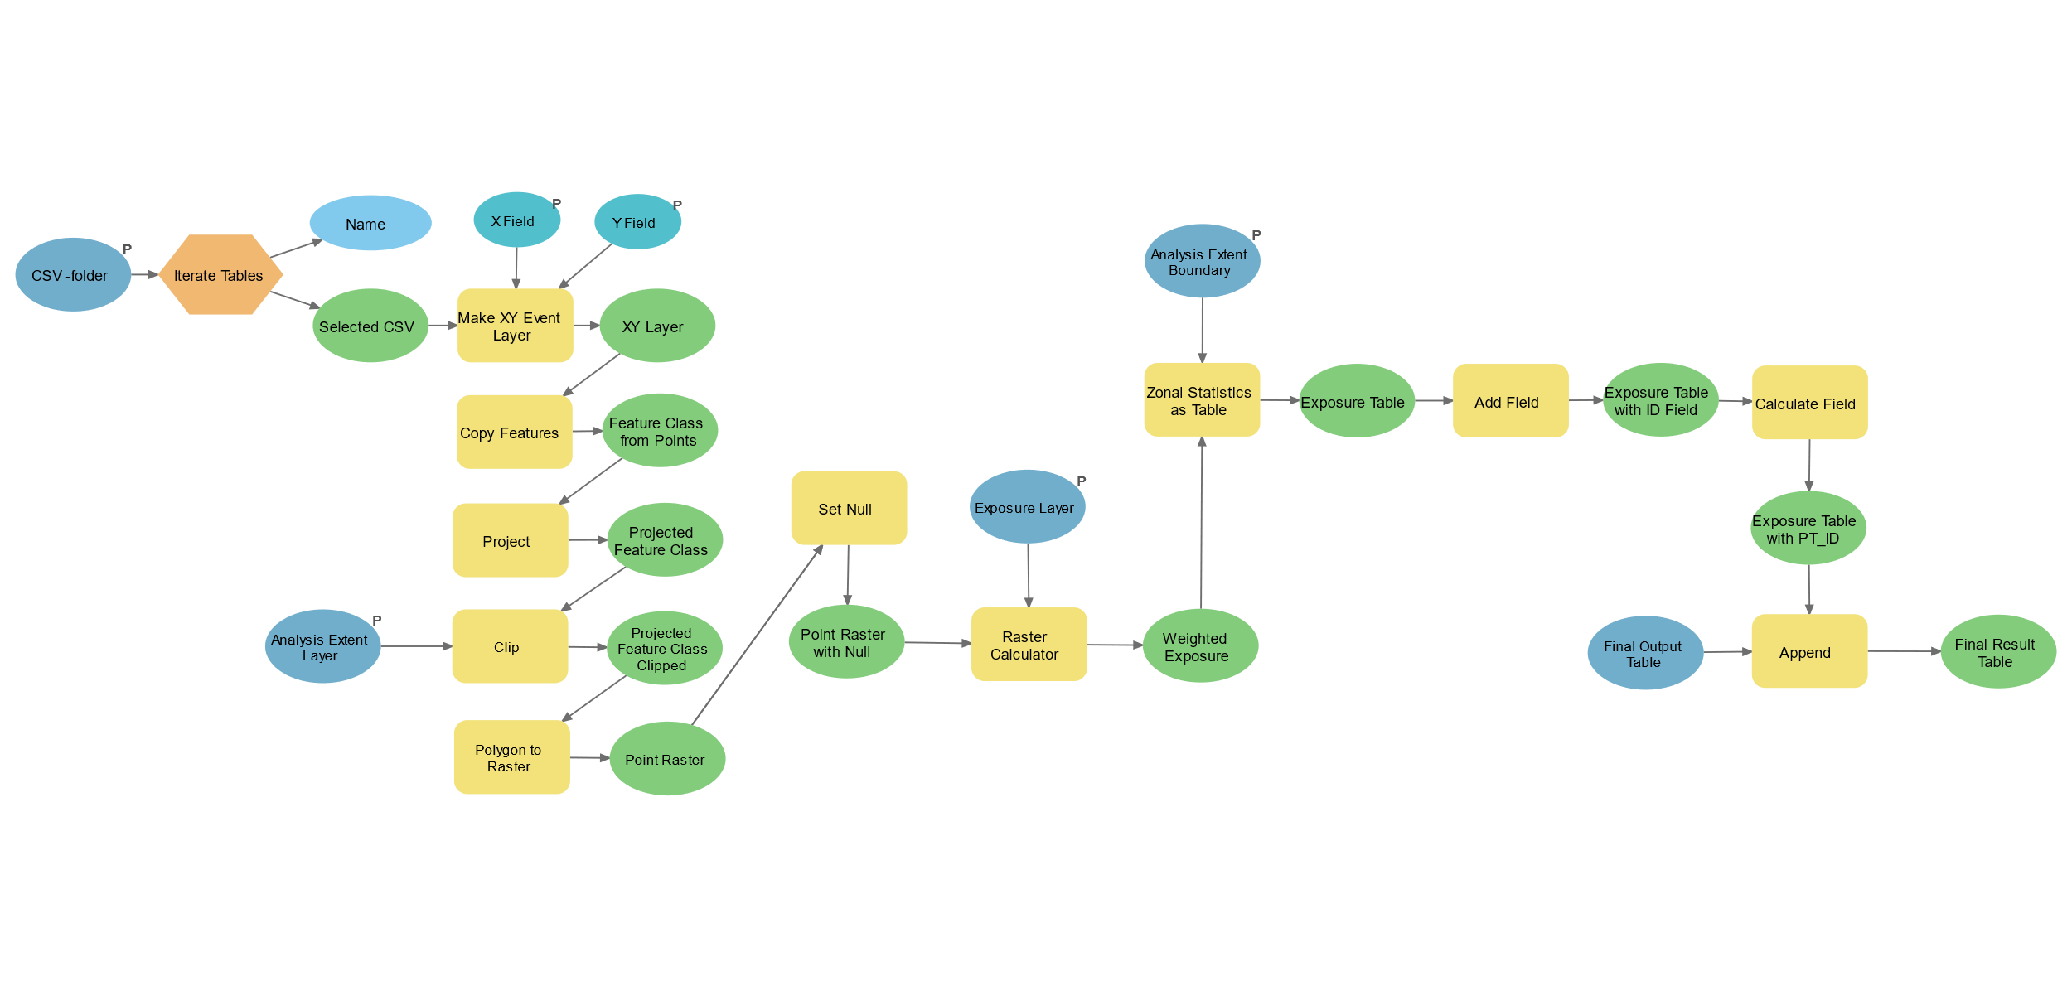
Dynamic Exposure Calculation Workflow – PO (Point Overlay)
Input:
A directory with CSV files (GPS points)
Study area boundary (polygon)
Exposure layer (raster)
Output: Exposure Table

Slide 6
Workflow option #2
For KDE & DR, option #2 is to first generate the activity space raster, then calculate the exposure.

Slide 7
GPS → Activity Space (Raster)
In workflow #2, the steps that convert GPS points to an Activity Space (highlighted in the dotted box) are modularized into standalone codes to enhance efficiency for calculating multiple exposures for the same participant/cohort.

Slide 8
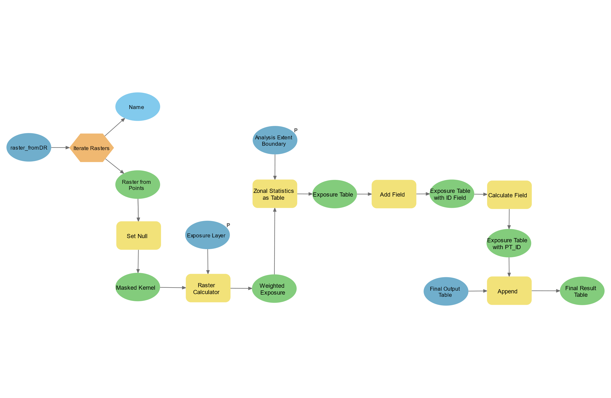
Dynamic Exposure Calculation Workflow for
DR (Density Ranking) & KDE (kennel density estimation)
raster_fromKDE
Input:
Pre-generated activity space raster from KDE/DR method
Study area boundary (polygon)
Exposure layer (raster)
Output: Exposure Table

Slide 9
Notes
For best performance and computation efficiency, user should employ the following workflow approaches for dynamic exposure calculation:
Approach | Workflow Option
KDE | Option #2
DR | Option #2
PO | Option #1

