Slide 1
Analysis Workflow for Dynamic Exposure Calculation KDE – DR - PO
Jay Yang, HDScaleCollab
12/22/2023

Slide 2
PM2.5
Activity
Space
Exposure
To
PM2.5
GPS

Slide 3
Workflow option #1
For KDE & PO, option #1 is to calculate the exposure directly from GPS files.

Slide 4
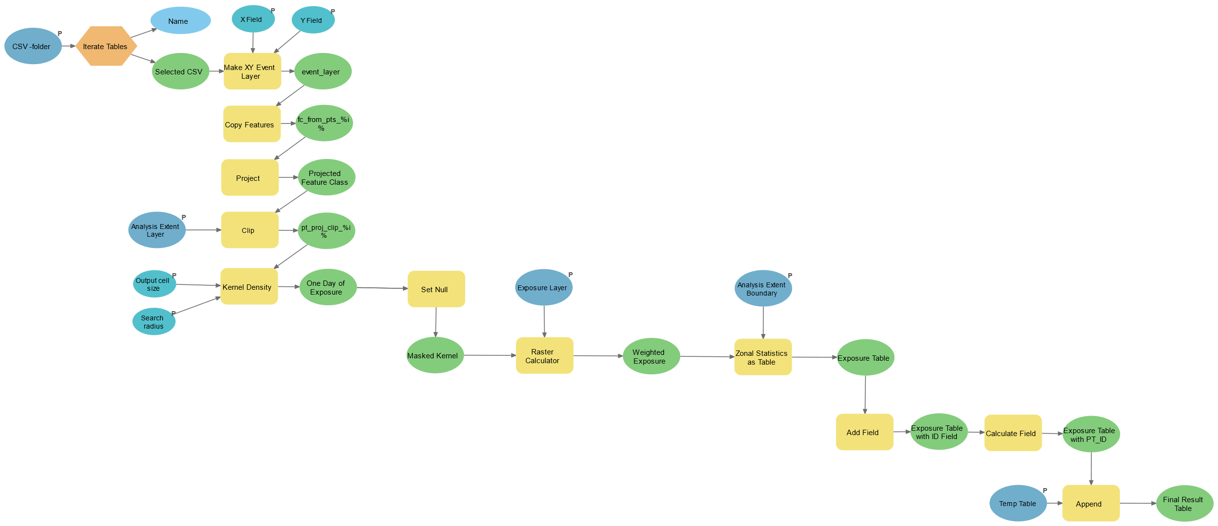
Dynamic Exposure Calculation Workflow – KDE (kernel density estimation)
Input:
A directory with CSV files (GPS points)
Study area boundary (polygon)
Exposure layer (raster)
Output: Exposure Table

Slide 5
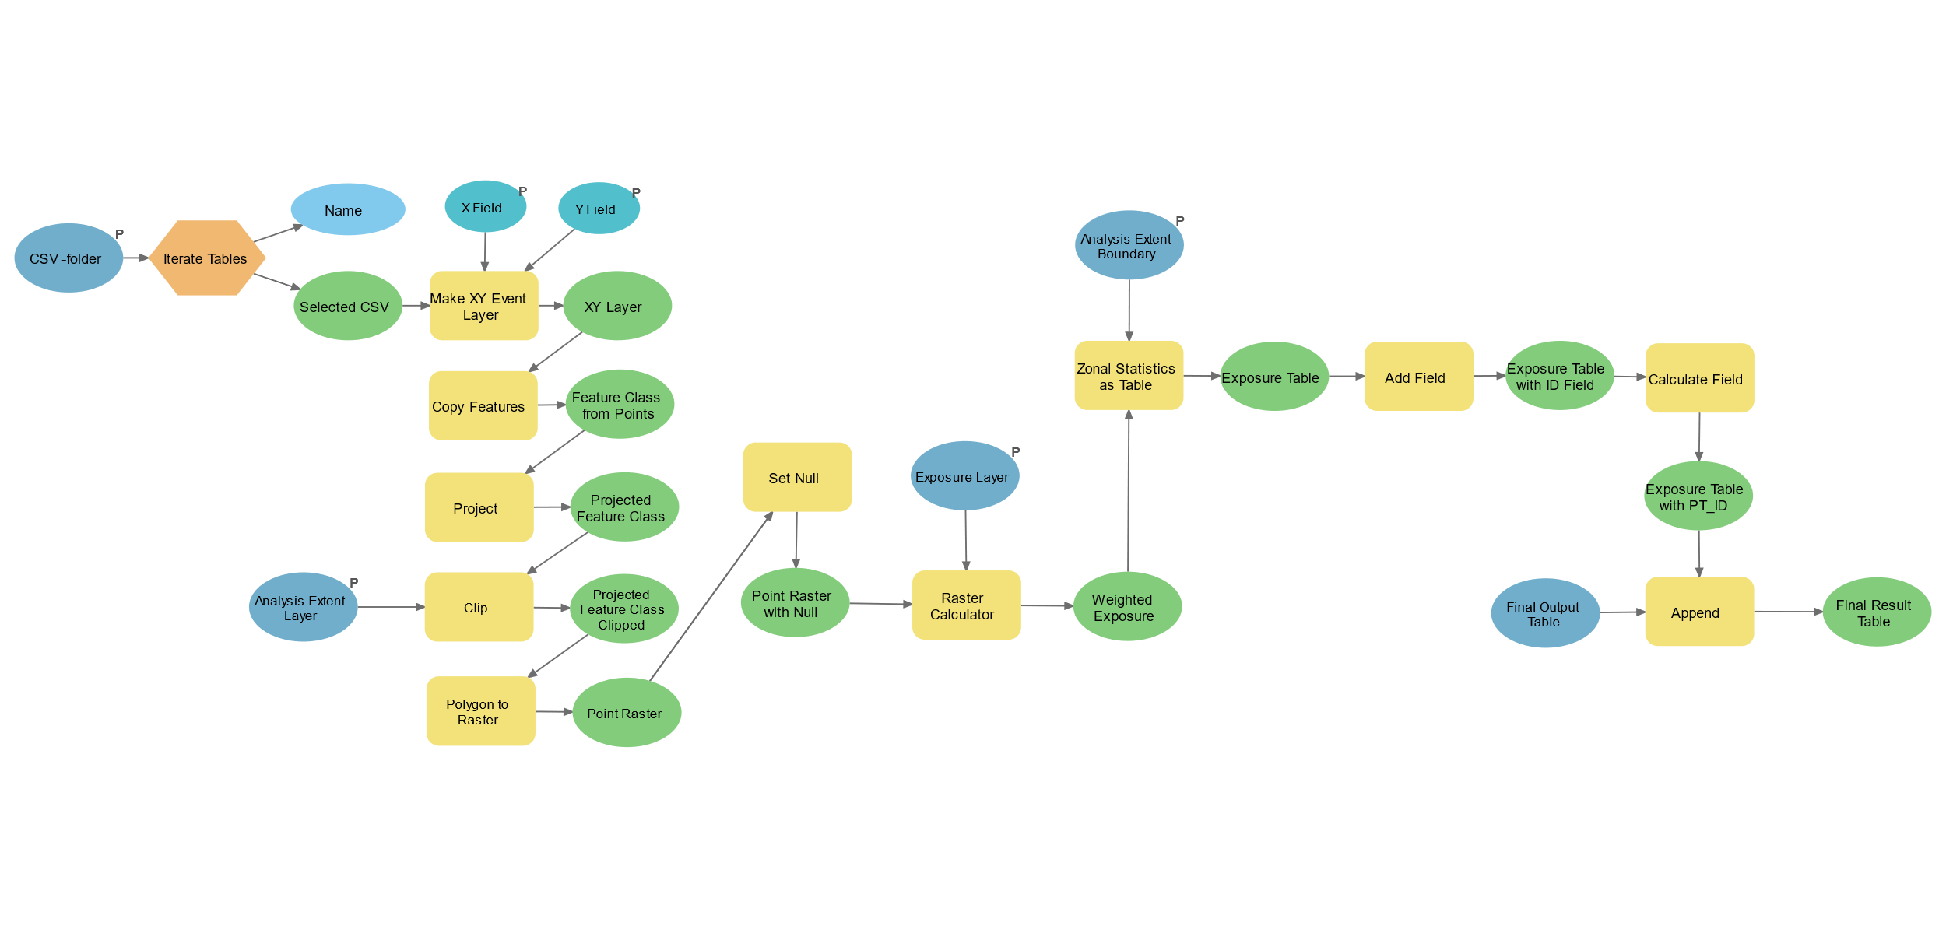
Dynamic Exposure Calculation Workflow – PO (Point Overlay)
Input:
A directory with CSV files (GPS points)
Study area boundary (polygon)
Exposure layer (raster)
Output: Exposure Table

Slide 6
Workflow option #2
For KDE & DR, option #2 is to first generate the activity space raster, then calculate the exposure.

Slide 7
GPS → Activity Space (Raster)

Slide 8
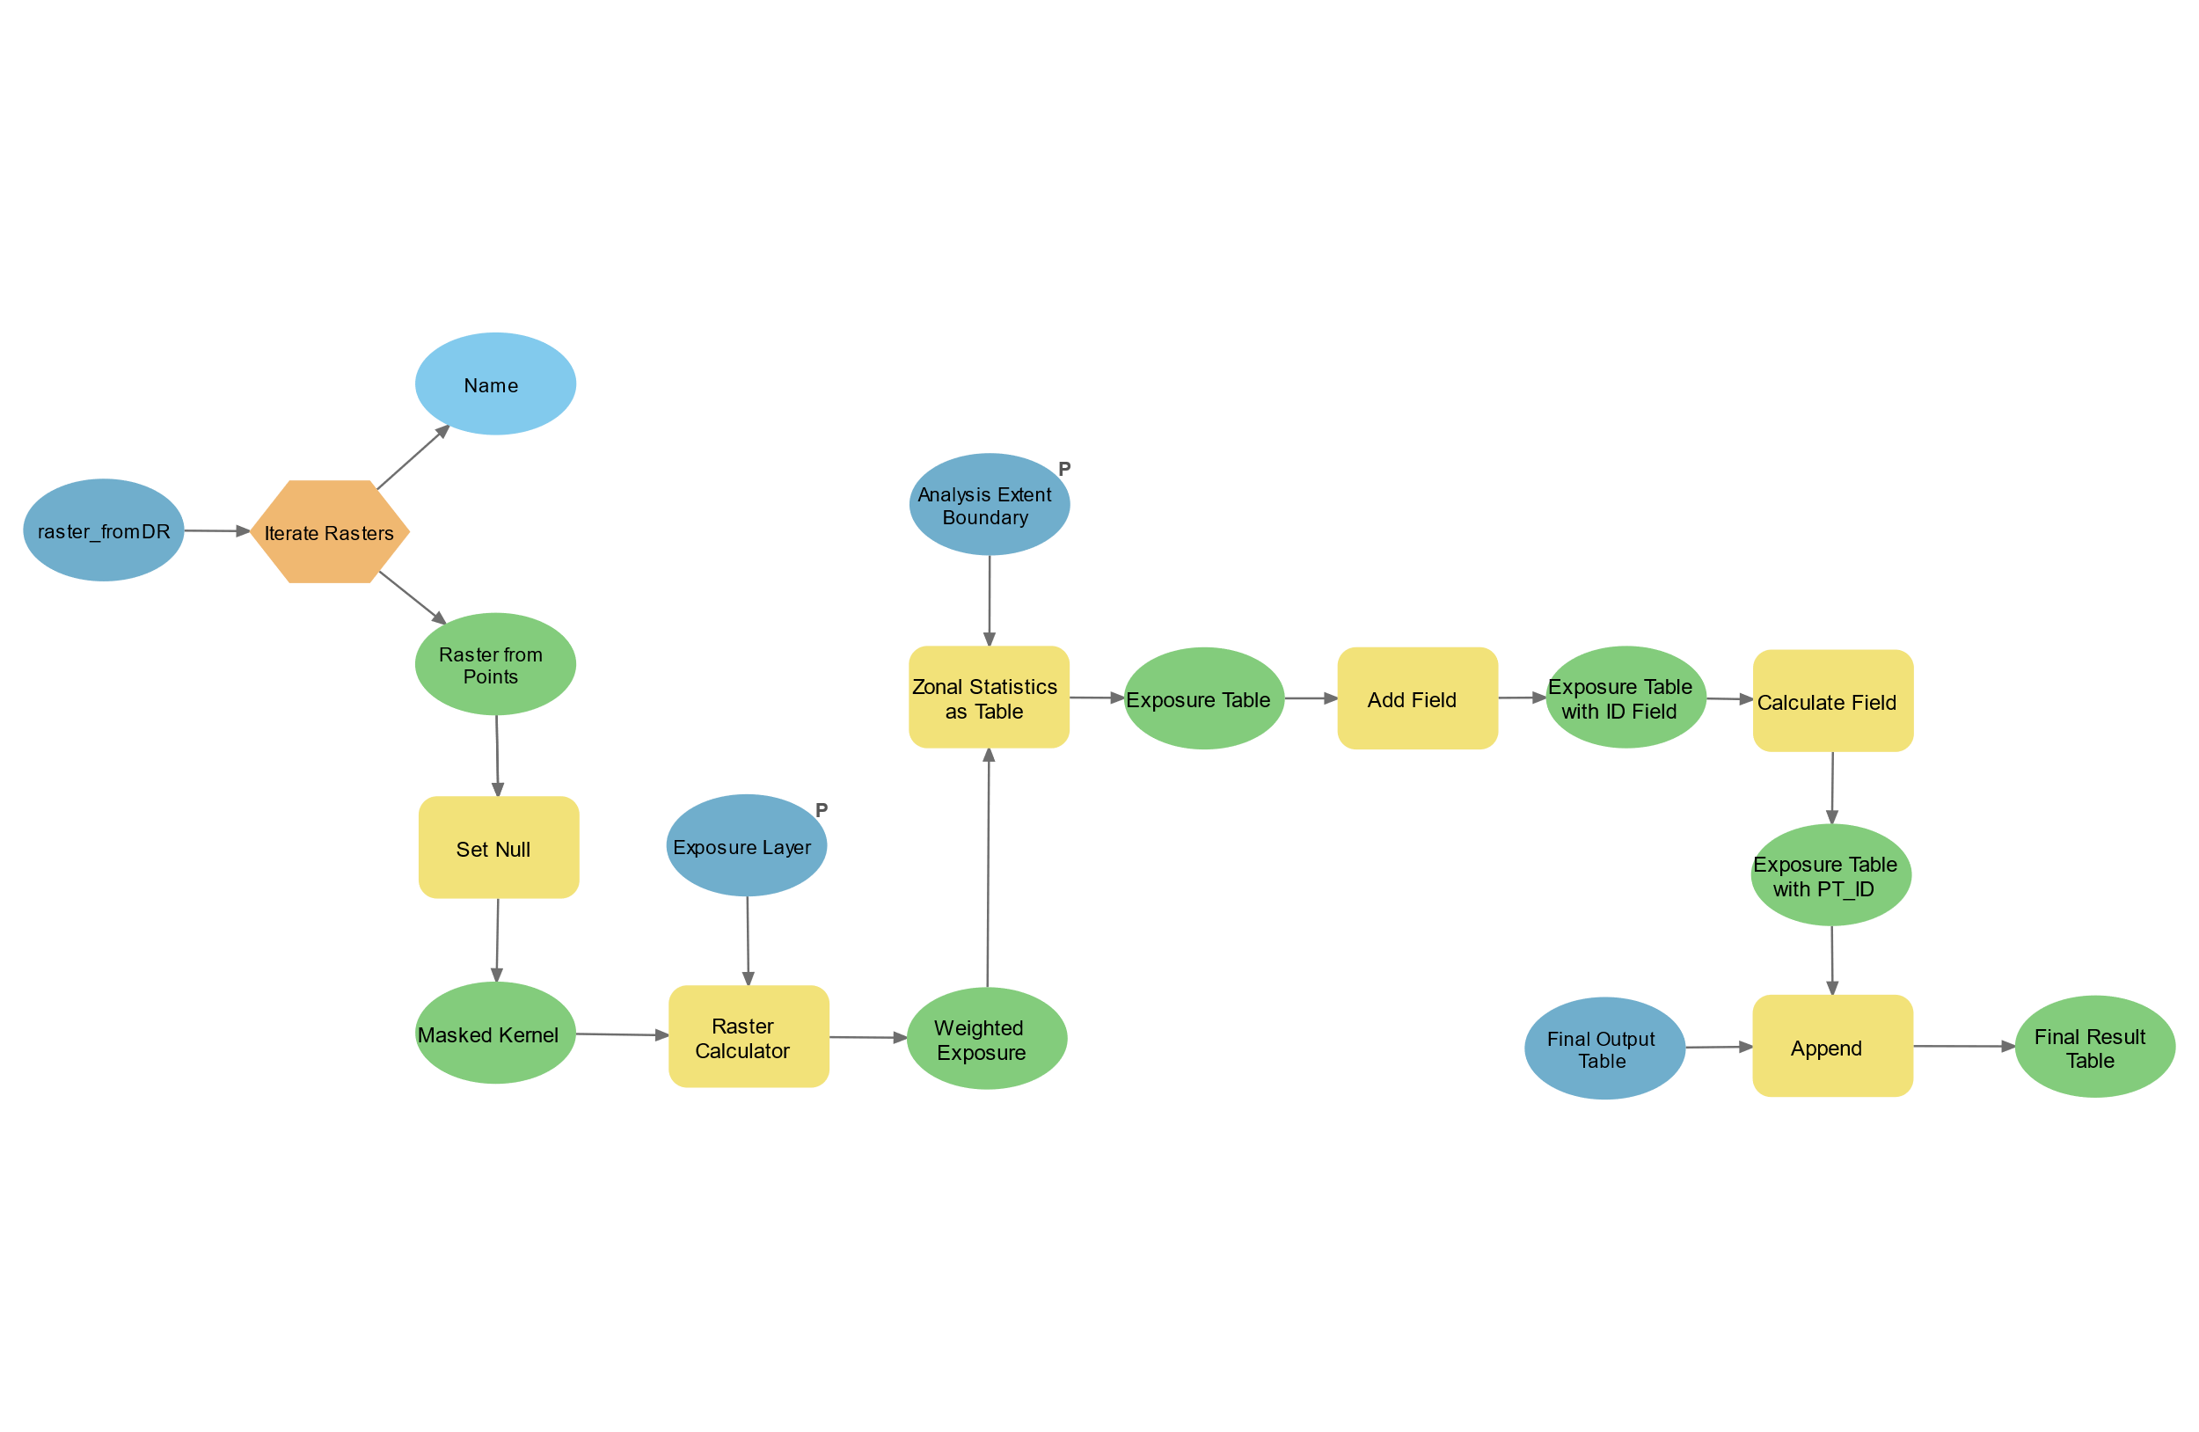
Dynamic Exposure Calculation Workflow –
DR (Density Ranking) & KDE (kennel density estimation)
raster_fromKDE
Input:
Pre-generated activity space raster from KDE/DR method
Study area boundary (polygon)
Exposure layer (raster)
Output: Exposure Table

