Slide 1
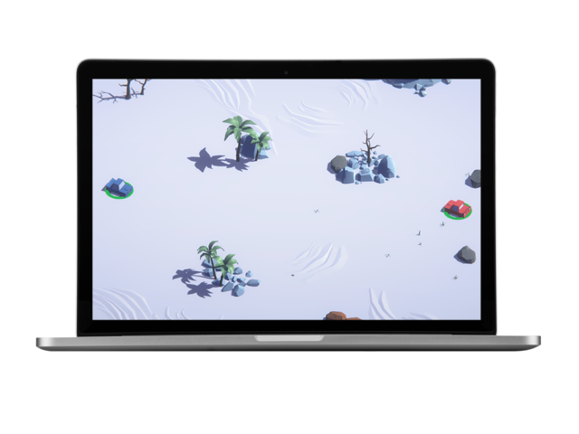
UNITY 3D GAME
Sha Senevirathne
11 Jan 2018

Slide 2
Agenda
Motivation
What is it about?
Features / game modes
Demo
Questions

Slide 3

Disclaimer
A statement that denies something, especially responsibility…

Slide 4

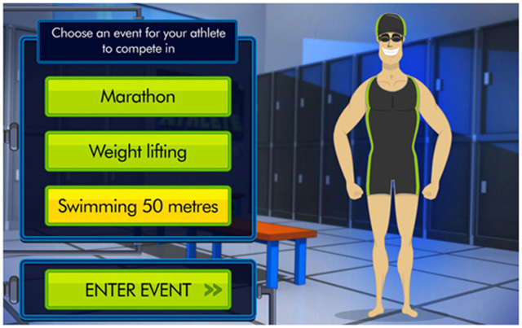
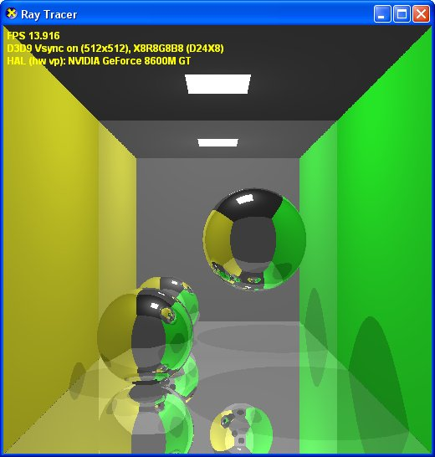
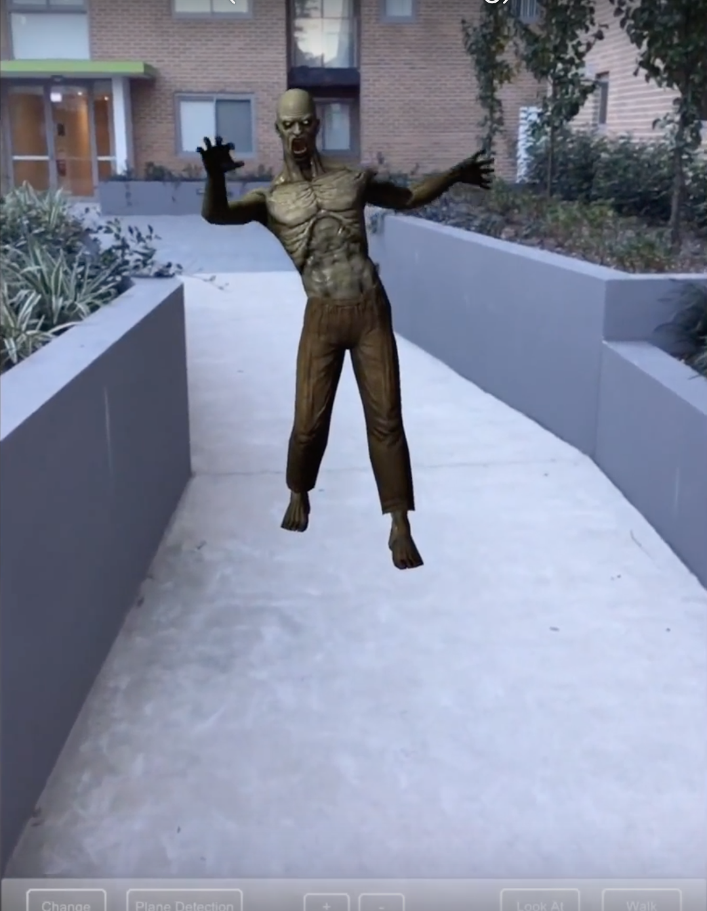
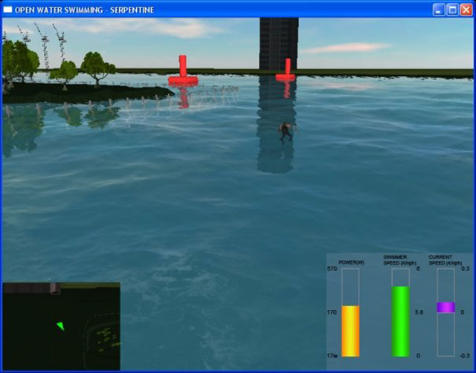

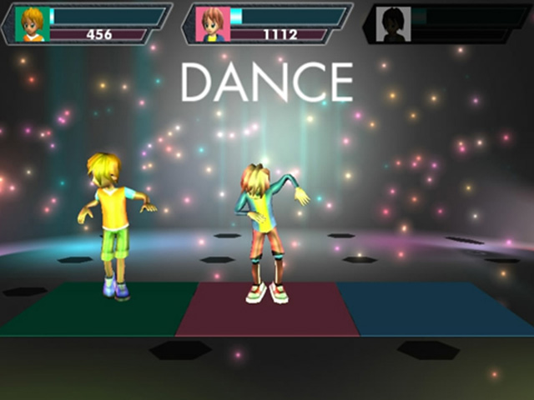
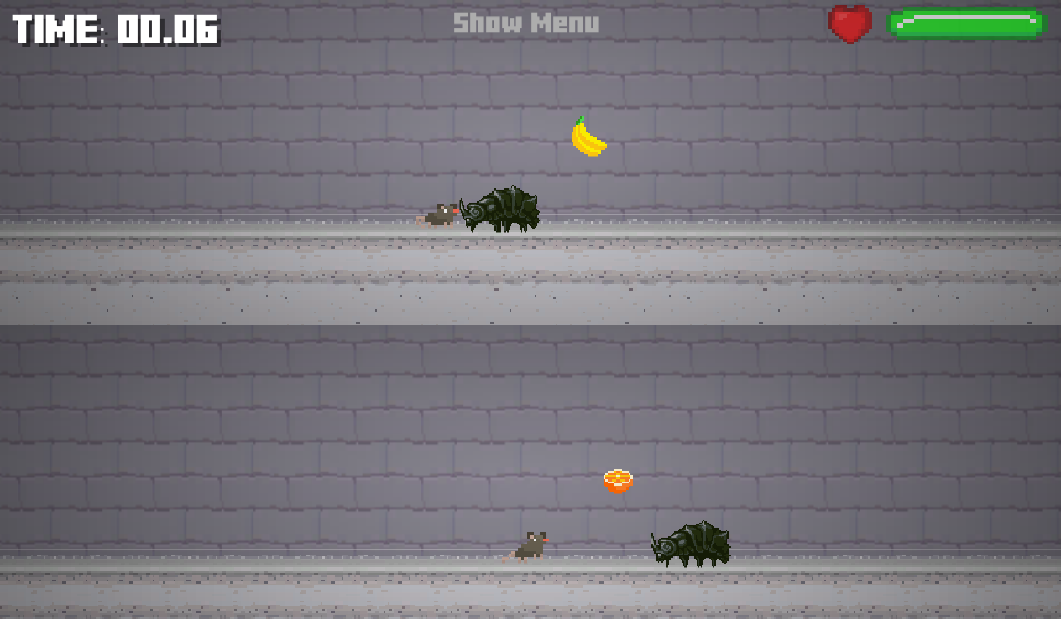
Motivation
Lets put that Netflix time to good use…

Slide 5
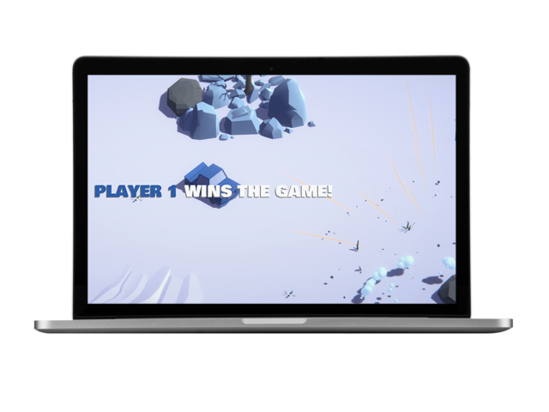
What is it about?
Twin stick 🚗 shooter…
Shoot 🚀 at one another with…

Slide 6
Game modes
Local multiplayer
Player who wins best of 3(?) rounds wins match

Slide 7
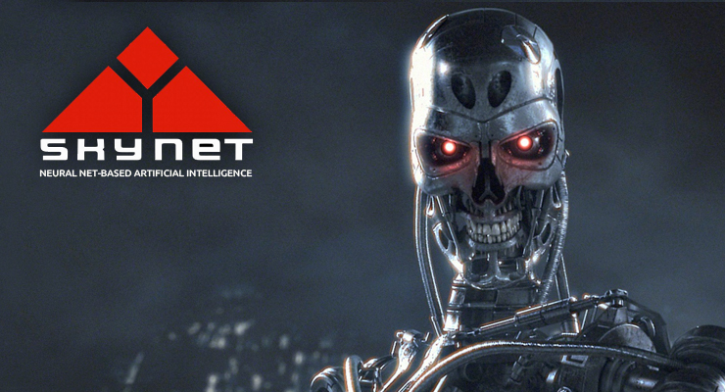
Game modes cont.
Single player with AI / bots
Don’t think
SKYNET
ML
Neural network

Slide 8
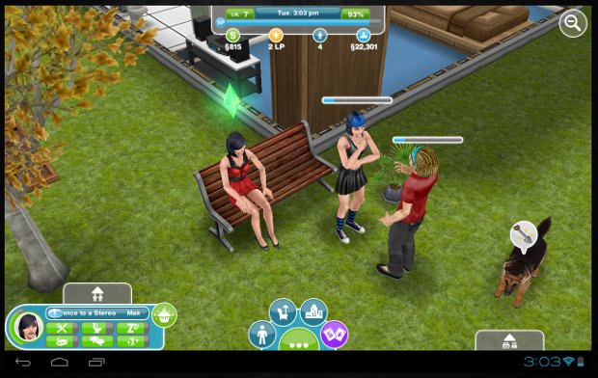
Game modes cont.
Single player with AI / bots
Think
Finite state machines
Binary trees

Slide 9
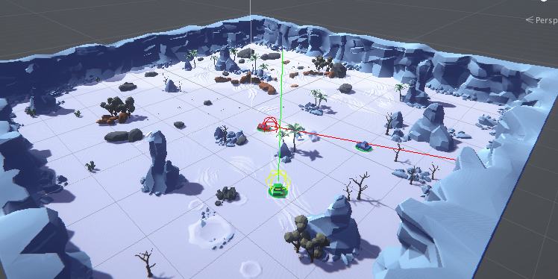
AI cont.
Bots can
Navigate and path find
Avoid static objects
Patrol
Make basic decisions
Move
Look for player?
Fire at player?

Slide 10
Game modes
Survival mode
Horde mode
Endless rounds
Enemies come in wave
Increase in difficulty
How long can you survive?

Slide 11
DEMO

Slide 12
QUESTIONS?

Slide 13
Conclusion
Download beta version from
shanaka.info/battle-cars

