Slide 1
hdub-tech@dc512
+
_ □ ×
// LIGHTNING TALK // 10 MIN
[1/26]
Down a WordPress XML-RPC rabbit hole
# what’s old is new-to-me?
> mission: WordPress multicall attack tool with user and password lists
> time budget: 1 business day (narrator: try 2 weeks)
> tool: TrixSec/Brute-XMLRPC
> status: Complete! (brain attic full, must donate unused things)
hdub-tech@dc512$ python talk.py --start █
Notes:
# I can barely do this in 10 minutes so I'm going to have to talk really fast
# You can take pics of the slides, but not me.
# Link to all the things will be on the last slide
# Now let's go down a WordPress XML-RPC rabbit hole!

Slide 2


hdub-tech@dc512
+
_ □ ×
$ whoami
[2/26]
$ cat profile.json
{
"name": "H Dub",
“github”: "github.com/hdub-tech",
"role": "between gigs",
"does": { "infra/automation/tools engineer",
"build and fix stuff"},
"linkedin": "linkedin.com/in/h-dub",
"discord": "@hdub.tech"
}
$ xdg-open images/profile-pics/*.jpg
# Sometimes I break stuff first. Just ask my bikes
# Open to Work!
hdub-tech@dc512$ whoami █
Notes:
# Hi. I'm H Dub.
# I'm an infra/automation/tools engineer who loves to help pentesters and cares about security.
# If you see either of these 2 avatars, it is almost certainly me.

Slide 3
hdub-tech@dc512
+
_ □ ×
Friend request
[3/26]
“Tool idea if you want to run with it”
# Continue job hunting? Orrrrrr let myself be distracted by what I love to do?
hdub-tech@dc512$ cat friend_request.md █
Notes:
# SO. I’m still friends with a bunch of the pentesters I used to support at Rapid7, and when I left, I told them they could ping me with tool ideas, or feature/bug fix ideas for open source tools, and that I would see what I could do about it
# Three years later, someone finally decided to take me up on this.

Slide 4

hdub-tech@dc512
+
_ □ ×
Tool idea / the claim
[4/26]
“Wordpress XMLRPC interface allows for submitting a f*** ton of auth in one post request. And far as i can tell, no one has made a tool that you can use to just feed a username and password list and just send one bulk auth”
> [!IMPORTANT]
> WordPress novice presenting here, just come along for the ride
hdub-tech@dc512$ cat the_idea_claim.md █
Notes:
# THEIR CLAIM
# “Wordpress XMLRPC interface allows for submitting a f*** ton of auth in one post request. And far as i can tell, no one has made a tool that you can use to just feed a username and password list and just send one bulk auth”
# Now please keep in mind I have never used, installed, updated, defended or offended WordPress before this, so if you are already thinking of a tool in your head, just hush, y'all can suffer in order, like I did.
# **_I_** needed to put these words into context first

Slide 5

hdub-tech@dc512
+
_ □ ×
Breaking it down: WordPress
[5/26]
- Content Management System (CMS)
- Started as blogging software
- Free and open source
- Written in PHP
- Paired with MySQL or MariaDB
# [WordPress]: wordpress.org
# [Wikipedia]: wikipedia.org/wiki/WordPress
hdub-tech@dc512$ cat breaking_it_down_wordpress.md █
Notes:
# WordPress is a free and open source content management system, written in PHP and paired with a database.
# This image is not a meme, it is literally off the WordPress website, and sharing is caring, so I leave it here with you

Slide 6
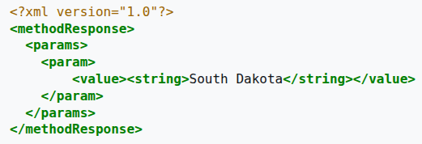
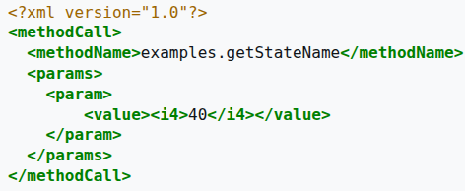
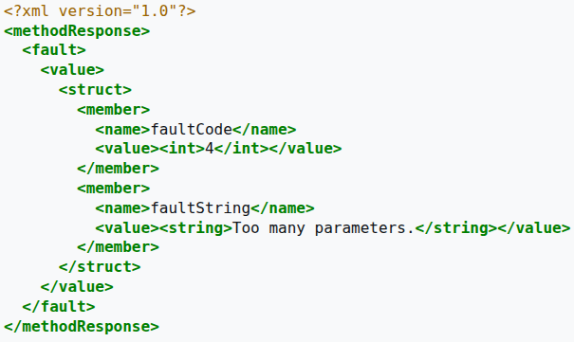
hdub-tech@dc512
+
_ □ ×
Breaking it down: XML-RPC Protocol
[6/26]
Sample Responses:
- Remote Procedure Call (RPC) with an XML payload using HTTP
- Existed since the beginning of time (1998)
Sample Request:
# [wikipedia]: wikipedia.org/wiki/XML-RPC
hdub-tech@dc512$ cat breaking_it_down_xmlrpc_protocol.md █
Notes:
# The XML-RPC protocol is a remote procedure call with an XML payload over HTTP which has existed _since the beginning of time_
# For those of you who have already attacked the WordPress XML-RPC interface, you might recognize this XML format. I just thought I would point out that the methodCall/methodName/params and the methodResponse/params/fault stuff - these are not WordPress specific, they are part of the definition of the XML-RPC protocol itself.
# It is up to the implementing software, such as WordPress, to define it's own methodNames, params, responses, faults and fault codes

Slide 7
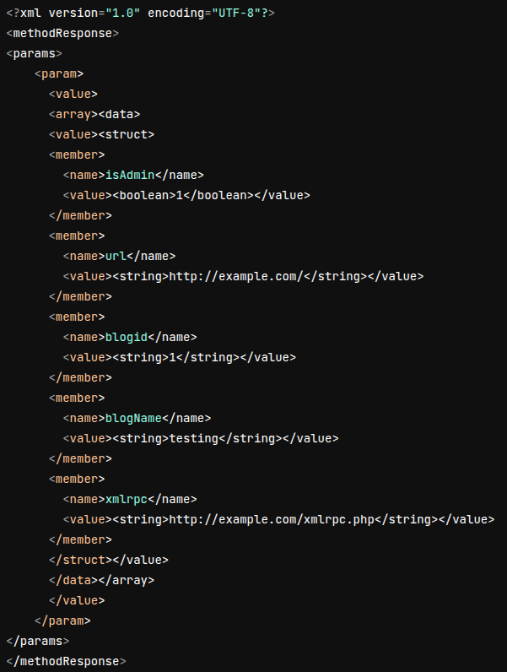
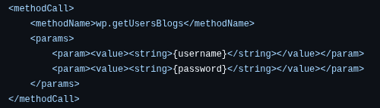
hdub-tech@dc512
+
_ □ ×
Breaking it down: XML-RPC in WordPress
[7/26]
- Legacy endpoint which has existed from the beginning of time (at least version 1.5 / 2005)
- Enabled by default since 3.5
- It’s unauthenticated
- As mentioned, XML-RPC (in general) is HTTP
- It was designed for programs and not humans
- 2fa NOT supported natively
- Useful methodName: wp.getUsersBlogs (since 2.6)
Sample Request (below) Sample Response ===>
# [wordpress-xmlrpc]: developer.wordpress.org/apis/xml-rpc/
# [cloudflare]: blog.cloudflare.com/a-look-at-the-new-wordpress-brute-force-amplification-attack/
hdub-tech@dc512$ cat breaking_it_down_xmlrpc_wordpress.md █
Notes:
# So XML-RPC _in WordPress_ has also existed _since the beginning of time_. We're talking AT LEAST over 20 years and for as long as WordPress has had their code in GitHub.
# It was designed for programs, not humans, it's unauth, and 2fa is not supported natively.
# wp.getUsersBlogs is going to be the methodName you see written up in a bunch of blogs discussing attacking this endpoint. It's a useful method because you don’t need to know additional information to send as params - just username/password, making it ideal for testing login creds
# On the right we have a successful login, and you'll see `isAdmin` in the methodResponse. If this had been a failed login, you would NOT see `isAdmin` and you WOULD see a fault methodResponse, with a faultCode.

Slide 8
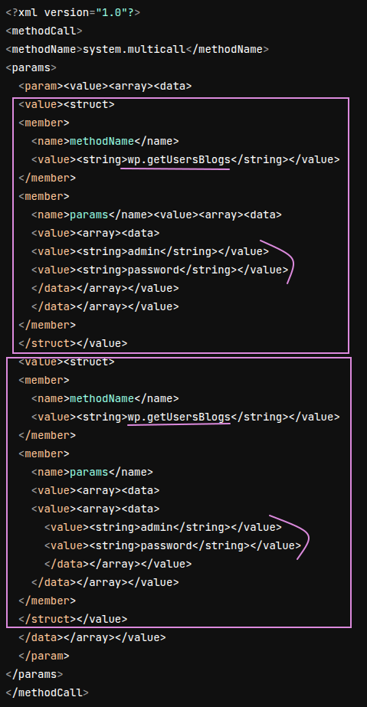
hdub-tech@dc512
+
_ □ ×
Breaking it down: system.multicall
[8/26]
Somewhere between the protocol and WordPress
- TECHNICALLY not part of XML-RPC, but RFC’ed to the discussion board and adopted in places which use it.
- Existed in WordPress from the beginning of time (1.5.0 / 2004)
- Why does it matter? It lets you do “a f*** ton of auth in one post request.” Great way to test a whole bunch of usernames/passwords at once without flooding the network or an instance.
> [!NOTE] Delib omission on this slide which veterans are probably chuckling about already
#web.archive.org/web/20060624230303/http://www.xmlrpc.com/discuss/msgReader$1208?mode=topic
# blog.cloudflare.com/a-look-at-the-new-wordpress-brute-force-amplification-attack/
hdub-tech@dc512$ cat breaking_it_down_multicall.md █
Notes:
# Now system.multicall is weird – it sits somewhere in between the XML-RPC protocol definition and WordPress. TECHNICALLY it's not part of the protocol, but it was RFC'ed to its discussion board and adopted by a bunch of products that implement XML-RPC, like WordPress
# So why do we care? Because this glorious little method will basically let you send as many methodName requests to the XML-RPC endpoint in a SINGLE POST as you want.
# OR as pentest friend so eloquently put it, "a f*** ton of auth in one post request" – Great way to test a whole bunch of username/password combos without flooding the network or an instance
# So if you look at that hot XML body on the right, you can see it has TWO wp.getUsersBlogs requests in with what SHOULD be different usernames and passwords, but I stole this screenshot from one of these credited blogs and for some reason they used the same username/password twice. Silly gooses.
# NOW I'm deliberately omitting a piece of info about the vulnerability of multicall - so IYKYK don't blurt it out, y'all can suffer in order, like I did.

Slide 9

hdub-tech@dc512
+
_ □ ×
Back to the claim
[9/26]
“Wordpress XMLRPC interface allows for submitting a f*** ton of auth in one post request. And far as i can tell, no one has made a tool that you can use to just feed a username and password list and just send one bulk auth”
> oh cmon that HAS to exist
# I don't like to reinvent the wheel, unless the wheel is square
hdub-tech@dc512$ cat the_idea_claim_response.md █
Notes:
# OK so now that I know what all these words mean, I am able to make a coherent response to pentester friend.
# I don't believe you – this MUST exist already.
# I will find it

Slide 10
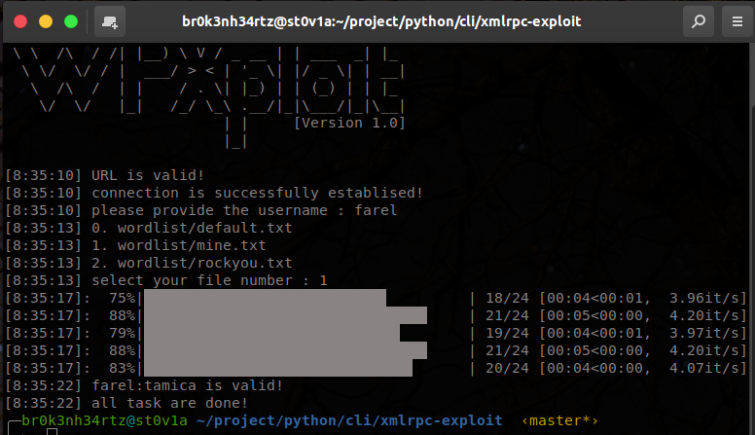
hdub-tech@dc512
+
_ □ ×
Tools: VigneshSahoo’s WPXploit
[10/26]
- [WPXploit] was referenced on [hacktricks] wiki page on WordPress: Takes a user! takes a wordlist! *my work here is done*
- Oh but wait:
- Doesn't take a user list.
- It is only doing brute force (NOT utilizing multicall)
# [hacktricks]: hacktricks.wiki/en/network-services-pentesting/pentesting-web/wordpress.html
# [wpxploit]: github.com/VigneshSahoo/wpxploit
hdub-tech@dc512$ cd wpxploit && ./exploit.py █
Notes:
# Friend linked me to hacktricks' WordPress wiki page, and I found WPXploit on it. Takes a user! Takes a wordlist! *my work here is done*
# Butttt it doesn't take a userlist, and its not using multicall, effectively its just straight up brute forcing
# I thought about forking it and adding those features, but I decided to search a little more.

Slide 11
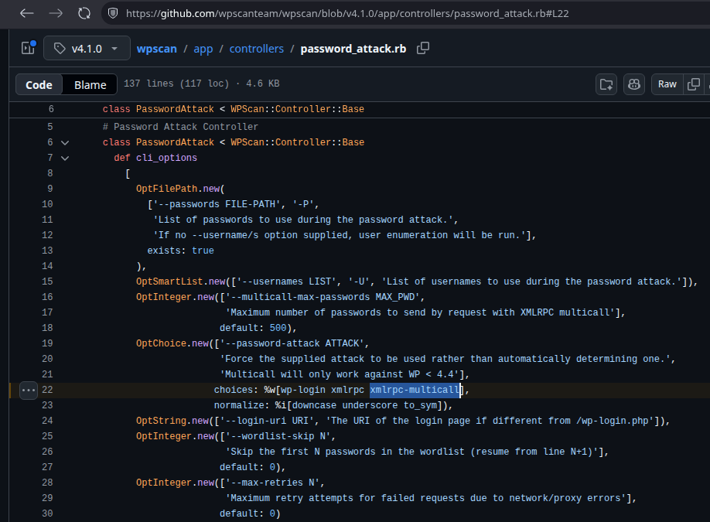
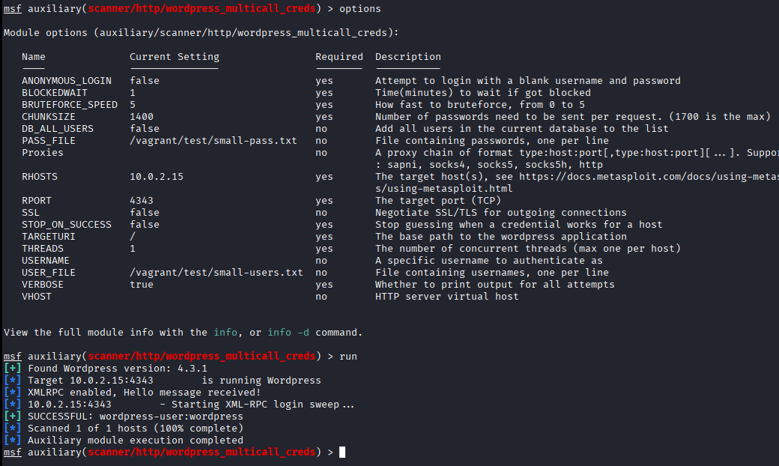
hdub-tech@dc512
+
_ □ ×
[11/26]
Tools: <spoiler> WPScan/Metasploit </spoiler>
# [wpscan]: wpscan.com/wordpress-cli-scanner
# [metasploit]: rapid7.com/db/modules/auxillary/scanner/http/wordpress_multicall_creds
hdub-tech@dc512$ cat wpscan_metasploit.md █
Notes:
# SPOILER ALERT: WPScan does do this, so does Metasploit
# I discovered this while putting these slides together
# Metasploit I just totally forgot to check, which is ironic given I worked for Rapid7.
# And I did look at WPScan, butttt ….

Slide 12
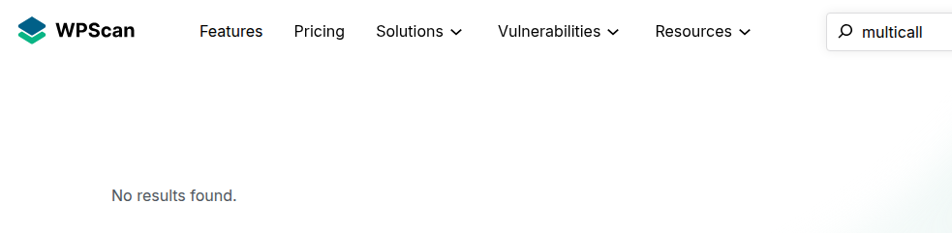

hdub-tech@dc512
+
_ □ ×
Tools: WPScan / Metasploit (later)
[12/26]
# [wpscan]: wpscan.com/wordpress-cli-scanner
hdub-tech@dc512$ xdg-open images/cone-of-shame.gif █
Notes:
…. I searched their webpage for multicall and nothing came back.
# There is at least one person who has said to me on multiple occasions “How do you find ANYTHING?”
# I promise, when its job related, I’m usually much better about research.
# I think this time I was just too excited to have something fun to do.
# So continuing!

Slide 13
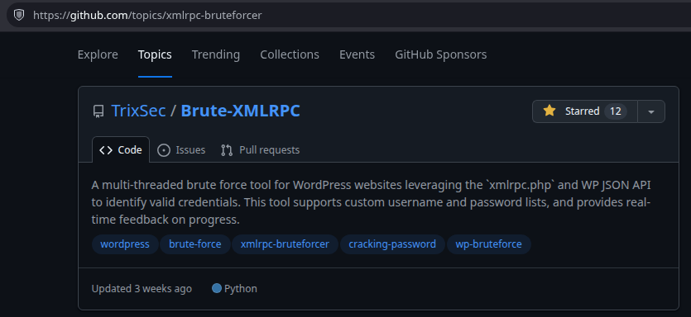
hdub-tech@dc512
+
_ □ ×
Tools: TrixSec’s Brute-XMLRPC
[13/26]
[Brute-XMLRPC] already supports:
- confirming xmlrpc available
- username and password files
- multicall or brute force
- user enumeration (API)
- outputs successful user/pass combos to successful_logins.json file
- ships with a default wordlist
- Tor support
- WAF detection
...but does it work?
# [Brute-XMLRPC]: github.com/TrixSec/Brute-XMLRPC
hdub-tech@dc512$ cd trixsec/brute-xmlrpc && cat README.md █
Notes:
# SOMEHOW I ended up looking at the `xmlrpc-bruteforcer` Topic on GitHub, found trixsec/brute-xmlrpc was DARN close,
# <features on slide>
=========== IGNORE ================
and was updated last year even. Most of the things I was seeing were 6+ years old, and given some of the articles on this were 10+ years old, I probably should have been surprised they weren’t older

Slide 14
hdub-tech@dc512
+
_ □ ×
Time for a test environment!
[14/26]
Options:
1. [Vulhub]
- only 2 WordPress versions
- does automate the manual part of setup
2. [Docksal]
- found (after the fact) because Metasploit contributors used it for testing
- single version of WordPress
3. [Official WordPress] containers
- docs contain usable compose files
- all the versions
- you do need to do the click thru to setup the initial user
# [vulhub]: github.com/vulhub/vulhub
# [Docksal]: github.com/docksal/boilerplate-wordpress
# [Official WordPress]: hub.docker.com/_/wordpress
hdub-tech@dc512$ cat test_environments.md █
Notes:
# OK so how do I get a WordPress for testing?
# There are options, we don't have time to talk about the alternatives.
# Suffice to say, WordPress has official containers, for all the versions, and documented compose scripts. So I went this route.
=============IGNORE====================
# Something about the vulhub compose scripts bothered me, like mismatched script names which made it look like it wouldn’t even work.

Slide 15
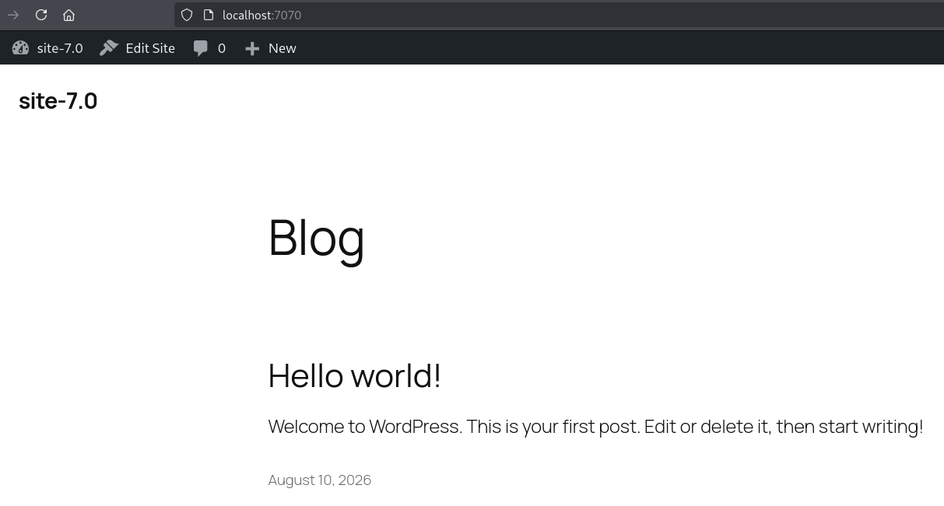
hdub-tech@dc512
+
_ □ ×
Test Environment accomplished
[15/26]
hdub-tech@dc512$ xdg-open images/wp-7.0-blog.png █
Notes:
# Great I'm good to go - I've got WordPress 7 running.
# some of y'all probably just giggled at this version number. The rest of you get to suffer, in order, like I did

Slide 16
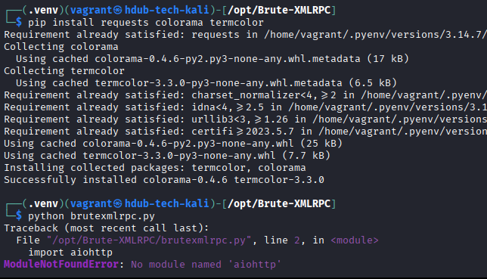
hdub-tech@dc512
+
_ □ ×
$ python brutexmlrpc.py
[16/26]
# Clone the project
$ git clone TrixSec/Brute-XMLRPC
# Set-up Python things
$ uv venv .venv
$ source .venv/bin/activate
$ pip install <pkgs_in_README>
# Create user/password list with known goods
$ echo “wordpress-user” > small-users.txt
$ echo “wordpress-password” > small-pass.txt
# Run the tool
$ python brutexmlrpc.py
hdub-tech@dc512$ python brutexmlrpc.py █
Notes:
# Clone the Brute-XMLRPC project!
# Setup the python things!
# Create user and password list with just a known good user/pass for now! (Baby steps!)
# Run the tool!
# Immediately fails with No Module found
# OK well that's certainly an easy fix, I'll fork the project now, and send that back in a PR since I'm here!

Slide 17

hdub-tech@dc512
+
_ □ ×
Let’s fork this b
[17/26]
hdub-tech@dc512$ xdg-open images/two-weeks-later.png █
Notes:
*Sighs*
# Well I learned something like every day of that 2 weeks, but we don’t have time to talk about EVERYTHING, so on to Key Learnings

Slide 18

hdub-tech@dc512
+
_ □ ×
Key Lessons: multicall nerfed (4.4+)
[18/26]
system.multicall was [nerfed] in version 4.4 (can still brute force with getUsersBlogs)
- TRANSLATION: Once you hit an invalid user/pass in a multicall batch, WordPress won’t even try to login the rest of the batch.
- ELI5: Don’t bother with multicall in 4.4+
Brute-XMLRPC: Updated to not allow multicall in 4.4+, prompts for Brute Force method instead
# [nerfed]: github.com/WordPress/wordpress-develop/commit/75ab50c
hdub-tech@dc512$ cat learnings-multicall.md █
Notes:
# So you know how I mentioned some people were probably chuckling at my version 7 test environment? Yeah this is why. Multicall was nerfed in version 4.4
# The whole purpose of me going down this rabbit hole was to find a tool that did multicall and I wasn’t even testing against an exploitable version of WordPress.
# BASICALLY: Once you hit an invalid user/pass in a single multicall batch in 4.4+, WordPress won't even try to login the rest of the batch. Everything will come back as a fault with a faultCode _even if it is a valid username/password combo_. So BASICALLY utilizing multicall to test user/password combos is pointless in 4.4+
# SO I updated the Brute-XMLRPC tool to not allow you to use the multicall method against versions 4.4 or later, but it will prompt you to try brute forcing instead, rather than just exiting or doing it without asking first.

Slide 19
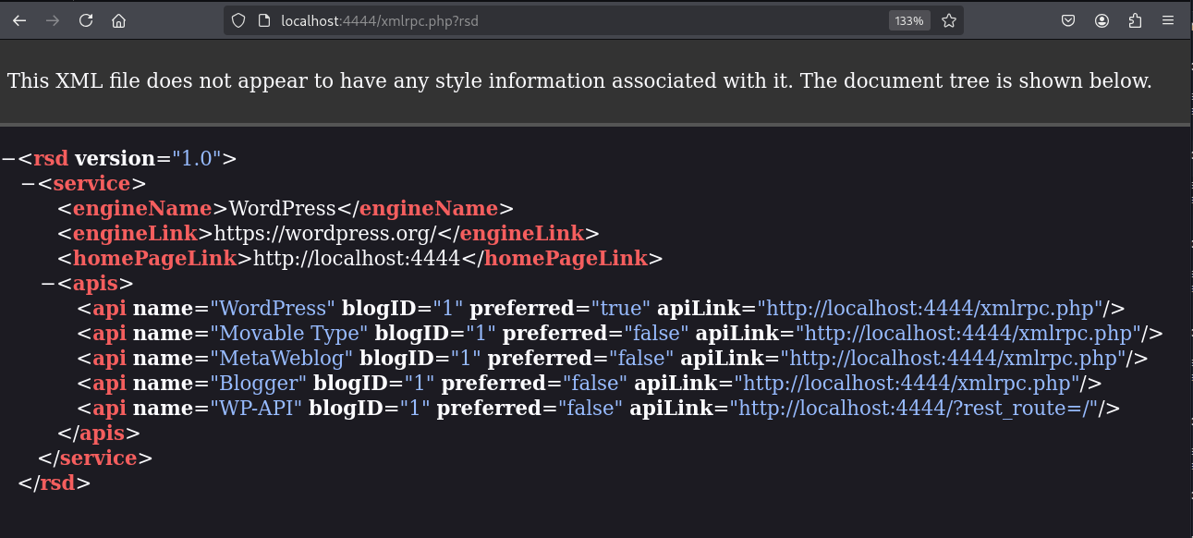
hdub-tech@dc512
+
_ □ ×
Key Lessons: REST API (4.4+)
[19/26]
[Detect] URL with:
- HEAD to server to get Link
- GET on SERVER/xmlrpc.php?rsd
- Look for WP-API
- REST API is usually at one of two locations:
- /wp-json
- /?rest_route=/
Brute-XMLRPC: updated to key off API presence to determine whether to support multicall attacks, and properly discover route
# [detect]: developer.wordpress.org/rest-api/using-the-rest-api/discovery
hdub-tech@dc512$ cat learnings-rest.md █
Notes:
# So how did I do that?
# At this point I had not yet seen the glorious version detections in wpscan or metasploit, and I was having trouble finding a quick and dirty version check. (No, it wasn't as simple as just hitting a `version` endpoint).
# SO I went to the WordPress changelog to see what else changed in that version, and low and behold! The REST API was added in 4.4 and that is super easily detectable (and also very useful).
# SO I codified that as Brute-XMLRPC’s way to determine whether or not to allow you to use the multicall feature in the tool. It's not a fancy version detection like the other ones do, but it will get 'er done
# While in there, I also noticed that Brute-XMLRPC was using a hard-coded API route rather than detecting it, which is sadly necessary, because apparently WordPress can default to 2 different places. So I fixed that in Brute-XMLRPC too..

Slide 20
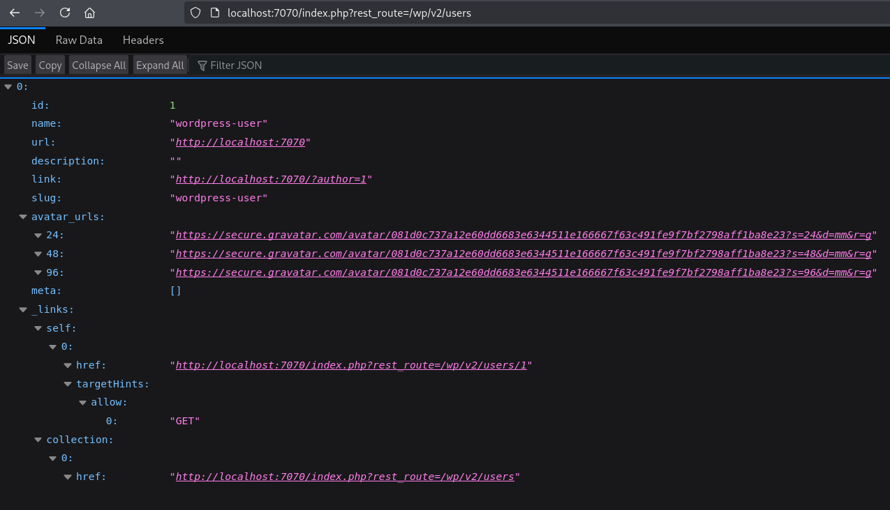
hdub-tech@dc512
+
_ □ ×
[20/26]
Key Lessons: list users (4.7+)
- wp/v2/users will list any user that has made a public post: no auth necessary ([by design])
- UNCONFIRMED: Always returns the first created admin?
- tried marking private AND deleting the first post which is auto created on install and this user is STILL returned with the REST API
Brute-XMLRPC: updated to gracefully fail if no endpoint and allow file input
# [by design]: reddit.com/r/ProWordPress/comments/1clp2dm/comment/l2v1nu2/
hdub-tech@dc512$ cat learnings-list-users.md █
Notes:
# So Brute-XMLRPC already had user enumeration capability which was using the REST API `users` endpoint which, BY DESIGN, unauthenticated, will return any user that has made a public post.
# Now when I tried to use that feature in the Brute-XMLRPC, it would just exit. At this point I'm testing against 4.4, because I knew that was when the REST API was added, but it turns out `list users` wasn't added until 4.7.
# SO I updated Brute-XMLRPC to fail gracefully if `users` wasn't there, and instead prompt you to input users or a userlist.
# I really want to talk about some of the -isms with this, but we don't have time 😭 , so go check out the slides later.

Slide 21

hdub-tech@dc512
+
_ □ ×
[21/26]
Key Lessons: Crashing WordPress XML-RPC
- ‘Allowed memory size of 134217728 exhausted’ with large multicall POSTs
Brute-XMLRPC multicall: updated to batch at random 1300-1500 combos per POST, with random 15-30 second sleeps between POSTs.
- Brute forcing – (on my machine) at almost exactly 5 minutes consistently, XML-RPC would start throwing TimeoutErrors
Brute-XMLRPC bruting: updated to batch at random 900-1100 requests with random 15-30 sec sleep between brutes.
# How is this hole so deep. I just wanted to put up a PR to fix Python requirements.
hdub-tech@dc512$ cat learnings-crashing-wordpress.md █
Notes:
# OK so I've eliminated the little bugs and improved the happy paths. Now lets test a little more realistically before I send this PR back and tell my buddy there is a tool for them to use: I've got a 5-user userlist, and a 20k wordlist.
# WHAT COULD GO WRONG
# WELL apparently you can't send 100-thousand methods in a single multicall POST or WordPress WILL throw memory errors (which at least it bothered to tell me about).
# SO, I "fixed" Brute-XMLRPC to batch in random amounts, around 1400 method calls per multicall, with a random sleep in between. Great. It's "happy." No more multicall errors.
# OK so let's make sure I didn't break brute force mode. Same 5 users, and 20k passwords, but at almost exactly 5 minutes every single time, my instance's XML-RPC endpoint would throw Timeout Errors
# SO I updated Brute-XMLRPC to random batch and random sleep on that too, and it's all good.

Slide 22
hdub-tech@dc512
+
_ □ ×
Brute-XMLRPC fixes / improvements
[22/26]
- fix multicall XML request body
- fix multicall/brute force XML response parsing for isAdmin (working u/p combo)
- fix output working u/p combos to json
- fix REST API URL detection
- fix multicall to use random 1300-1500 sized u/p combo POST to avoid memory exhaustion
- fix brute force TimeoutErrors with 900-1100 random sized batches with 15-30 second random sleeps between
- de-dupe and strip user/passwords with xml chars
- python reqs file
- don’t allow multicall if 4.4 later
- support for multiple REST API root locations
- allow option of brute force if multicall unsupported
- if no users detected via API, prompt for user/file input
- improve progress printing
- add “wordpress” to wordlist
- remove stale threading logic
- update docs / gitignore
- appease pylint (some)
# [my PR for fixes/improvements]: github.com/TrixSec/Brute-XMLRPC/pull/1
# WaRnInG: I’ve never really coded in Python before, and I went straight to concurrency - there may be dragons here
hdub-tech@dc512$ git diff upstream HEAD █
Notes:
*Sigh*
There was more updates to the tool than was covered in those last slides, but if you really want to know about it, you'll have to go check out the PR.

Slide 23
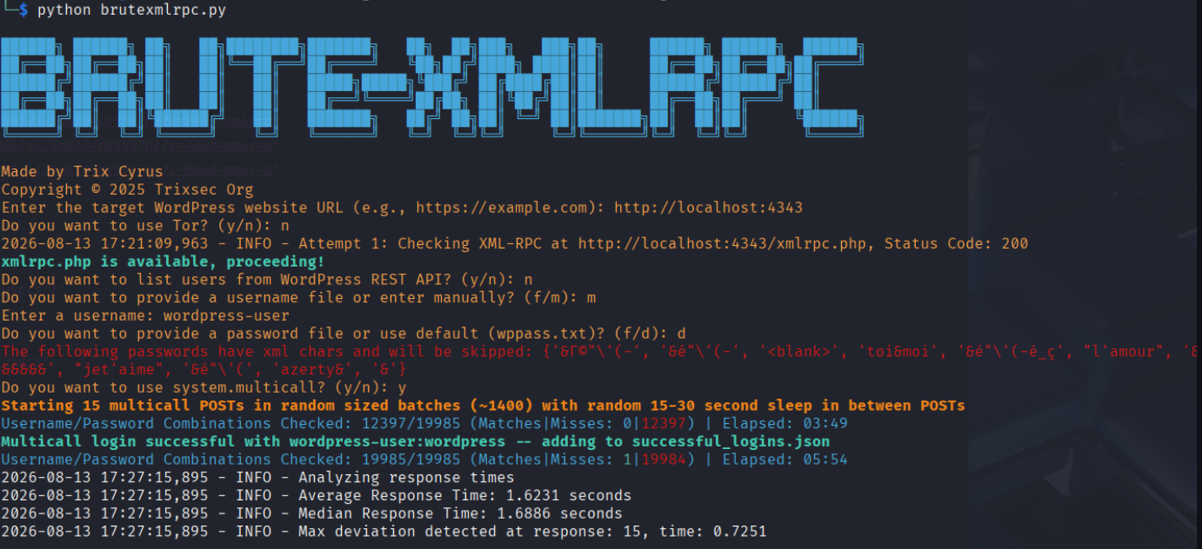
hdub-tech@dc512
+
_ □ ×
Tool Updates accomplished
[23/26]
# [brute-xmlrpc]: github.com/TrixSec/Brute-XMLRPC
hdub-tech@dc512$ xdg-open images/brute-xmlrpc.png █
Notes:
# SO, the tool is updated and it's pretty solid now, if I don't say so myself.
# PLEASE NOTE that pentest friend has NOT had a gig with WordPress since my updates were completed, so I have received ZERO real world feedback, and it is crushing my soul a little.
*_please give me feedback_*

Slide 24
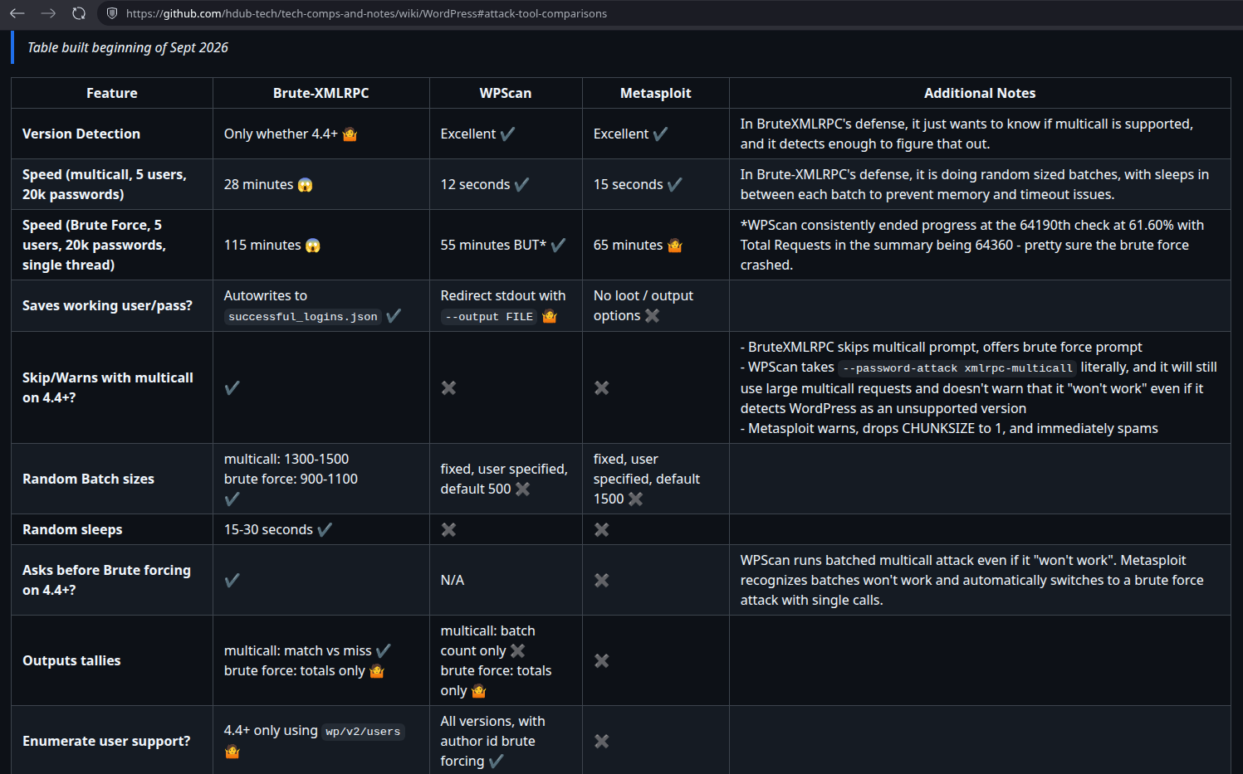
hdub-tech@dc512
+
_ □ ×
Tool comparisons
[24/26]
hdub-tech@dc512$ xdg-open images/attack-tool-comparisons.png █
Notes:
# Regarding Wpscan and Metasploit….I DID deep dive into them while making these slides. We don't have time to go over this comparison chart of Brute-XMLRPC vs the other 2, but it is on the wiki page mentioned on the last slide.
# TLDR: Brute-XMLRPC is slower, it doesn't have fine grained version detection like the others, but it has what it needs to get the job done, it has more protections for users, it won’t hide silent crashes (which WPScan does), it won't brute force without your permission (which Metasploit does), and it outputs successful logins to a file (which surprisingly neither of the other 2 do).
=================== IGNORE DETAILS =====================
# Brute-XMLRPC:
- Pros: supports user/pass input files, saves you from yourself and the server, lots of protections, outputs successful logins to a json file, random batch sizes and sleeps, nice progress output and tallies, basic user enum support
- Cons: “set it and forget it” (multicall runs in minutes, brute forcing can be hours), version detection is just enough to determine whether to support multicall, most basic of user enum support
# WPScan:
- Pros: Excellent version support, mulicall runs in seconds, brute forcing is fastest of the three (close to an hour), user enumeration uses author id brute forcing (likely higher return rate than just the public API), outputs successful logins as it goes
- Cons: Brute force method is crashing but not reporting it, redirect output to a file (not just the working users/pass), doesn’t warn you about multicall not working in 4.4
# Metasploit (wordpress_multicall_creds aux module)t:
- Pros: Excellent version detection, fast for multicall, tad slower than wpscan for brute forcing, if 4.4+ it automatically switches to brute force mode and skips multicall
- Cons: no output to file or loot capability, no user enum, doesn’t warn you that it will bruteforce

Slide 25
hdub-tech@dc512
+
_ □ ×
[25/26]
For Defenders
[00]
Keep WordPress and all of its components up to date
[01]
Advanced Admin Handbook [Security] section, which has hardening
[02]
Disable XML-RPC endpoint, restrict it with WAF rules, rate limit
[03]
WP core does not support 2FA since 2025, but there are plugins to support it (checkout [Wordfence])
[04]
Configure SSO/IdP
# [security]: developer.wordpress.org/advanced-administration/security
# [wordfence]: wordfence.com
hdub-tech@dc512$ cat defenders.md █
Notes:
Quick words for defenders:
# Keep WordPress and its bits updated
# Read the hardening guide
# Disable XML-RPC if you don't use it
# Check out Wordfence
# Configure SSO/IdP

Slide 26
hdub-tech@dc512
+
_ □ ×
[26/26]
$ exit
# thanks. feedback welcome.
# (Hopefully at least 1 person learned 1 thing)
slides -> github.com/hdub-tech (Talks section)
the PR -> github.com/TrixSec/Brute-XMLRPC/pull/1
the Wiki -> github.com/hdub-tech/tech-comps-and-notes/wiki/WordPress
linkedin -> linkedin.com/in/h-dub
# employment also welcome (contracts or direct hire)
hdub-tech@dc512$ exit █
Notes:
# All the resources are linked on this slide
# If at least 1 person learned 1 thing, than my mission was accomplished

