Slide 1
Computer Graphics
Programming with OpenGL

Slide 2
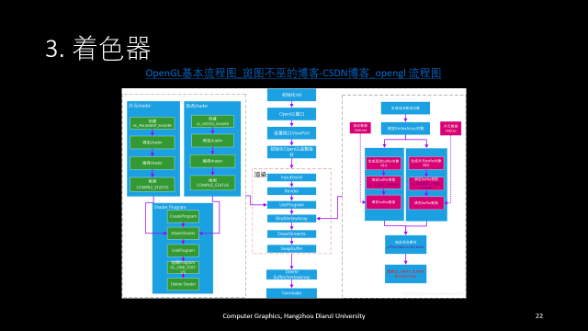
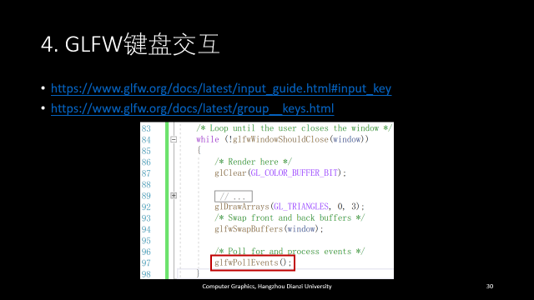
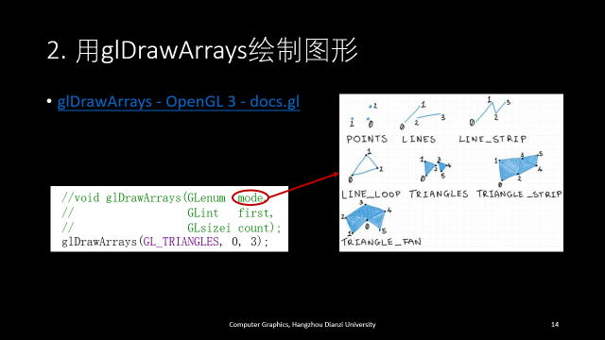
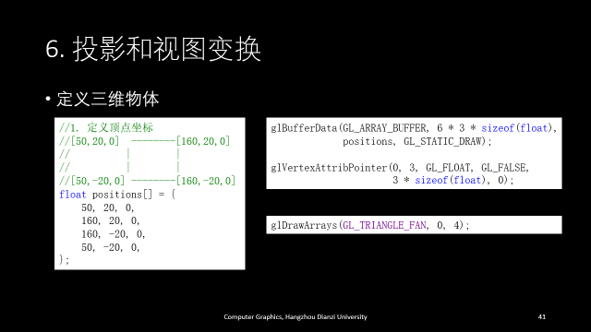
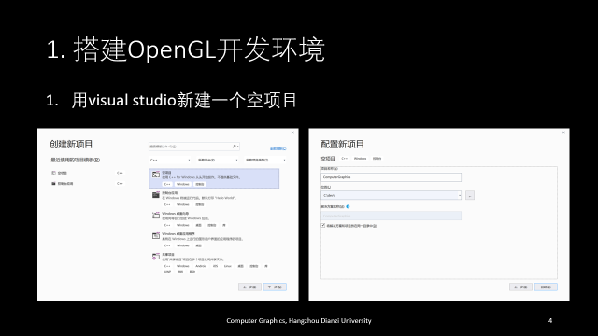
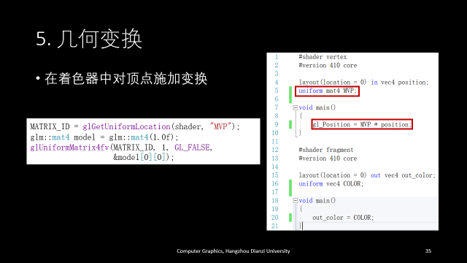




Contents

Slide 3
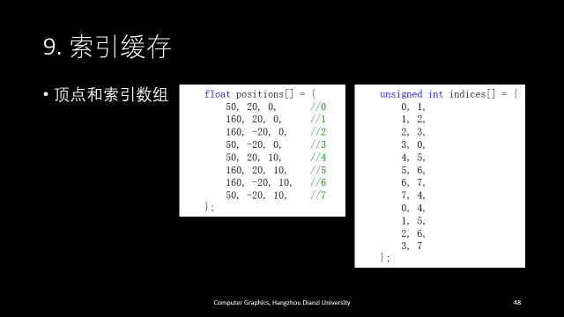
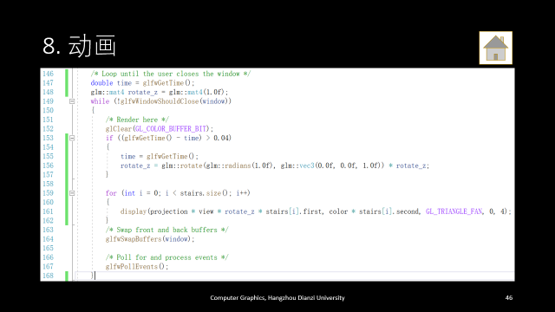
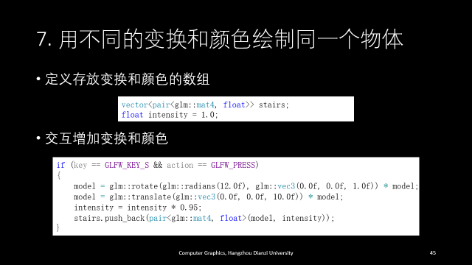




Slide 4
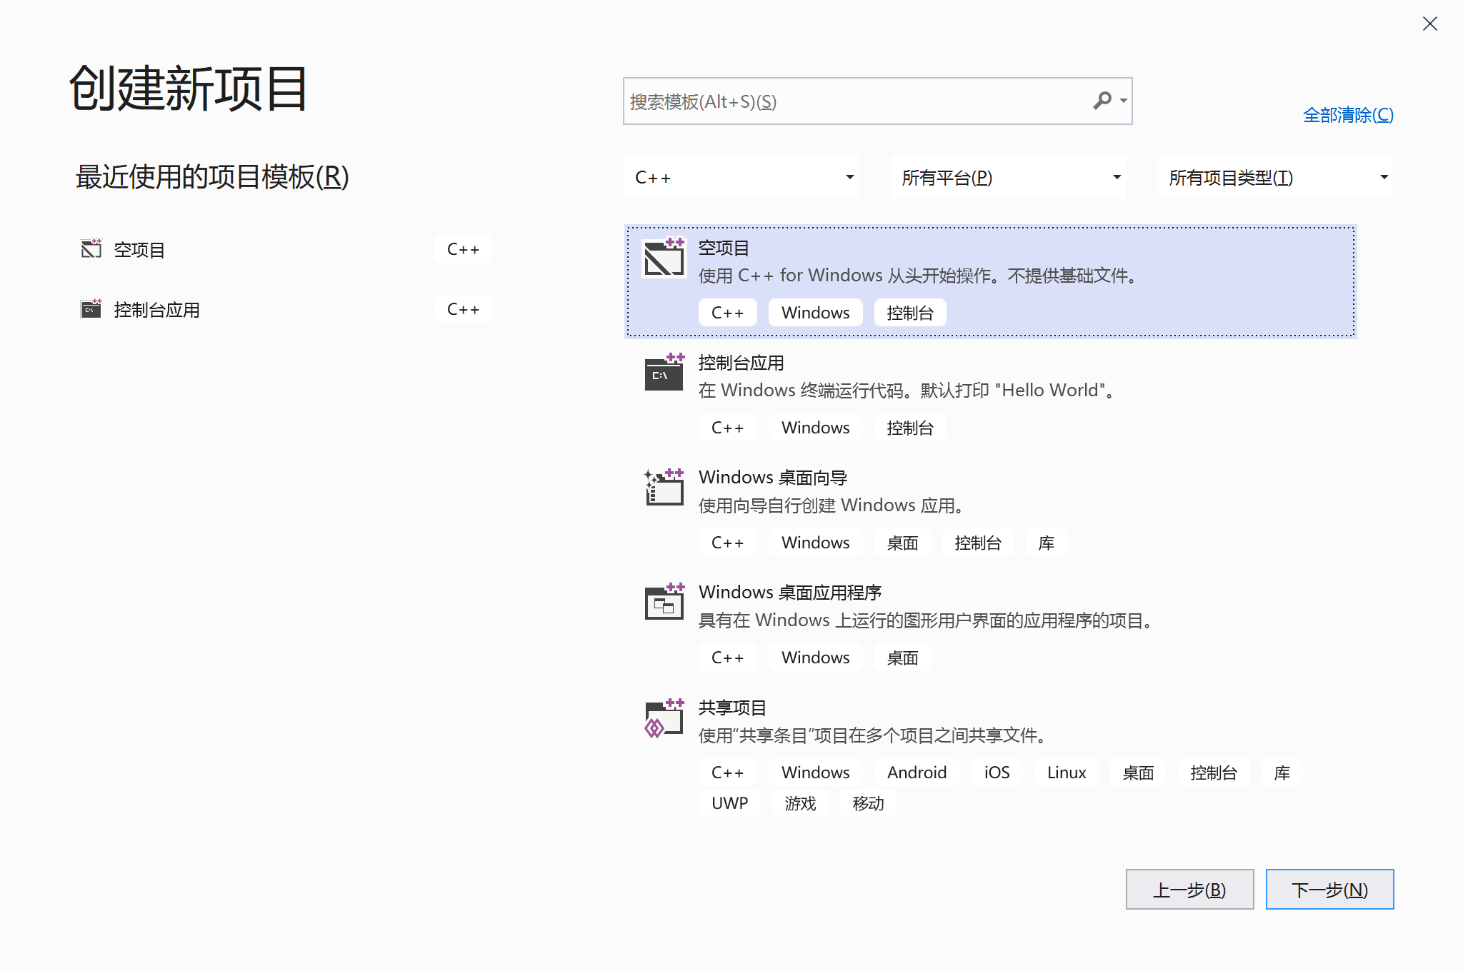
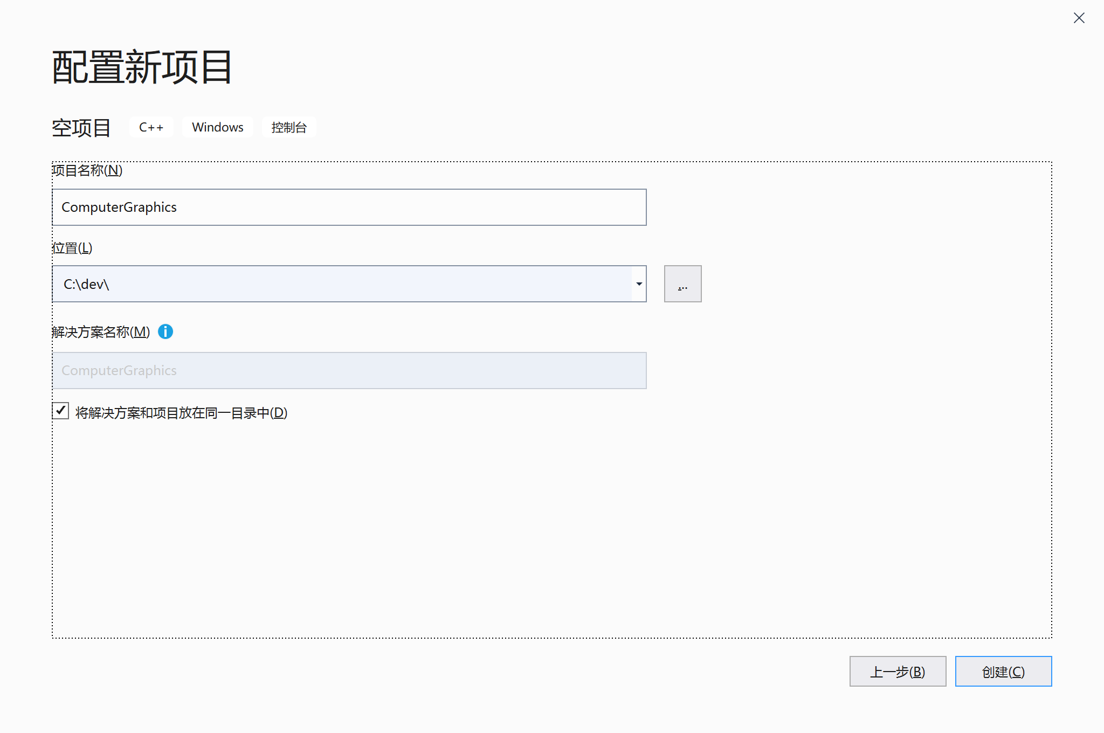
1. 搭建OpenGL开发环境
用visual studio新建一个空项目

Slide 5
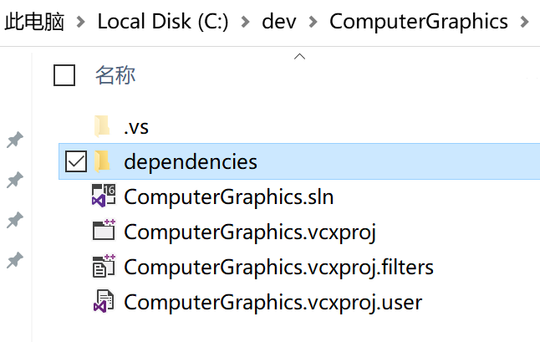
在项目文件夹新建dependencies文件夹

Slide 6

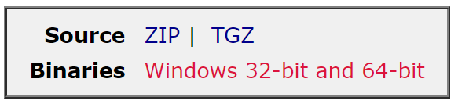
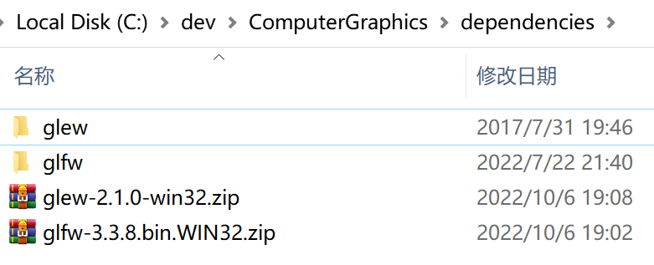
下载glfw和glew库，解压到dependencies文件夹

Slide 7
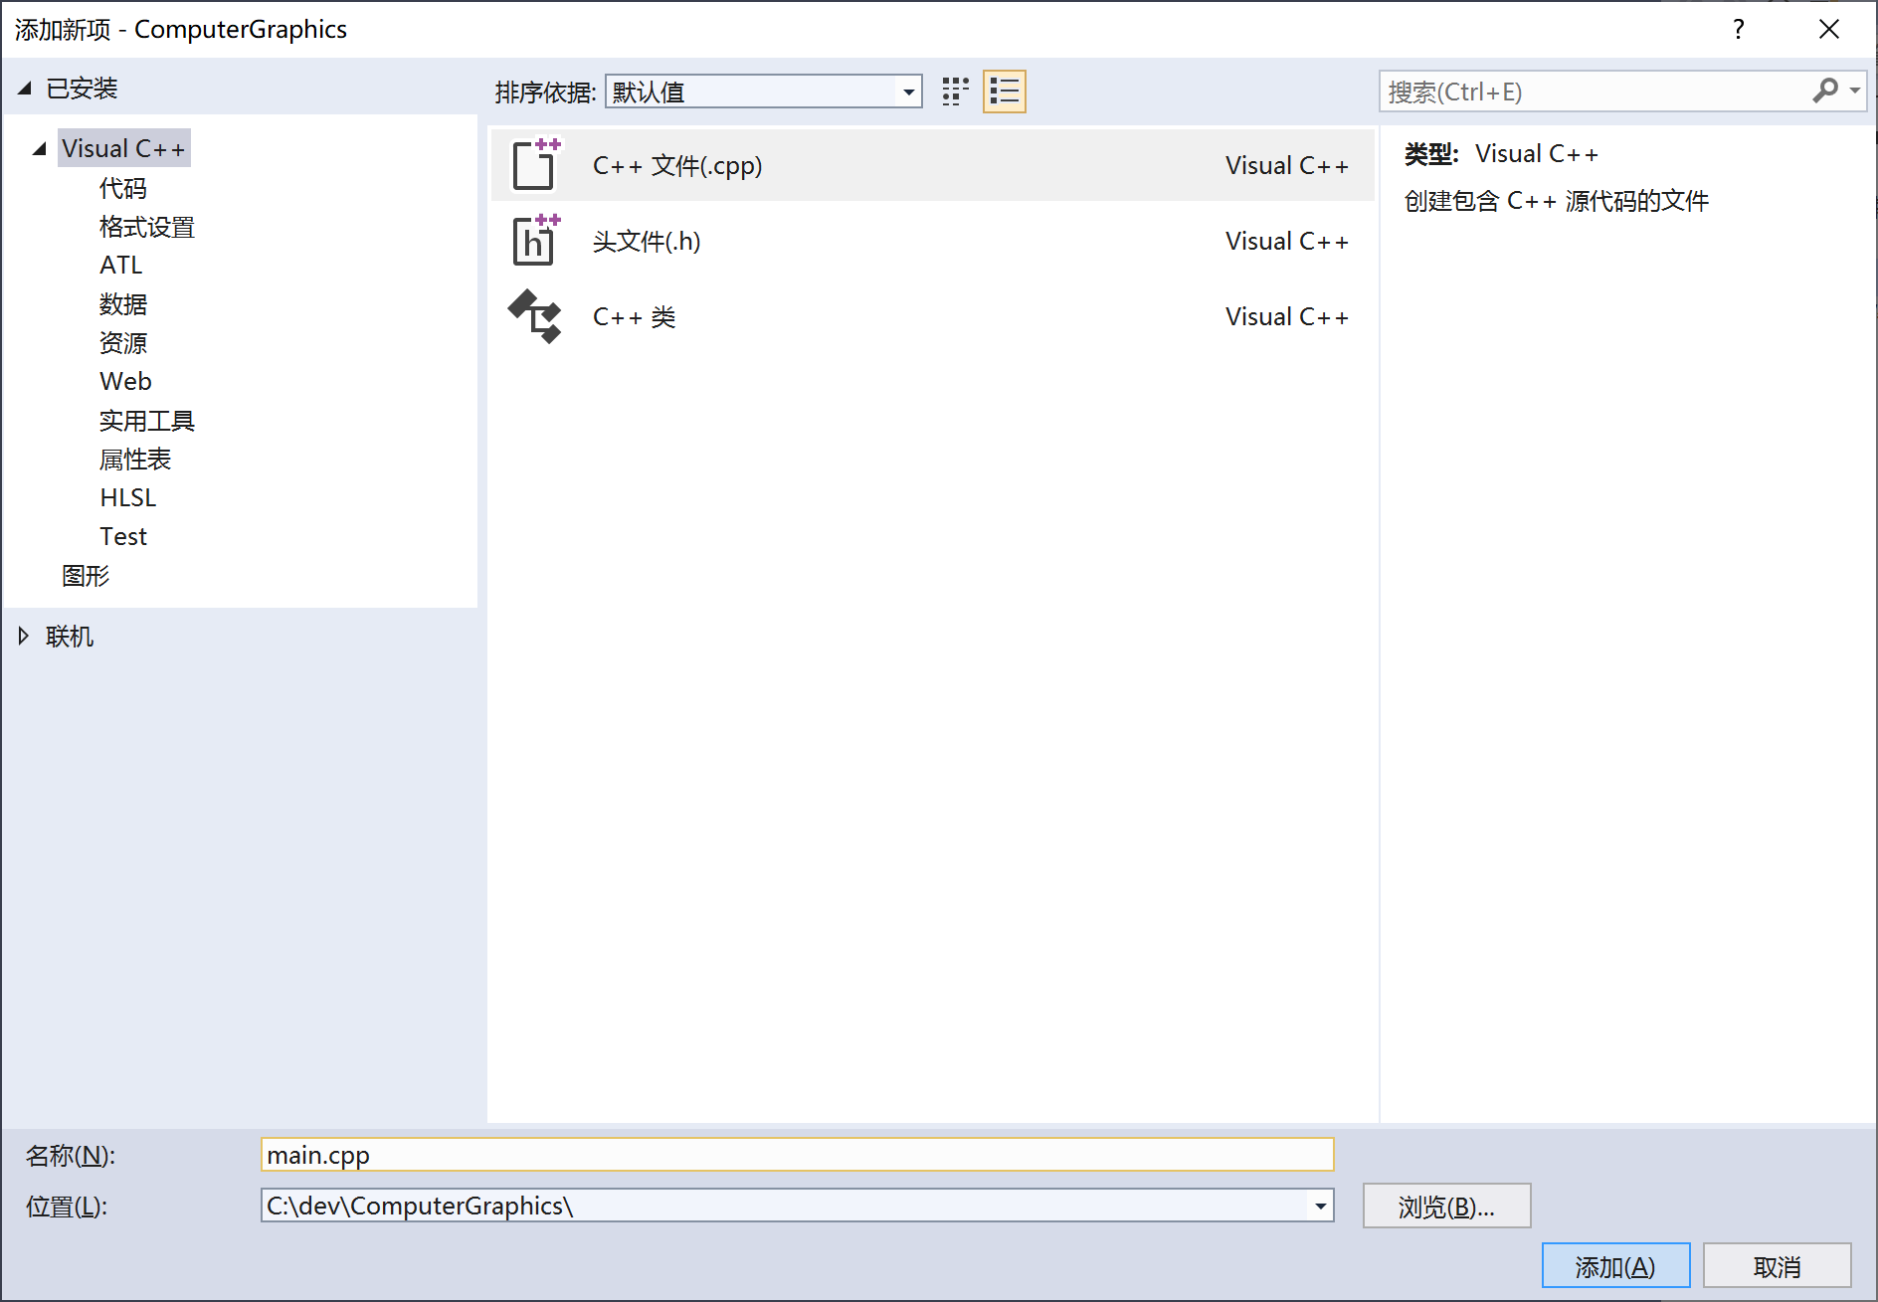
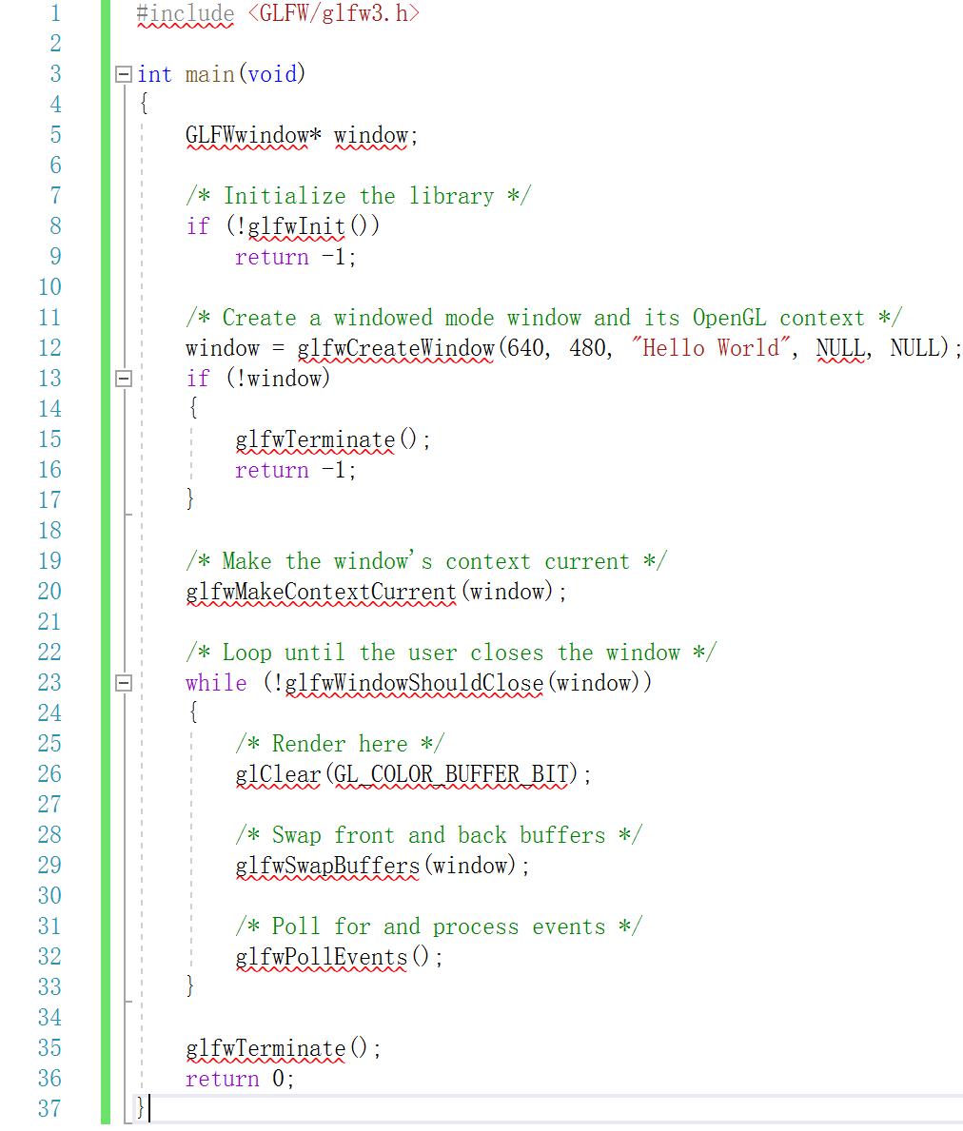
新建源码文件，编辑代码 Documentation | GLFW

Slide 8
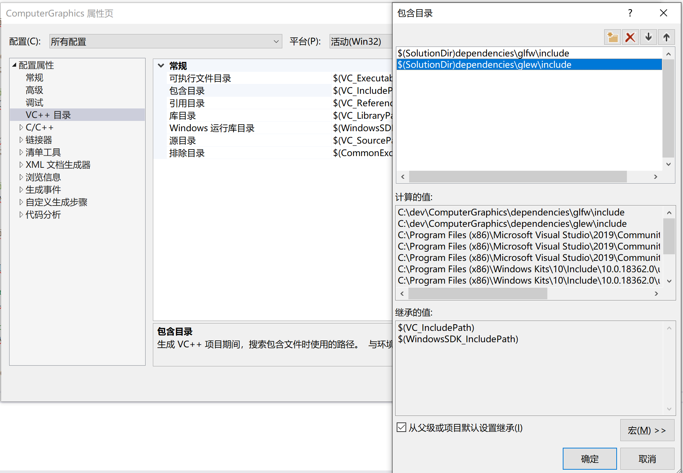
配置工程包含目录

Slide 9
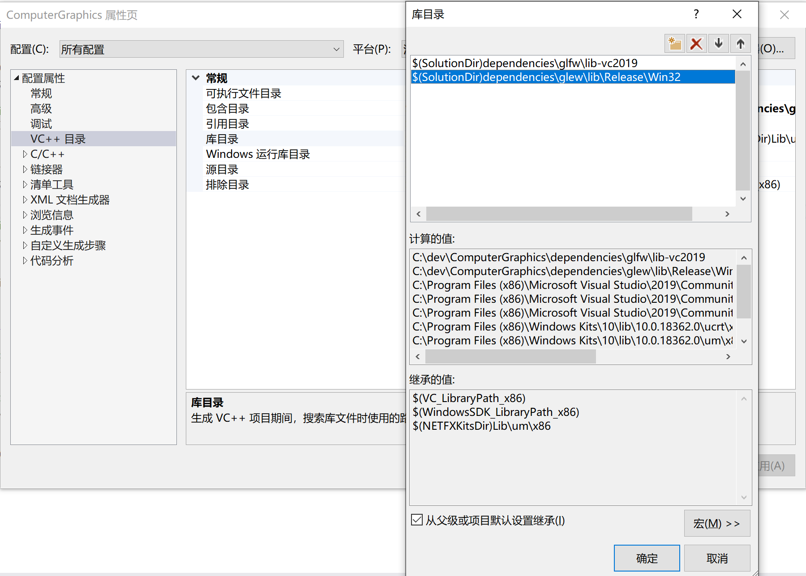
配置工程库目录
选择与你的vs版本对应的glfw库

Slide 10
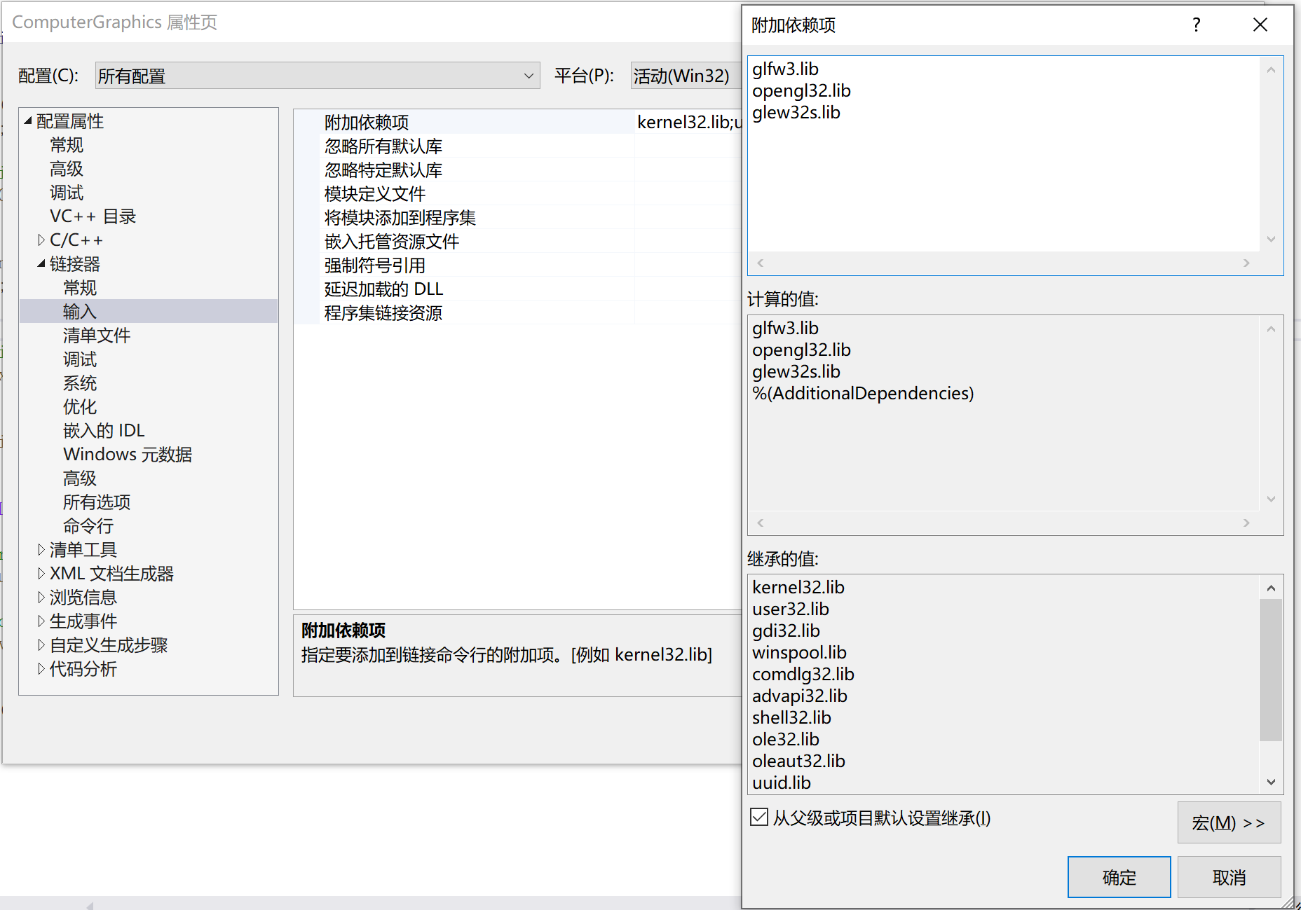
配置附加依赖项

Slide 11
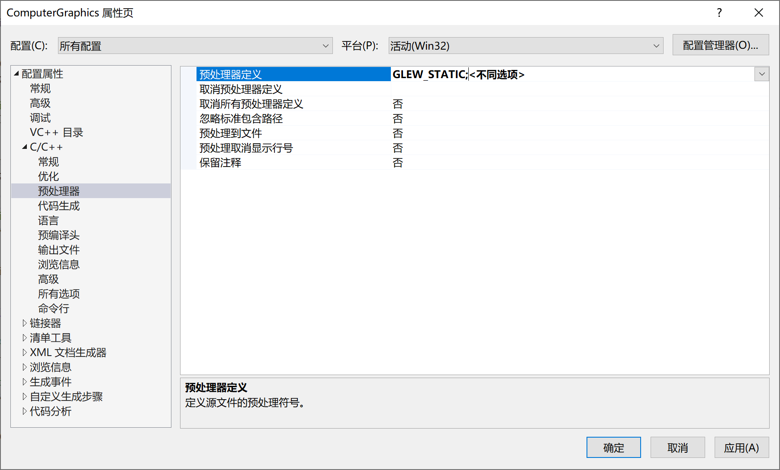
定义预处理器

Slide 12
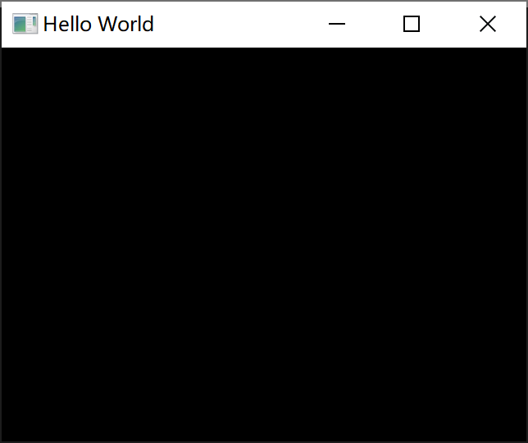
编译运行程序

Slide 13
初始化glew
#include <GL/glew.h>
#include <GLFW/glfw3.h>
#include <iostream>
…
/* Make the window's context current */
glfwMakeContextCurrent(window);
GLenum err = glewInit();
if (GLEW_OK != err)
{
/* Problem: glewInit failed, something is seriously wrong. */
std::cout << "Error: \n", glewGetErrorString(err);
}
…

Slide 14
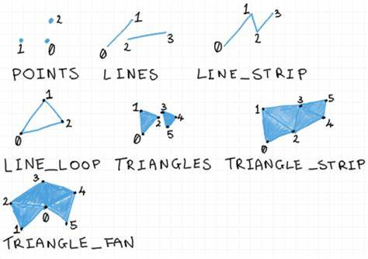
2. 用glDrawArrays绘制图形
glDrawArrays - OpenGL 3 - docs.gl
//void glDrawArrays(GLenum mode,
// GLint first,
// GLsizei count);
glDrawArrays(GL_TRIANGLES, 0, 3);

Slide 15
glDrawArrays - OpenGL 3 - docs.gl
Vertex Buffer
vertex1 | vertex2 | vertex3
//void glDrawArrays(GLenum mode,
// GLint first,
// GLsizei count);
glDrawArrays(GL_TRIANGLES, 0, 3);
3

Slide 16
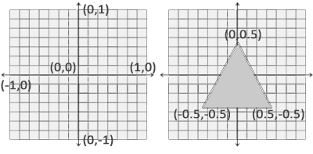
创建vertex buffer
//1. 定义顶点坐标
float positions[6] = {
-0.5,-0.5,
0.0,0.5,
0.5,-0.5
};
//2. 申请缓存
unsigned int buffer;
glGenBuffers(1, &buffer);
//3. 指定当前缓存
glBindBuffer(GL_ARRAY_BUFFER, buffer);
//4. 指定数据
glBufferData(GL_ARRAY_BUFFER, 6 * sizeof(float), positions, GL_STATIC_DRAW);

Slide 17
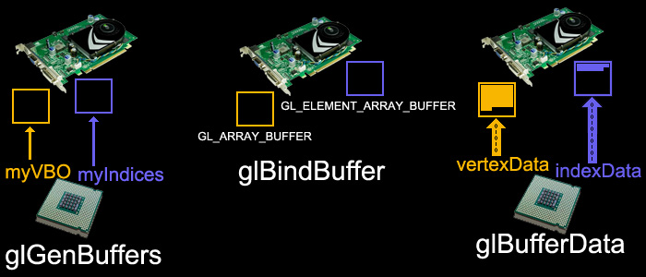
创建vertex buffer
//1. 定义顶点坐标
float positions[6] = {
-0.5,-0.5,
0.0,0.5,
0.5,-0.5
};
//2. 申请缓存
unsigned int buffer;
glGenBuffers(1, &buffer);
//3. 指定当前缓存
glBindBuffer(GL_ARRAY_BUFFER, buffer);
//4. 指定数据
glBufferData(GL_ARRAY_BUFFER, 6 * sizeof(float), positions, GL_STATIC_DRAW);

Slide 18
glVertexAttribPointer - OpenGL 3 - docs.gl
Vertex Buffer
//5. 指定缓存结构
glEnableVertexAttribArray(0);
//void glVertexAttribPointer(GLuint index,
// GLint size,
// GLenum type,
// GLboolean normalized,
// GLsizei stride,
// const GLvoid * pointer);
glVertexAttribPointer(0, 2, GL_FLOAT, GL_FALSE, 8, 0);
vertex1 |  | vertex2 |  | vertex3
x | y | x | y | x | y
2
8 bytes

Slide 19

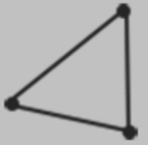
CPU
GPU
①
positions
-0.5 | -0.5 | 0.0 | 0.5 | 0.5 | -0.5
VBO1
②
glGenBuffers
VBO2
Frame buffer
③
glBindBuffer
-0.5 | -0.5 | 0.0 | 0.5 | 0.5 | -0.5
④
glBufferData
⑨
Fragment shader
out vec4 color;
⑤
glEnableVertexAttribArray
index
size
type
stride
VAO
⑥
glVertexAttribPointer
⑦
glDrawArrays
⑧
Vertex shader
in vec4 position;

Slide 20
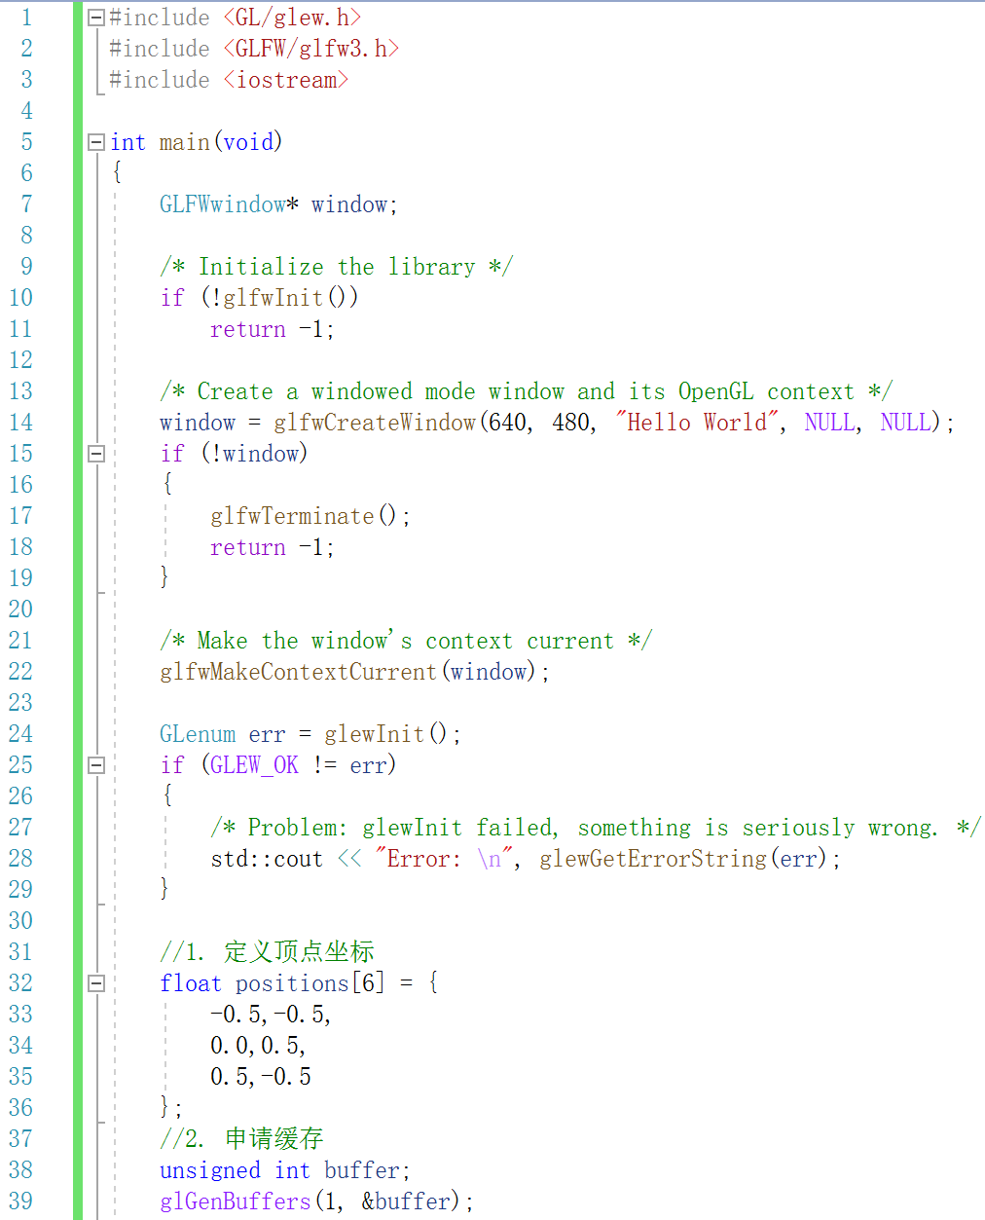
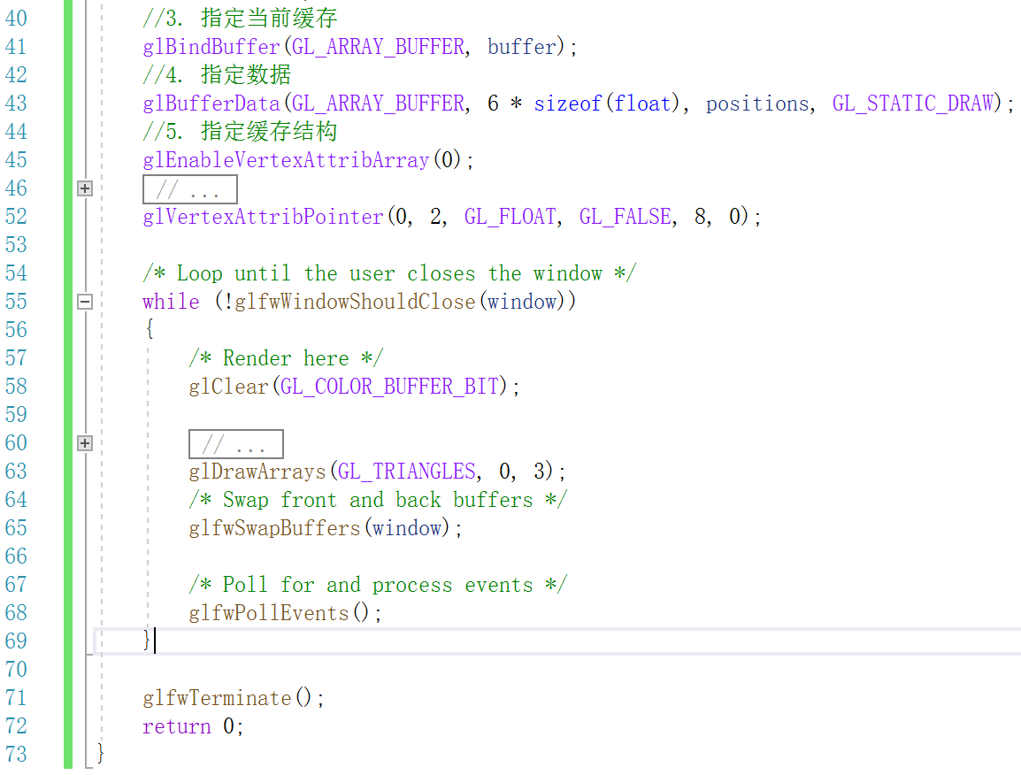
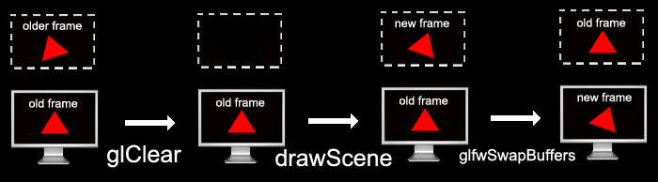

Slide 21
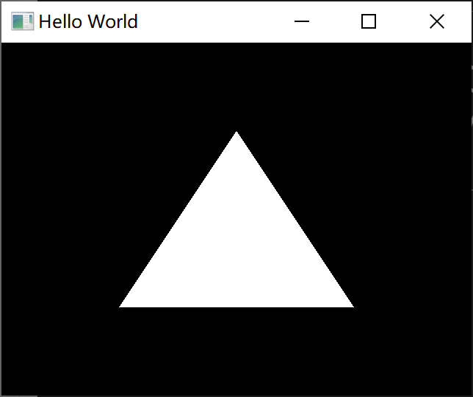
运行结果

Slide 22
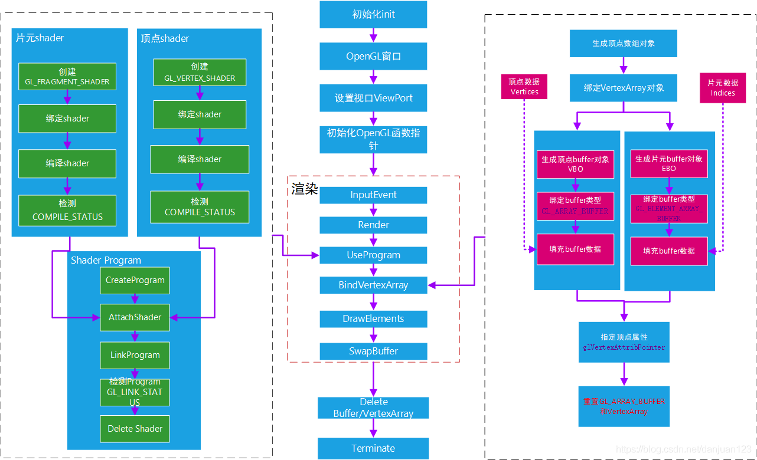
3. 着色器
OpenGL基本流程图_斑图不巫的博客-CSDN博客_opengl 流程图

Slide 23
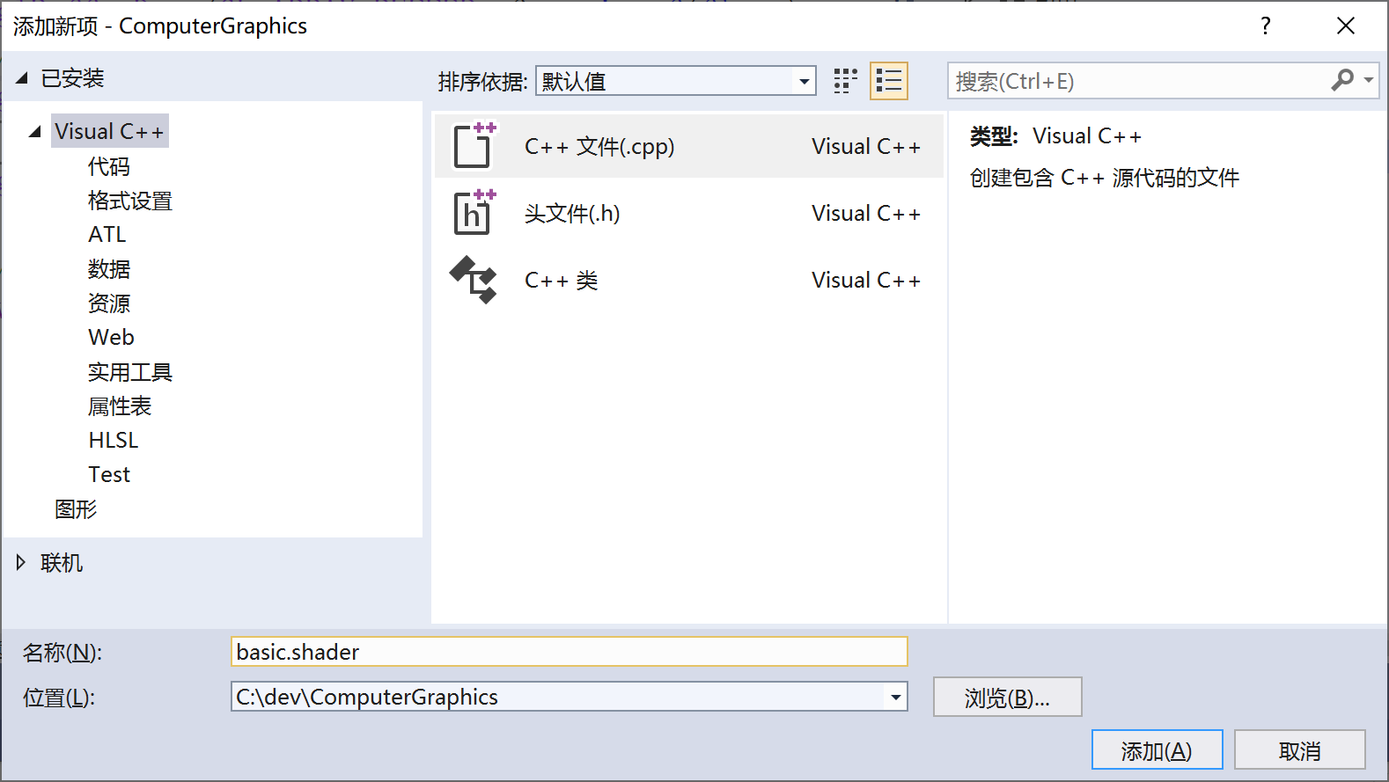
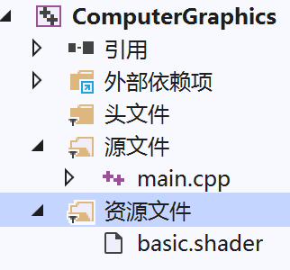
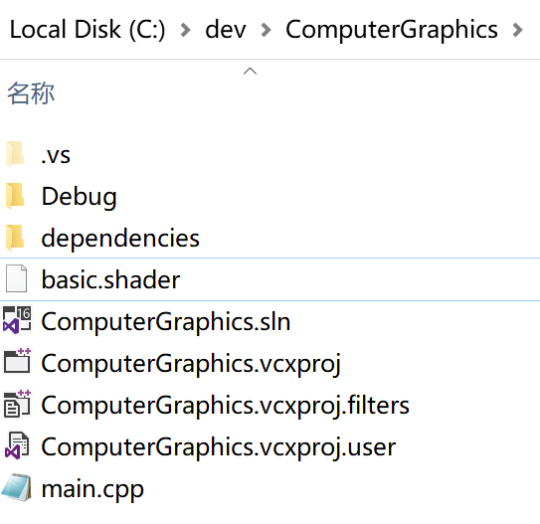
新建shader文件

Slide 24
#shader vertex
#version 410 core
layout(location = 0) in vec4 position;
void main()
{
gl_Position = position;
}
#shader fragment
#version 410 core
layout(location = 0) out vec4 out_color;
void main()
{
out_color = vec4(1.0, 0.0, 0.0, 1.0);
}
编辑着色器代码

Slide 25
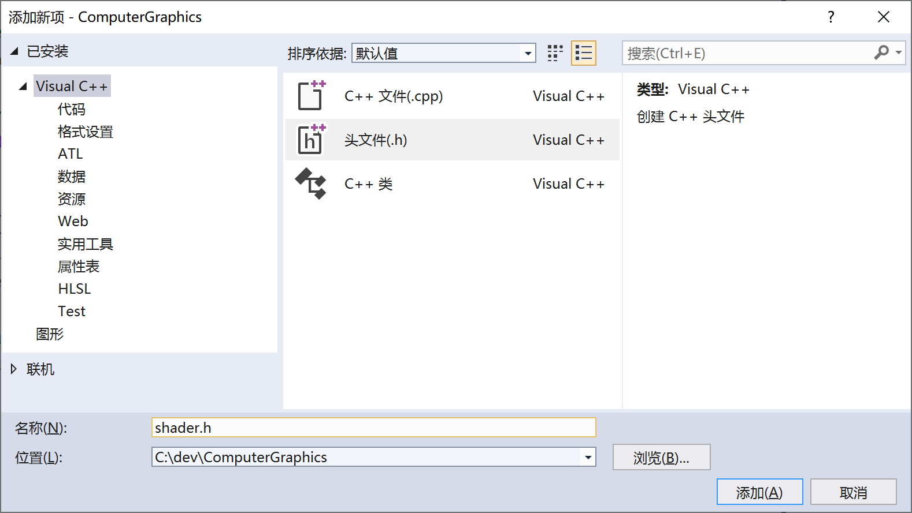
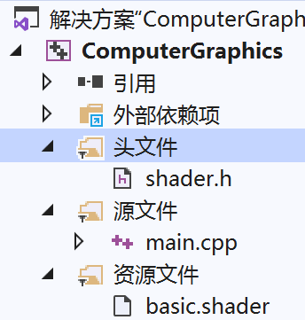
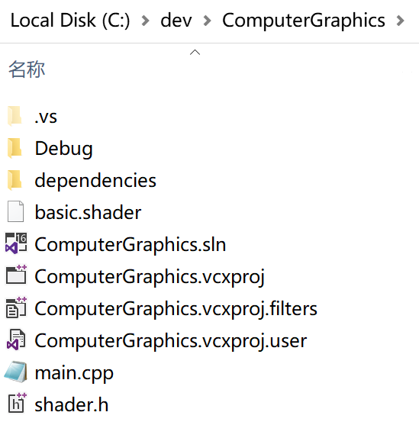
新建shader.h头文件

Slide 26
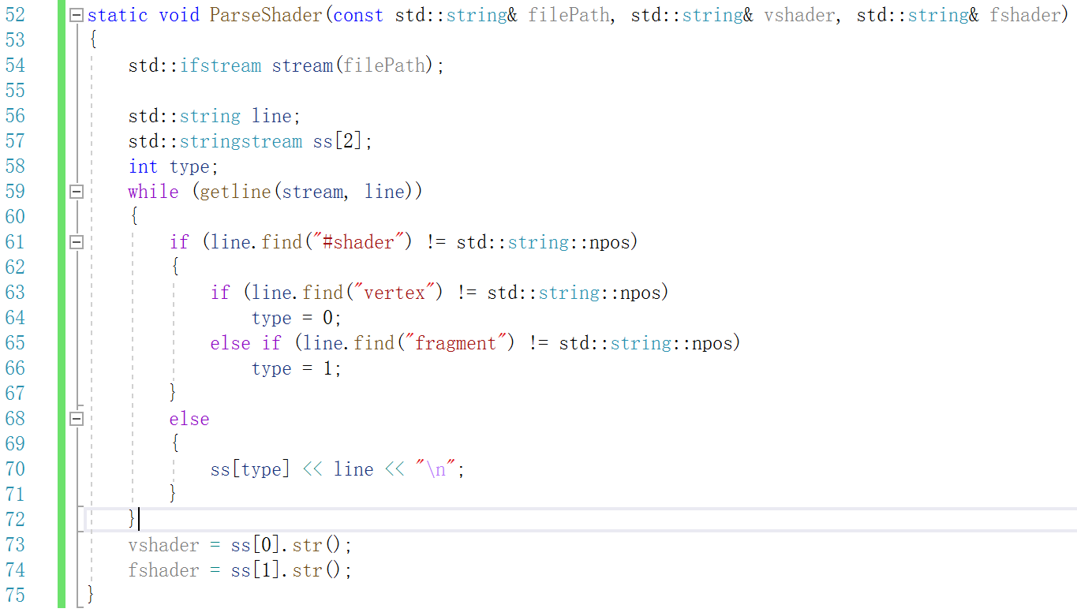
在shader.h文件中定义解析着色器文件的函数

Slide 27
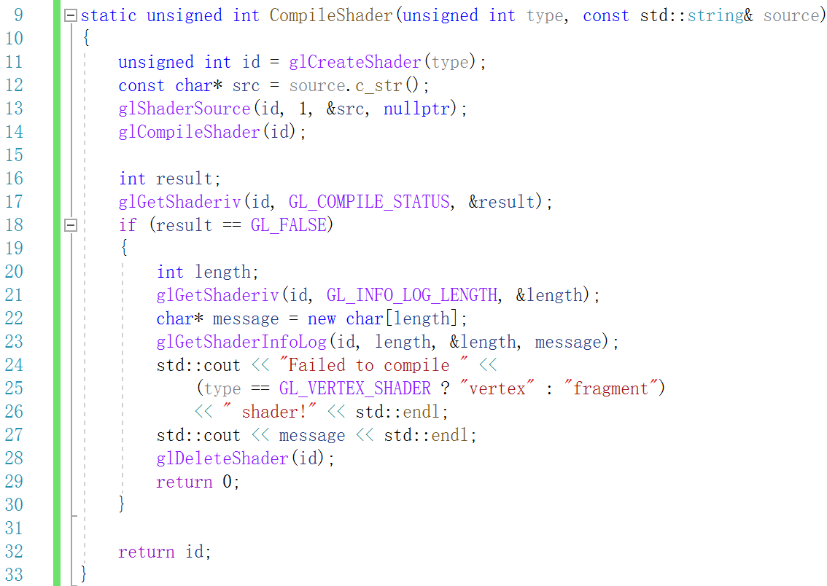
在shader.h文件中定义编译着色器的函数

Slide 28
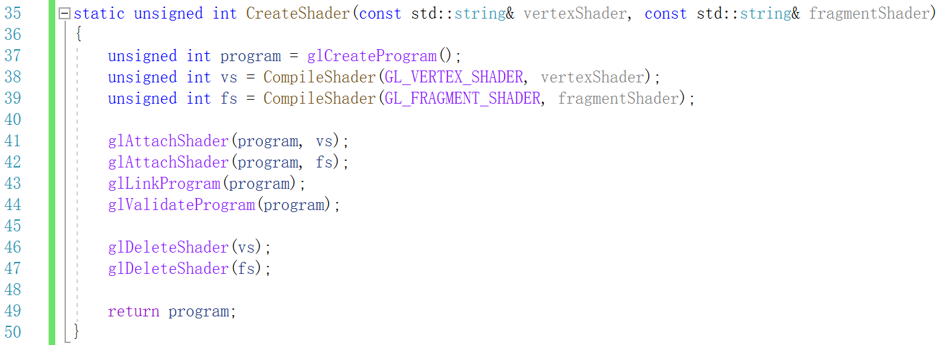
在shader.h文件中定义链接并生成着色器程序的函数

Slide 29
在主函数中创建并使用着色器
//0. 创建着色器
std::string vertexShader, fragmentShader;
ParseShader("basic.shader", vertexShader, fragmentShader);
unsigned int shader = CreateShader(vertexShader, fragmentShader);
glUseProgram(shader);

Slide 30
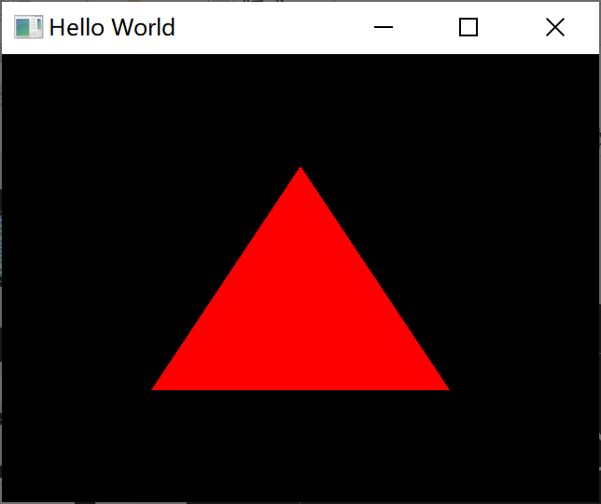
运行结果

Slide 31
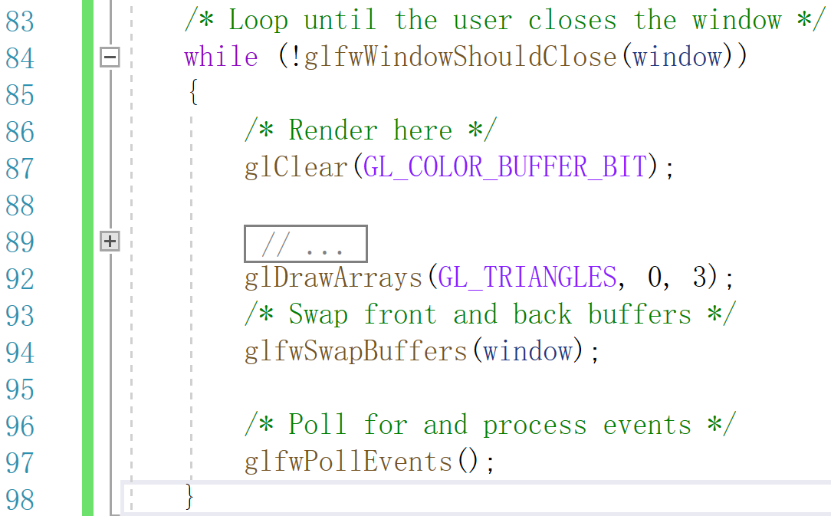
4. GLFW键盘交互
https://www.glfw.org/docs/latest/input_guide.html#input_key
https://www.glfw.org/docs/latest/group__keys.html

Slide 32
#shader vertex
#version 410 core
layout(location = 0) in vec4 position;
void main()
{
gl_Position = position;
}
#shader fragment
#version 410 core
layout(location = 0) out vec4 out_color;
uniform vec4 COLOR;
void main()
{
out_color = COLOR;
}
修改着色器代码

Slide 33
在main.cpp中定义全局变量COLOR_ID
在创建着色器代码之后，获取着色器中uniform变量的id
unsigned int COLOR_ID;
COLOR_ID = glGetUniformLocation(shader, "COLOR");
glUniform4f(COLOR_ID, 1.0, 0.0, 0.0, 1.0);

Slide 34
void key_callback(GLFWwindow* window, int key, int scancode,
int action, int mods)
{
if (key == GLFW_KEY_R && action == GLFW_PRESS)
{
glUniform4f(COLOR_ID, 1.0, 0.0, 0.0, 1.0);
}
if (key == GLFW_KEY_G && action == GLFW_PRESS)
{
glUniform4f(COLOR_ID, 0.0, 1.0, 0.0, 1.0);
}
if (key == GLFW_KEY_B && action == GLFW_PRESS)
{
glUniform4f(COLOR_ID, 0.0, 0.0, 1.0, 1.0);
}
}
定义glfw键盘回调函数

Slide 35
设置glfw回调函数
glfwMakeContextCurrent(window);
glfwSetKeyCallback(window, key_callback);

Slide 36
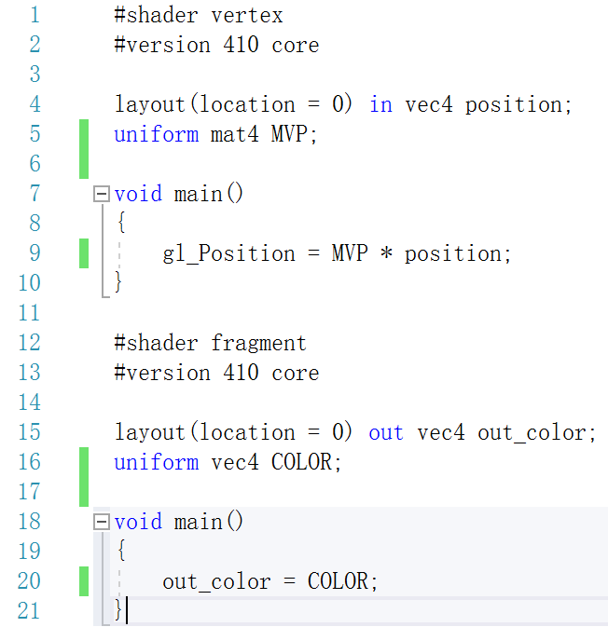
5. 几何变换
在着色器中对顶点施加变换
MATRIX_ID = glGetUniformLocation(shader, "MVP");
glm::mat4 model = glm::mat4(1.0f);
glUniformMatrix4fv(MATRIX_ID, 1, GL_FALSE,
&model[0][0]);

Slide 37
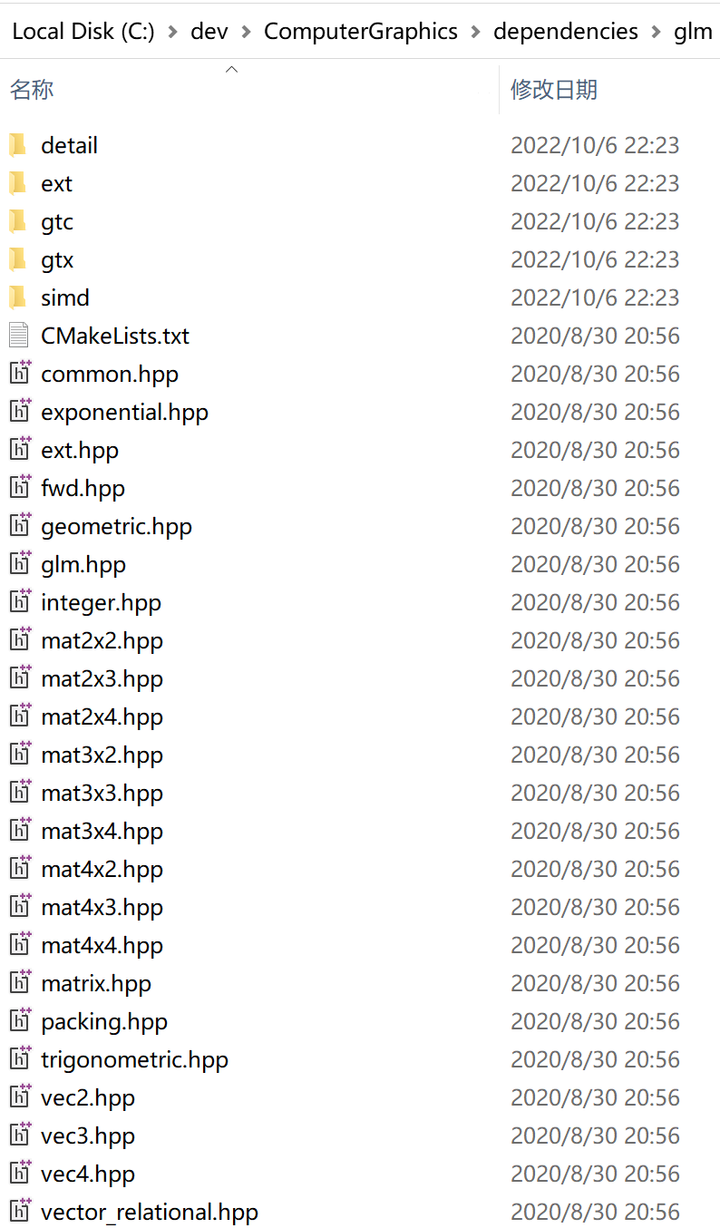
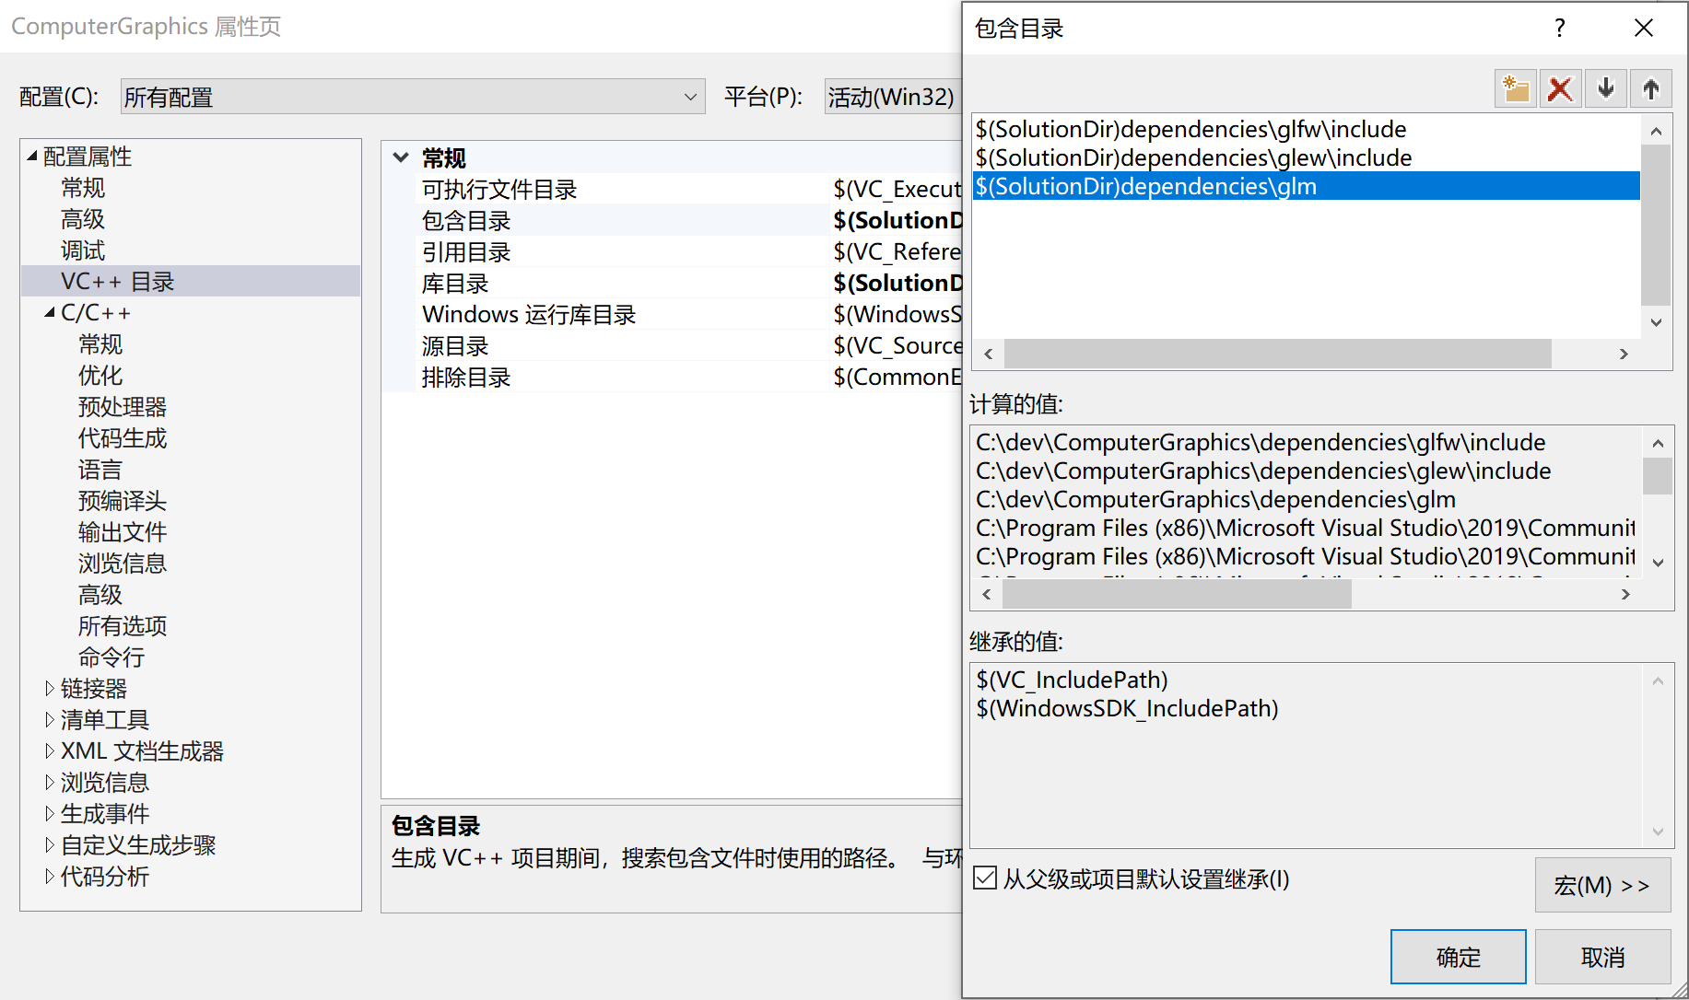
GitHub - g-truc/glm: OpenGL Mathematics (GLM)
将glm文件夹提取到dependencies文件夹
配置工程包含目录

Slide 38
用glm定义旋转变换矩阵
用glm定义平移变换矩阵
用glm定义缩放变换矩阵
glm::mat4 matrix_r = glm::rotate(glm::radians(90.0f), glm::vec3(0.0f, 0.0f, 1.0f));
glm::mat4 matrix_t = glm::translate(glm::vec3(0.0f, 0.1f, 0.0f));
glm::mat4 matrix_s = glm::scale(glm::vec3(0.8f, 0.6f, 1.0f));

Slide 39
用glm定义组合变换矩阵
先平移，再旋转，最后缩放
glm::mat4 model = glm::mat4(1.0f);
model = matrix_s * matrix_r * matrix_t * model;

Slide 40
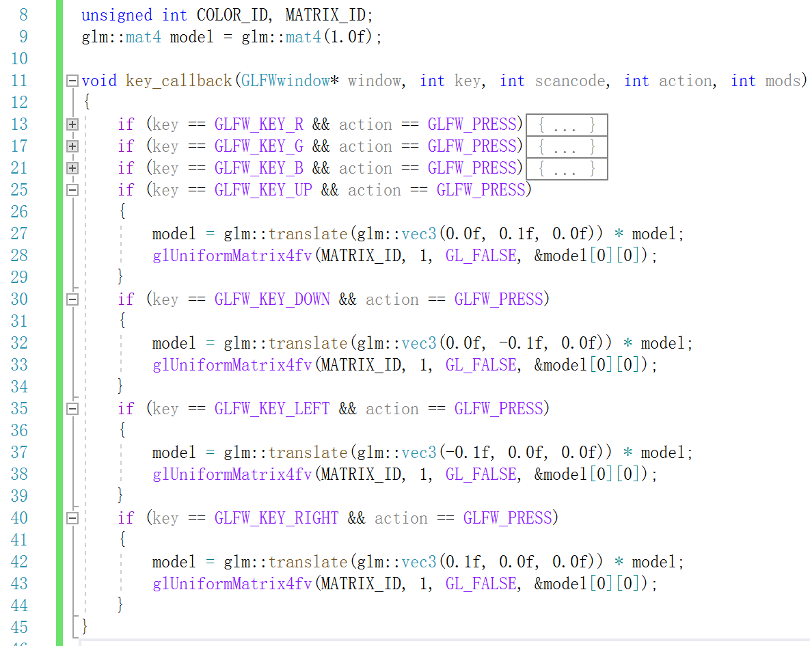

Slide 41
6. 投影和视图变换
定义三维物体
//1. 定义顶点坐标
//[50,20,0] --------[160,20,0]
// | |
// | |
//[50,-20,0] --------[160,-20,0]
float positions[] = {
50, 20, 0,
160, 20, 0,
160, -20, 0,
50, -20, 0,
};
glBufferData(GL_ARRAY_BUFFER, 6 * 3 * sizeof(float),
positions, GL_STATIC_DRAW);
glVertexAttribPointer(0, 3, GL_FLOAT, GL_FALSE,
3 * sizeof(float), 0);
glDrawArrays(GL_TRIANGLE_FAN, 0, 4);

Slide 42
视图变换
glm::vec3 center = glm::vec3(0.0f, 0.0f, 0.0f);
glm::vec3 camera = glm::vec3(0.0f, 0.0f, 350.0f);
glm::mat4 view = glm::lookAt(camera, center, glm::vec3(0.0f, 1.0f, 0.0f));

Slide 43
if (key == GLFW_KEY_UP && action == GLFW_PRESS)
{
camera += glm::vec3(0.0f, 5.0f, 0.0f);
view = glm::lookAt(camera, center, glm::vec3(0.0f, 1.0f, 0.0f));
}
if (key == GLFW_KEY_DOWN && action == GLFW_PRESS)
{
camera += glm::vec3(0.0f, -5.0f, 0.0f);
view = glm::lookAt(camera, center, glm::vec3(0.0f, 1.0f, 0.0f));
}
if (key == GLFW_KEY_LEFT && action == GLFW_PRESS)
{
camera += glm::vec3(-5.0f, 0.0f, 0.0f);
view = glm::lookAt(camera, center, glm::vec3(0.0f, 1.0f, 0.0f));
}
if (key == GLFW_KEY_RIGHT && action == GLFW_PRESS)
{
camera += glm::vec3(5.0f, 0.0f, 0.0f);
view = glm::lookAt(camera, center, glm::vec3(0.0f, 1.0f, 0.0f));
}

Slide 44
正交平行投影
透视投影
glm::mat4 projection = glm::orthoRH_NO(-180.0f, 180.0f, -180.0f, 180.0f, 0.0f, 400.0f);
glm::mat4 projection = glm::perspective(glm::radians(90.0f), 1.0f, 0.0f, 400.0f);

Slide 45
7. 用不同的变换和颜色绘制同一个物体
定义存放变换和颜色的数组
交互增加变换和颜色
vector<pair<glm::mat4, float>> stairs;
float intensity = 1.0;
if (key == GLFW_KEY_S && action == GLFW_PRESS)
{
model = glm::rotate(glm::radians(12.0f), glm::vec3(0.0f, 0.0f, 1.0f)) * model;
model = glm::translate(glm::vec3(0.0f, 0.0f, 10.0f)) * model;
intensity = intensity * 0.95;
stairs.push_back(pair<glm::mat4, float>(model, intensity));
}

Slide 46
for (int i = 0; i < stairs.size(); i++)
{
display(projection * view * stairs[i].first, color * stairs[i].second,
GL_TRIANGLE_FAN, 0, 4);
}
绘制
void display(const glm::mat4& m, const glm::vec4& c,
int mode, int first, unsigned count)
{
//1.选择变换矩阵
glUniformMatrix4fv(MATRIX_ID, 1, GL_FALSE, &m[0][0]);
//2.选择颜色
glUniform4fv(COLOR_ID, 1, &c[0]);
//3.绘制
glDrawArrays(mode, first, count);
}

Slide 47
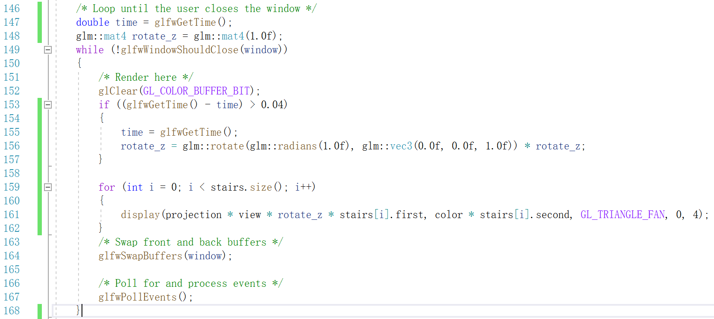
8. 动画

Slide 48
9. 索引缓存
顶点和索引数组
float positions[] = {
50, 20, 0, //0
160, 20, 0, //1
160, -20, 0, //2
50, -20, 0, //3
50, 20, 10, //4
160, 20, 10, //5
160, -20, 10, //6
50, -20, 10, //7
};
unsigned int indices[] = {
0, 1,
1, 2,
2, 3,
3, 0,
4, 5,
5, 6,
6, 7,
7, 4,
0, 4,
1, 5,
2, 6,
3, 7
};

Slide 49
创建索引缓存
//4. 创建索引缓存
unsigned int ibo;
glGenBuffers(1, &ibo);
glBindBuffer(GL_ELEMENT_ARRAY_BUFFER, ibo);
glBufferData(GL_ELEMENT_ARRAY_BUFFER, 12 * 2 * sizeof(unsigned int), indices,
GL_STATIC_DRAW);

Slide 50
用glDrawElements绘制
void display(const glm::mat4& m, const glm::vec4& c, int mode, unsigned count)
{
//1.选择变换矩阵
glUniformMatrix4fv(MATRIX_ID, 1, GL_FALSE, &m[0][0]);
//2.选择颜色
glUniform4fv(COLOR_ID, 1, &c[0]);
//3.绘制
glDrawElements(mode, count, GL_UNSIGNED_INT, nullptr);
}
display(projection * view * rotate_z * stairs[i].first, color * stairs[i].second,
GL_TRIANGLES, 36);

