Slide 1
Li-Fi Technology
Nguyễn Trí Đạt – Hoàng Đức Minh – Lương Hùng Sơn – Đào Lê Duy

Slide 2
Overview
Introduction
Mechanism
Li-Fi vs Wi-Fi
Pros vs cons
Conclusion

Slide 3

Introduction
Wireless Connection
Travelling with the speed of light
Tested lab speed of 224Gbps.
Theoretical speed of 100Gbps.
Current Status.
Under development.
Conjunction with others devices.

Slide 4
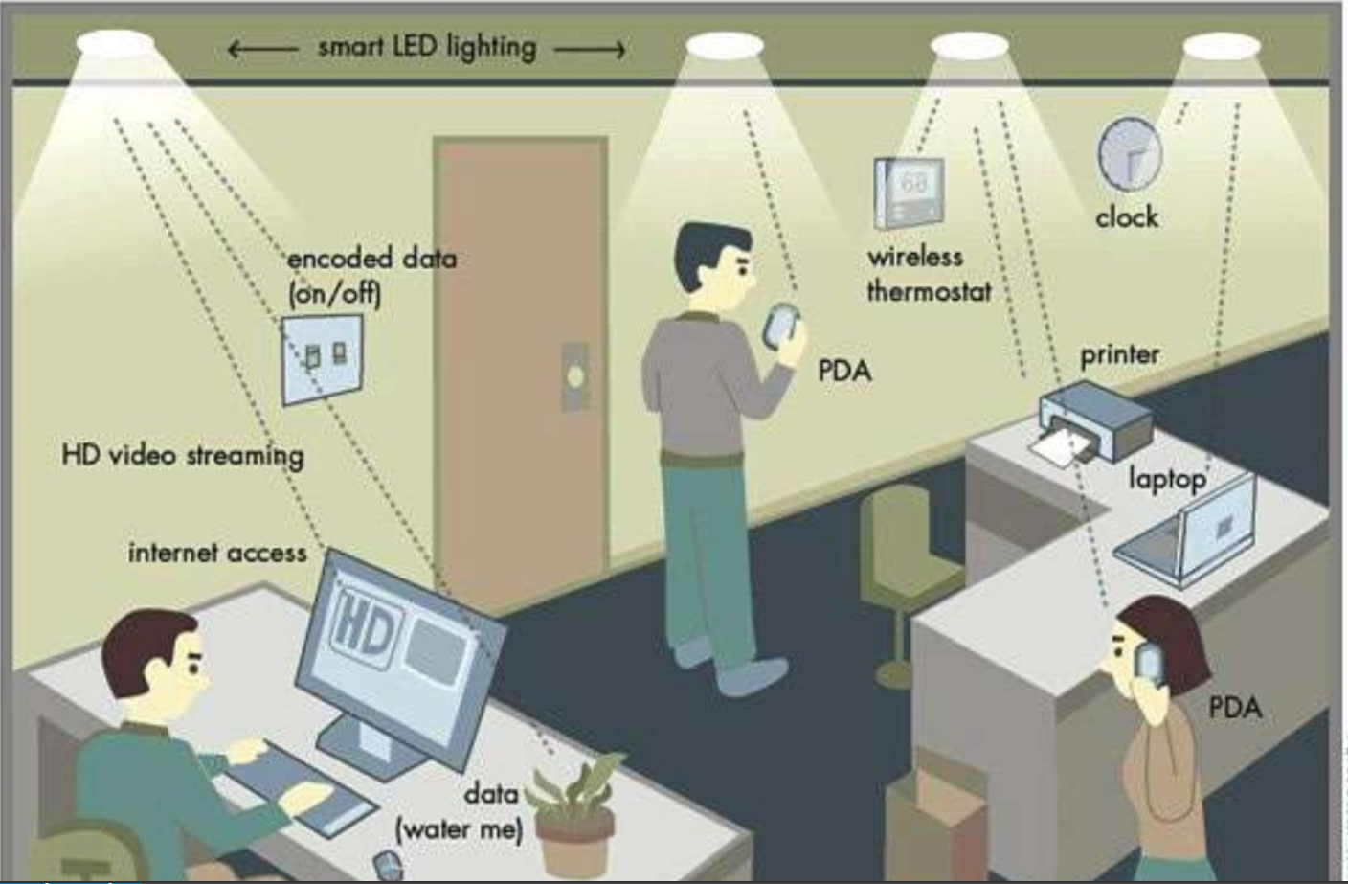
Notes:
Founded orginally in 1990s when harald knows that LEDs can pas signal

Slide 5
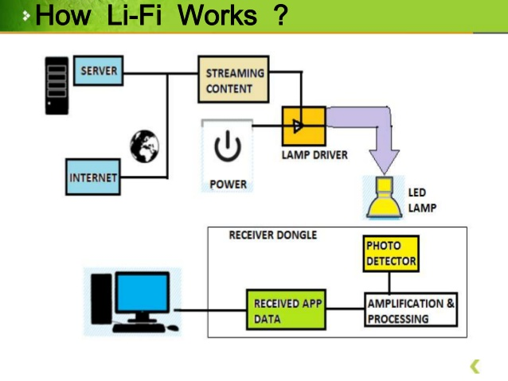

Slide 6
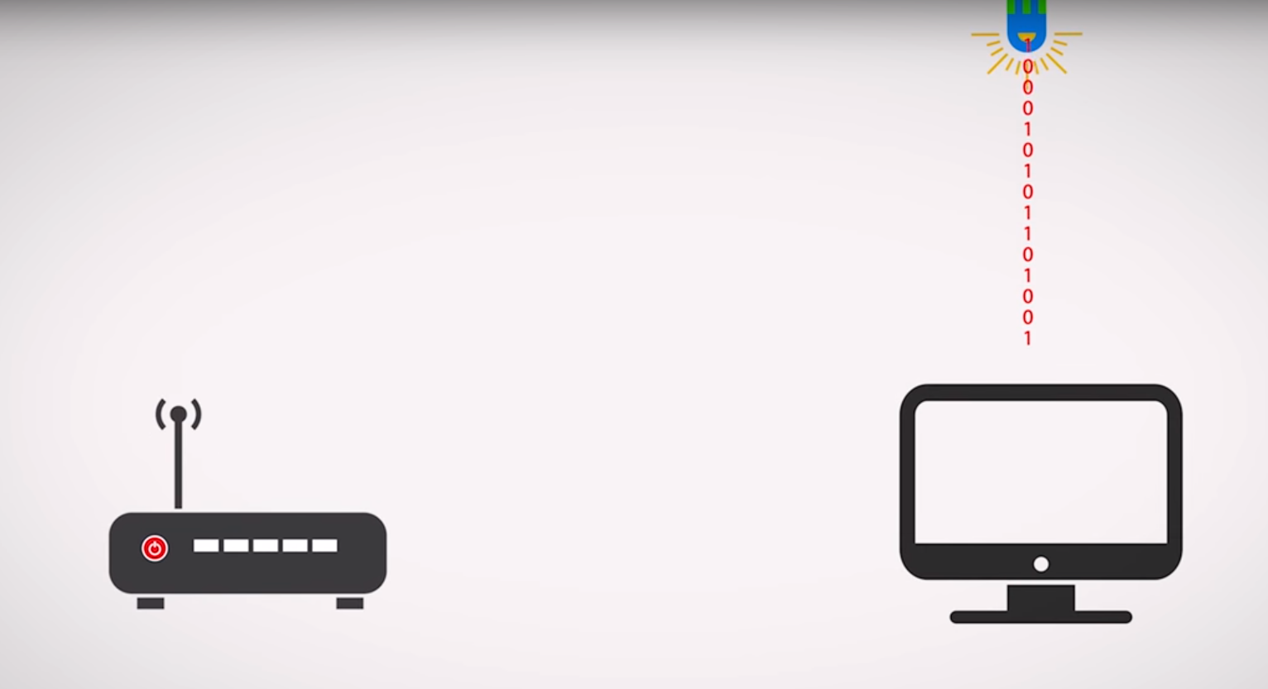
Wi-Fi vs Li-Fi

Slide 7
Medium of data transfer:
Li-Fi: Light
Wi-Fi: Radio spectrum
Transfer speed: Li-Fi > Wi-Fi
Spectrum range: Li-Fi > Wi-Fi
Cost: Li-Fi < Wi-Fi
Operating frequency: Li-Fi > Wi-Fi

Slide 8
Pros and Cons
Advantages
Efficiency: in terms of costs as well as energy
Availability: a light source -> Internet
Security
100 times faster than Wifi ( reach a speed of 224 Gbps )
Disadvantages
Cannot be used without a light source
Limited range of signal
Interference
Whole new infrastructure
Expensive

Slide 9
Conclusion
New technology
In development
Faster speed
Public debut in 7 years

Slide 10
Thank you for your attention

