Slide 1
Amaysim Test Strategy
Hans Dushanthakumar

Slide 2
Assumptions
Whole 2 teams are dedicated for this work (No BAU activities in the meantime)
Project methodology resembles Agile
Project plan already takes care of scheduling (given dependencies between teams) + target dates
Security testing / external audits etc. not relevant

Slide 3
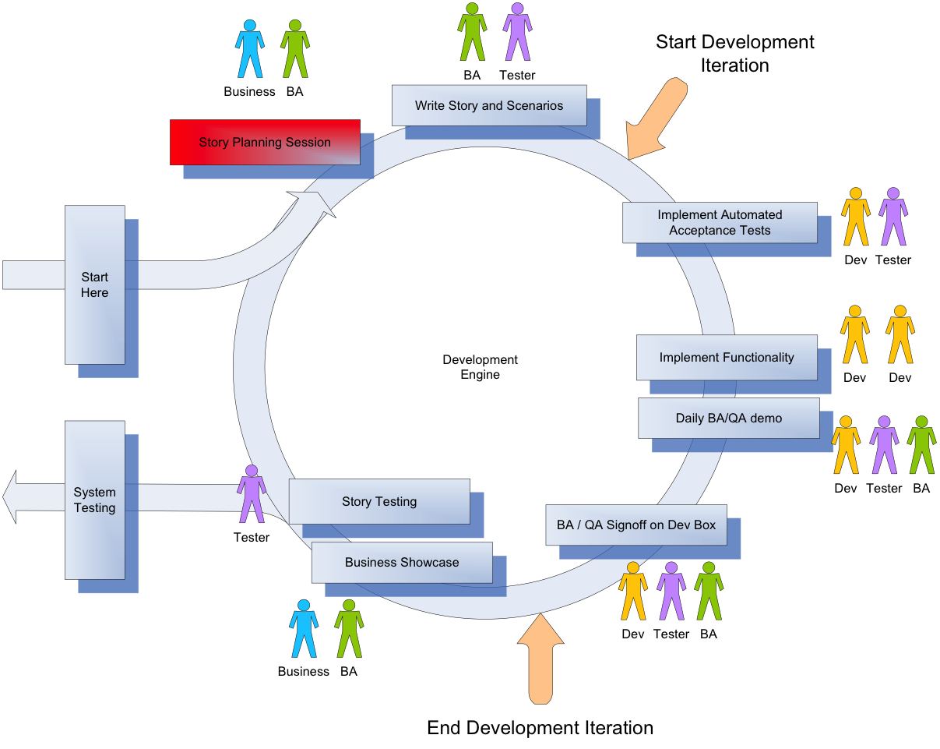
Story Lifecycle

Slide 4
QA And The Story Lifecycle
Story Analyzing
Flesh out story
Acceptance criteria

Slide 5
QA And The Story Lifecycle
Story Analyzing
Story Planning
Identify QA tasks
Consider the QA effort during sizing

Slide 6
QA And The Story Lifecycle
Story Analyzing
Story Planning
Story Development
Pair with DEV to implement automated tests
Communicates issues/defects to the team

Slide 7
QA And The Story Lifecycle
Story Analyzing
Story Planning
Story Development
BA/QA Signoff
QA/BA to conduct Dev-box testing to provide instant feedback
Review/Provide feedback on unit tests coverage

Slide 8
QA And The Story Lifecycle
Story Analyzing
Story Planning
Story Development
BA/QA Signoff
Story/Exploratory Testing
Acceptance tests
Exploratory testing
Help diagnose bugs
Add automated tests for bugs if needed

Slide 9
QA And The Story Lifecycle
Story Analyzing
Story Planning
Story Development
BA/QA Signoff
Story/Exploratory Testing
System Testing/Showcase
Conducts end-to-end system testing / business scenarios
Showcase functionality/feature

Slide 10



Parallel QA Activities
Exploratory test the current stories
n
n
n+1
Pair with Dev to automate iteration n stories
Pair with BA to analyze iteration n+1 stories and write Acceptance tests
Notes:
QA’s will need to orient towards multiple iterations: the current iteration and the next iteration
In Current Iteration
- pairing with dev to write automated tests for stories
- performing exploratory testing of current iteration stories
For next iteration
- pairing with BA on analysis and acceptance test creation

Slide 11

I am responsible for quality…
Iteration Manager
Tech Lead / Architect
BA / UX
TEAM
Business SME
Tester
Developer
Notes:
Tech Lead: Set code quality standards, encourage coding practices (TDD, pair programming), review code, appropriate design, provide necessary infrastructure
Business SME(Subject matter expert): Be available for any queries, provide feedback during development and showcase
Developer: Follow code quality standards, TDD, create unit/automated tests
QA: I follow different techniques to prevent defect-leakage in production. Also work with team members to provide early feedback and monitor the quality of the product.
BA/UX: Work closely with the team, to ensure the code matches the business requirements, map business requirements with acceptance criteria.
IM: Facilitate/Drive all activities (standups, retrospectives, showcases), to achieve the quality and to move the story to "Done" status. Drive prioritisation. ‘Admin’ activities.

Slide 12


Story “Done” Criteria
Analysis
In Progress
Testing
Showcase
Done
Tests passed, No major bugs
Kickoff
Desk Check, Deployed to Test Env
Showcase to Stakeholder,
Live in Prod?
Agree criteria for each transition!

Slide 13
Some key practices
Three Amigos approach to stories
BA/QA/Dev to do story kickoff
QA/Dev pairing on tests
Desk check to BA/QA by the Dev once development done
QA emphasis on defect prevention over defect detection
Business Stakeholder commitment:
Continuous prioritization
Feedback/Signoff of stories
Fewer UI tests:
E2E automated tests focus on user journeys
Tests not to take long (no longer that 15 mins?)
Ceremonies:
Standups
Showcases
Retrospectives

Slide 14







CD Pipeline
Deploy
(INT/Perf/PreProd)
Deploy
(PROD)
Version Control
Deploy (Dev)
Build
Continuous Integration
Continuous Delivery
Continuous Deployment
Notes:
Different stages of a CD pipeline.
CD as an extension of CI.
Continuous Integration : Integrating code contributed by different developers into a working codebase continuously. Always working software.
Continuous Delivery : Delivering the integrated code into test environments continuously. Always releasable software.
Continuous Deployment: The practice of delivering every good build to production.
Continuous Delivery is about keeping the code in a state that’s always able to be delivered to Prod. Relies on the complete automation of the build, test and deployment processes.
Continuous Deployment is actually deploying every change to Prod.

Slide 15
Types of tests in CD pipeline
Deploy
(INT/Perf/PreProd)
Deploy
(PROD)
Version Control
Deploy (Dev)
Build
Unit tests
Contract tests
Unit tests
Contract tests
Integration* tests
Static Analysis check
Functional tests
Integration tests
Performance
Manual Exploratory
E2E tests
Performance
Manual UAT
PVT
Notes:
What checks fit in at what stage in a typical CD pipeline.
CI/CD concepts to reiterate:
Early discovery of problems
Finding bugs close to when it gets introduced
Unit tests : exercise the smallest pieces of testable software in the application to determine whether they behave as expected.
Integration tests : verify the communication paths and interactions between components to detect interface defects.
Component tests : limit the scope of the exercised software to a portion of the system under test, manipulating the system through internal code interfaces and using test doubles to isolate the code under test from other components.
Contract tests : verify interactions at the boundary of an external service asserting that it meets the contract expected by a consuming service.
End-to-end tests : verify that a system meets external requirements and achieves its goals, testing the entire system, from end to end.

Slide 16
Types of Tests
Unit Tests/Integration tests for components within the service
Contract Tests
E2E/System tests
E2E/System tests (Manual exploratory)
UAT
Production Verification tests
Notes:
Unit tests : exercise the smallest pieces of testable software in the application to determine whether they behave as expected.
Integration* tests : verify the communication paths and interactions between components to detect interface defects.
Contract tests : verify interactions at the boundary of an external service asserting that it meets the contract expected by a consuming service.
End-to-end tests : verify that a system meets external requirements and achieves its goals, testing the entire system, from end to end.

Slide 17
Types of tests in CD pipeline
Deploy
(INT/Perf/PreProd)
Deploy
(PROD)
Version Control
Deploy (Dev)
Build
E2E tests
Performance
Manual UAT
Notes:
What checks fit in at what stage in a typical CD pipeline.
CI/CD concepts to reiterate:
Early discovery of problems
Finding bugs close to when it gets introduced

Slide 18
Dependent Features
If not already covered by Project Plan, a workshop needed to identify and sequence dependencies
Stories/Features with dependencies marked as so
Story stays ‘Blocked’ until it has been tested against its dependencies
The ‘Consumer’ team drives the E2E tests
Ongoing E2E tests (some manual)

Slide 19
Test Environments
Environment | Purpose
Local Development (Repeatable) | Development of code, tests
Dev (All dependencies Stubbed) (1…n) | To test the service/app in isolation
INT (External dependencies stubbed?) | Integrated env to run E2E and integrated tests, Business showcases
PERF (External dependencies stubbed?) | Prod-like (or scaled down), for performance tests
PreProd | UAT, with same settings as PROD (eg feature toggle states)
Comparison | Running the old coldfusion app, for comparison purposes
PROD

Slide 20
Test Data Management
Dedicated effort to create a Data creation framework
Works with testers to identify data needs
Utilize services/API’s to efficiently create test data (or at DB level)
Provide easy means of specifying and creating data
Environment-specific data files in test suites
As much as possible, automated tests are responsible for creating their test data
PERF, PreProd to have data refreshed periodically from PROD (mirrored DB’s? Incremental table copy?)

Slide 21
Defect Management
If found during shoulder check, fix rightaway (don’t record)
If found while testing story, record, demo to Developer immediately
At story signoff/showcases, review open defects on the story
Daily prioritization of defects (with BA/Stakeholder)

Slide 22
Metrics / Visibility of Progress
Stakeholder Signoff’s for each story
Regular Showcase of working software
No separate ‘Test’ Progress monitoring
Metrics:
Story points per iteration
Defects found in Prod
Proportion of Unit vs Integration/Contract vs End-to-End tests
Unit test coverage
Time taken for all automated tests to run

Slide 23
Testability Features
Easy-to-use Feature Toggle mechanism
Log Aggregation/Search
Health Page showing health status of services
Ability to turns services On/Off
Ability to change endpoints (via config files?)

Slide 24
Resourcing
Tester Tech skills:
Able to analyze a functionality and come up with good tests
Able to contribute to automation code
Able to look at logs, stack traces, talk similar language as devs
Able to review/contribute to unit & integration tests
Tester soft skills
Able to work effectively in a close team
Able to wear multiple hats
Communication skills

Slide 25
Risks & Mitigation
Risk | Mitigation
Falling back to default way of working | Monitoring, Checkpoints
Too many tests at upper levels | Track test time, Reviews
Spending time on low priority tasks/bugs | Weekly review of priorities with Stakeholders
No enough time-commitment from stakeholders | Educate about process, Upfront time booking
Testers leaving (given low numbers to start with) | Pairing with BA’s & Devs early on, Peer reviews
Major Defects in PROD | Rollback, Monitoring of service statuses and errors, Phased Go live

