Slide 1
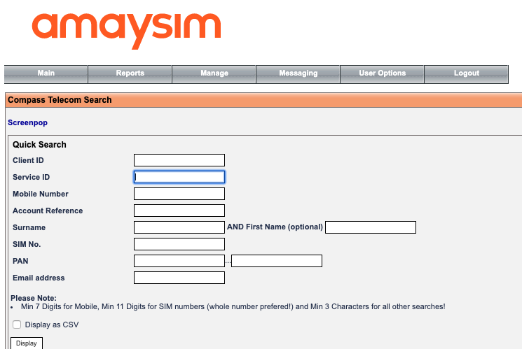



BSS
Zuora
event
AWS S3
Mobile Billing Sync (MBS)
Billing Gateway

Slide 2




Zuora
BSS
DnA
AWS S3
Daily csv upload
Daily email
AWS SES
S3 “ObjectCreated” event
AWS S3
Reconcilator
Incomingemail rule

