Slide 1


Slide 2
0.
Introduction

Slide 3

Introduction
Qu’est ce qu’une base de données ?
Notes:
A database is a separate application that stores a collection of data.
Each database has one or more distinct APIs for creating, accessing, managing, searching and replicating the data it holds.

Slide 4
Introduction
Qu’est ce qu’une base de données relationnelle ?
Notes:
A Relational DataBase Management System (RDBMS) is a software that :
> Enables you to implement a database with tables, columns and indexes.
> Guarantees the Referential Integrity between rows of various tables.
> Updates the indexes automatically.
> Interprets an SQL query and combines information from various tables.

Slide 5
Notions clés en relationnel
Database
Table
Colonne
Ligne
Notes:
A Relational DataBase Management System (RDBMS) is a software that :
> Enables you to implement a database with tables, columns and indexes.
> Guarantees the Referential Integrity between rows of various tables.
> Updates the indexes automatically.
> Interprets an SQL query and combines information from various tables.

Slide 6
Notions clés en relationnel
Clé primaire
Clé étrangère
Contrainte
Index
Notes:
A Relational DataBase Management System (RDBMS) is a software that :
> Enables you to implement a database with tables, columns and indexes.
> Guarantees the Referential Integrity between rows of various tables.
> Updates the indexes automatically.
> Interprets an SQL query and combines information from various tables.

Slide 7
Notions clés en relationnel
Utilisateur
Privilège
Transaction
Sauvegarde / Restauration
Notes:
A Relational DataBase Management System (RDBMS) is a software that :
> Enables you to implement a database with tables, columns and indexes.
> Guarantees the Referential Integrity between rows of various tables.
> Updates the indexes automatically.
> Interprets an SQL query and combines information from various tables.

Slide 8
Les atouts du modèle relationnel
1.

Slide 9
Relationnel everywhere
Un Data Model :
Naturel
Intuitif
Propre (Normalisation des données)

Slide 10
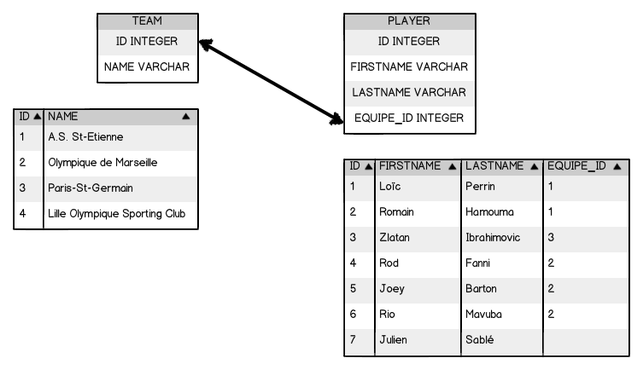
Relationnel everywhere

Slide 11
Relationnel everywhere
Standardisation et Richesse du langage SQL
Définition des données
Manipulation des données

Slide 12
Relationnel everywhere
Définition des données
Définition des tables
Définition des contraintes
Définition d’index

Slide 13
Relationnel everywhere
Manipulation des données
Requêtes de sélection
Requêtes de mise à jour

Slide 14
Relationnel everywhere
Support des transactions ACID
Atomicité
Cohérence
Isolation
Durabilité
Notes:
Atomicity
Atomicity requires that each transaction is "all or nothing": if one part of the transaction fails, the entire transaction fails, and the database state is left unchanged. An atomic system must guarantee atomicity in each and every situation, including power failures, errors, and crashes.
Consistency
The consistency property ensures that any transaction will bring the database from one valid state to another. Any data written to the database must be valid according to all defined rules, including but not limited to constraints,cascades, triggers, and any combination thereof.
Isolation
The isolation property ensures that the concurrent execution of transactions results in a system state that could have been obtained if transactions are executed serially, i.e. one after the other.^{[citation needed]}
Durability
Durability means that once a transaction has been committed, it will remain so, even in the event of power loss, crashes, or errors. In a relational database, for instance, once a group of SQL statements execute, the results need to be stored permanently (even if the database crashes immediately thereafter).

Slide 15

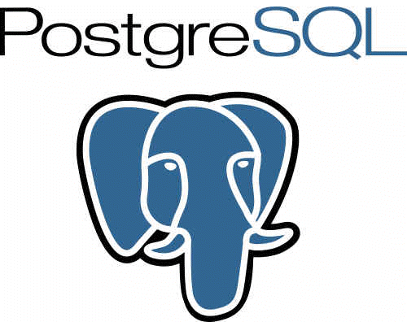
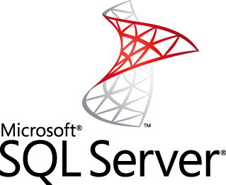

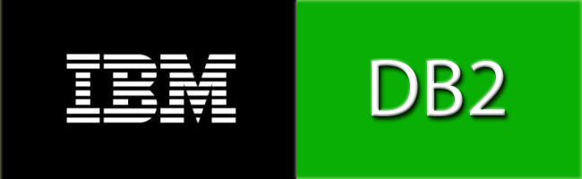
Relationnel everywhere
Variété de l’offre

Slide 16
Les limites du modèle relationnel
2.

Slide 17
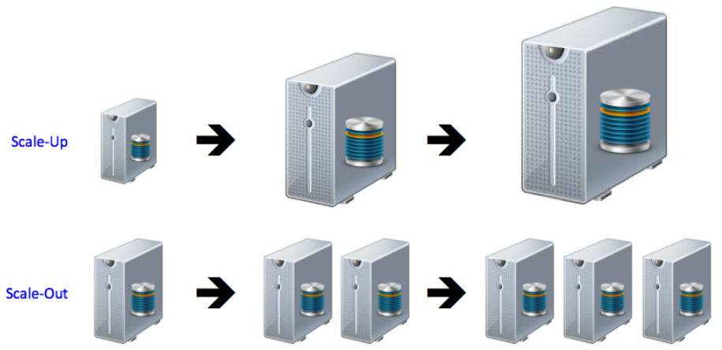
Le volume de données

Slide 18
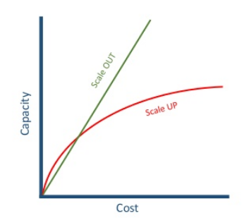
Le volume de données

Slide 19

La complexité des données

Slide 20

La complexité des données

Slide 21
La percée NoSQL
3.

Slide 22
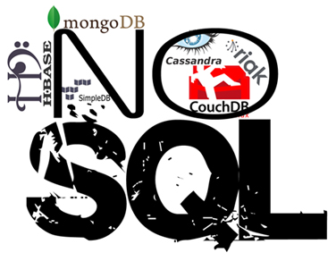
La variété de l’offre

Slide 23
Bases NoSQL : les points communs
Stockage de données
Scalabilité horizontale
Simplification du Data Model

Slide 24
Bases NoSQL : les disparités
Des différences dans le Data Model
Des différences dans la façon de requêter les données

Slide 25
Bases NoSQL : les 4 familles
Key-Value
Column-Oriented
Document-Oriented
Graph-Oriented

Slide 26
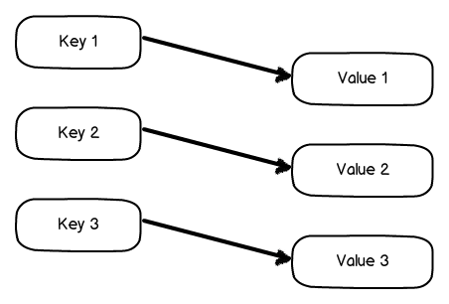
Bases NoSQL : Key - Value

Slide 27
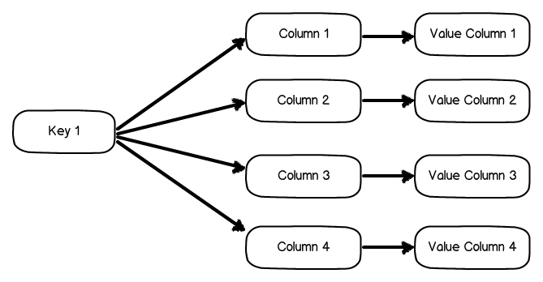
Bases NoSQL : Column-oriented

Slide 28
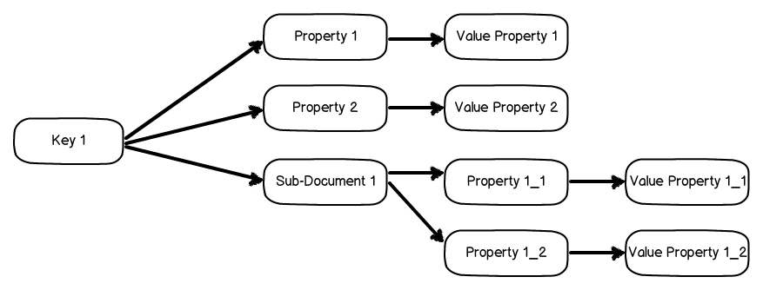
Bases NoSQL : Document-oriented

Slide 29
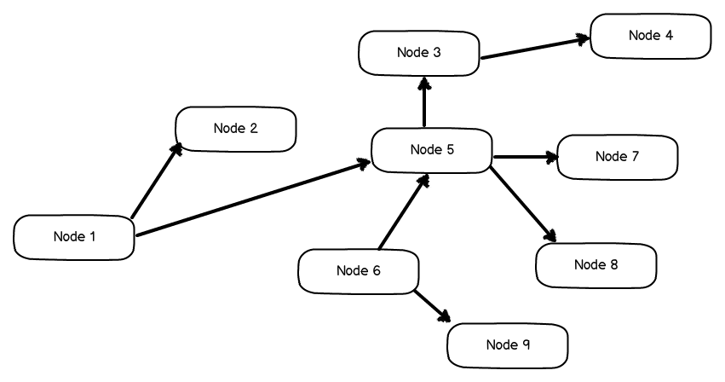
Bases NoSQL : Graph-oriented

Slide 30
Focus Redis
4.

Slide 31

Focus Redis : Key - Value
Simplicity
Speed
Reliability

Slide 32
Focus Redis : Key - Value
id_14 ➔ String
String commands
Row
id_15 ➔ List
List commands
Row
id_16 ➔ Set
Set commands
Row
id_17 ➔ Sorted Set
Sorted Set commands
Row
id_18 ➔ Hash
Hash commands
Row

Slide 33
Focus Redis : Key - Value
https://redislabs.com/ebook/part-1-getting-started/chapter-1-getting-to-know-redis/1-2-what-redis-data-structures-look-like/

Slide 34
Focus Cassandra
5.

Slide 35
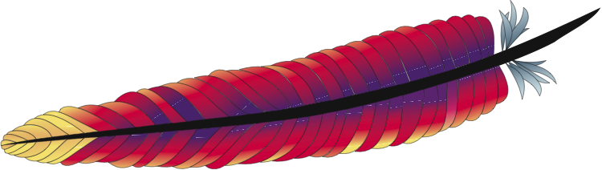



Focus Cassandra : Column-oriented

Slide 36
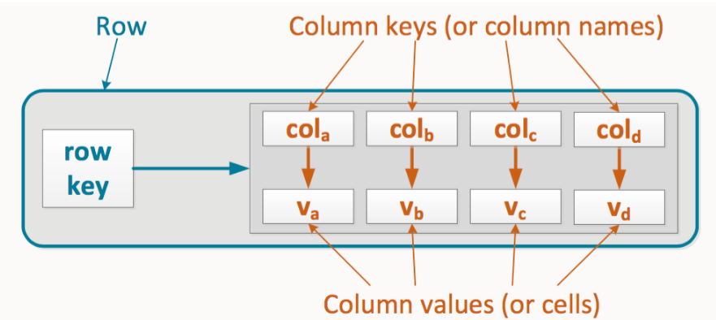
Focus Cassandra : Column-oriented

Slide 37
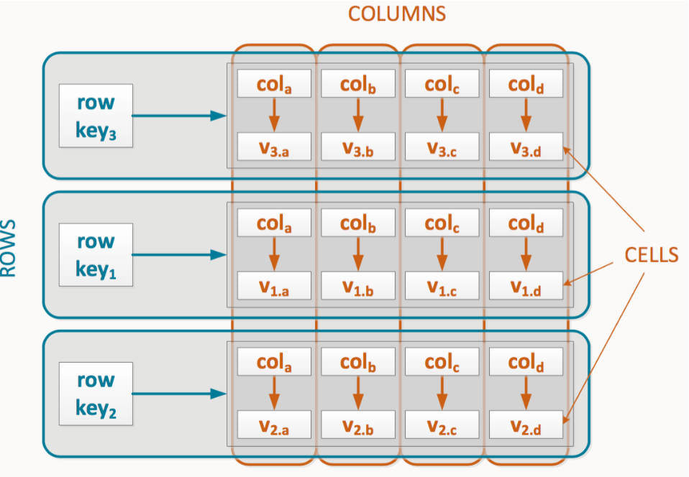
Focus Cassandra : Column-oriented

Slide 38
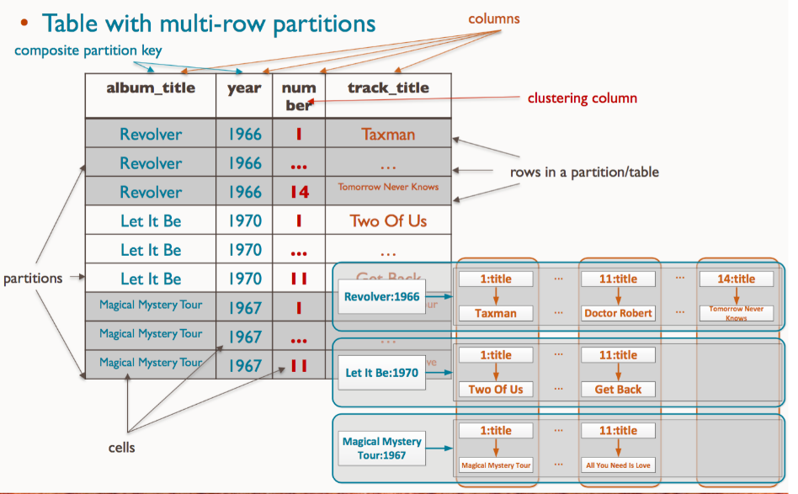
Focus Cassandra : Column-oriented

Slide 39
Focus MongoDB
6.

Slide 40

Focus MongoDB : Document-oriented

Slide 41
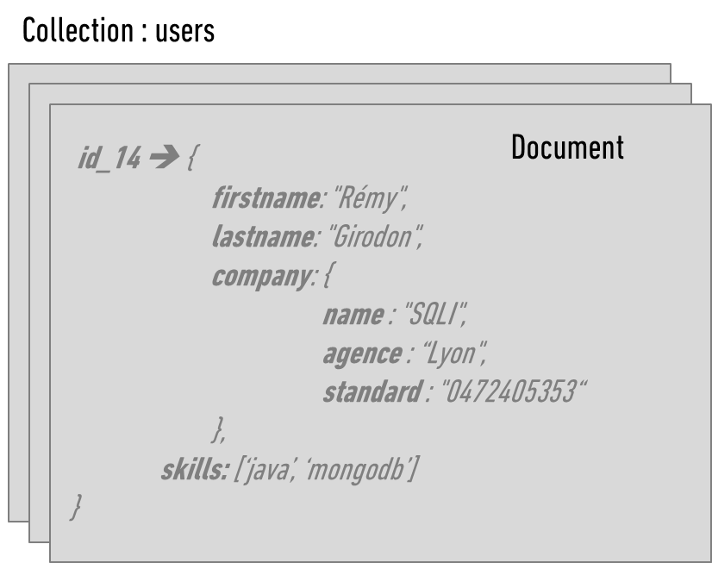
Focus MongoDB : Document-oriented

Slide 42
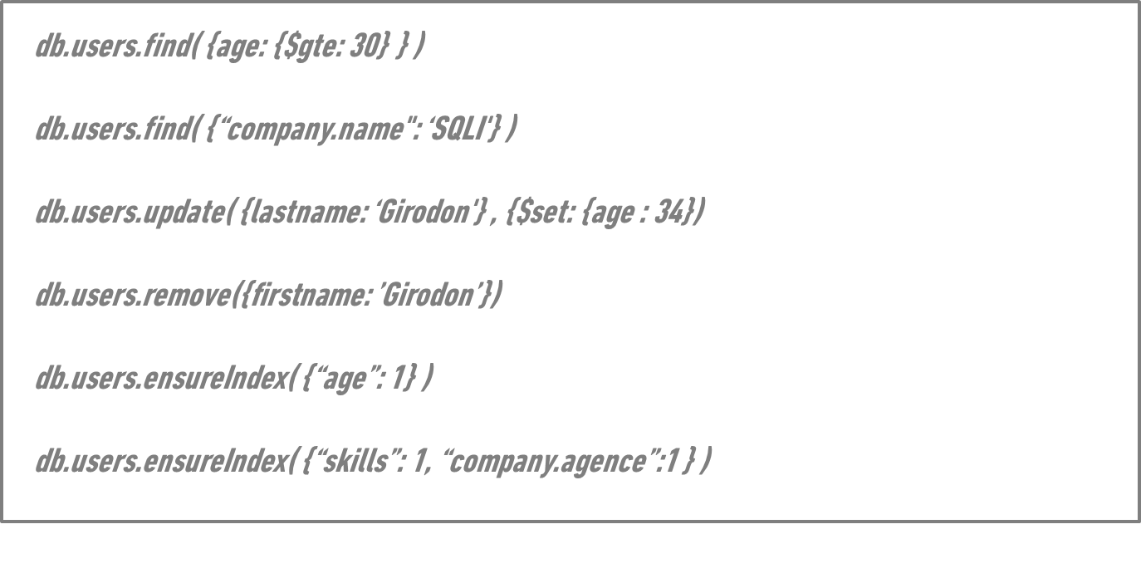
Focus MongoDB : Document-oriented

Slide 43
Focus Neo4J
7.

Slide 44
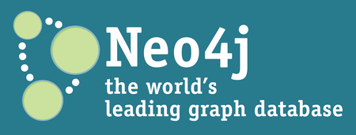

Focus Neo4j : Graph-oriented

Slide 45
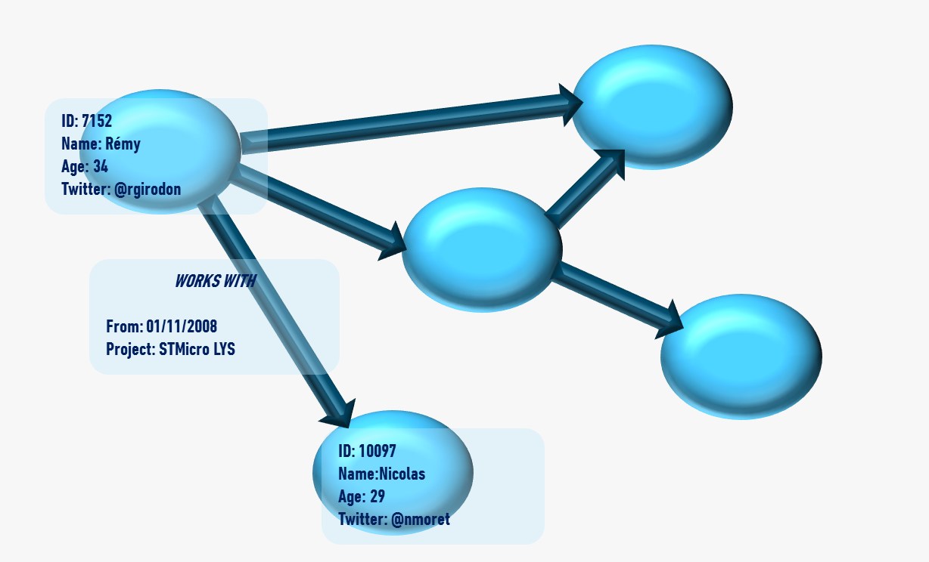
Focus Neo4j : Graph-oriented

Slide 46
Focus Neo4j : Graph-oriented
Le requêtage
  Par Index
    Applicable aux propriétés des nœuds et arêtes
  Par Traversal
    Navigation dans le graphe à partir d’un nœud
  Par Cypher
    Declarative Graph Query Language

