Slide 1
Using Polygonal Data Clusters to Investigate LIME
Jesse He, Ohio State University
Subhasish Mazumdar, New Mexico Institute of Mining and Technology

Slide 2
Machine Learning and Explanations
Given representative data samples with class labels, an algorithm can learn and predict the label of a novel, unseen sample.
Greater adoption of machine learning in diverse fields requires interpretable explanation in order to trust models
Models which rely on features relevant to humans are considered more trustworthy than those which rely on accidentally correlated features
Rules-based models like decision trees are easy to explain, while “black box” classifiers like neural networks are more difficult

Slide 3
Synthetic Datasets
We can use existing datasets to test models and explanation frameworks, but appropriate ones may be difficult to find or gather
Generating new datasets that are easy to visualize lets us investigate these models and explanations more easily
A tool for generating such datasets lets us customize these example problems

Slide 4
Post-Hoc Explanations and Vulnerabilities
One approach to machine learning explanations is post-hoc explanation, which attempts to explain a classifier using its predictions rather than its structure [3]
Two particularly popular examples are
LIME (Local Interpretable Model-agnostic Explanations) [2] and
SHAP (SHapely Additive exPlanations) [1]
Sharp et al. demonstrated a scaffolding technique which can create a biased classifier whose bias is undetected by LIME and SHAP [5]

Slide 5
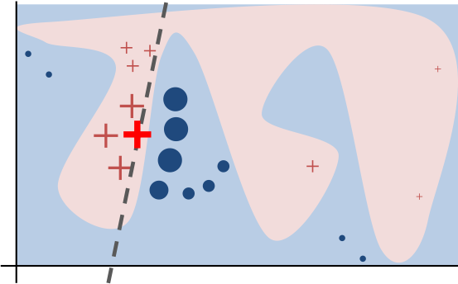
What Is LIME?
LIME tries to explain why a classifier makes a prediction by observing the classifier’s behavior on nearby points. [2]
LIME has been successful with image and text data but has trouble with tabular data. [3]
Intuition for LIME [1]
Each data element is of the form (x,y) and has been classified as either a circle or a cross.
Question: how can we explain the classifier’s behavior near the red cross?
LIME queries the classifier at the other data points marked and uses those predictions, weighted by their distance from the red cross, to produce the dashed line

Slide 6
Why Polygons?
Generate synthetic classification problems with tabular data to see what LIME is doing
Use geometry to describe n-dimensional data clusters (we will refer to these as polygonal clusters)
Geometrically defined boundaries let us easily customize the difficulty of the classification problem
Polygonal models can be helpful representations of clusters in machine learning [4] but polygonal datasets lack a robust synthetic generation tool

Slide 7
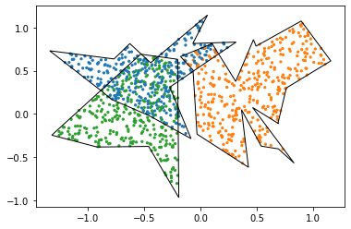
Generating Polygonal Clusters
Start by generating a random polygon
Generate a few points in polar and connect them counterclockwise
The distance from each point to a “center” point is in some range
Use rejection sampling to generate points inside the polygon
Use this to generate multiple polygons around different centers

Slide 8
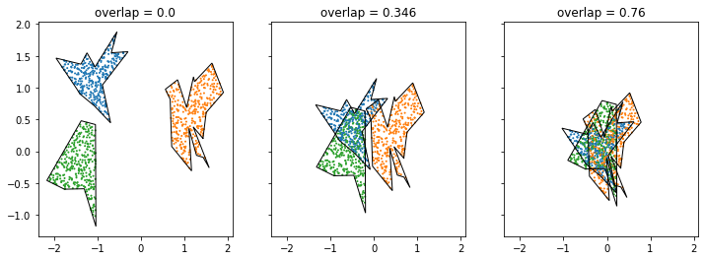
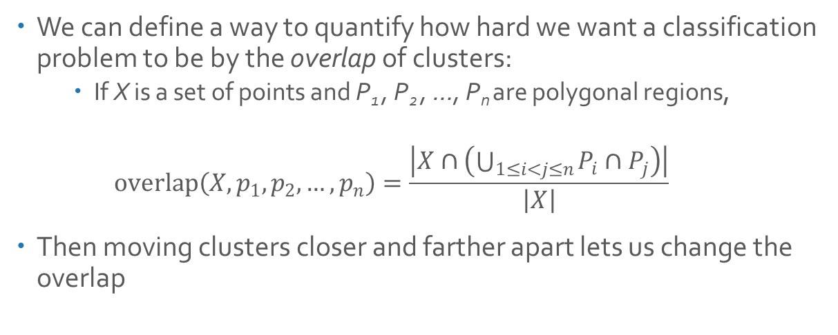
Controlling Overlap
We can define a way to quantify how hard we want a classification problem to be by the overlap of clusters:
If X is a set of points and P₁ , P₂ , …, P_{n} are polygonal regions,
$$overlap\left(X, p_{1},p_{2},…, p_{n}\right)=\frac{\left|X∩\left(\bigcup_{1≤i<j≤n}{P_{i}∩P_{j}}\right)\right|}{\left|X\right|}$$
Then moving clusters closer and farther apart lets us change the overlap

Slide 9
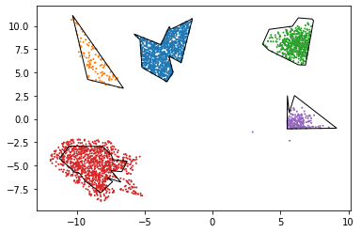
Other Capabilities
The tool we created can generate these clusters with a certain proportion of points outside each polygon, or with a normal distribution instead of uniform

Slide 10
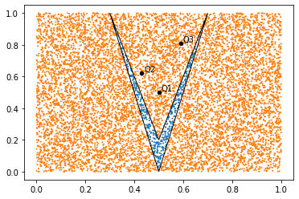
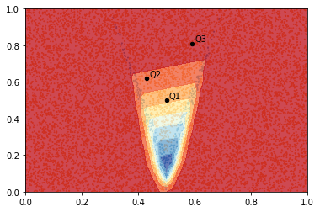
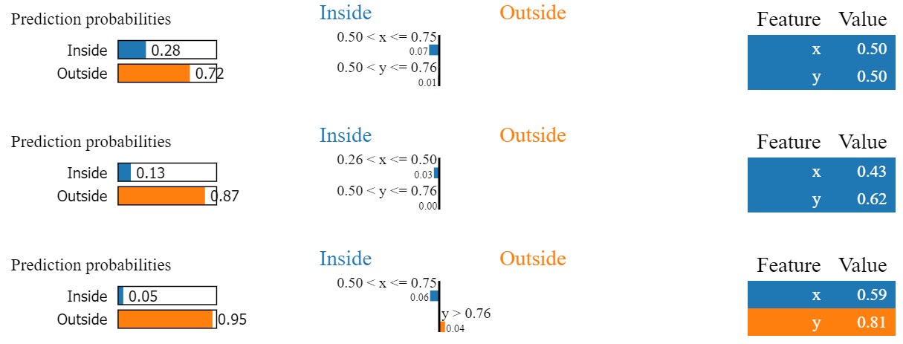
LIME and Polygonal Clusters
In this example, we trained an MLP (Multi-Layer Perceptron) classifier to identify points as being inside or outside a concave polygon
LIME’s explanations do not match the classifier’s behavior, violating its local faithfulness at the example points
Two classes: inside polygon (blue) and outside polygon (orange)
Heatmap of MLP prediction probabilities
Q1
Q2
Q3

Slide 11
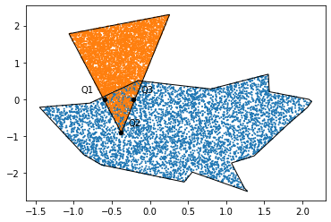
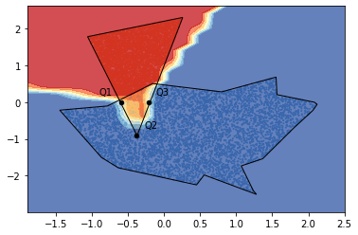
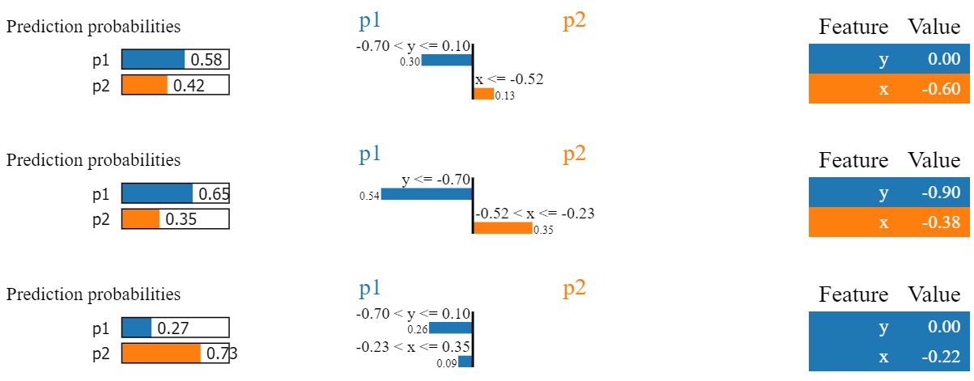
LIME: Another Hard Example
We generated a 2-dimensional clustering problem with an overlap of 0.1061, trained an MLP classifier on it, and picked three challenging points:
We then asked LIME to explain the MLP’s predictions:
Q1
Q2
Q3

Slide 12
Results
Our tool can successfully produce customizable synthetic datasets which we can describe using geometry.
We have demonstrated a situation where LIME’s explanation violates local faithfulness.

Slide 13
Future Work
Evaluate a wider variety of classification techniques
More robust methods of representing higher-dimensional polytopes
Extending overlap functionality to higher dimensions
Investigate other explanation frameworks

Slide 14
References
[1] S. Lundberg and S. Lee, “A unified approach to interpreting model predictions,”CoRR, vol. abs/1705.07874, 2017.
[2] M. Ribeiro, S. Singh, and C. Guestrin. 2016. "Why Should I Trust You?": Explaining the Predictions of Any Classifier. InProceedings of the 22nd ACM SIGKDD International Conference on Knowledge Discovery and Data Mining (KDD ’16). ACM, New York, NY, USA, 1135–1144.
[3] P. Biecek and T. Burzykowski. 2021. Explanatory Model Analysis. Chapman and Hall/CRC, New York.
[4] F. Akdag, C. Eick, and G. Chen. 2014. Creating Polygon Models for Spatial Clusters. InFoundations of Intelligent Systems, Troels Andreasen, Henning Christiansen, Juan-Carlos Cubero, and Zbigniew W. Raś (Eds.). Springer International Publishing, Cham, 493–499.
[5] D. Slack, S. Hilgard, E. Jia, S. Singh, and H. Lakkaraju, “Fooling LIME and SHAP: Adversarial attacks on post hoc explanation methods,” inProceedings of the AAAI/ACM Conference on AI, Ethics, and Society, ser. AIES ’20. New York, NY, USA: Association for Computing Machinery, 2020, pp. 180–186.

Slide 15
Acknowledgements
This work is supported by the National Science Foundation under grant number CNS-1757945 and was inspired by work performed by the second author under Subcontract number 612048 from the Los Alamos National Laboratory.

