Slide 1


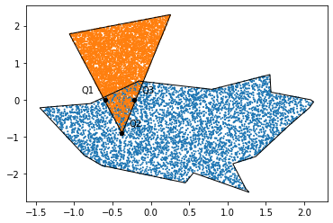
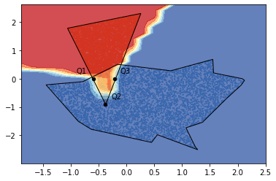
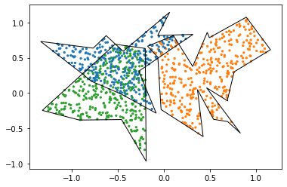
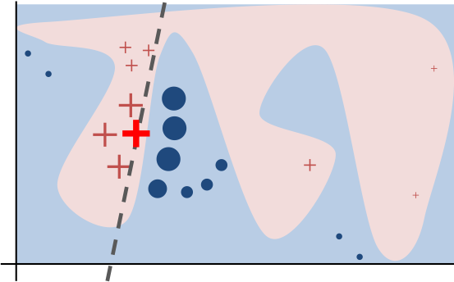
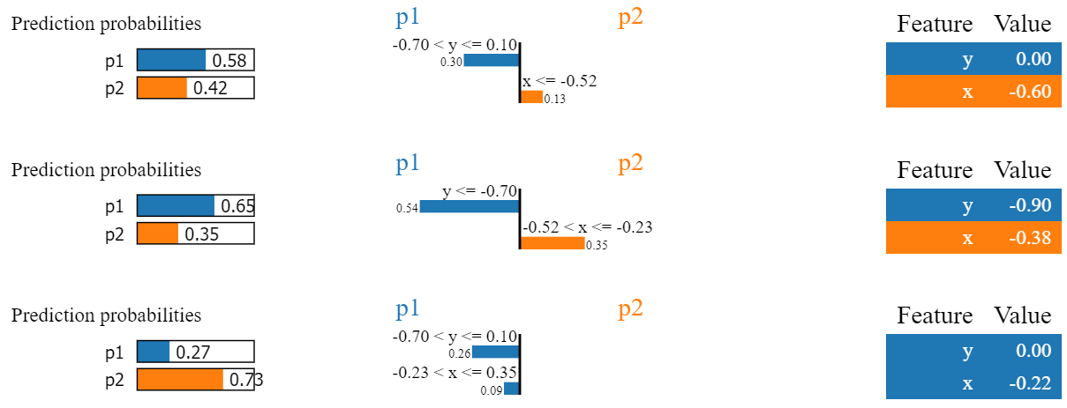
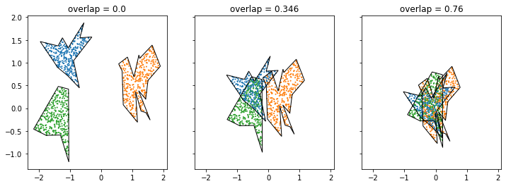


Using Polygonal Data Clusters to Investigate LIME
Jesse He¹, Subhasish Mazumdar²
1. The Ohio State University, Columbus, OH
2. New Mexico Institute of Mining and Technology, Socorro, NM
National Science Foundation
Background
Increasing adoption of “black-box” machine learning methods have
prompted efforts to create frameworks for generating interpretable
explanations of predictions. One such framework is Local Interpretable
Model-agnostic Explanation (LIME) [1], which attempts to create a locally
faithful explanation of a model’s prediction by probing the model’s
behavior on small perturbations of the sample. Although LIME has seen
success with image and text data, difficulties exist with tabular and
spatial data [2]. In order to investigate classifier and explainer behavior,
it is useful to generate synthetic datasets which are easy to visualize.
One particularly interesting class
of spatial clustering problem
involves developing polygonal
models for spatial data, which
allows for a higher-level
representation of cluster
geometry [3]. However, this class
of clustering problem lacks a robust
solution for generating new
example datasets.
Dataset Generation
Randomly generate cluster center locations inside a specified bounding box
Generate a random polygon about each cluster center by generating each vertex as a polar point $(r, θ)$, where $r$ is in some specified range ${[r}_{m},r_{M}$), then
converting to rectangular coordinates and connecting the vertices counter-
clockwise.
Use rejection sampling to generate points inside each polygon.
Results
We generated a 2-polygon dataset of 10000 points with an overlap of 0.1061 and trained a multi-layer perceptron (MLP) classifier on a sample.
We then asked LIME to explain predictions for three challenging points:
The generated dataset with test points marked by red ‘X’s
The MLP’s decision function with test points marked by red ‘X’s
LIME Intuition [1].
Objectives
Develop a tool for generating and manipulating synthetic data sets with polygonal cluster boundaries.
Develop a method of adjusting the difficulty of generated polygonal clustering problems.
Utilize the generated datasets to train classifiers on clustering tasks of varying difficulty.
Investigate LIME’s ability to provide meaningful explanations for classifier behavior.
LIME explanations for the test points
Controlling Overlap
With polygons $p_{1},p_{2},…, p_{n}$ and a point set $X$, we define overlap as the number
of points in $X$ that are enclosed by at least two polygons divided by the total
number of points in $X$: if $P_{i}$ is the area enclosed by $p_{1}$,
$overlap\left(X, p_{1},p_{2},…, p_{n}\right)=\frac{\left|X∩\left(\bigcup_{1≤i<j≤n}{P_{i}∩P_{j}}\right)\right|}{\left|X\right|}$
Then moving clusters closer and farther apart can change the overlap:
Conclusions
Our results show the efficacy of our synthetic data tool for generating
synthetic datasets. The generated datasets are easily visualized and can
be customized to fit different geometric and statistical structures. Using
polygons to specify the geometric structure allows for customization of
cluster shape, and using overlap allows for customization of the difficulty
of a generated classification problem.
We have also shown that this method of polygonal data can be used to
investigate classifier and explainer behavior by producing interesting
behavior of LIME. The explanation for point Q3 at (-0.22, 0) above shows
that LIME’s explanation may differ from the actual prediction of the
classifier.
References
[1] M. Ribeiro, S. Singh, and C. Guestrin. 2016. "Why Should I Trust You?": Explaining the Predictions of Any Classifier. InProceedings of the 22nd ACM SIGKDD International Conference on Knowledge Discovery and Data Mining (KDD ’16). ACM, New York, NY, USA, 1135–1144.
[2] P. Biecek and T. Burzykowski. 2021. Explanatory Model Analysis. Chapman and Hall/CRC, New York.
[3] F. Akdag, C. Eick, and G. Chen. 2014. Creating Polygon Models for Spatial Clusters. InFoundations of Intelligent Systems, TroelsAndreasen, Henning Christiansen, Juan-Carlos Cubero, and Zbigniew W. Raś (Eds.). Springer International Publishing, Cham, 493–499.
Acknowledgements
This work is supported by the National Science Foundation under grant no. CNS-1757945.

