Slide 1


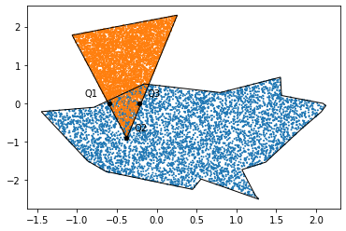
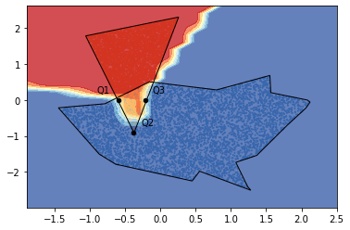
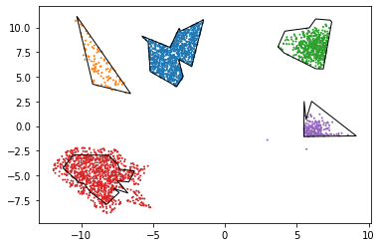
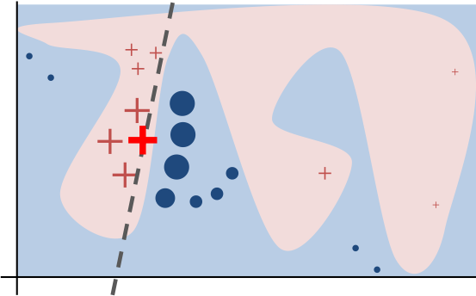
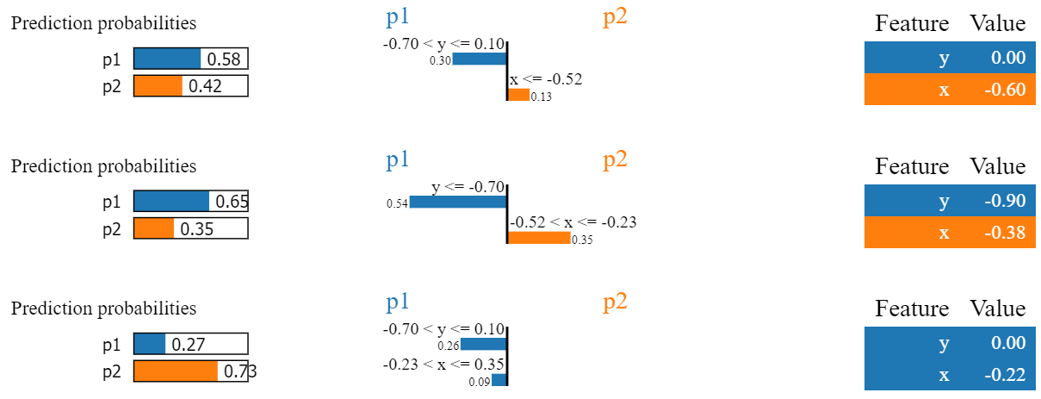
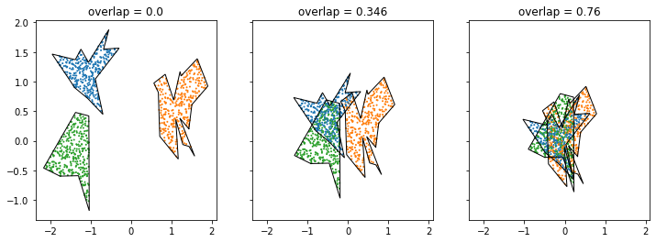


Using Polygonal Data Clusters to Investigate LIME
Jesse He¹, Subhasish Mazumdar²
1. The Ohio State University, Columbus, OH
2. New Mexico Institute of Mining and Technology, Socorro, NM
National Science Foundation
Background
The increasing adoption of opaque “black box” machine learning models
requires interpretable explanation framework, particularly in applications
where it is important to trust machine learning predictions.
One such framework is Local Interpretable Model-agnostic Explanation
(LIME) [1], which attempts to explain a particular prediction made by a
model by examining its behavior on nearby points. Although LIME has
seen success with image and text data, difficulties exist with tabular and
spatial data [2]. However, testing such post-hoc explainers can be difficult,
so it is useful to generate synthetic datasets for such testing.
Synthetic datasets which are easy
to visualize provide an especially
useful tool in investigating attempts
at explaining machine learning.
Polygonal cluster boundaries offer
a method of generating visualizable
datasets with higher-level geometric
representations [3], but no robust
tool exists for generating such
datasets.
Dataset Generation
Randomly generate cluster center locations inside a specified bounding box
Generate a random polygon about each cluster center by generating each vertex as a polar point $(r, θ)$, where $r$ is in some specified range ${[r}_{m},r_{M}$), then
converting to rectangular coordinates and connecting the vertices counter-
clockwise.
Use rejection sampling to generate points inside each polygon.
Our developed tool also allows for customization of the polygonal clusters, including allowing outside points, unbalanced clusters, and different point distributions.
Results
We generated a 2-polygon dataset of 10000 points with an overlap of 0.1061 and trained a multi-layer perceptron (MLP) classifier on a sample.
We then asked LIME to explain predictions for three challenging points:
The explanation for point Q3 at (-0.22, 0) above shows
that LIME’s explanation may differ from the actual prediction of the
classifier, appearing to violate the local faithfulness of LIME’s
explanations.
The generated dataset with test points
Q1, Q2, and Q3
The MLP’s decision function with test points Q1, Q2, and Q3
LIME Intuition [1].
Objectives
Develop a tool for generating and manipulating synthetic data sets with polygonal cluster boundaries.
Develop a method of adjusting the difficulty of generated polygonal clustering problems.
Utilize the generated datasets to train classifiers on clustering tasks of varying difficulty.
Investigate LIME’s ability to provide meaningful explanations for classifier behavior.
Top to Bottom: LIME explanations for the points Q1, Q2, and Q3
Controlling Overlap
With polygons $p_{1},p_{2},…, p_{n}$ and a point set $X$, we define overlap as the number
of points in $X$ that are enclosed by at least two polygons divided by the total
number of points in $X$: if $P_{i}$ is the area enclosed by $p_{1}$,
$overlap\left(X, p_{1},p_{2},…, p_{n}\right)=\frac{\left|X∩\left(\bigcup_{1≤i<j≤n}{P_{i}∩P_{j}}\right)\right|}{\left|X\right|}$
Then moving clusters closer and farther apart can change the overlap:
Conclusions
Our results show the efficacy of our synthetic data tool for generating
synthetic datasets in order to investigate classifier and explainer
behavior. The generated datasets are easily visualized and can be
customized to fit different geometric and statistical structures. Using
polygons to specify the geometric structure allows for customization of
cluster shape, and using overlap allows for customization of the difficulty
of a generated classification problem.
References
[1] M. Ribeiro, S. Singh, and C. Guestrin. 2016. "Why Should I Trust You?": Explaining the Predictions of Any Classifier. InProceedings of the 22nd ACM SIGKDD International Conference on Knowledge Discovery and Data Mining (KDD ’16). ACM, New York, NY, USA, 1135–1144.
[2] P. Biecek and T. Burzykowski. 2021. Explanatory Model Analysis. Chapman and Hall/CRC, New York.
[3] F. Akdag, C. Eick, and G. Chen. 2014. Creating Polygon Models for Spatial Clusters. InFoundations of Intelligent Systems, TroelsAndreasen, Henning Christiansen, Juan-Carlos Cubero, and Zbigniew W. Raś (Eds.). Springer International Publishing, Cham, 493–499.
Acknowledgements
This work is supported by the National Science Foundation under grant no. CNS-1757945.

