Slide 1
Island Escape
Survive, bargain, and escape with AI agents.
He Yufeng | Xu Junjie | Yu Erfei | Long Huzhiyuan

Slide 2
Core Game Loop
Labor Fish +3 or Farm +8
Trade 2 slots merchant / NPC
AI Turns 4 LLM agents act
Settlement -1 fish -1 wheat survive or die
>
>
>
Key Numbers
Start: 5 fish + 5 wheat
Daily cost: 1 fish + 1 wheat
Fish: +3 per labor
Wheat: +8 in 3 days
Fish price: 2-6 coins
Wheat price: 1-4 coins
Win: 100 coins
Slots: 2 per day
[ Insert gameplay screenshot: daily cycle in action ]

Slide 3
Why LLM Agents Fit This Game
LLM Controls
Game Engine Controls
Intention — what the NPC wants
Dialogue — how it expresses itself
Personality — cautious, aggressive, etc.
Bargaining style — generous or hard
Resources — fish, wheat, coins
Phases — labor, trade, settlement
Trade execution — validate & transfer
Win/loss — elimination and escape
"The model creates expression; the typed game engine owns the rules."
[ Insert screenshot: NPC dialogue with personality ]

Slide 4
NPC Negotiation Flow
Player sends message
NPC thinks (LLM call)
NPC replies with proposal
Accept / Counter / Reject
>
>
>
NPC Personalities
Tom
Cautious Fisherman
Sam
[ Insert screenshot: DialoguePanel with chat history ]
Aggressive Trader
Lily
Cooperative Farmer
Jack
Cunning Opportunist

Slide 5
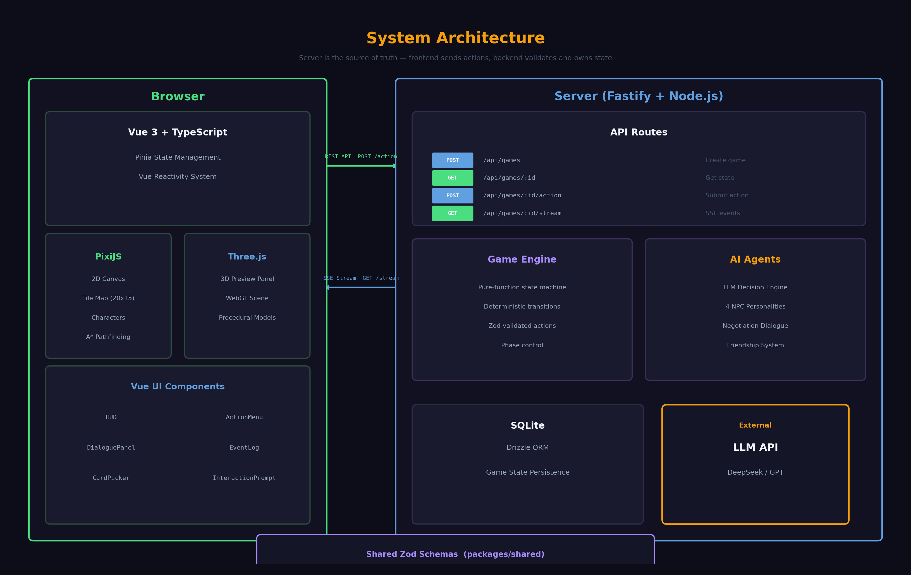
[ Insert architecture diagram or code snippet: Zod schema + route handler ]

Slide 6
Boss Dungeon
Risk / Reward
Boss: Giant Crab
Card System
1 trade slot to enter
Once per day
Win: +20 coins
Lose: -5 fish, -5 wheat
60 HP, state machine AI
Phase 1: 3-bullet spread
Phase 2: 5-bullet, faster
Charge attack: 5 dmg
8 upgrade card types
XP from boss hits
Choose 1 of 3 on level up
Multi Shot, Piercing, Heal...
Design Question
Do I use my trade slot safely... or risk resources for a faster path to escape?
[ Insert screenshot: dungeon boss fight in action ]

Slide 7
Demo
[ Embed 90-120s demo video here ]
New Game > Movement > Labor > NPC Negotiation > AI Turn > Dungeon Boss

Slide 8
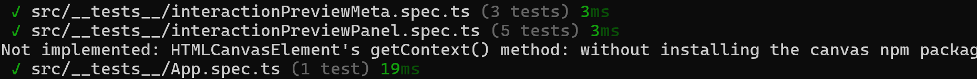
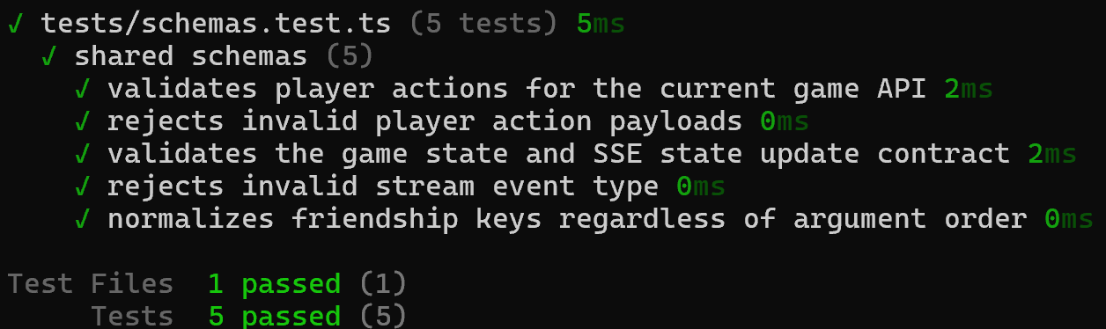
Validation & Next Steps
Validation
Team
He Yufeng — AI, coordination, integration
Xu Junjie — dialogue, bugs, server
Yu Erfei — boss dungeon, combat
Long Huzhiyuan — 3D preview, visuals
Limitations
Future Work
LLM latency affects pacing
Game balance needs tuning
NPCs lack long-term memory
Deeper agent memory
Better economy-dungeon coupling
Multiplayer real-time mode
Thank You
"LLM agents make negotiation feel alive, while typed deterministic code keeps the game fair and correct."

