Slide 1
Heterogeneous Hyperthreading Mingxuan He*, Fangping Liu†, Sang Wook Stephen Do† *Purdue University †Futurewei inc

Slide 2
Heterogeneous Multicore
Heterogeneous CPU Architecture
ARM → big.LITTLE
Intel’s Alder Lake Architectures → Performance/efficiency cores
Threads can be schedule and migrated between cores
Migration use coherent interconnect near the LLC
In coarse granularity only
Performance Core
LLC
Efficiency cores
Heterogeneous Multicore CPU Architectures Example
Heterogeneous Architecture has demonstrated its effectiveness

Slide 3
Phases in Program and Dynamic Thread Assignment
Programs Exhibit Distinct Phases During Execution
such as varying loops or regions within a loop.
These Phases Exhibit Different Performance Characteristics
IPC may be comparable on P/E cores during certain phases.
Dynamic Thread Assignment at a Coarse Granularity
Operating system reschedules threads every tens of milliseconds
The performance difference between P/E cores is phase-dependent.
Predict the performance of each threads on P/E-core
Schedule on P/E-cores based on prediction to improve performance
The scheduling mechanism aims to maintain fairness among threads.
Opportunities in fine-grained phase is not captured

Slide 4
Heterogeneous Single Core
Previous Works Deployed Heterogeneous in one core
Each core has multiple backends – P/E
Reschedule in fine-grained (In-core migration controller)
Copy architecture status without coherent interconnect
Scheduling window tens of milliseconds → 1000s instrs
Predict the performance in hardware for each window
Schedule to Optimize Energy-Delay-Product (EDP)
Issue with Previous Heterogeneous Single Core
Only one thread is scheduled (low utilization)
One backend of CPU always idle
Only optimize the EDP
Needs to improve the pipeline utilization

Slide 5
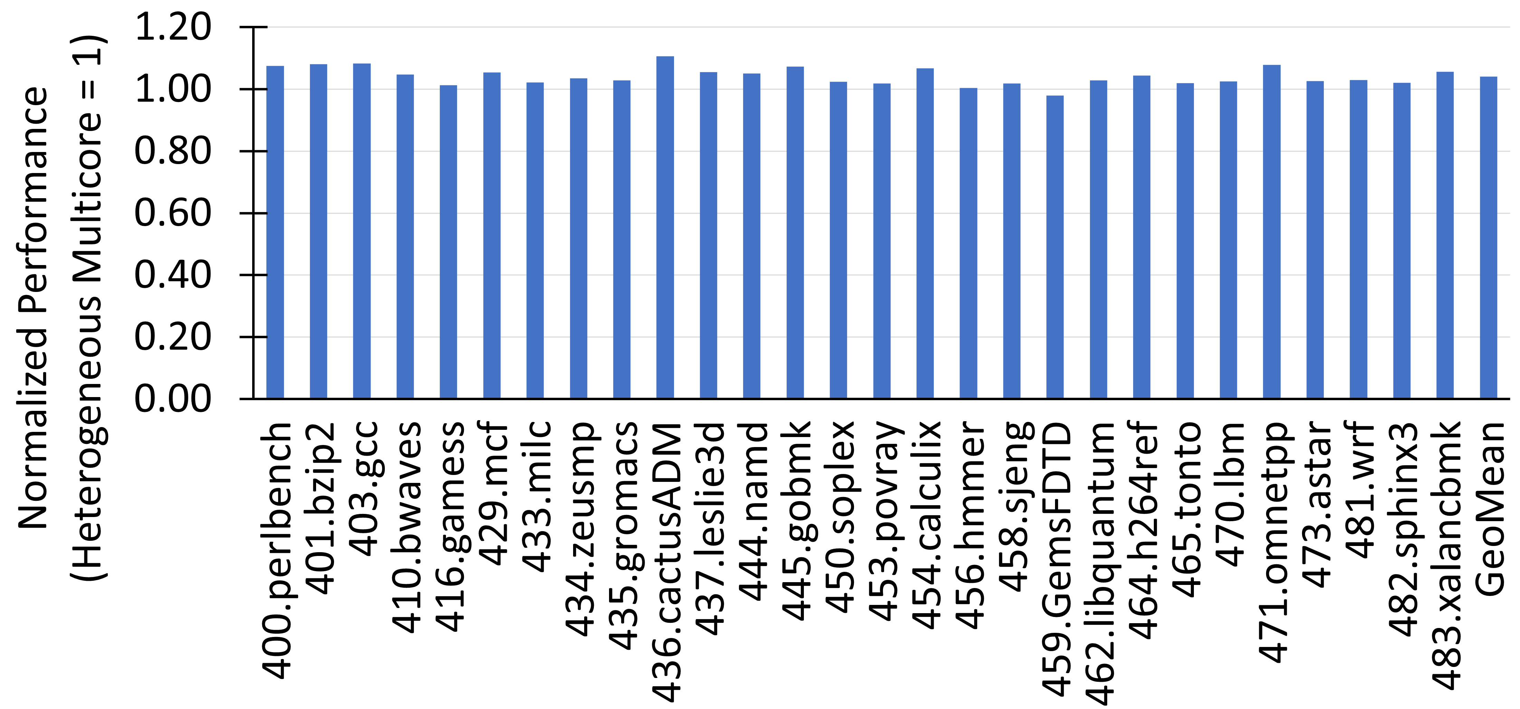
Opportunity of Heterogeneous Single Core
Heterogeneous Single Core v.s. Heterogeneous Multicore
Heterogeneous Single-Core enables fine-grained thread swapping.
MeoMean of each benchmark when paired with all benchmarks
Zero migration time and perfect performance prediction for both.
Heterogeneous multicore is unfair → Good for baseline

Slide 6
Performance Prediction
Predictors in Pervious Heterogeneous Single Core Architecture
Determine one thread P/E-backend
Binary classification based on architecture status
e.g. cache miss rate, PB miss rate
Needs to Schedule 2 Threads
A more complex model needed
Our simulation shows that the previous algorithm does not fit
Keep fairness as well as performance
Need new performance predictor for scheduling
The hardware can determine when turn off all migration
Needs to predict IPC of both workloads on P/E backends

Slide 7
Challenges in Heterogeneous Single-Core Workloads
When schedule same workload
threads in equivalent phases, limits speedup
Like in pervious figures
When schedule distinct workloads
Differences in program characteristics can outweigh the diversity in phases.
The combination of some threads yields good performance
Pairing certain threads can lead to enhanced performance
Advanced OS algorithms needed
Constraints on Heterogeneous Single-Core Systems
Needs to simplify the task of identifying workloads

Slide 8
Contributions
Heterogeneous Hyperthreading
Extend the previous single-core heterogeneous architecture
Enable simultaneous multi-threading on both backends
Maintain grained thread scheduling with better utilization
History Based Performance Predictor
Improve Prediction accuracy by caching previous performance
Yield better schedule compare with previous work
Phase-shifted Batched Execution
Schedule similar threads with a phase-change
Similar threads are common in servers and multithread programs
Reduce the effort of the OS to find suitable workloads
Thread Switching Mechanism
Minimized stall on P-backend at the expense of E-backed stall

Slide 9
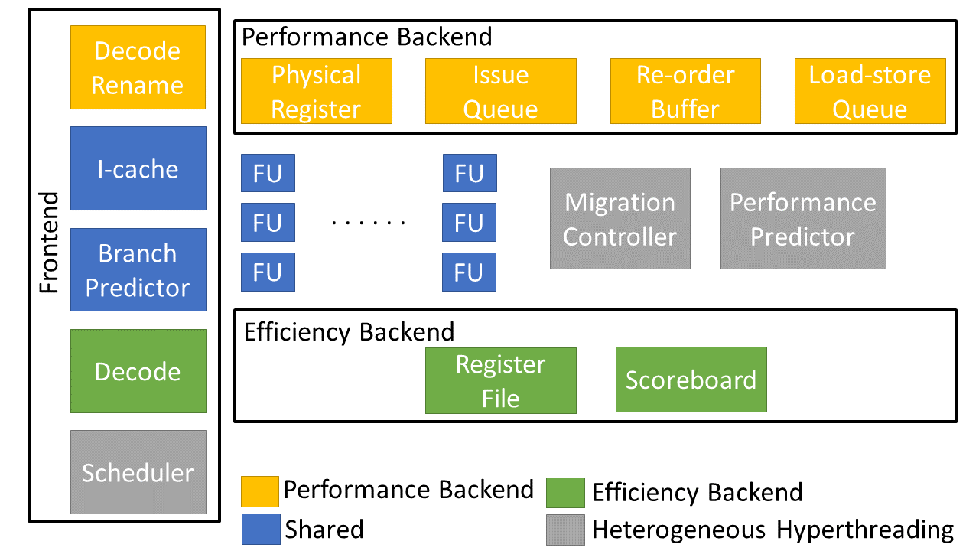
Heterogeneous Hyperthreading Architecture
Share resource as Hyperthreading, but Heterogeneous

Slide 10
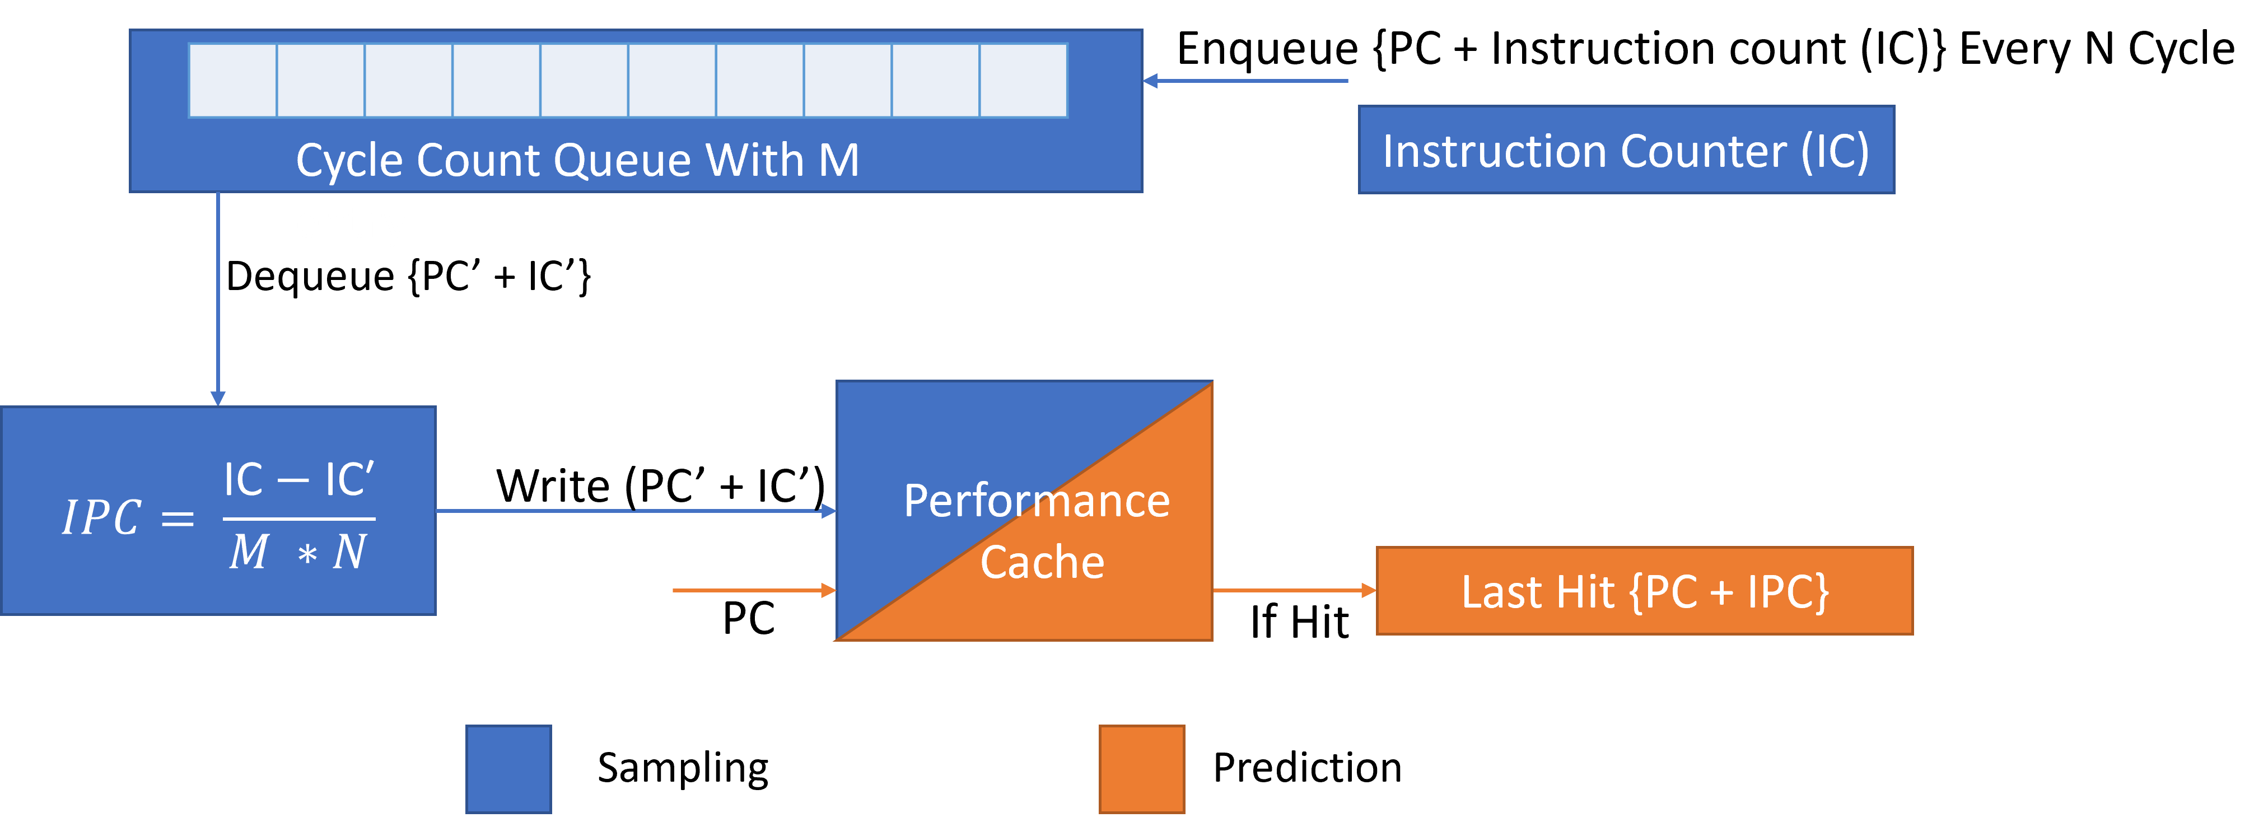
History Based Performance Predictor
Predict IPC for next scheduling window with previous IPC

Slide 11
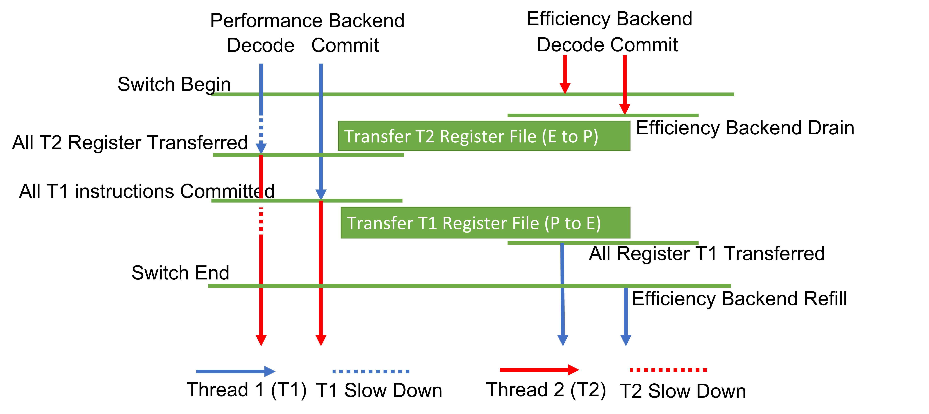
Optimized Thread Migration
Minimized stall on P-backend

Slide 12
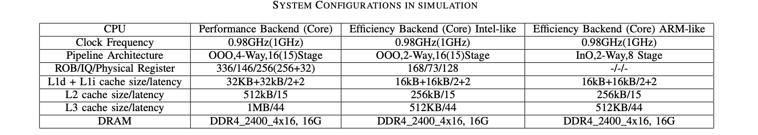
Methodology
GEM5 in X86 + Modifications
Intel Skylake architecture config -> P-Backend
Intel Skylake architecture config scale down > E-Backend
Same scale down in Alderlake architecture E-core
In-order core similar to ARM.
SpecCPU 2006 and Redis + YCSB
Considered the overhead of Hyperthreading

Slide 13
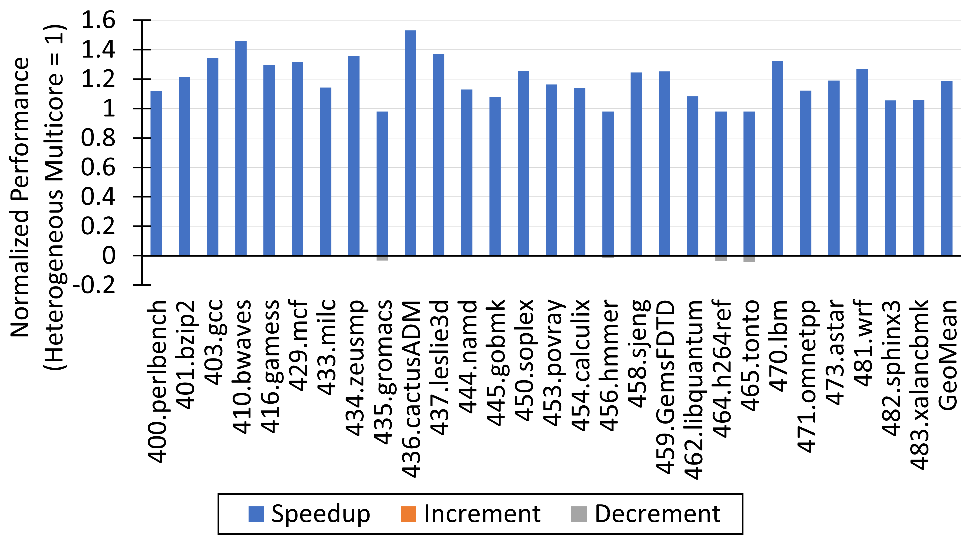
Speedup with Intel Config

Slide 14
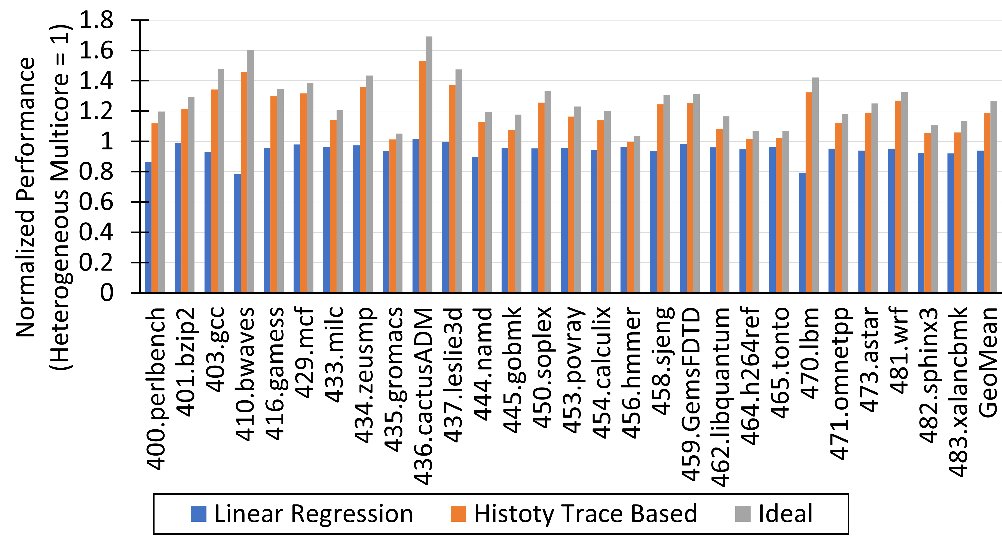
History Based Performance Predictor

Slide 15
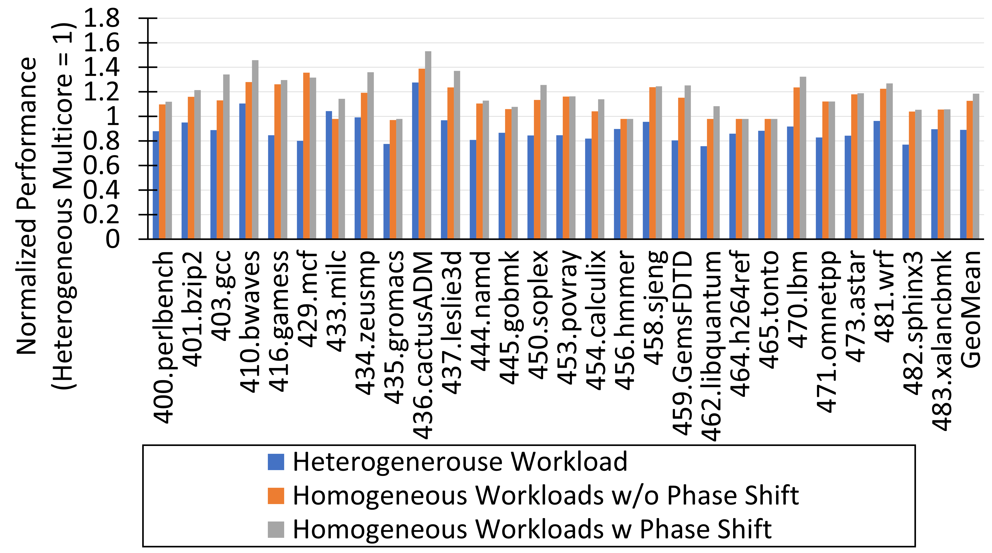
Phase-shifted Batched Execution

Slide 16
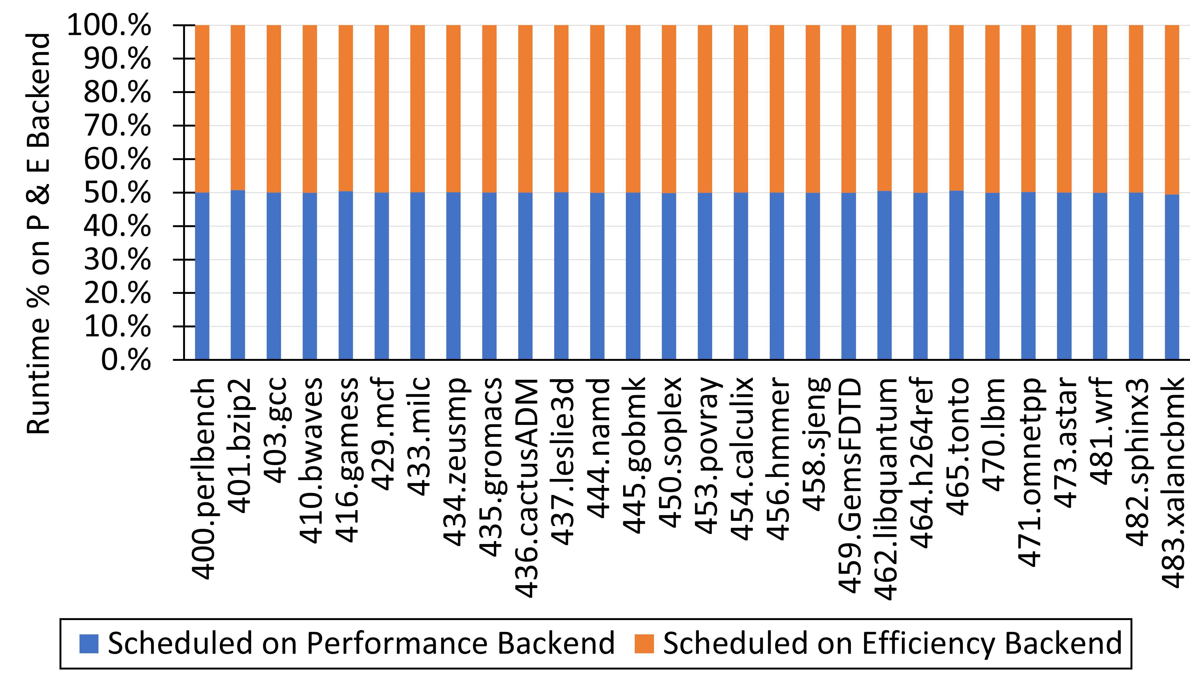
Fairness in Scheduling
Heterogeneous Hyperthreading achieve fair scheduling

Slide 17
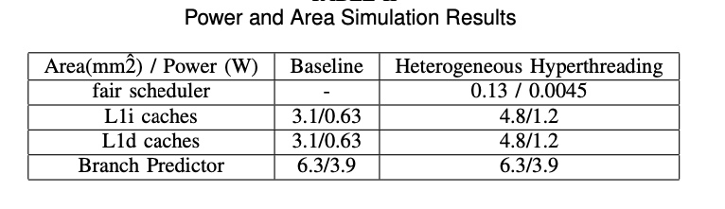
Power and Area
Power and Area estimation with McPAT + Cacti.
In 40 nm technology
Heterogeneous Hyperthreading incurs 6% area overhead

Slide 18
Conclusion
Heterogeneous Hyperthreading improve the hardware utilization of single core Heterogeneous architecture
All contributions improved the performance
Heterogeneous Hyperthreading
History Based Performance Predictor
Phase-shifted Batched Execution
Thread Switching Mechanism
Heterogeneous Hyperthreading achieves 18% speedup compare with Heterogeneous multicore with 6% of overhead

Slide 19
Thank you
Acknowledgement
Mingxuan He would like to say thank you to his colleagues at Futurewei for their invaluable assistance, insightful brainstorming sessions, and diligent proofreading throughout this project.
Mingxuan He would particularly acknowledge Dr. Sang Wook Stephen Do for his guidance and mentorship.

